Slide 1
14: Motivation and Reward
Cognitive Neuroscience
David Eagleman
Jonathan Downar

Slide 2
Chapter Outline
Motivation and Survival
The Circuitry of Motivation: Basic Drives
Reward, Learning, and the Brain
Opioids and the Sensation of Pleasure
Dopamine, Learning, Motivation, and Reward
Addiction: Pathological Learning and Motivation
Unlearning Addiction

Slide 3
Motivation and Survival
Addiction: An Illness of Motivation
Why Motivation Matters
Feelings: The Sensory Side of Motivation

Slide 4
Addiction: An Illness of Motivation
Motivation typically rewards us for doing things that will keep us alive.
Addiction twists the circuitry of motivation to reward something different from typical motivated behaviors.

Slide 5
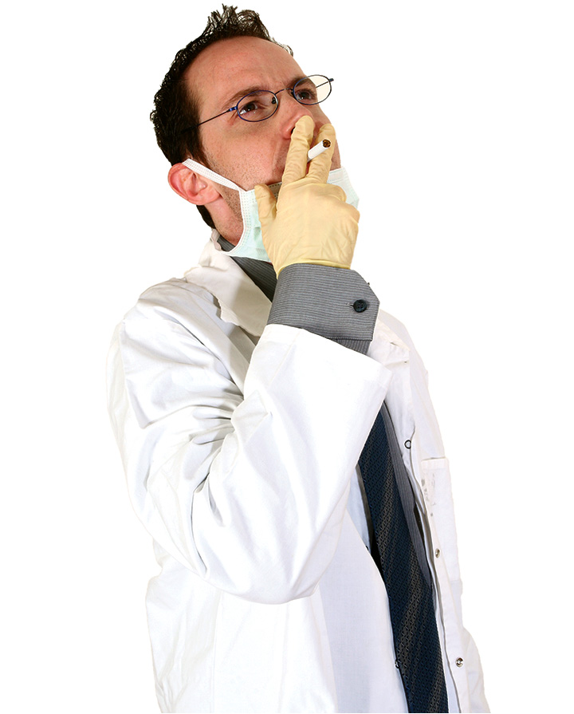
Addiction: An Illness of Motivation
Figure 14.1 Motivation and survival. Why would a doctor who suffered a heart attack and had seen so many patients with lung cancer and heart disease over the years continue to smoke himself?
Notes:
Figure 14.1 Motivation and survival. Why would a doctor who suffered a heart attack and had seen so many patients with lung cancer and heart disease over the years continue to smoke himself?

Slide 6
Why Motivation Matters
Motivation allows the brain a way of setting priorities.
Motivation could be described as the ability to make predictions about what is most important in a particular scenario.
Motivational drives can be internal or external.

Slide 7
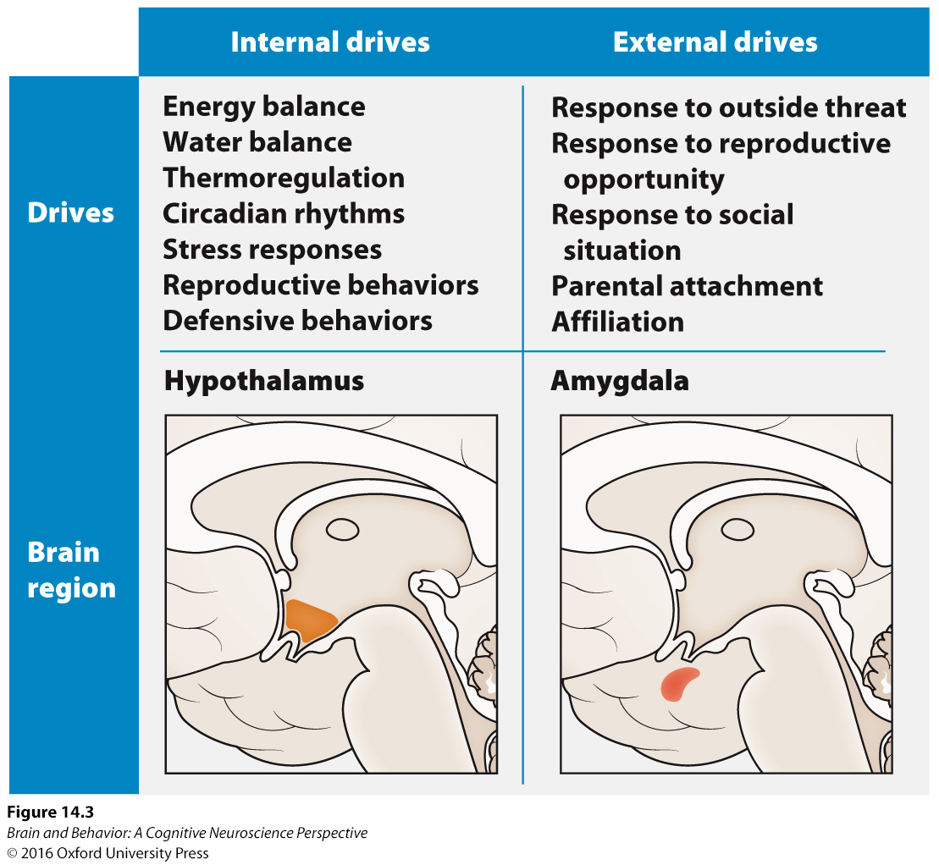
Why Motivation Matters
Figure 14.3 Internal and external survival drives. Internal drives tend to be coordinated by the hypothalamus from internal sensory inputs, while external drives tend to be coordinated by the amygdala from external sensory inputs.
Notes:
Figure 14.3 Internal and external survival drives. Internal drives tend to be coordinated by the hypothalamus from internal sensory inputs, while external drives tend to be coordinated by the amygdala from external sensory inputs.

Slide 8
Feelings: The Sensory Side of Motivation
Basic drives maintain homeostasis: energy, temperature, chemical balance, etc.
The body can maintain homeostasis by autonomic responses, neuroendocrine responses, or behavioral responses.

Slide 9
The Circuitry of Motivation: Basic Drives
Hypothalamus and Homeostatic Drives
Amygdala and External-World Drives
Midbrain Dopamine Neurons and the Common Currency of Motivation

Slide 10
Hypothalamus and Homeostatic Drives
The hypothalamus is important for maintaining homeostasis.
It collects information about the internal state of the body and initiates responses.
There are many different nuclei within the hypothalamus.
Some seem to be predominantly input while others are mostly output nuclei.

Slide 11
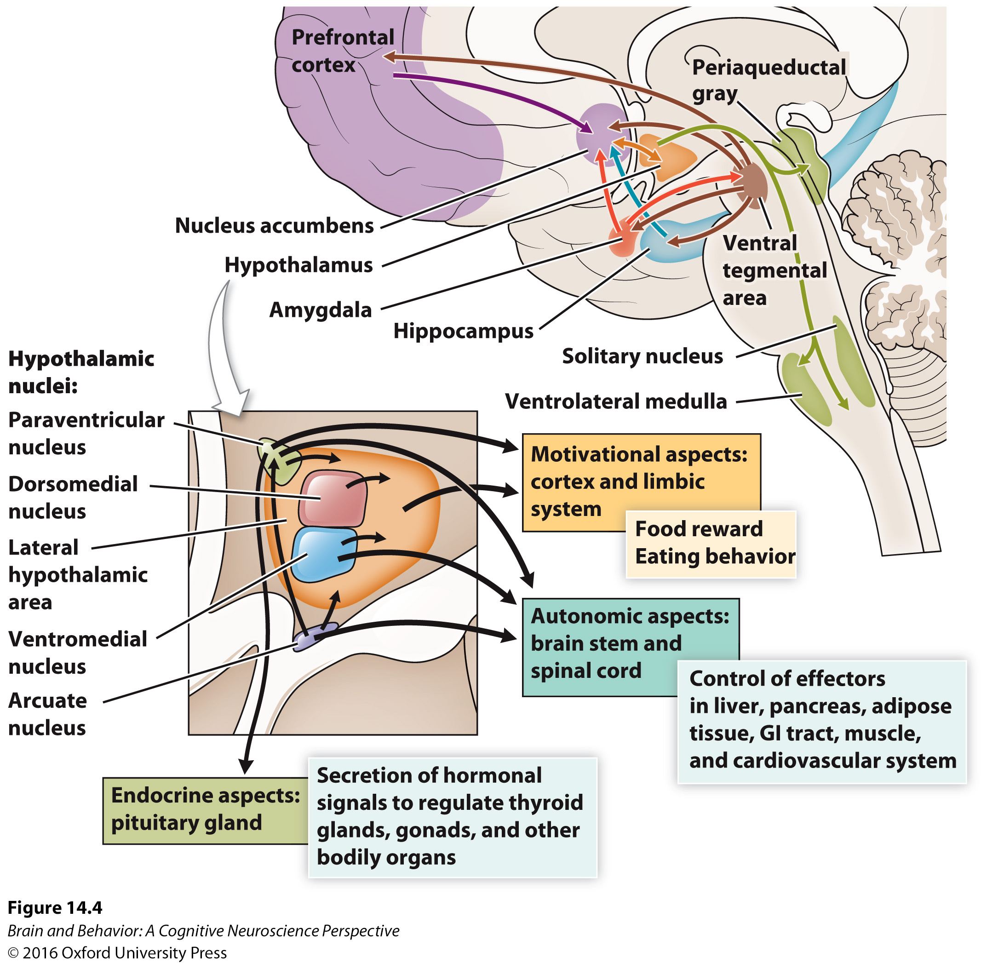
Hypothalamus and Homeostatic Drives
Figure 14.4 The hypothalamus is involved in a wide range of behaviors. The hypothalamus is connected directly with the nucleus accumbens, and indirectly with the prefrontal cortex, hippocampus, and amygdala, all of which are part of the brain's motivational architecture. These connections direct the autonomic, endocrine, and motivational aspects of homeostasis.
Notes:
Figure 14.4 The hypothalamus is involved in a wide range of behaviors. The hypothalamus is connected directly with the nucleus accumbens, and indirectly with the prefrontal cortex, hippocampus, and amygdala, all of which are part of the brain's motivational architecture. These connections direct the autonomic, endocrine, and motivational aspects of homeostasis.

Slide 12
Hypothalamus and Homeostatic Drives
Energy balance has been fairly well studied.
  The hormones ghrelin and leptin signal hunger and satiety, respectively.
  Neuropeptide Y acts on the paraventricular nucleus to stimulate feeding.
  A different neurotransmitter, POMC, acts on the arcuate nucleus to inhibit feeding.

Slide 13
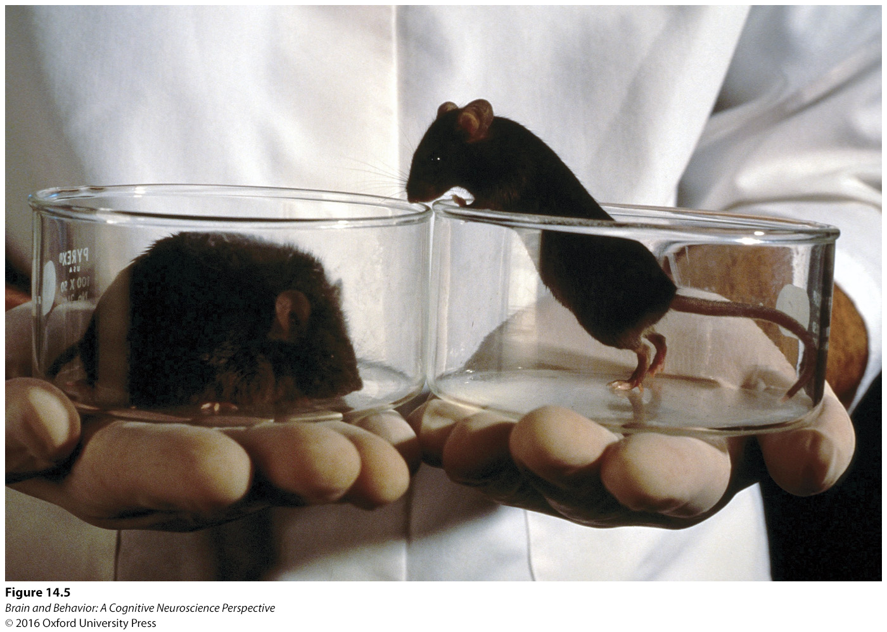
Hypothalamus and Homeostatic Drives
Figure 14.5 Obesity is influenced by the presence of hormones. The mouse on the left has a mutation in the ob gene and is unable to produce leptin. The mouse on the right is a wild-type mouse with normal leptin production.
Notes:
Figure 14.5 Obesity is influenced by the presence of hormones. The mouse on the left has a mutation in the ob gene and is unable to produce leptin. The mouse on the right is a wild- type mouse with normal leptin production.

Slide 14
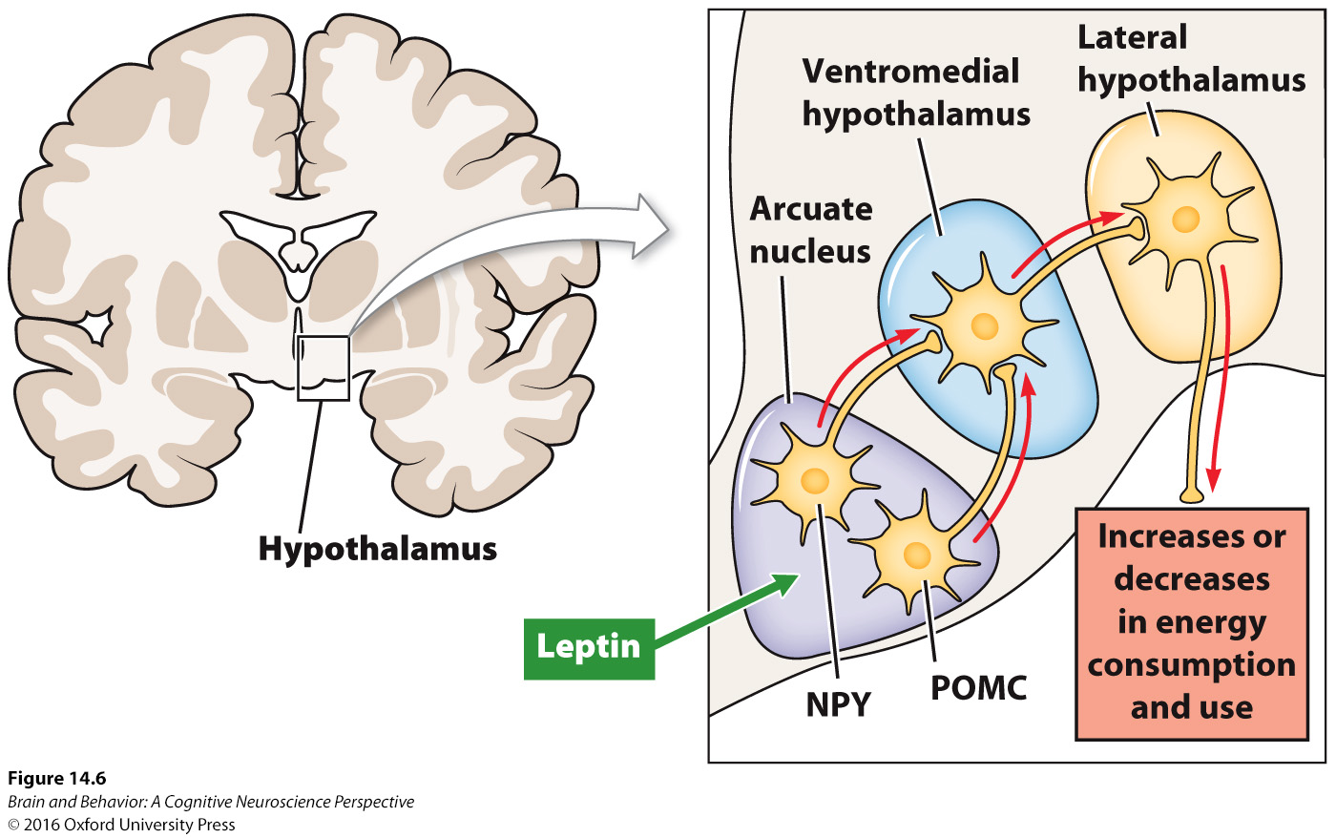
Hypothalamus and Homeostatic Drives
Figure 14.6 Regulation of eating behavior by the hypothalamus. Leptin stimulates receptors in the arcuate nucleus of the hypothalamus to release neuropeptide Y (NPY). An alternate pathway uses the neurotransmitter pro-opiomelanocortin (POMC). Although these pathways are not yet fully understood, the output from the arcuate nucleus stimulates the ventromedial hypothalamus and the lateral hypothalamus to change energy intake and use. The pathway that uses NPY generally increases energy intake, whereas the pathway that uses POMC generally reduces food intake.
Notes:
Figure 14.6 Regulation of eating behavior by the hypothalamus. Leptin stimulates receptors in the arcuate nucleus of the hypothalamus to release neuropeptide Y (nPY). An alternate pathway uses the neurotransmitter pro- opiomelanocortin (POMC). Although these pathways are not yet fully understood, the output from the arcuate nucleus stimulates the ventromedial hypothalamus and the lateral hypothalamus to change energy intake and use. The pathway that uses nPY generally increases energy intake, whereas the pathway that uses POMC generally reduces food intake.

Slide 15
Amygdala and External-World Drives
Sensory systems project to the amygdala, which monitors the external world.
Output options for the amygdala include autonomic responses, neuroendocrine responses, or behavioral responses.

Slide 16
Amygdala and External-World Drives
The basolateral amygdala responds very rapidly to threatening stimuli from the external world.
The centromedial amygdala coordinate the responses of other areas to the sensory stimuli.

Slide 17
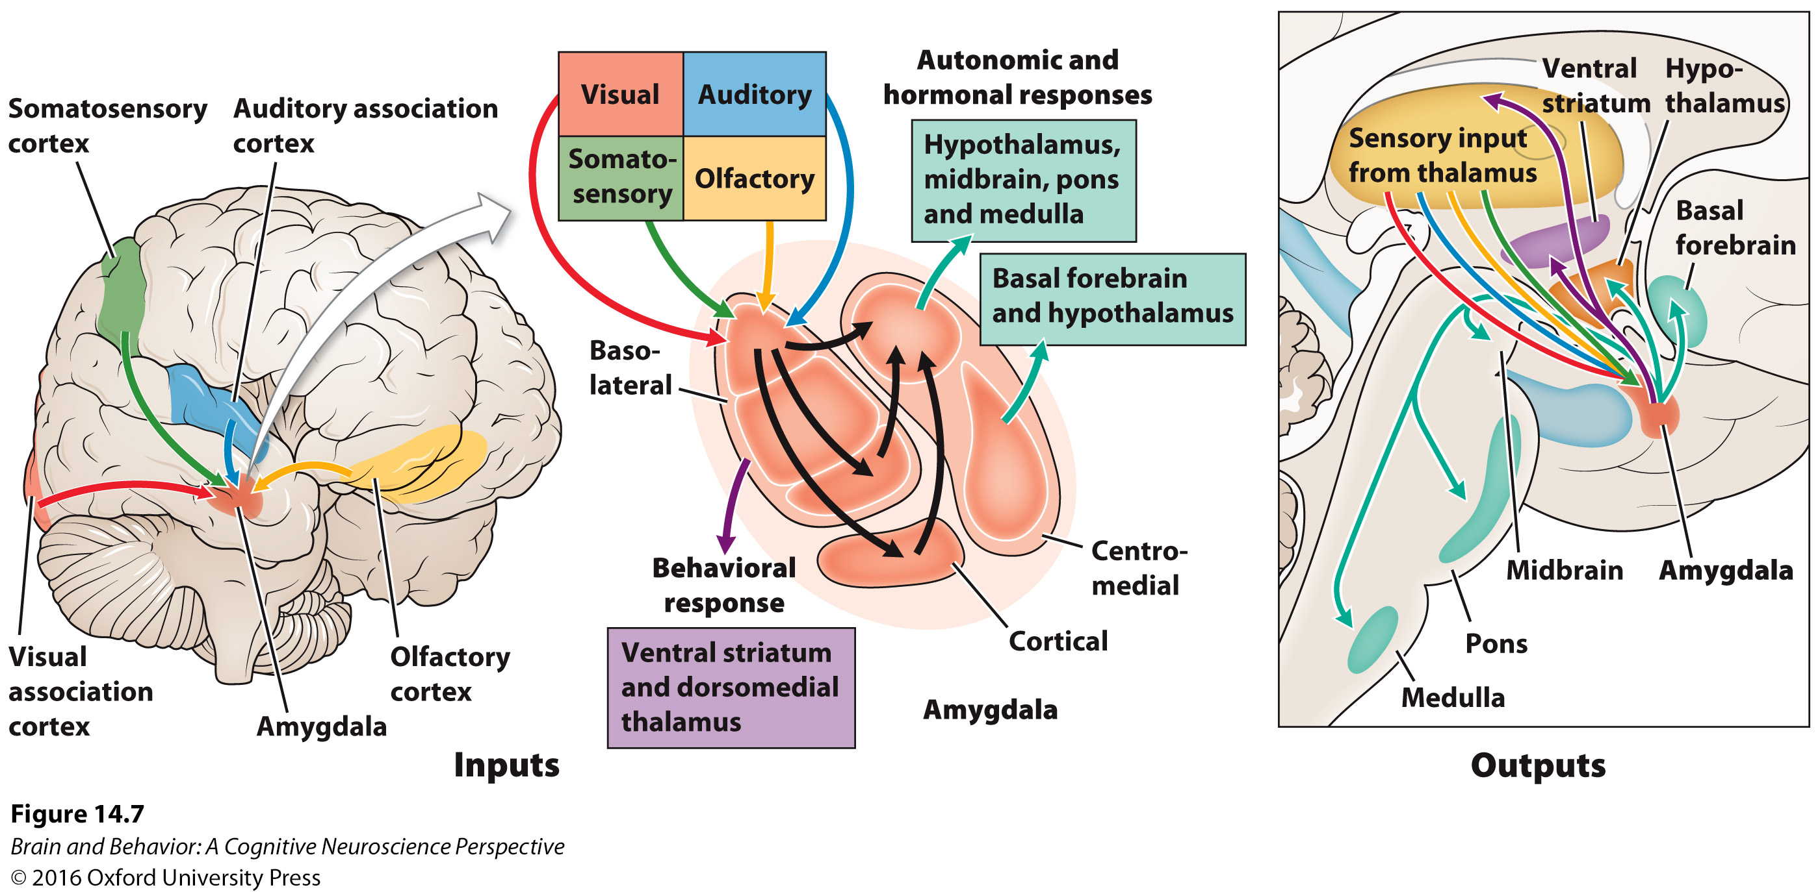
Amygdala and External-World Drives
Figure 14.7 The amygdala. Like the hypothalamus, the amygdala contains several nuclei. This coronal section through the brain depicts the location of the amygdala and some nuclei within the medial temporal lobe. The basolateral nuclei take sensory input from the thalamus and cortex, while the central and medial nuclei send behavior-regulating output to the brainstem, the hypothalamus, and indirectly to the prefrontal cortex.
Notes:
Figure 14.7 The amygdala. Like the hypothalamus, the amygdala contains several nuclei. This coronal section through the brain depicts the location of the amygdala and some nuclei within the medial temporal lobe. The basolateral nuclei take sensory input from the thalamus and cortex, while the central and medial nuclei send behavior- regulating output to the brainstem, the hypothalamus, and indirectly to the prefrontal cortex.

Slide 18
Amygdala and External-World Drives
There is a stress response (allostasis) to external stimuli.
  Short term allostasis prepares the body for challenges.
  Long term allostasis is harmful to the body, resulting in suppression of the immune system and metabolic changes.

Slide 19
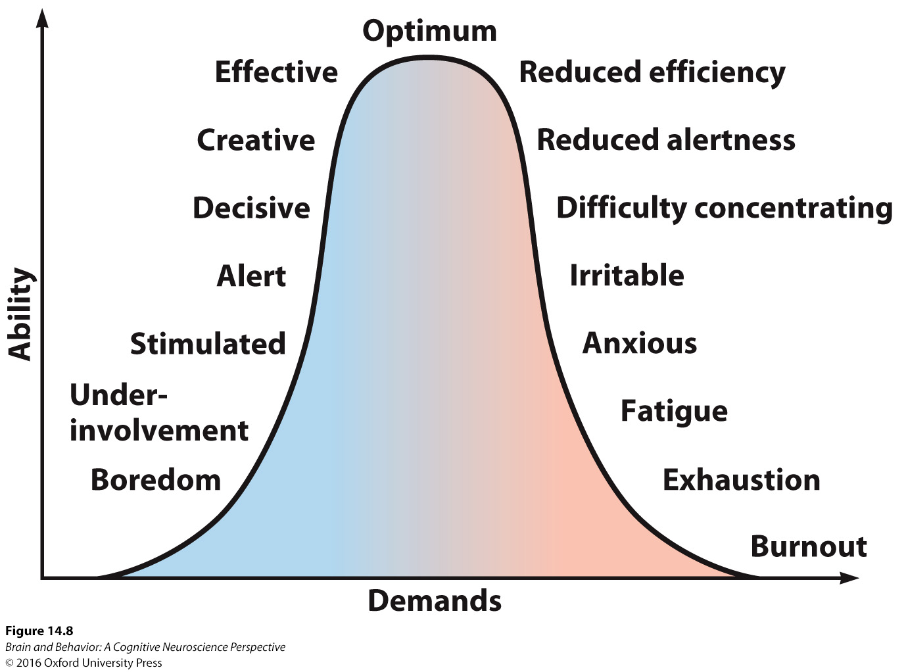
Amygdala and External-World Drives
Figure 14.8 The stress response curve. Up to a point, increased stress enhances performance because it increases cognitive and immune function. Beyond that point, however, the body becomes exhausted and the same cognitive and immune functions that were previously improved are now impaired.
Notes:
Figure 14.8 The stress response curve. up to a point, increased stress enhances performance because it increases cognitive and immune function. Beyond that point, however, the body becomes exhausted and the same cognitive and immune functions that were previously improved are now impaired.

Slide 20
Midbrain Dopamine Neurons and the Currency of Motivation
The nigrostriatal pathway projects from the substantia nigra to the striatum and is important for motor control.
The mesocortical pathway projects from the ventral tegmental area to the prefrontal cortex and is important for cognition.
The mesolimbic pathway projects to the cingulate cortex and is important for emotional regulation.

Slide 21
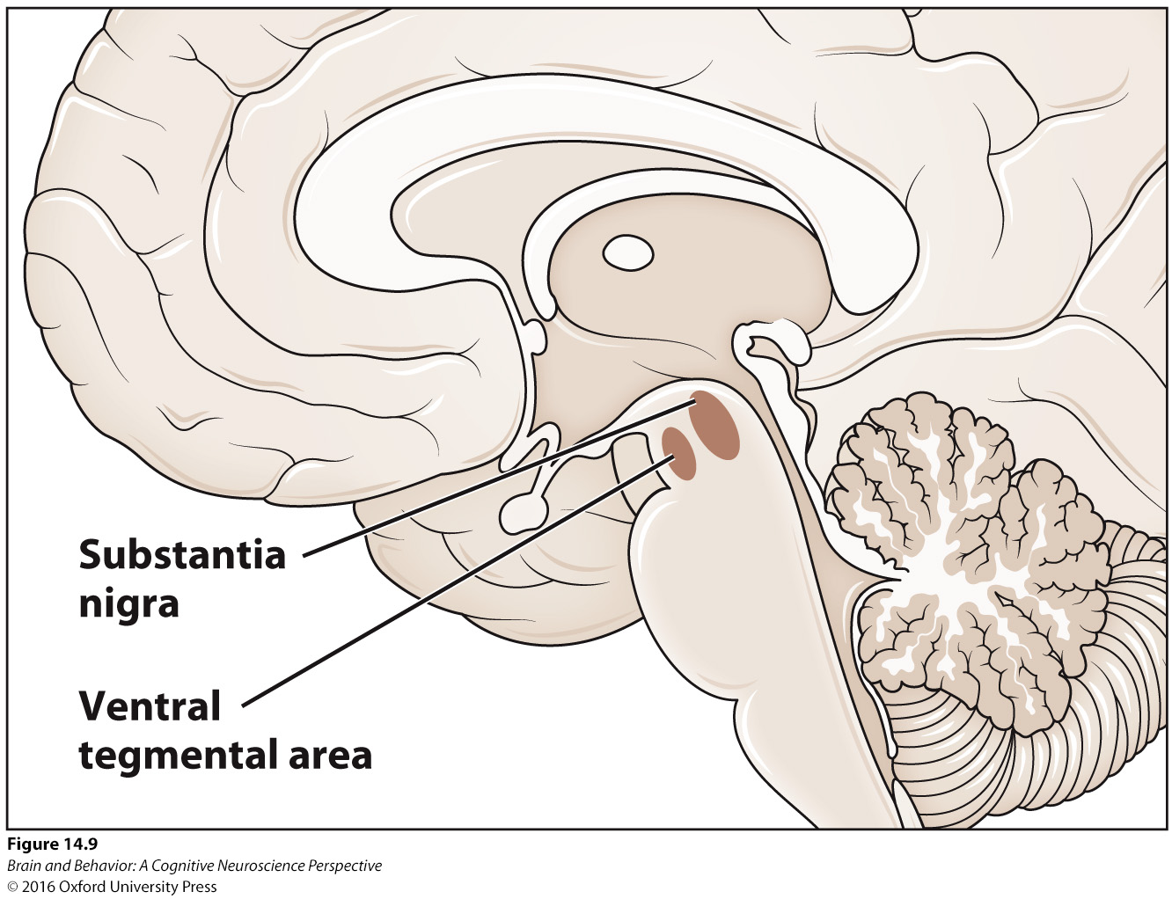
Midbrain Dopamine Neurons and the Currency of Motivation
Figure 14.9 The ventral tegmental area and the substantia nigra. Both of these areas are important parts of the midbrain dopamine network.
Notes:
Figure 14.9 The ventral tegmental area and the substantia nigra. Both of these areas are important parts of the midbrain dopamine network.

Slide 22
Reward, Learning, and the Brain
Defining Reward
Learning from Reward Using Prediction Error
“Liking” Is Different from “Wanting”

Slide 23
Defining Reward
Rewards increase the motivation to engage in a particular behavior.
Punishments make it less likely to engage in that particular behavior.
Primary rewards directly affect homeostasis.
Secondary rewards are associated with primary rewards.

Slide 24
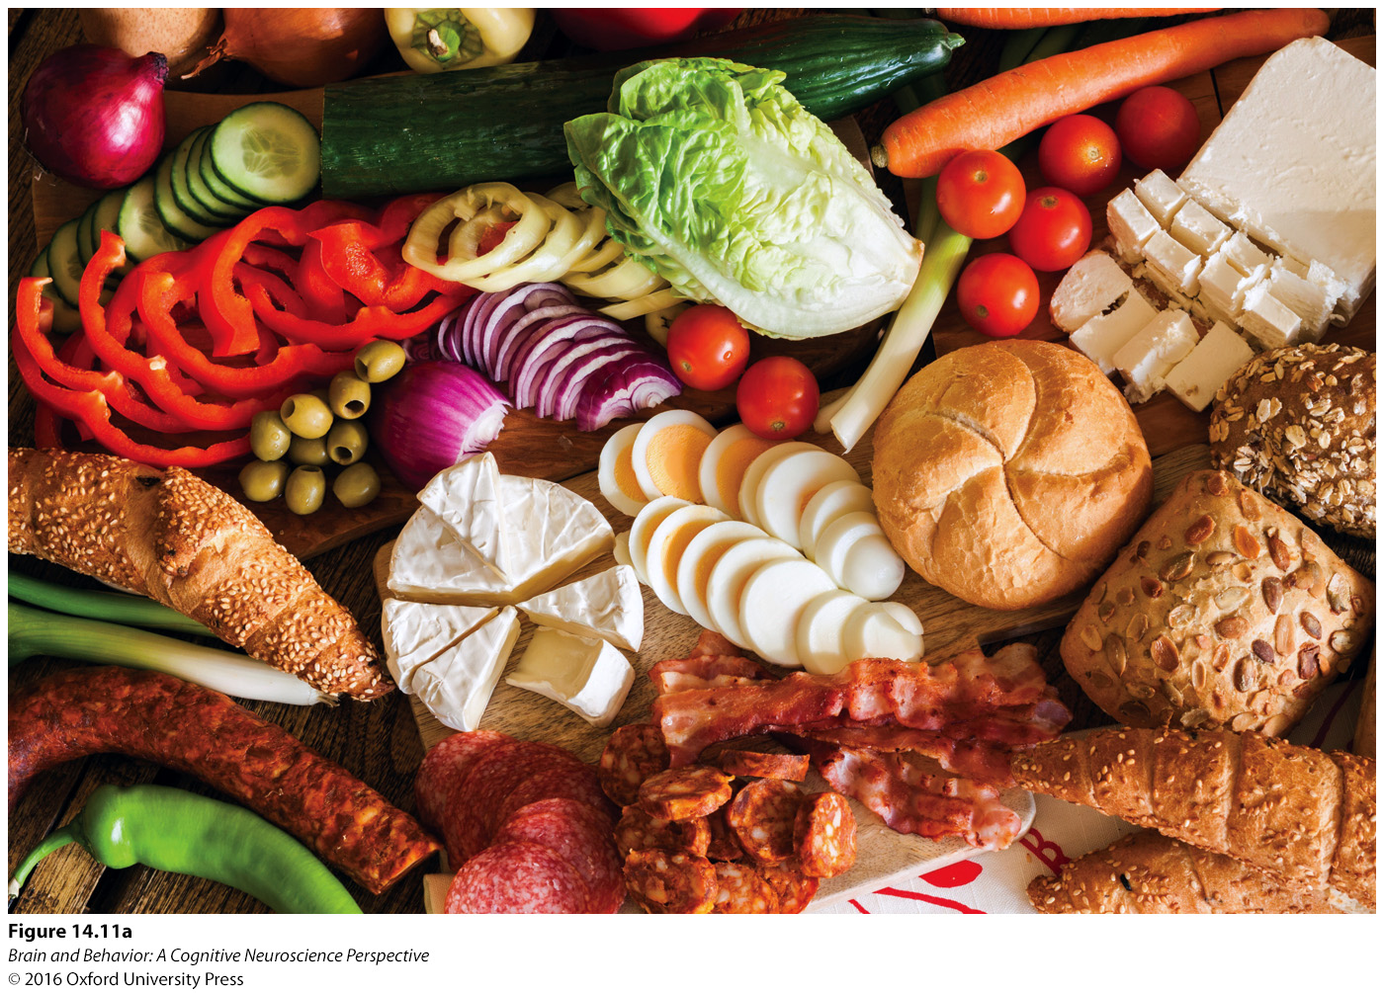

Defining Reward
Figure 14.11 Primary and secondary rewards. (a) Primary rewards provide an inherent survival advantage, such as food or drink. (b) Secondary rewards have no direct survival advantage, but we have learned that they enable us to get the primary rewards.
Notes:
Figure 14.11 Primary and secondary rewards. (a) Primary rewards provide an inherent survival advantage, such as food or drink. (b) Secondary rewards have no direct survival advantage, but we have learned that they enable us to get the primary rewards.

Slide 25
Learning from Reward Using Prediction Error
The prediction error is the discrepancy between what is expected and what actually occurs.
This can be positive or negative, and can include information about the timing of the reward.
As the response becomes expected, the prediction error drops to zero.

Slide 26
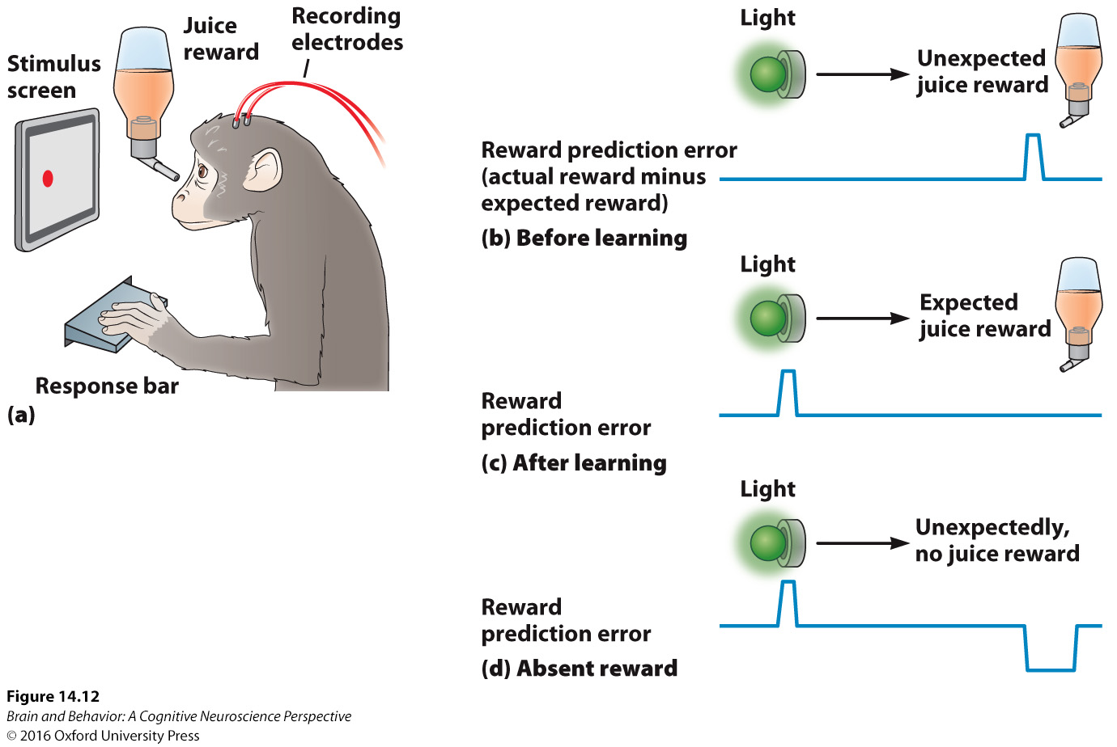
Learning from Reward Using Prediction Error
Figure 14.12 The role of prediction error during associative learning.(a) The monkey is seated and will receive a juice reward when the response bar moves. (b) Before learning, the juice reward is unexpected, so its arrival has positive prediction error (better than expected). (c) After learning, the juice is expected after the light, so it no longer has positive prediction error. The positive prediction error then shifts to the light, which signals that a reward will soon arrive. (d) If for some reason the juice does not arrive as expected, its absence has negative prediction error (worse than expected). These prediction error signals can be used to guide associative learning.
Notes:
Figure 14.12 The role of prediction error during associative learning. (a) The monkey is seated and will receive a juice reward when the response bar moves. (b) Before learning, the juice reward is unexpected, so its arrival has positive prediction error (better than expected). (c) After learning, the juice is expected after the light, so it no longer has positive prediction error. The positive prediction error then shifts to the light, which signals that a reward will soon arrive. (d) If for some reason the juice does not arrive as expected, its absence has negative prediction error (worse than expected). These prediction error signals can be used to guide associative learning.

Slide 27
“Liking” Is Different from “Wanting”
Many addictive substances are pleasant at first, but that decreases with exposure.
Yet, the amount of effort to obtain the drug increases.
Liking is due to interoceptive feelings of well-being.
Wanting is due to a future prediction of liking the drug.

Slide 28
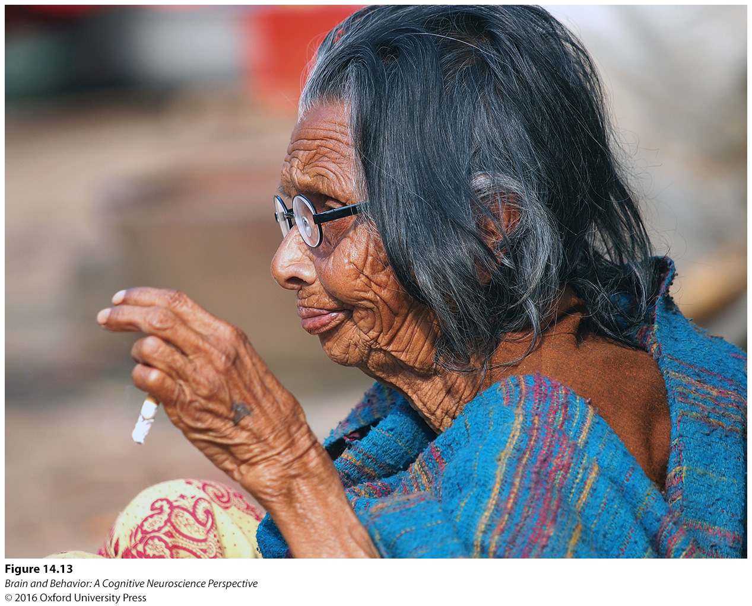
“Liking” Is Different from “Wanting”
Figure 14.13. Cigarette smokers sometimes report that they do not especially enjoy smoking, even though they feel strongly compelled to smoke.
Notes:
Figure 14.13 Cigarette smokers sometimes report that they do not especially enjoy smoking, although they feel strongly compelled to smoke.

Slide 29
Opioids and the Sensation of Pleasure
Opioids, Opioid Receptors, and Opioid Functions
Opioids and Reward

Slide 30
Opioids, Opioid Receptors, and Opioid Functions
Opioids both relieve pain and produce euphoria.
There are four different types of opioid receptors:
  Mu
  Kappa
  Delta
  Nociceptin

Slide 31
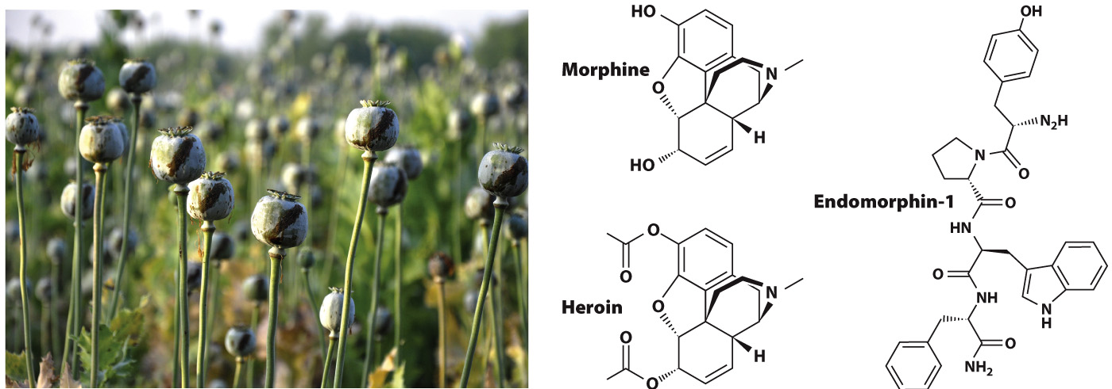
Opioids, Opioid Receptors, and Opioid Functions
Figure 14.14 Some species of poppies produce opium, which contains substances that are chemically similar to endogenous opioids used as neurotransmitters in the human brain. Compare the chemical structures of the pharmacologically active component of opium, morphine (and its chemically modified relative, heroin), versus endomorphin-1, one of the brain’s endogenous opioids.

Slide 32
Opioids, Opioid Receptors, and Opioid Functions
Mu receptors are important for analgesia and euphoria.
Kappa receptors produce unpleasant reactions to opiates.
Delta seem similar to mu receptors and may have antidepressant effects.
Delta and nociceptin receptors are not well understood at this time.

Slide 33
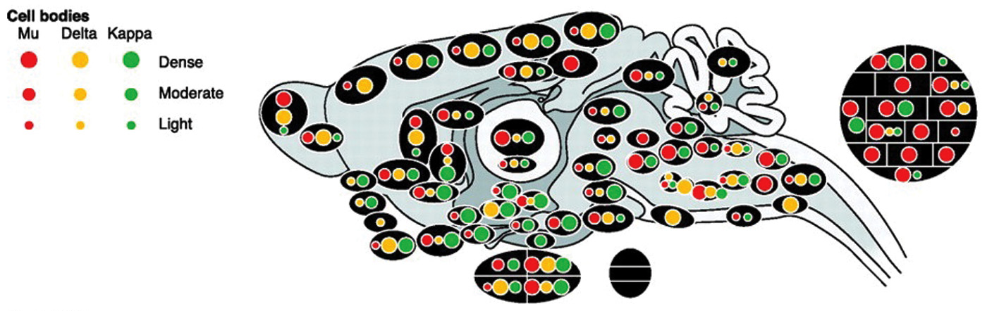
Opioids, Opioid Receptors, and Opioid Functions
Figure 14.15 The distribution of the mu-, delta-, and kappa-opioid receptors in the rat brain. The different type of receptor is indicated by the color. The density of receptors within a particular region is indicated by the size of the circle. The three black ovals outside the brain are blowups showing the receptors in (clockwise, from the top) the thalamus, the pituitary, and the amygdala.
Notes:
Figure 14.15 The distribution of the mu-, delta-, and kappa- opioid receptors in the rat brain. The different type of receptor is indicated by the color. The density of receptors within a particular region is indicated by the size of the circle. The three black ovals outside the brain are blowups showing the receptors in (clockwise, from the top) the thalamus, the pituitary, and the amygdala.

Slide 34
Opioids and Reward
Opioids increase the reward value of naturally-occurring rewards.
Stimulation of mu and delta opioid receptors makes aversive stimuli more pleasant.
The mu opioid system seems particularly important for determining the current liking of a reward.

Slide 35
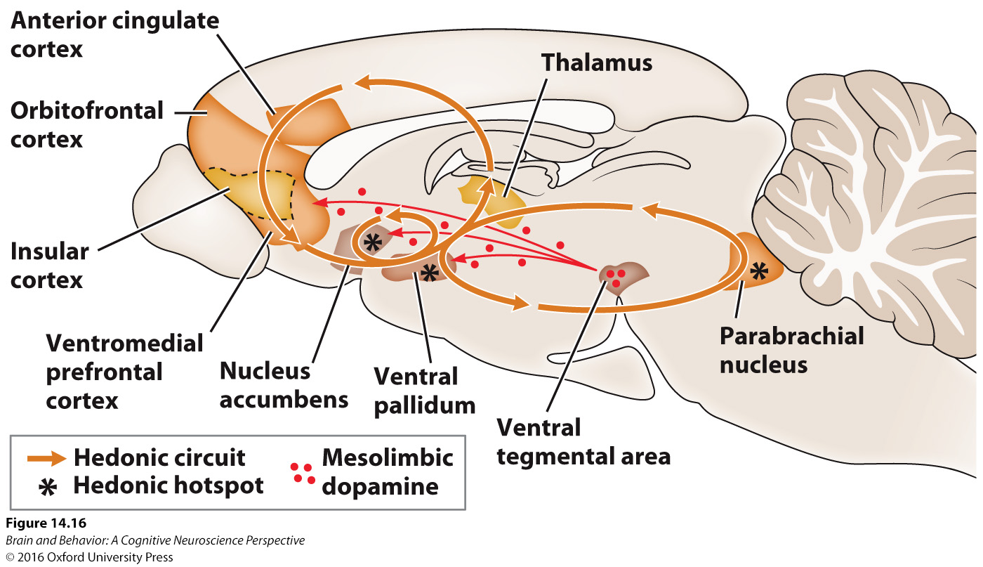
Opioids and Reward
Figure 14.16 Hedonic “hotspots” within the brain. In the rat brain, injections of opioids into the nucleus accumbens, ventral pallidum, or parabrachial nucleus in the brainstem increase food-enjoying behaviors such as lip-licking.
Notes:
Figure 14.16 Hedonic “hotspots” within the brain. In the rat brain, injections of opioids into the nucleus accumbens, ventral pallidum, or parabrachial nucleus in the brainstem increase food- enjoying behaviors such as lip- licking.

Slide 36
Dopamine, Learning, Motivation, and Reward
Dopamine Functions in Motivation and Reward
Unifying the Functions of Dopamine
Neurotransmitters Are Messengers, Not Functions

Slide 37
Dopamine Functions in Motivation and Reward
Neurons in the ventral tegmental area have a baseline firing rate, that can be increased by an unexpected reward.
If the stimulus is preceded by a signal, the animal learns that the signal predicts the stimulus, and will react to the signal.
This predicted reward does not alter the firing rate of the neurons.

Slide 38
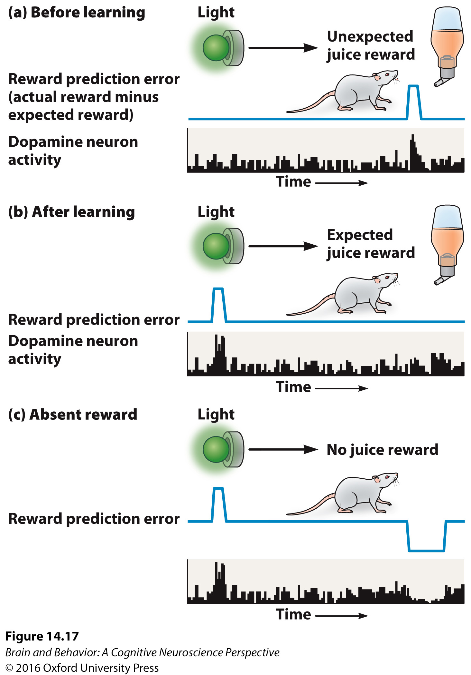
Dopamine Functions in Motivation and Reward
Figure 14.17 Dopamine activity during reward learning. (a) In this experiment, a light signals that a juice reward will soon appear. Before learning, the juice is unexpected. Its arrival has positive prediction error (better than expected), which is reflected in a burst of activity in dopamine neurons. (b) After learning, the dopamine neurons shift to firing when the light flashes, since the juice no longer has positive prediction error (no better than expected). (c) If the light flashes but no juice appears, its absence has negative prediction error (worse than expected), and the dopamine neurons temporarily reduce their activity.
Notes:
Figure 14.17 Dopamine activity during reward learning. (a) In this experiment, a light signals that a juice reward will soon appear. Before learning, the juice is unexpected. Its arrival has positive prediction error (better than expected), which is reflected in a burst of activity in dopamine neurons. (b) After learning, the dopamine neurons shift to firing when the light flashes, since the juice no longer has positive prediction error (no better than expected). (c) If the light flashes but no juice appears, its absence has negative prediction error (worse than expected), and the dopamine neurons temporarily reduce their activity.

Slide 39
Dopamine Functions in Motivation and Reward
If the expected reward is not provided, the firing rate will decrease.
A positive prediction signal occurs when the reward is better than expected.
A negative prediction signal occurs when the reward is worse than expected.

Slide 40
Unifying the Functions of Dopamine
There are multiple dopaminergic loops that connect the cortex to subcortical areas.
The function of computing value is similar across the brain.
The varying effects of dopamine may differ depending on where in the brain it acts or the time scale on which it acts.

Slide 41
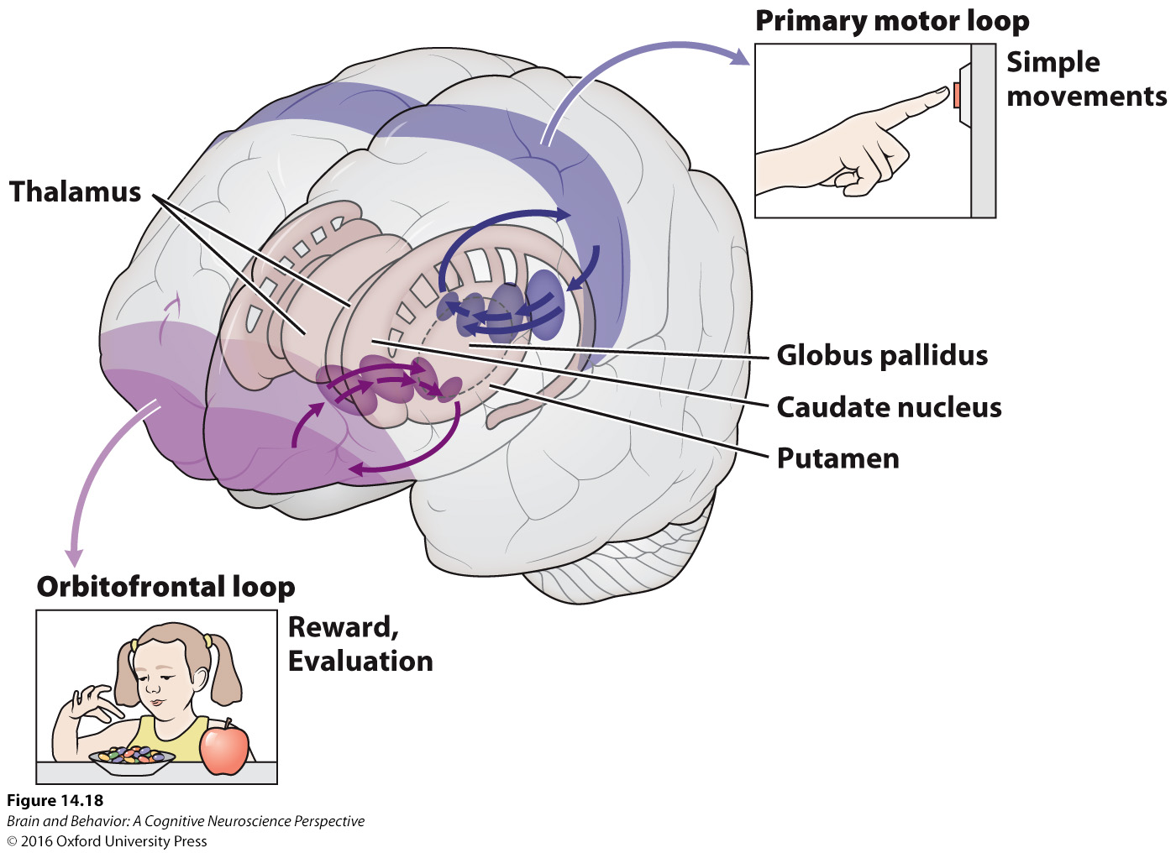
Unifying the Functions of Dopamine
Figure 14.18 Corticostriatal–thalamic loop circuits are important for both motor control and reward behaviors.
Notes:
Figure 14.18 Corticostriatal–thalamic loop circuits are important for both motor control and reward behaviors.

Slide 42
Neurotransmitters Are Messengers, Not Functions
A neurotransmitter can have many different effects in different parts of the brain.
The exact effects depend on the timing of the release or on the receptor involved.

Slide 43
Addiction: Pathological Learning and Motivation
Addictive Substances Have Distorted Reward Value
Addiction Is a Result of Pathological Learning
The Circuitry and Chemistry of Addiction

Slide 44
Addictive Substances Have Distorted Reward Value
Whether or not a substance is interpreted as a reward depends on the organism’s needs.
Addiction research often provides the neurotransmitter that signals a reward as a more direct way to study the system.

Slide 45
Addictive Substances Have Distorted Reward Value
Provide a large reward, larger than any natural reward, and you can observe that the system is plastic.
Tolerance is the situation in which you need larger and larger doses to achieve the same effect.
This is because the brain produces fewer receptors after the increased stimulation.

Slide 46
Addictive Substances Have Distorted Reward Value
Following tolerance, all rewards are less valuable.
With incentive sensitization, the cues associated with the artificial reward are valued more.
In withdrawal, there are aversive side effects of ceasing to use the rewarded stimulus.

Slide 47
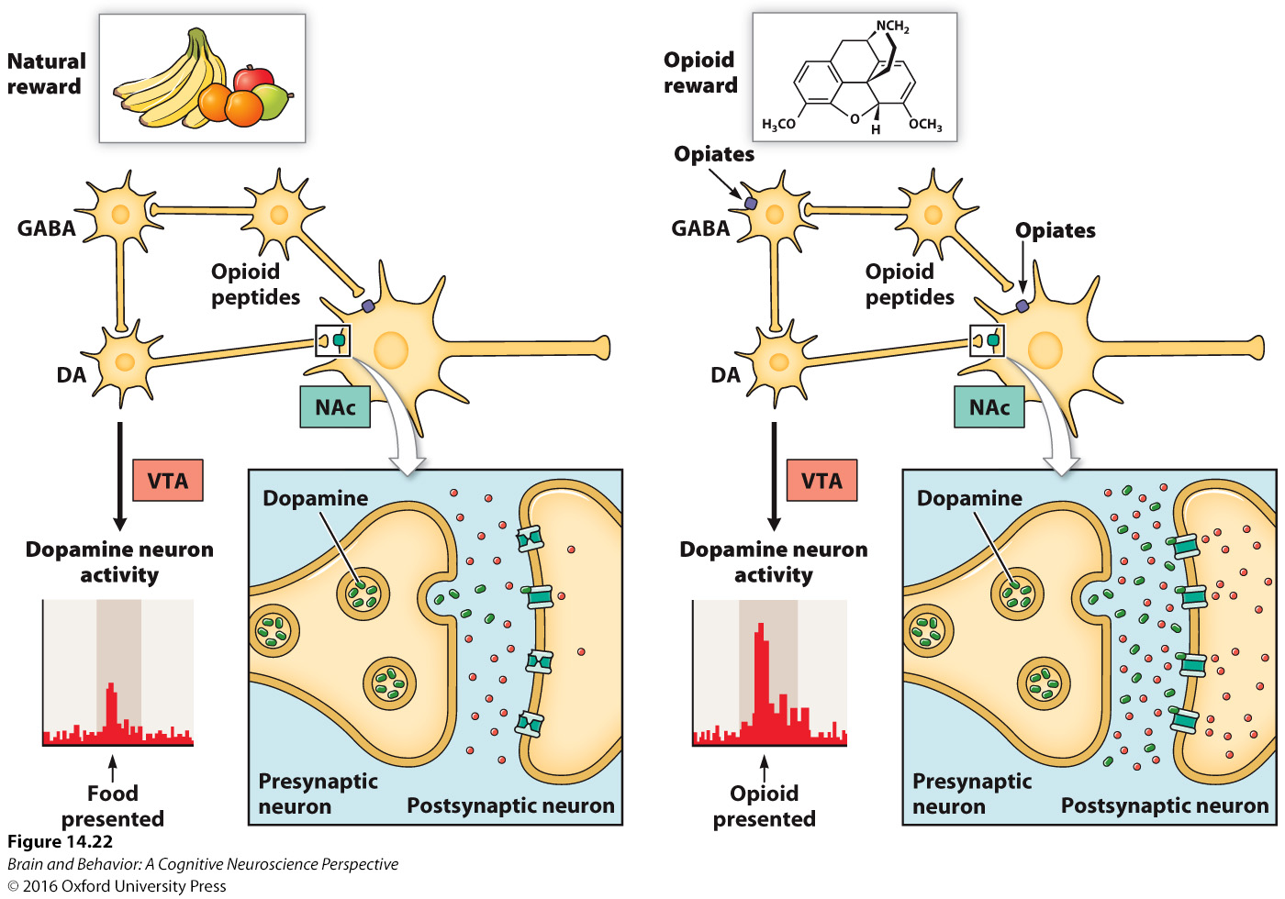
Addictive Substances Have Distorted Reward Value
Figure 14.22 Effects of natural and artificial rewards on dopamine activity in the reward circuitry of the brain. Natural rewards, when they are better than expected, elicit a burst of activity from dopamine neurons. Drugs of abuse, such as opioids, produce artificially large reward signals in this system, even though the organism’s internal state has not actually improved. Over many exposures, these artificially large signals can lead to addiction: “pathological learning” to prefer the substance over natural rewards.
Notes:
Figure 14.22 effects of natural and artificial rewards on dopamine activity in the reward circuitry of the brain. natural rewards, when they are better than expected, elicit a burst of activity from dopamine neurons. Drugs of abuse, such as opioids, produce artificially large reward signals in this system, even though the organism’s internal state has not actually improved. Over many exposures, these artificially large signals can lead to addiction: “pathological learning” to prefer the substance over natural rewards.

Slide 48
Addiction Is a Result of Pathological Learning
The artificial reward produces a strong positive prediction error signal.
Any and all cues associated with the stimulus would develop positive prediction value.
Learning continues with every exposure and previously rewarded activities are no longer motivational.

Slide 49
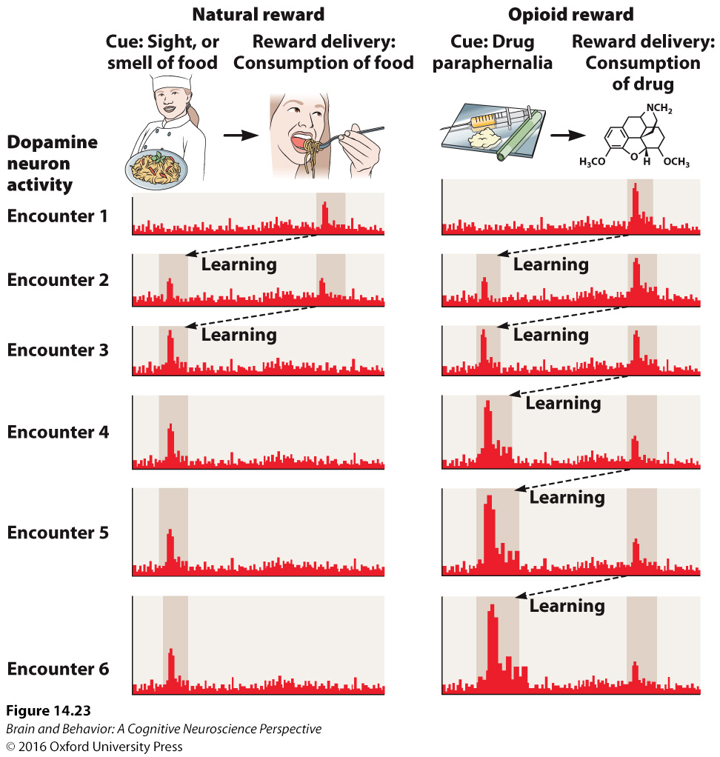
Addiction Is a Result of Pathological Learning
Figure 14.23 Pathological learning mechanisms in addiction. (a) Natural rewards produce a small “better than expected” signal on the first few encounters, but this signal diminishes, so the reward value of the cue eventually stabilizes. (b) Drugs of abuse, like opioids, can generate much larger “better than expected” signals, and these do not diminish as quickly over successive encounters. Therefore, the reward value of the cues keeps increasing and can eventually exceed the value of all natural rewards—even those required for survival.
Notes:
Figure 14.23 Pathological learning mechanisms in addiction. (a) natural rewards produce a small “better than expected” signal on the first few encounters, but this signal diminishes, so the reward value of the cue eventually stabilizes. (b) Drugs of abuse, like opioids, can generate much larger “better than expected” signals, and these do not diminish as quickly over successive encounters. Therefore, the reward value of the cues keeps increasing and can eventually exceed the value of all natural rewards— even those required for survival.

Slide 50
The Circuitry and Chemistry of Addiction
The neurons of the nucleus accumbens are important in addiction.
Addictive substances cause the release of dopamine in the nucleus accumbens.
Stimulating the circuit from the nucleus accumbens to the ventral tegmental area produces positive reinforcement.

Slide 51
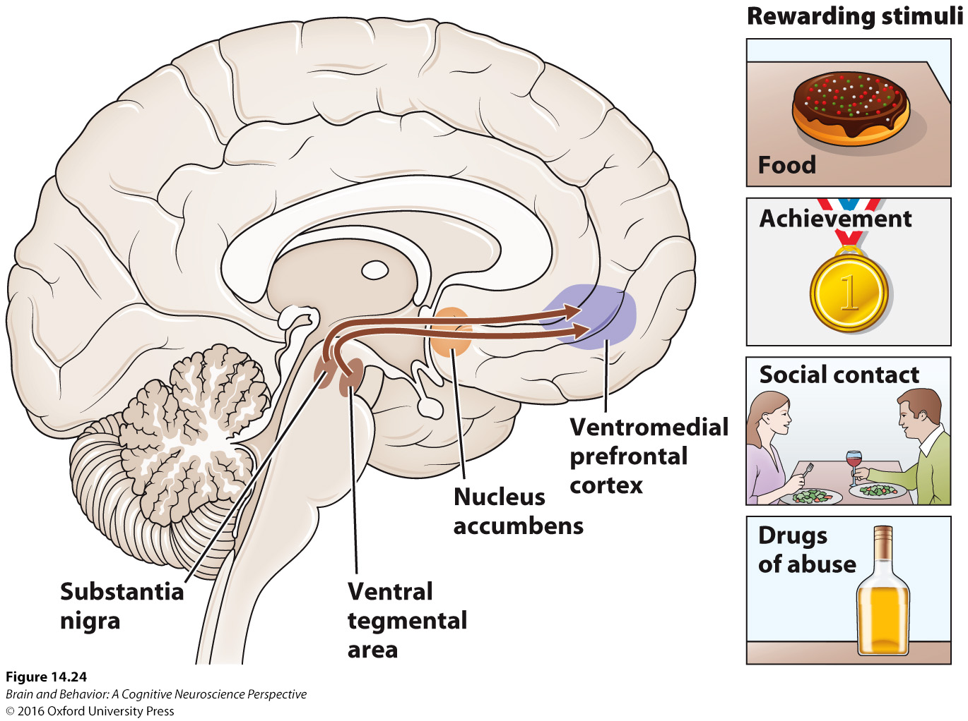
The Circuitry and Chemistry of Addiction
Figure 14.24 Dopamine pathways for reward signaling. Projections from the ventral tegmental area and substantia nigra to the nucleus accumbens and ventromedial prefrontal cortex form part of the pathway activated by natural rewards or addictive substances.
Notes:
Figure 14.24 Dopamine pathways for reward signaling. Projections from the ventral tegmental area and substantia nigra to the nucleus accumbens and ventromedial prefrontal cortex form part of the pathway activated by natural rewards or addictive substances.

Slide 52
Unlearning Addiction
The Challenge of Treatment
Existing Approaches to Treatment
Future Approaches to Treatment

Slide 53
The Challenge of Treatment
Addictive substances hijack reward circuits
  By creating the illusion of improvements in well-being.
  By creating the illusion of being better than expected (positive prediction error).
Addictive drugs contribute to about 10% of the global burden of disease.
Available treatments have not been effective.

Slide 54
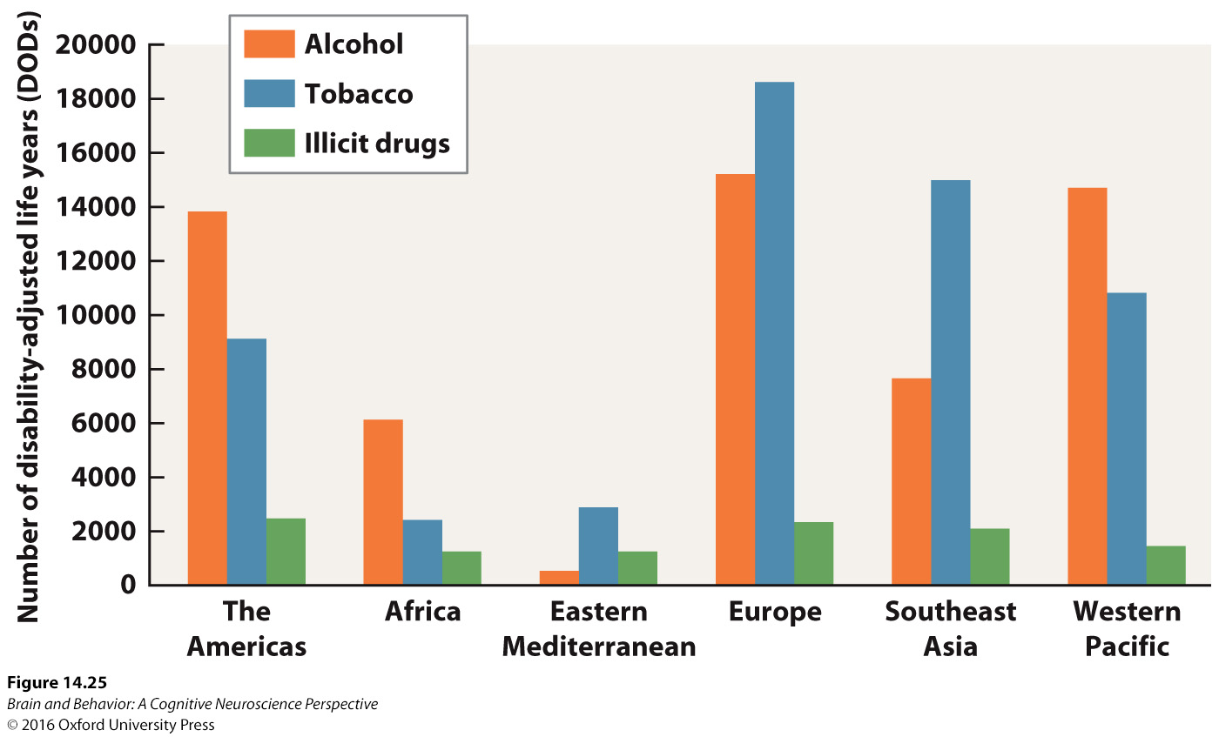
The Challenge of Treatment
Figure 14.25 The global burden of addiction, as measured by disability-adjusted life years. The disability-adjusted life year is a way of measuring the health impact of a disease and calculating how many years of normal, healthy life are lost to the disease.
Notes:
Figure 14.25 The global burden of addiction, as measured by disability- adjusted life years. The disability- adjusted life year is a way of measuring the health impact of a disease and calculating how many years of normal, healthy life are lost to the disease.

Slide 55
Existing Approaches to Treatment
Current treatments involve a combination of counseling and medication.
For alcohol addiction, opioid antagonists reduce the pleasure of alcohol.
Other medications inhibit the breakdown of alcohol, making the individual sick.
Many addicts do not adhere to their medications.

Slide 56
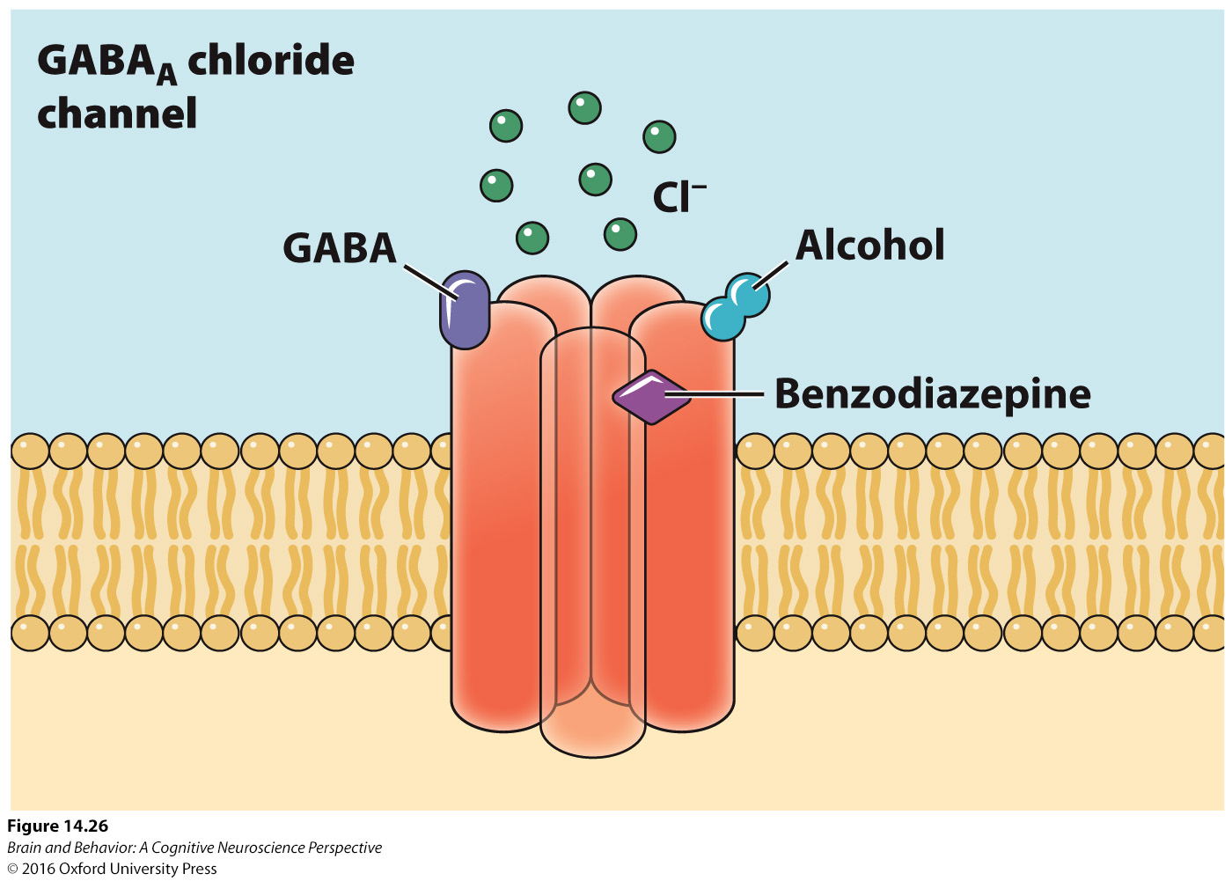
Existing Approaches to Treatment
Figure 14.26 Alcohol is an agonist for the GABAA ionotropic receptor. Alcohol binding to the receptor makes the GABA more potent, resulting in greater inhibition of the neuron. Benzodiazepine medications have a similar effect on this receptor, and can be used to prevent withdrawal symptoms in patients with alcohol addiction.
Notes:
Figure 14.26 Alcohol is an agonist for the GABAA ionotropic receptor. Alcohol binding to the receptor makes the GABA more potent, resulting in greater inhibition of the neuron. Benzodiazepine medications have a similar effect on this receptor, and can be used to prevent withdrawal symptoms in patients with alcohol addiction.

Slide 57
Existing Approaches to Treatment
For nicotine addiction, medications reduce the cravings for and pleasure from smoking.
Nicotine replacement helps somewhat.
In all cases, treatment is most effective when behavioral counseling is combined with medication.

Slide 58
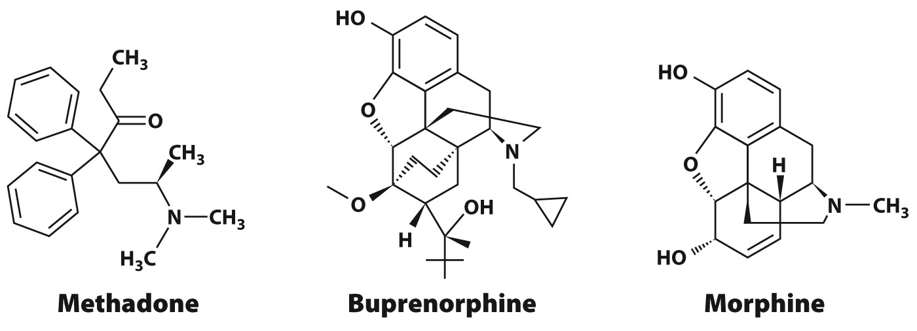
Existing Approaches to Treatment
Figure 14.27 Chemical structures of medications for treating opioid dependence. Methadone is a long-acting opioid that helps individuals avoid withdrawal symptoms. Buprenorphine weakly stimulates opioid receptors, while also blocking them, preventing tolerance or overdose. Both have a similar chemical structure to morphine.
Notes:
Figure 14.27 Chemical structures of medications for treating opioid dependence. Methadone is a long- acting opioid that helps individuals avoid withdrawal symptoms. Buprenorphine weakly stimulates opioid receptors, while also blocking them, preventing tolerance or overdose. Both have a similar chemical structure to morphine.

Slide 59
Future Approaches to Treatment
Immunization against addictive substances has been tried, but has not be very successful.
Ibogaine is a derived from an African tree and shows some signs of antiaddictive properties.
Patients with damage to the anterior insula find it much easier to quit smoking.

Slide 60
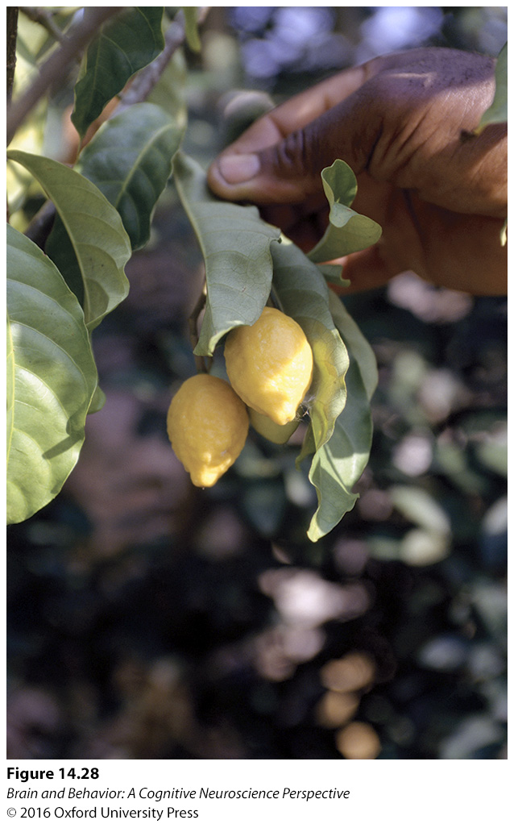
Future Approaches to Treatment
Figure 14.28 The iboga tree is native to western Africa. The tree produces ibogaine naturally in its bark. Some people believe that ibogaine has antiaddictive properties.
Notes:
Figure 14.28 The iboga tree is native to western Africa. The tree produces ibogaine naturally in its bark. Some people believe that ibogaine has antiaddictive properties.

Slide 61
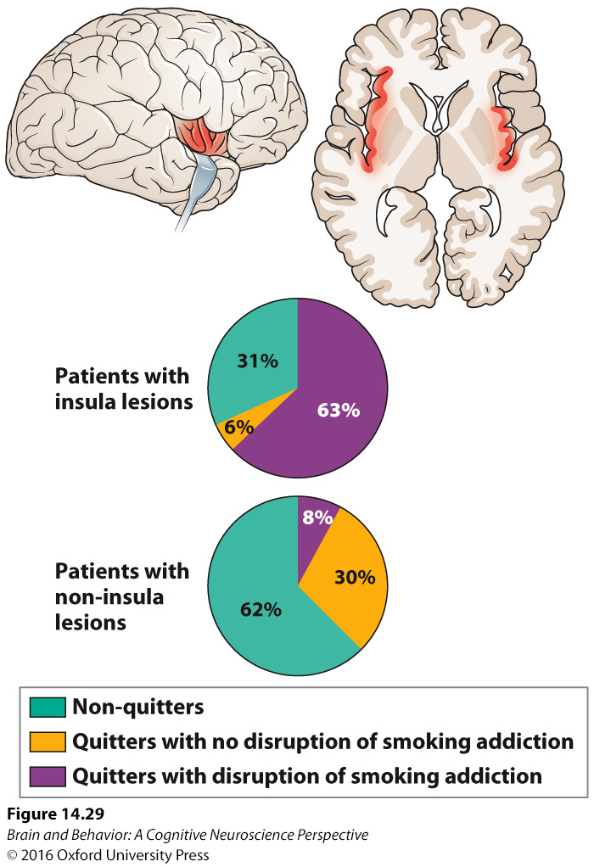
Future Approaches to Treatment
Figure 14.29 Damage to the insula makes it easier to quit smoking. Patients who had stroke damage to their insula (highlighted in red) were significantly more likely to successfully quit smoking than individuals without stroke damage or with stroke damage to other brain regions.
Notes:
Figure 14.29 Damage to the insula makes it easier to quit smoking. Patients who had stroke damage to their insula (highlighted in red) were significantly more likely to successfully quit smoking than individuals without stroke damage or with stroke damage to other brain regions.

