Slide 1
5: Vision
Cognitive Neuroscience
David Eagleman
Jonathan Downar

Slide 2
Chapter Outline
Visual Perception
Anatomy of the Visual System
Higher Visual Areas
Perception Is Active, Not Passive
Vision Relies on Expectations

Slide 3
Visual Perception
What Is It Like to See?
Signal Transduction

Slide 4
What Is It Like to See?
Visual illusions, such as the Mach band illusion, teach us about the visual system.
What we perceive is a poor representation of the stimuli in the world around us.
All perception, including vision, is a construct of our brain.

Slide 5
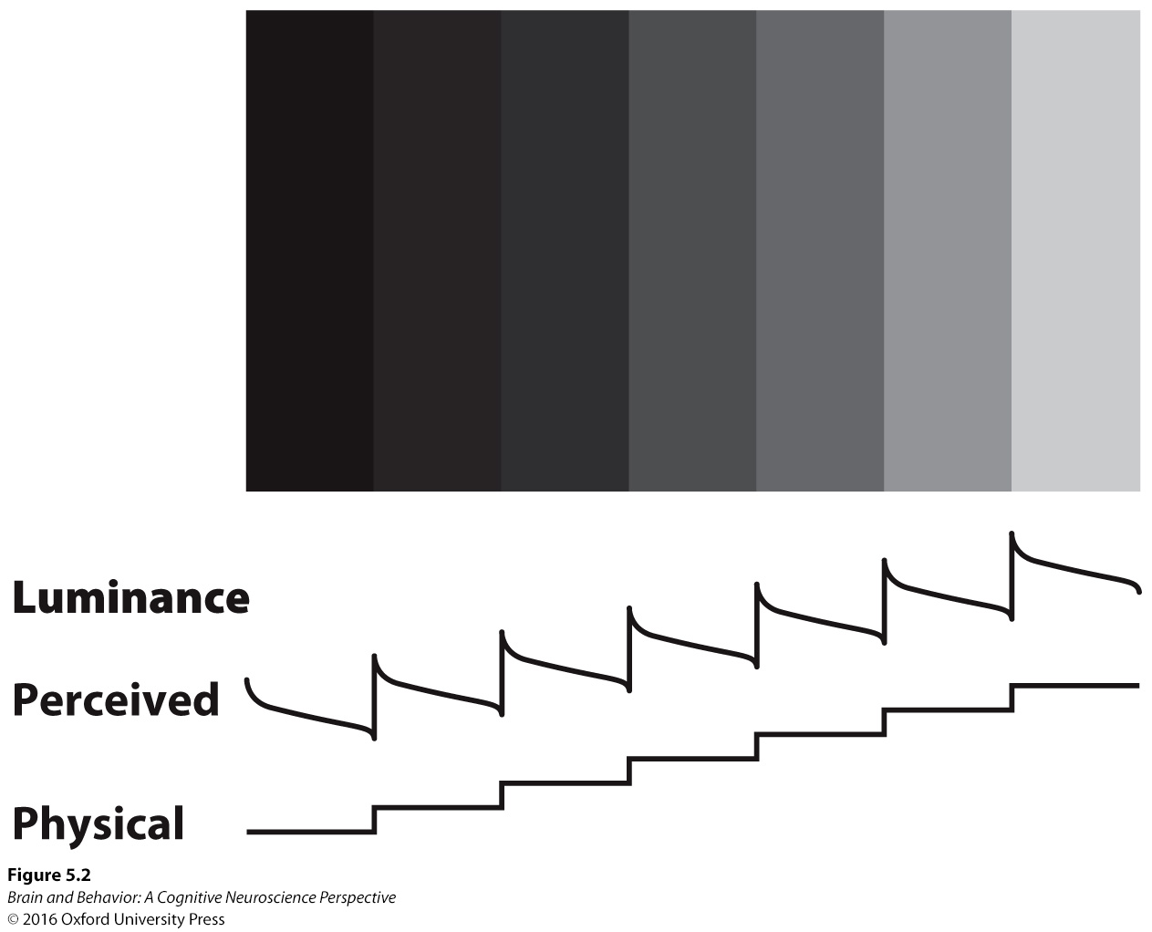
What Is It Like to See?
Figure 5.2. Mach band illusion. To prove to yourself that each vertical strip in the figure is in fact uniform in brightness, cover up all but one. When that same strip is viewed in context with the others, it appears to be darker on the right side and lighter on the left.
Notes:
FIGURE 5.2 Mach band illusion. To prove to yourself that each vertical strip in the figure is in fact uniform in brightness, cover up all but one. When that same strip is viewed in context with the others, it appears to be darker on the right side and lighter on the left.

Slide 6
Signal Transduction
Transduction is the process of converting information from the outside world into the electrical and chemical signals of our nervous system.
The sensory receptors that we possess determines what we perceive.
About 30% of our brain is involved in visual processing.

Slide 7
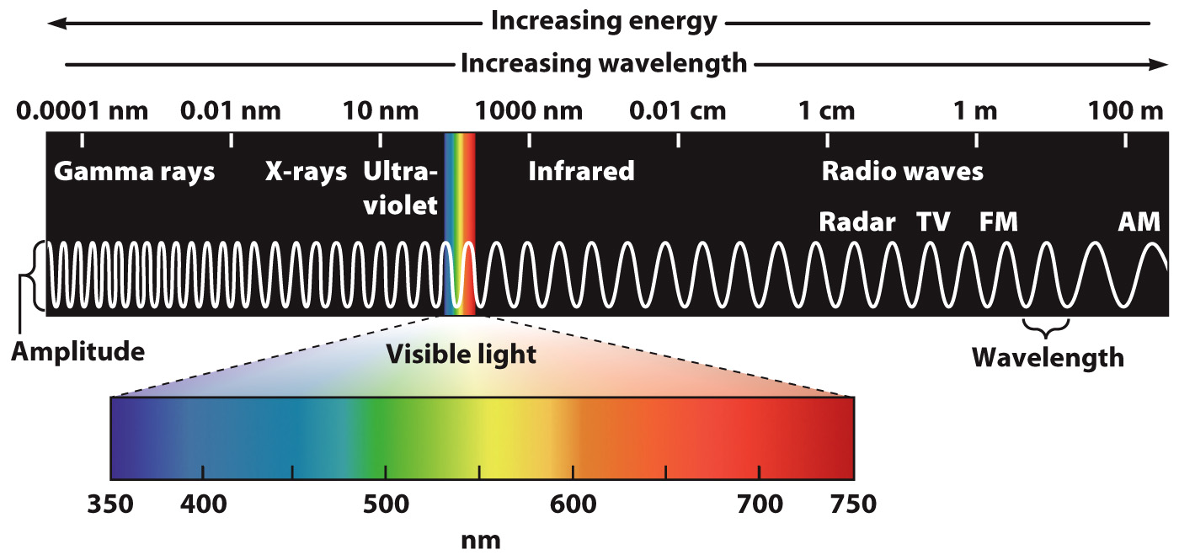
Signal Transduction
Figure 5.4. The electromagnetic spectrum. The fraction we detect, and thus call “visible light,” is approximately one 10-trillionth of the spectrum.
Notes:
FIGURE 5.4 The electromagnetic spectrum. The fraction we detect, and thus call “visible light,” is approximately one 10-trillionth of the spectrum.

Slide 8
Anatomy of the Visual System
Sensory Transduction: The Eye and Its Retina
Path to the Visual Cortex: The Lateral Geniculate Nucleus
The Visual Cortex
Two Eyes Are Better Than One: Stereo Vision

Slide 9
Sensory Transduction: The Eye and Its Retina
Light passes through the cornea and into the eye.
The pupil is surrounded by the iris, which can contract to limit the amount of light.
The lens focuses the light on the retina at the back of the eye.
There are five layers of cells that the light must pass through.

Slide 10
Sensory Transduction: The Eye and Its Retina
Cellular layers of the retina
  Retinal ganglion cells: Pass information to brain
  Amacrine cells: Allow communication between different parts of the retina
  Bipolar cells: Carry information from photoreceptors to retinal ganglion cells
  Horizontal cells: Communication between adjacent parts of the retina
  Photoreceptors: Transduce light signals

Slide 11
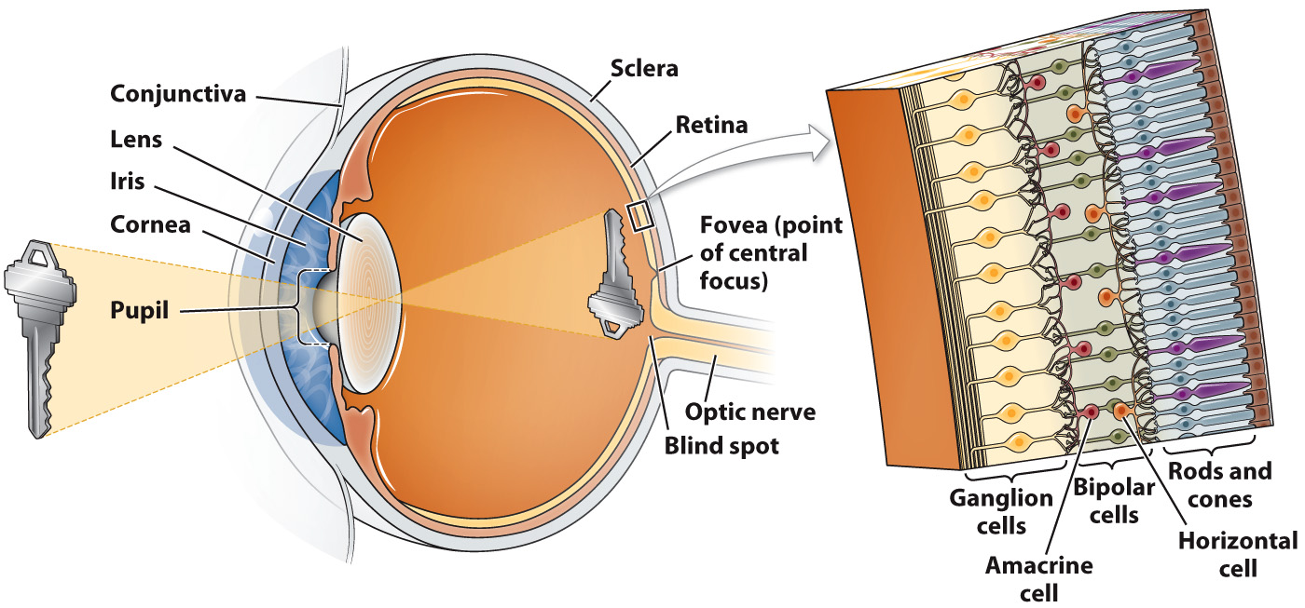
Sensory Transduction: The Eye and Its Retina
Figure 5.5. The anatomy of the eye and the cellular layers of the retina.
Notes:
FIGURE 5.5 The anatomy of the eye and the cellular layers of the retina.

Slide 12
Sensory Transduction: The Eye and Its Retina
Light strikes a pigment molecule in the photoreceptor.
The pigment molecule breaks apart.
Pieces act on proteins to change resting membrane potential and release neurotransmitter.
Enzymes reassemble pigment molecules.

Slide 13
Sensory Transduction: The Eye and Its Retina
Two different types of photoreceptors
Rods are more numerous, but are sensitive to a wide range of frequencies (colors).
Cones are concentrated in the fovea and provide more detailed visual information.
Three different cones are sensitive to short, middle, and long wavelengths of light.

Slide 14
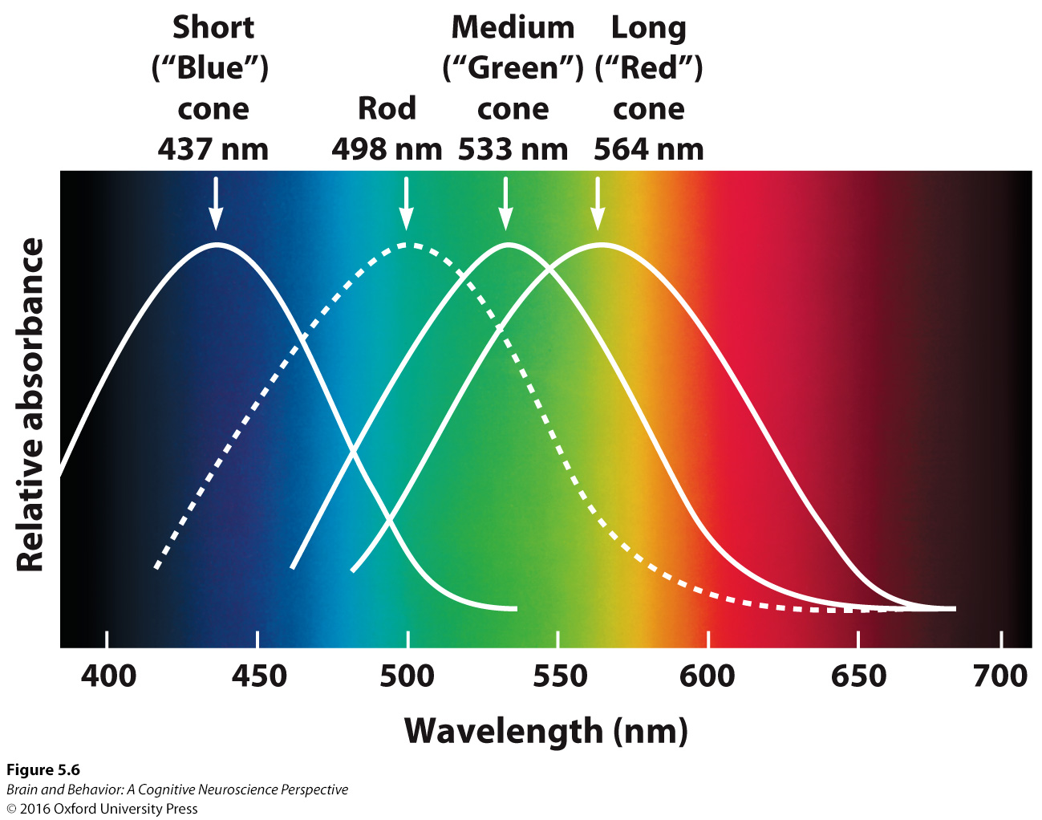
Sensory Transduction: The Eye and Its Retina
Figure 5.6. Spectral sensitivity of photoreceptors. This image shows the sensitivity of rods and cones to the visible wavelengths of light.
Notes:
FIGURE 5.6 Spectral sensitivity of photoreceptors. This image shows the sensitivity of rods and cones to the visible wavelengths of light.

Slide 15
Sensory Transduction: The Eye and Its Retina
Each neuron has a receptive field, in which it is sensitive to light at a particular point in the visual field.
The neurons have a center-surround organization, with the center sensitive to light and the surround inhibited by light, or vice versa.
This organization makes the neurons good at detecting contrast.

Slide 16
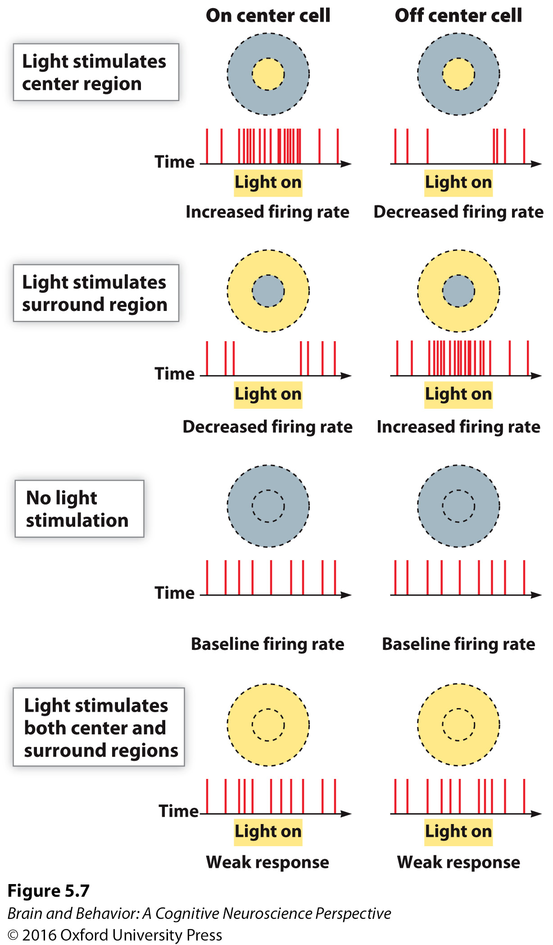
Sensory Transduction: The Eye and Its Retina
Figure 5.7. The center-surround receptive field of on-center and off-center retinal ganglion cells.
Notes:
FIGURE 5.7 The center-surround receptive field of on-center and off-center retinal ganglion cells.

Slide 17
Sensory Transduction: The Eye and Its Retina
Axons of the retinal ganglion cells converge to form the optic nerve.
There are no photoreceptors where the optic nerve leaves the eye, resulting in a blind spot.

Slide 18
Sensory Transduction: The Eye and Its Retina
Information from the nasal hemiretina (the half of the retina closest to the nose) crosses to the contralateral side at the optic chiasm.
Information from the temporal hemiretina (the half of the retina closest to the side of the head) does not cross at the optic chiasm.

Slide 19
Sensory Transduction: The Eye and Its Retina
All information from the left visual field is processed in the right hemisphere.
All information from the right visual field is processed in the left hemisphere.

Slide 20
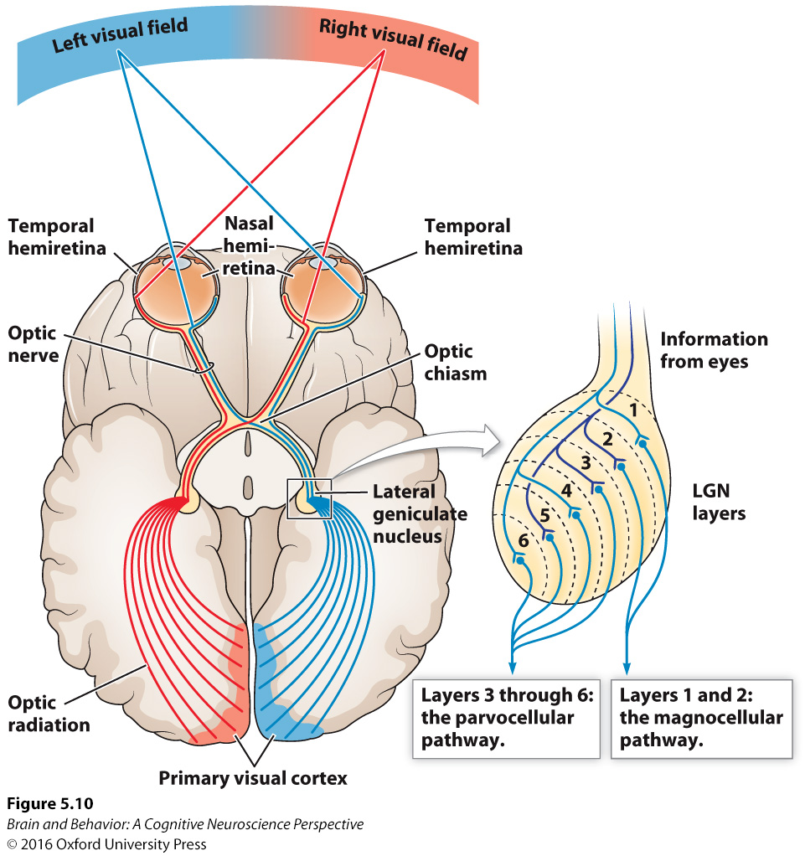
Sensory Transduction: The Eye and Its Retina
Figure 5.10 The optic nerve and optic chiasm. Axons of the retinal ganglion cells exit the back of the eye and form the optic nerve. At the optic chiasm, the output from the nasal hemiretina crosses over to the opposite side of the brain, while the information from the temporal hemiretina remains uncrossed. After the chiasm, the nerve bundles carry information about the right or left visual hemifield rather than the right or left eye.
Notes:
FIGURE 5.10 The optic nerve and optic chiasm. Axons of the retinal ganglion cells exit the back of the eye and form the optic nerve. At the optic chiasm, the output from the nasal hemiretina crosses over to the opposite side of the brain, while the information from the temporal hemiretina remains uncrossed. After the chiasm, the nerve bundles carry information about the right or left visual hemifield rather than the right or left eye.

Slide 21
Path to the Visual Cortex: The Lateral Geniculate Nucleus
Visual information moves from the optic chiasm to the lateral geniculate nucleus of the thalamus.
Information from the magnocellular retinal ganglion cells (originating from the rods) is separate from information from the parvocellular retinal ganglion cells (from the cones).

Slide 22
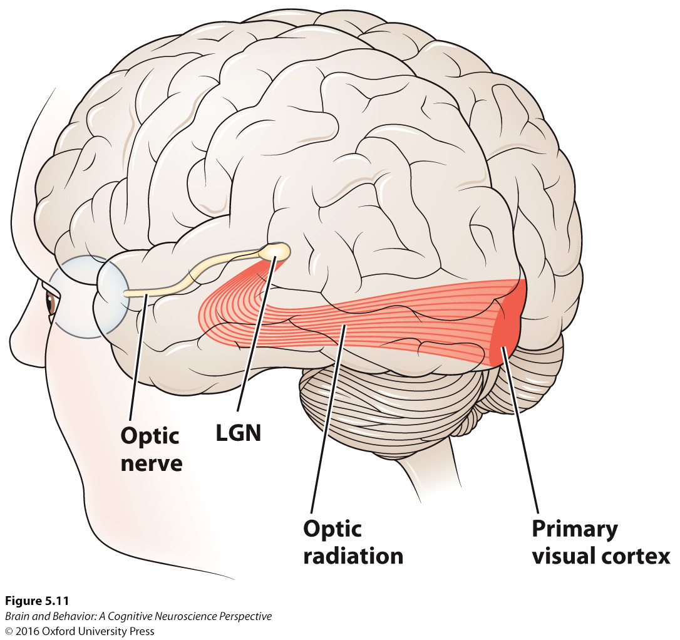
Path to the Visual Cortex: The Lateral Geniculate Nucleus
Figure 5.11. Pathway to the primary visual cortex, also known as the striate cortex.
Notes:
FIGURE 5.11 Pathway to the primary visual cortex, also known as the striate cortex.

Slide 23
The Visual Cortex
Information from the lateral geniculate nucleus projects to the primary visual cortex (V1) in the occipital lobe.
Information is structured in a retinotopic organization.
Many neurons in V1 respond to lines or edges at a particular angle.

Slide 24
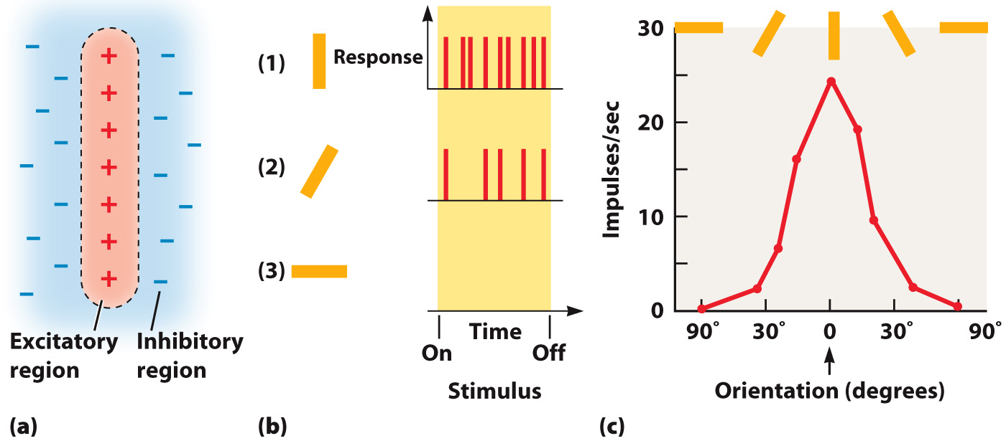
The Visual Cortex
Figure 5.12 Orientation tuning in V1 neurons. (a) Particular regions in a neuron’s receptive field respond with excitation or inhibition to stimulation. (b) As a result, each neuron can be maximally activated by a particular visual orientation. (c) The response of a neuron to different orientations of a stimulus can be measured—the resultant graph is known as the neuron’s tuning curve.
Notes:
FIGURE 5.12 Orientation tuning in V1 neurons. (a) Particular regions in a neuron’s receptive field respond with excitation or inhibition to stimulation. (b) As a result, each neuron can be maximally activated by a particular visual orientation. (c) The response of a neuron to different orientations of a stimulus can be measured—the resultant graph is known as the neuron’s tuning curve.

Slide 25
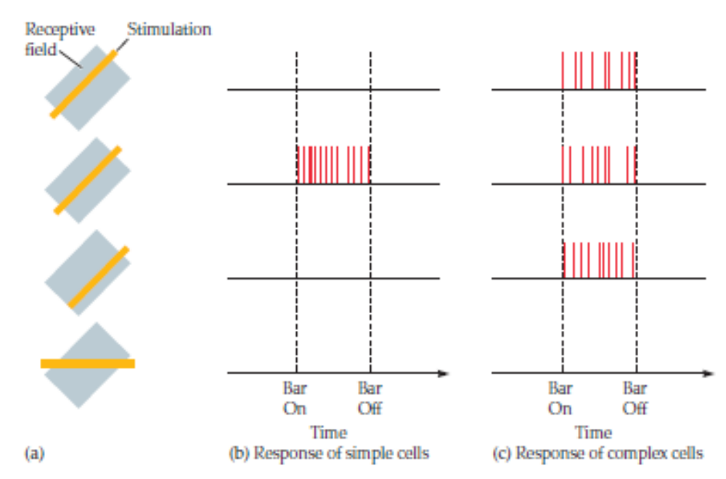
The Visual Cortex
Figure 5.13 Response of simple cells and complex cells to stimulation. (a) The dark shaded area represents a neuron’s receptive field, and the yellow line shows where a bar of light is presented. (b) Simple cells respond maximally to a bar at a preferred orientation in a specific location, while complex cells (c) are orientation-selective but location-insensitive.
Notes:
FIGURE 5.13 Response of simple cells and complex cells to stimulation. (a) The dark shaded area represents a neuron’s receptive field, and the yellow line shows where a bar of light is presented. (b) Simple cells respond maximally to a bar at a preferred orientation in a specific location, while complex cells (c) are orientation-selective but location-insensitive.

Slide 26
The Visual Cortex
Simple cells respond to an edge at a particular part of the visual field.
Complex cells respond to an edge anywhere within their receptive field.
At higher levels of the visual system, the receptive properties of the cells are built from the simpler cells.

Slide 27
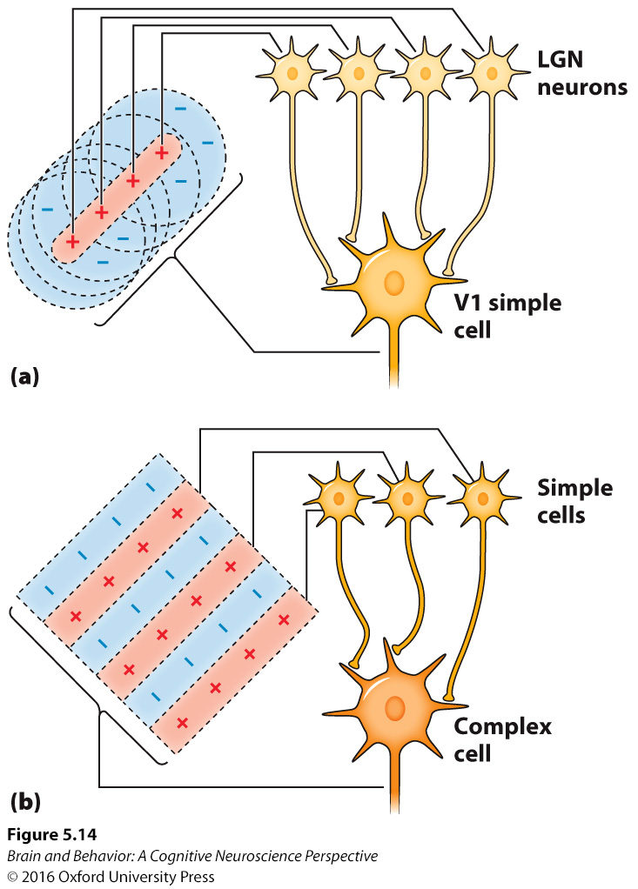
The Visual Cortex
Figure 5.14 Building successively richer layers of processing from simple parts. (a) When several LGN neurons converge on a V1 simple cell, the new receptive field can be tuned to more than spots—in this case, it becomes tuned to oriented lines. (b) When several simple cells converge onto a complex cell, that neuron can respond to the preferred orientation in many locations.
Notes:
FIGURE 5.14 Building successively richer layers of processing from simple parts. (a) When several LGN neurons converge on a V1 simple cell, the new receptive field can be tuned to more than spots—in this case, it becomes tuned to oriented lines. (b) When several simple cells converge onto a complex cell, that neuron can respond to the preferred orientation in many locations.

Slide 28
The Visual Cortex
Cells in the visual cortex are organized into columns, forming a two-dimensional grid on the surface of the brain.
Along one dimension, the cells are sensitive to orientation of the lines.
Along the other dimension, the columns have alternating input, from the left eye and the right eye.

Slide 29
The Visual Cortex
Blobs are clusters of cells within V1 that are specialized to process color.
The combination of blobs, orientation-sensitive cells, and input from both the left and right eye forms a hypercolumn.
The hypercolumn represents all the information from one point of the visual field.

Slide 30
Two Eyes Are Better Than One: Stereo Vision
Information from both the left and right eyes are combined in V1.
The input from both the left and right eyes is slightly different.
The visual system uses that difference, called binocular disparity, to make a three-dimensional model of the world.

Slide 31
Higher Visual Areas
Secondary and Tertiary Visual Cortex: Processing Becomes More Complex
Ventral Stream: What an Object Is
Dorsal Stream: How to Interact with the World
Attention and the Dorsal Stream
Comparing the Ventral and Dorsal Processing Streams
The Bigger Picture of the Visual Brain

Slide 32
Secondary and Tertiary Visual Cortex
Cells in secondary and tertiary visual cortex receive input from V1 and have larger receptive fields.
Cells respond to more complex stimuli as you get higher in the visual hierarchy.

Slide 33
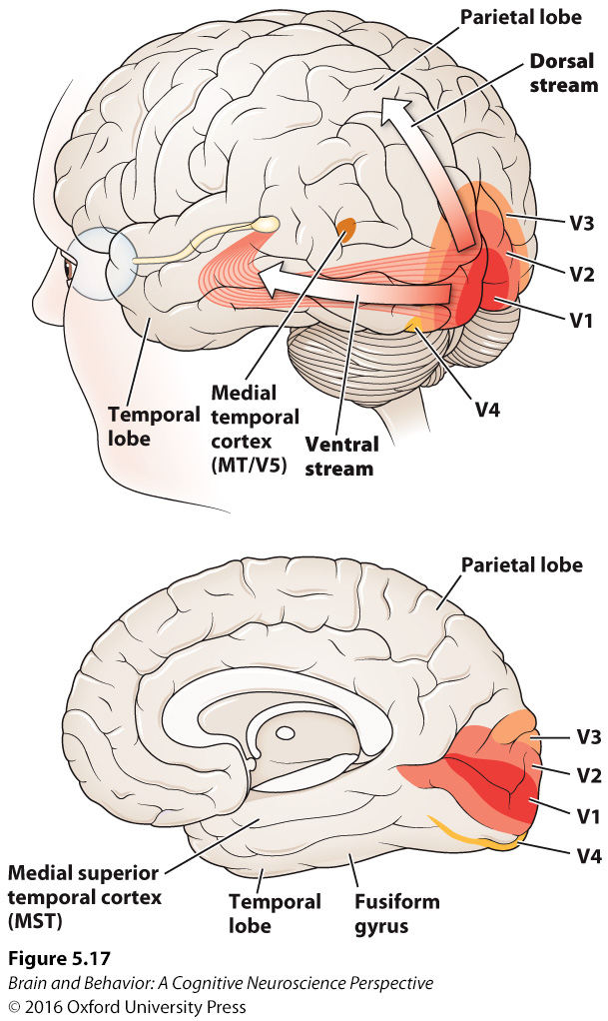
Secondary and Tertiary Visual Cortex
Figure 5.17. Lateral and medial view of the brain, highlighting higher visual areas, including V2, V3, V4, V5/MT.
Notes:
FIGURE 5.17 Lateral and medial view of the brain, highlighting higher visual areas, including V2, V3, V4, and V5/MT.

Slide 34
Ventral Stream: What an Object Is
The ventral stream projects from V1 to the inferotemporal cortex.
The ventral stream identifies and characterizes objects.
This system encodes features and specific objects.
Within the inferior temporal (IT) regions, cells are selective for tools, animals, faces.

Slide 35
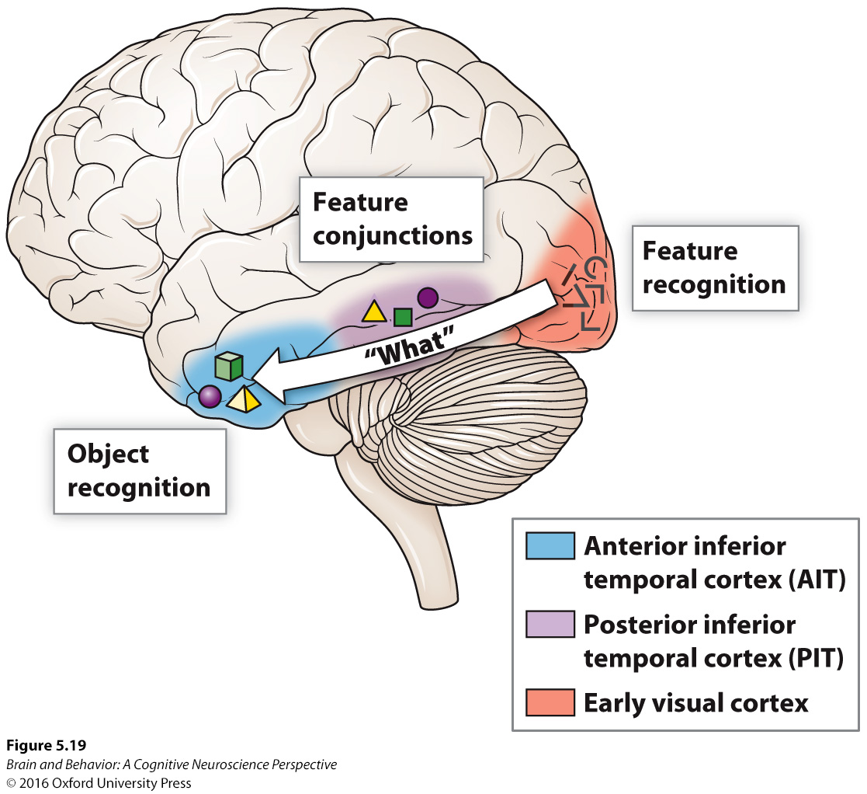
Ventral Stream: What an Object Is
Figure 5.19 The ventral stream in inferior temporal cortex. The inferior temporal cortex is subdivided into several areas, and the complexity of information processed increases from the posterior inferior temporal cortex (PIT) to the anterior inferior temporal cortex (AIT). Each of these areas has a full representation, or map, of the visual world. In the progression from posterior to anterior, the response of neurons evolves from specific visual features to generalized understanding of objects.
Notes:
FIGURE 5.19 The ventral stream in inferior temporal cortex. The inferior temporal cortex is subdivided into several areas, and the complexity of information processed increases from the posterior inferior temporal cortex (PIT) to the anterior inferior temporal cortex (AIT). Each of these areas has a full representation, or map, of the visual world. In the progression from posterior to anterior, the response of neurons evolves from specific visual features to generalized understanding of objects.

Slide 36
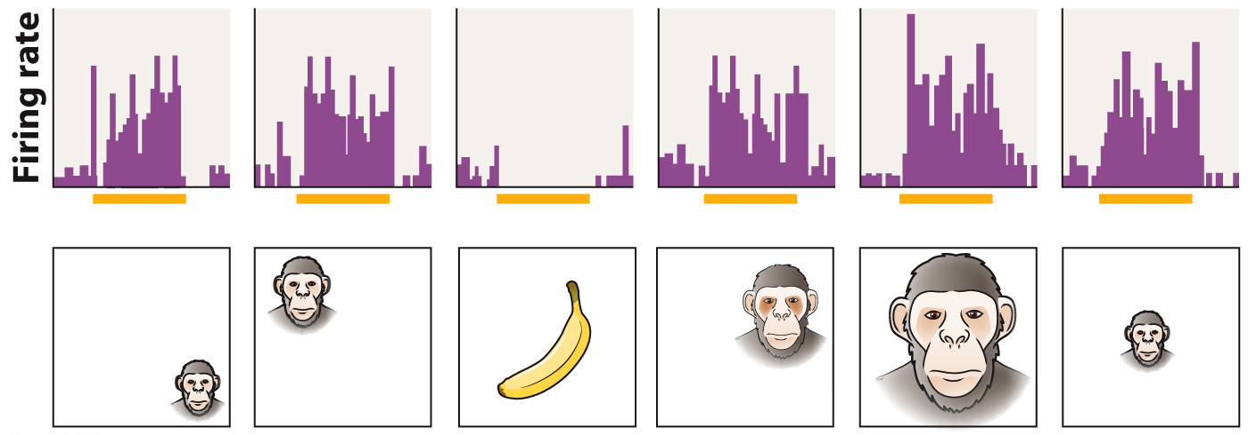
Ventral Stream: What an Object Is
Cells in IT show position and size invariance.
Figure 5.20 Position and size invariance. With large receptive fields, neurons in IT are not focused so much upon where an object is nor on the size of the object. Instead, the response is tied to the object’s identity. Yellow bars represent when the stimulus is present.
Notes:
FIGURE 5.20 Position and size invariance. With large receptive fields, neurons in are not focused so much upon where an object is nor on the size of the object. Instead, the response is tied to the object’s identity. Yellow bars represent when the stimulus is present.

Slide 37
Ventral Stream: What an Object Is
Two ways to encode information in IT.
  Sparse Coding
    A small number of neurons responds to a particular stimulus.
    Face coding for highly familiar faces uses this.
  Population Coding
    Most neurons respond to all stimuli, but the pattern of responses differs for each stimulus.
    Most non-familiar stimuli are encoded by population coding.

Slide 38
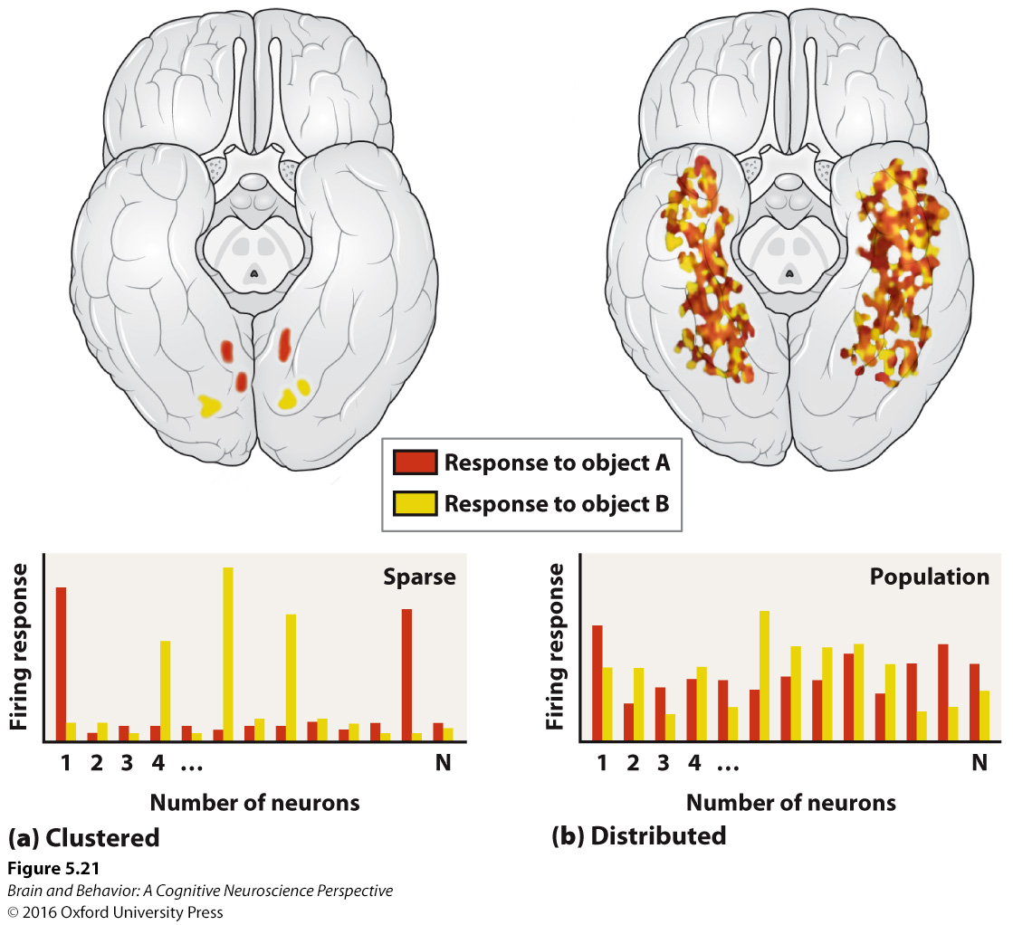
Ventral Stream: What an Object Is
Figure 5.21 An illustration of sparse versus population coding schemes. (a) Where sparse coding is found in the brain, small numbers of responsive neurons usually lie in close proximity to one another. (b) In population coding, responsive neurons tend to be more spread out. The brain here is viewed from underneath to see the inferior temporal lobes. Figure from Reddy and Kanwisher (2006).
Notes:
FIGURE 5.21 An illustration of sparse versus population coding schemes. (a) Where sparse coding is found in the brain, small numbers of responsive neurons usually lie in close proximity to one another. (b) In population coding, responsive neurons tend to be more spread out. The brain here is viewed from underneath to see the inferior temporal lobes. Figure from Reddy and Kanwisher (2006).

Slide 39
Dorsal Stream: How to Interact with the World
The dorsal stream projects from the rods to V1 to the parietal lobe.
It processes information about where an object is.
In motion blindness, an individual is unable to detect motion, although they can identify the object.

Slide 40
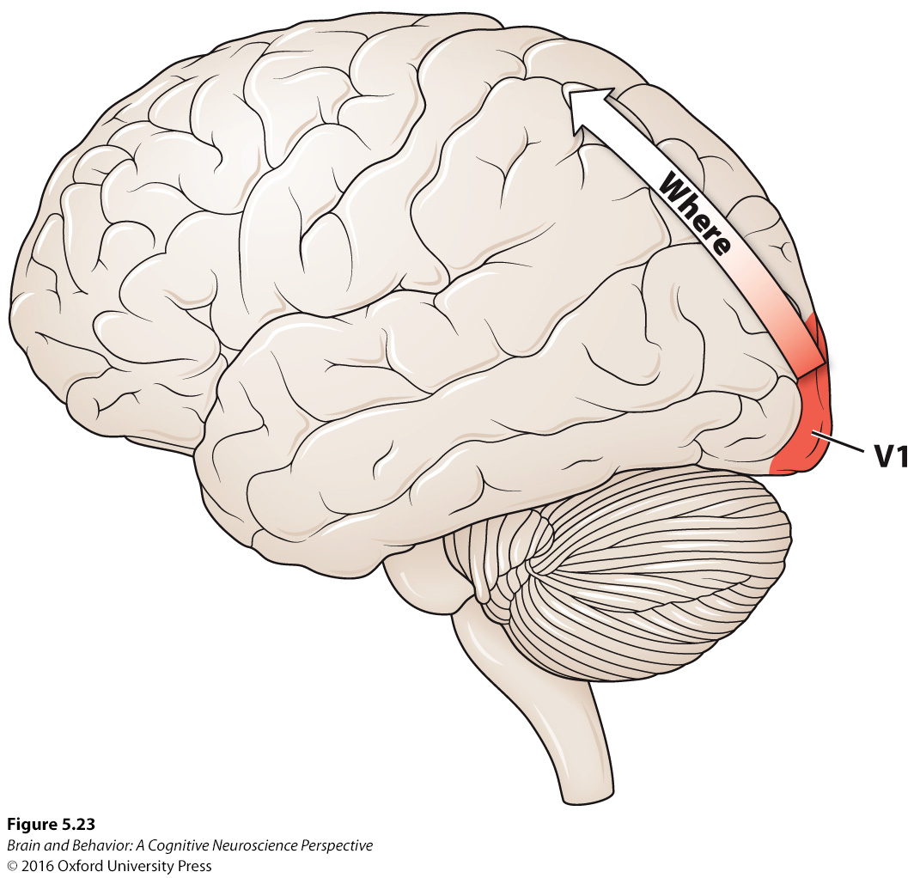
Dorsal Stream: How to Interact with the World
Figure 5.23. The dorsal stream moves from V1 into the parietal lobe.
Notes:
FIGURE 5.23 The dorsal stream moves from V1 into the parietal lobe.

Slide 41
Attention and the Dorsal Stream
You can only attend to a limited part of the visual field at one time.
Attention improves perception of the object you are attending to and degrades perception of unattended objects.
Attention is like a spotlight, which can be focused on an area, but cannot be divided.
The dorsal stream guides attention.

Slide 42

Attention and the Dorsal Stream
Figure 5.25. How many horses are in the picture?
Notes:
FIGURE 5.25 How many horses are in the picture?
This would be an easy question to answer if we could attend to all parts of the visual scene at once.

Slide 43
Attention and the Dorsal Stream
In hemineglect, a patient is unable to focus their attention onto objects on the left side.
Hemineglect typically results from damage to the right parietal lobe.
In Balint’s syndrome, the parietal lobes are damaged on both sides of the brain, resulting in the loss of the dorsal stream to direct attention.

Slide 44
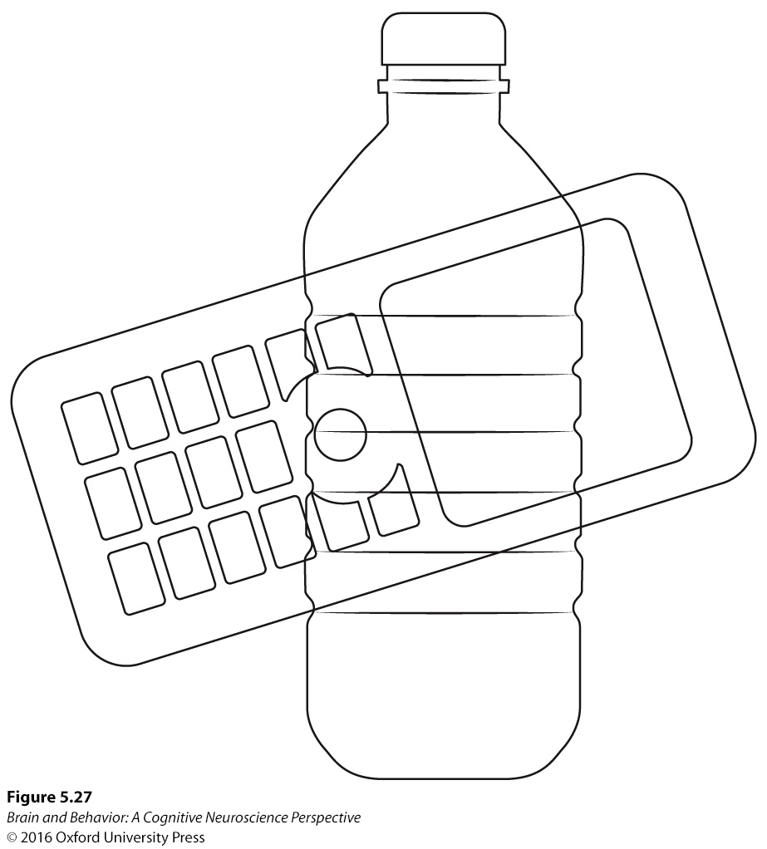
Attention and the Dorsal Stream
Simaltagnosia, a symptom of Balint’s syndrome, is the inability to recognize multiple objects presented simultaneously.
Figure 5.27. A typical test for simultagnosia. A person is asked to look at a picture like this one and describe what he or she sees. A person with simultagnosia will report seeing only one object at a time.
Notes:
FIGURE 5.27 A typical test for simultagnosia. A person is asked to look at a picture like this one and describe what he or she sees. A person with simultagnosia will report seeing only one object at a time.

Slide 45
Comparing the Ventral and Dorsal Processing Streams
Prosopagnosia (face blindness) is caused by bilateral damage to the face area of the visual stream.
Damage to dorsal stream affect knowledge of how and where to interact with objects.
Damage to dorsal stream also affects the ability to shift attention.

Slide 46
The Bigger Picture of the Visual Brain
As one moves higher in the visual hierarchy, the processing becomes more abstract and object oriented.
Damage to different visual areas results in different types of visual problems.

Slide 47
The Bigger Picture of the Visual Brain
There is significant interaction between the dorsal and ventral streams throughout the visual system.
About 10% of the output from the retina does not project to the lateral geniculate nucleus, but to other areas.

Slide 48
Perception Is Active, Not Passive
Interrogating the Scene with Our Eyes
The Blind Spot
Seeing the Same Object Different Ways: Multistability
Binocular Rivalry: Different Images in the Two Eyes
We Don’t See Most of What Hits Our Eyes: Fetching Information on a Need-to-Know Basis

Slide 49
Interrogating the Scene with Our Eyes
The brain directs the eyes to specific parts of the visual field to take in the information that is needed at that moment.
We do not take in the entire scene at one time.

Slide 50
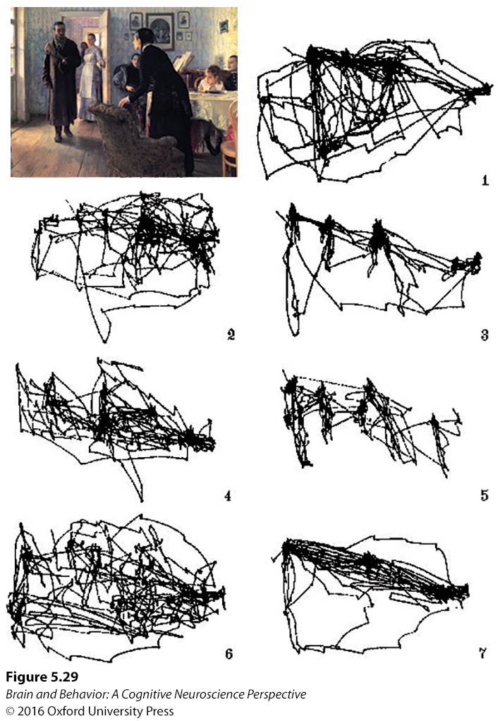
Interrogating the Scene with Our Eyes
Figure 5.29 Eye movement recordings from a participant looking at The Unexpected Visitor. The different conditions were: (1) Free examination. Then, before the next recordings, participants were asked to (2) judge the wealth of the family, (3) estimate the ages of the people, (4) deduce what the family was doing just before the arrival of the unexpected visitor, (5) recall the clothes worn by the people, (6) remember the positions of the objects and people in the room, and (7) guess how long the unexpected visitor had been away. Each eye-recording lasted 3 minutes.
Notes:
FIGURE 5.29 Eye movement recordings from a participant looking at The Unexpected Visitor. The different conditions were: (1) Free examination. Then, before the next recordings, participants were asked to (2) judge the wealth of the family, (3) estimate the ages of the people, (4) deduce what the family was doing just before the arrival of the unexpected visitor, (5) recall the clothes worn by the people, (6) remember the positions of the objects and people in the room, and (7) guess how long the unexpected visitor had been away. Each eye-recording lasted 3 minutes.

Slide 51
The Blind Spot
The brain often builds up, and sometimes makes up, what is going on in the outside world.
There is a blind spot in each retina, where the optic nerve exits the eye.
This is generally not noticed in daily life.
The brain fills in the missing information.

Slide 52
Seeing the Same Object Different Ways: Multistability
A multistable precept is an ambiguous stimulus that can be perceived in multiple ways.
The perception will alternate back and forth between the different possible interpretations.

Slide 53
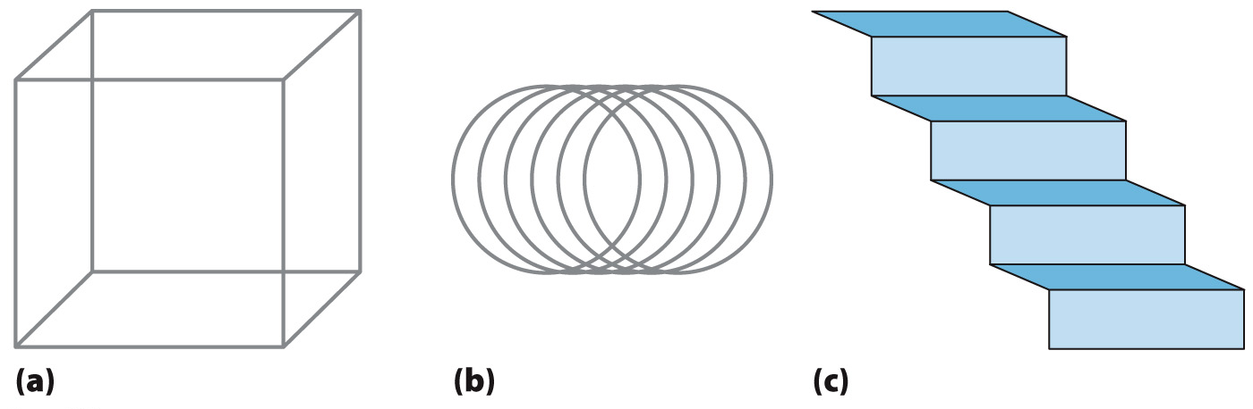
Seeing the Same Object Different Ways: Multistability
Figure 5.31 Ambiguous figures. The Necker cube (a) can be perceived as coming out of the page in one of two ways, as can the cylinder (b). The staircase (c) can be viewed as going up and into the page or as the underside of a staircase coming out of the page. The perceived “switching” of the figure orientation takes place because “seeing” is an active process: nothing about the figure on the page has changed.
Notes:
FIGURE 5.31 Ambiguous figures. The Necker cube (a) can be perceived as coming out of the page in one of two ways, as can the cylinder (b). The staircase (c) can be viewed as going up and into the page or as the underside of a staircase coming out of the page. The perceived “switching” of the figure orientation takes place because “seeing” is an active process: nothing about the figure on the page has changed.

Slide 54
Binocular Rivalry: Different Images in the Two Eyes
Binocular rivalry is when two significantly different images are projected onto each retina.
Then, you perceive one image, then the other, alternating back and forth.

Slide 55

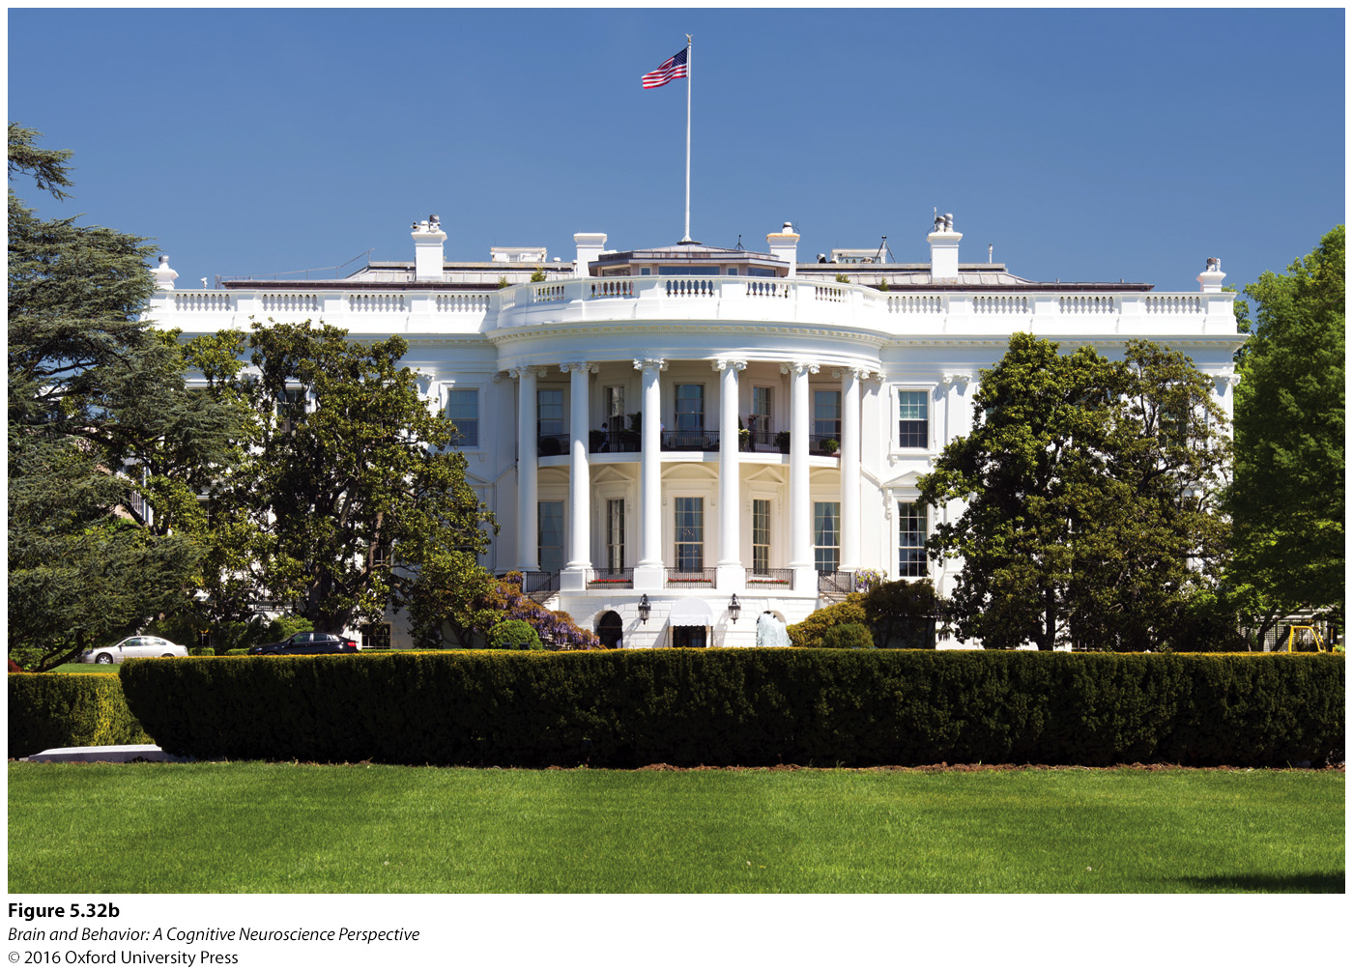
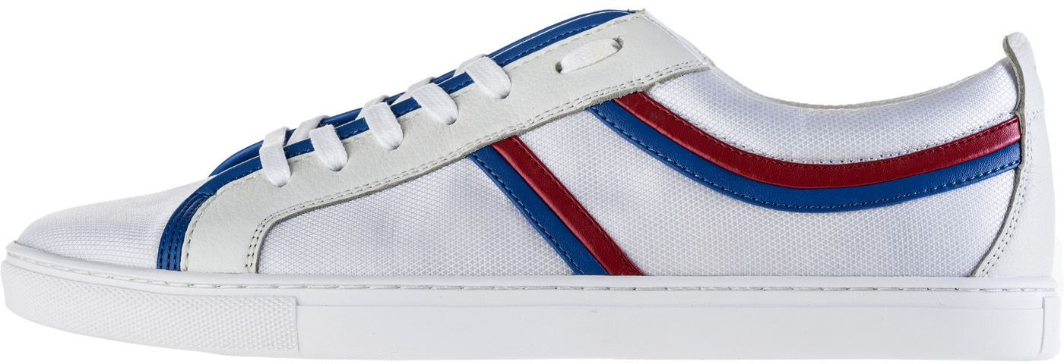
Binocular Rivalry: Different Images in the Two Eyes
Figure 5.32. Binocular rivalry. When two different images are presented individually to the two eyes, the brain does not perceive a fusion of both images. Instead, it perceives one image alternating sporadically with the other.
Notes:
FIGURE 5.32 Binocular rivalry. When two different images are presented individually to the two eyes, the brain does not perceive a fusion of both images. Instead, it perceives one image alternating sporadically with the other.

Slide 56
We Don’t See Most of What Hits Our Eyes
Our brain does not store all of the details of the world around us, just enough to know where to look next.
We become aware of details only when we need them or when we are asked more questions about the scene.

Slide 57
Vision Relies on Expectations
Change Blindness
Saving Resources by Embedding Prior Experience
Unconscious Inference
Activity from Within
Feedback Allows an Internal Model

Slide 58
Change Blindness
What we see is our internal model of the world, not a perfect representation of what is around us.
We do not notice even fairly obvious differences between two similar scenes unless we are attending to the difference.

Slide 59
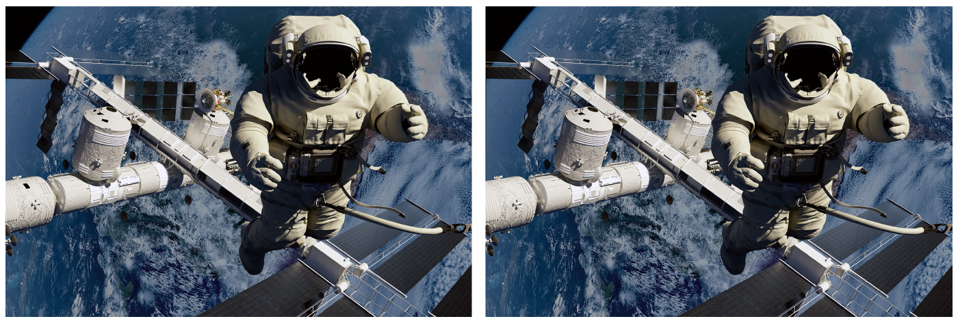
Change Blindness
What is the difference between these two images?
Figure 5.33. Two slightly different pictures to demonstrate change blindness.
Notes:
FIGURE 5.33 Two slightly different pictures to demonstrate change blindness.

Slide 60
Saving Resources by Embedding Prior Experience
Possessing an internal model of the world saves the brain time and energy.
The visual system includes its previous experience with the world to help interpret what is seen

Slide 61
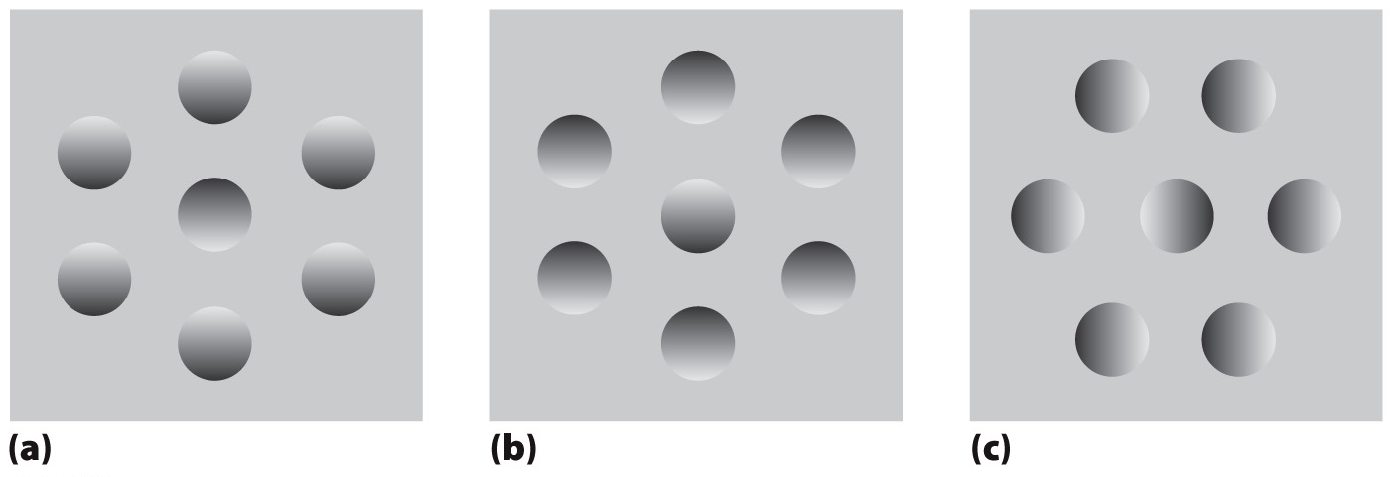
Saving Resources by Embedding Prior Experience
Figure 5.35 Light sources are preferentially seen as coming from the top. (a) Generally interpreted as bumps with a dimple in the middle. (b) Merely the same picture upside down—but it is now interpreted as dimples with a bump in the middle. (c) The same picture rotated 90 degrees; the depth information (a) (b) (c) now appears ambiguous.
Notes:
FIGURE 5.35 Light sources are preferentially seen as coming from the top. (a) Generally interpreted as bumps with a dimple in the middle. (b) Merely the same picture upside down—but it is now interpreted as dimples with a bump in the middle. (c) The same picture rotated 90 degrees; the depth information now appears ambiguous.

Slide 62
Unconscious Inference
The brain makes assumptions about incoming information, based on past experience.
The brain interprets the stimulus based on what is most likely, given past experience.

Slide 63
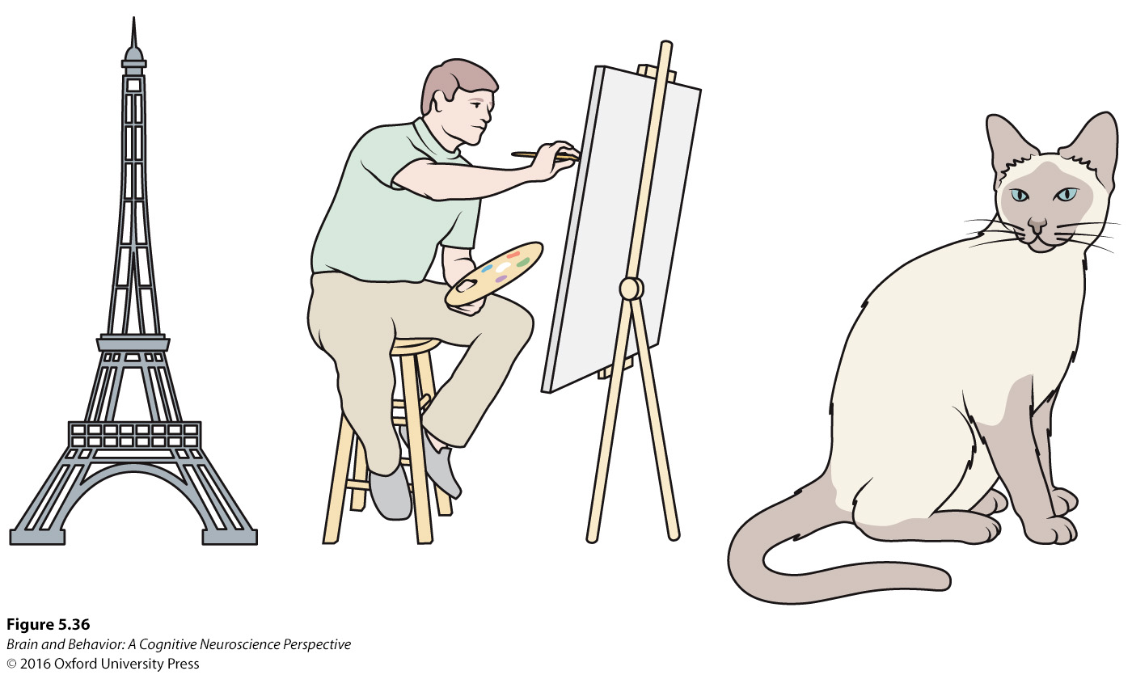
Unconscious Inference
Figure 5.36 Our prior knowledge about size is a cue for depth. Because we know the size of cats, artists, and the Eiffel Tower, we assume that they exist in that order of nearness to us in the cartoon. An alien from a planet with giant cats and tiny towers would interpret the depth in the scene differently.
Notes:
FIGURE 5.36 Our prior knowledge about size is a cue for depth. Because we know the size of cats, artists, and the Eiffel Tower, we assume that they exist in that order of nearness to us in the cartoon. An alien from a planet with giant cats and tiny towers would interpret the depth in the scene differently.

Slide 64
Activity from Within
Most activity within the brain is produced on the inside and is only modified by sensory input.
Patients who lose their vision hallucinate that they still see objects around them.

Slide 65
Feedback Allows an Internal Model
Connections in the brain run both forward and backwards.
In other words, primary visual areas project to secondary areas, but secondary areas also project to primary areas.
There is as much feedback as feedforward in the brain, which is known as recurrence.

Slide 66
Feedback Allows an Internal Model
The visual system could be considered a reverse hierarchy, where information from higher levels influences lower levels.
Visual cortex may build a model of the world and sensory input updates the model by reporting differences between the model and reality.

Slide 67
Feedback Allows an Internal Model
Sensation is detecting the sensory signal.
Perception is the comparison between the sensory signal and the internal model to understand the information.

