Slide 1
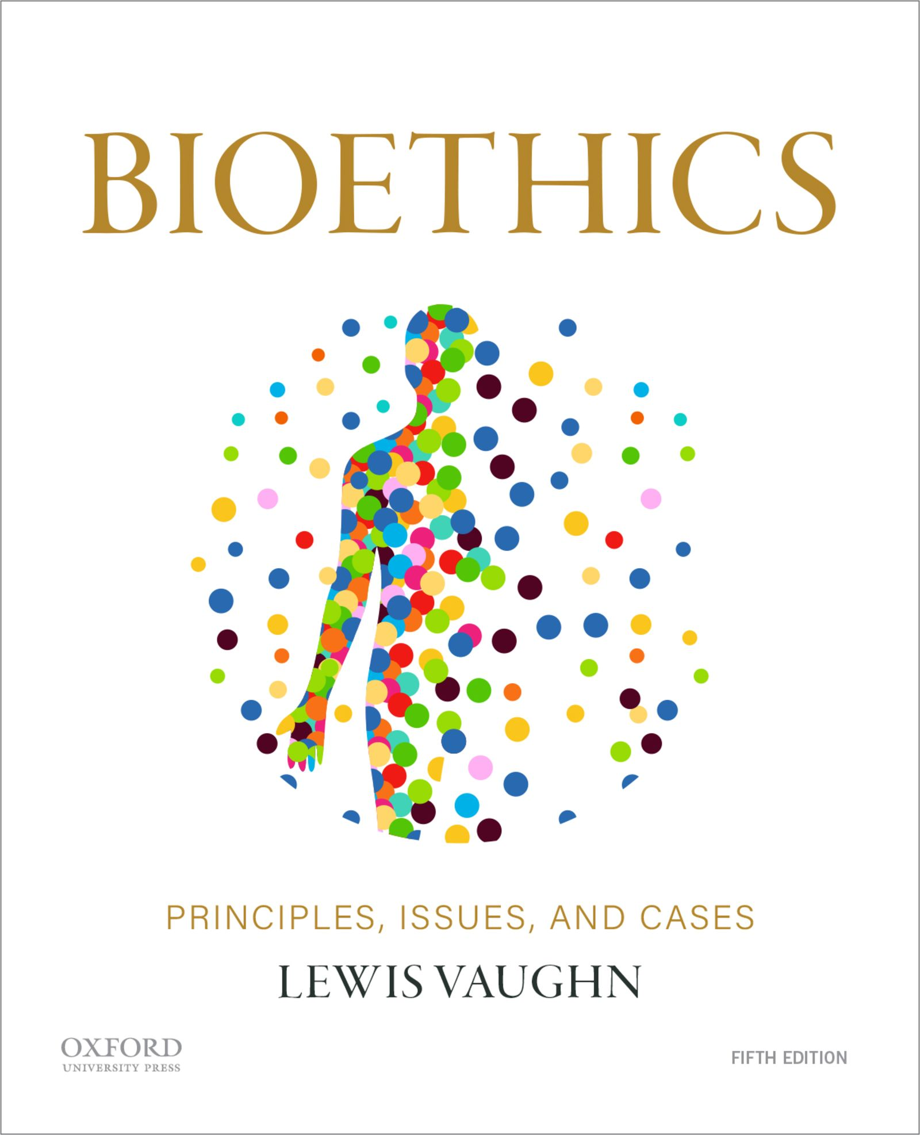
Bioethics: Chapter 13
Lewis Vaughn

Slide 2

Racism
Involves:
    Inherency—the notion that certain traits of mind, character, and temperament are inescapably part of a racial group’s nature
    Inferiorization—the treatment of certain groups as inferior to other groups
    Racial Antipathy—general racial bigotry, hostility, and hatred

Slide 3
Racism Is Empirically Wrong
The consensus among scientists and scholars is that the traditional view of races—that there are distinct groups of people sharing significant biological characteristics—is false.
Race has no physical scientific basis.
Race is a social construction, an idea we endow with meaning through daily interactions.

Slide 4
Scientific Racism
Scientific Racism
The attempt to prove there are separate races, race explains basic differences among people, some races are superior to others
Discredited
Based on obvious biases, faulty assumptions, methodological errors, and motivated reasoning

Slide 5

Why Not Discard the Concept of Race?
Race-based social grouping has led to real differences in resources, opportunities, and well-being.
The concept of race must be conserved in order to facilitate race-based social movements or policies.

Slide 6
Racism Is Morally Wrong
Respect for persons—persons possess inherent worth and have rights—the rights of free expression, choice, and privacy, the right not to be coerced, enslaved, cheated, or discriminated against.
Principle of justice—equals should be treated equally unless there is a morally relevant reason for treating them differently—and racial difference is not morally relevant.
Utility—we should produce the most favorable balance of benefit over harm for all concerned and racist beliefs, words, and actions can do harm or lead to harm that is magnified when operating through institutions, corporations, governments, and the law.

Slide 7
Structural vs. Individual Racism
Individual Racism
Person-to-person acts of intolerance or discrimination
Institutional or Structural Racism
Unequal treatment that arises from the way organizations, institutions, and social systems operate

Slide 8
Health Disparities and Race
Infant mortality—the number of infants who die before their first birthday per 1,000 live births
  In 2013, the infant mortality rate among African Americans (11.1 per 1,000 live births) was double the rate among whites (5.06 per 1,000 live births).
  American Indians/Alaska Natives and Puerto Ricans also experienced higher infant mortality rates (of 7.61 and 5.93 per 1,000 live births, respectively) than whites.

Slide 9
Health Disparities and Race 2
Life expectancy—a measure of the overall health of a population, typically expressed as the average number of years a newborn would be expected to live
  In 2014, the life expectancy for white males was 76.5 years, African American males was 72.0 years, Latino males was 79.2 years.
  In the same year, life expectancy was 78.1 years for African American females, 81.1 years for white females, and 84.0 years for Latina females.

Slide 10
Health Disparities and Race 3
Age-adjusted death rates—sum of deaths in a population from all causes except old age
  The age-adjusted death rate per 100,000 (for the years 2012–2014) was 729.1 for whites and 858.1 for African Americans.
  The death rate due to heart disease was 165.9 deaths per 100,000 for whites and 206.3 deaths for African Americans.
  For cancer the death rate was 161.9 for whites but 185.6 for African Americans; for diabetes, 19.3 for whites, 37.3 for African Americans.

Slide 11
Reasons for Race-Based Health Disparities
Laying the blame on socioeconomic status (SES) is too simplistic:
Chronic exposure to racial discrimination has deleterious effects on the physical and mental health of individuals.
Residential segregation can exacerbate the rates of disease among minorities and reduce the sense of urgency about the need to intervene.
Implicit bias and prejudice leads to widespread differences in health care by race and ethnicity.

Slide 12
Race-Based Medicine
using race as a factor in determining appropriate treatment for patients
Problems:
  Drug treatment based on a population-level study ignores intraracial differences.
  It assumes that race is the best predictor available, but the rate at which a drug is metabolized varies as a result of many factors, including environment and lifestyle.
  There is no reason to treat race as an independent variable that causes or explains differences in treatment response.

