Slide 1
A History of Africa
by Toyin Falola and Timothy Stapleton

Slide 2
10
1

Slide 3
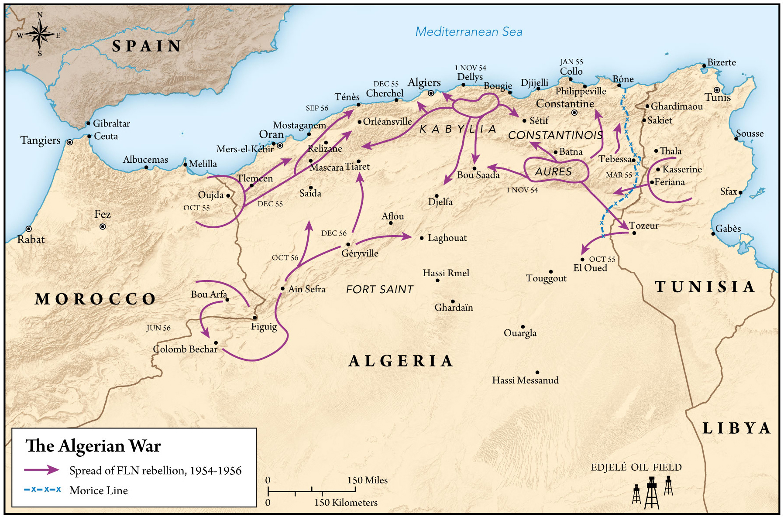
MAP 22.1

Slide 4
10
1

Slide 5
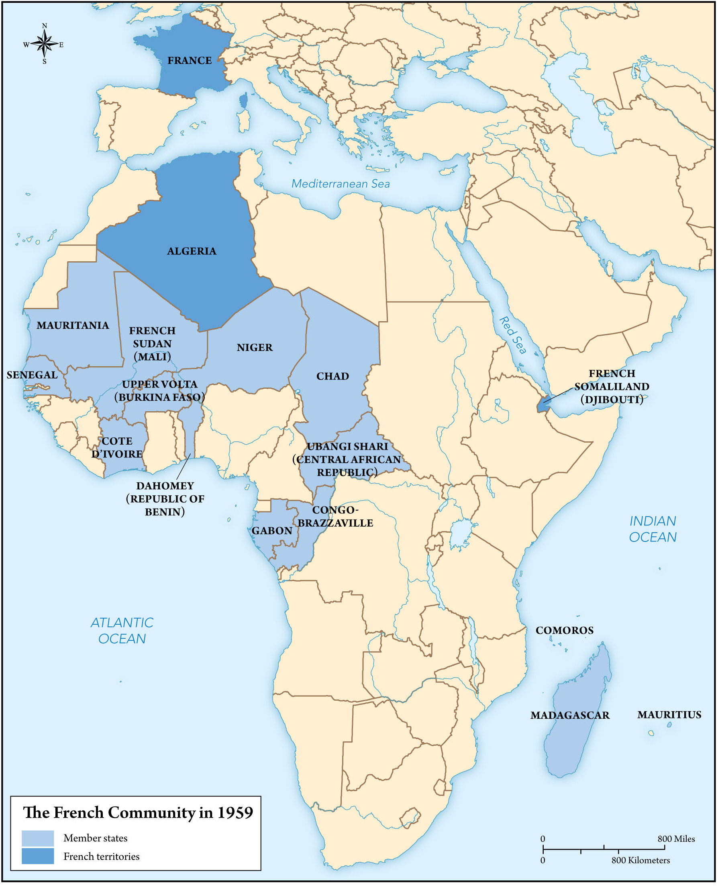
MAP 22.2

Slide 6
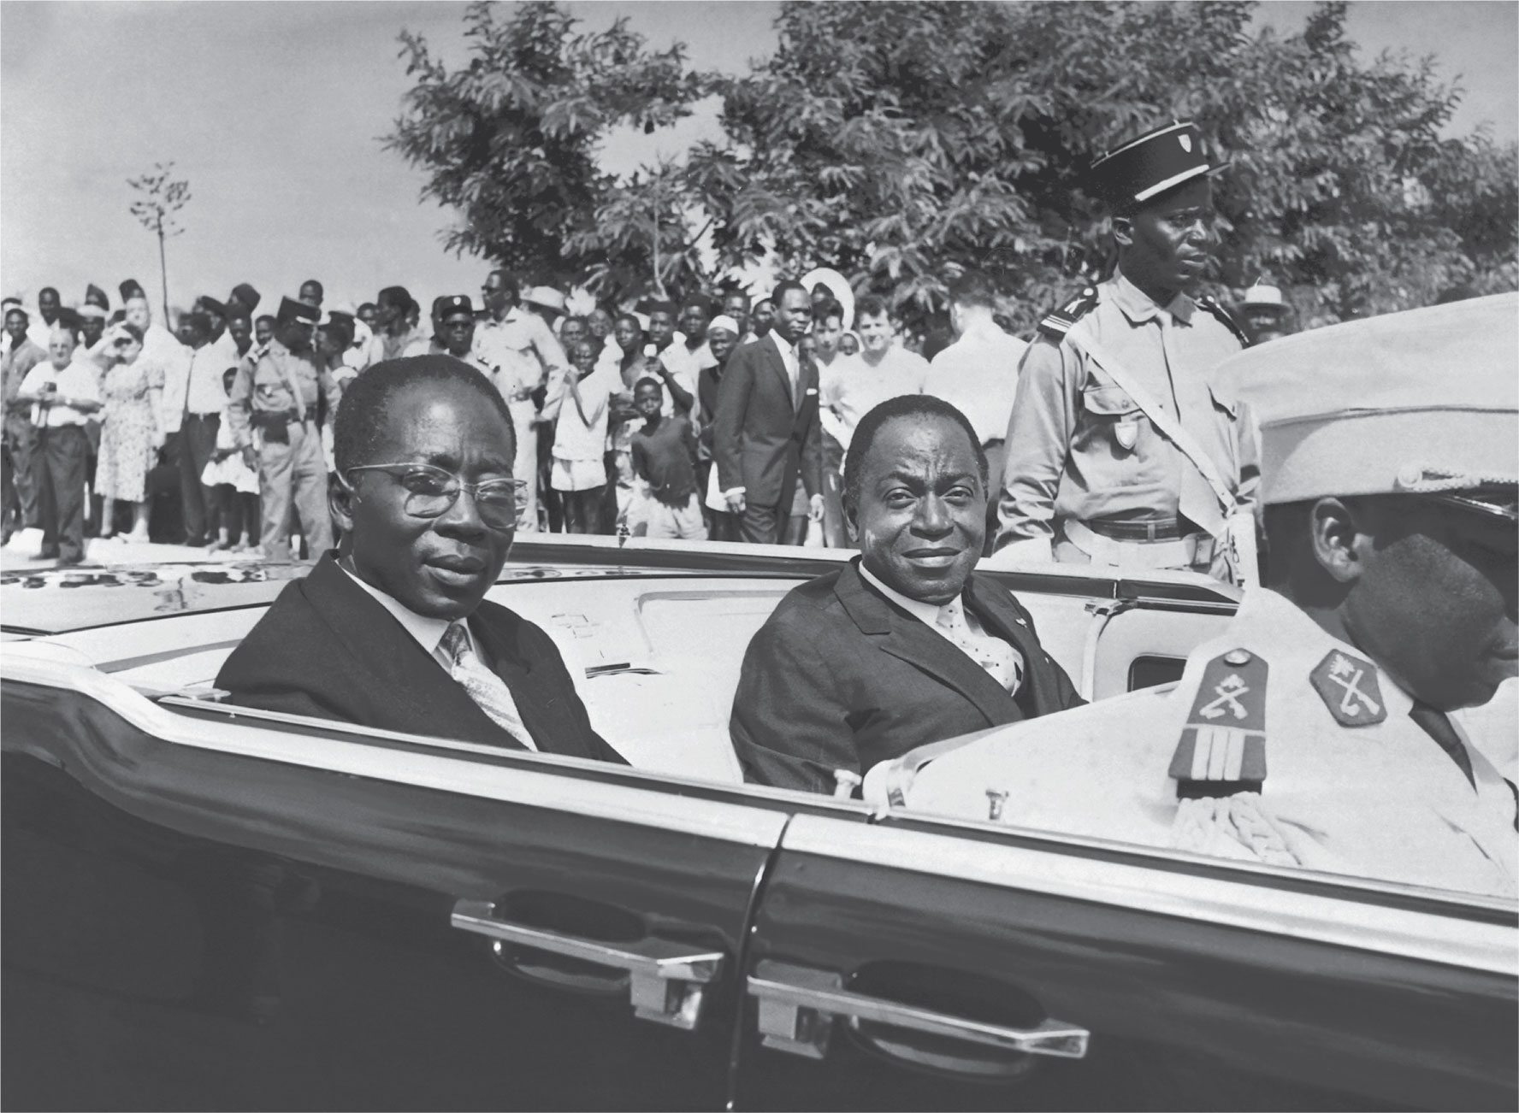
10
1

Slide 7
10
1

Slide 8
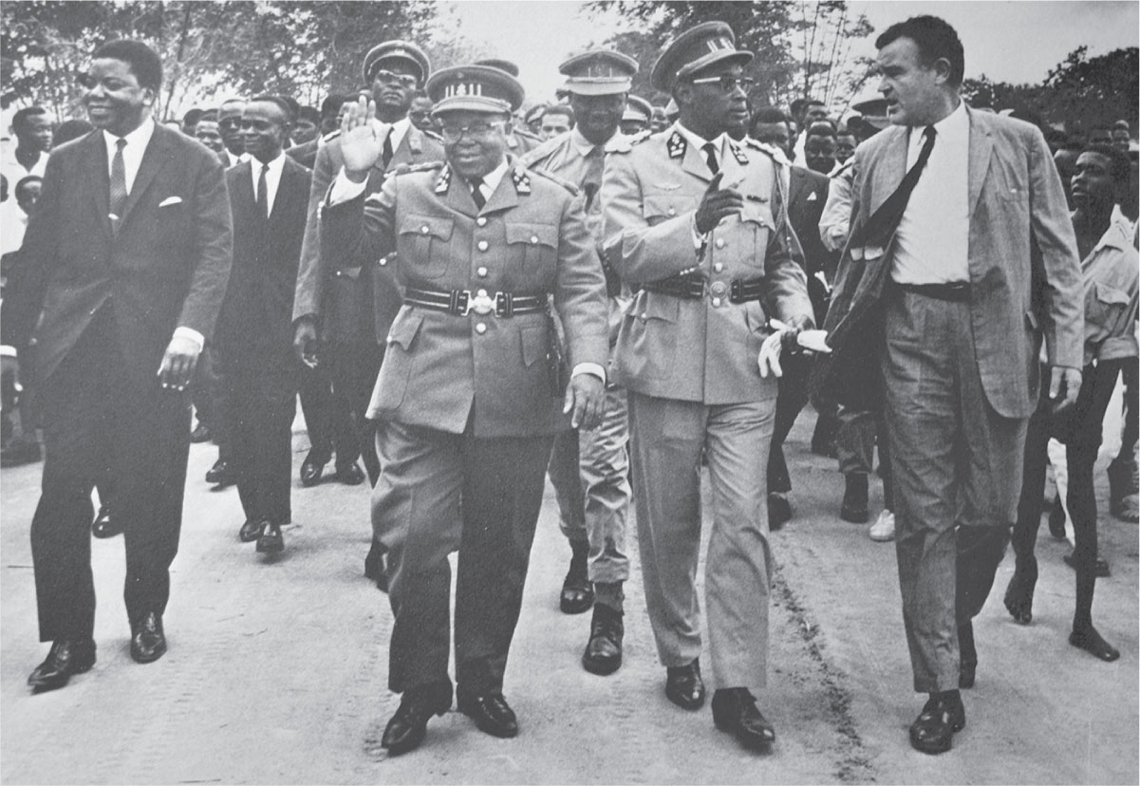
10
1

Slide 9
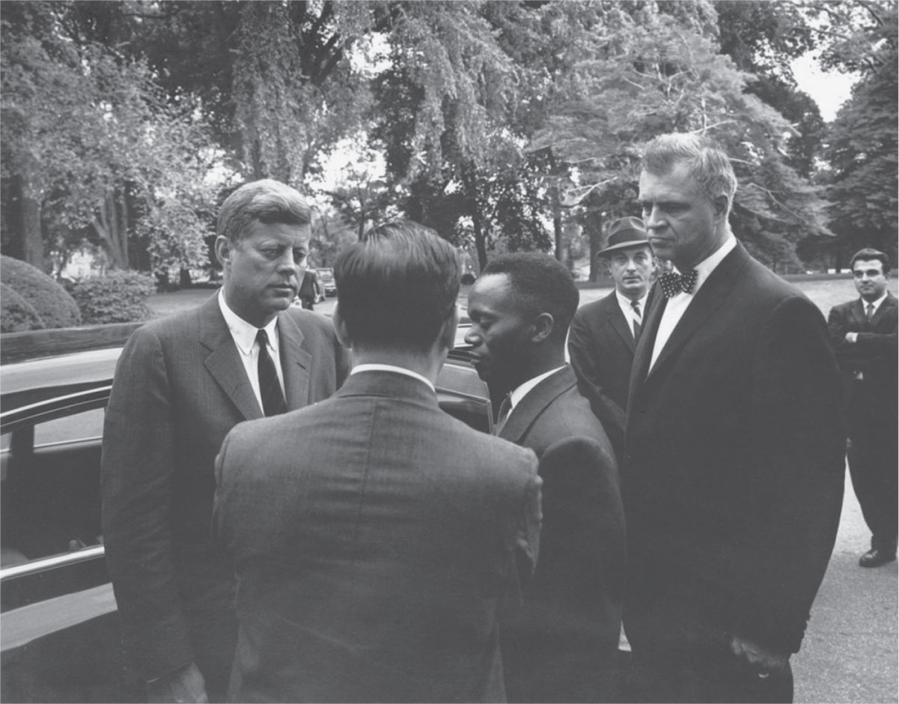
10
1

Slide 10
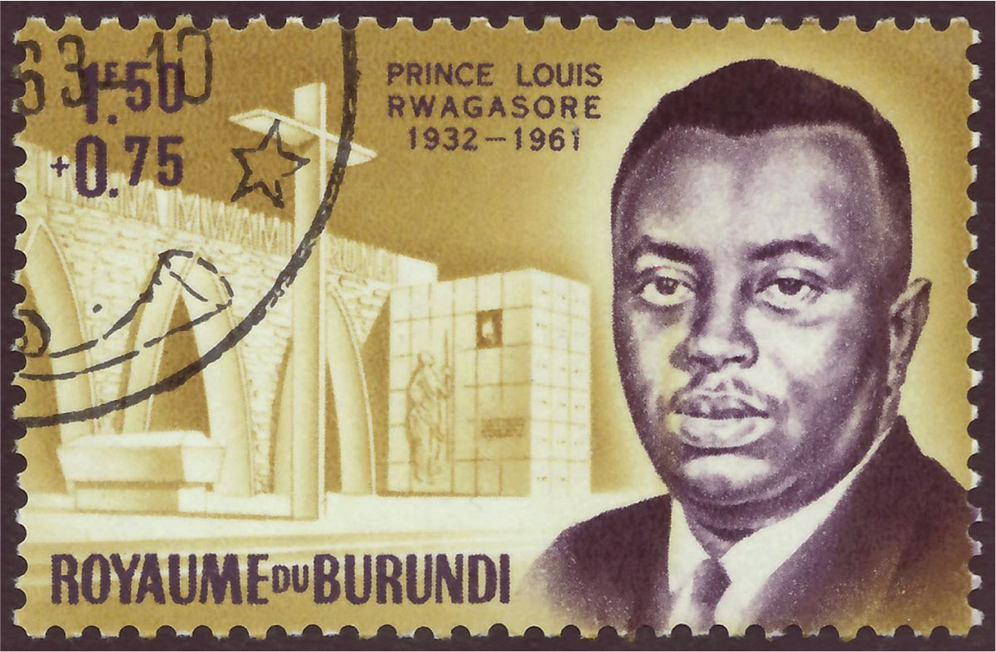
10
1

Slide 11
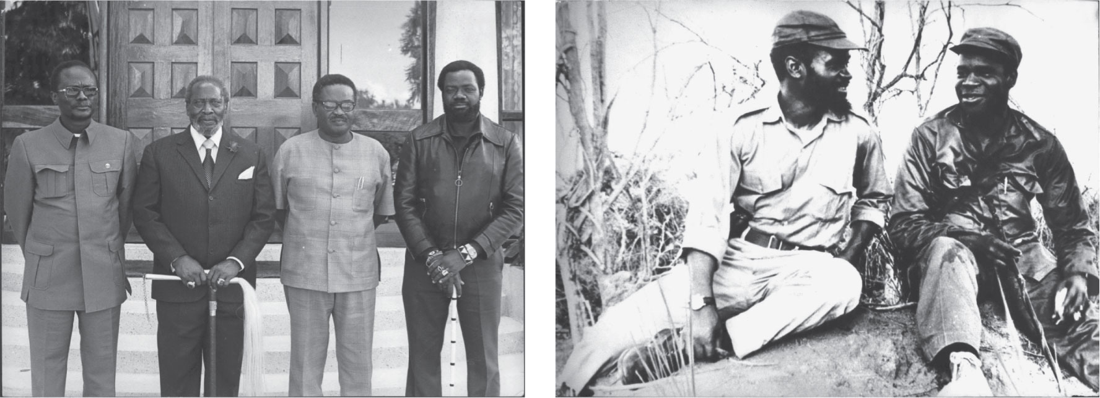
10
1

Slide 12
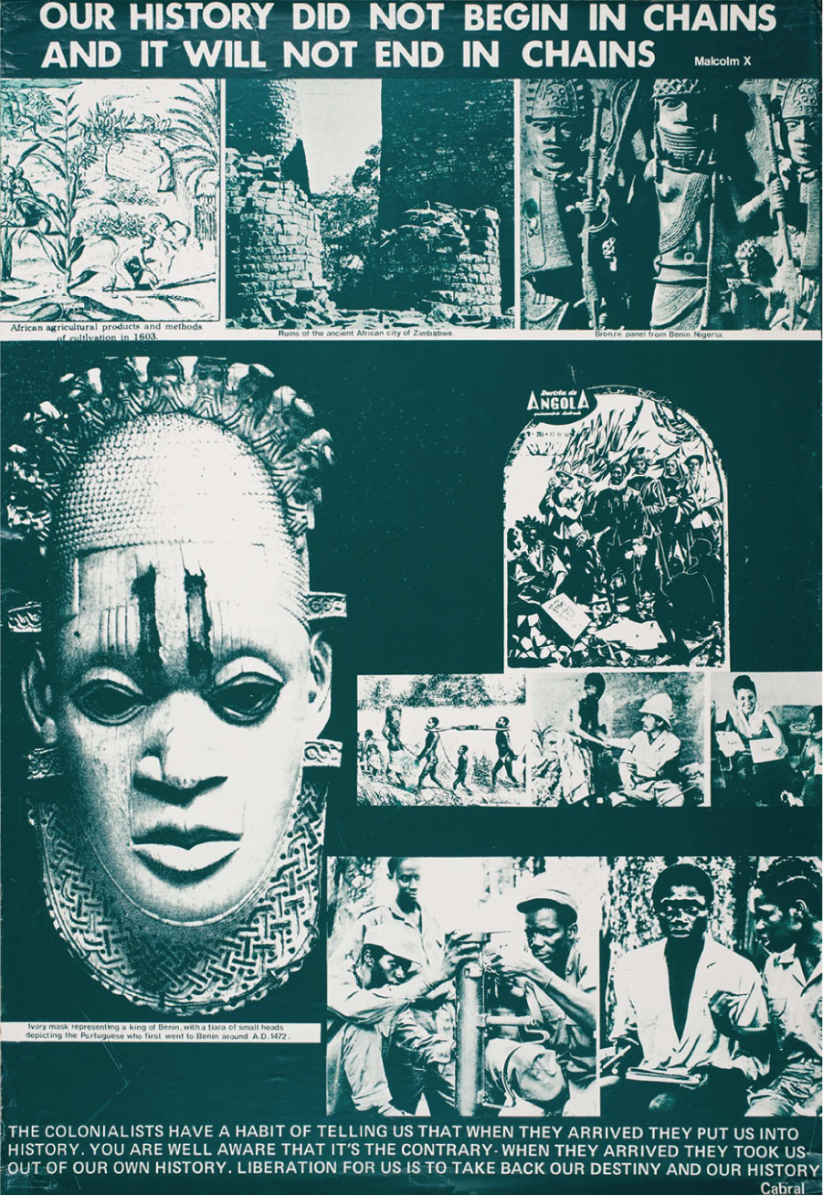
10
1

