Slide 1

Gendered Voices, Feminist Vision
by Susan M. Shaw and Janet Lee

Slide 2
Chapter 3: Learning Gender
Gender, Culture, and Biology
Masculinity
Femininity
Gender Fluidity
Gender Ranking

Slide 3
Chapter 3: Learning Objectives
3.1 Understand the ways in which society creates patterns as it relates to gender.
3.2 Define masculinity and femininity.
3.3 Examine the differences between gender fluidity and gender ranking.

Slide 4
Terminology
Gender
Masculinity
Femininity
Two-Spirit
Transgender
Sexual identity
Intersex
Queer
Nonbinary
Gender Fluidity
Gender Ranking
Cisgender
Gender assignment
Gender expression
Gender identity
Gender performance

Slide 5
Gender, Culture, and Biology ( 1 of 2)
Society constructs the gives us the definition of “feminine” and “masculine.”
The meaning of “feminine” and “masculine” varies from culture to culture.
They are performed in by bodies daily and we see these activities as “normal” (e.g., walking, talking, etc.)

Slide 6
Gender, Culture, Biology (2 of 2)
The relationship between biology and gender is complicated, there are two things to consider:
There is greater gender diversity than before. Some are male or female but others are both female and male at the same time.
Biology and culture as it relates to gender are interconnected and you cannot talk about one without the other.

Slide 7
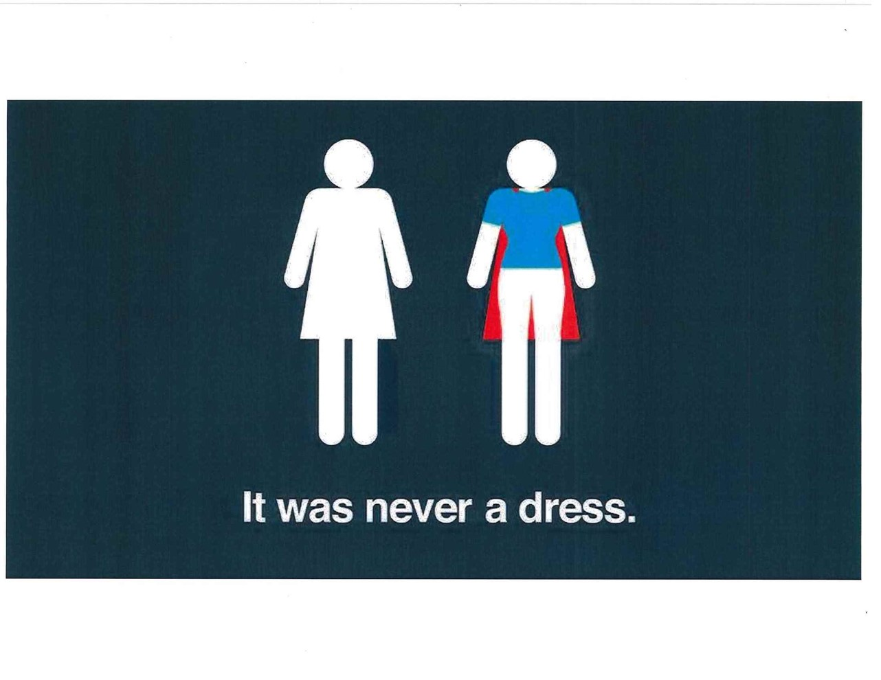
Gender Roles (1 of 2)

Slide 8
Gender Roles (2 of 2)
Gender is always experienced in intersection with other identities (e.g., race, ethnicity, age, etc.)
Gender assignment is usually given to people at birth and determined by one’s physical body type.

Slide 9
Social Construction of Gender (1 of 4)
Judith Lorber says that gender involves the process of multiple patterns of interactions that are created and re-created between human interactions (e.g., boys and girls).
Gender is performed daily, over and over again.

Slide 10
Social Construction of Gender (2 of 4)
Gender expression is not always the same as a persons gender identity. Or, it may not align with a persons gender at birth.
It is how we perform and express gender in our world which shapes an individual’s sense of self.

Slide 11
Social Construction of Gender (3 of 4)
Lorber explains, gender as a process that involves multiple interactions created and re-created in human interaction.
Most of what we gender, we don’t recognize and it is a normal part of assimilating to societal standards.

Slide 12
Social Construction of Gender (4 of 4)
Gender is the process of what we “do” rather than what we “have.”
It was not until the 1940s that manufacturers dictated specific colors for boys and girls. (e.g., pink and blue)

Slide 13
Masculinity (1 of 2)
Strong, independent, in control, out of touch emotionally.
Michael Kimmel discusses that boys do what is called “gender policing” which they conform to a narrow definition of “masculinity.”
Some key dimensions of this include “no sissy stuff” or “sturdy oak” – words used to describe boys masculinity as defined by society.

Slide 14
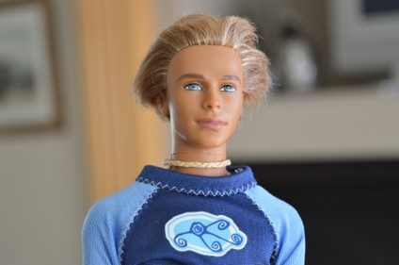
Masculinity (2 of 2)
Discuss in small groups the following questions:
How does American society in comparison to other groups define masculinity?
What masculinity characteristics does Ken represent?

Slide 15
Femininity (1 of 2)
Passive, dependent, intuitive, and emotional. These qualities have taken away power from women and kept them in subordinate positions in society.
Femininity varies across cultures.
A central component of femininity is that it involves chase, domestic, caring or the sexy, seductive, fun-loving playmate.

Slide 16
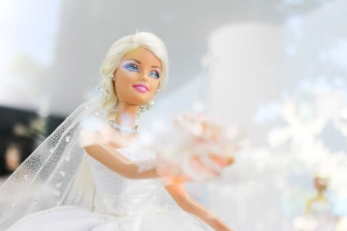
Femininity (2 of 2)
Discuss in small groups the following questions:
In what ways does femininity vary across other cultures?
What femininity characteristics does Barbie represent?

Slide 17
Gender Fluidity
Individuals who do not label themselves as male or female are gender fluid.
New trends: fashion industry is starting to create clothing that is not gendered (e.g., pink = girl, blue = boy)

Slide 18
Gender Ranking
The idea that genders are ranked decreases the power of the devalued gender.
For example, African American women may be characterized as matriarchal or promiscuous while African American men are seen as strong and athletic.

Slide 19
Gender Ranks and Stratification
In the stratification system, gender ranks men above women of the same race/ethnicity and class.
The “other” is seen as one who lacks valuable qualities in comparison to the dominant group.

Slide 20
Social Construction of Sexuality
Sexuality is an essential part of your identity and your relationship to others.
Across cultures and within our own, human sexual expression includes a wide range of behaviors and attitudes.

Slide 21
Gender Identity Terms
Jane Lockhart indicates in this chapter that there are twenty-seven gender identity terms that everyone should know.
What are they?
Break into groups of 3-4 to discuss them.

Slide 22
Review of Learning Objectives
3.1 Understand the ways in which society creates patterns as it relates to gender.
3.2 Define masculinity and femininity.
3.3 Examine the differences between gender fluidity and gender ranking.

