Slide 1
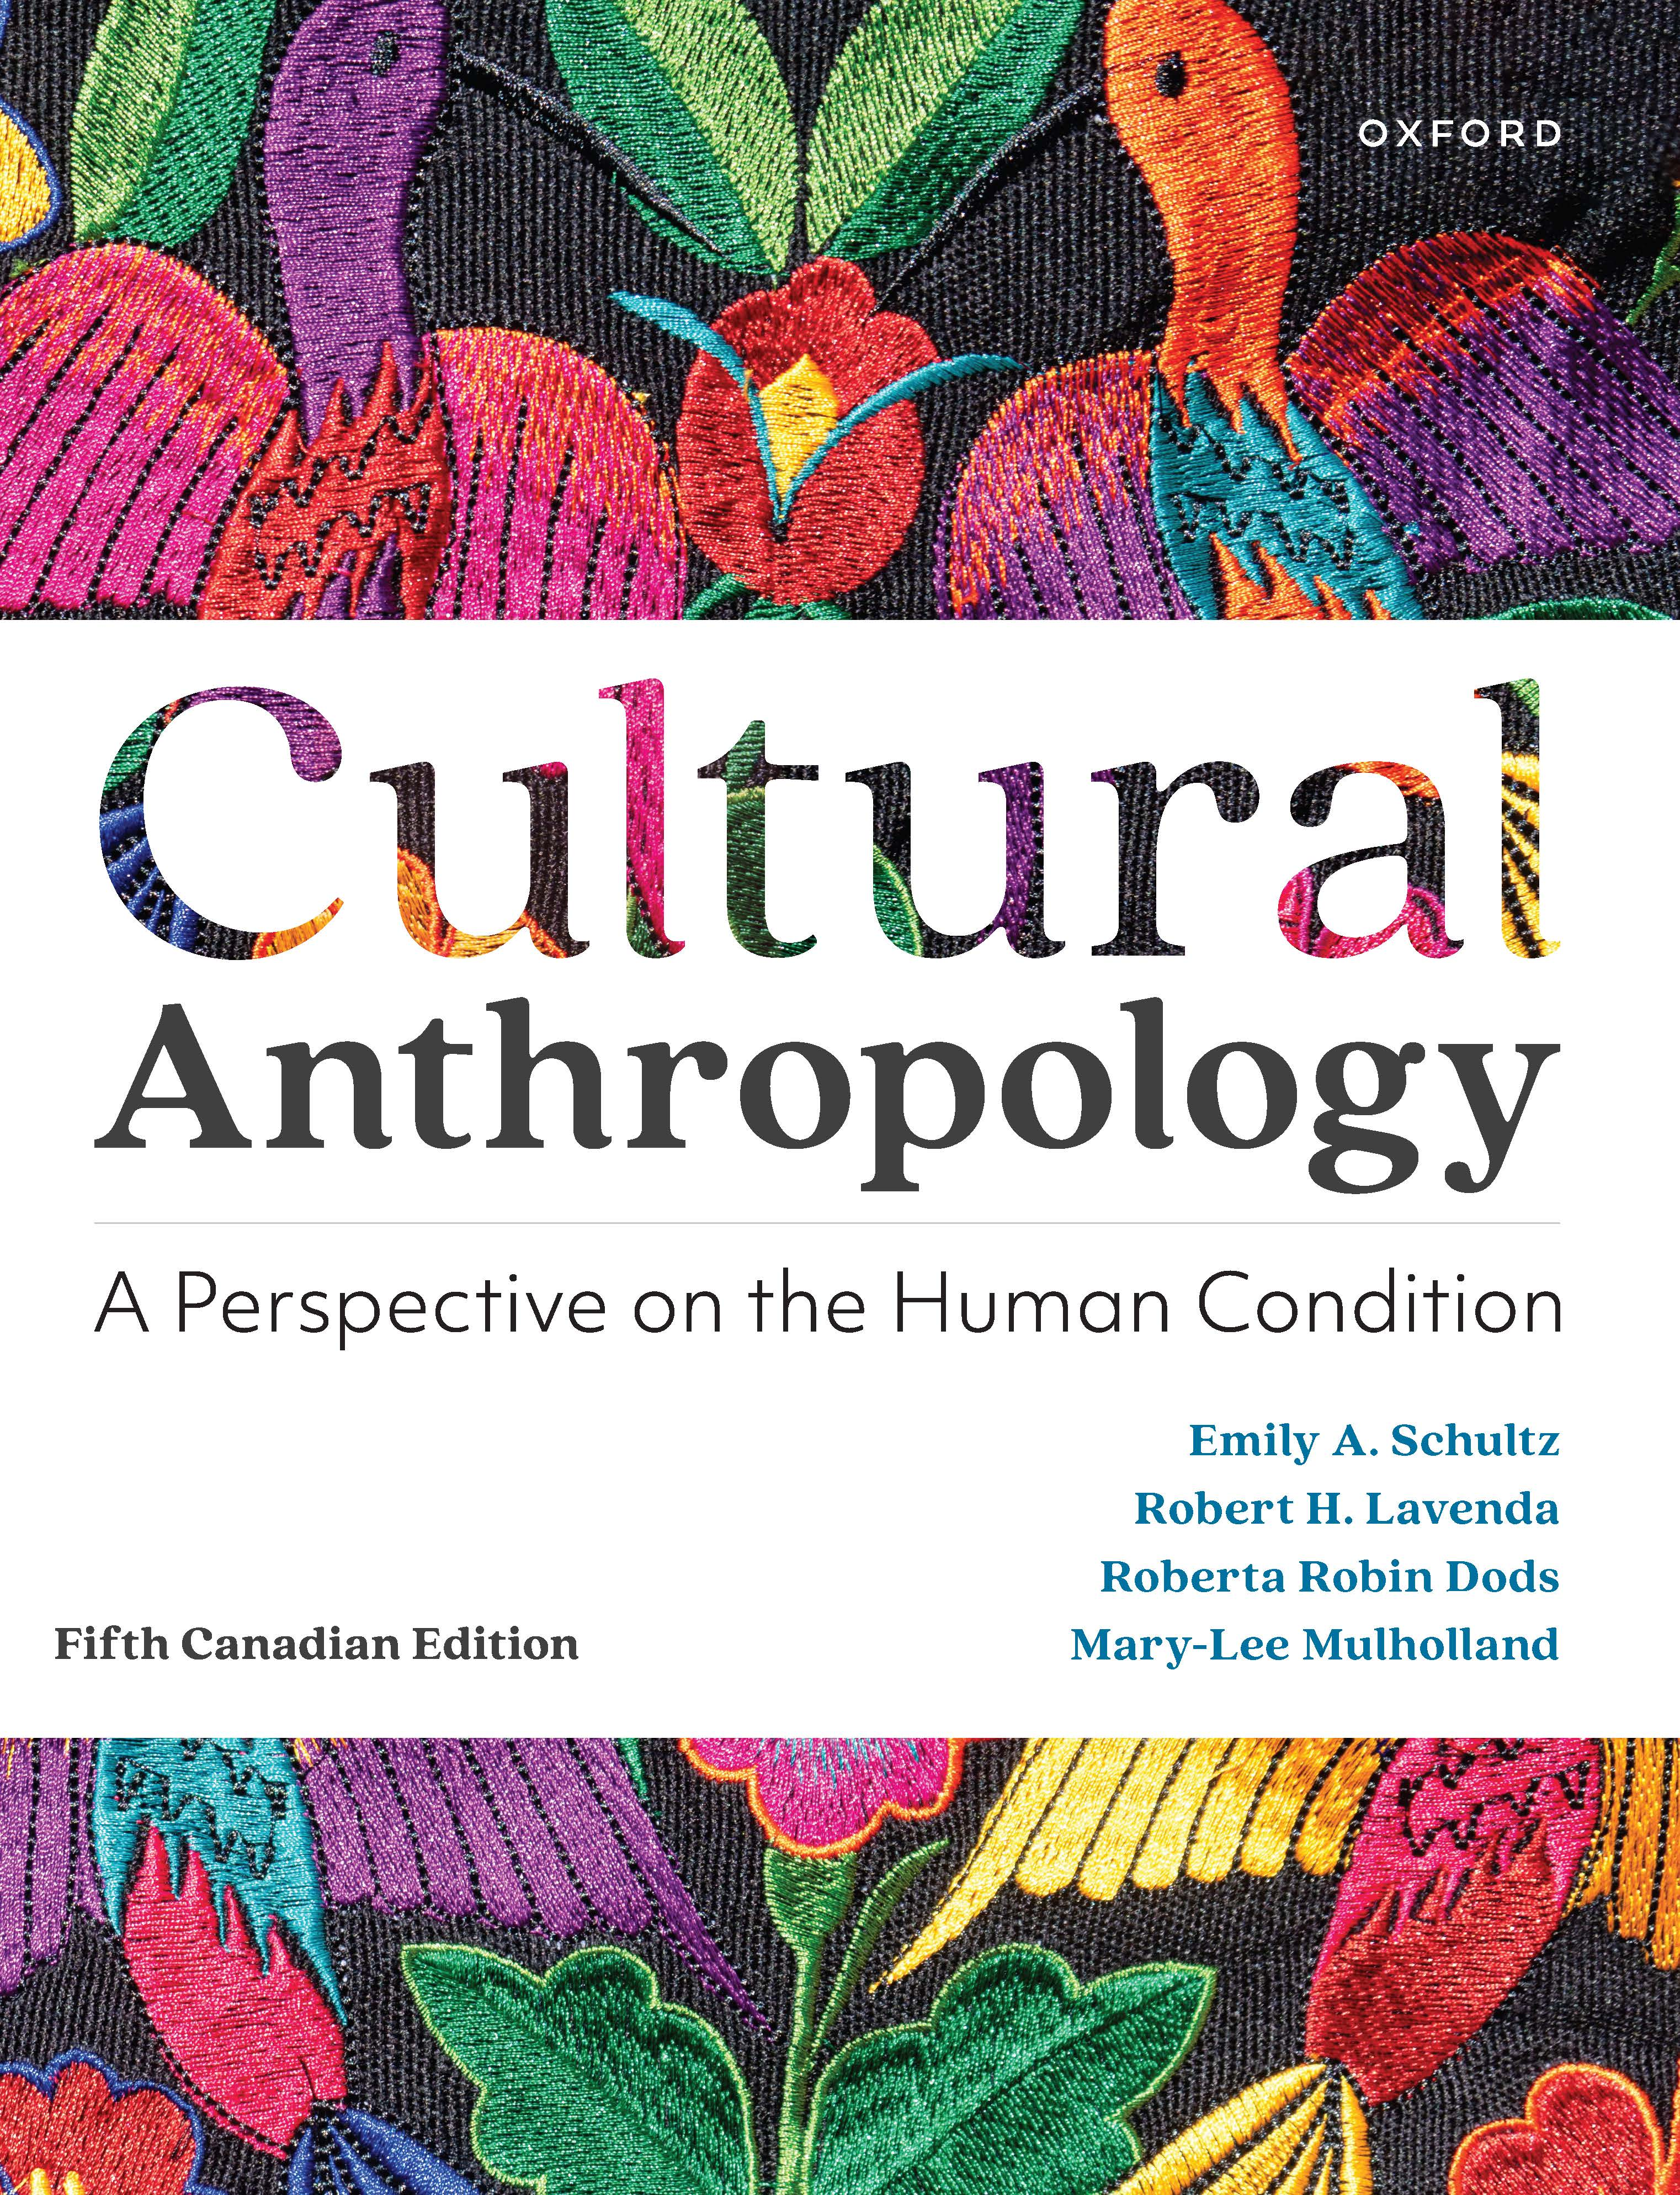
Cultural Anthropology
by Schultz, Lavenda, Dods, and Mulholland

Slide 2
Chapter 1: The Anthropological Perspective on the Human Condition
The Anthropological Perspective: The Cross-disciplinary Discipline
Anthropology and the Concept of Culture
Explaining Cultural Differences
Culture, History, and Human Agency

Slide 3
The Anthropological Perspective
Anthropology is the integrated study of human nature, human society, and human history. It is a scholarly discipline that aims to describe, in the broadest possible sense, what it means to be human.
What is distinctive about the way anthropologists study human life?
The anthropological perspective - An approach to examining the human condition that is holistic, comparative, evolutionary, and grounded in fieldwork.

Slide 4
The Anthropological Perspective
Anthropological Perspective
Holism A perspective on the human condition that assumes that mind and body, nature and culture, individual and society, and individual and environment permeate and even define one another.
Comparative A characteristic of the anthropological perspective that requires anthropologists to consider similarities and differences in a wide range of human societies before generalizing about human nature, human society, or human history.

Slide 5
The Anthropological Perspective
Evolutionary A characteristic of the anthropological perspective that requires anthropologists to place their observations about human nature, human society, or human history in a flexible framework that takes into consideration change over time.
Fieldwork The practice of data collection in anthropology that takes anthropologists into direct contact and experience with the people, the sites, or the animals that are of interest.

Slide 6
The Anthropological Perspective
In North America, anthropology has traditionally been divided into four main subfields: biological anthropology, archaeology, linguistic anthropology, and cultural anthropology—as well as applied anthropology.

Slide 7
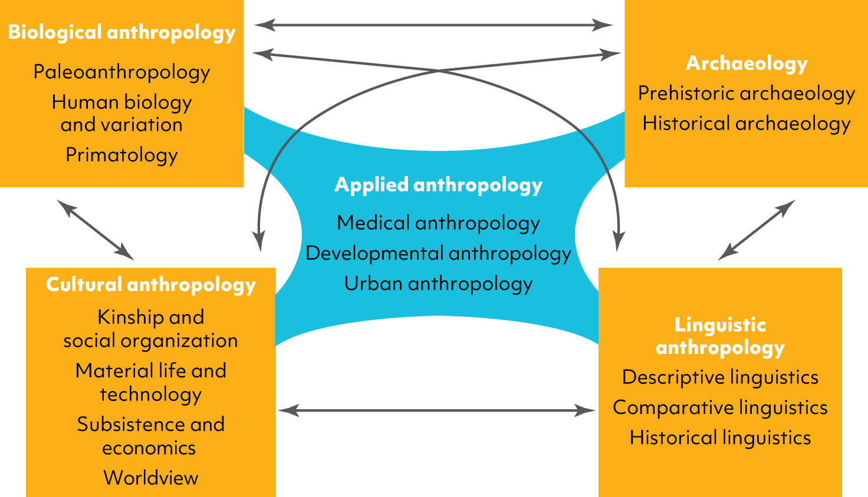
The Anthropological Perspective
Four Main Subfields of Anthropology

Slide 8
The Anthropological Perspective
Biological Anthropology
The specialty of anthropology that looks at humans as biological organisms
Includes paleoanthropology, human biology and variation, primatology, and forensics.
In the beginning, biological anthropology was complicit with the emergence of scientific racism but would soon become an important source of research and scholarship that would debunk and counter racist ideas and policies.

Slide 9
The Anthropological Perspective
Archaeology
Learning from material remains, this specialty focuses on past ways of life.
One growing area of archaeology is cultural resource management (CRM).
CRM is a type of applied anthropology that develops research, policy, and programming for the management and protection of natural and cultural resources.

Slide 10
The Anthropological Perspective
Linguistic Anthropology
Focuses on language and the relationship between language and identity, and language within subcultures
Sociolinguistics looks at how language differences frequently correlate with differences in gender, class, or ethnic identity
Many linguistic anthropologists collaborate and support communities whose languages are at risk because of structural inequalities and ongoing colonialism

Slide 11
The Anthropological Perspective
Cultural Anthropology
The specialty of anthropology that studies how variation in beliefs and behaviours is shaped by culture and learned by different members of human groups.
Culture is sets of learned behaviours and ideas that humans acquire as members of a society.
Focuses on present-day societies.

Slide 12
The Anthropological Perspective
Cultural Anthropology (con’t)
Uses an extended fieldwork method to gather information from people they encounter in the field who are variously called research participants, consultants, teachers, etc.
This information is analyzed and presented in ethnographies and ethnologies

Slide 13
The Anthropological Perspective
Some anthropologists argue there is a fifth subfield - applied anthropology.
Focuses on the application of anthropological theories and methods to the solution of everyday problems
Applies to all four fields:
E.g., public health, social policy, revitalization of Indigenous languages, forensic investigation, cultural resource management, and social justice.

Slide 14
The Anthropological Perspective
Anthropology and the Connection to colonialism
Anthropology emerged as a discipline during a time when the scientific perspective developed in the Age of Enlightenment, capitalism emerged as the dominant economic model, and colonialism accelerated.
As part of this, many early anthropologists were from Europe and settler-colonial nations such as the United States, Canada, and Australia that studied people of the non-European and colonized world.

Slide 15
The Anthropological Perspective
Anthropology and the Connection to colonialism (con’t)
This problematic and imbalanced power relationship between ‘observers’ and ‘observed’ meant that much of early anthropological research and writing objectified non-European peoples while trafficking in colonial and racist stereotypes.

Slide 16
Anthropology and the Concept of Culture
E.B. Tylor defined culture as “that complex whole which includes knowledge, belief, art, morals, law, customs, and any other capabilities and habits acquired . . . as a member of society.”

Slide 17
Anthropology and the Concept of Culture
Human beings are biocultural organisms:
Defined by biology and culture
Brains are capable of symbolic thought and ‘creating’ culture
Hands can manipulate matter into material culture
Symbol Something that stands for something else.
Material culture Objects created or shaped by human beings and given meaning by cultural practices.

Slide 18
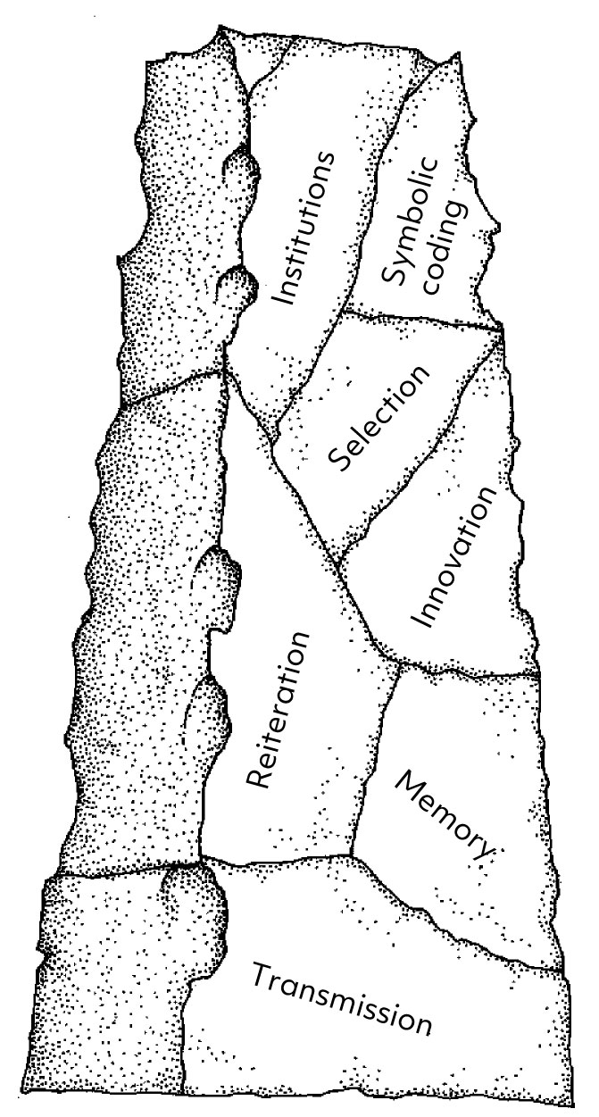
Anthropology and the Concept of Culture
Paleoanthropologist Richard Potts identifies five basic, foundational elements of culture:
Transmission
Memory
Reiteration
Innovation
Selection

Slide 19
Anthropology and the Concept of Culture
Potts adds three more elements that he argues evolved later and made human culture possible:
Symbolic coding/representation
Complex symbolic representation
Institutional development

Slide 20
Anthropology and the Concept of Culture
Culture as learned, symbolic, and adaptive
Habitus: routine activities rooted in habitual behaviours that are learned
Co-evolution: the relationship between biological processes and symbolic cultural processes in which each makes up an important part of the environment to which the other must adapt

Slide 21
Anthropology and the Concept of Culture
There is debate surrounding the use of culture (singular) versus cultures (plural):
Singular concerns patterned and symbolically mediated ideas
i.e. all humans have the capacity to create culture
Plural concerns the learned ways of life of a specific group
i.e. Mexican or Canadian culture
The critique of the plural aspect of culture:
Cultures are not neatly bounded and closed off from other cultures, nor are they uniform within

Slide 22
Anthropology and the Concept of Culture
Sherry Ortner argues for a reconfiguration of the concept of culture that:
reduces difference
Making the strange familiar and familiar strange
emphasizes the issue of meaning-making (singular culture), and
is situated beneath larger analyses of social and political events and processes.

Slide 23
The Challenge of Cultural Differences
Ethnocentrism is the term anthropologists use to describe the opinion that one’s own way of life is natural or correct—indeed, the only way of being fully human. This explanation is problematic because it reduces other ways of life to distorted versions of one’s own.
Ethnocentric views are entangled with both colonialism and racism. As such, any attempts must also be committed to an anti-racist approach which recognizes, analyses, and works to dismantle these structural and social inequalities.

Slide 24
The Challenge of Cultural Differences
Cultural relativism
The perspective that all cultures are equally valid and can only be truly understood in their own terms
Can help outsiders understand why something occurs in a society (e.g., bullfighting)
Cultural relativism is an argument against ethnocentrism but, there is a concern that extreme cultural relativism can act as a means to justify ethnocentric and oppressive views (e.g. Holocaust in Europe).

Slide 25
The Challenge of Cultural Differences
This tension between understanding and justification is often cast as the difference between cultural and ethical relativism.
Whereas cultural relativism is a commitment to understand a culture on their own terms, ethical relativism is the notion that what is considered moral, immoral, good, or evil is dependent on culture.
Thus, while many anthropologists are cultural relativists, few are ethical relativists.
Recognizing these internal differences, fluidity between cultures, and the complex power dynamics within and between cultures in our understanding of cultural difference is referred to as critical cultural relativism.

Slide 26
The Challenge of Cultural Differences
The problems of cultural determinism (cultural determines all human behavior)
Reduces human action to cultural explanations (“my culture made me do it”)
Denies an individual’s agency and dissent to cultural norms and beliefs
Alternative perspectives may exist within cultures based on experience and choice
Is linked to extreme cultural relativism and together can justify practices that are harmful merely because they are cultural

Slide 27
Culture, History, and Human Agency
One response to the problem of cultural determinism:
Recognizing that humans have agency and can choose to act in certain ways, to keep or reject traditions or reconfigure traditions to fit new realities
Yet as Karl Marx noted, human agency is also limited by history, culture, and the material conditions of existence

Slide 28
Culture, History, and Human Agency
Limits to Agency – History and Structure
The human condition is rooted in time and shaped by history.
Yet, some anthropologists in the past did not take historical process, particularly those of non-western people, into consideration.
Thus, we must take note of Ortner’s third point to situate our understandings of culture in broader social and political events and processes.

Slide 29
The Promise of the Anthropological Perspective
It forces us to question common-sense assumptions
It makes moral and political decisions more difficult
It decreases ethnocentric thinking
Recognizes history, agency, and culture.

Slide 30
Chapter 1 Learning Objectives
Define anthropology’s aims and scope of study, distinguishing cultural anthropology as a subfield of anthropology
Explain culture as a concept within anthropology
Explain the relationship between cultural relativism and ethnocentrism, and give examples of both
Articulate different anthropological viewpoints on human history and on human agency

