Slide 1
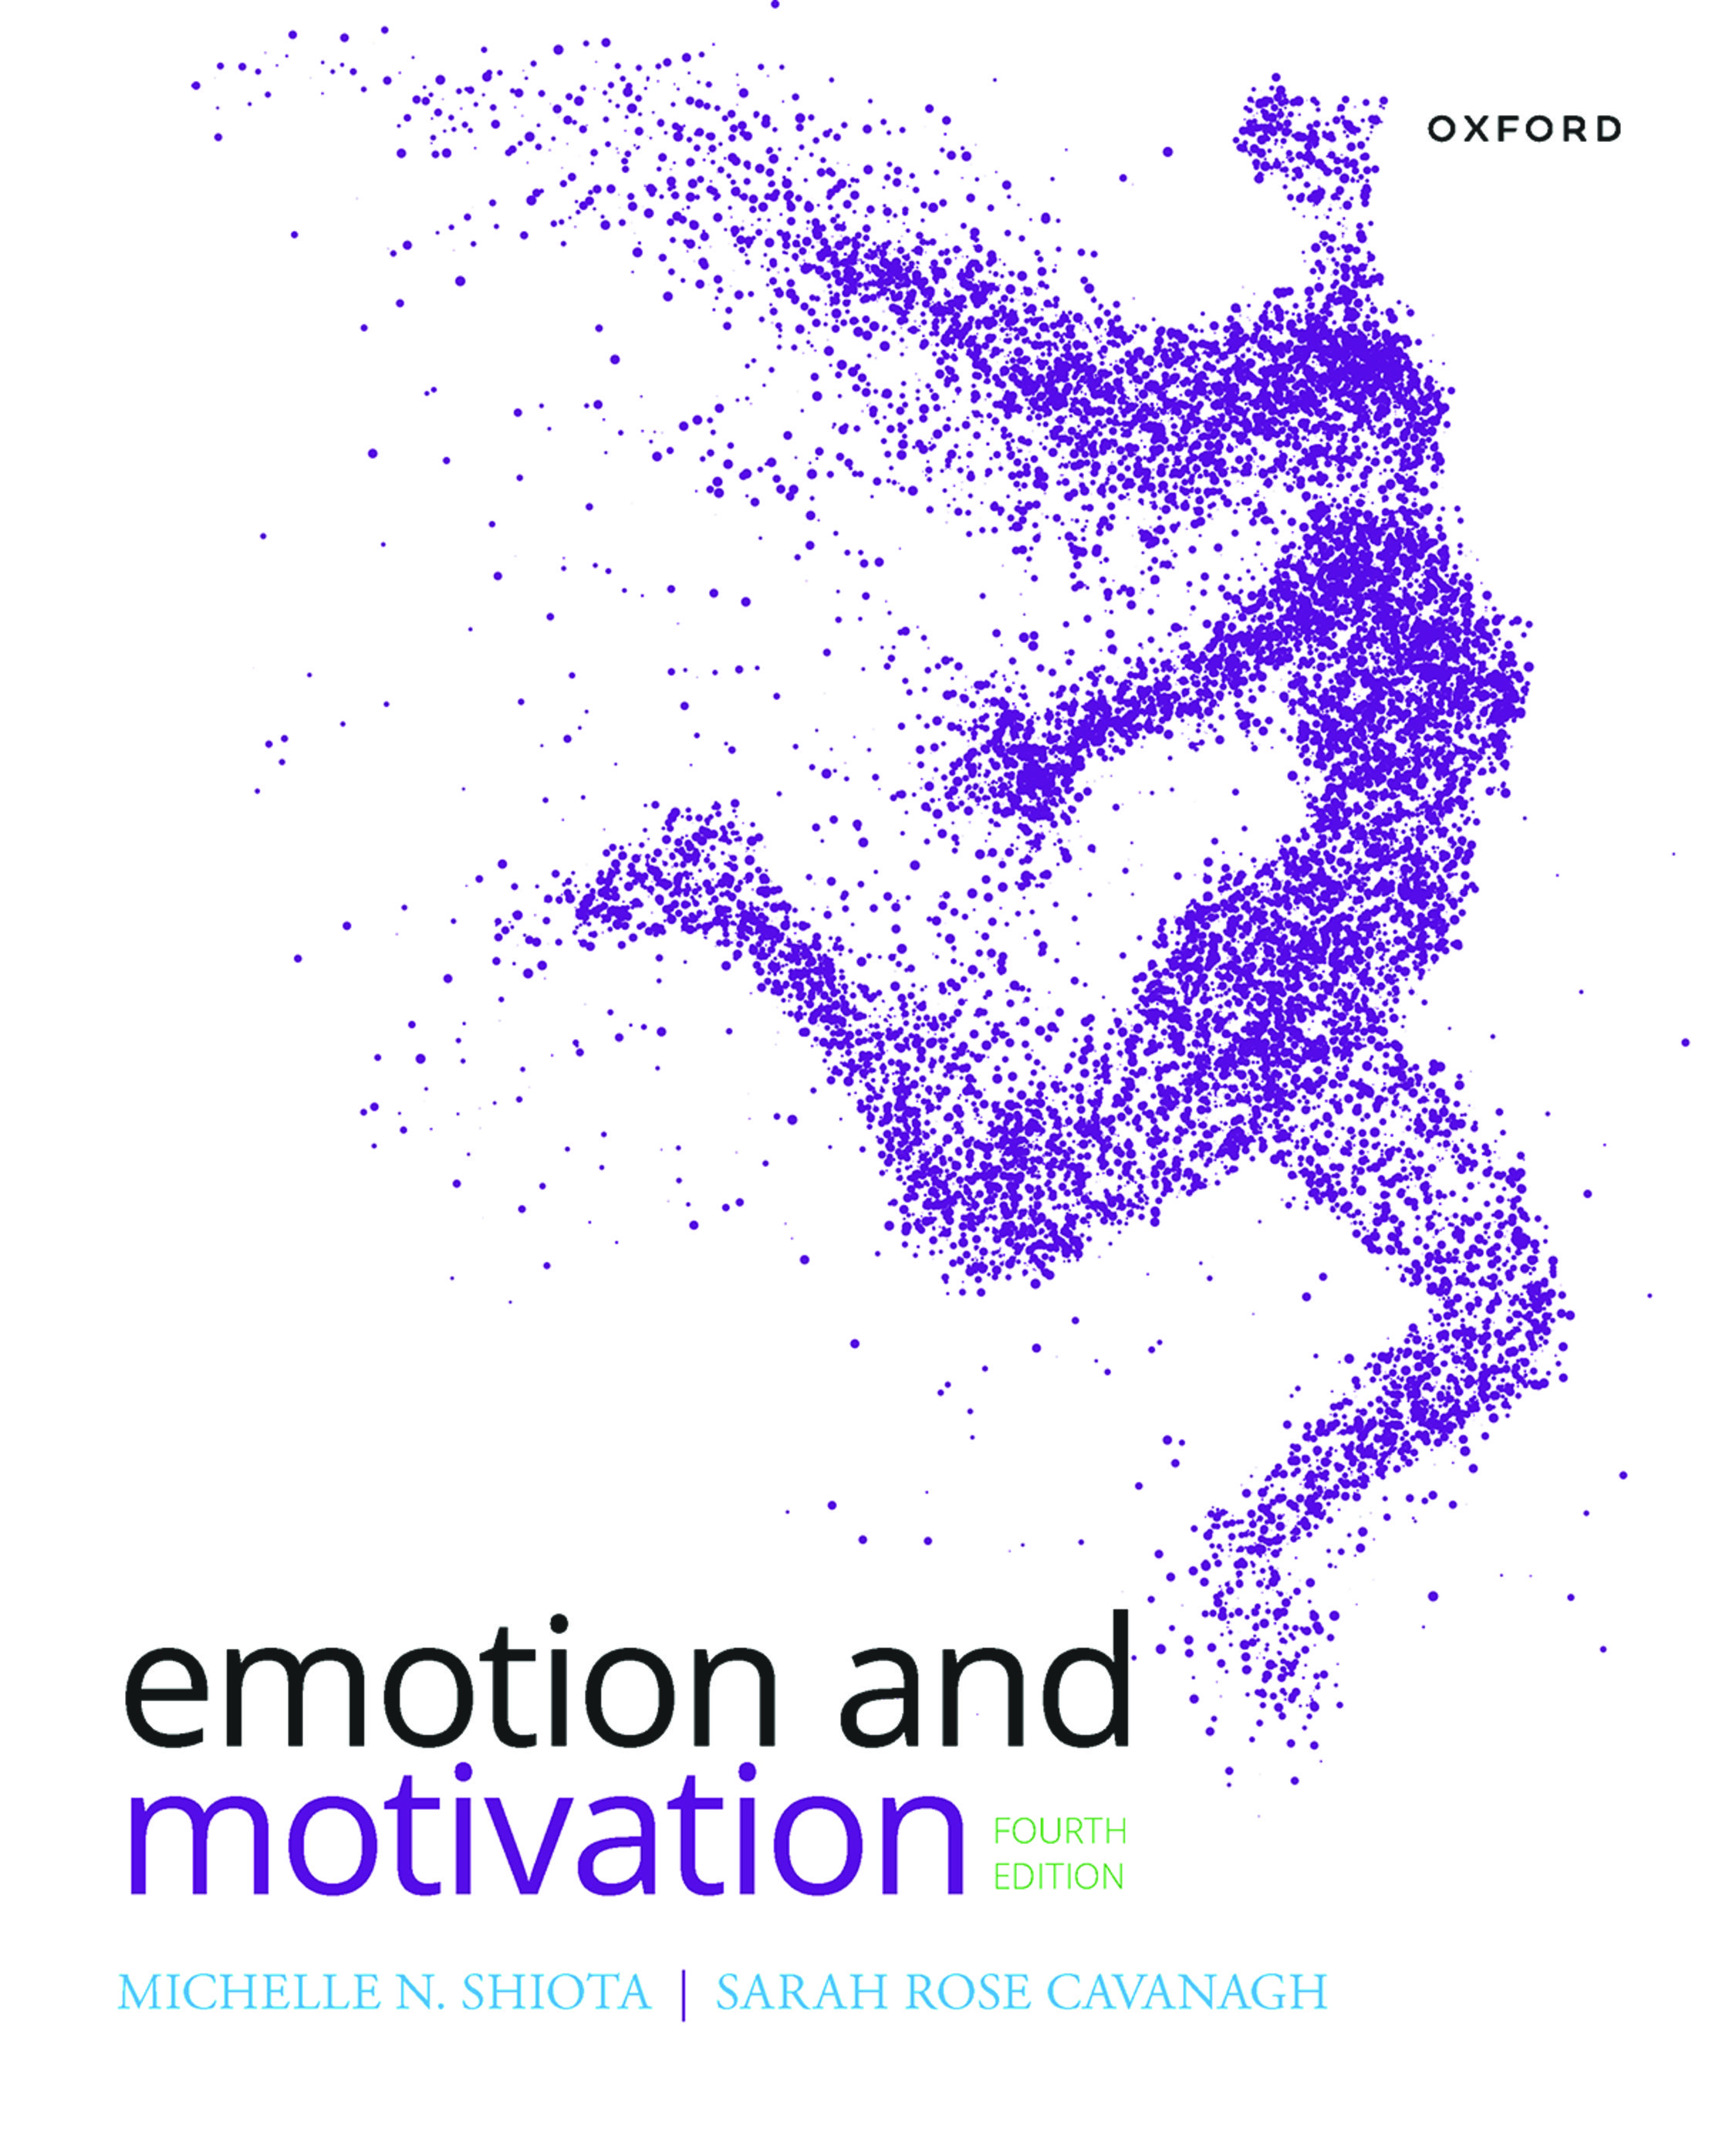
EMOTION AND MOTIVATION
by Michelle N. Shiota and Sarah Rose Cavanagh

Slide 2
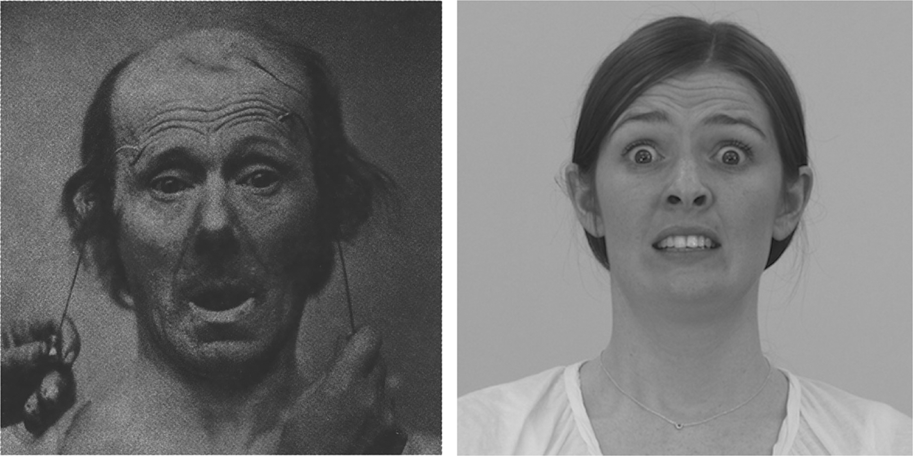
FIGURE 11.1. The prototypical facial expression of fear.
Notes:
FIGURE 11.1. The prototypical facial expression of fear.

Slide 3
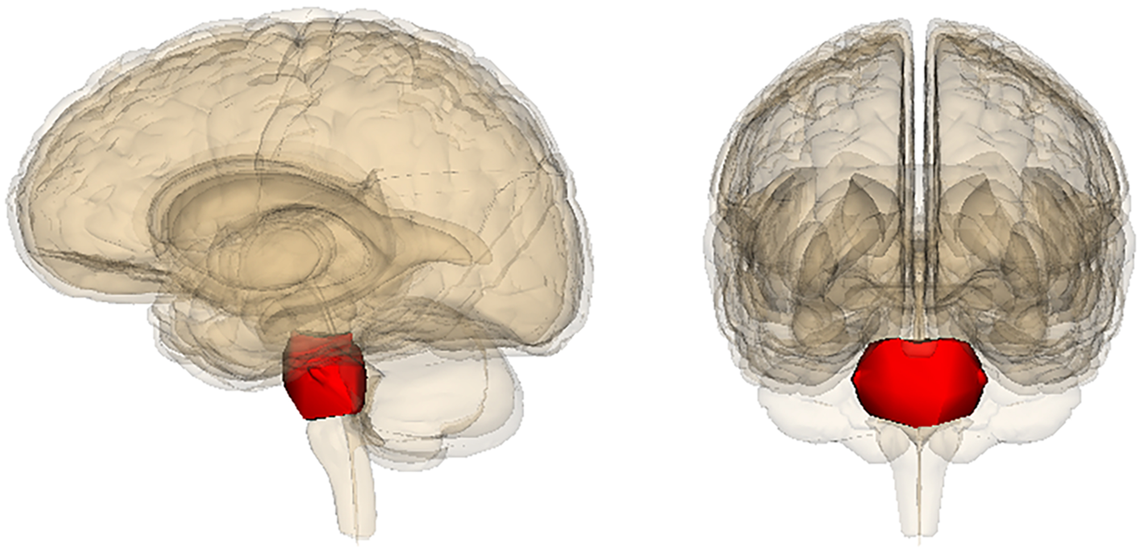
FIGURE 11.2. The startle response depends on a reflexive response by the pons to sudden, loud noises. The startle response can be augmented or diminished by input from the amygdala, which helps scan information from the environment, assessing whether it is dangerous or safe.
Notes:
FIGURE 11.2. The startle response depends on a reflexive response by the pons to sudden, loud noises. The startle response can be augmented or diminished by input from the amygdala, which helps scan information from the environment, assessing whether it is dangerous or safe.

Slide 4
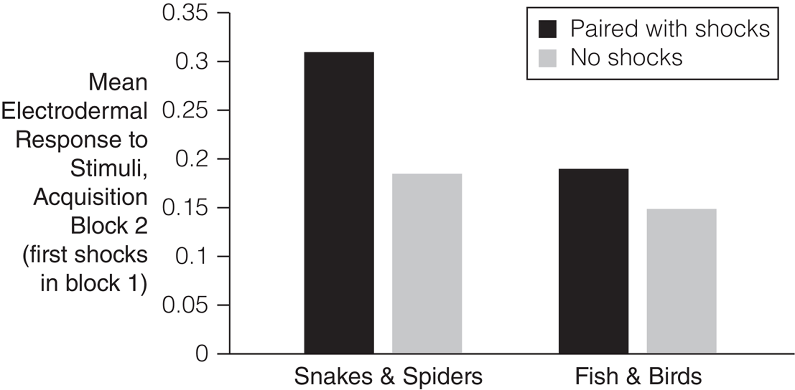
FIGURE 11.3. People develop conditioned fears more rapidly to images of snakes and spiders than to fish and birds, requiring fewer pairings of the image with an electrical shock. Some researchers interpret this as evidence that humans are prepared by evolution to learn specific fears of dangerous animals.
Notes:
FIGURE 11.3. People develop conditioned fears more rapidly to images of snakes and spiders than to fish and birds, requiring fewer pairings of the image with an electrical shock. Some researchers interpret this as evidence that humans are prepared by evolution to learn specific fears of dangerous animals. Data from Ho & Lipp (2014).

Slide 5
FIGURE 11.4. Although freezing and fleeing are very different behaviors, associated with different physiological states, each can facilitate escape from danger.
Notes:
FIGURE 11.4. Although freezing and fleeing are very different behaviors, associated with different physiological states, each can facilitate escape from danger.

Slide 6
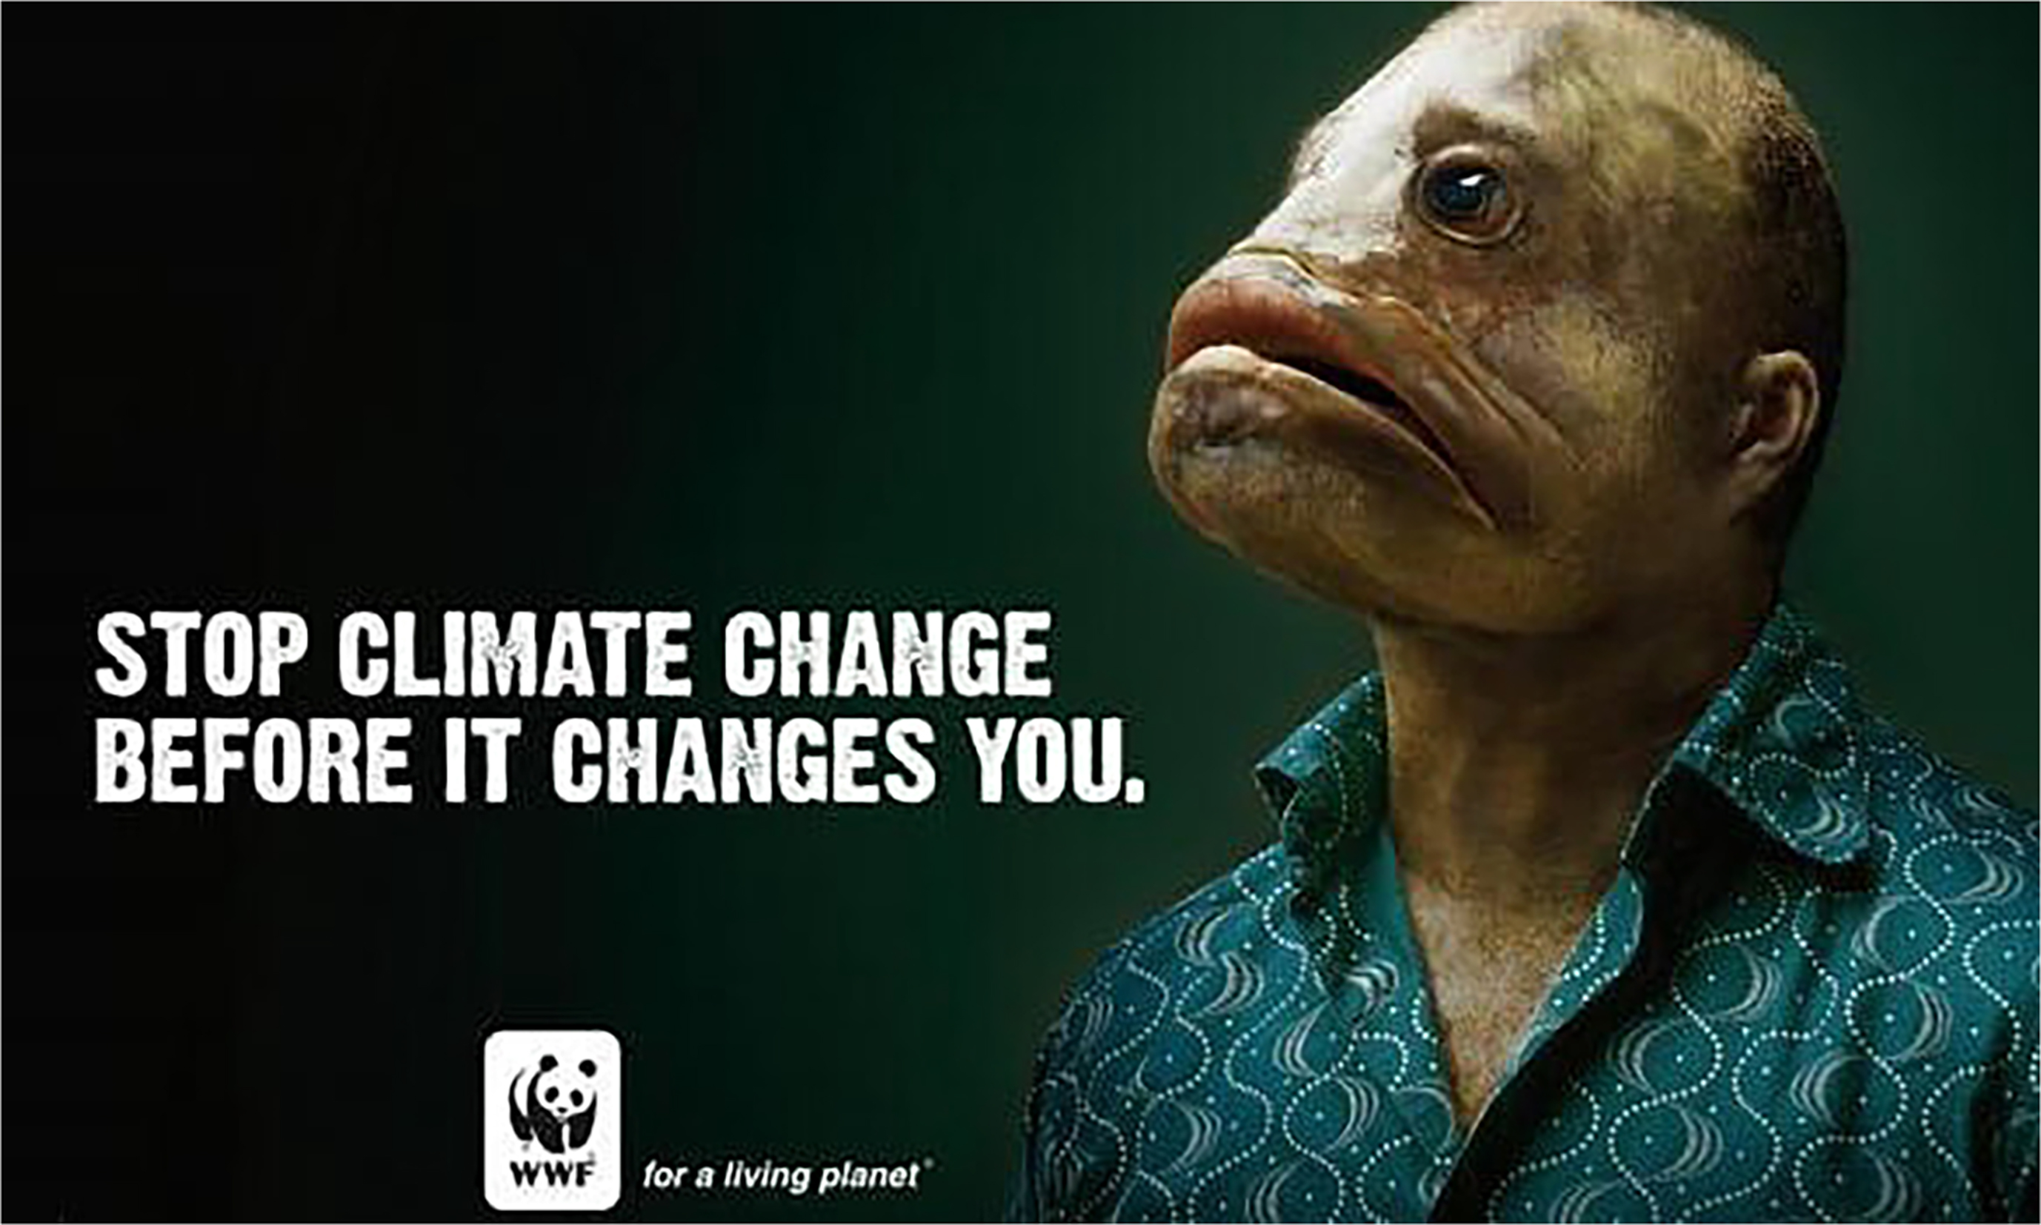
FIGURE 11.5. Fear appeals use threats of the negative consequences of failing to change one’s current behavior.
Notes:
FIGURE 11.5. Fear appeals use threats of the negative consequences of failing to change one’s current behavior.

Slide 7
FIGURE 11.6. Fear-based behavior change interventions are most likely to be effective if the threatening message is paired with clear, easy-to-implement action steps for preventing the unwanted outcome, aimed at increasing self-efficacy.
Notes:
FIGURE 11.6. Fear-based behavior change interventions are most likely to be effective if the threatening message is paired with clear, easy-to-implement action steps for preventing the unwanted outcome, aimed at increasing self-efficacy.

Slide 8
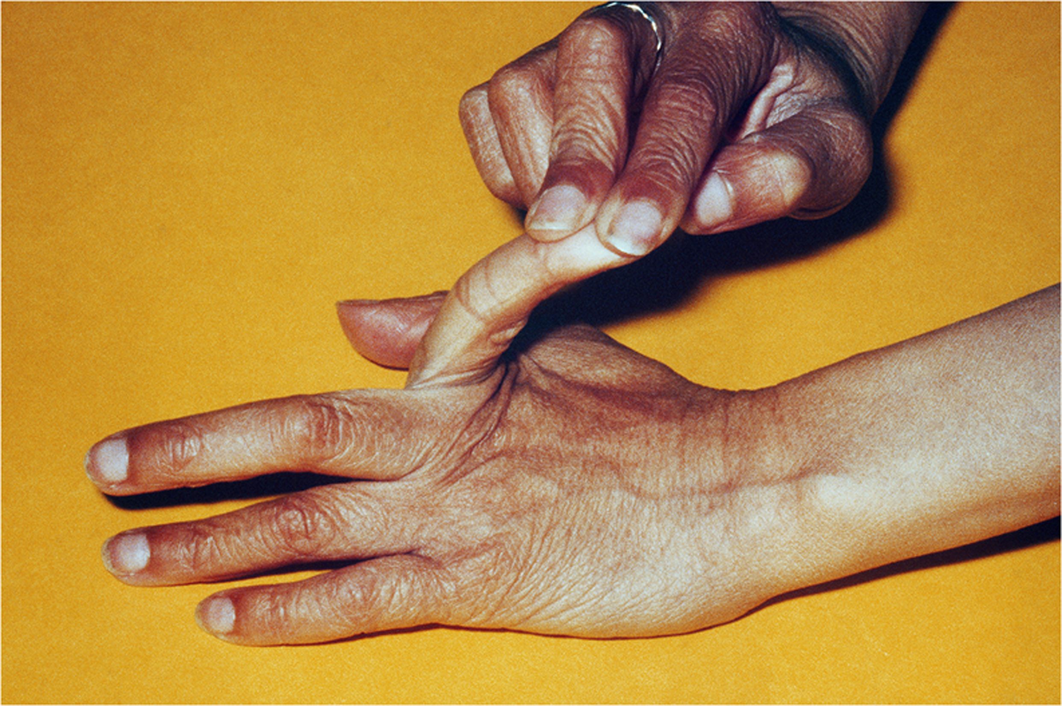
FIGURE 11.7. Joint laxity syndrome by itself is harmless, but many people with this genetic condition also develop severe anxieties. The two conditions may have overlapping genetic bases.
Notes:
FIGURE 11.7. Joint laxity syndrome by itself is harmless, but many people with this genetic condition also develop severe anxieties. The two conditions may have overlapping genetic bases.

Slide 9
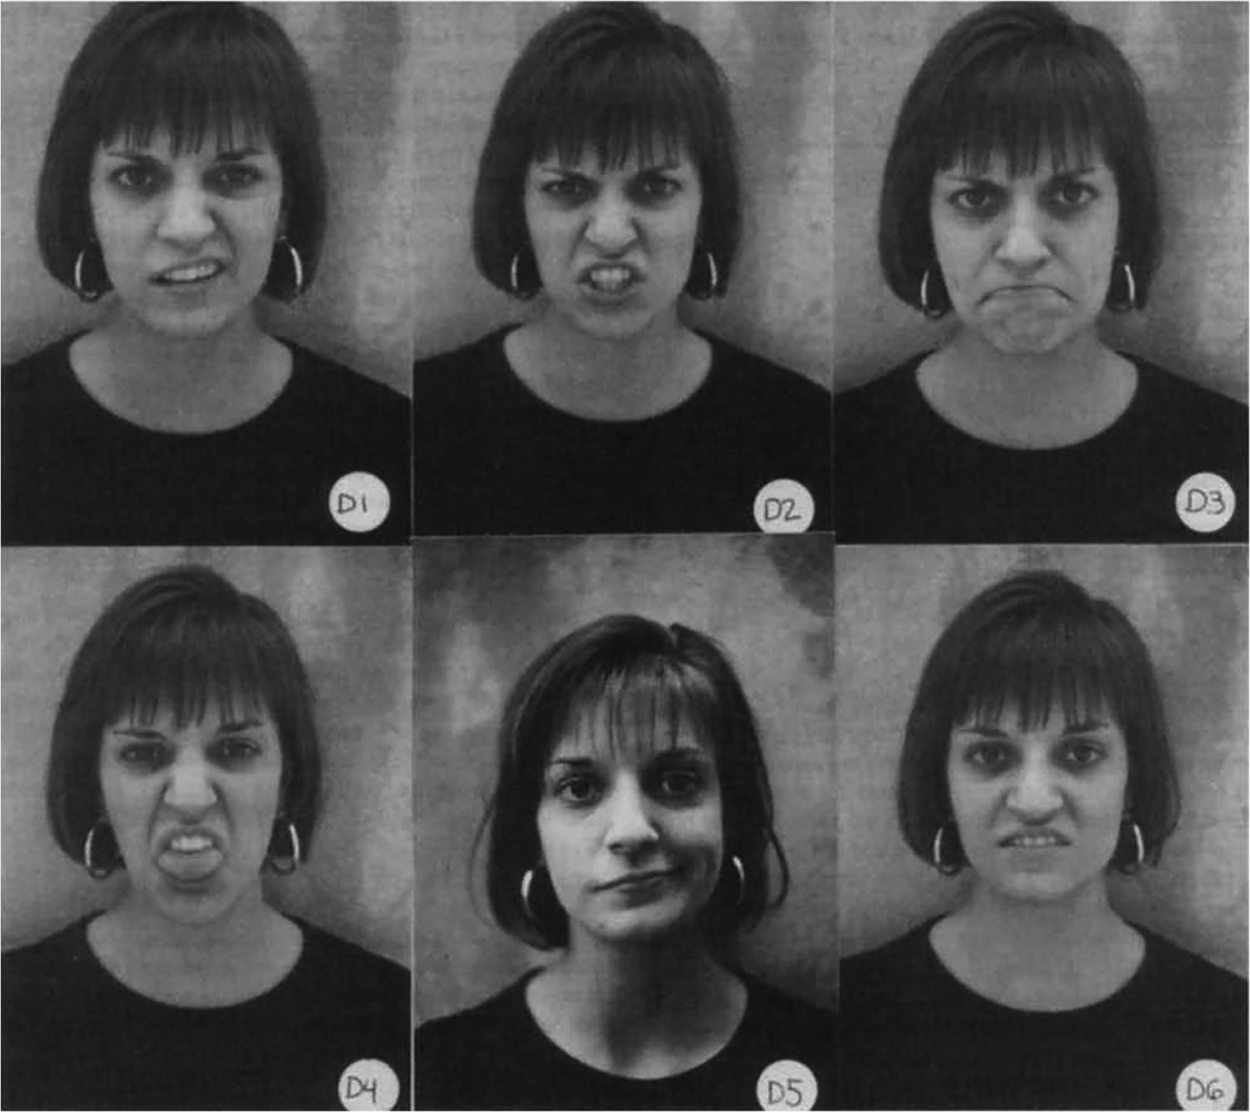
FIGURE 11.8. One set of facial expressions offered as choices for how to react to various types of offense. Faces D1 and D5 represent contempt, D2 and D3 represent anger, and D4 and D6 represent disgust. Some participants viewed these European American faces, whereas others saw a set of Indian or Japanese faces.
Notes:
FIGURE 11.8. One set of facial expressions offered as choices for how to react to various types of offense. Faces D1 and D5 represent contempt, D2 and D3 represent anger, and D4 and D6 represent disgust. Some participants viewed these European American faces, whereas others saw a set of Indian or Japanese faces. From Rozin et al. (1999).

Slide 10
FIGURE 11.9. Facial expressions of anger vary across individuals, situations, and cultures, but common elements can be seen.
Notes:
FIGURE 11.9. Facial expressions of anger vary across individuals, situations, and cultures, but common elements can be seen.

Slide 11
FIGURE 11.10. You are supposed to tell the person on the other side of the chess board to move a piece to their left. Do you say “move the piece to the right” reflecting your own visual perspective, or “move the piece to the left,” acknowledging theirs? People who are angry are less likely to take the other person’s perspective.
Notes:
FIGURE 11.10. You are supposed to tell the person on the other side of the chess board to move a piece to their left. Do you say “move the piece to the right” reflecting your own visual perspective, or “move the piece to the left,” acknowledging theirs? People who are angry are less likely to take the other person’s perspective.

Slide 12
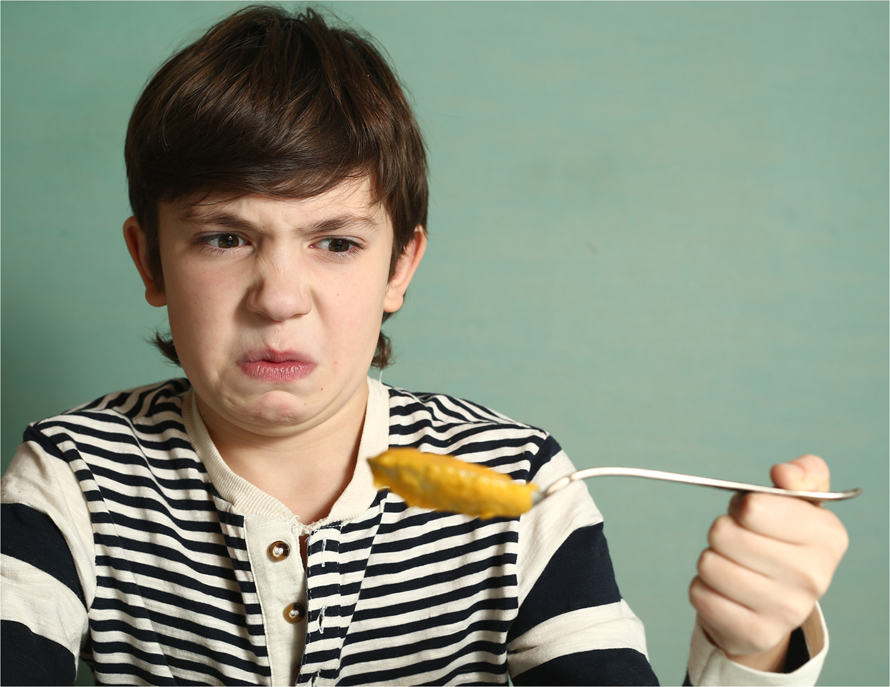
FIGURE 11.11. The prototypical facial expression of disgust narrows the nasal passages and expels contents from the mouth, reducing the risk of contamination through breathing or eating.
Notes:
FIGURE 11.11. The prototypical facial expression of disgust narrows the nasal passages and expels contents from the mouth, reducing the risk of contamination through breathing or eating.

Slide 13
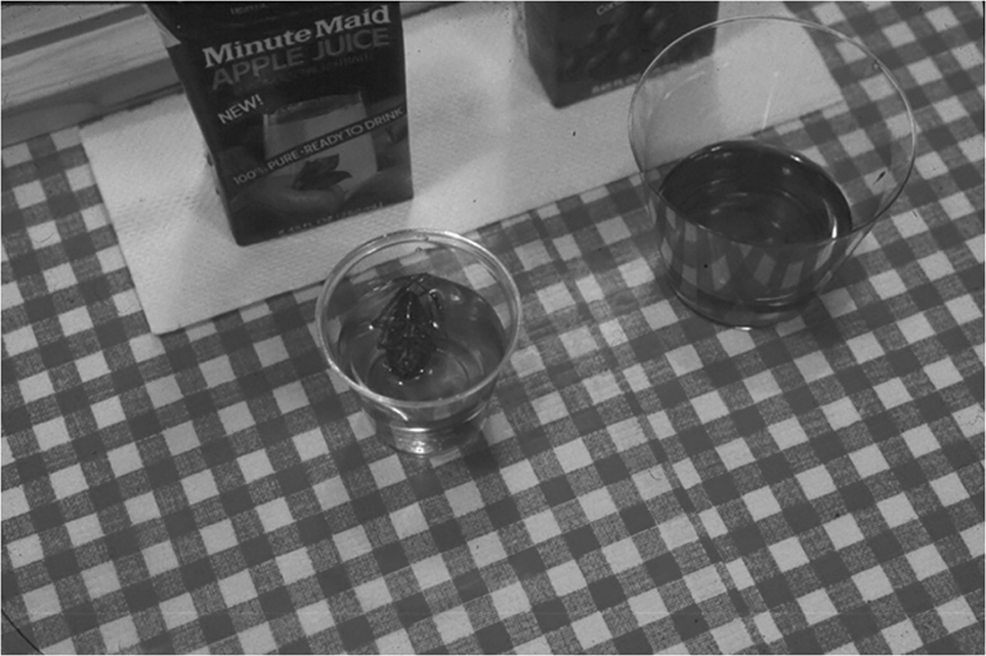
FIGURE 11.12. Would you drink apple juice from a cup holding a cockroach, if the roach had been thoroughly sterilized before being placed in the cup?
Notes:
FIGURE 11.12. Would you drink apple juice from a cup holding a cockroach, if the roach had been thoroughly sterilized before being placed in the cup?

Slide 14
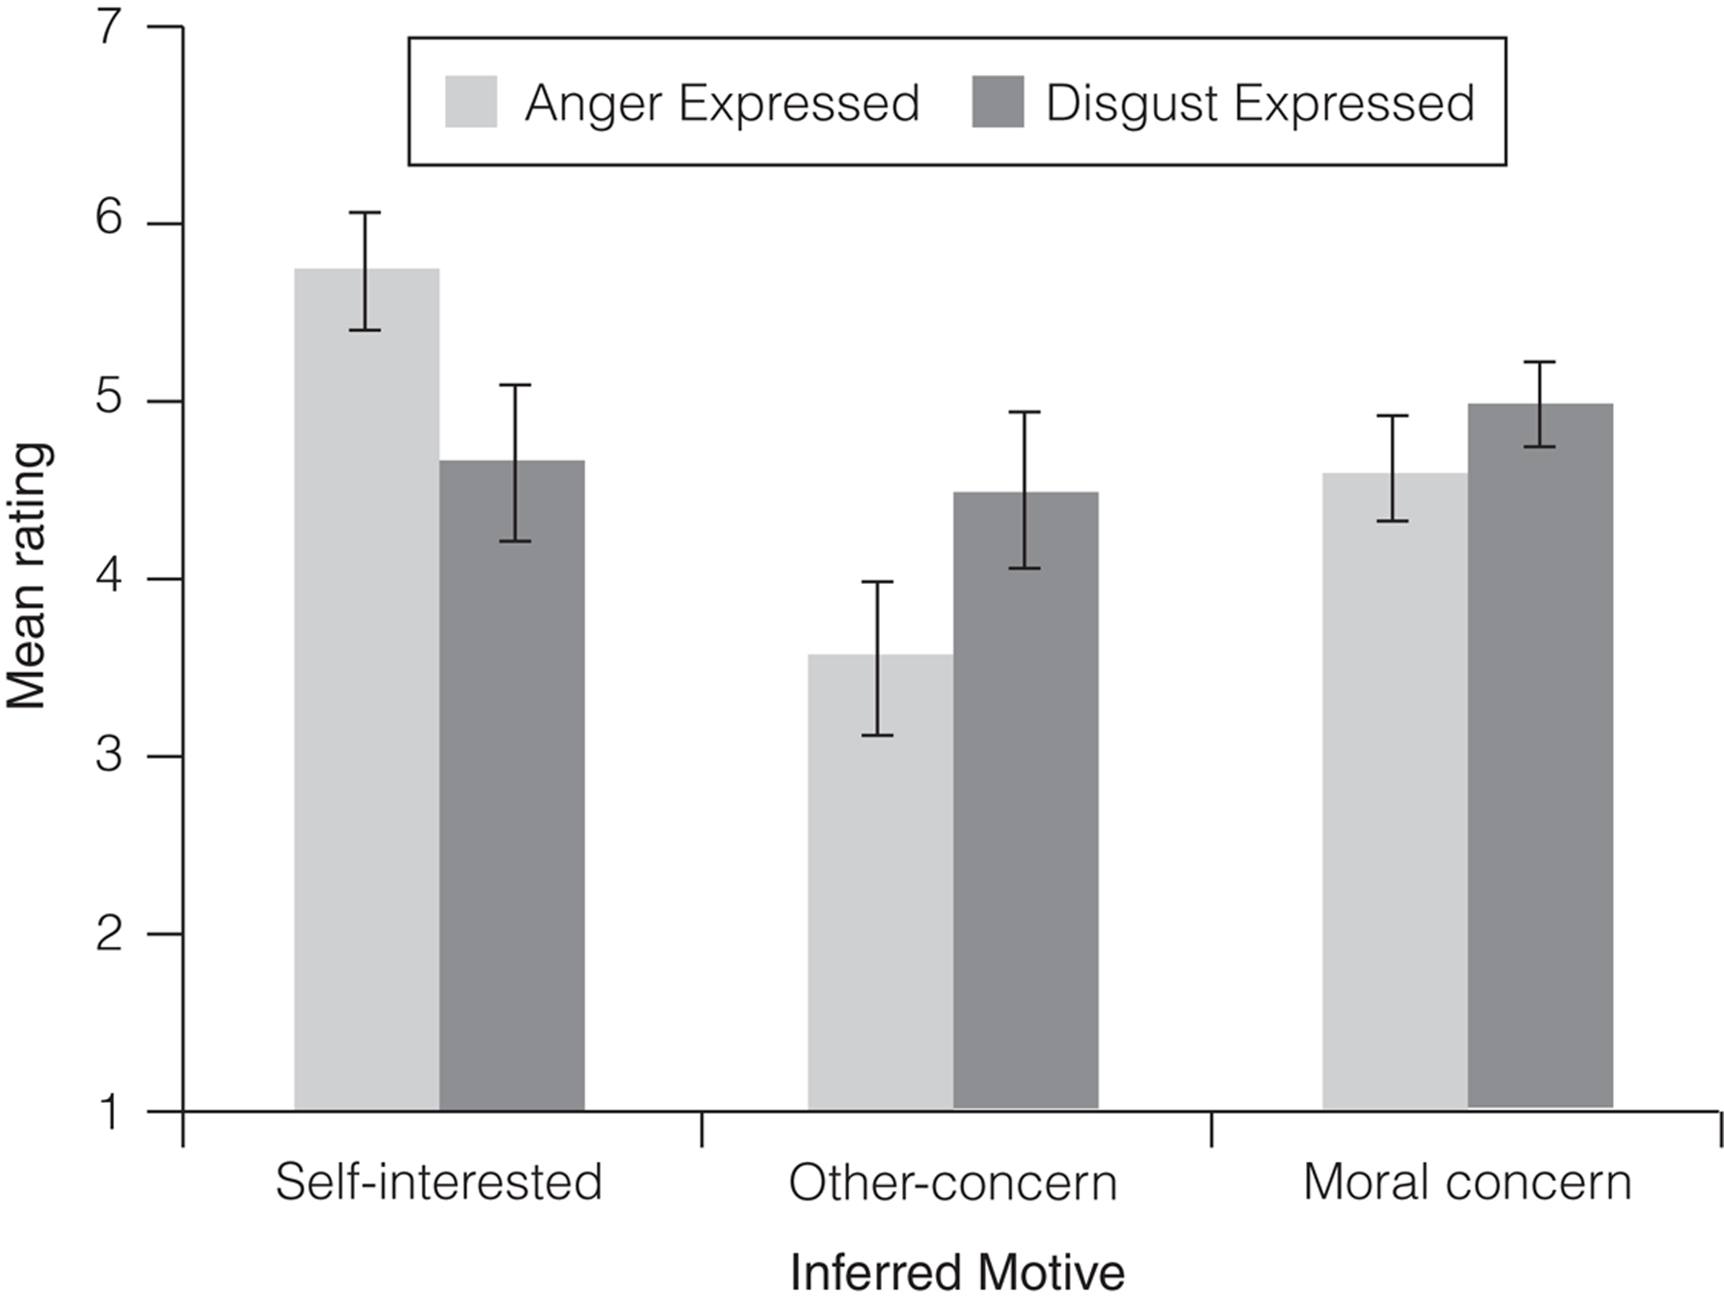
FIGURE 11.13. Participants in this study imagined overhearing an emotional rant by a colleague, without understanding exactly what the conversation was about.
Notes:
FIGURE 11.13. Participants in this study imagined overhearing an emotional rant by a colleague, without understanding exactly what the conversation was about. Participants were more likely to infer the speaker’s concern for another person’s welfare when the speaker expressed disgust rather than anger; the reverse was true for assumptions about the speaker’s self-interest. From Kupfer & Giner-Sorolla (2017).

Slide 15
FIGURE 11.14. The facial and postural expression of sadness is easily recognized, especially when someone is crying.
Notes:
FIGURE 11.14. The facial and postural expression of sadness is easily recognized, especially when someone is crying.

Slide 16
FIGURE 11.15. Freud originally proposed that expressing your feelings would get them out of your system and make you feel better. Research tells a more complicated story.
Notes:
FIGURE 11.15. Freud originally proposed that expressing your feelings would get them out of your system and make you feel better. Research tells a more complicated story.

Slide 17
FIGURE 11.16. A prototypical expression of embarrassment.
Notes:
FIGURE 11.16. A prototypical expression of embarrassment.

Slide 18
FIGURE 11.17. The expression of shame/guilt implies a more serious violation than the ­expression of embarrassment.
Notes:
FIGURE 11.17. The expression of shame/guilt implies a more serious violation than the ­expression of embarrassment.

