Slide 1
Chapter 6: Principles of 4D Art and Design

Slide 2
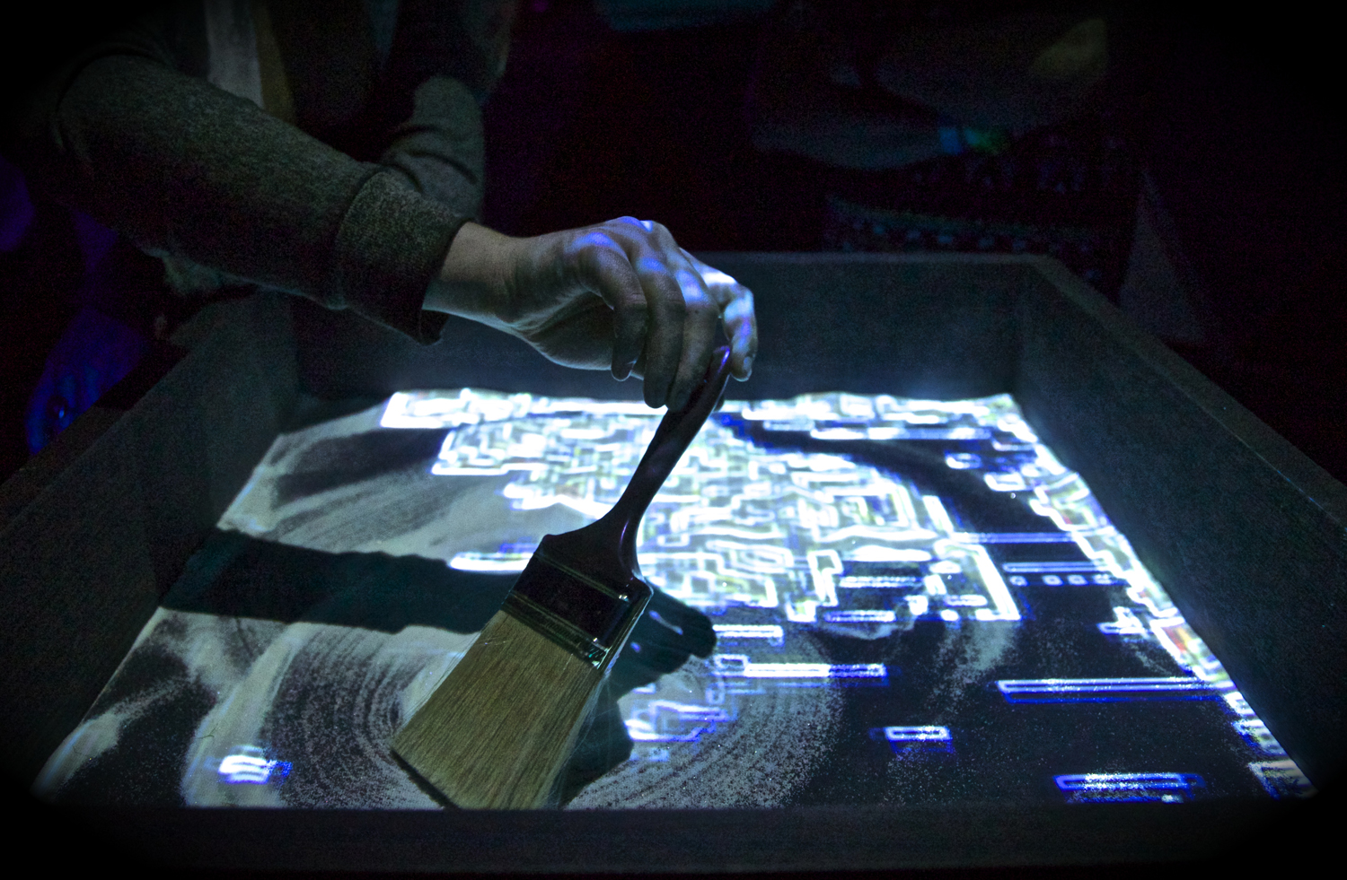
Fig. 6-1. Casey Scalf, The Sandbox of Life (2014), interactive installation, dimensions variable. Courtesy of the Artist.

Slide 3
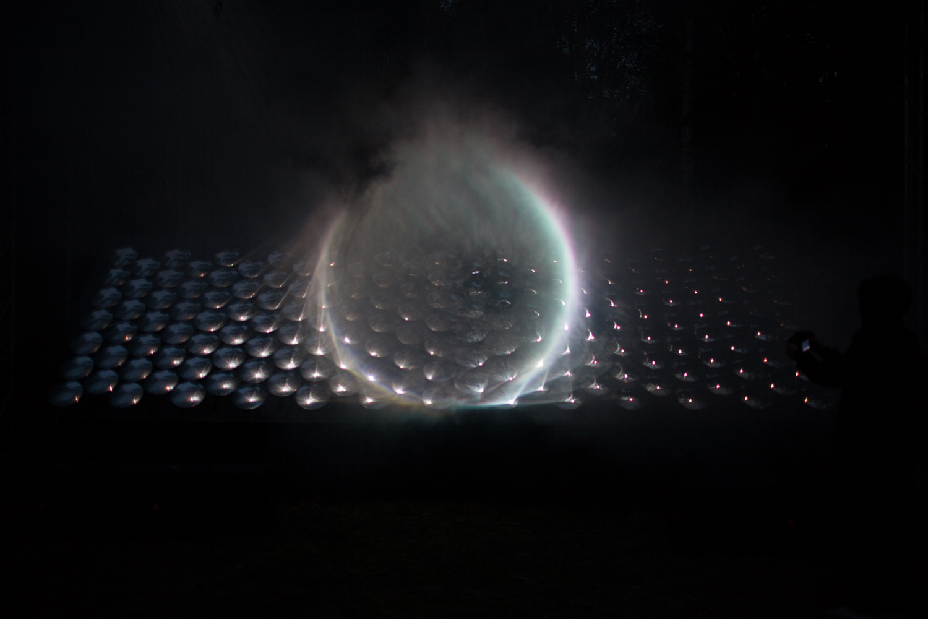
Fig. 6-2. Kimchi and Chips, Light Barrier (2014), convex mirrors, projection, scanning, dimensions variable. Courtesy of the Artists.

Slide 4
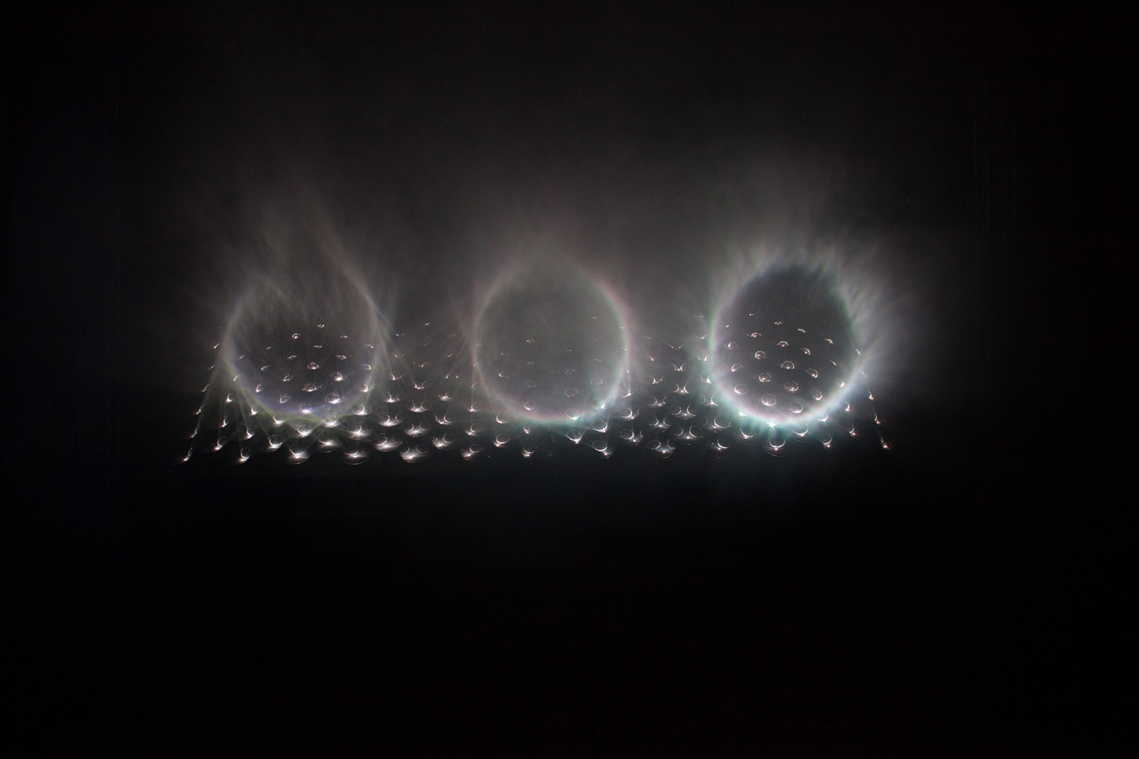
Fig. 6-2. Kimchi and Chips, Light Barrier (2014), convex mirrors, projection, scanning, dimensions variable. Courtesy of the Artists.

Slide 5
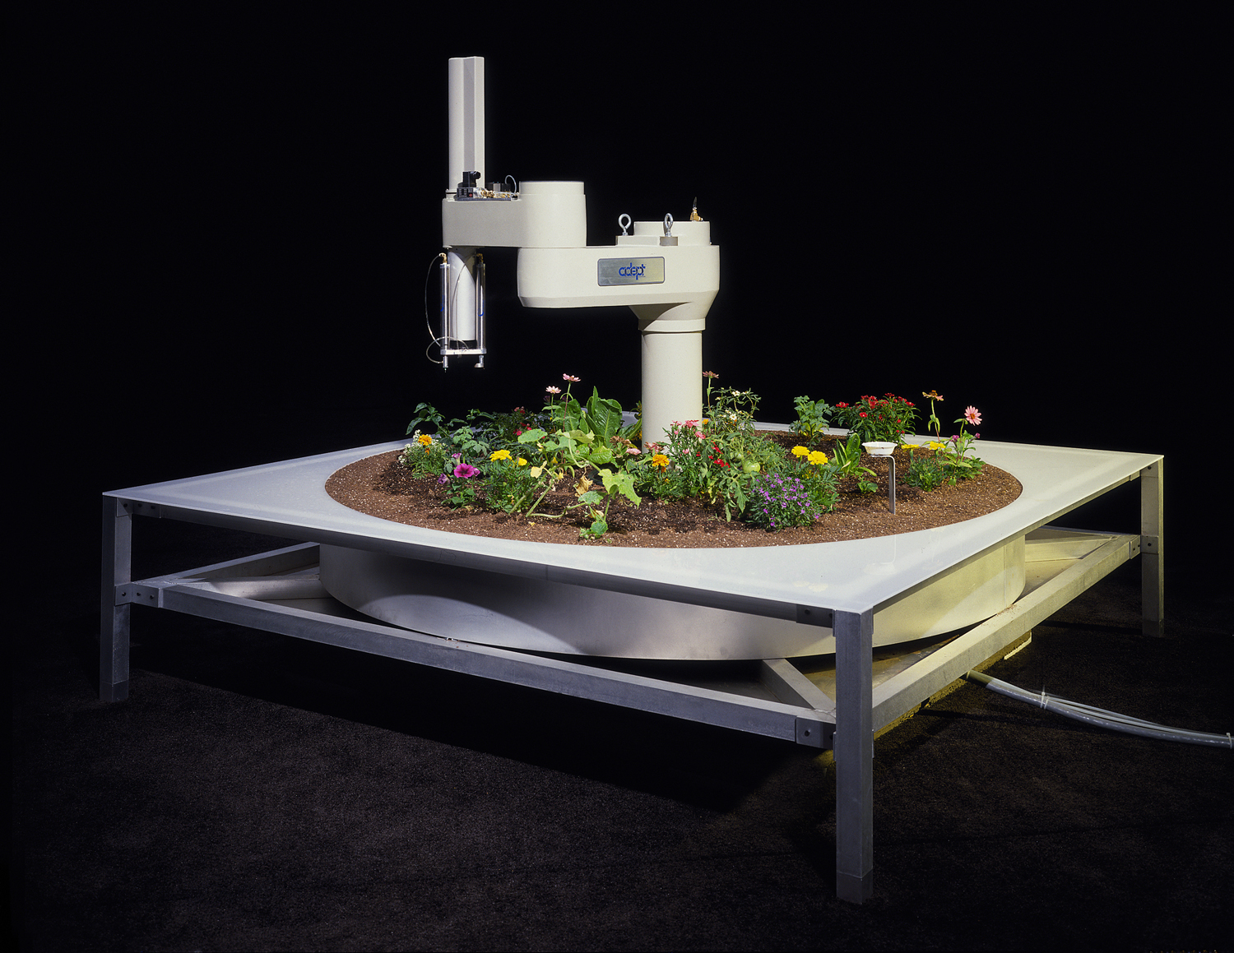
Fig. 6-3. The Telegarden (1995–2004), networked art installation at Ars Electronica Museum, Austria. Co-directors: Ken Goldberg and Joseph Santarromana. Project team: George Bekey, Steven Gentner, Rosemary Morris Carl Sutter, Jeff Wiegley, Erich Berger. Photo by Robert Wedemeyer. http://goldberg.berkeley.edu/garden/Ars/.

Slide 6
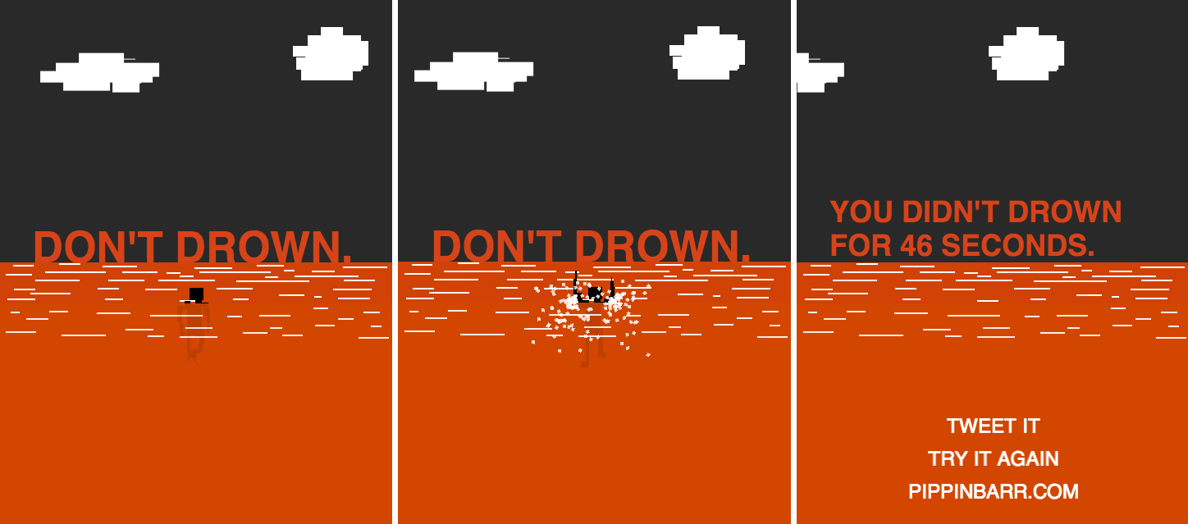
Fig. 6-4. Pippin Barr, Don’t Drown (2014), browser-based video game. © Pippin Barr.

Slide 7
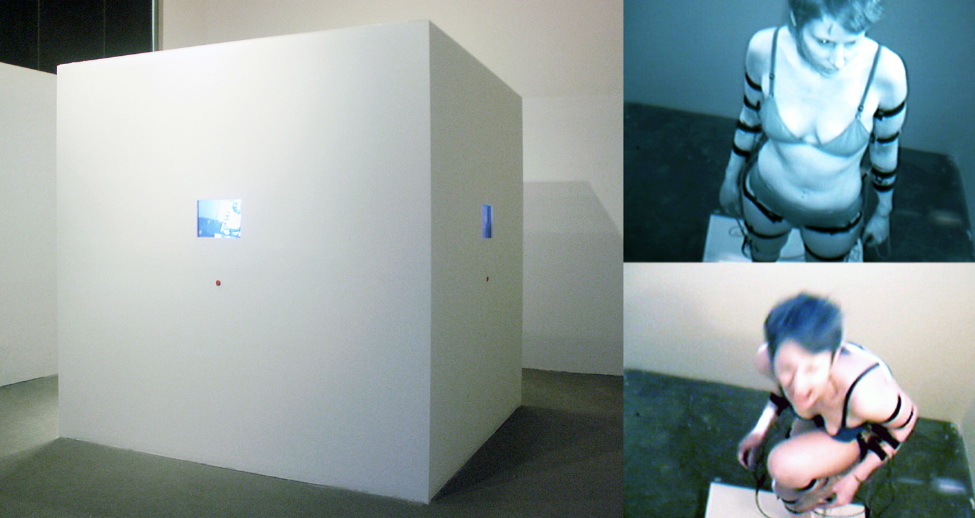
Fig. 6-5. Noelle Mason, Mise-en-Scene (2004), performative installation, duration variable. Courtesy of the artist.

Slide 8
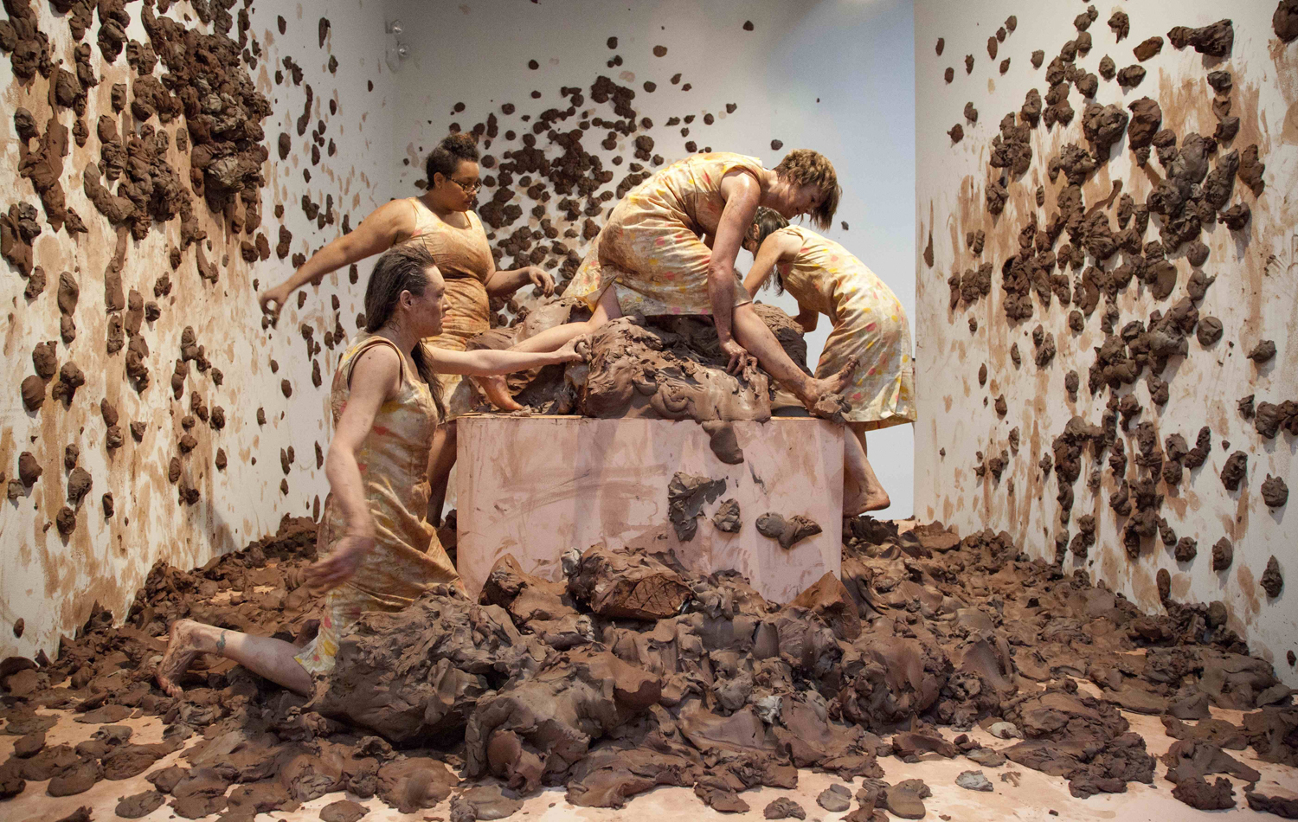
Fig. 6-6. Kate Gilmore, Through the Claw (2011), performance still taken at Pace Gallery, New York. Courtesy of David Castillo Gallery.

Slide 9
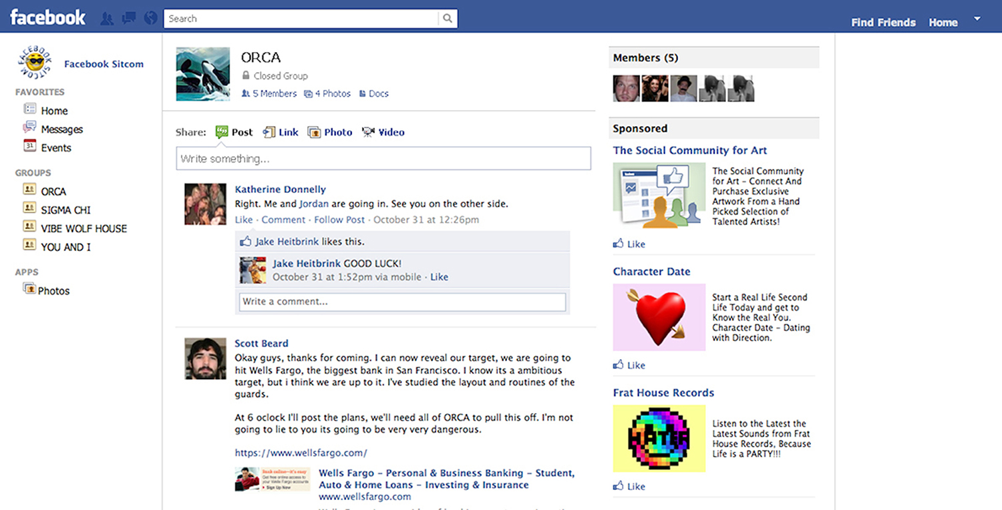
Fig. 6-8. Ed Fornieles, Dorm Daze (2011), screen capture, dimensions variable. © The artist, courtesy of Carlos/Ishikawa, London.

Slide 10
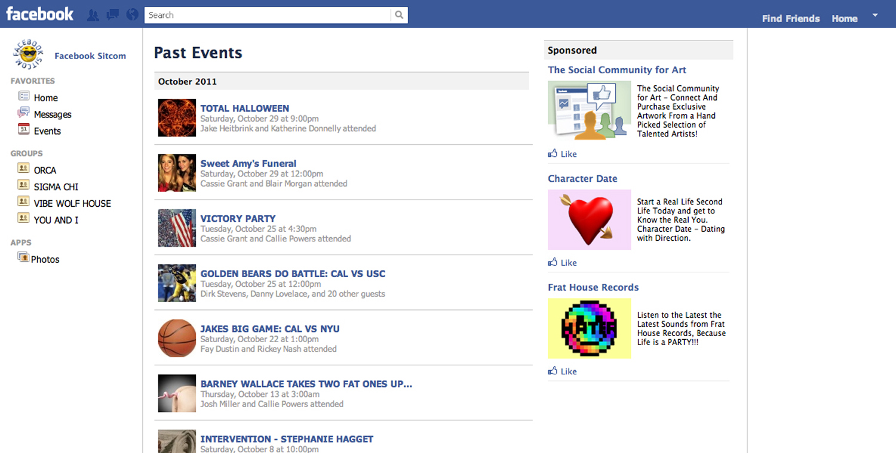
Fig. 6-8. Ed Fornieles, Dorm Daze (2011), screen capture, dimensions variable. © The artist, courtesy of Carlos/Ishikawa, London.

Slide 11
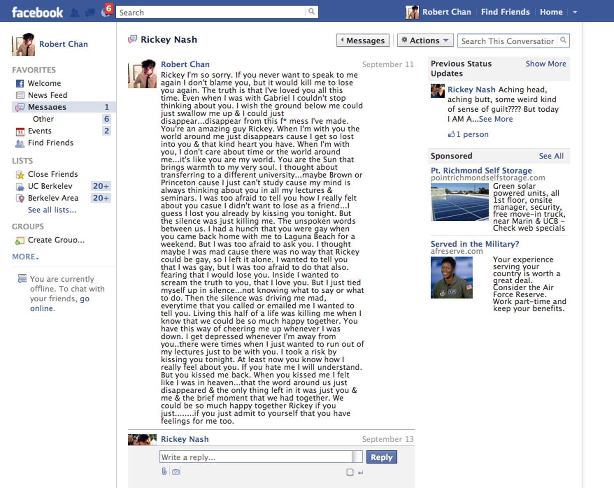
Fig. 6-8. Ed Fornieles, Dorm Daze (2011), screen capture, dimensions variable. © The artist, courtesy of Carlos/Ishikawa, London.

Slide 12
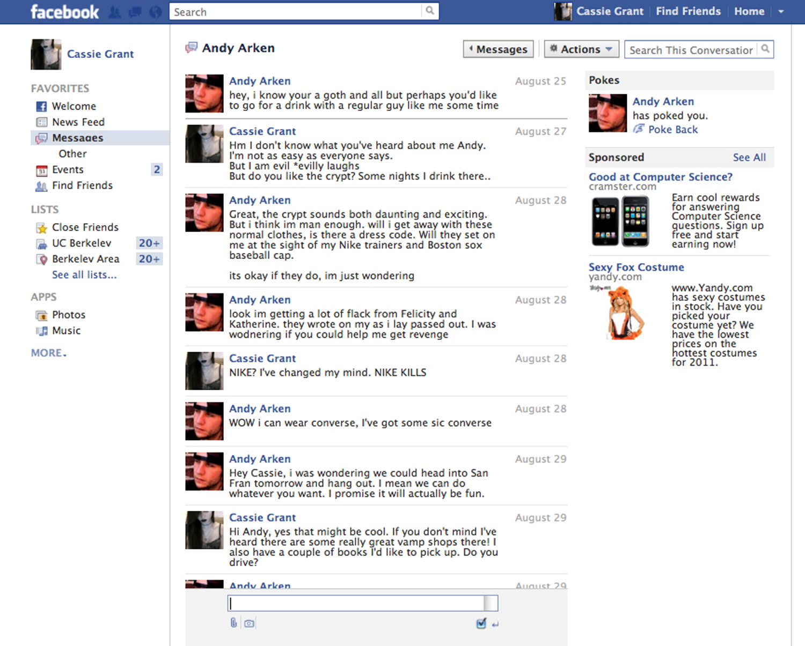
Fig. 6-8. Ed Fornieles, Dorm Daze (2011), screen capture, dimensions variable. © The artist, courtesy of Carlos/Ishikawa, London.

Slide 13
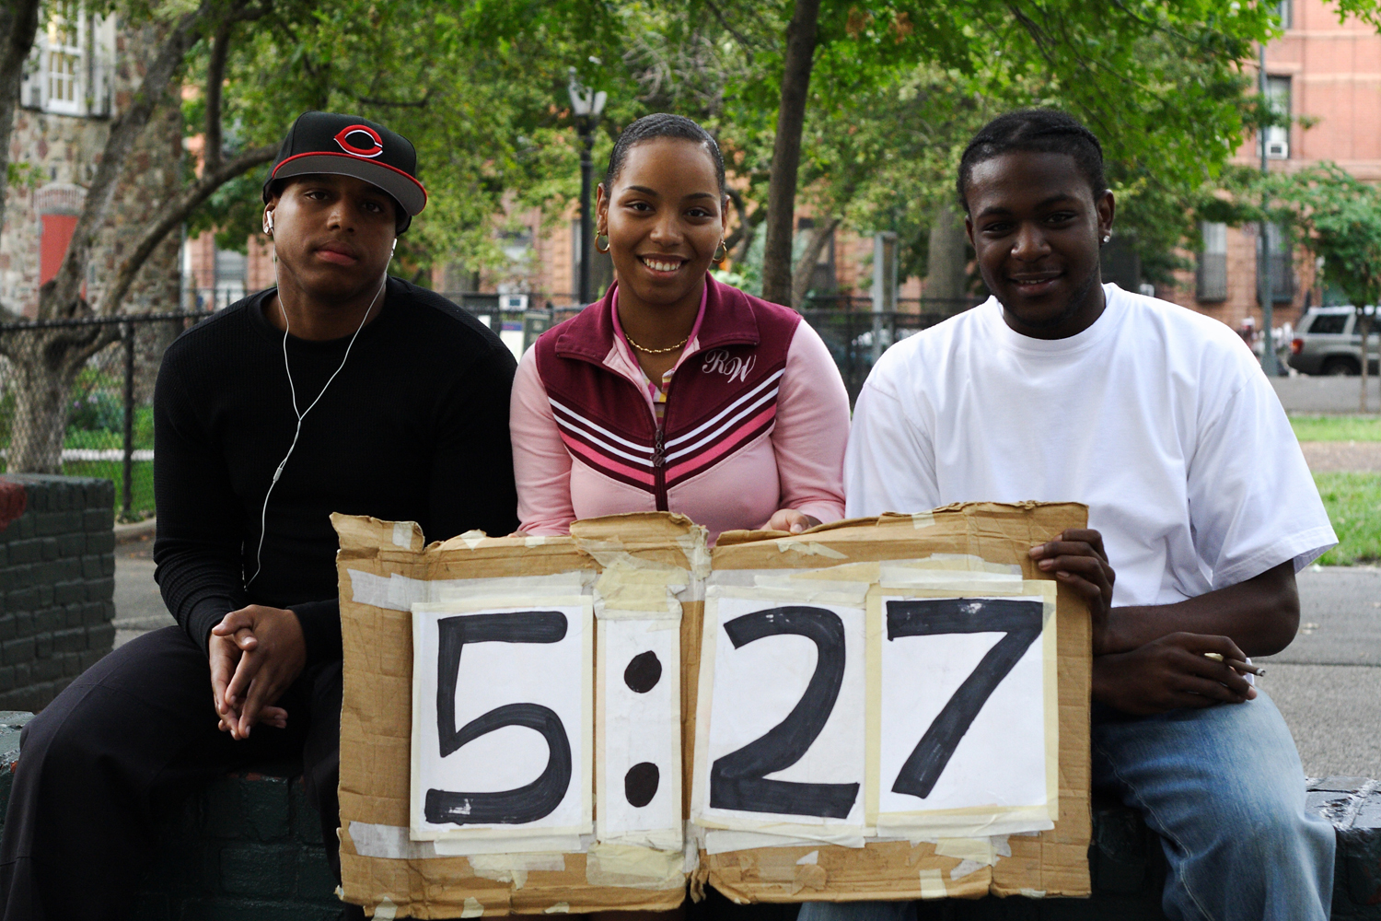
Fig. 6-9. Craig D. Giffen, Human Clock (2001–ongoing), performance still, dimensions variable. Courtesy of the Artist.

Slide 14
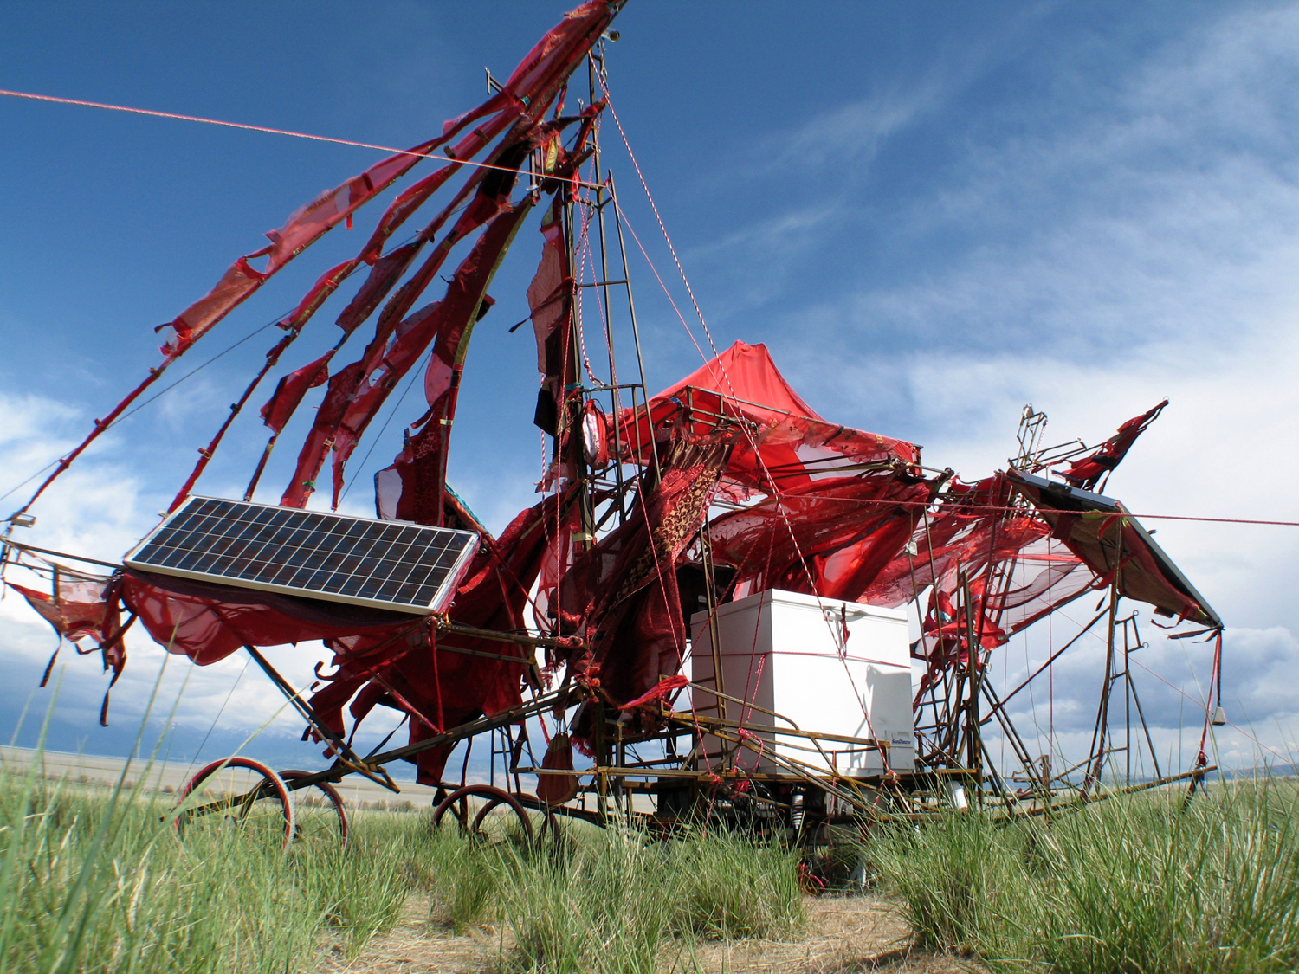
Fig. 6-10. Duane McDiarmid, Trickster Project (2009–2010), solar-powered ice cream cart in remote locales; max length 26′, max width 24′, and max height 20′. Courtesy of the Artist.

Slide 15
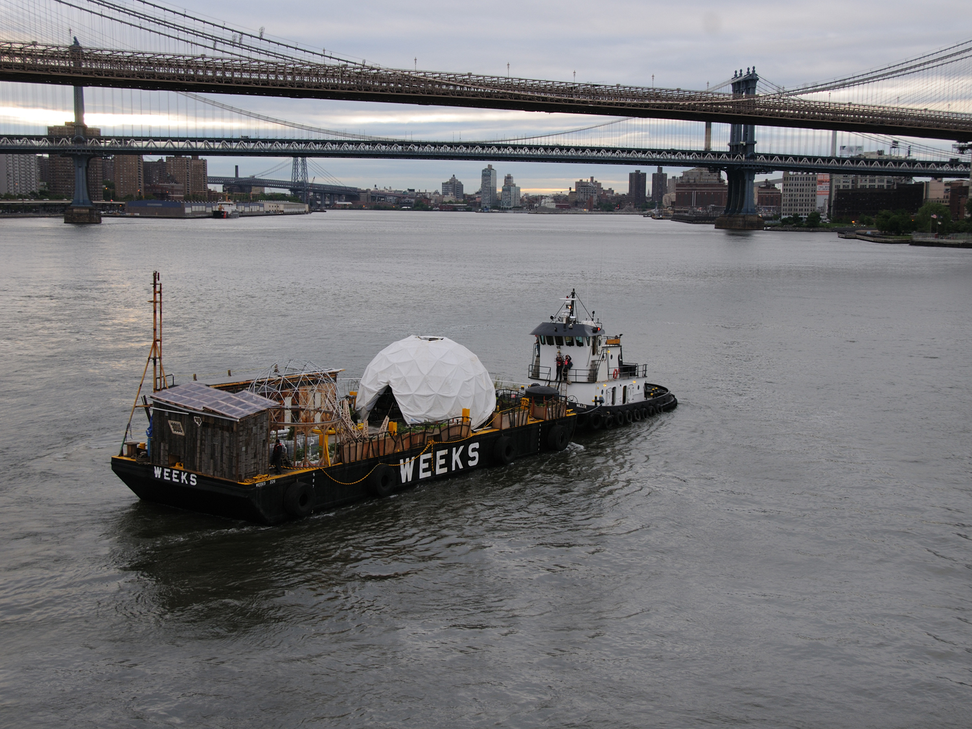
Fig. 6-11. Mary Mattingly, The Waterpod Project (2009), 100-foot-long floating sculptural living structure. Courtesy of the Artist.

Slide 16
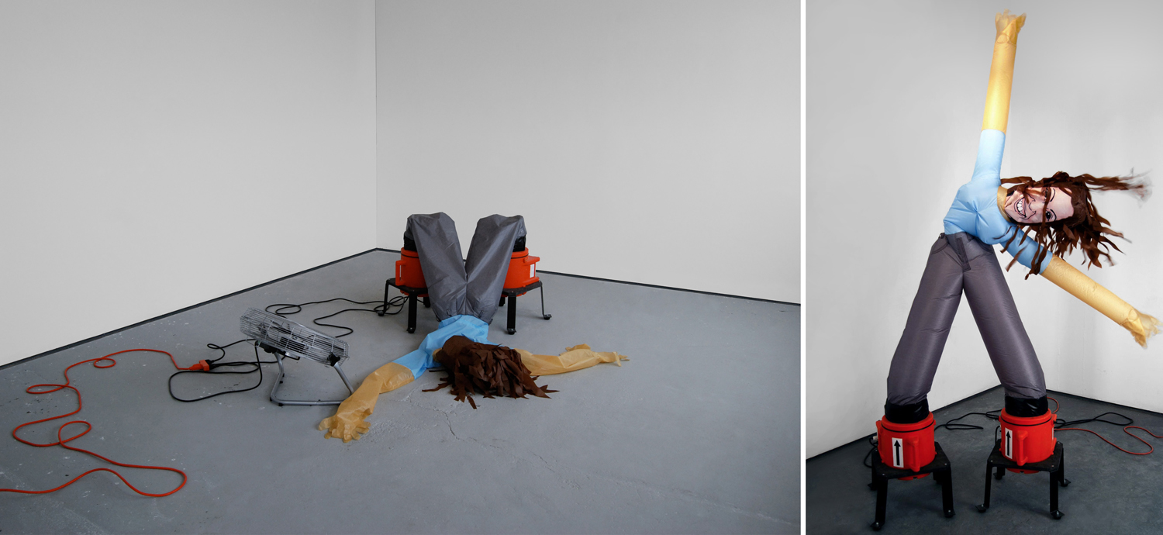
Fig. 6-12. Alicia Eggert, It’s Nice to Meet You! (2007–2008), motion sensor, inflatable self-portrait,. blower fans, industrial fan, Arduino microprocessor, electrical components, 83′ × 78′ × 20′. Courtesy of the Artist.

Slide 17
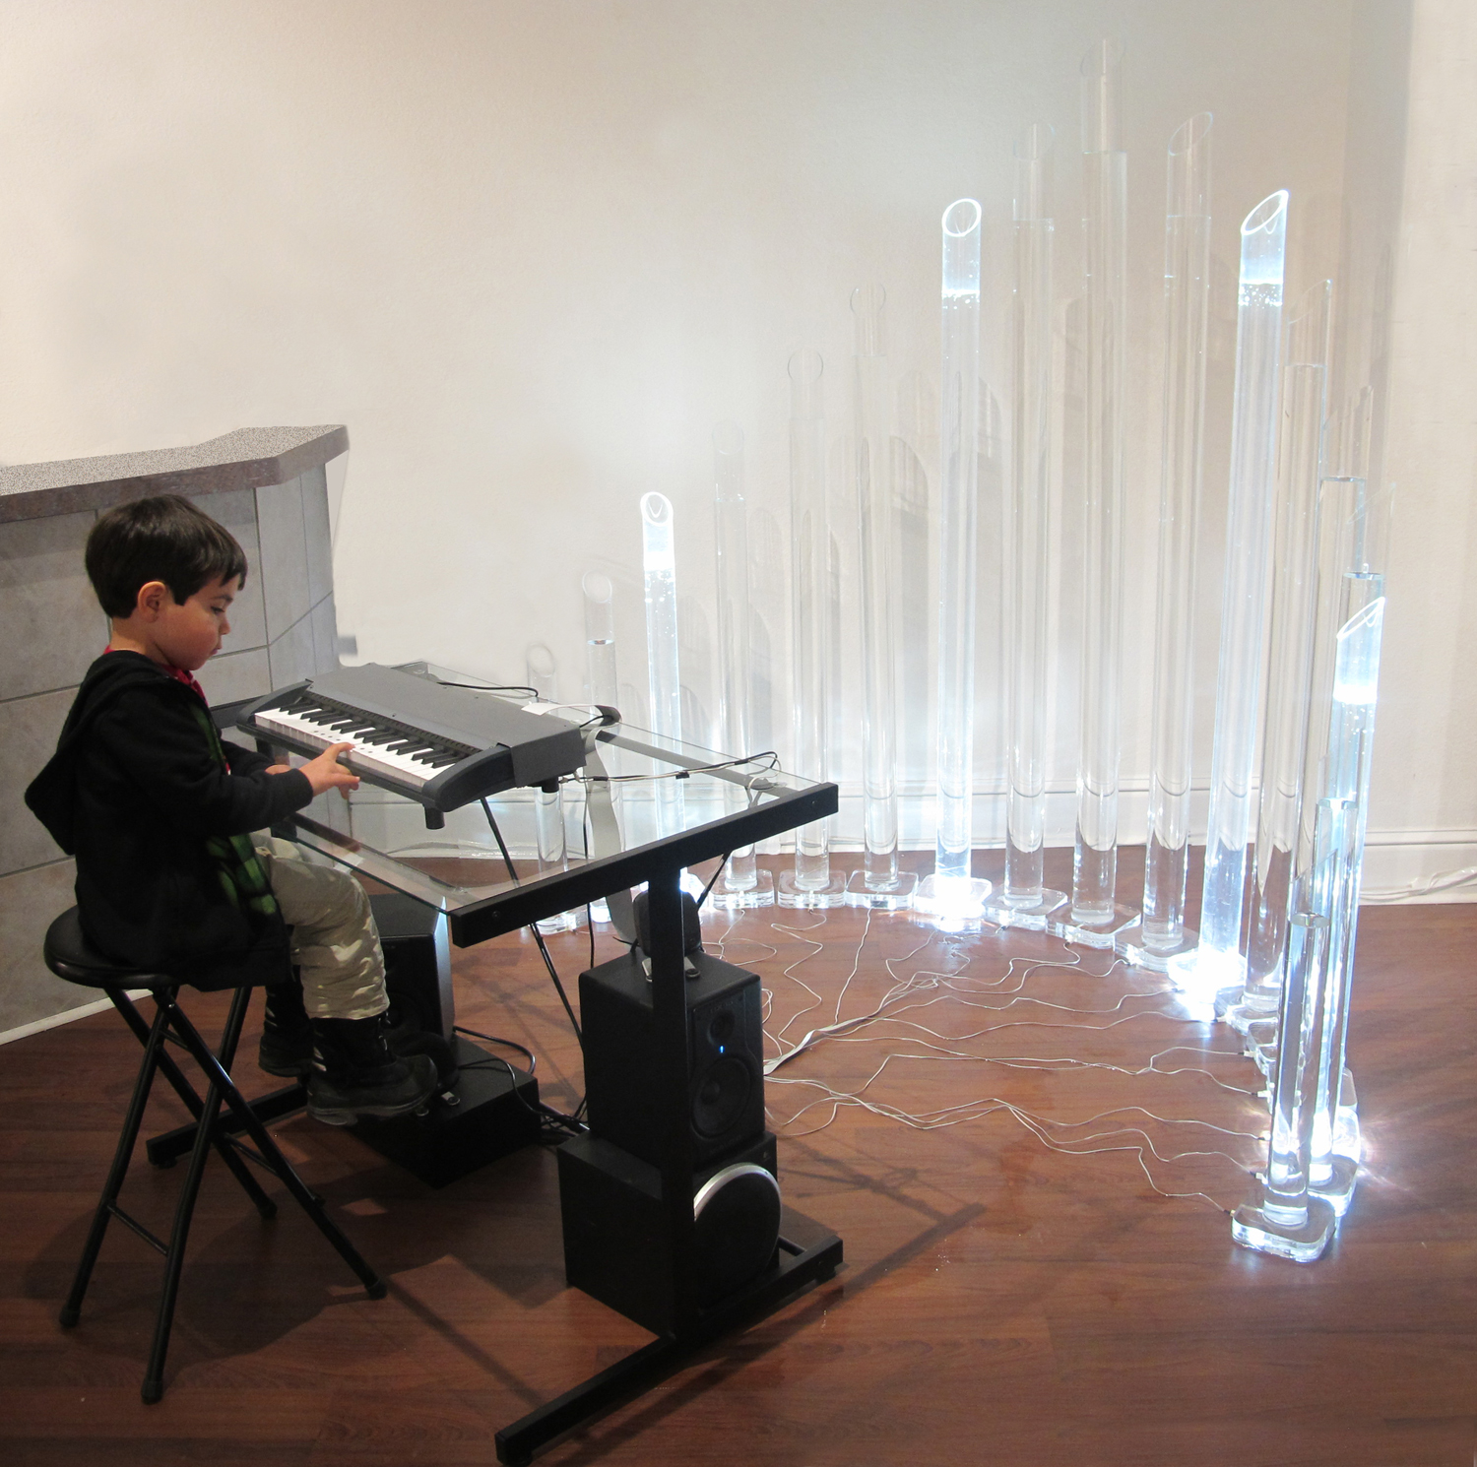
Fig. 6-13. Nikki Pike, Ice Bellows (2011), interactive sound installation, dimensions variable. Photography: Nikki Pike.

Slide 18
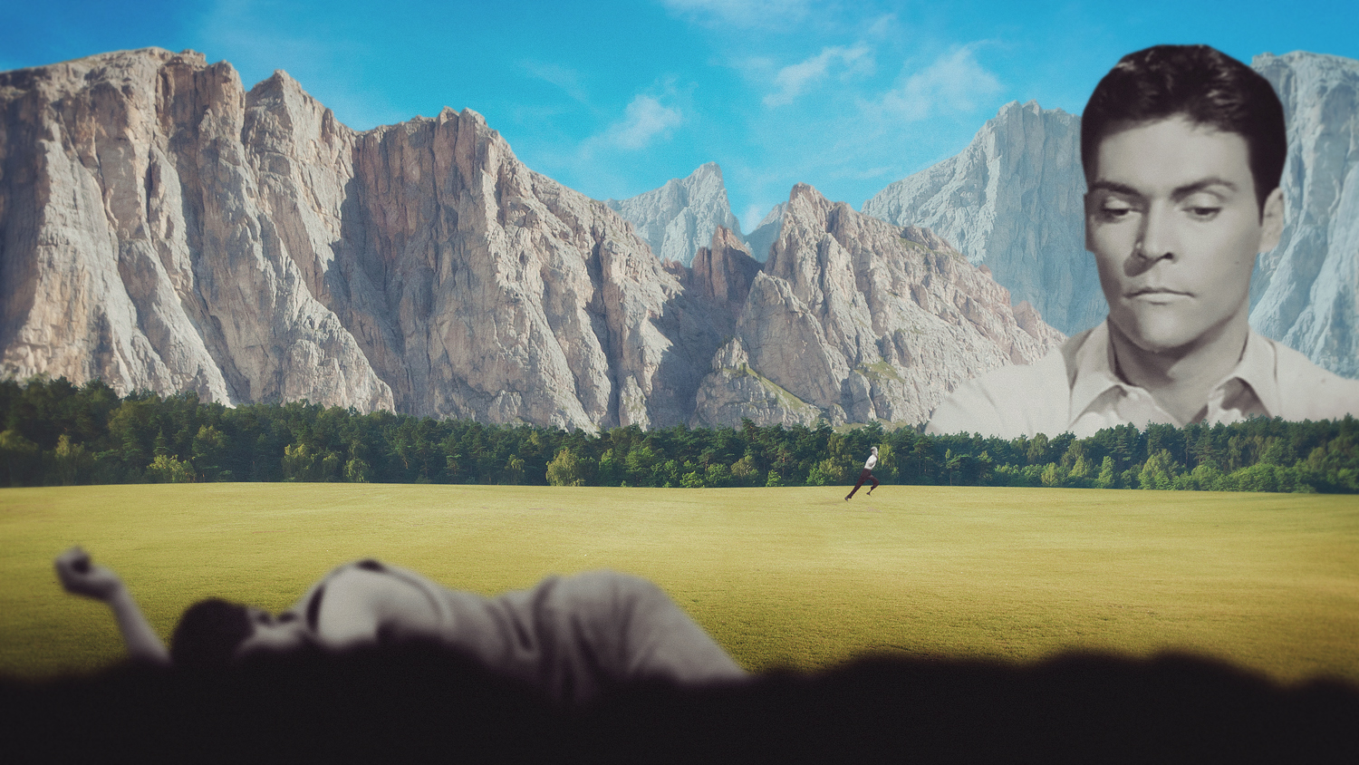
Fig. 6-14. Joseba Elorza, Air Review—Young (2014), digital animation, 3:50 minutes. Courtesy of Joseba Elorza.

Slide 19
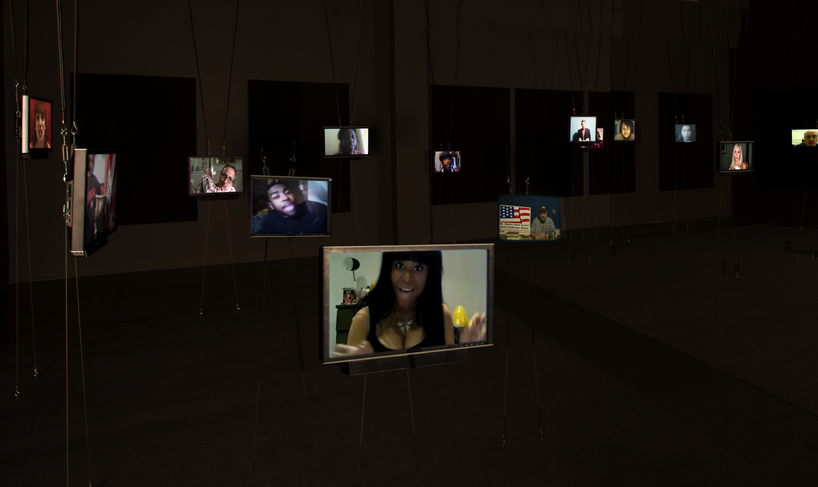
Fig. 6-15. Natalie Bookchin, Now He’s Out in Public and Everyone Can See (2012), 18-channel video installation, 16-minute loop. Courtesy of the Artist.

Slide 20
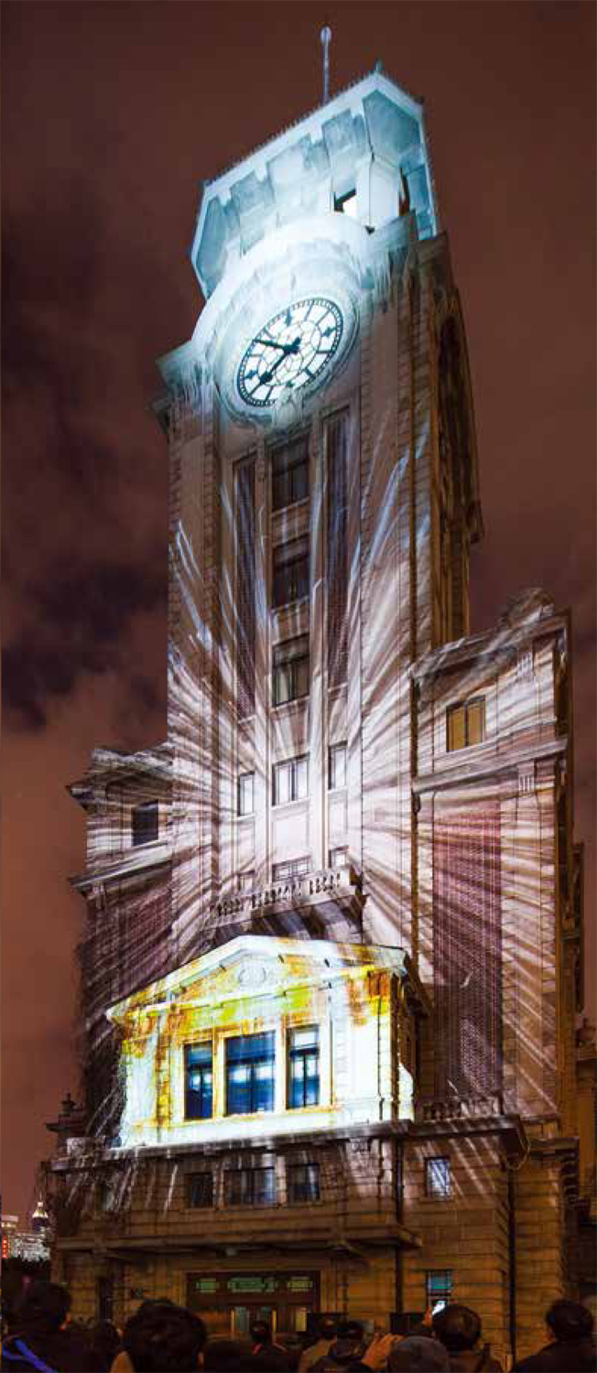
Fig. 6-17. Aaajiao, Time Refactoring (2012), projection mapping for Shanghai Art Museum, 12 m × 38 m. © aaajiao.

Slide 21
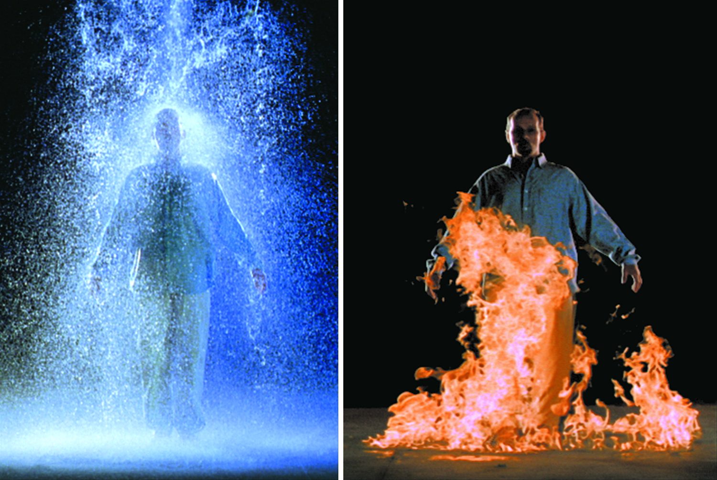
Fig. 6-22. Bill Viola, The Crossing (1996), Video/sound installation, 4.9 × 8.4 × 17.4 m. Two channels of color video projections from opposite sides of large dark gallery onto two large back-to back screens suspended from ceiling and mounted to floor; four channels of amplified stereo sound, four speakers. Performer: Phil Esposito. Courtesy of Bill Viola Studio LL C.

Slide 22
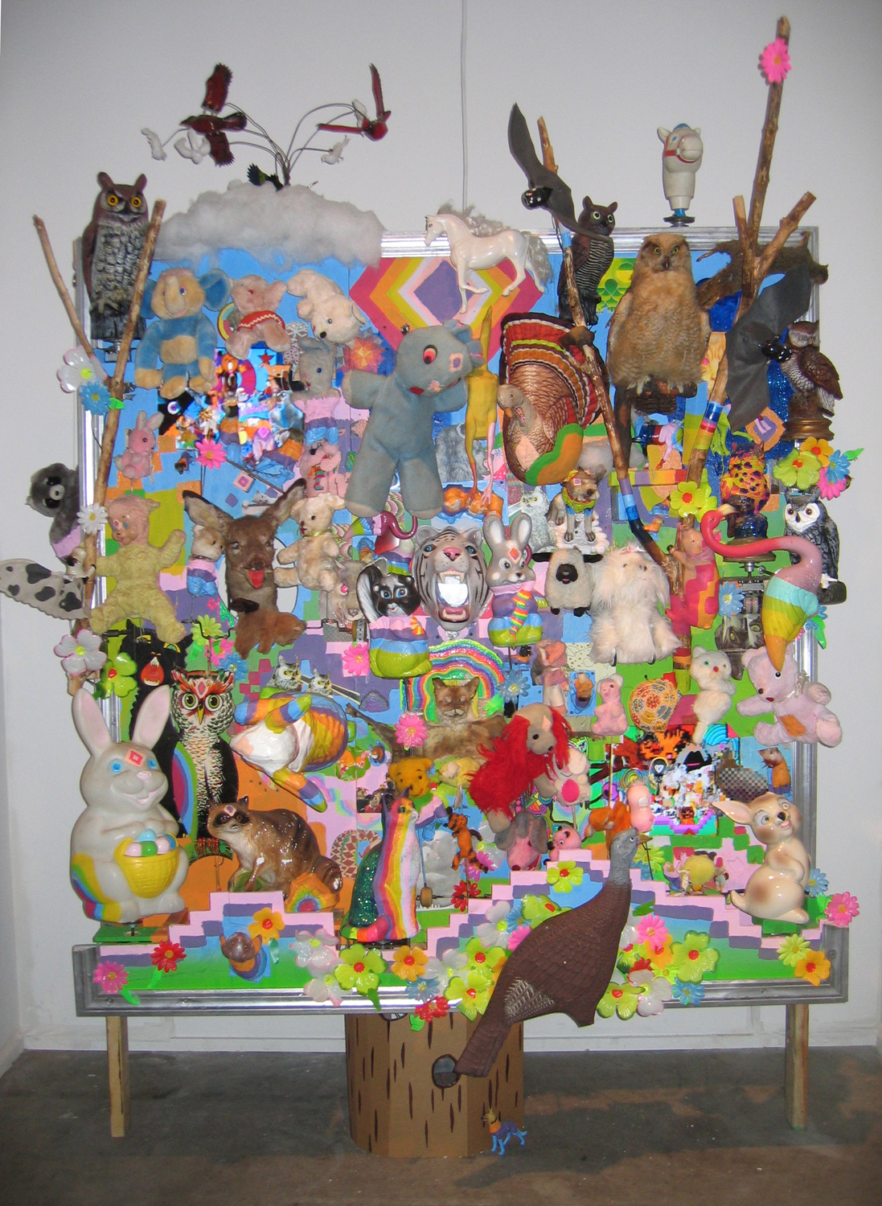
Fig. 6-23. Matt Barton and Jacob Ciocci, Extreme Animalz: the Movie, Part 1 (2005), multimedia installation. Courtesy of the Artist.

Slide 23
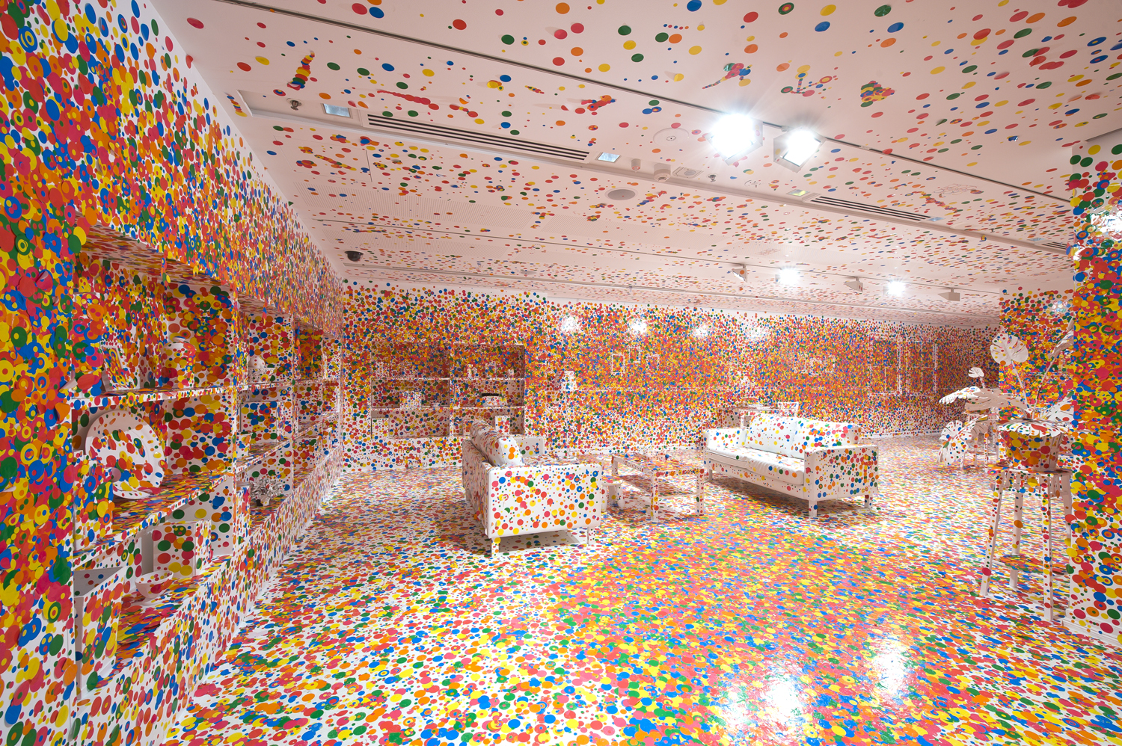
Plate 15. Yayoi Kusama, Japan, b. 1929, The Obliteration Room (2002 to present), furniture, white paint, dot stickers, dimensions variable. Collaboration between Yayoi Kusama and Queensland Art Gallery. Commissioned by the Queensland Art Gallery, Australia. Gift of the artist through the Queensland Art Gallery Foundation (2012). Collection: Queensland Art Gallery. Image © Yayoi Kusama. Courtesy David Zwirner, Victoria Miro Gallery, Ota Fine Arts, Yayoi Kusama Studio Inc.

