Slide 1
Interplay
by Adler, Rosenfeld, and Proctor II

Slide 2
Chapter 2
Mediated Interpersonal Communication
Mediated Communication: Pros and Cons
Mediated Interpersonal vs. Masspersonal Communication
Competence in Mediated Communication

Slide 3
Chapter 2
Learning Objectives
L.O. 2.1: Identify the benefits and drawbacks of mediated communication
L.O. 2.2: Distinguish between mediated interpersonal and masspersonal communication, and use each appropriately
L.O. 2.3: Apply the principles of competence to your mediated interpersonal and mass personal communication

Slide 4
Mediated Communication: Pros & Cons
Is mediated communication a source of:
Alienation?
Or Connection?
Does it create social distance or bring people together?

Slide 5
Mediated Communication & Alienation
Health threats
Substitution for face-to-face interaction
Vicious cycle of alienation

Slide 6
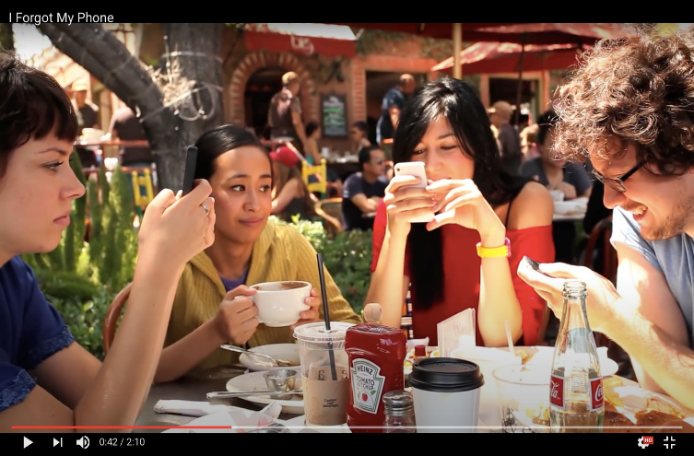
Mediated Communication & Alienation
I Forgot My Phone
Notes:
Discuss the video: I Forgot My Phone: https://www.youtube.com/watch?v=OINa46HeWg8
How do you feel when you are “together, but alone” on your phone, or when someone else is on their phone? Why do you perceive that people want to be together, but then permit themselves to be distracted by phones? Have you found a way to comfortably address this with others?

Slide 7
Mediated Communication & Connection
Relationship enhancement
Supplement to face-to-face interaction
Ease in new relationship creation
Sustaining connection in romantic relationships

Slide 8
Mediated Communication:
Alienation or Connection?
Discuss: Select two of the alienating factors of mediated communication and two of the connecting factors of mediated communication and create an alternate viewpoint for each. Include specific examples from your experience or experiences of others.

Slide 9
Mediated Communication: Pros & Cons
Is mediated communication:
Superficial?
Or Meaningful?
Are relationships that are created or sustained only via social media necessarily superficial?

Slide 10
Mediated Communication: Superficial?
Actual number of “friends”
“Richer” connection that can’t be achieved online

Slide 11
Mediated Communication: Meaningful?
Like-minded people
Strengthen existing relationships: media multiplexity
Build social capital
Weak ties stave off loneliness

Slide 12
Dark Side of Communication
The Effects of Smartphone Use among Teens
What effects do smartphones have on teens?
Do you think smartphones cause loneliness and depression, or that lonely and depressed teens use their smartphones more?

Slide 13
Focus on Research
Social Media Detox
How long did the subjects in this experiment last without social media? What were the effects of their social media detox?
Have you ever done a social media detox? If so, was it helpful? If not, how long do you think you would last before exhibiting effects?

Slide 14
Mediated Communication: Pros & Cons
Why do weak ties
sometimes offer strong rewards?

Slide 15
Mediated Communication: Pros & Cons
Discuss: Look through your recent text messages and locate examples that you would not have said the same way in person. Describe how you would alter your statements, or how you would have taken the conversation offline.

Slide 16
Mediated Communication: Pros & Cons
Is mediated communication:
Healthy?
Or Unhealthy?
Some critics say that communication technology is unhealthy. Others say it can improve health. What do you say?

Slide 17
Mediated Communication: Healthy?
Develop and maintain connections
Social support
Feedback on a variety of topics

Slide 18
Mediated Communication: Unhealthy?
Sleep deprivation
Depression, loneliness, social anxiety
Diminished self-esteem
Lack of well-being

Slide 19
What’s the Bottom Line?
Moderation
Active versus passive use
Known versus unknown communicators
Discuss: “Social media users who interact with those they know offline fare better with depression than those who mainly follow strangers.”
Notes:
The bottom line
Moderation
Balance is vital to the healthy use of social media
Underusing mediated communication can negatively affect relationships
Active versus passive use
The way we use mediated channels can shape whether the outcomes are beneficial or harmful.
Known vs unknown communicators
Social media users who interact with those they know offline fare better with depression than those who mainly follow strangers.
Phone calls/texting are positively correlated with well-being; gaming has opposite effect.
Ill effects from media channels appear smaller than some critics originally claim.

Slide 20
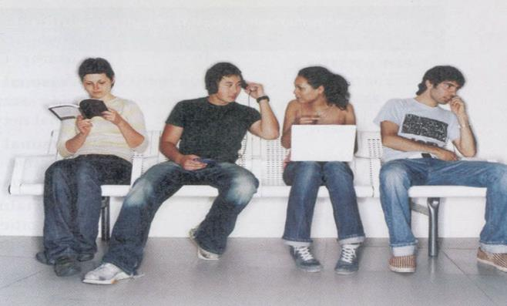
How People Use Social Media
Mediated Communication can sometimes be as rewarding a face-to-face interaction.
How does the amount and nature of your mediated communication affect your in-person relationships?

Slide 21
What’s the Bottom Line?
Discuss: “Phone calls/texting as positively correlated with well-being. Gaming has the opposite effect.”

Slide 22
What’s the Bottom Line?
Ill effects from media channels aren’t as great as some critics thought. Agree? Disagree?

Slide 24
Mediated Interpersonal Communication vs. Masspersonal Communication
Discuss: Personal messages don’t have to be deeply revealing. Oversharing online can be obnoxious and awkward.

Slide 25
Mediated Interpersonal Communication vs. Masspersonal Communication
Discuss: Describe someone that you know who only posts the positive in mediated environments and how you believe this impacts that person. What would you say to them about this habit?

Slide 26
Mediated Interpersonal Communication vs. Masspersonal Communication
Discuss: Masspersonal messages involve risk. Some masspersonal messages are helpful.
How can masspersonal messages strengthen interpersonal relationships and build support?

Slide 27
Focus on Research
The Many Meetings of the Like Button
Describe some of the meanings of the Like button, and explain how their content and relational dimensions differ?
What are your rules when Liking someone’s post? What rules do you expect from others—particularly friends and family—when Liking one of your posts?

Slide 28
Competence in Mediated Communication: Consider the Channel
Richness
Leanness
Determining which is the best message route to take
Hyperpersonal communication

Slide 29
Leanness-Richness Spectrum

Slide 30
Competence in Mediated Communication: Consider the Channel
Discuss: Create a chart of up to five people in your life and the primary way you communicate with them, whether via mostly rich or lean channels, or multimodality.
Describe why your communication channels work or don’t work for this relationship. What would you say to that person to create a richer channel?

Slide 31
Competence in Mediated Communication: Synchronicity
Synchronous vs. asynchronous communication
Discuss: What are benefits of asynchronous messages?
Notes:
Synchronicity
Synchronous vs. asynchronous communication
Asynchronous messages are fundamentally different from face-to-face synchronous communication.
Choice to not respond
Edit your reply
Useful when emotions run high
Good for apologies

Slide 32
Competence in Mediated Communication: Permanence
Discuss: Social tools, such as SnapChat, circumvent the “permanence” of mediated communication. Is this a guarantee of safety?

Slide 33
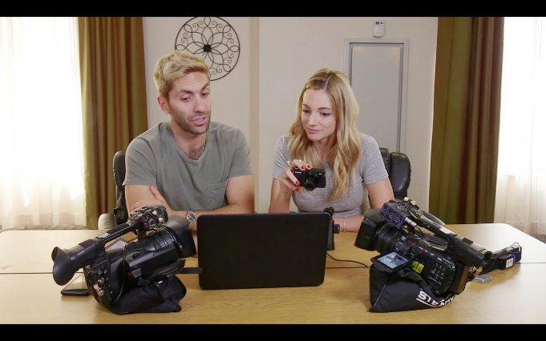
Competence in Mediated Communication:
Be Careful What You Post
Embarrassment
Potential employers
“Sexting”

Slide 34
Competence in Mediated Communication: Respect Privacy Boundaries
Discuss: Masspersonal messages aimed at large audiences are fine to share.
Others may be uncomfortable with their lives/personal details shared.
How do you gauge the difference, even if the share is well-intentioned?

Slide 35
Competence in Mediated Communication: Respect Privacy Boundaries
Discuss: Describe two specific masspersonal messages that you’ve seen that yielded unexpected results on social media.

Slide 36
Competence in Mediated Communication:
Keep Your Tone Civil
Discuss: Scroll through your messages
and ask yourself:
“Would I deliver the same message in person?”
Do you see messages with a clear answer of “No”?

Slide 37
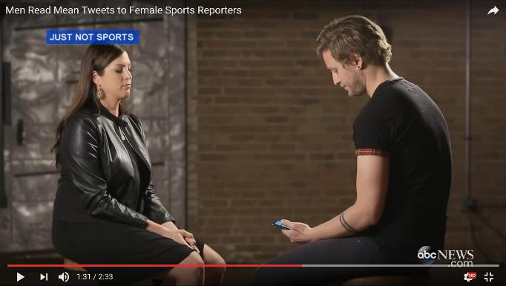
Competence in Mediated Communication:
Keep Your Tone Civil
Women in Sports Face Harassment
Notes:
Discuss the video: Women in Sports Face Harassment(https://www.youtube.com/watch?v=OINa46HeWg8) and the role of civility and disinhibition in mediated communication. Why do you believe people don’t consider the consequences of their “flaming” online?

Slide 38
Competence in Mediated Communication:
Consider Communicators & Environment
Consider the receiver’s preferences: use multimodality.
Respect others’ need of undivided attention.
Be mindful of bystanders.
Balance mediated and face time.

Slide 39
Competence in Mediated Communication:
Consider Communicators & Environment
Discuss: How “multimodal” are you?
If you are resistant, why?

Slide 40
Competence in Mediated Communication:
Consider Communicators & Environment
Discuss: Why is it so hard to say, “Put away that phone and talk to me!”
Why do people want to be together only to divide their attention?

Slide 41
Review of Learning Objectives
L.O. 2.1 What are the benefits and drawbacks of mediated communication?
L.O. 2.2 How can we distinguish between mediated interpersonal and masspersonal communication, and use each appropriately?
L.O. 2.3 How would you apply principles of competence to your mediated interpersonal and mass personal communication?

Slide 42
Interplay – IM Activities
by Adler, Rosenfeld, and Proctor II

Slide 43
Activity #1: “Help Scott”
Watch & Discuss: What’s On Your Mind?
Analyze how Scott used mediated communication to share about his life.
Determine how Scott could have used more competent communication in his social media use (or if mediated communication was the right channel).
Share strategies with the class-at-large to determine “best practices.”

Slide 44
Activity #1: “Help Scott”
Post-Activity Discussion:
Describe risks of Scott’s online behavior, both personally and professionally.
Discuss whether Scott’s use of mediated communication was the “right” channel for him, personally and professionally.

Slide 45
Activity #2: “Texts With My Ex”
Watch & Discuss: Seven Millennials Read The Last Text Messages From Their Exes
Discuss the benefits versus synchronous versus asynchronous communication in these situations;
Discuss the nature of lean and rich messages in the exchanges. Which ones might have benefitted from a “richer” exchange?

Slide 46
Activity #2: “Texts With My Ex”
Post-Activity Discussion
What are some considerations about synchronicity when ending a friendship or a relationship, or when dealing with a conflict? Draw from the chapter and your own experience.
Why do you perceive that people use lean messages in situations when richer messages are needed—even though the message may come across in an unintentional way, may create long-term damage, and may cause the exchange to last longer than necessary?

Slide 47
Activity #3: “Quit Social Media”
Watch & Discuss:
Quit Social Media – Dr. Cal Newport
Connected But Alone - Dr. Sherry Turkle
What are points/counterpoints to each “argument” about social media?

Slide 48
Activity #3: “Quit Social Media”
  Homework:
  Select one form of mediated communication to temporarily stop using.
  Replace mediated communication with richer channels i.e., in-person, Skype/Zoom/FaceTime, etc.
  Keep a diary that describes their emotions over those days, their interactions with others, and any lasting changes they would make after the experiment.

Slide 49
Activity #3: “Quit Social Media”
Post-Homework Discussion
What are key takeaways from your diaries?
What do you think about the original the points/counterpoints derived from Dr. Cal Newport and Dr. Sherry Turkle’s TED Talks? Do you still hold the same perspectives?

Slide 50
Activity #4: “About Those Bubbles”
Describe emotions generated from seeing bubbles, and then nothing, or from texts/messages that don’t receive a response.
Consider the role of cognitive complexity and “other orientation.” What are some alternative perspectives we can take instead of the often negative reaction?

