Slide 1
Imagining Sociology An Introduction with Readings, Third Edition
by Catherine Corrigall-Brown

Slide 2
3

Slide 3
2

Slide 4
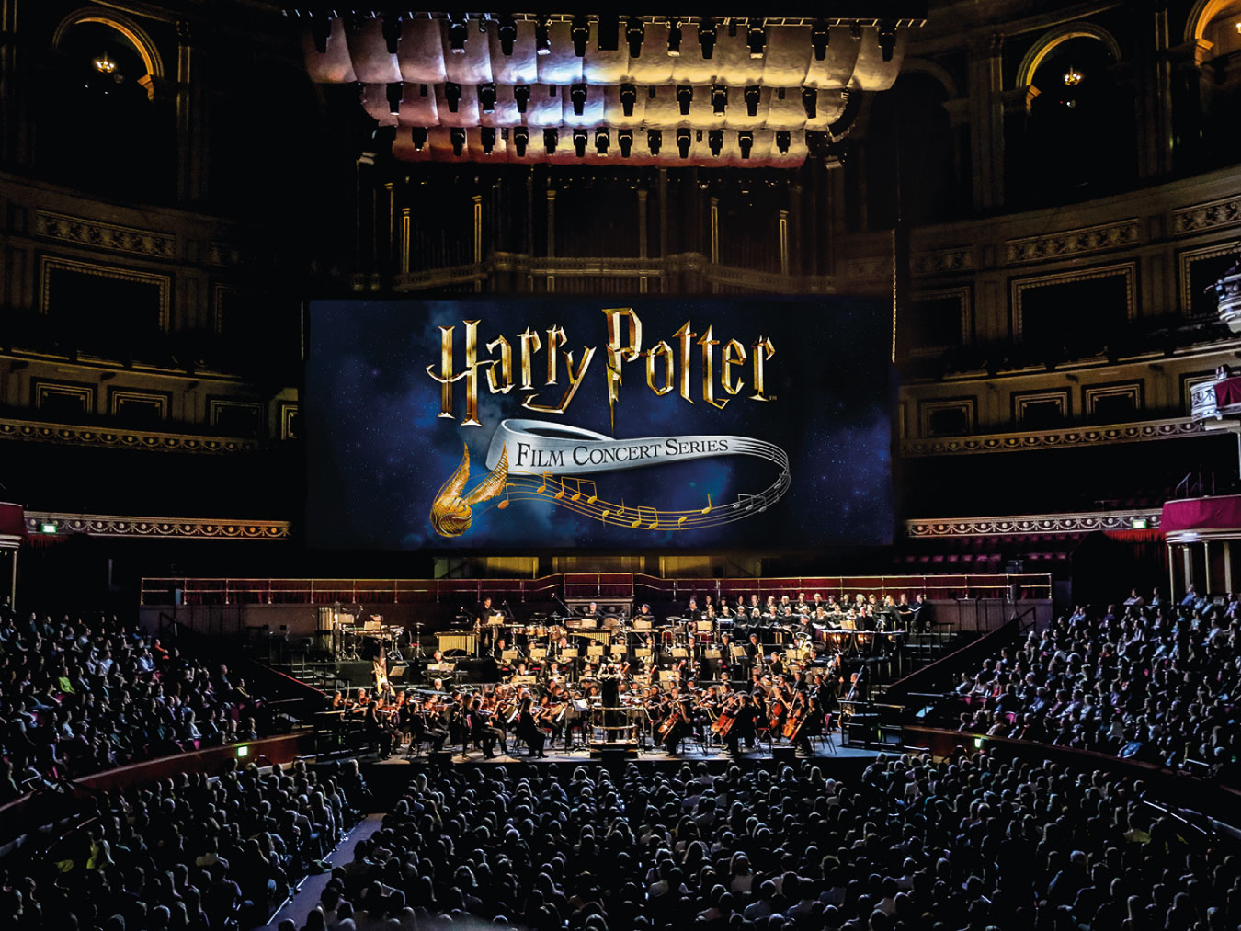
PHOTO 1.1 The Harry Potter in Concert series is an example of the merging of high and popular culture.
Notes:
PHOTO 1.1 The Harry Potter in Concert series is an example of the merging of high and popular culture.

Slide 5
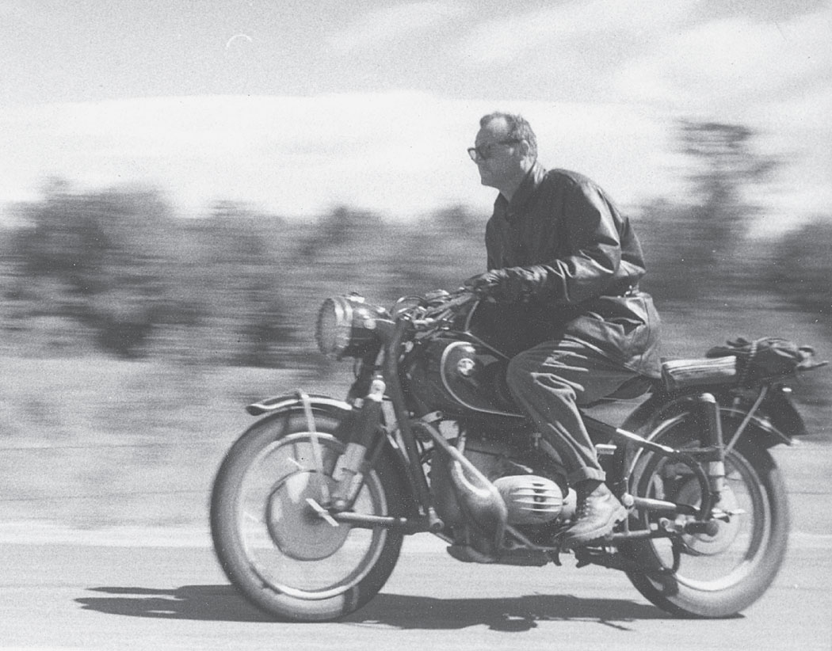
PHOTO 1.2 C. Wright Mills, the author of The Sociological Imagination, is pictured here on his motorcycle.
Notes:
PHOTO 1.2 C. Wright Mills, the author of The Sociological Imagination, is pictured here on his motorcycle. Using the sociological imagination, we can see how society as a whole can shape our individual experiences and how our own personal biographies are related to larger historical processes.

Slide 6
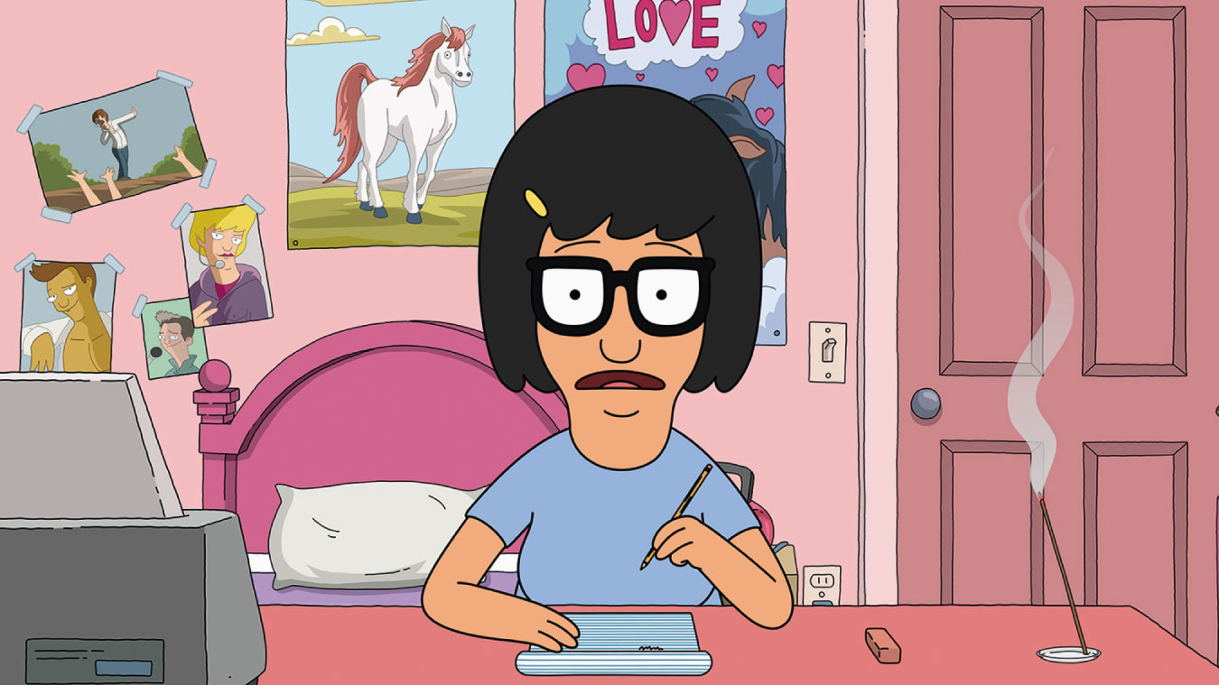
6
Notes:
Socially “awkward” behaviours can inspire sociologists to ask what we consider “normal” or “acceptable” behaviours. Tina Belcher, from Bob’s Burgers, often engages in unusual behaviour, which lead to humorous incidents on the show. What are some of the unspoken social rules that you must follow in your life as a student to appear normal?

Slide 7
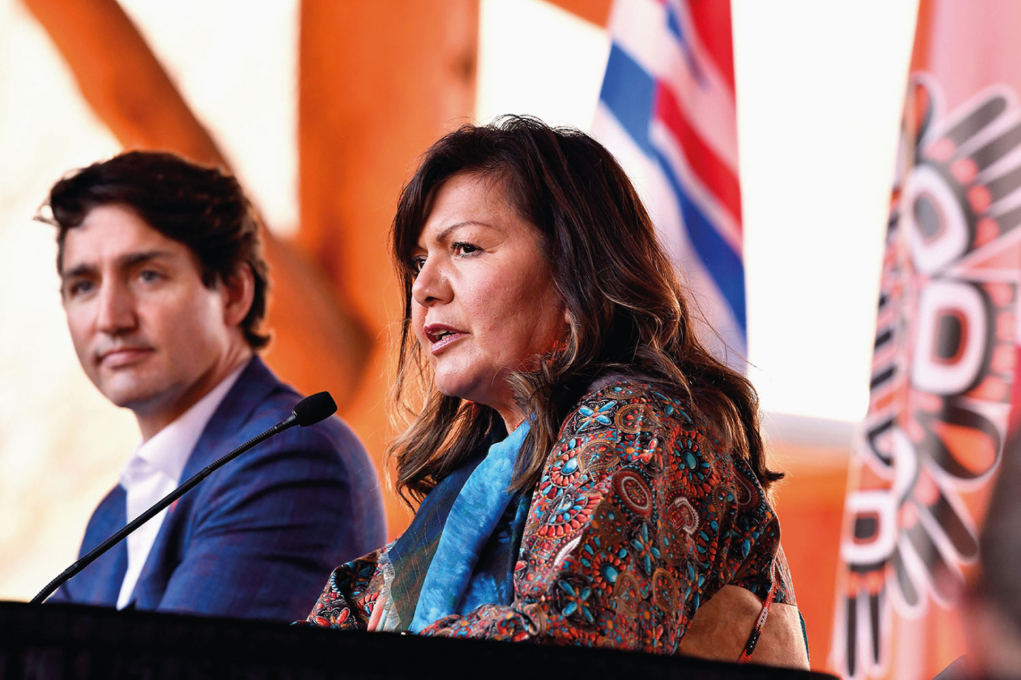
PHOTO 1.3 Prime Minister Justin Trudeau meets with Tk’emlúps te Secwépemc Kukpi7 (chief) Rosanne Casimir.
Notes:
PHOTO 1.3 Prime Minister Justin Trudeau meets with Tk’emlúps te Secwépemc Kukpi7 (chief) Rosanne Casimir. This meeting between one governing leader and another highlights the complexity and multifaceted nature of institutions such as governments.

Slide 8
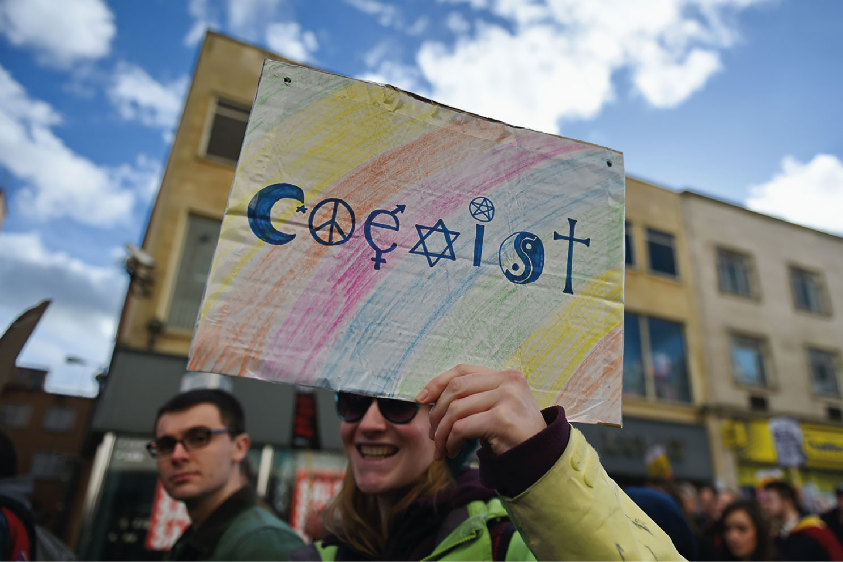
PHOTO 1.4 The Coexist image shows a more inclusive way of thinking about religion in the modern age, highlighting how people from different religions, and those who are not religious, can share values and live together peacefully. Clearly, this message is important, but is it convincing and effective?
Notes:
PHOTO 1.4 The Coexist image shows a more inclusive way of thinking about religion in the modern
age, highlighting how people from different religions, and those who are not religious, can share values and live together peacefully. Clearly, this message is important, but is it convincing and effective?

Slide 9
9
Notes:
Who is in this classroom and who is not? To what extent does this photo depict the ethnic, class, and gender makeup of your class?

Slide 10
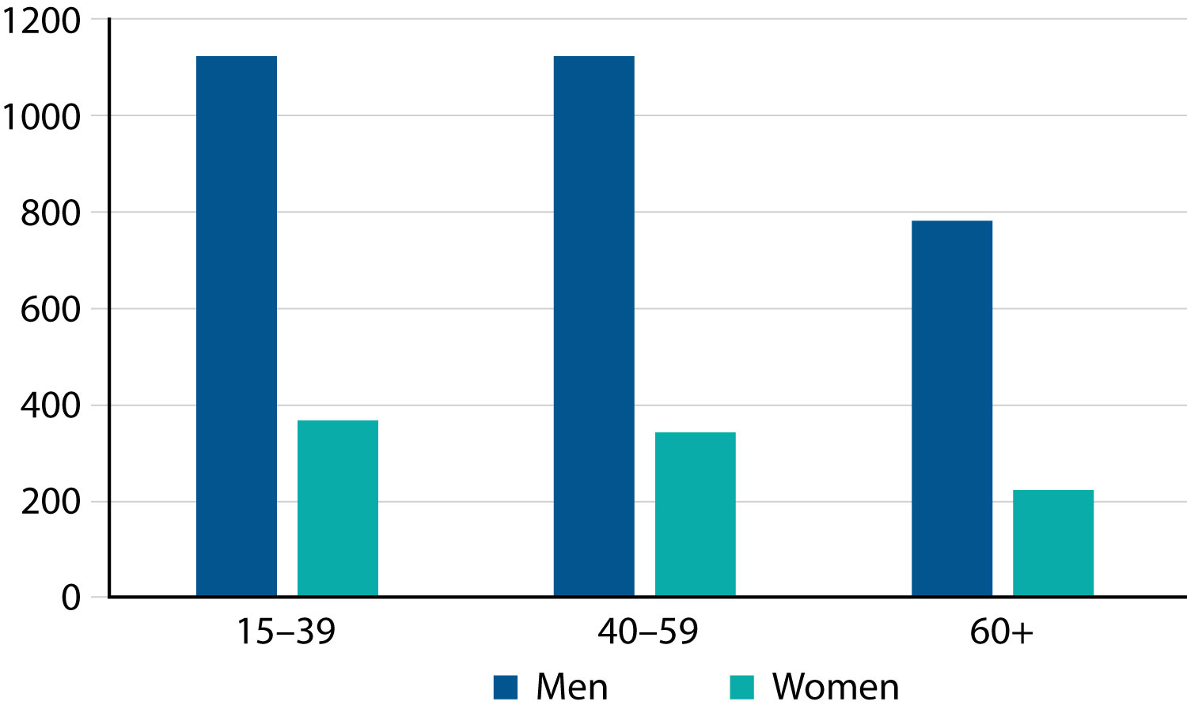
Number of Suicides in Canada, 2019
Notes:
Number of Suicides in Canada, 2019
Source: Based on Centre for Suicide Prevention, “Suicide Stats for Canada, Provinces and Territories.” https://www.suicideinfo.ca/resource/suicide-stats-canada-provinces/

Slide 11
11
Notes:
According to the homophily principle, friends and romantic partners tend to have similar interests and to come from similar backgrounds. This group of friends at a music festival shares an interest in music and fashion and probably comes from similar ethnic and class backgrounds. What similarities and dissimilarities can you find between you and your friends?

