Slide 1
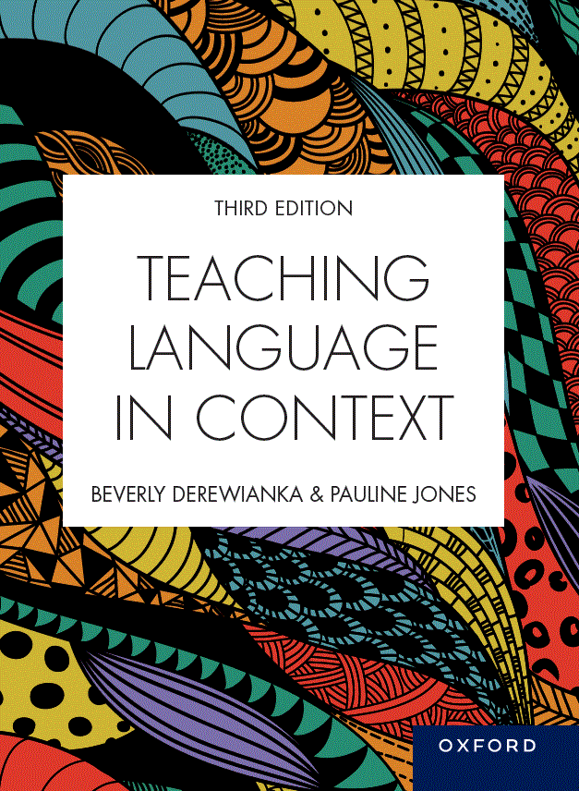
Image Bank
Teaching Language in Context, third edition
Beverly Derewianka and Pauline Jones
Chapter 1
COPYRIGHT NOTICE
This image bank is copyright protected. Contact Oxford University Press. It is intended for use only by lecturers prescribing Teaching Language in Context, third edition, in their courses and should not be distributed or copied for any other purpose or for use with any other text.

Slide 2
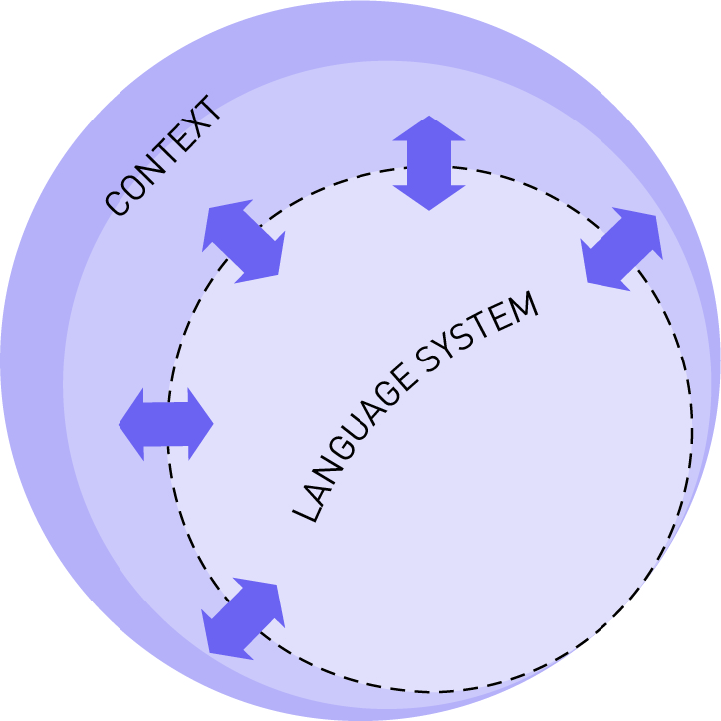
FIGURE 1.1 The language system in a dynamic relationship with the context

