Slide 1
WORLD IN THE MAKING A Global History
by Bonnie G. Smith, Marc Van De Mieroop, Richard von Glahn and Kris Lane

Slide 2
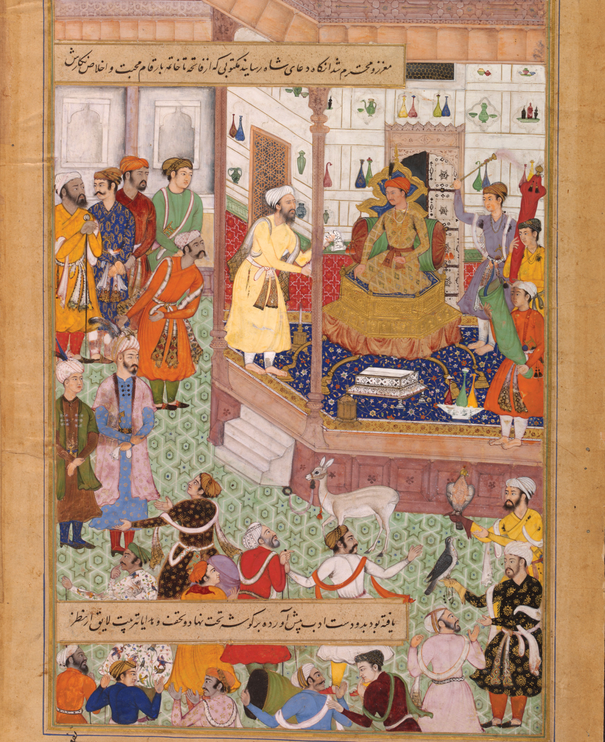
1

Slide 3
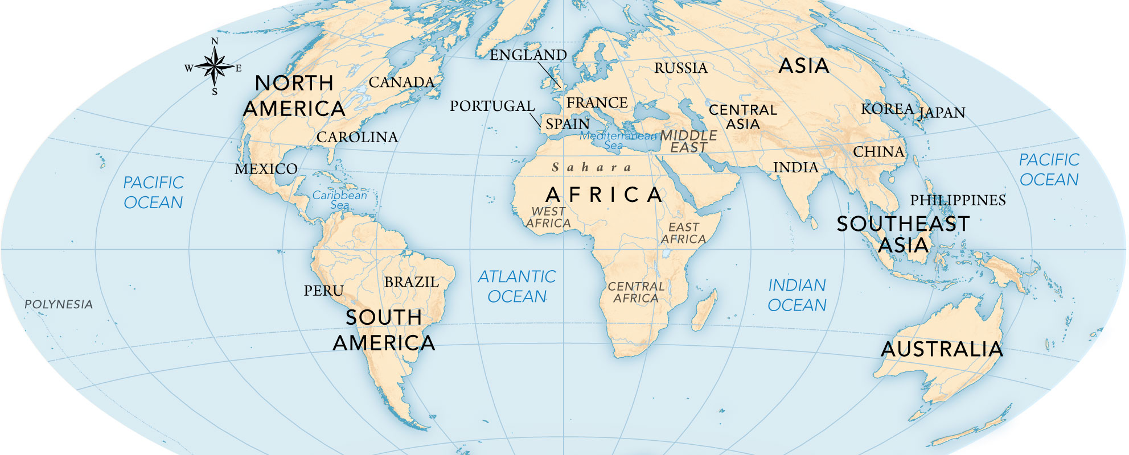
3

Slide 4
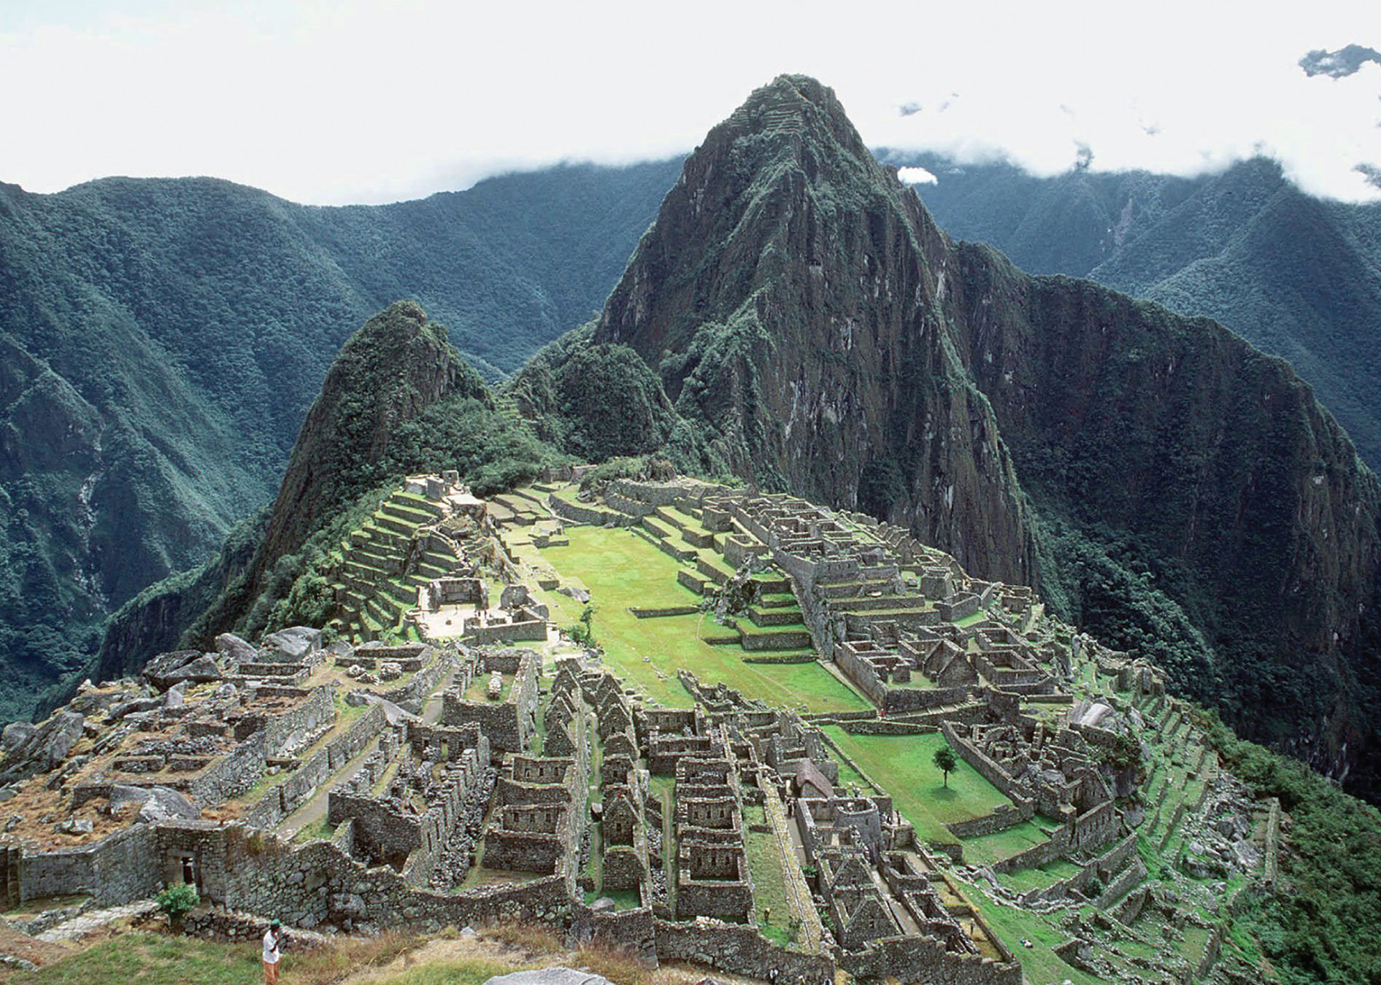
World in the Making
Notes:
World in the Making Perched on a granite ridge high above Peru’s Urubamba River, the Inca site of Machu Picchu continues to draw thousands of visitors each year. First thought to be the lost city of Vilcabamba, then a convent for Inca nuns, Machu Picchu is now believed to have been a mid-fifteenth-century palace built for the Inca emperor and his mummy cult. It was probably more a religious site than a place of rest and recreation.

Slide 5
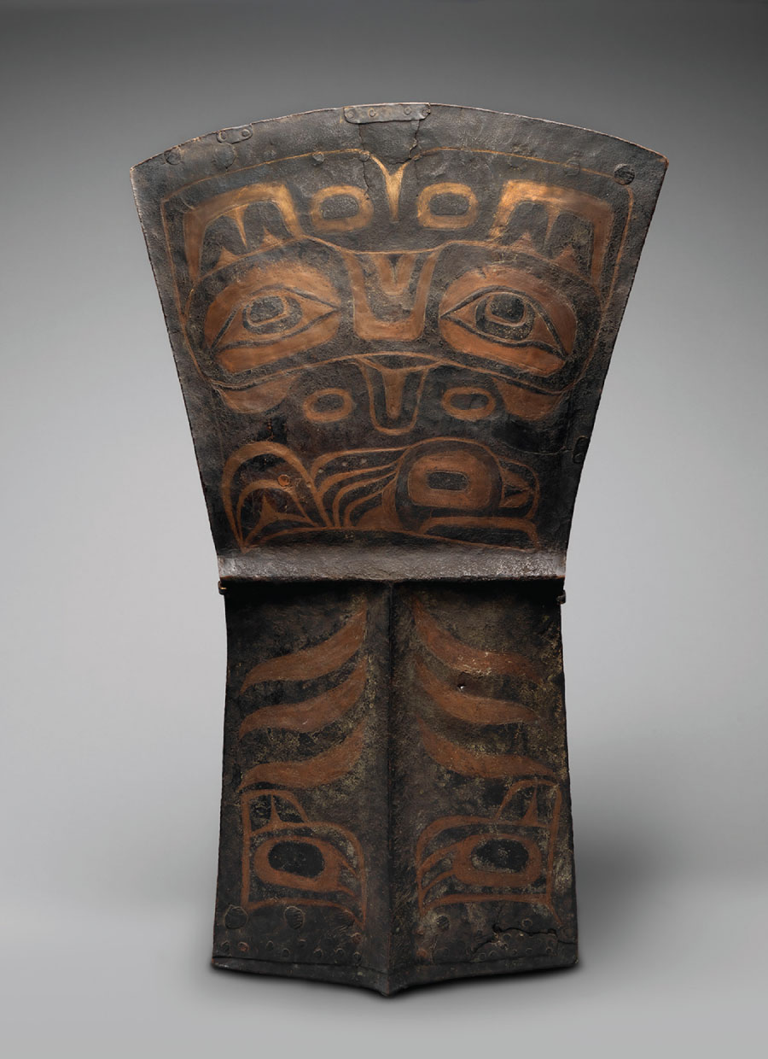
Tlingit Ceremonial Copper
Notes:
Tlingit Ceremonial Copper Many indigenous nations in North America prized copper as a trade good and prestige item. Much of the metal originated in Upper Michigan, home of the world’s largest native (unalloyed) copper deposits. Copper sources were also found in the Pacific Northwest, however, and this decorated copper “shield” was a symbol of chiefly wealth among the Tlingit of Alaska’s Pacific coast. Along with other valuable items such as blankets and skins, “coppers” were exchanged at potlatch feasts, which dumbfounded outsiders for their extreme generosity. The copper’s upper design element identifies its owner’s lineage and the T-shaped ridges below represent ancestral vertebrae.

Slide 6
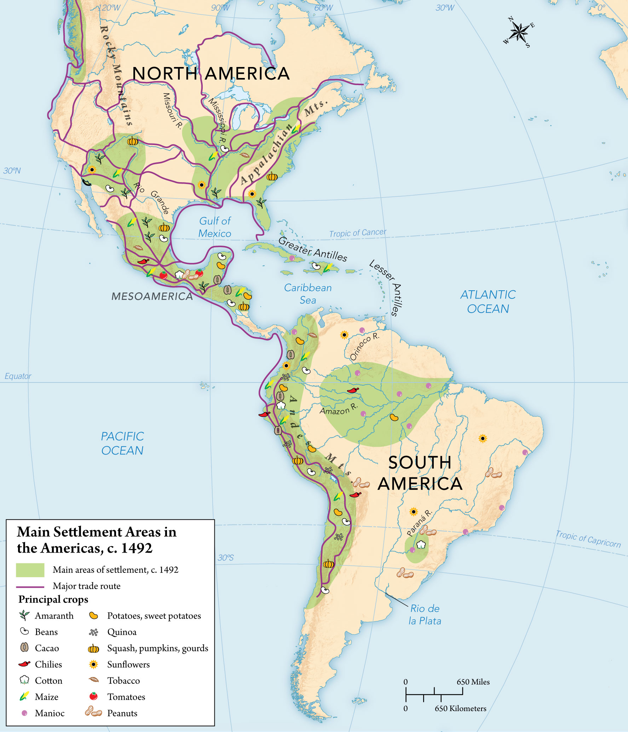
MAP 15.1 Main Settlement Areas in the Americas, c. 1492
Notes:
MAP 15.1 Main Settlement Areas in the Americas, c. 1492 Most native Americans settled in regions that supported intensive agriculture. The trade routes shown here linked peoples from very different cultures, mostly to exchange rare items such as shells, precious stones, and tropical bird feathers, but seeds for new crops also followed these paths.

Slide 7
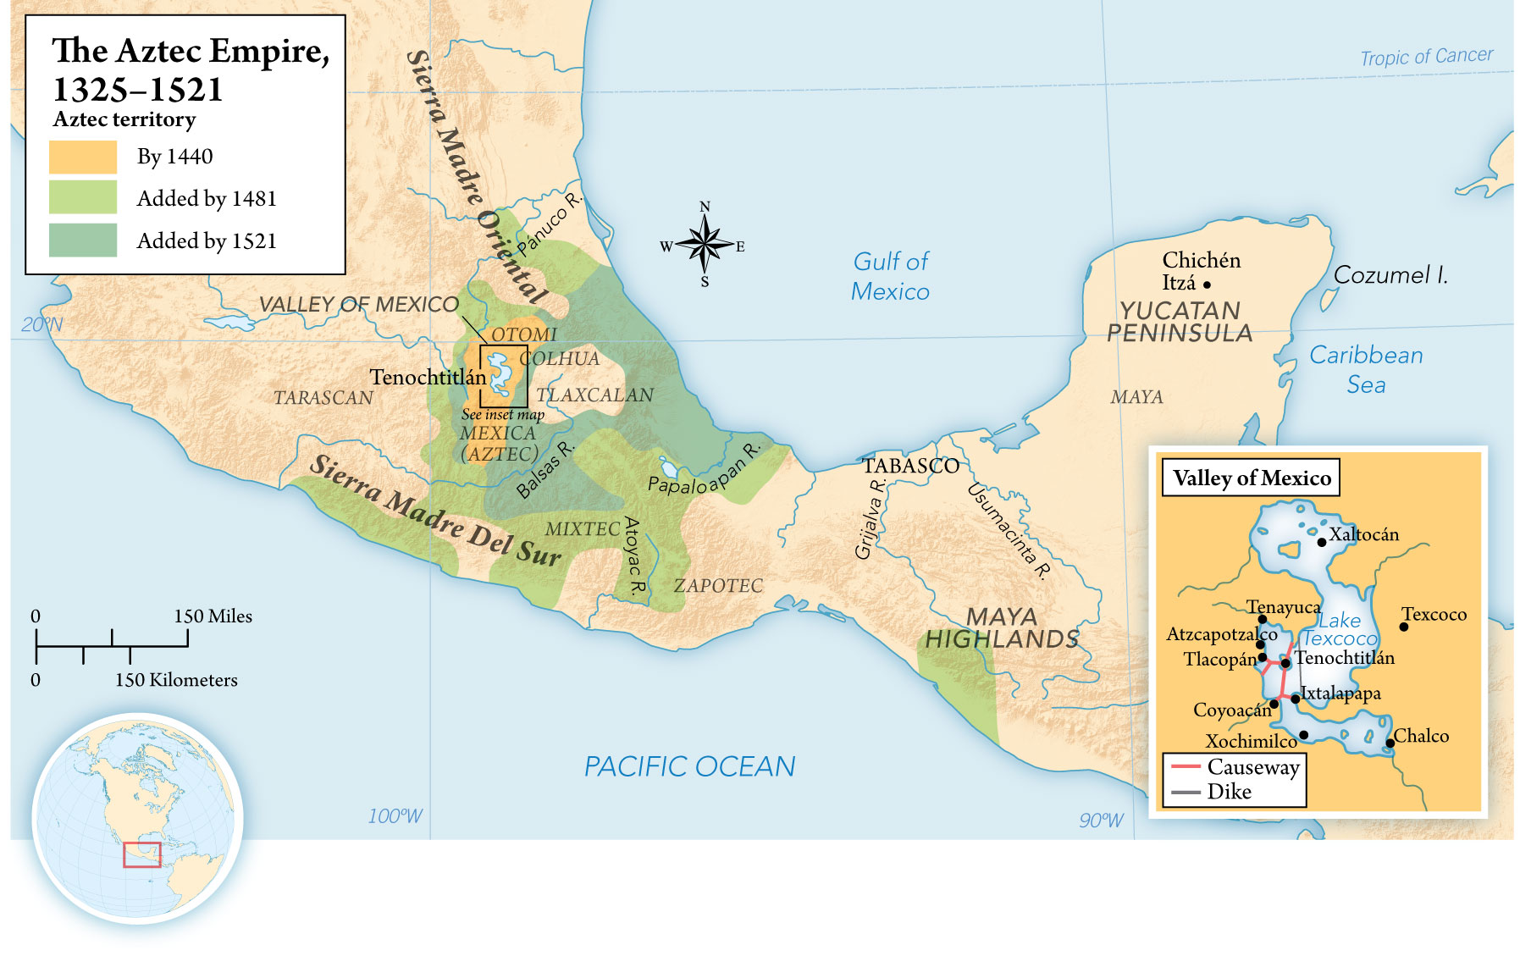
MAP 15.2 The Aztec Empire, 1325–1521
Notes:
MAP 15.2 The Aztec Empire, 1325–1521 Starting from their base in Tenochtitlán (now Mexico City), the Aztecs quickly built the most densely populated empire in the Americas. Their first objective was the Valley of Mexico itself. Although a line of kings greatly extended the empire, not all peoples fell to the Aztec war machine, including the Tlaxcalans to the east of Tenochtitlán and the Tarascans to the west. Also unconquered were the many nomadic peoples of the desert north and the farming forest peoples of the southeast.

Slide 8
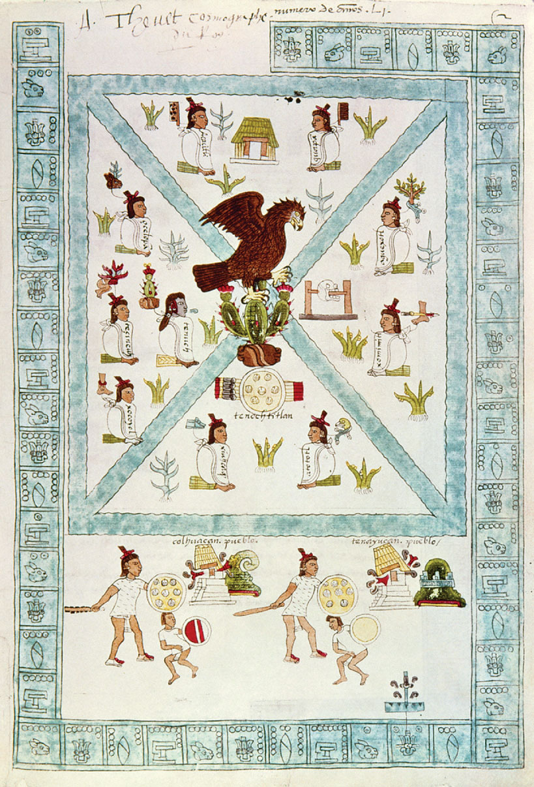
Tenochtitlán, from the Codex Mendoza (Granger)
Notes:
Tenochtitlán, from the Codex Mendoza (Granger)

Slide 9
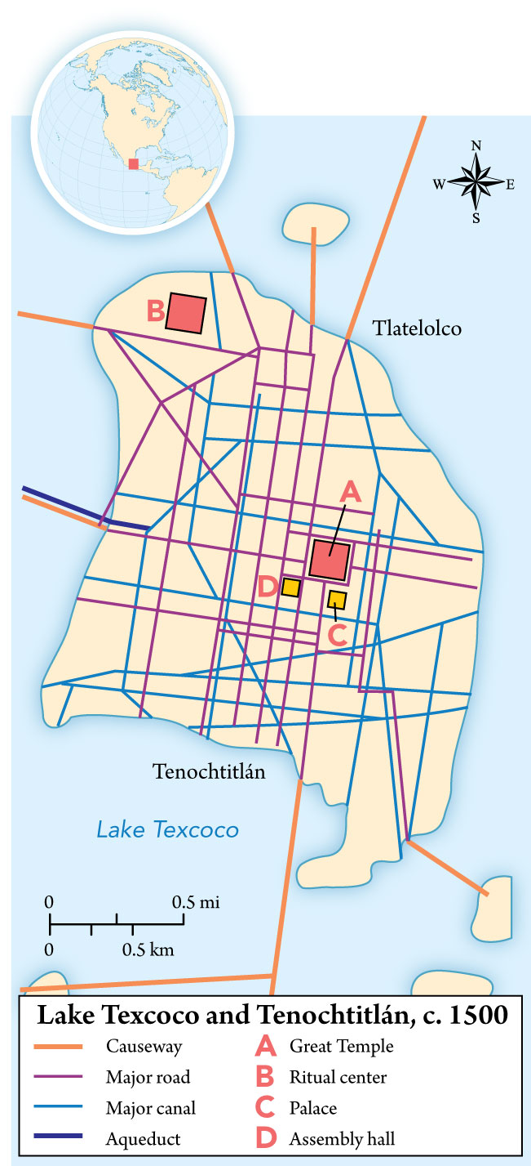
Lake Texcoco and Tenochtitlán, c. 1500
Notes:
Lake Texcoco and Tenochtitlán, c. 1500

Slide 10
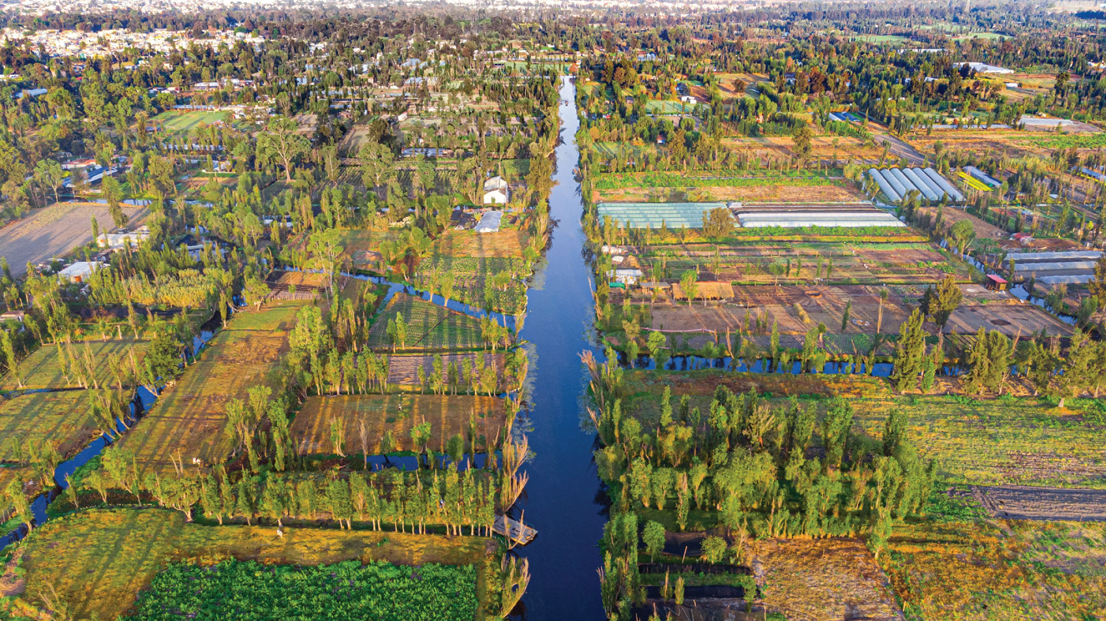
Aztec Chinampa
Notes:
Aztec Chinampa The Aztec capital of Tenochtitlán was one of several cities occupying the huge basin of the Lake of Mexico, a complex tropical environment located at roughly 7,000 feet above sea level. The Aztecs and their subjects learned to efficiently farm lake margins by way of so-called floating gardens, or chinampas. The chinampa, as diagrammed here, took advantage of lake water, compost, and interwoven reeds to maximize crop yields, resist winter frosts, and produce food year-round. Canals allowed passage of large dugout canoes loaded with produce, wood, rocks, and soil.

Slide 11
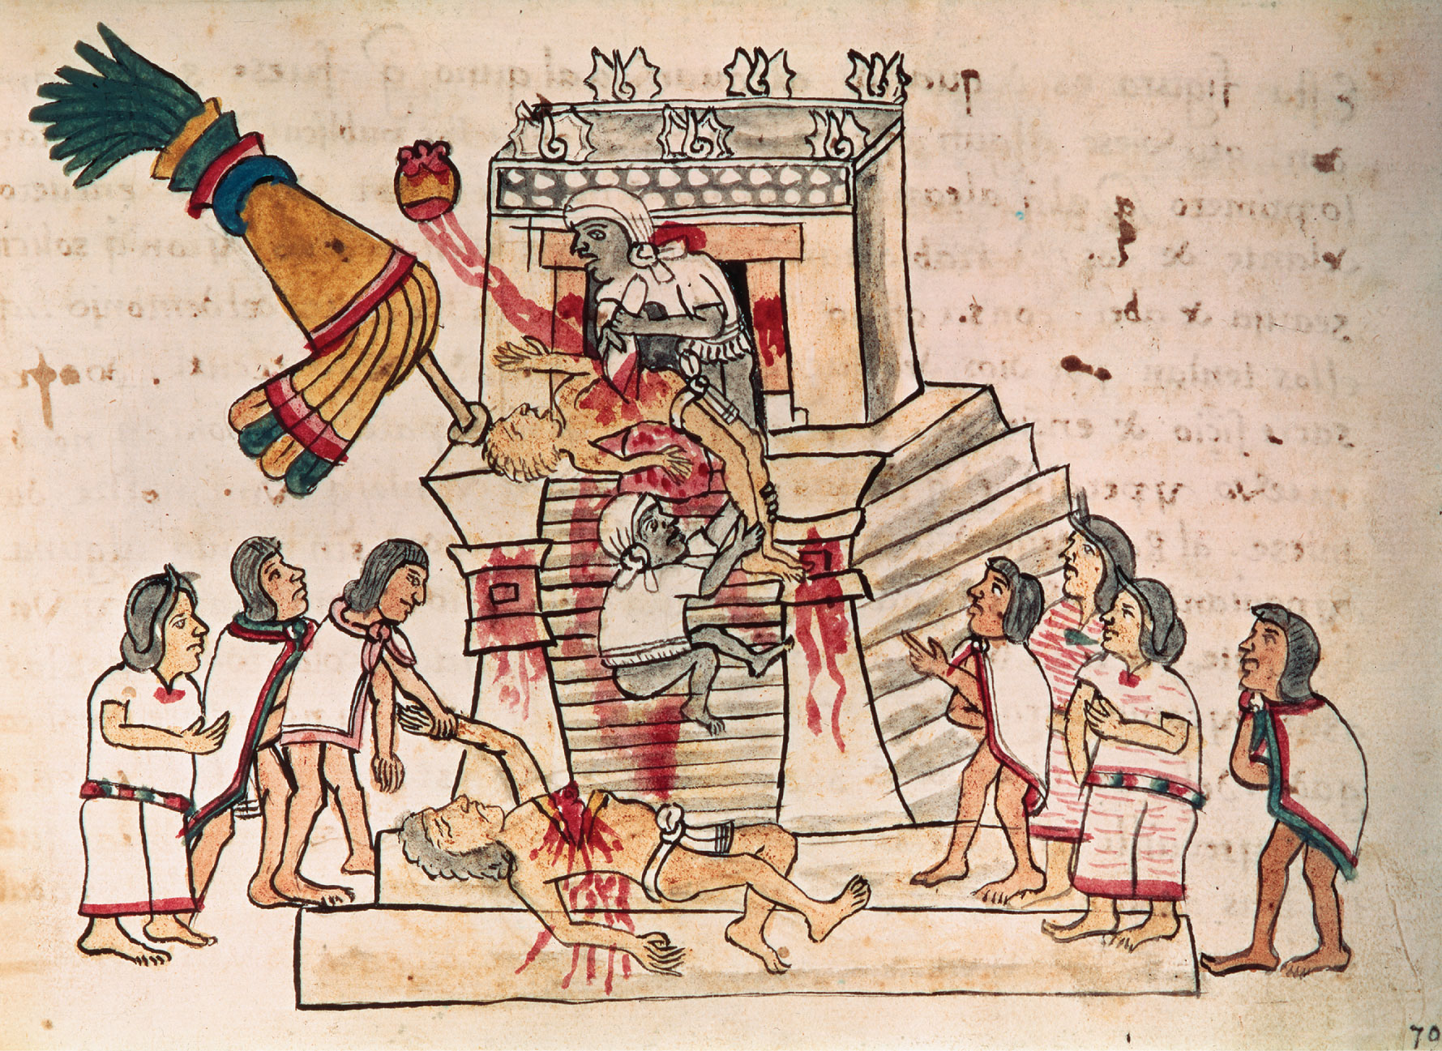
Aztec Human Sacrifice
Notes:
Aztec Human Sacrifice This image dates from just after the Spanish Conquest of Mexico, but it was part of a codex about Aztec religious practices and symbols. Here a priest is removing the beating heart of a captive with a flint knife as an assistant holds his feet. The captive’s bloody heart, in the form of a cactus fruit, ascends, presumably to the gods (see the same icon in Seeing the Past: An Aztec Map of Tenochtitlán, page 559). At the base of the sacrificial pyramid lies an earlier victim, apparently being taken away by noble Aztec men and women responsible for the handling of the corpse.

Slide 12
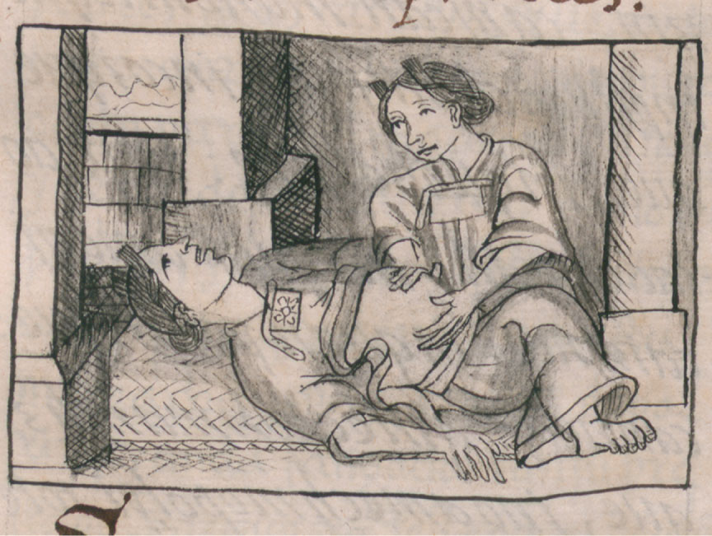
Aztec Midwife
Notes:
Aztec Midwife This image accompanies a description in Nahuatl, the Aztec language, of the midwife’s duties written soon after the Spanish Conquest. (Firenze, Biblioteca Medicea Laurenziana, Ms. Med. Palat. 219, f. 132v. Su concessione del MiBACT)

Slide 13
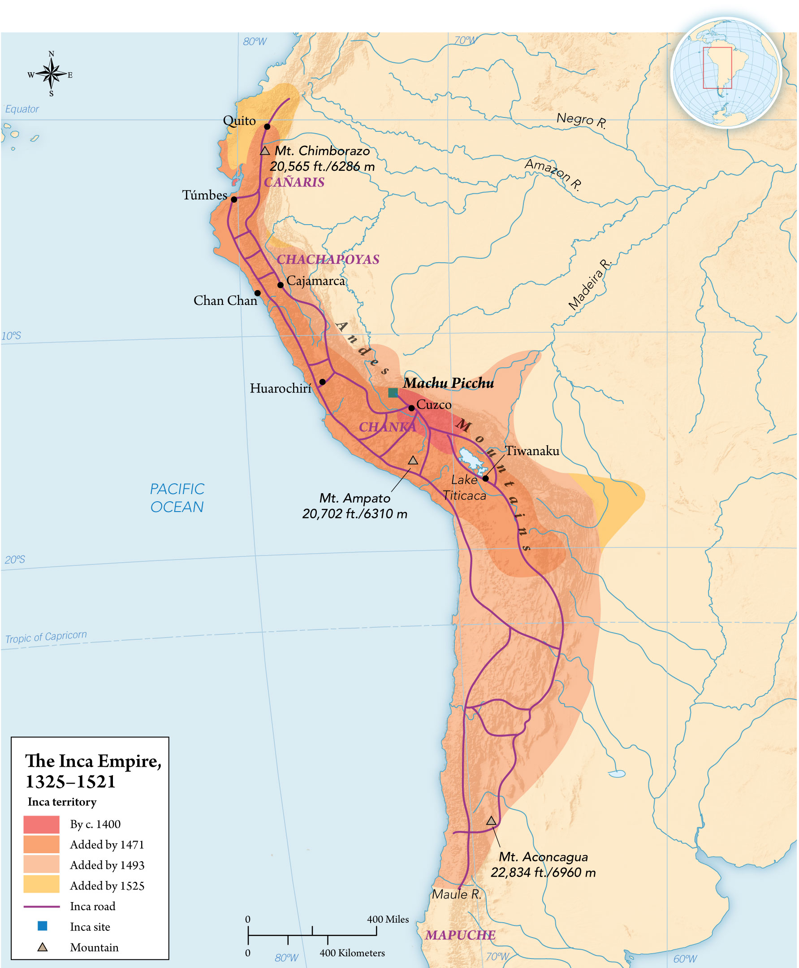
MAP 15.3 The Inca Empire, 1325–1521
Notes:
MAP 15.3 The Inca Empire, 1325–1521 Starting from their base in Cuzco, high in the Andes, the Incas built the most extensive empire in the Americas, and the second most populous after that of the Aztecs. They linked it by a road system that rivaled that of the ancient Romans. Some groups, such as the Cañaris and Chachapoyas, resisted Inca domination for many years, and the Mapuche of Chile were never conquered.

Slide 14
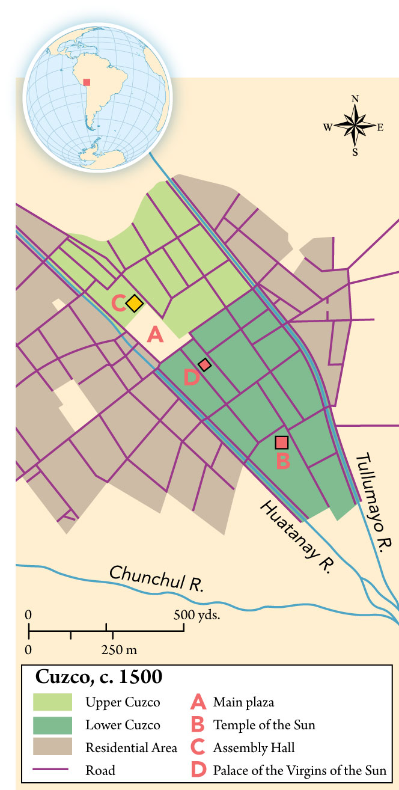
Cuzco, c. 1500
Notes:
Cuzco, c. 1500

Slide 15
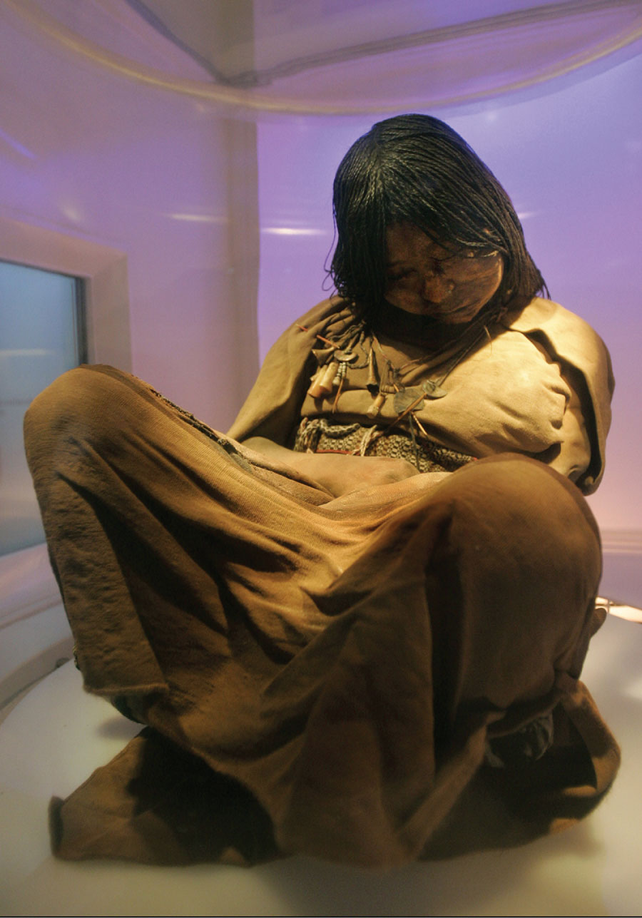
Inca Mummy
Notes:
Inca Mummy The Incas did not sacrifice humans as often as the Aztecs did, but headmen in newly conquered regions were sometimes required to give up young sons or daughters for live burial on high mountains. Such sacrifices were known as capacocha, or “debt payment.” The victims, including this adolescent girl found in a shallow tomb atop 20,000-foot Mount Lullaillaco in the Argentine Andes, died of exposure after the long climb, but the Incas believed them to remain semiconscious and in communication with the spirit world.

Slide 16
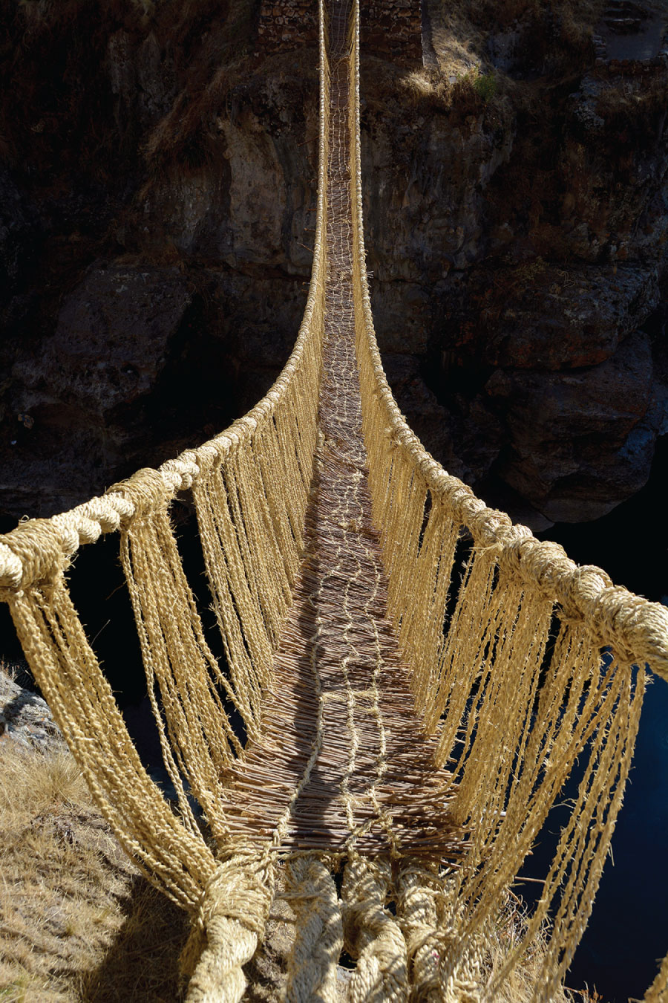
Inca Hanging Bridge
Notes:
Inca Hanging Bridge Among the great challenges facing the Incas as they expanded their empire across the rugged Andes Mountains of South America were deep canyons cut by swift rivers. Drawing on ancestral techniques, the Incas spanned these chasms with braided-grass bridges of remarkable strength and durability. Such bridges, carefully maintained, allowed passage of heavily burdened people as well as llama trains, linking up a road system that spanned tens of thousands of kilometers. These Indigenous bridgebuilding technologies survived throughout the colonial period in Peru and Ecuador, supplemented by Spanish pulleys and straps for transporting large livestock. In some places, old-style hanging footbridges survived well into the twentieth century.

Slide 17
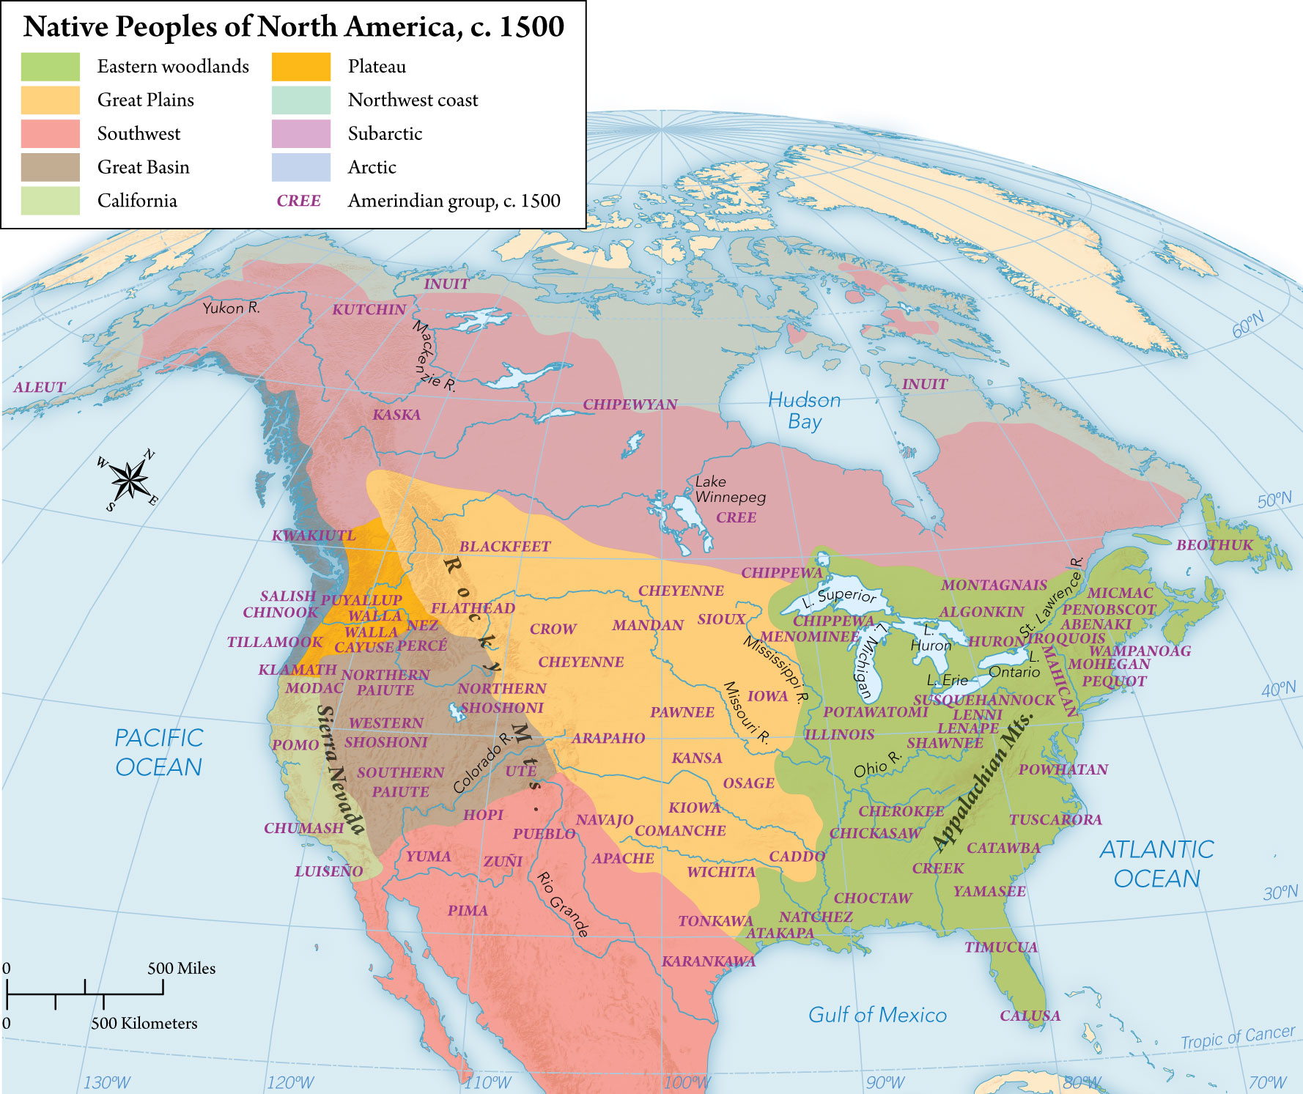
MAP 15.4 Native Peoples of North America, c. 1500
Notes:
MAP 15.4 Native Peoples of North America, c. 1500 To the north of Mesoamerica, hundreds of native American groups, most of them organized as chiefdoms, flourished in a wide array of climate zones, from the coldest Arctic wilderness to the hottest subtropical deserts. Populations were highest where maize and other crops could be grown, as in the Rio Grande and Mississippi Valleys, Great Lakes, and eastern woodlands regions.

Slide 18
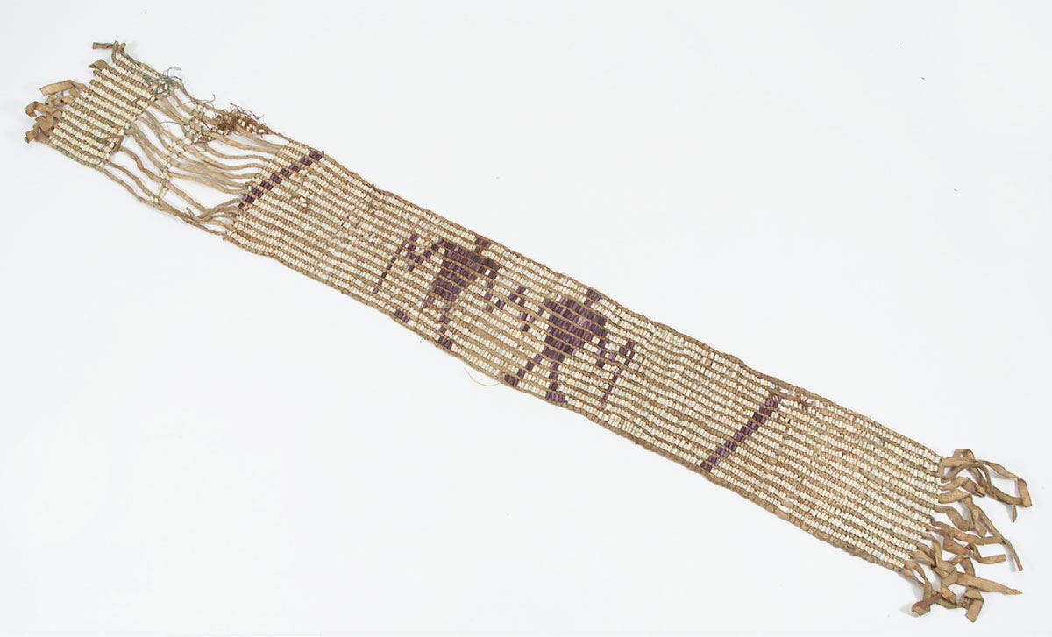
Huron Wampum Belt
Notes:
Huron Wampum Belt For many Eastern Woodlands peoples such as the Huron, seashells like the New England quahog (a variety of clam) were sacred trade goods. Shell beads, or wampum, were woven into ceremonial belts whose geometrical designs and color schemes represented clans and sometimes treaties between larger groups. The linked-hands motif in this belt suggests a treaty or covenant.

