Slide 1
Critical Concepts: An Introduction to Politics
by Brodie, Rein, and Smith
Cover Image Unavailable

Slide 2
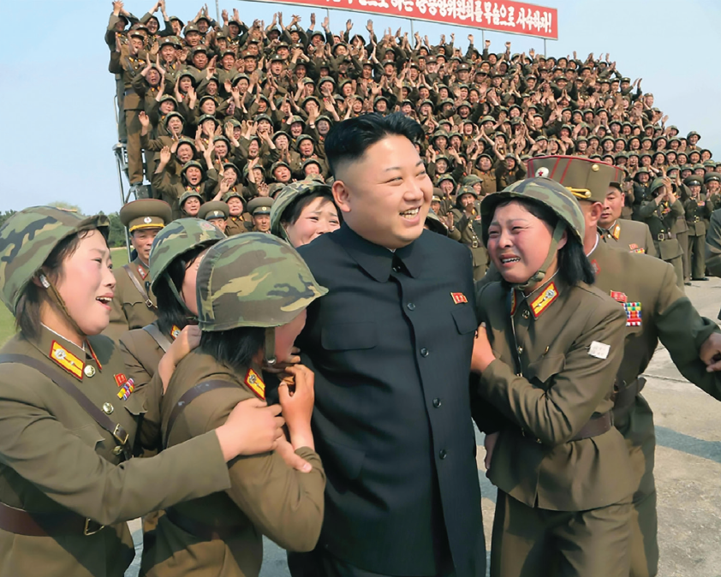
[Image 1.1] North Korea is an example of a totalitarian state that prohibits political opposition, controls the daily lives of its citizens, and demands complete obedience to its “Great Leader” Kim Jong-un Source: Pictorial Press Ltd / Alamy Stock Photo
DRAFT
DRAFT
DRAFT

Slide 3
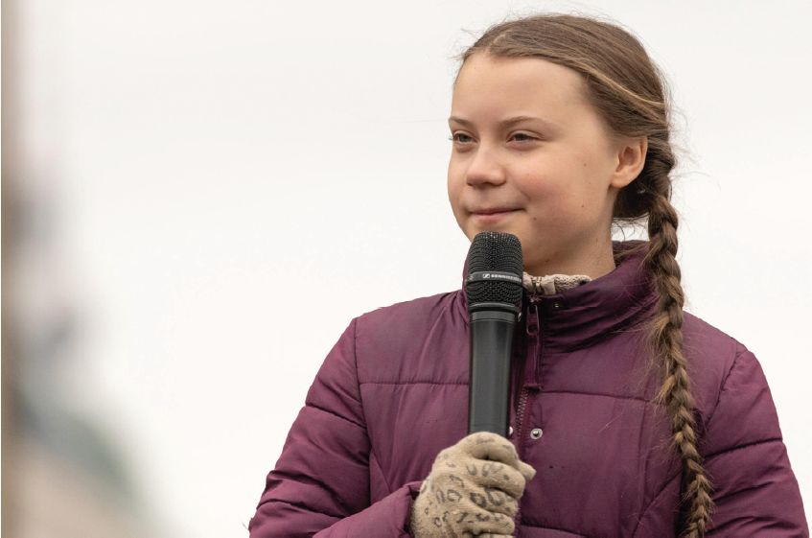
[Image 1.2] Greta Thunberg speaks at a Fridays for Future demonstration in Berlin, demanding action for climate change. Source: Panther Media GmbH / Alamy Stock Photo
DRAFT
DRAFT
DRAFT

Slide 4
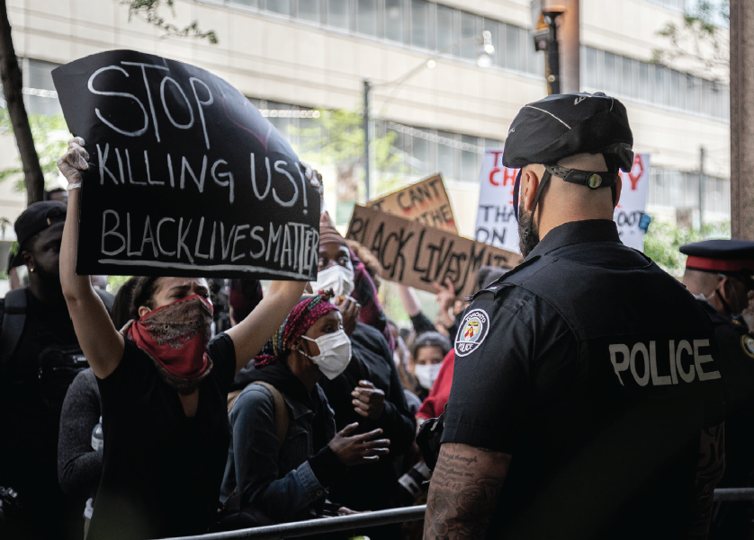
[Image 1.3] A Black Lives Matter protest in Toronto, Ontario. Source: NixZ/Shutterstock
DRAFT
DRAFT
DRAFT

Slide 5
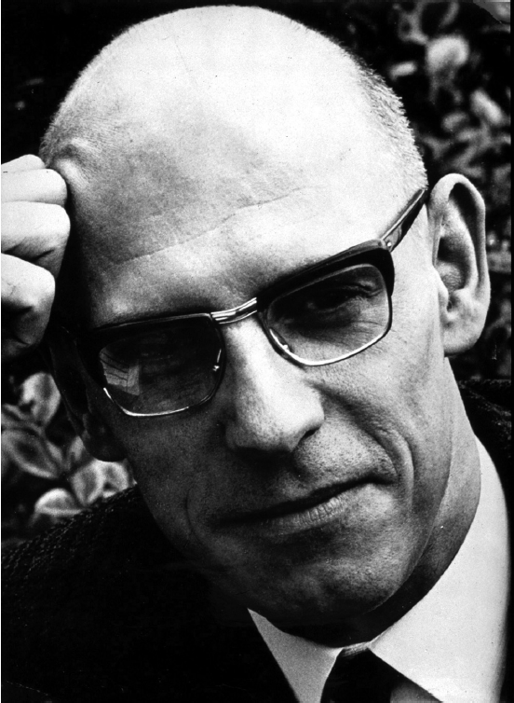
[Image 1.4] French philosopher and social theorist Michel Foucault. Source: INTERFOTO / Alamy Stock Photo
DRAFT
DRAFT
DRAFT

Slide 6
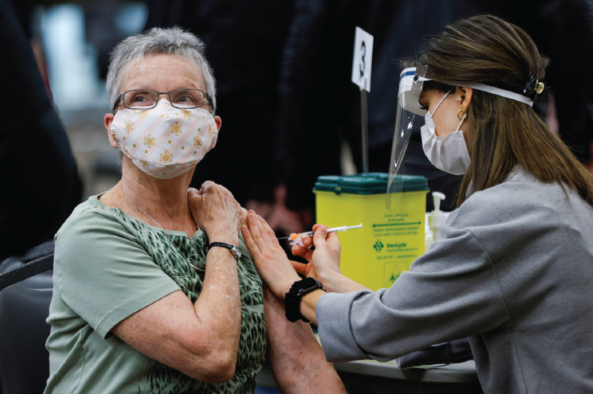
[Image 1.5] A woman receives a vaccine at a clinic in Ottawa, Ontario. Source: REUTERS / Alamy Stock Photo
DRAFT
DRAFT
DRAFT

