Slide 1
Critical Concepts: An Introduction to Politics
by Brodie, Rein, and Smith
Cover Image Unavailable

Slide 2
Chapter 1 Learning Objectives
1.1 Introduce the ideas of concepts, conceptualization, and critical concepts.
1.2 Outline the differences among three different perspectives on power: power to, power over, and power/knowledge.
1.3 Situate the concept of crisis within current politics and society and consider how politics might move forward.

Slide 3
Chapter 1: Governing Ideas
“Man” as a political animal
Aristotle in Ancient Greece
Politics as inescapable force in everyone’s lives
Shapes interests, fates, fuels competition and conflict
Concepts
How we view ourselves and our world
From singular to the general
Conceptualization
Exercise in imagination
How we name, group and understand things
Notes:
- Ask the class, what do you think Aristotle meant when he said that man is a political animal?

Slide 4
Politics as Contested
Concepts in everyday life hardwired in our shared language
Embedded in daily experiences
Rarely examined and challenged
In contrast, political concepts are highly contested
Source of struggle over meaning and application
Justice, equality, democracy, representation, freedom, power
Notes:
- Ask the class, what does justice, democracy, power, freedom mean to you? How do our understandings of these terms differ from one person to the next? What are the implications of these differing ideas?

Slide 5
Governance, Politics and Power
Political Science:
focuses on questions related to governance, politics and power

Slide 6
Governance, Politics and Power2
Governance:
How political life is organized
Who decides and for whom
How politics is organized varies across time and space
Empires and city-states to nation-states
Notes:
Provide examples of “governance” (i.e.. institutions like the House of Commons or United Nations; actors such as Prime Minister Trudeau or Members of the US Senate; and processes such as voting, participating in a social movement or tweeting something about politics)
Provide examples of different forms of political organization (empires, city-states, nation-states)

Slide 7
The Nation-State
Nation-State:
Political unit that claims supreme authority (sovereignty) and the legitimate use of force over a defined territory and population
Use of force legitimate to repel internal and external threats
Treaty of Westphalia 1648
Number of states has multiplied
1900: 55 sovereign states
2022: 193 sovereign states

Slide 8
Typologies of the Modern State
Nation-States divided into three broad categories:
Authoritarian Systems
Absolute monarchies to dictatorships
Concentration of power in state
Few constitutional constraints on state power
Use of force and repression
Notes:
What are examples of authoritarian systems? (Saudi-Arabia, Brunei, Kuwait, contemporary China)

Slide 9
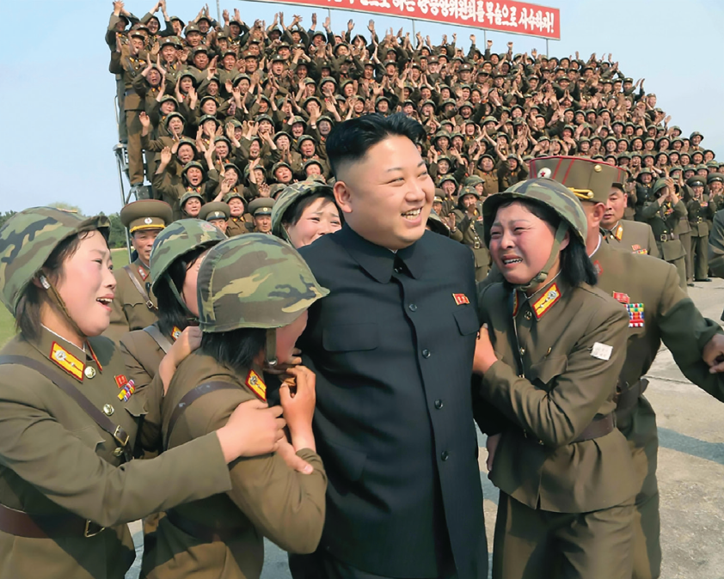
[Image 1.1] North Korea is an example of a totalitarian state that prohibits political opposition, controls the daily lives of its citizens, and demands complete obedience to its “Great Leader” Kim Jong-un Source: Pictorial Press Ltd / Alamy Stock Photo
DRAFT
DRAFT
DRAFT

Slide 10
Typologies of the Modern State2
2. Totalitarian Systems
Extreme authority over all aspects of economic and social life
Use of force and ideological control
Notes:
What are examples of a totalitarian system? (North Korea)

Slide 11
Typologies of the Modern State3
3. Liberal Democracies
Rules-based government
Constitutionalism and the rule of law
Protection of individual freedoms and rights
Guarantees of free and fair elections
Illiberal democracies
The United States under Donald Trump
Notes:
- Examples of a liberal democracy?
- Examples of illiberal democracies? (Russia, Hungary, Turkey, Brazil, the Philippines). Trump was accused of systematically shifting the US from a liberal to an illiberal democracy. Ask the class in what ways Trump did this (trying to get the results of the 2020 presidential election overturned; introducing new electoral laws suppressing voter rights; attacks on Congress; Jan 6 insurrection, etc.)

Slide 12
Politics
Politics:
“Things concerning the polis”
Who gets what, when, how
Processes of collective decision-making
Advancement of individual and group interests
Resolution of conflict
Competition for scare public goods
Unrelenting struggle for power, advantage and dominance
Notes:
- Ask the students, which of these definitions best fits their understanding of politics?

Slide 13
Politics2
Politics as the Master Science
Aristotle
Also the Master’s Science
Exploitation
Colonialism
Inequality
Inequity
Notes:
- Ask the class, why does the author describe politics as not only the master science but also the master’s science?

Slide 14
Power
Power:
Most critical but most elusive concept in Political Science
Eludes a singular definition:
To make someone do what they would otherwise not do
Often invisible and hidden
Deeply embedded in rules, practices, institutions and structures
Not experienced by everyone in same way

Slide 15
Understanding Power
Three Framings of Power:
Power To
Power Over
Power/Knowledge

Slide 16
Power To
Power To
Ability to achieve political ends through individual and collective action
Liberal democracy
Power of the People
Social movements, mass protests, rebellions
Notes:
- Ask class for examples of power to

Slide 17
Power To2
Pluralism:
Mobilization of groups to advance interests
Community organizations, interest groups, advocacy associations
Sees democracy as hive of competing groups representing different issues
But assumes everyone has equal ability to organize and advance their interests
And that political organization can have a meaningful impact
Notes:
Ask class to provide other examples of community/interest/lobby groups
What groups have more access to ‘power to” (to successfully organize to advance their interests) over others?
Does joining a lobby group or participating in a protest really make a difference to those in power?

Slide 18
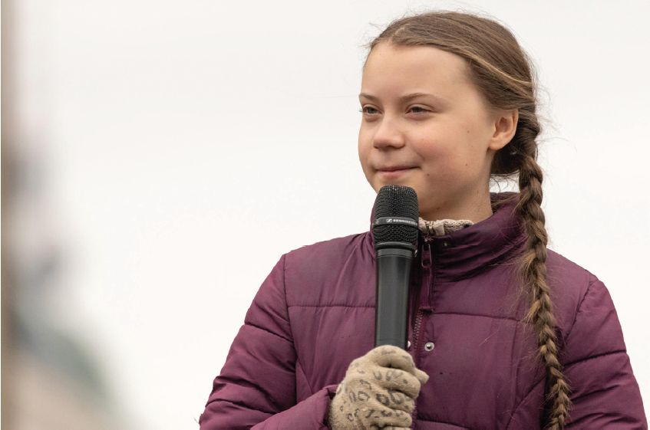
[Image 1.2] Greta Thunberg speaks at a Fridays for Future demonstration in Berlin, demanding action for climate change. Source: Panther Media GmbH / Alamy Stock Photo
DRAFT
DRAFT
DRAFT

Slide 19
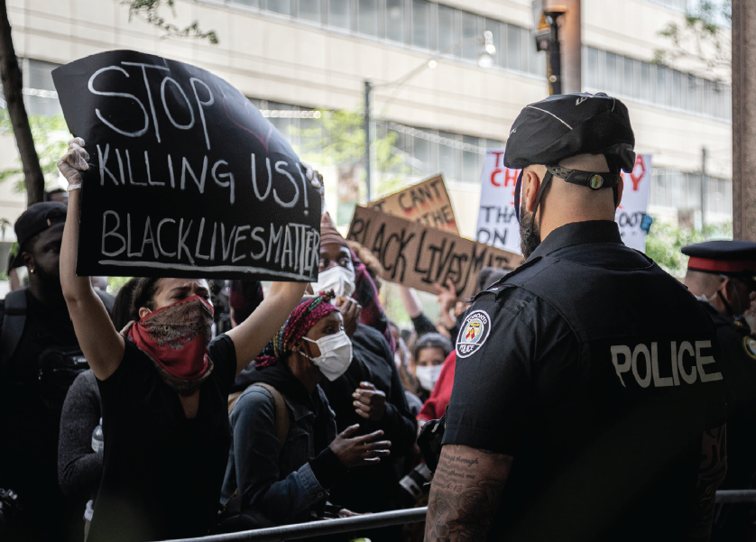
[Image 1.3] A Black Lives Matter protest in Toronto, Ontario. Source: NixZ/Shutterstock
DRAFT
DRAFT
DRAFT

Slide 20
Power Over
2. Power Over
Power possessed by some and wielded over others
Power unequally distributed
Disparities in resources, influence, knowledge
Embedded in structures and institutions

Slide 21
Power Over2
Elite Theory:
Two groups in society – haves and have nots
Haves (elites) occupy most powerful positions in key institutions
Military, religion, economy, politics, culture
Is rule by a few desirable or inevitable?
Roberto Michels and the iron law of the oligarchy
Notes:
- Ask the class: do you think that some people are better equipped to rule than others? Is elite rule better in some circumstances?

Slide 22
Power Over3
Class Analysis:
Power unequally distributed between different classes
Karl Marx:
Rise of capitalism
exploitation of the proletariat by the bourgeoisie
Results in class conflict
Privileging of class conflict over sexism, colonialism, racism
Unequal distribution of power continues to shape politics of the present
Notes:
- Ask class: do you think class conflict is the most important source of conflict in contemporary society? Or are other sources of oppression (sexism, colonialism, heteronormativity, racism) more significant?

Slide 23
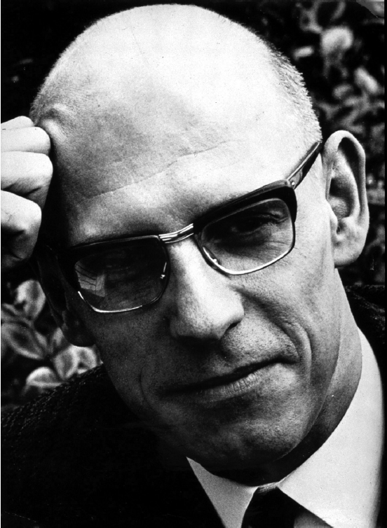
[Image 1.4] French philosopher and social theorist Michel Foucault. Source: INTERFOTO / Alamy Stock Photo
DRAFT
DRAFT
DRAFT

Slide 24
Power/Knowledge
Michel Foucault (1926-1984)
French philosopher and social theorist
Need to look beyond the state to see other ways power operates
How power operates in knowledge and truth claims; what is “good” and what is “bad”
Two forms of non-sovereign power increasingly important:
Disciplinary Power
Biopower

Slide 25
Disciplinary Power
Exercised on individual bodies
How we conform our behavior to societal expectations and norms
What is considered “good” and “bad” conduct in society
Enforcement of “appropriate” forms of behavior through
social approval and reward
Social inclusion and exclusion
Labelling of LGBTQ2S folx as “deviant” and “mentally ill”
Notes:
Ask class, what are some examples that we can point to, of how disciplinary power works in our lives? How have some of these norms and expectations changed over time for individuals as well as groups such as the LGBTQ2S community and women?
How has the rise of social media impacted what is considered acceptable in society?

Slide 26
Biopower
How state exerts power by regulating and managing its population
Statistics on birth and death rates, incidence of disease, accidents, etc.
Goal to produce healthier and more productive citizens
But selectively applied
underfunding of Indigenous communities
Notes:
- Biopower suggests a dynamic of survival of the fittest, where information is used to selectively promote the health and wellbeing of more desirable bodies over others. How can we see this playing out in Canada?

Slide 27
Power and the Pandemic
All three forms of power (sovereign, disciplinary, biopower) evident in the COVID-19 pandemic
Sovereign Power
Closing of borders
Vaccine mandates
Disciplinary Power
Social distancing
Mask Wearing

Slide 28
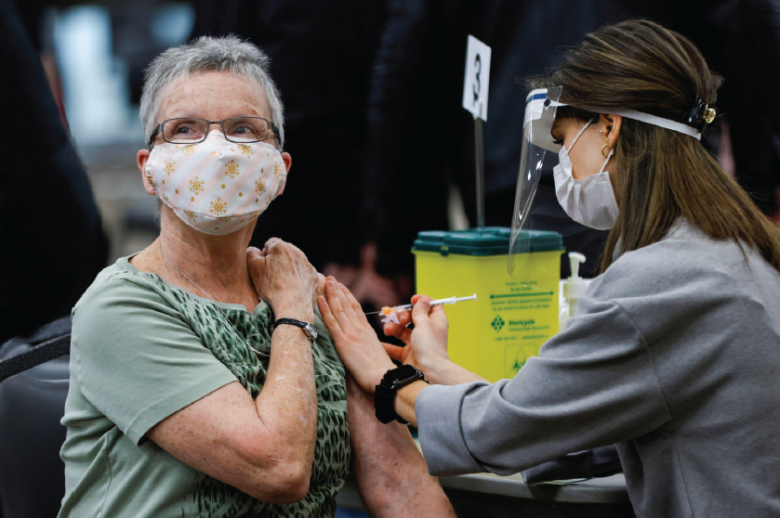
[Image 1.5] A woman receives a vaccine at a clinic in Ottawa, Ontario. Source: REUTERS / Alamy Stock Photo
DRAFT
DRAFT
DRAFT

Slide 29
Power and the Pandemic2
Biopower:
Public Health monitoring of infection rates
Testing and contract-tracing
Exercise of three forms of power also met with resistance, counter-discourses and acts of rebellion
Anti-mask protests
Spread of misinformation online
Impact of COVID-19 on modern-day politics
Crisis: can’t go back but uncertain about future
Notes:
Ask the class to describe some of the various ways in which individuals and groups pushed back against the exercise of these forms of power by Canada and other states around the world
How has COVID-19 and the challenges brought by the pandemic changed our world? Are these changes permanent or will we ever go back to politics as usual?

Slide 30
Conclusion
Politics asks three basic questions:
How do we organize our common affairs?
How are collective decisions made and for whom?
How are we obliged to abide by these decisions?
Contested questions with no clear answers or consensus
But as critical today as they were in Aristotle’s time

