Slide 1
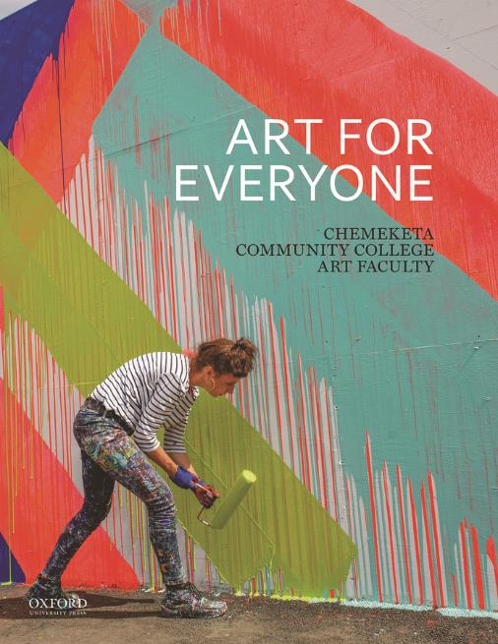
Art for Everyone
by the Chemeketa Community College Art Faculty
Chapter 12: Art is Everywhere

Slide 2
Learning Objectives (1 of 2)
Outline the etiquette of art exhibitions.
Compare various art locales, including museums, art fairs, informal galleries, arts districts, and street art.
Explain how artist residencies work.
Illustrate how art represents cultural capital, cultural values, and power structures.
Identify how formal elements and principles are used in advertising.

Slide 3
Learning Objectives (2 of 2)
Define propaganda and explain the positive and negative traits associated with propaganda.
Recognize the creative instinct in both children’s art and outsider art examples.
Outline the stages of the creative process.
Explain how art can be a means of healing, connection, and play.
Determine how access to art making can be equitable

Slide 4
Where Is Art? (1 of 3)
As you begin reading this final chapter, keep these questions in mind:
  What surprising works of art have you discovered in your local area after reading this text?
  Do you think advertisements and propaganda affect you more or less now that you know how designers use the formal elements and principles to visually “lead” us around an image?
  Now that you know art is all around you, do you think that some kinds of art are better than others? Who gets to decide?

Slide 5
Where Is Art? (2 of 3)
The answer to this question is a simple one. Art is everywhere, including:
  museums
  craft fairs
  coffee shops
  skate parks
  advertisements
  inside your own home
  … and much more

Slide 6
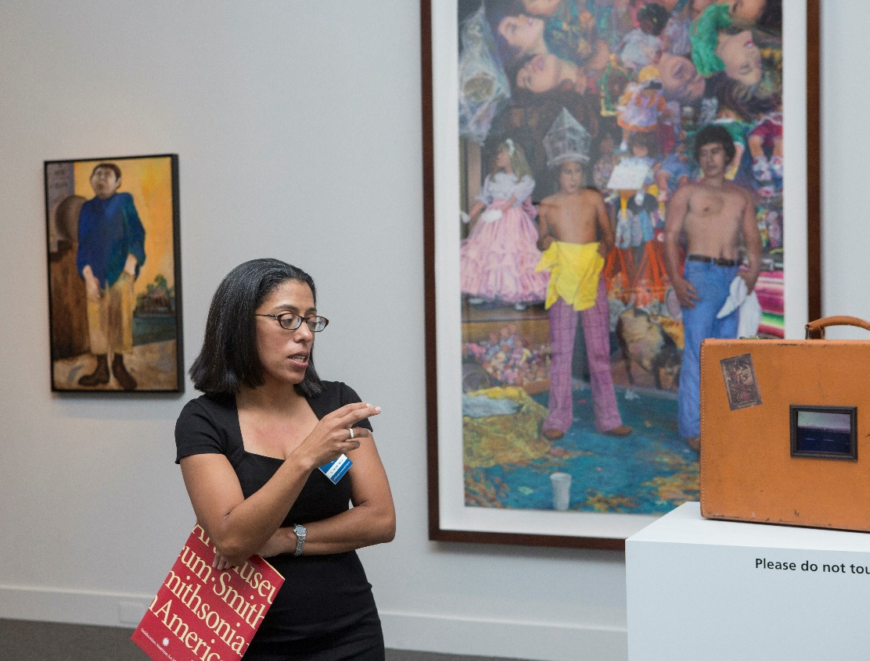
Where Is Art? (3 of 3)
E. Carmen Ramos, the Curator of Latino Art at the Smithsonian American Art Museum in Washington, D.C. (Figure 12.1), discussing the traveling exhibit Our America: The Latino Presence in American Art.
Figure 12.1. Our America: The Latino Presence in American Art. October 2013–March 2014.
Notes:
FIGURE 12.1 Our America: The Latino Presence in American Art. October 2013–March 2014. Installation view at the Smithsonian American Art Museum, Washington, DC. Photograph by Amy Vaughters.

Slide 7
Art on Display
You can begin your search for art at locations designed primarily for the purpose, such as at museums and art galleries.
  There are various sizes for these venues, but they are not as inaccessible or exclusive as they seem
  Artists are eager for people to view their work
  Exhibits also vary by subject matter, so try more than one to experience the diversity that is available

Slide 8
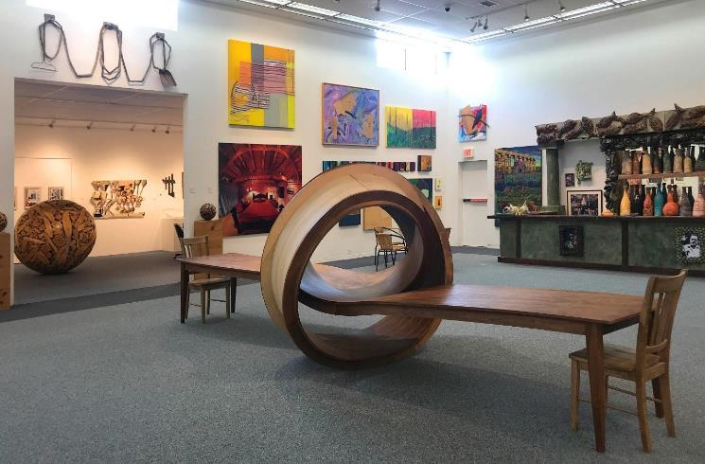
Museums (1 of 5)
Museums are for everyone and have a wide variety of art.
  Every state in the United States has art museums, such as the Anderson Museum of Contemporary Art in Roswell, New Mexico
Figure 12.2. North Gallery view of Anderson Museum of Contemporary Art featuring table by Michael Beitz, Not Now, 2014.
Notes:
FIGURE 12.2 North Gallery view of Anderson Museum of Contemporary Art featuring table by Michael Beitz, Not Now, 2014. Wood, 18 ft. long. Photo courtesy of the Anderson Museum of Contemporary Art, Roswell, New Mexico.

Slide 9
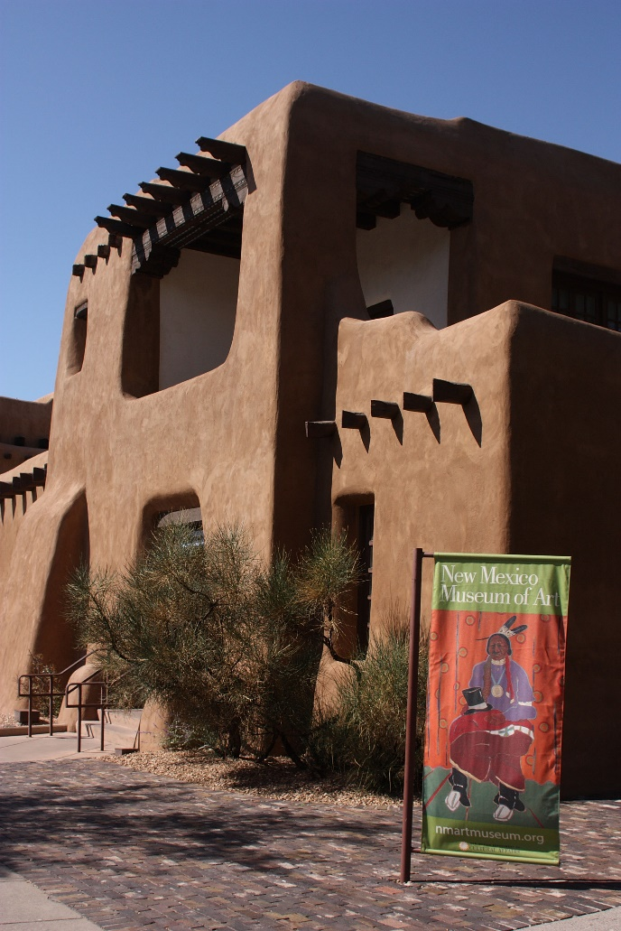
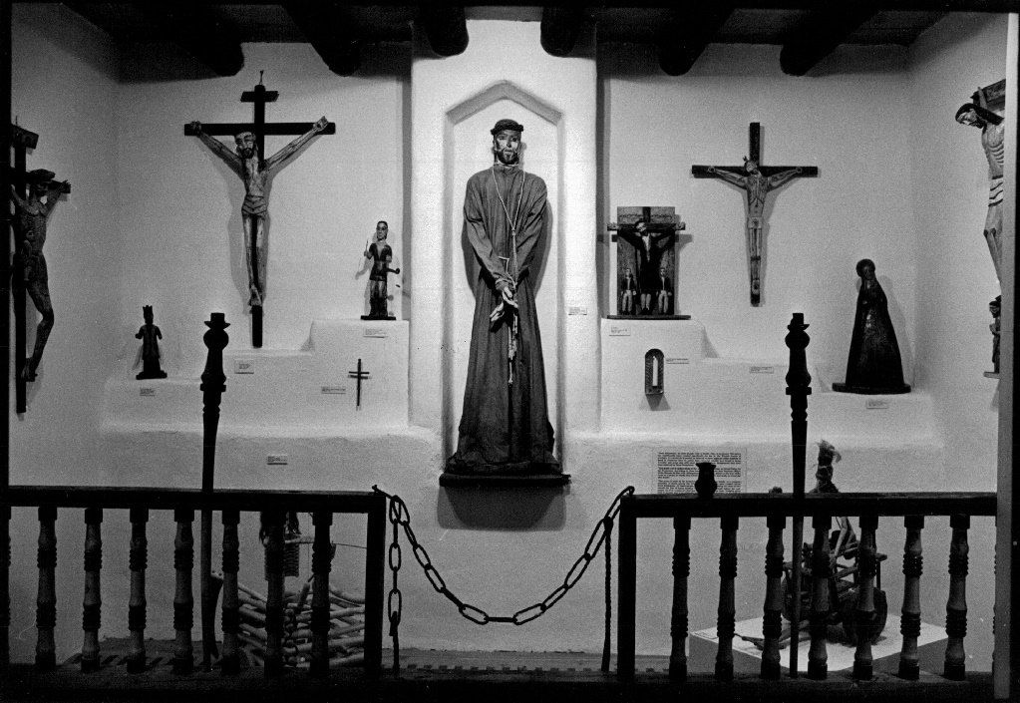
Museums (2 of 5)
Also in New Mexico:
  The New Mexico Museum of Art in Santa Fe
  Millicent Rogers Museum in Taos
Figure 12.4. Hispanic Arts Collection at the Millicent Rogers Museum of Art.
Figure 12.3. The New Mexico Museum of Modern Art on September 13, 2008, in Santa Fe, New Mexico.
Notes:
FIGURE 12.3 The New Mexico Museum of Modern Art on September 13, 2008, in Santa Fe, New Mexico. Santa Fe is known for its association with ancient Indigenous culture and architecture and is a popular tourist destination and a world-renowned center for painting, sculpture, and photography. Nina Raingold/Getty Images.
FIGURE 12.4 Hispanic Arts Collection at the Millicent Rogers Museum of Art. Susan Biddle/The Denver Post via Getty Images.

Slide 10
Museums (3 of 5)
Getting familiar with museum etiquette will ensure that you enjoy your visit.
  Touching the art is usually not permitted
  Don’t stand too close to a work of art
  Store bags before entering the museum
  Ask if photography is allowed, with or without flash
  Ask before attempting to sketch or paint on the premises

Slide 11
Museums (4 of 5)
Museums do not discriminate based on age or socioeconomic status.
  Most museums are kid-friendly, with specialty programming and admission discounts for younger visitors.
  Museum fees are used to maintain the facility and operations, not to exclude visitors
  Free or discounted admittance days are available periodically at many museums

Slide 12
Museums (5 of 5)
Act as a critical observer when visiting local museums and ask yourself the following:
  Is the level of importance for these works indicated by their placement within the museum space?
  Are social, cultural, and historical factors related to the area reflected in the exhibition?
  Which artists and time periods are represented in these displays?

Slide 13
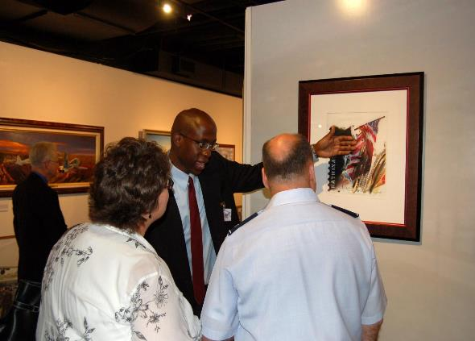
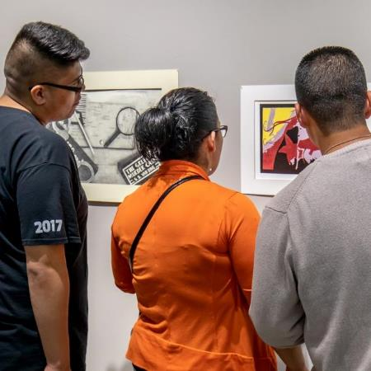
College and University Galleries
Colleges and universities host multiple exhibits each year, such as the ones represented below:
Figure 12.5. George McCowan explains some of the details of his work in Heritage to Horizons: U.S. Air Force History through Art, 2007.
Figure 12.6. Yakima Valley Community College students enjoy the student and faculty art exhibit.
Notes:
FIGURE 12.5 Art exhibit draws crowd to Air Force heritage. George McCowan explains some of the details of his work titled “A Lesson of Desperation,” which covers the Hurricane Katrina relief effort through a collage of images. Mr. McCowan is an Air Force Art Program artist member. U.S. Air Force photo/Staff Sgt. Shad Eidson.
FIGURE 12.6 Yakima Valley Community College students enjoy the student and faculty art exhibit. Courtesy of David Lynx, Larson Gallery, Yakima, Washington. Photograph by Lonny Smart.

Slide 14
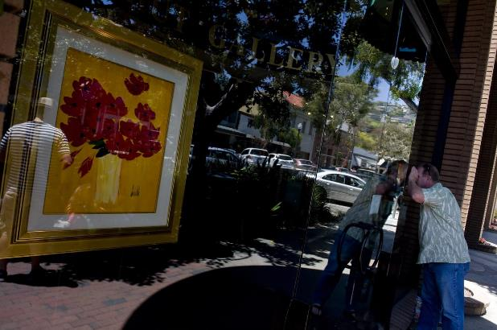
Art Galleries, Fairs, and Festivals (1 of 3)
Art galleries, fairs, and festivals provide a way for artists to show and sell work.
  Brick-and-mortar or online
  Usually no fee to enter
  Selective; might sell the work of only certain artists or a particular type of subject matter
  Each visit can be a new experience
Figure 12.7. A shopper looks in the window of an art gallery on Forest Avenue in Laguna Beach, CA.
Notes:
FIGURE 12.7 A shopper looks in the window of an art gallery on Forest Avenue in Laguna Beach, CA, on June 16, 2013. Paul Bersebach/Digital First Media/Orange County Register via Getty Images.

Slide 15
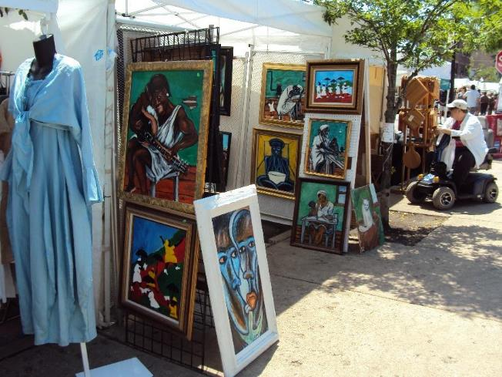
Art Galleries, Fairs, and Festivals (2 of 3)
Examples of art fairs:
  Art Basel in Miami
  Itinerant Performance Art Festival in New York City
  Hyde Park 57th Street Art Fair in Chicago (see Figure 12.8)
Figure 12.8. Hyde Park’s 57th Street Art Fair, 5 June 2011.
Notes:
FIGURE 12.8 Hyde Park’s 57th Street Art Fair, 5 June 2011. (393Edge Photographer)

Slide 16
Art Galleries, Fairs, and Festivals (3 of 3)
Things to notice at art fairs:
  How many rules of composition can you find?
  What is the style of the works?
  Are the pieces representative, abstract, or nonobjective?
  Does the artist favor a certain type of subject matter, color, or technique?

Slide 17
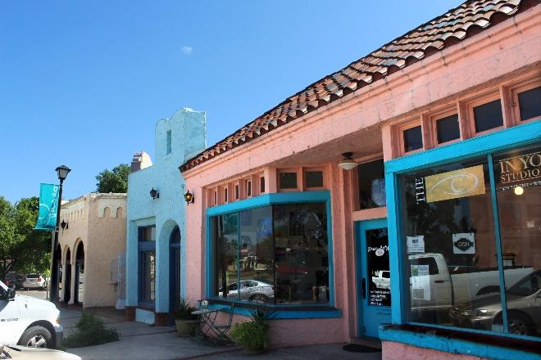
Art Districts (1 of 2)
Many communities have an art district, an area where galleries, studios, and other art-centered businesses tend to cluster.
  An example is the Paseo Arts District in Oklahoma City
Figure 12.9. Paseo Arts District, Oklahoma City, OK.
Notes:
FIGURE 12.9 Paseo Arts District, Oklahoma City, OK. Photograph by MARELBU. Courtesy of the Paseo Artist Association.

Slide 18
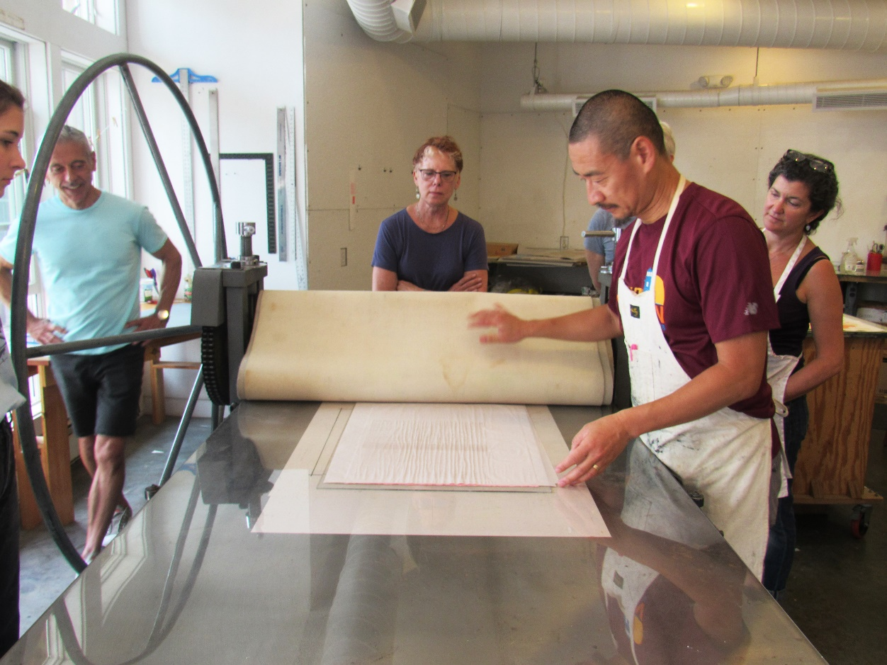
Art Districts (2 of 2)
Many art districts host a monthly “art walk” or a yearly “open studios” event that provides access to studios and galleries along with other cultural activities.
Figure 12.10. Master printer Fred Liang at work in the Fine Arts Work Center’s Michael Mazur Print Studio, Provincetown, MA.
Notes:
FIGURE 12.10 Master Printer Fred Liang at work in the Fine Arts Work Center’s Michael Mazur Print Studio, Provincetown, MA. Courtesy of the Fine Arts Work Center in Provincetown

Slide 19
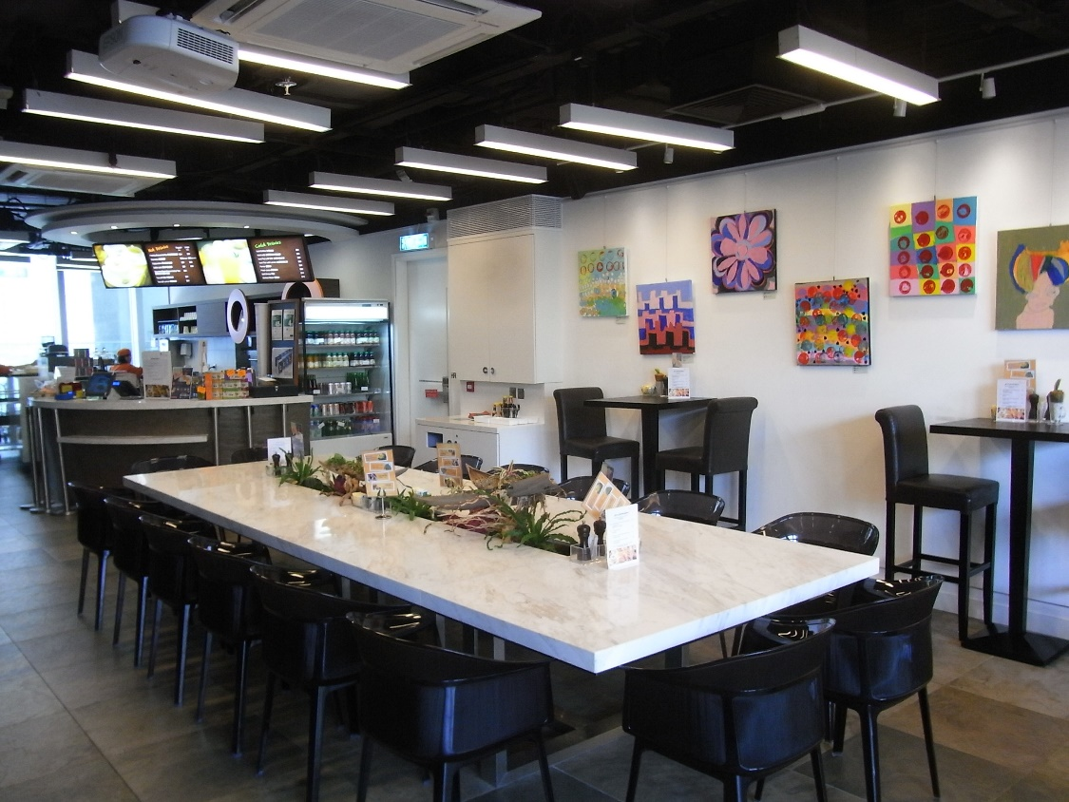
Informal Exhibitions (1 of 2)
These are exhibits or events, usually with a set time limit, in spaces where a general audience will come for some alternate purpose and happen upon the art by accident, such as:
  a coffee shop
  a restaurant
  a hospital (see Figure 12.11)
Figure 12.11. iBakery Gallery Cafe by Tung Wah Hospital, 2012.
Notes:
FIGURE 12.11 iBakery Gallery Cafe at Tung Wah Hospital, 2012. Photograph by Wong35Lau27.

Slide 20
Informal Exhibitions (2 of 2)
What to look for at informal exhibitions:
  What is the style or theme found in this work?
  What information about the artist(s) and artworks is displayed?
  Are the works available for purchase?
Benefits of informal exhibitions:
  Added attraction and revenue for the business
  Increased exposure for the artist
  Audiences get to experience something new without changing their normal routines

Slide 21
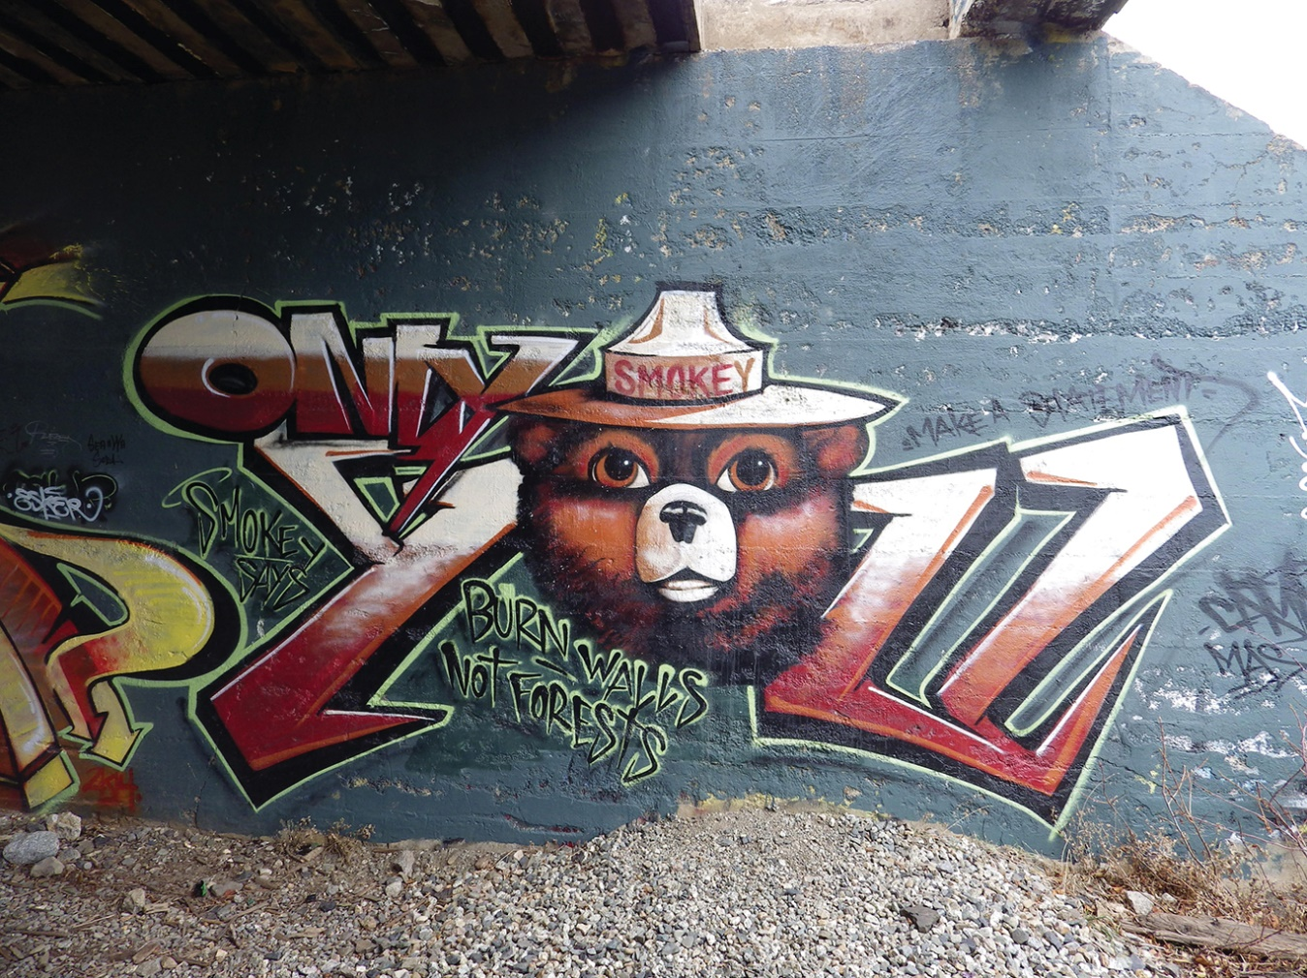
Graffiti
Although still considered destructive, graffiti or street art is widespread and can be beautiful.
  Spray paint is medium of choice
  Some street artists have gained acclaim in major art circles while others remain unknown
Figure 12.12. Unknown artist, Only You, date unknown. Donner Pass, California.
Notes:
FIGURE 12.12 Unknown artist, Only You, date unknown. Donner Pass, California. Photograph by Deanne Beausoleil.

Slide 22
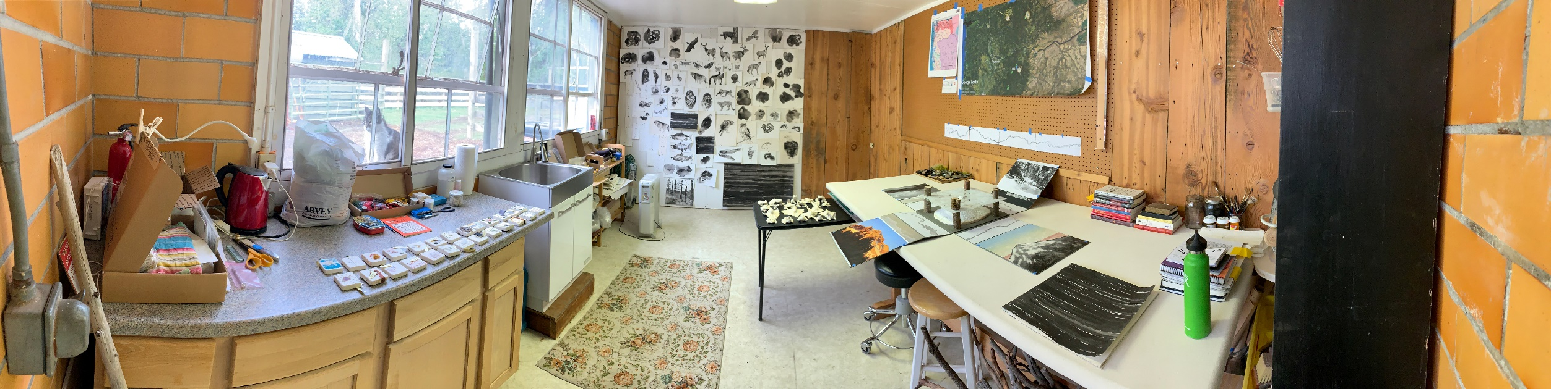
Artist at Work:
Diane Jacobs on Artist Residencies and Artist Books
Artist residencies offer artists access to facilities, time, and a readymade community.
  Diane Jacobs has attended multiple residencies and has made artist books there
Figure 12.13. Diane Jacobs’ studio in Portland, Oregon.
Notes:
FIGURE 12.13 Diane Jacobs’s residency studio at Pine Meadow Ranch in Sisters, Oregon. Photograph by Diane Jacobs.

Slide 23
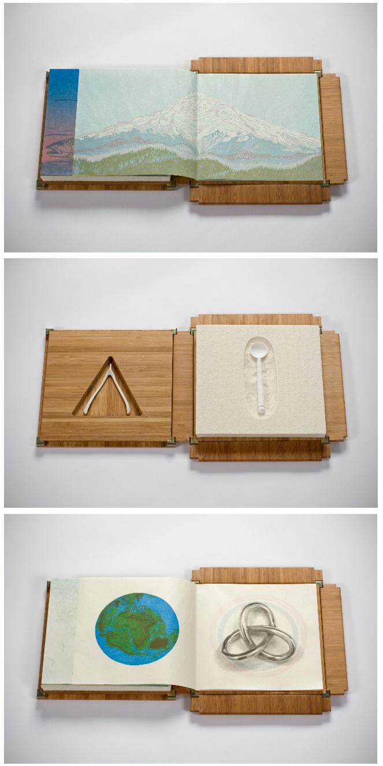
Artist Books
These works are a story, a sculpture, and an intimate, time-bound interaction that is both narrative and tactile.
  Jacobs’ book Nourish was created as a reaction to climate change
Figure 12.14. Diane Jacobs, Nourish (details), 2012.
Notes:
FIGURE 12.14 Diane Jacobs, Nourish (details), 2012. Letterpress printed reduction linoleum and woodblocks, pressure printing, polymer plates, handset title page and colophon, bamboo box, gampi paper, wool felt, cast paper pulp, porcelain, 8 × 8 × 2. Courtesy of the artist.

Slide 24
Art and Visual Culture
Art is not confined to museums, galleries, and art fairs. In our visual culture, we have many options to consider, such as:
  Public statues and monuments
  Portraits of politicians
  Graffiti-covered train cars
  Advertising

Slide 25
Advertisements (1 of 2)
Today’s advertising is often the product of careful design work that is not only aesthetically appealing but also meets the needs of the customer.
Advertisers take the following into consideration:
  Imagery
  Language
  Color
  Other details (such as product/service message)

Slide 26

Advertisements (2 of 2)
Figure 12.15 shows a humorous ad designed by Ogilvy & Mather.
  How do you visually read this advertisement?
Figure 12.15. Ogilvy & Mather, Lisbon, Portugal, Correio da Manhã English Course “Inglês Total”: Release your English, 2016.
Notes:
FIGURE 12.15 Ogilvy & Mather, Lisbon, Portugal, Correio da Manhã English Course “Inglês Total”: Release your English, 2016. Creative Director: Jorge Coelho. Art Director: Carlos Costa. Copywriter: Tiago Pereira. Illustrator: Hélder Oliveira.

Slide 27
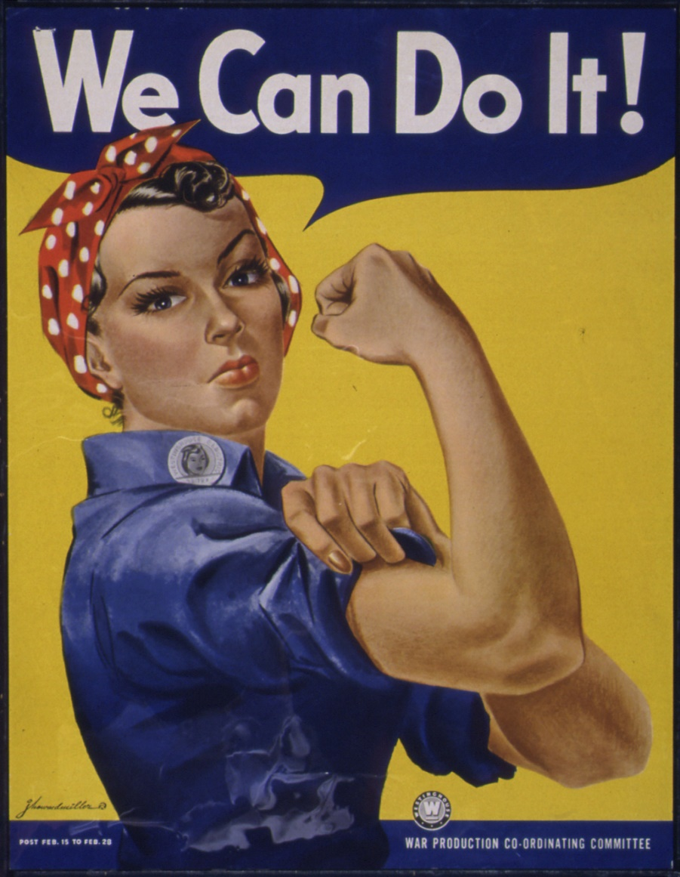
Propaganda
Like advertising, propaganda takes persuasiveness to the extreme in order to create social change.
  The term mostly seen as negative in modern times but originally neutral
  Once connected to motivating positive behavior (see Figure 12.16)
Figure 12.16. J. Howard Miller, "We Can Do It!" [Westinghouse poster used by the War Production Coordinating Committee], ca. 1942–45.
Notes:
FIGURE 12.16 J. Howard Miller, “We Can Do It!” [Westinghouse poster used by the War Production Coordinating Committee], ca. 1942–45. U.S. National Archives and Records Administration.

Slide 28

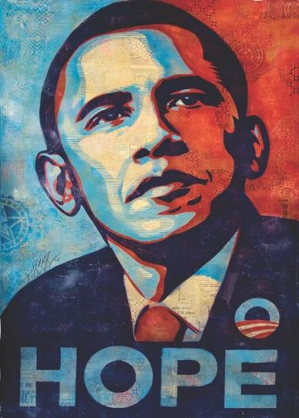
From Street Art to Commercial Success
Shepard Fairey has seen his work transition from avant-garde to fashionable.
Figure 12.17.
Shepard Fairey,
Obey Icon Face, 1989.
Figure 12.18.
Shepard Fairey,
OBAMA Hope, 2008.
Notes:
FIGURE 12.17 Shepard Fairey, Obey Icon Face, 1989. Digital file used for poster, sticker, and stencil production. Courtesy of the artist.
FIGURE 12.18 Shepard Fairey, OBAMA Hope, 2008. Digital files used for poster, sticker, and stencil production. Courtesy of the artist.

Slide 29
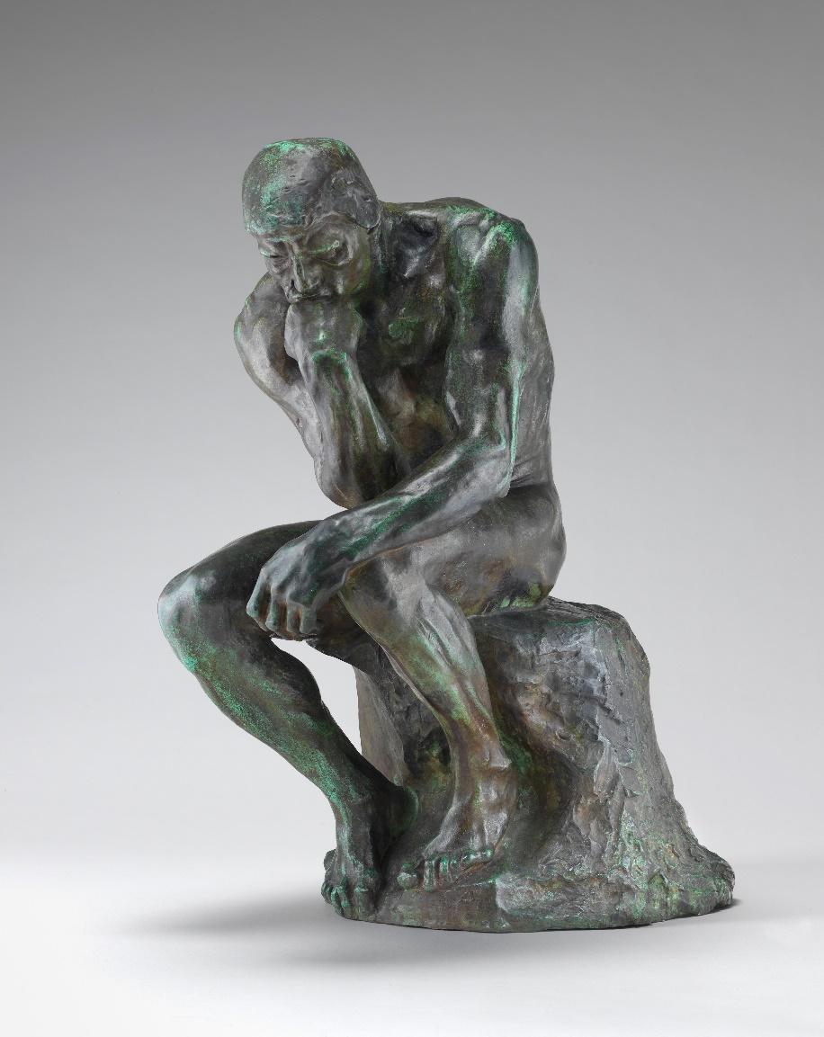
Close Examination:
Active Looking and Cultural Capital (1 of 3)
When you recognize an iconic work of art and can talk about it thoughtfully, you earn something called cultural capital.
  If you immediately recognize The Thinker (Figure 12.19), you can use this meaning as a shorthand for more complex ideas
Figure 12.19. Auguste Rodin,
The Thinker, bronze. Model 1880, cast 1901.
Notes:
FIGURE 12.19 Auguste Rodin, The Thinker, bronze. Model 1880, cast 1901, 28.25 × 14.3125 × 23.4375 in. Gift of Mrs. John W. Simpson. Courtesy of the National Gallery of Art, Washington, DC.

Slide 30
Close Examination:
Active Looking and Cultural Capital (2 of 3)
Benefits of cultural capital:
  Lets us broaden the definition of art
  Helps us find art in unexpected places
  Allows us to navigate popular culture, such as Internet memes
A meme is an idea or image that spreads rapidly among members of a specific audience.
  Contains within it some kind of cultural symbol or practice
  Communicates effectively to those who understand and recognize it

Slide 31
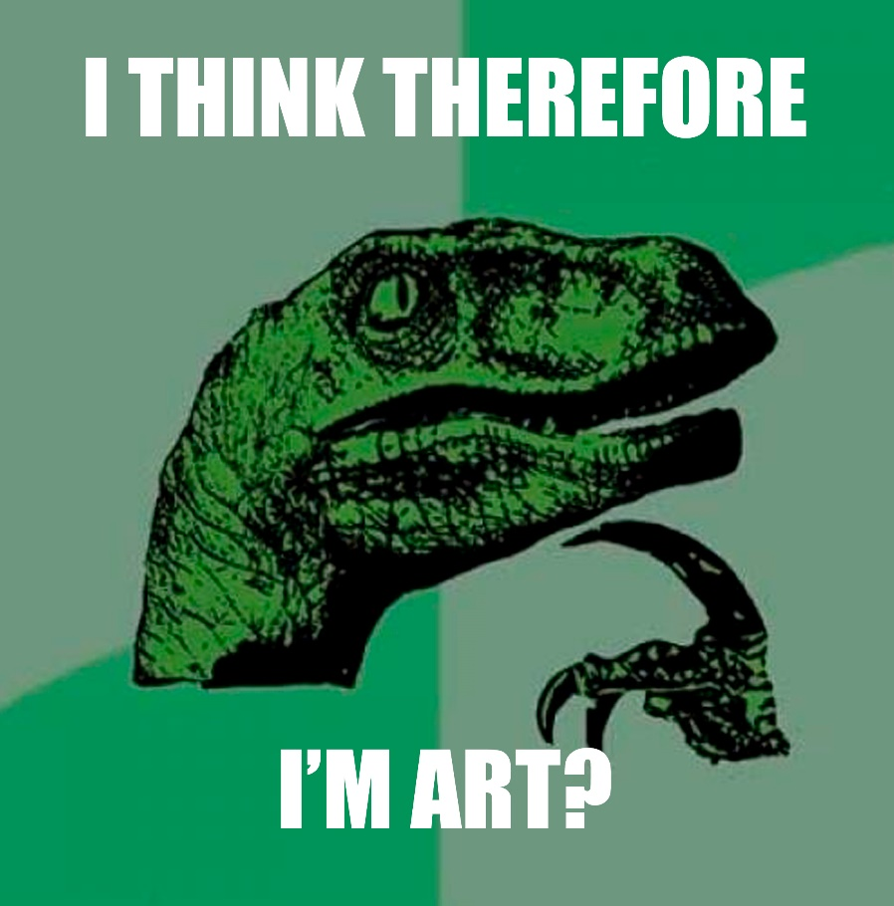
Close Examination:
Active Looking and Cultural Capital (3 of 3)
The “Philosoraptor” meme (Figure 12.20) resembles The Thinker’s gesture of deep contemplation
Figure 12.20.
Lonelydinosaur.com, Philosoraptor meme, 2015.
Notes:
FIGURE 12.20 Lonelydinosaur.com, Philosoraptor meme, 2015. Digital image.

Slide 32
Art in Us
This next section explores the creative impulse and asks one of the hard questions: Why make art?
There are many reasons to make art, and this section will look at what motivates people of all ages and backgrounds to create art.

Slide 33
The Art Instinct
Another great place to find art is in the work we produce ourselves.
  Some scholars suggest that humans have an art instinct
Everyday art creation includes:
  Doodling to relax or focus
  Sketching to solidify our ideas
  Exercising our minds in art classes

Slide 34
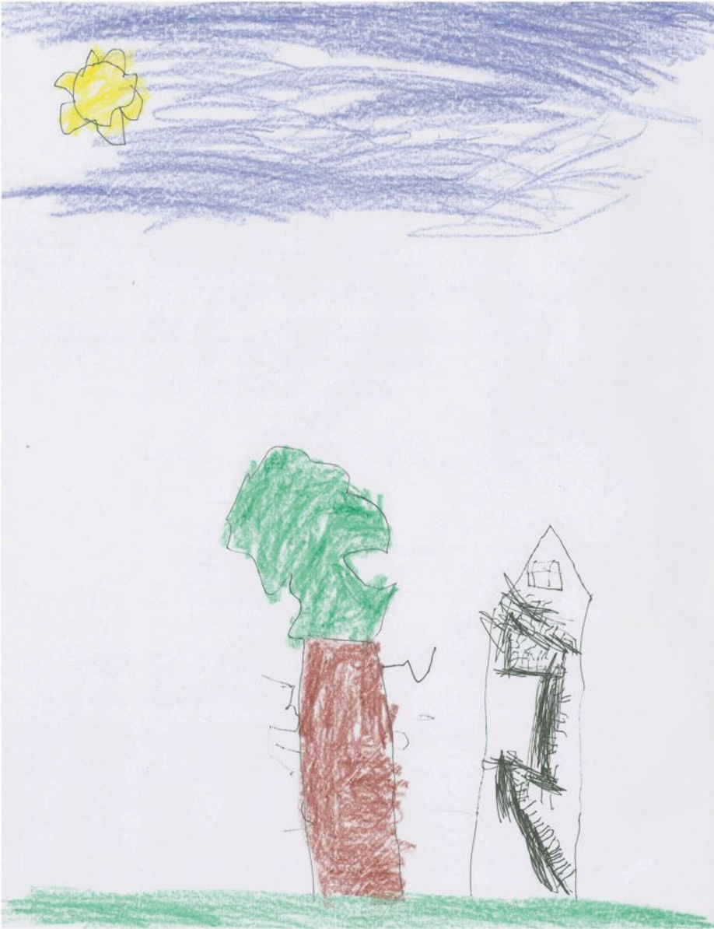
Children’s Art
With few concerns or expectations related to style or skill, children create art that is creative and unique.
  The four-year-old child’s drawing (Figure 12.21) contains a staircase that seems to defy the laws of physics and gravity
Figure 12.21.
Reid Mosher,
Old House, 2015.
Notes:
FIGURE 12.21 Reid Mosher, Old House, 2015. Crayon and ink on paper. 11 × 8.5 in. Refrigerator Gallery. Courtesy of the artist.

Slide 35
Folk Artists and Outsider Artists
The art instinct can be seen in artists who are self-taught, sometimes referred to as folk artists or outsider artists.
  without professional training or connections to other artists
  their art originates from deeply personal instincts
  use low-cost, accessible materials
  may never share art beyond a close circle of friends

Slide 36
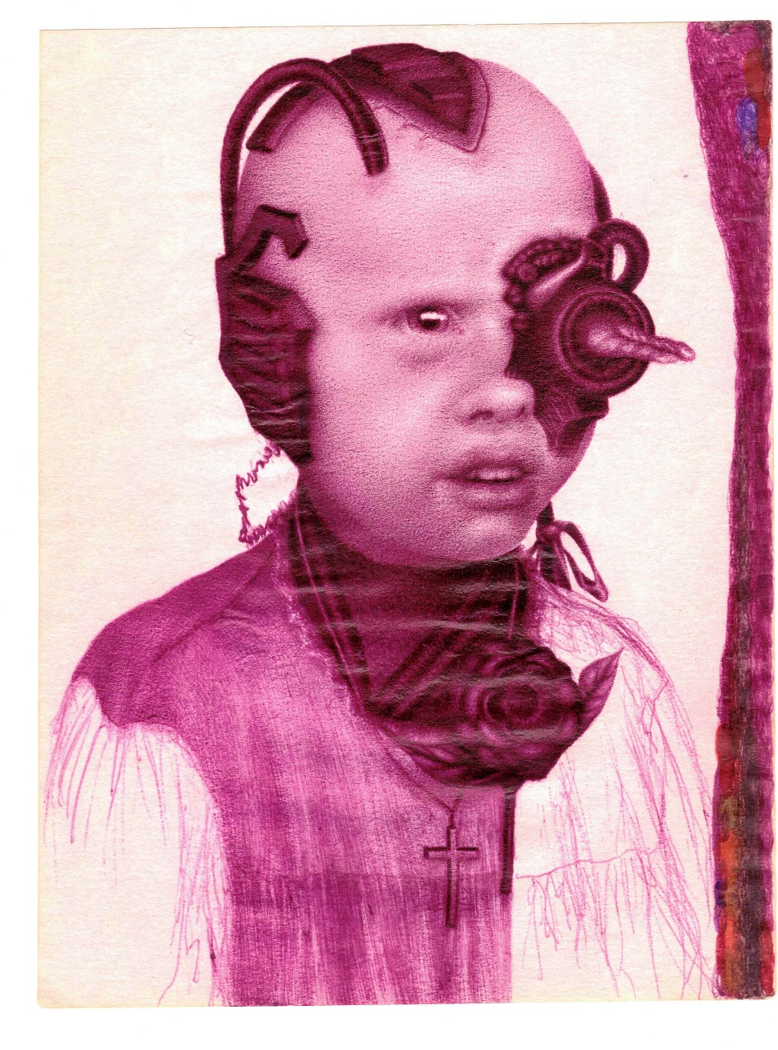
The Art of Joanne Macdonald
Figure 12.22. Joanne M. Macdonald,7 of 9: Sarah, 2014.
Notes:
FIGURE 12.22 Joanne M. Macdonald, 7 of 9: Sarah, 2014. Pen on paper, 8.5 × 11, Collection of the artist.

Slide 37
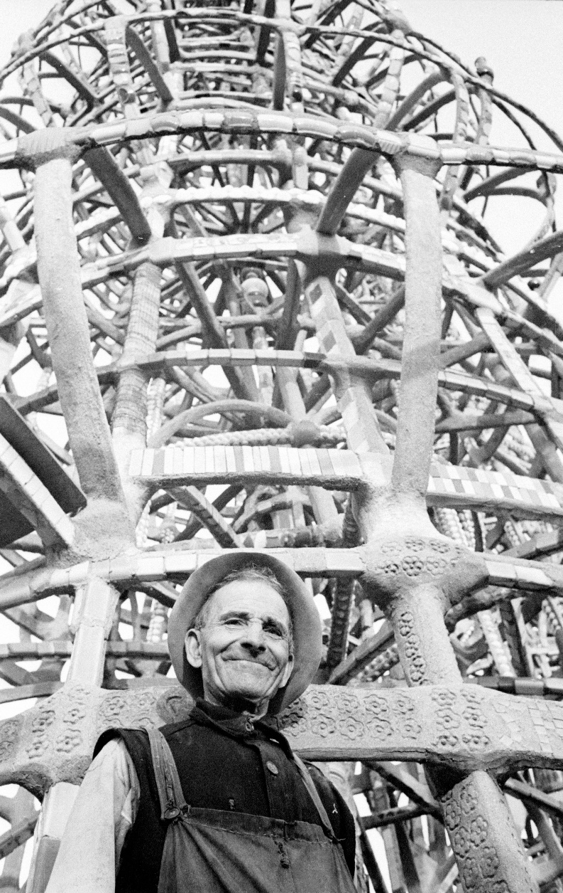
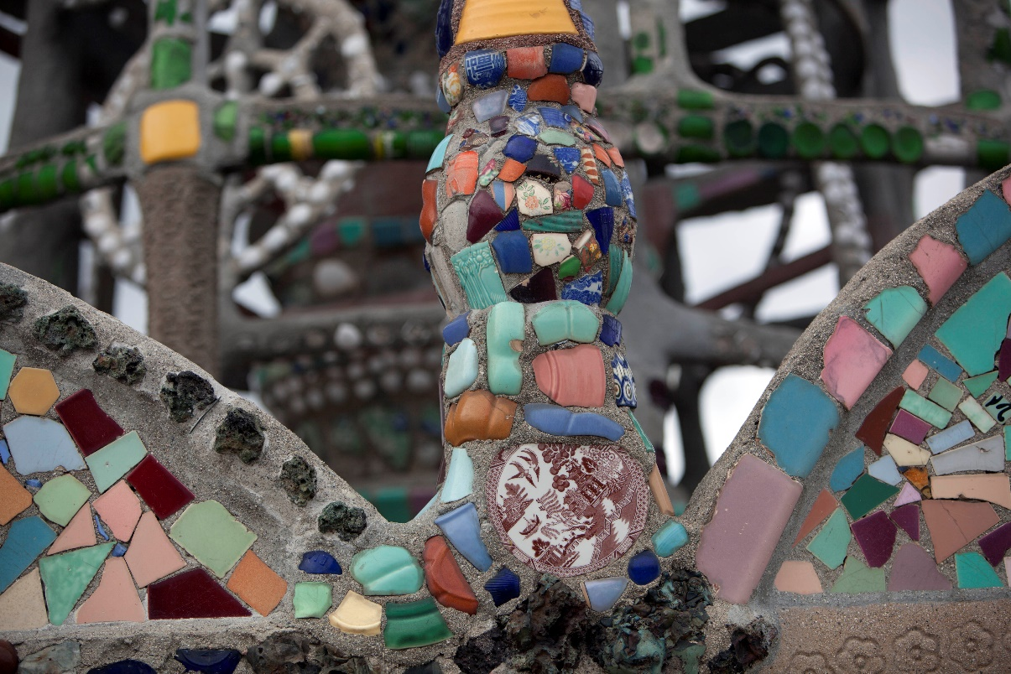
Simon Rodia’s Watts Towers in Los Angeles
Figure 12.23. Sanford H. Roth, Simon Rodia/Watts Towers, circa 1950.
Figure 12.24. Simon Rodia, Watts Towers (Nuestro Pueblo), 1921–1954.
Notes:
FIGURE 12.23 Sanford H. Roth, Simon Rodia/Watts Towers, circa 1950. 2 1/4 in. negative. Beulah Roth Bequest (PhA.1993.9.12.12). Los Angeles County Museum of Art, Los Angeles, California.
FIGURE 12.24 Watts Towers on the 20th Anniversary of the 1965 riots, Los Angeles, California.

Slide 38
The Creative Process (1 of 3)
The stages of the creative process, also referred to as design thinking, begin with preparation (also known as the research stage). This includes:
  Asking questions
  Looking at examples
  Gathering materials
  Evaluating available methods

Slide 39
The Creative Process (2 of 3)
The second step is the incubation stage:
  Breaks from intense work are required
  Ideas may come in the shower or after a nap
  Distractions do not detract from the process; they are part of the process.
The third step is the illumination stage
  Involves making a decision
  Moments of clarity happen
  Approach is refined, work begins

Slide 40
The Creative Process (3 of 3)
The fourth and final stage is verification.
  The making, the presentation, the deliverable
  Work with others to get feedback
  Evaluate alternative approaches, adding another layer to the creation or considering new avenues for research
  Not just making something, but making something better

Slide 41
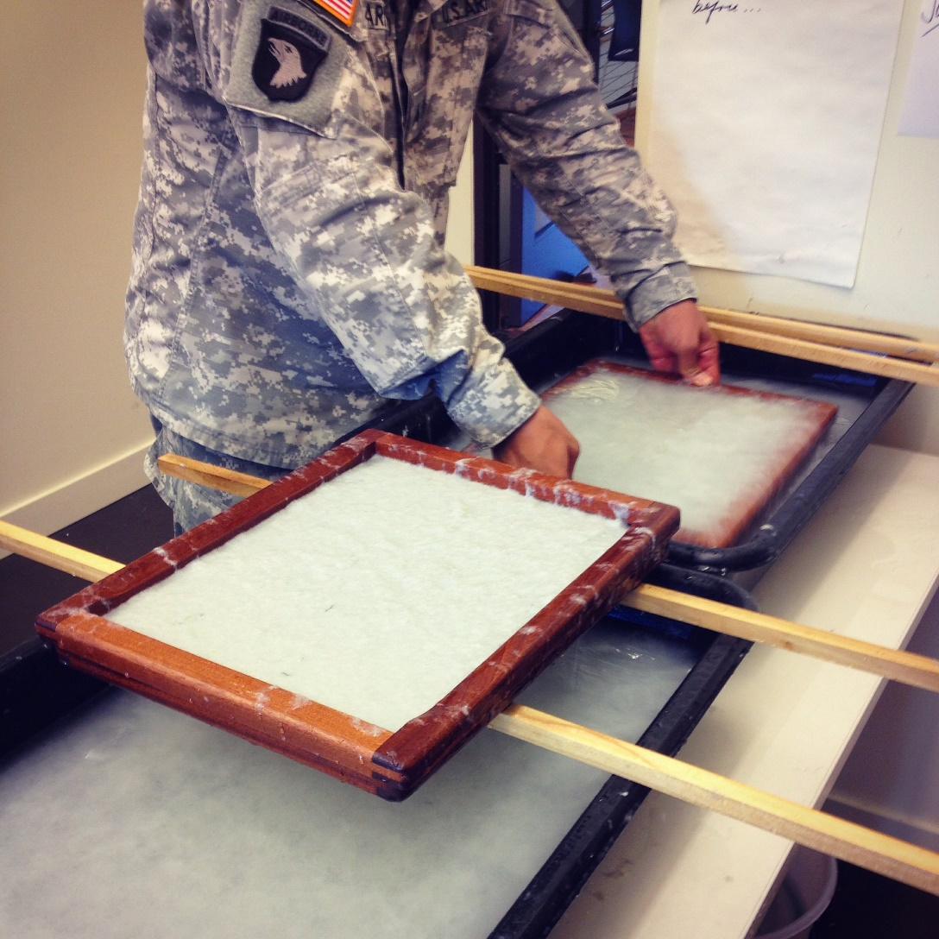
Art as Healing
Fort Belvoir Community Hospital is one institution that employs art therapists to work with veterans.
Figure 12.25. Veterans turn military uniforms into handmade paper in workshops led by Combat Paper at the USO Warrior and Family Center at Fort Belvoir.
Notes:
FIGURE 12.25 Veterans turn military uniforms into handmade paper in workshops led by Combat Paper at the USO Warrior and Family Center at Fort Belvoir. Image credit: Drew F. Cameron.

Slide 42
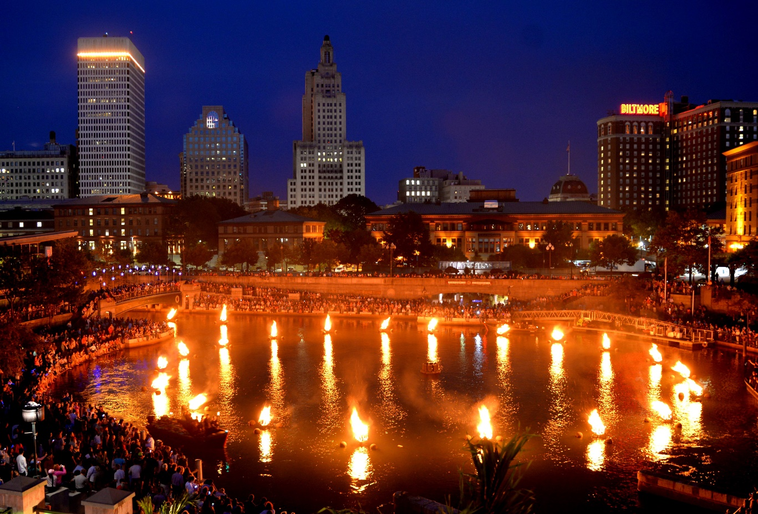
Art as Connection (1 of 3)
WaterFire, a sculpture by Barnaby Evans, is credited with revitalizing downtown Providence. In warm months, the fires are lit monthly and include a wider arts celebration.
Figure 12.26. Barnaby Evans, WaterFire, 2018.
Notes:
FIGURE 12.26 WaterFire, 2018. Courtesy of WaterFire Providence. Photograph by John Nickerson.

Slide 43
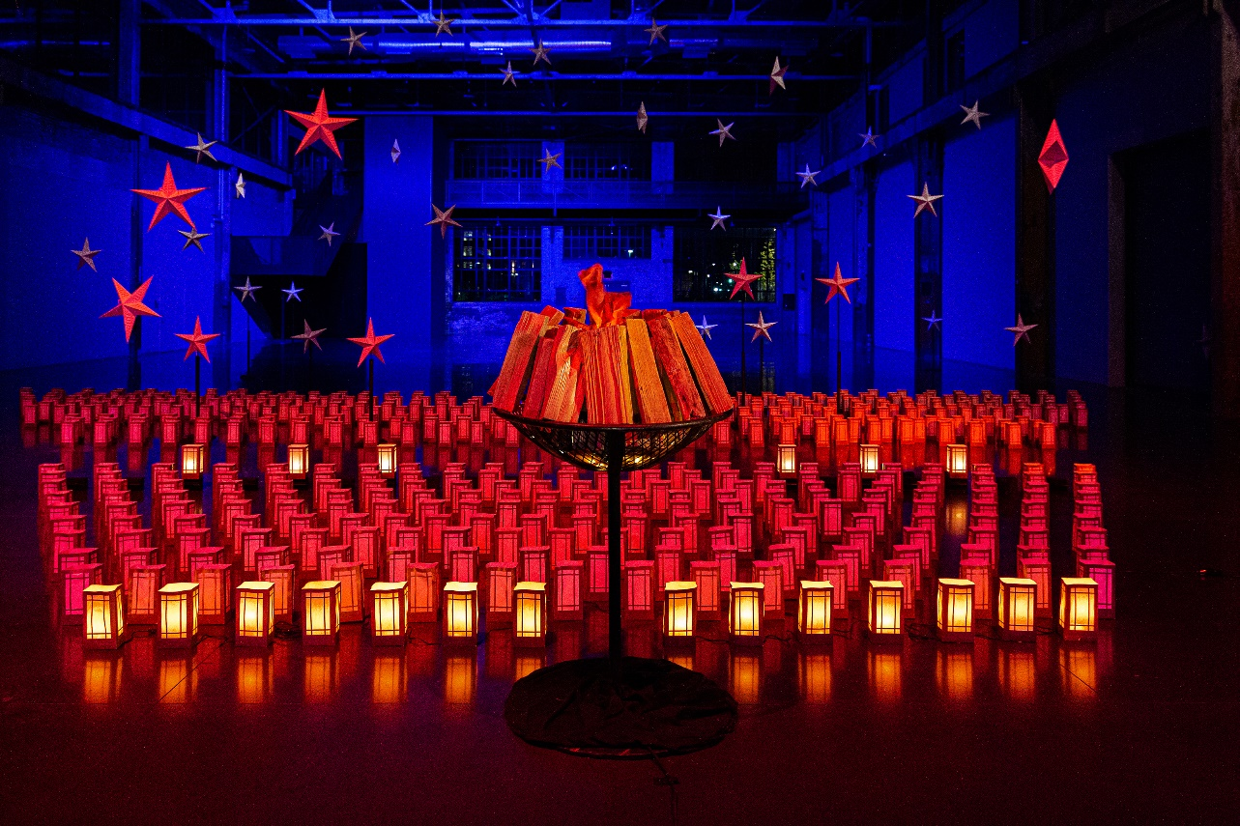
Art as Connection (2 of 3)
In response to the loss of life during the COVID-19 pandemic, Evans created Beacon of Hope to memorialize Rhode Island victims of the virus.
  A central brazier is surrounded by an increasing number of lanterns lit every evening.
Figure 12.27. Barnaby Evans, Beacon of Hope, 20 May 2020.
Notes:
FIGURE 12.27 Beacon of Hope, 20 May 2020. Courtesy of WaterFire Providence. Photograph by Jeff Meunier.

Slide 44
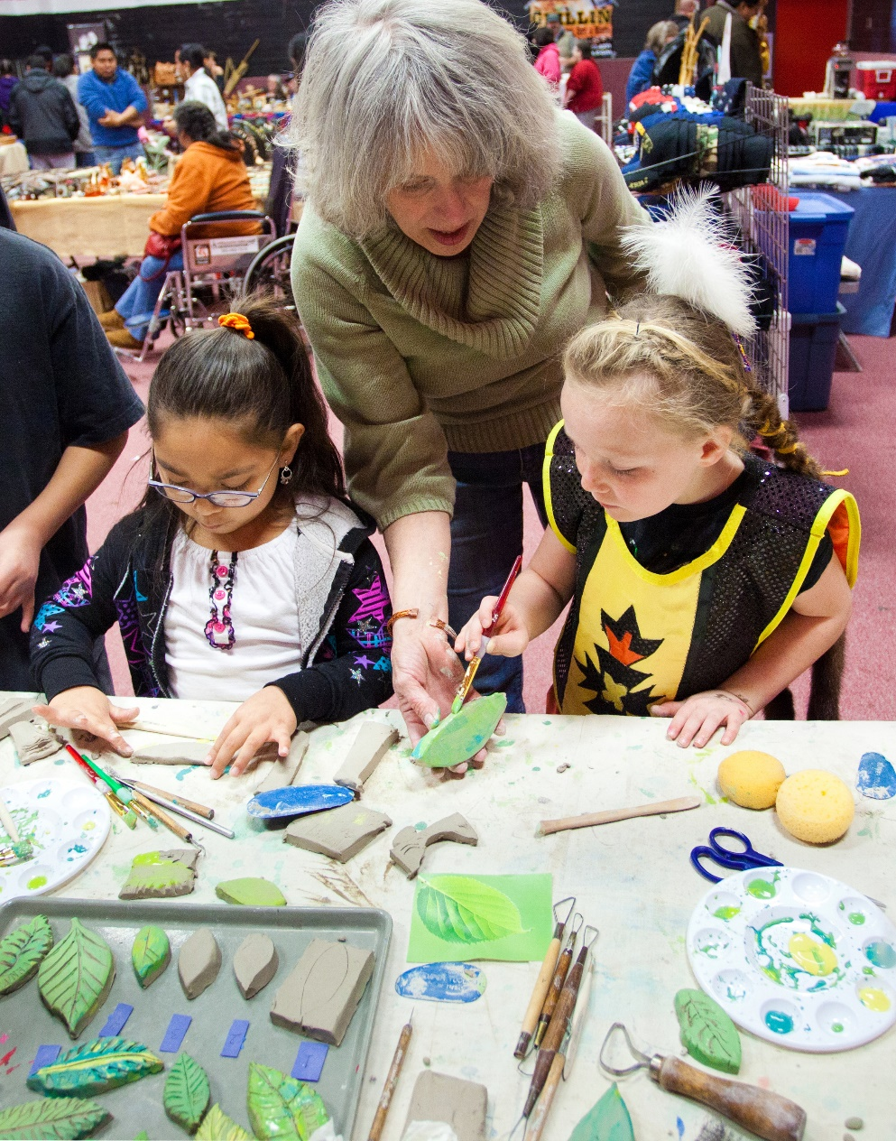
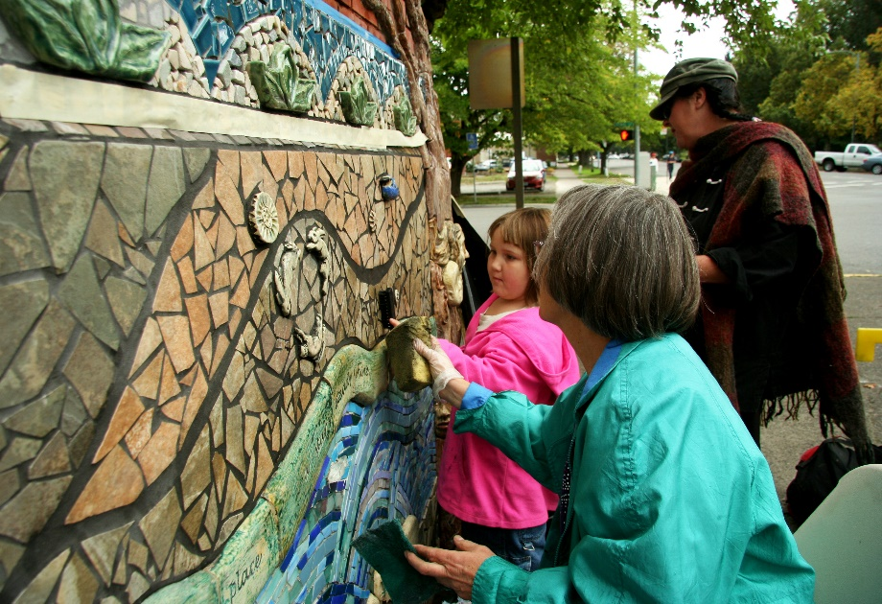
Art as Connection (3 of 3)
In Oregon, participatory artist Lynn Takata guided six hundred community members in the creation of the porcelain, glass, and stone tile Salem Peace Mosaic.
Figure 12.28 A and B. (A) Children paint ceramic leaves at the Chemawa Pow Wow; (B) Community members participate in the creation of the Salem Peace Mosaic.
Notes:
FIGURE 12.28 (a) Children paint ceramic leaves at the Chemawa Pow Wow as part of the Salem Peace Mosaic community art project in Salem, Oregon. Courtesy of Lynn Takata. Photograph by Frank Miller. (b) Community members participate in the creation of the Salem Peace Mosaic, YMCA building in Salem, Oregon. Courtesy of Lynn Takata. Photographs by Frank Miller.

Slide 45
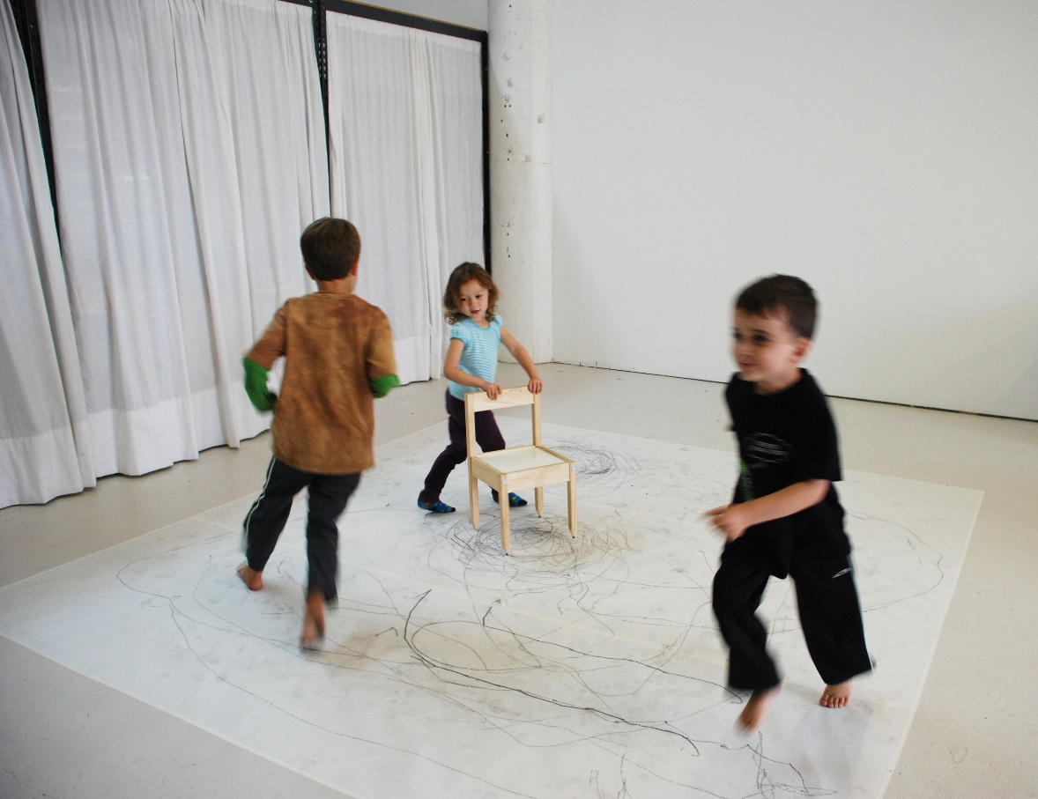
Art as Play
Rebecca Szeto created The Drawing Chair: Performance Piece for the Fidgety Child after her daughter accidentally broke a chair.
  Art as a fun solution to broken furniture creates a collaborative, interactive drawing
Figure 12.29. Rebecca Szeto, Drawing Chair: Performance Piece for the Fidgety Child, 2014.
Notes:
FIGURE 12.29 Rebecca Szeto, Drawing Chair: Performance Piece for the Fidgety Child, 2014. Graphite pencil leads, wood, metal, and Masonite, 20 × 11.5 × 11.5 in. Courtesy of the artist.

Slide 46
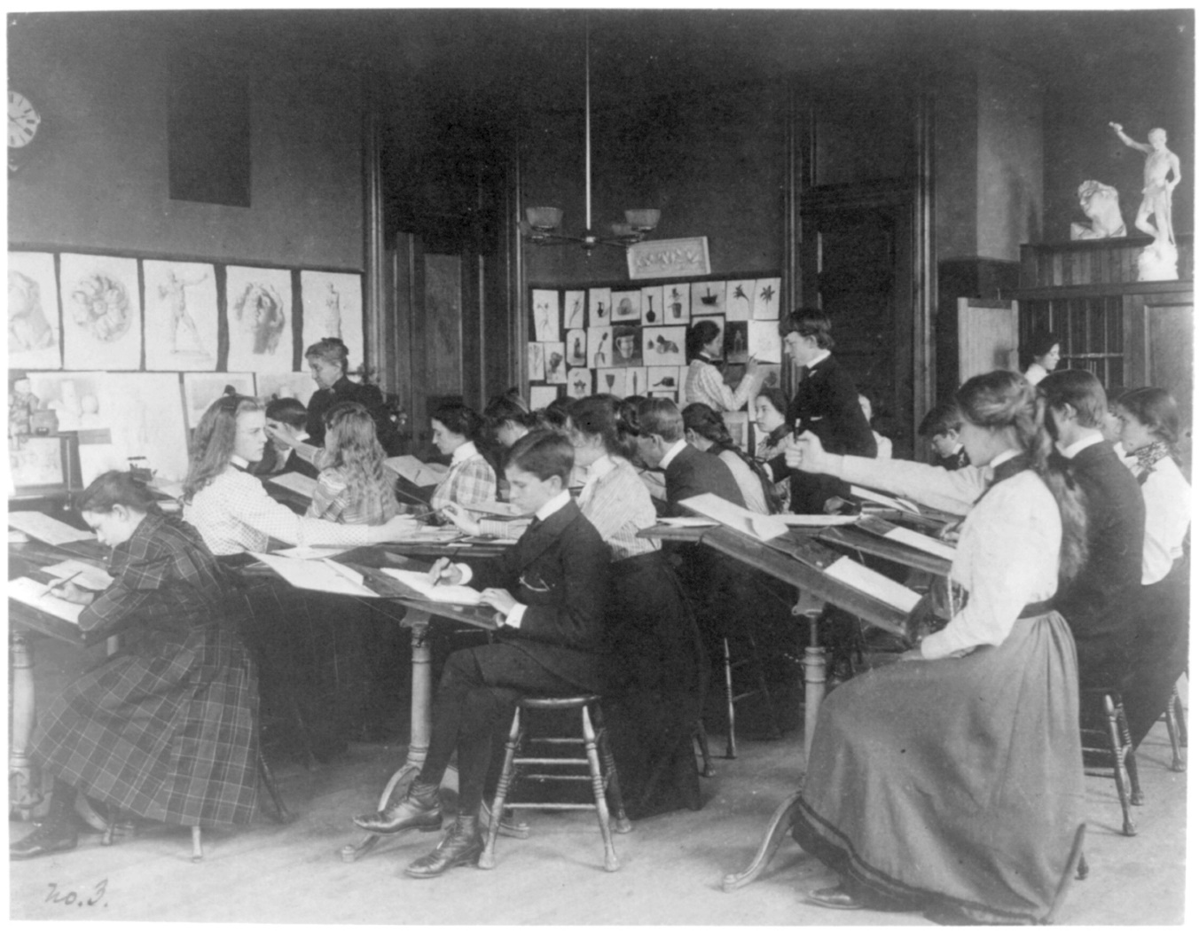
Art Classes
Learning about art takes place through the appreciation of the works of others as well as the work you make yourself.
  College classes are one option, but not the only avenue
Figure 12.30. Students drawing in an art class, Western High School, Washington, DC, 1899.
Notes:
FIGURE 12.30 Students drawing in an art class, Western High School, Washington, DC, 1899. Photograph by Frances Benjamin Johnston. Library of Congress Prints and Photographs Division Washington, DC.

Slide 47
Continuing Education Classes in Art
Several venues offer continuing education art classes, including:
  Community centers
  Public libraries
  Senior centers
  Art galleries
  Museums
While most continuing education classes are focused on adults, museums aim to provide educational experiences for all ages and abilities.

Slide 48
Courses Close to You
Other sources of art instruction may be closer than you think. Here are a few options:
  Craft and art supply stores
  Private lessons at an artist’s studio
  Free classes through MOOCs (massive open online courses)
  Thrift store art supplies

Slide 49
Art is for Everyone
Art is for everyone—and we can find art in everyone, too.
  Making art can help us return to the childlike boundlessness of expression, finding joy, serenity, and satisfaction in the process
  Historic definitions of art aid in our appreciation of it, but our modern understanding can go even further
  Your ability to find art everywhere will depend on your newfound vocabulary and comprehension of art, which continues to evolve with each encounter

Slide 50
Review and Do
Take a minute to test your understanding of this chapter by answering the following:
  What are some arguments for keeping all museums free and open to the public? What are some arguments for charging admission fees for certain museums? Cite examples from the chapter.
  Why do some people consider graffiti to be art? What distinguishes it from vandalism?
  What is the difference between an advertisement and propaganda? In what contexts are you more likely to see visual art used for persuasive purposes?

Slide 51
Review of Learning Objectives (1 of 2)
Outline the etiquette of art exhibitions.
Compare various art locales, including museums, art fairs, informal galleries, arts districts, and street art.
Explain how artist residencies work.
Illustrate how art represents cultural capital, cultural values, and power structures.
Identify how formal elements and principles are used in advertising.

Slide 52
Review of Learning Objectives (2 of 2)
Define propaganda and explain the positive and negative traits associated with propaganda.
Recognize the creative instinct in both children’s art and outsider art examples.
Outline the stages of the creative process.
Explain how art can be a means of healing, connection, and play.
Determine how access to art making can be equitable

Slide 53
Additional Credits (by Figure Number)
12.2 Courtesy the Anderson Museum of Art;
12.3 Nina Raingold/Getty Images;
12.4 Susan Biddle/The Denver Post via Getty Images;
12.5 Department of Defense / Photo by U.S. Air Force Staff Sgt. Shad Eidson;
12.6 Courtesy the artists;
12.7 Photo by Nina Raingold/Getty Images;
12.9 Photograph by MARELBU;
12.10 Courtesy of the Fine Arts Work Center in Provincetown;
12.19 Courtesy of the National Gallery of Art, Washington, DC;
12.23 Digital Image © 2021 Museum Associates / LACMA. Licensed by Art Resource, NY;
12.24 Getty Images stock photo;
12.25 Courtesy the Department of Defense;
12.26 Courtesy the artist;
12.27 Courtesy the artist;
12.28a Photo by Frank Miller / Image © Lynn Takata, 2011;
12.28b Photo by Frank Miller / Image © Lynn Takata, 2011;
12.29 Courtesy the artist;
12.30 Library of Congress, Prints & Photographs Division, [reproduction number, e.g., LC-J7-1234]

