Slide 1
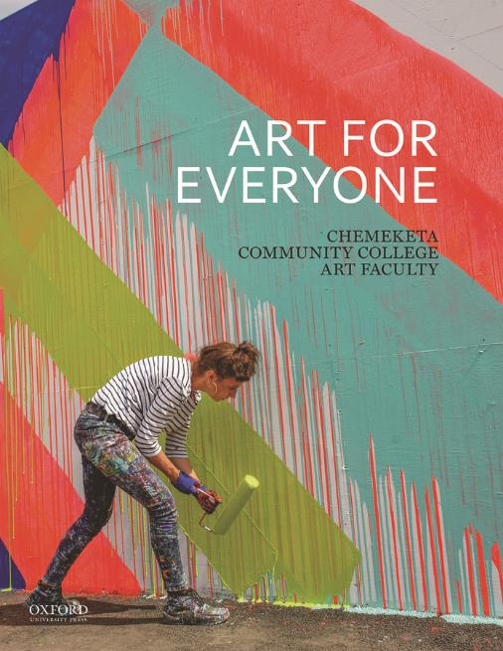
Art for Everyone
by the Chemeketa Community College Art Faculty
Chapter 2: Formal Elements

Slide 2
Learning Objectives (1 of 2)
List the different types of lines and explain the expressive qualities of each.
Using an example from the book, describe some of the ways artists use lines in their compositions.
Using examples from the book, identify the differences between two-dimensional and three- dimensional shape.
Explain value range and cite examples of high- and low-key value range from the book.
Explain how simultaneous contrast works.

Slide 3
Learning Objectives (2 of 2)
Identify everyday examples of additive and subtractive color.
List the three main attributes of color and explain their relationship to each other.
Using examples from the chapter, describe the difference between tactile and visual texture.
Explain the difference between three dimensional and two-dimensional space.
Explain how the formal elements of value, color, shape, line, and texture help artists create an illusion of depth.

Slide 4
Formal Elements (1 of 2)
Line
Shape
Value
Color
Texture
Space

Slide 5
Formal Elements (2 of 2)
As you begin reading this chapter, keep these questions in mind:
What is the primary function of the formal elements?
Do all works of art have all formal elements?
What can I learn about a work of art by identifying its formal elements?

Slide 6
The Building Blocks of Art (1 of 2)
Children’s blocks combine in many ways to make new creations
Towers and walls are created from squares, triangles, and rectangles
Artists combine formal elements in the creation of art
Their works may be surprising as well as interesting

Slide 7
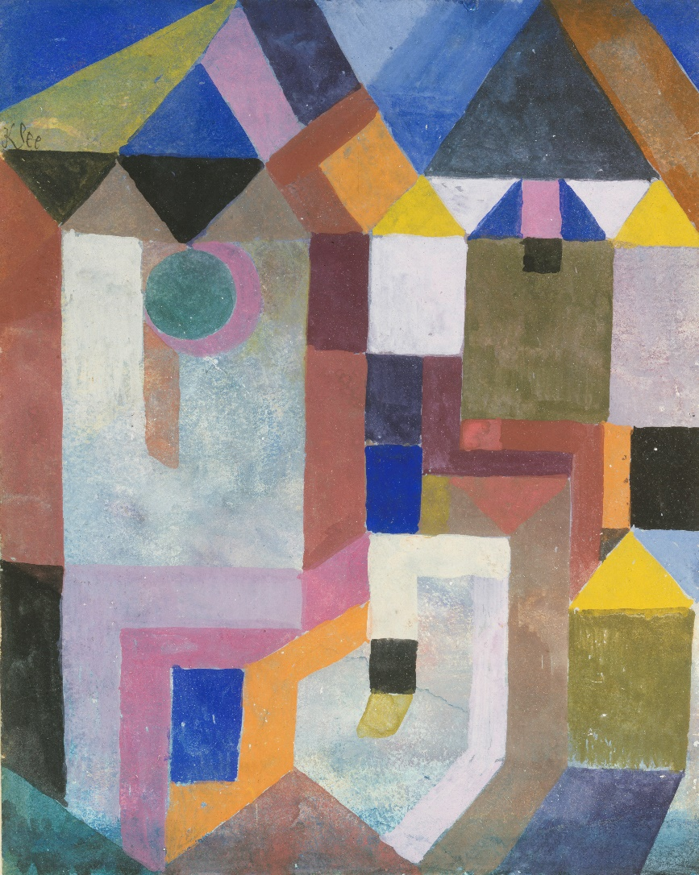
The Building Blocks of Art (2 of 2)
Consider how the formal elements work together in Swiss-German artist Paul Klee’s Colorful Architecture (Figure 2.1).
Notice the use of shape and color
Simple triangles, rectangles, and circles stand in for buildings
Flat color reinforces the geometric shapes
As Klee explains, “Color is the place where our brain and the universe meet.”
Figure 2.1. Paul Klee, Colorful Architecture, 1917.
Notes:
FIGURE 2.1 Paul Klee, Colorful Architecture, 1917. Gouache on paper mounted on cardboard, 10.25 × 7.875 in. The Berggruen Klee Collection, 1984, The Metropolitan Museum of Art, New York.

Slide 8
Line
We can define line as a mark noticeably longer than it is wide.
Paul Klee says that a line is a dot that goes for “a walk”
Can be the path of the pencil on the paper or the edges of objects in the real world
Artists can use lines in expressive ways

Slide 9
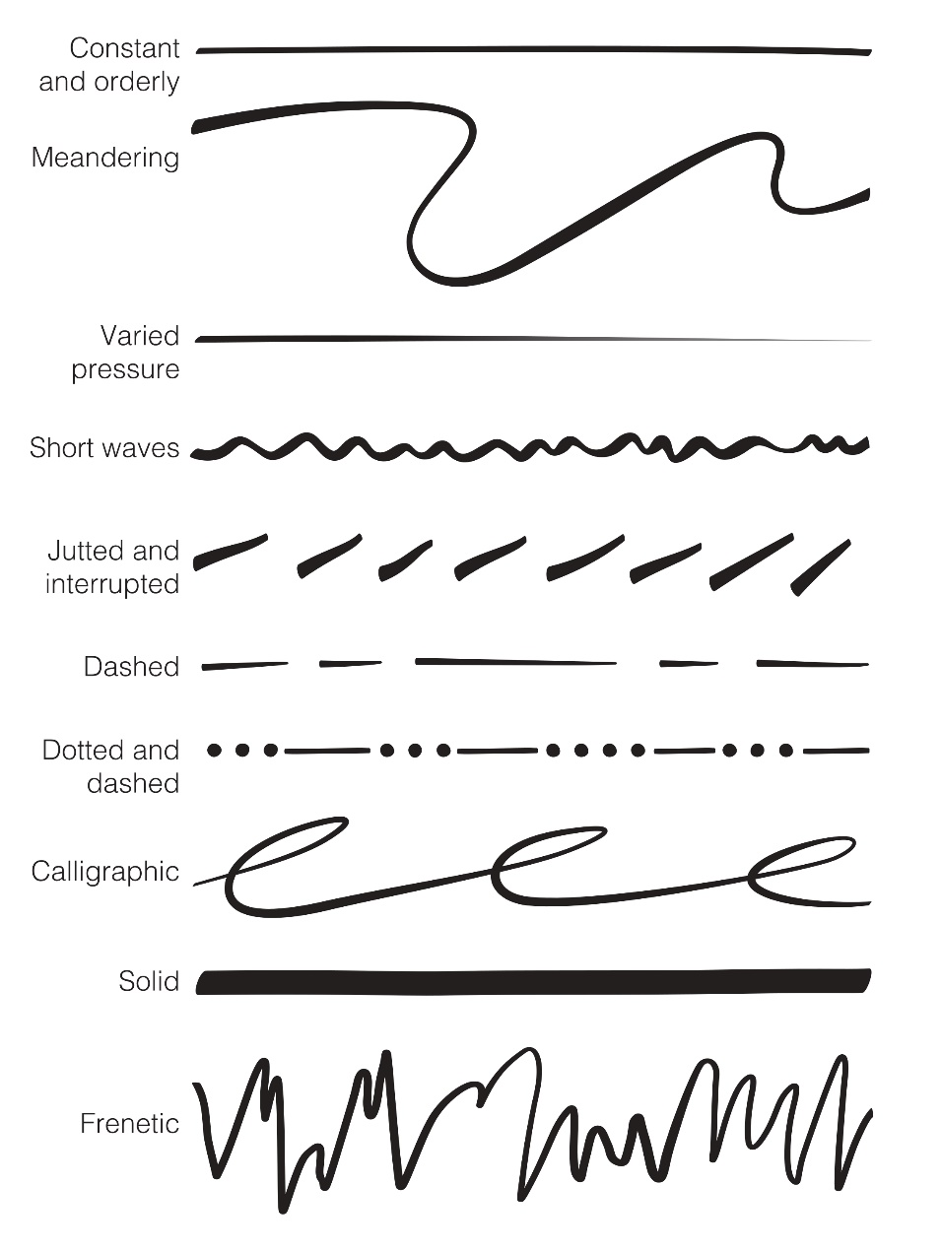
Expressive Lines (1 of 3)
An artist can use lines to
Define shapes
Suggest mood or movement
Figure 2.2. Illustration of line variation.
Notes:
FIGURE 2.2 Illustration of line variation.

Slide 10
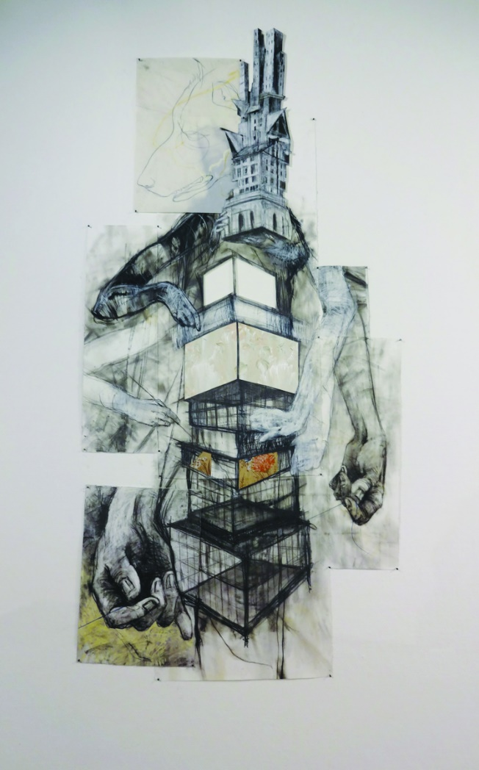
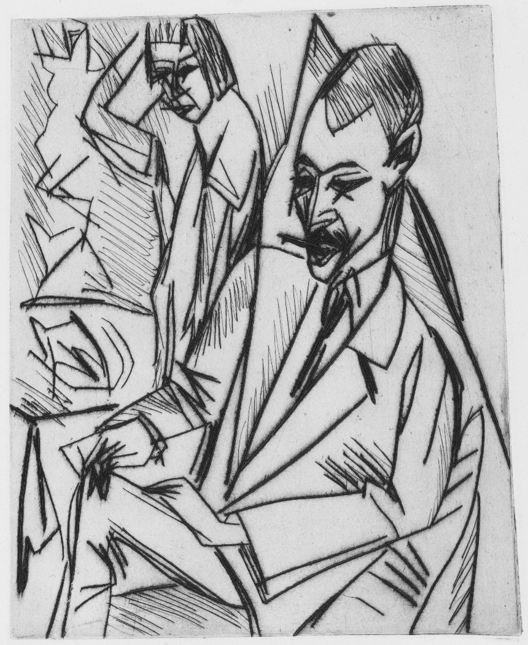
Expressive Lines (2 of 3)
Figure 2.3. Example of rectilinear and geometric line. Andrew Myers, Stack #1, 2013.
Figure 2.4. Example of jagged lines. Ernst Ludwig Kirchner, Gewecke and Erna (Gewecke und Erna), 1913.
Notes:
FIGURE 2.3 Example of rectilinear and geometric line. Andrew Myers, Stack #1, 2013. Mixed media on paper, 87 × 48 in. Collection of the artist.
FIGURE 2.4 Example of jagged lines. Ernst Ludwig Kirchner, Gewecke and Erna (Gewecke und Erna), 1913. Drypoint, 10.06 × 8.19 in. The Museum of Modern Art, New York.

Slide 11
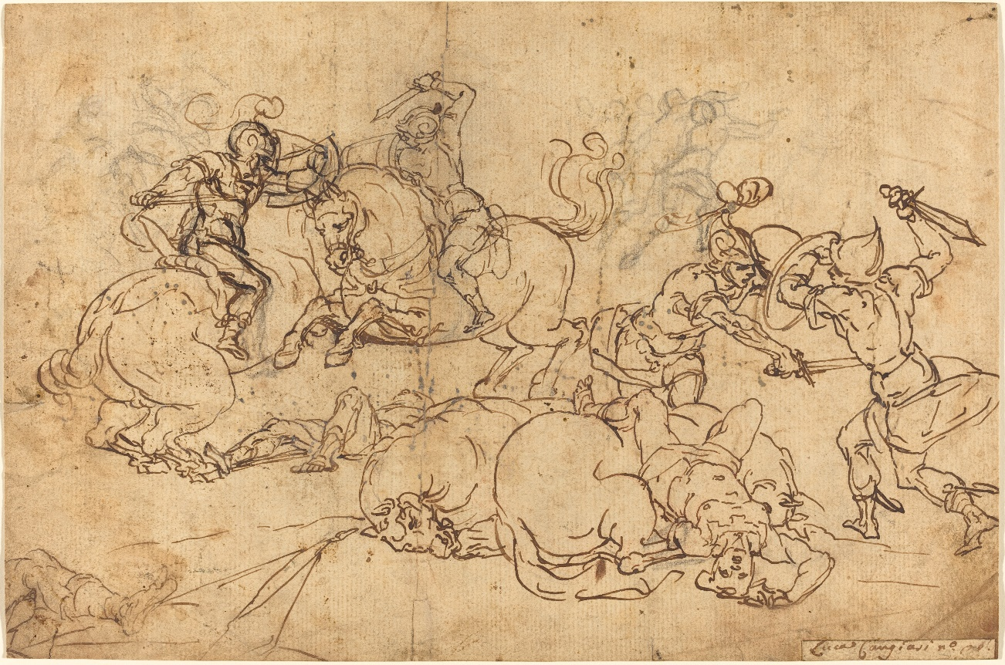
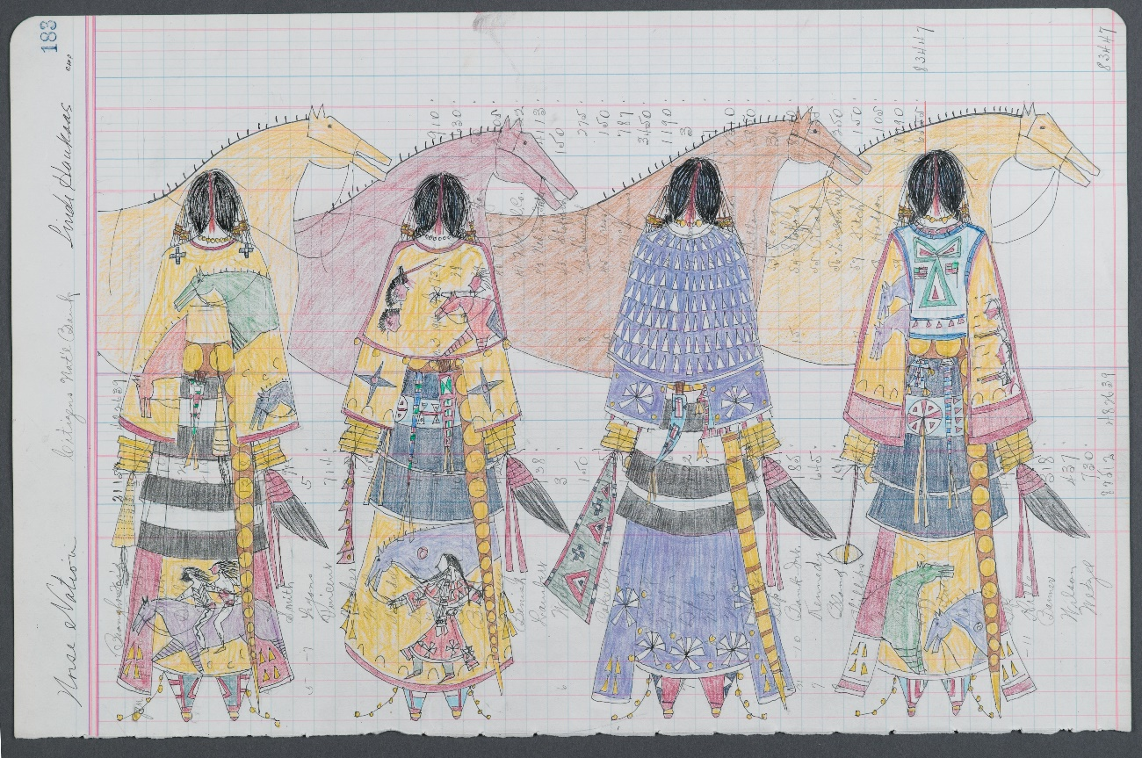
Expressive Lines (3 of 3)
Figure 2.5. Example of curvilinear line. Giovanni Andrea Ansaldo, Soldiers Fighting, ca. 1584–1638.
Figure 2.6. Example of contour and cross contour lines. Linda Haukaas, Horse Nation, 2010.
Notes:
FIGURE 2.5 Example of curvilinear line. Giovanni Andrea Ansaldo, Soldiers Fighting, ca. 1584–1638. Pen and brown ink over black chalk on laid paper, 7.25 × 11 in. Joseph F. McCrindle Collection, National Gallery of Art, Washington, DC.
FIGURE 2.6 Linda Haukaas, Horse Nation, 2010. Colored pencil and ink on late 1916 ledger paper, 11.5 × 17.6 in. Brooklyn Museum of Art, New York.

Slide 12
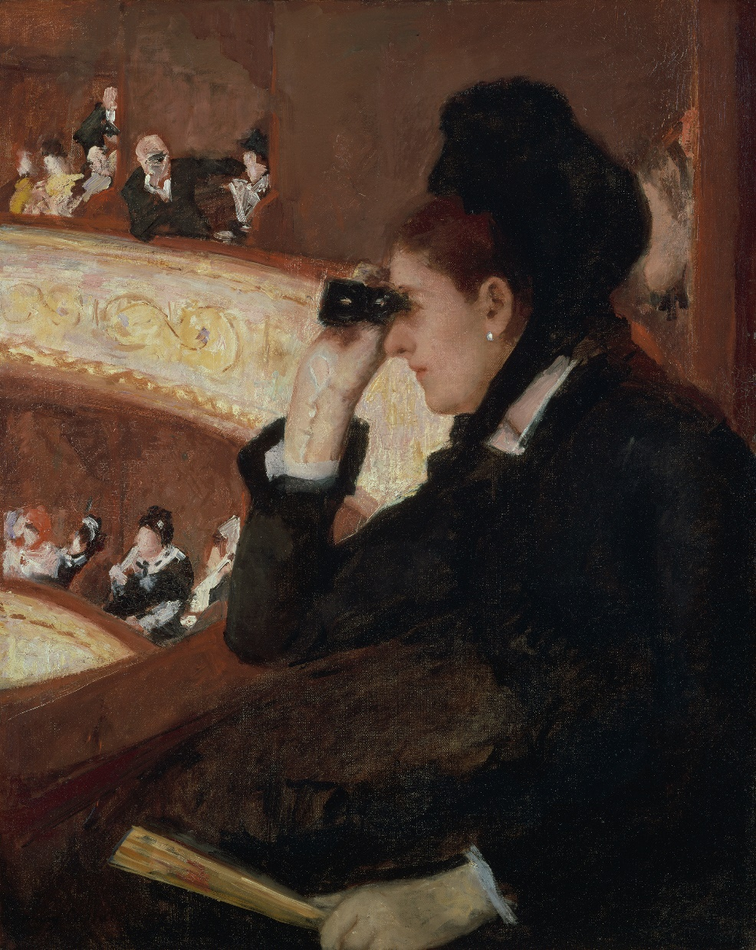
Close Examination: Line in Mary Cassatt’s In the Loge (1 of 2)
Figure 2.7. Mary Cassatt,
In the Loge, 1878.
Notes:
FIGURE 2.7 Mary Stevenson Cassatt, In the Loge, 1878. Oil on canvas, 32 × 26 in. Museum of Fine Arts, Boston, Massachusetts.

Slide 13
Close Examination: Line in Mary Cassatt’s In the Loge (2 of 2)
Actual lines can be found in the
Woman’s elbow and fan
Brushstrokes forming the two balconies
Vertical lines dividing the seated patrons
Implied lines can be found in the
Space between the woman and her opera box
Gaze of the woman at the performance
Gaze of the man looking at the woman through his opera glasses

Slide 14
Shape (1 of 4)
We can define shape as an enclosed area.
Can be created by lines, edges, as well as color, value, or texture changes
Can be two-dimensional (flat) or three-dimensional (with height, width, and depth)

Slide 15
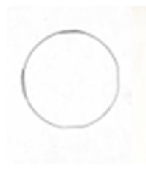
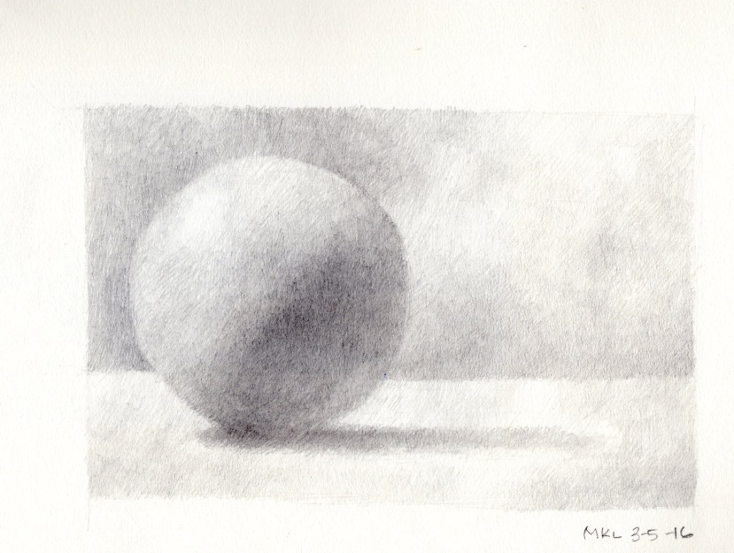
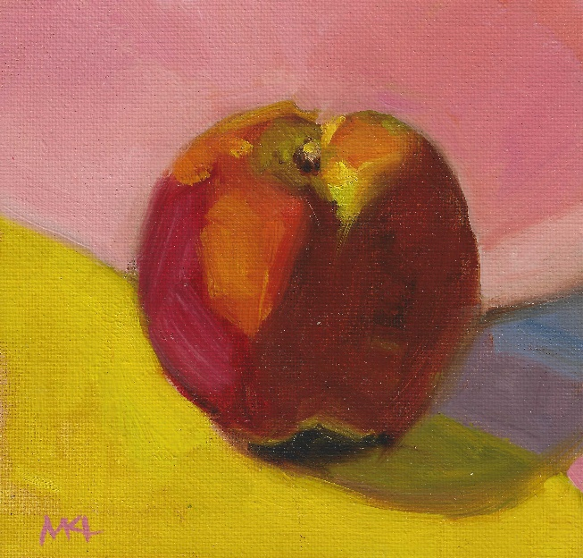
Shape (2 of 4)
Volume is measured by height, weight, and depth.
Relates to an object’s outer edges or dimensions
Can be implied on a two-dimensional surface through shading
Figure 2.8. Hand-drawn circle beside a values sphere and painting of an apple. Artwork courtesy of Marlene Lee.
Notes:
FIGURE 2.8 Example of how value and color create the illusion of three-dimensional space. Hand-drawn circle beside a values sphere (graphite on paper, 2016) and painting of an apple (Apple Against Pink, 2016. Oil on canvas, 6 × 6 in.). Artwork courtesy of Marlene Lee.

Slide 16
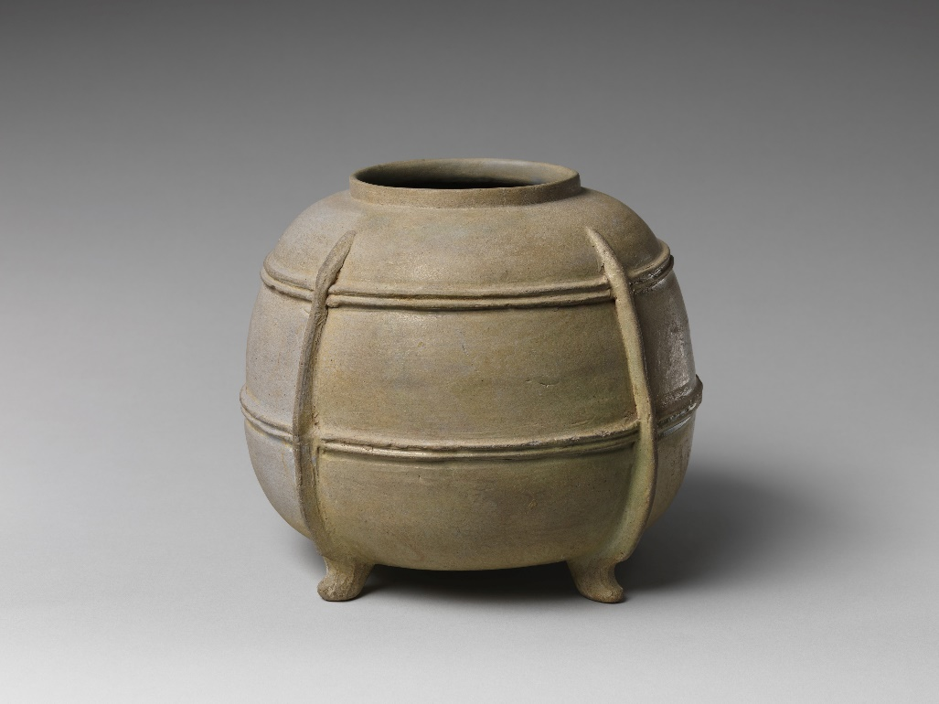
Shape (3 of 4)
Mass is measured by the weight and density of a shape.
If you filled this Japanese Heian jar with plaster, you would refer to the jar’s mass
Figure 2.9. Four-Legged Jar, Heian Period (794–1185 CE), ninth century.
Notes:
FIGURE 2.9 Four-Legged Jar, Heian Period (794–1185 CE), ninth century. Stoneware with green glaze and relief decoration (Sanage ware), 7.31 × 8.75 in. The Metropolitan Museum of Art, New York.

Slide 17
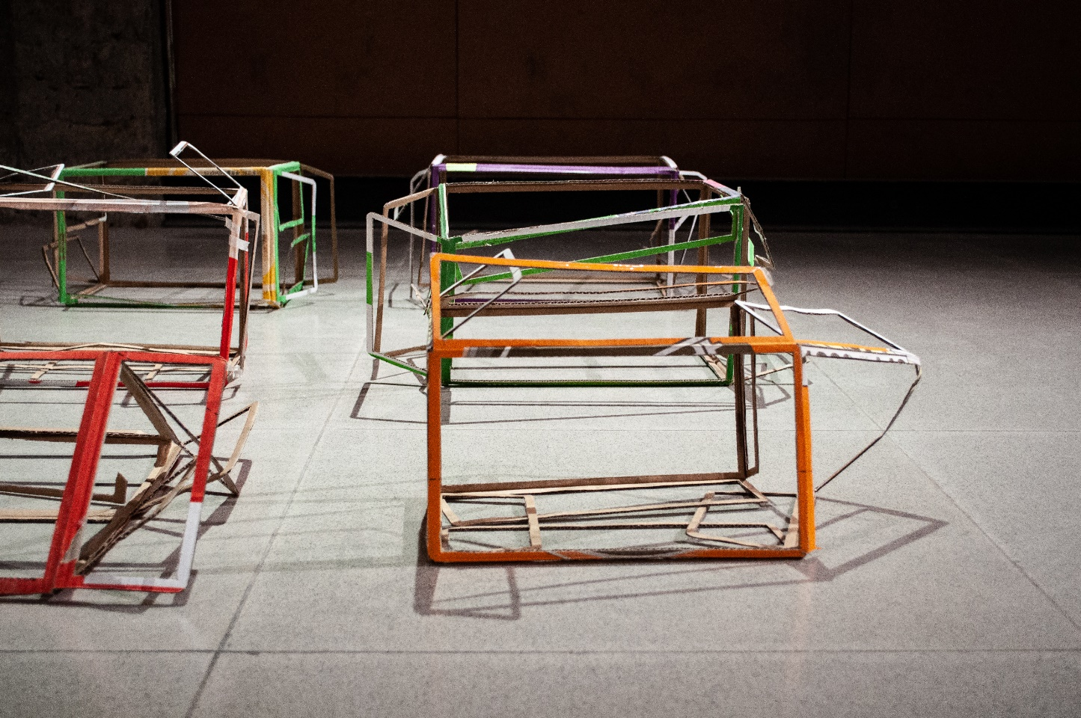
Shape (4 of 4)
Suggested volume can be accomplished by creating physical barriers between the interior and exterior of the art object.
Figure 2.10. Brian Caponi, detail of Without Organs, 2013.
Notes:
FIGURE 2.10 Brian Caponi, detail of Without Organs, 2013. Porcelain, artist’s hair, altered found cardboard boxes, found mirror, digital print, incense, paper, graphite, borrowed coat, video monitor with ten-minute loop. Central Academy of Fine Arts, Gallery 8, Beijing, China.

Slide 18
Expressive Shapes (1 of 3)
Like lines, shapes can be expressive. Their expressive qualities can be demonstrated through the artistic use of two types of shapes: geometric and curvilinear.
Geometric shapes: edges are clean and precise
Curvilinear shapes: designs are based on curved lines, such as those seen in nature

Slide 19
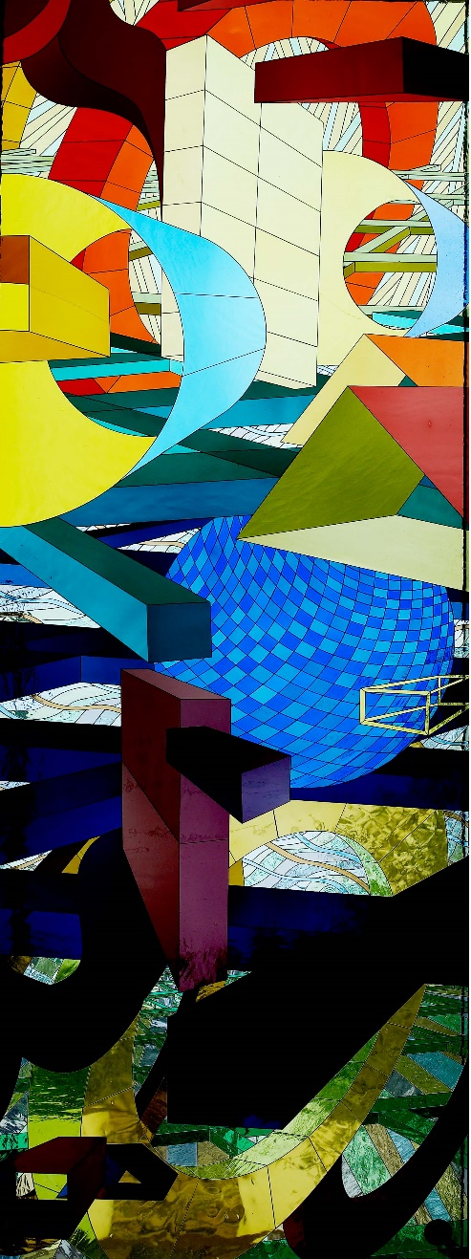

Expressive Shapes (2 of 3)
Figure 2.12. Al Held, Gravity’s Strings, 2005.
Compare the geometric shapes in these works.
Figure 2.11. Paul Kelpe, Machinery (Abstract #2),
1933–1934.
Notes:
FIGURE 2.11 Paul Kelpe, Machinery (Abstract # 2), 1933–1934. Oil on canvas, 38.25 × 26.375 in. Transfer from the US Department of Labor, Smithsonian American Art Museum, Washington, DC.
FIGURE 2.12 Al Held, Untitled, 2006. Art glass window, at U.S. Court House, Orlando, Florida, 50 × 20 ft. Photographs in the Carol M. Highsmith Archive, Library of Congress, Prints and Photographs Division.

Slide 20
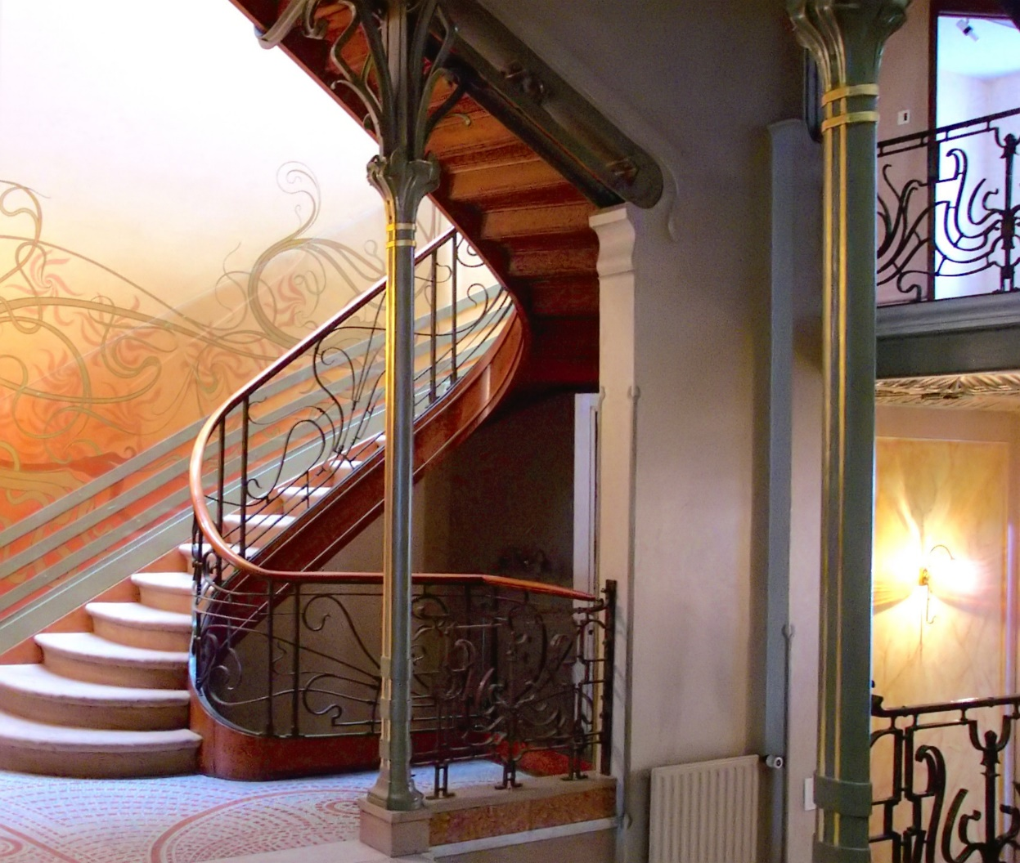
Expressive Shapes (3 of 3)
Identify the curvilinear shapes in this stairway.
Figure 2.13. Victor Horta, Hôtel Tassel Stairway, 1894.
Notes:
FIGURE 2.13 Victor Horta, Hôtel Tassel Stairway, 1894. Brussels, Belgium.

Slide 21
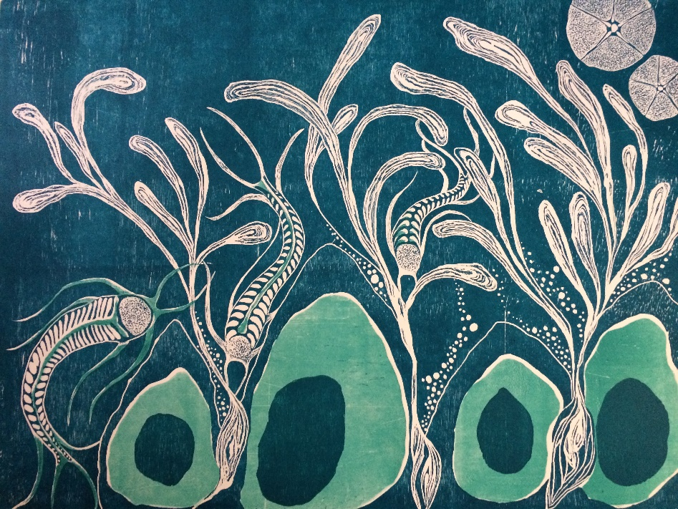

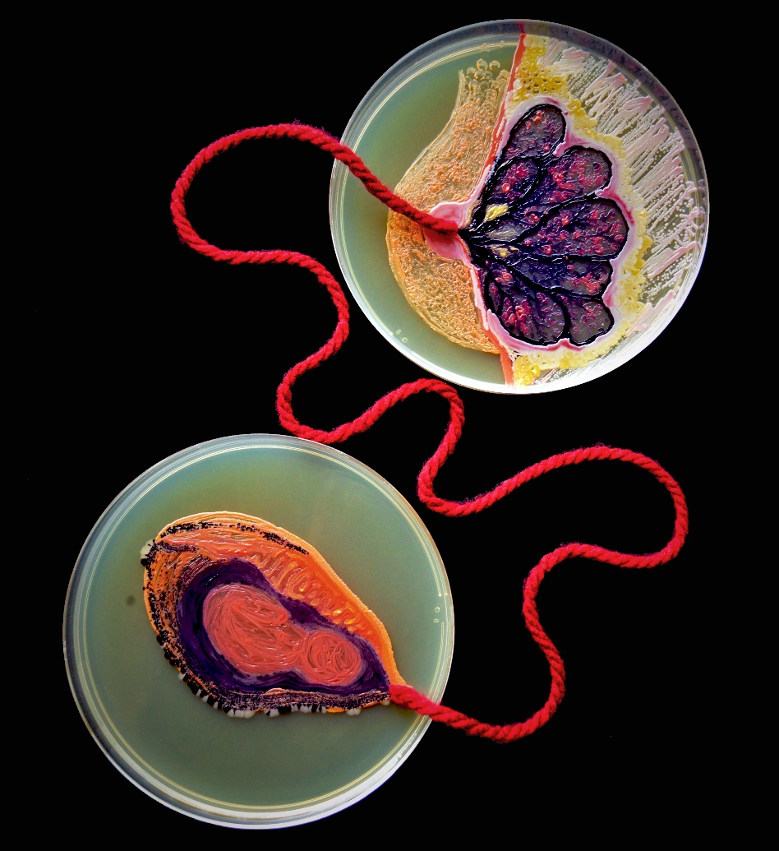
Artist at Work: Maria Peñil Cobo’s Bacteria Paintings
Figure 2.14. Maria Peñil Cobo, Subconscious Landscape II, 2019.
Figure 2.15. Maria Peñil Cobo in the laboratory, New England Biolabs, Ipswich, Massachusetts.
Figure 2.16. Maria Peñil Cobo, Sustenance, 2019.
Notes:
FIGURE 2.14 Maria Peñil Cobo, Subconscious Landscape II, 2019. Woodcut print, 20 × 26.87 in. Collection of the artist.
FIGURE 2.15 Maria Peñil Cobo in the laboratory, New England Biolabs, Ipswich, Massachusetts. Photo courtesy of the artist.
FIGURE 2.16 Maria Peñil Cobo, Sustenance, 2019. Agar, arthobacter, nesterenkonia, deinococcus, E. coli, bacteria isolated from Maria’s breast, bacteria isolated from Maria’s daughter’s hands, wool thread, epoxy, 13.8 × 9.7 in. Collection of the artist.

Slide 22
Positive and Negative Shape (1 of 3)
Positive shape: the object in a two-dimensional work of art.
Negative shape: the area outside the object.
When a two-dimensional work creates the illusion of three-dimensional space, we refer to the relationship between positive and negative shape as positive and negative space.

Slide 23
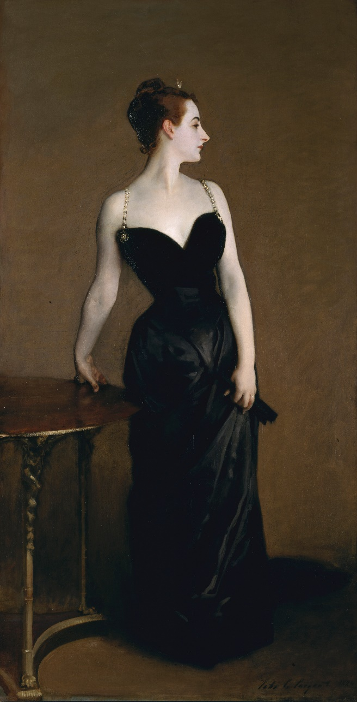
Positive and Negative Shape (2 of 3)
Figure 2.17. John Singer Sargent, Madame X (Madame Pierre Gautreau), 1883–84.
Positive and negative shape can also be referred to as the figure-ground relationship.
In Madame X by American expatriate artist John Singer Sargent:
The woman is the positive shape (figure)
The warm brown area around her is the negative shape (ground)
Notes:
FIGURE 2.17 John Singer Sargent, Madame X (Madame Pierre Gautreau), 1883–84. Oil on canvas, 82.125 × 43.25 in. Arthur Hoppock Hearn Fund, 1916. The Metropolitan Museum of Art, New York.

Slide 24
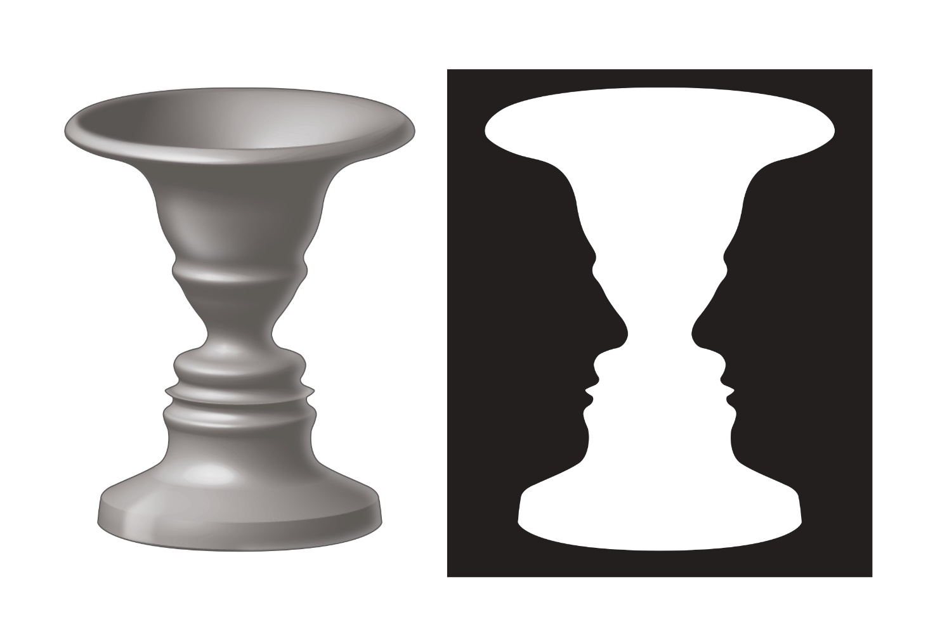
Positive and Negative Shape (3 of 3)
When looking at these two images, which do you see first, the vase or the faces?
Rubin’s Vase:
Based on Edgar Rubin’s research into how we see positive and negative shapes
Figure 2.18. Example of positive shape (on left) and negative shape (on right).
Notes:
FIGURE 2.18 Example of positive shape (on left) and negative shape (on right).

Slide 25

Value (1 of 2)
We can define value as the lightness or darkness of a given area.
The eye sees a wider range of values than color
Artists can control mood through value
Illusion of depth and space can be created through value
Value range divided into:
High-key value (light)
Mid-key value (in the middle zone of the value scale)
Low-key value (dark)
Figure 2.19.
Illustration of a ten-step value scale.
Notes:
FIGURE 2.19 Illustration of a ten-step value scale.

Slide 26
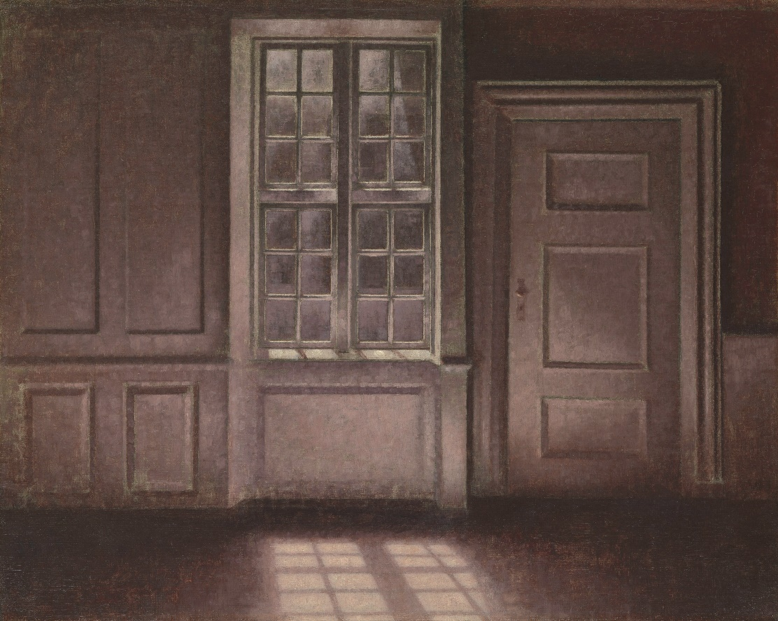
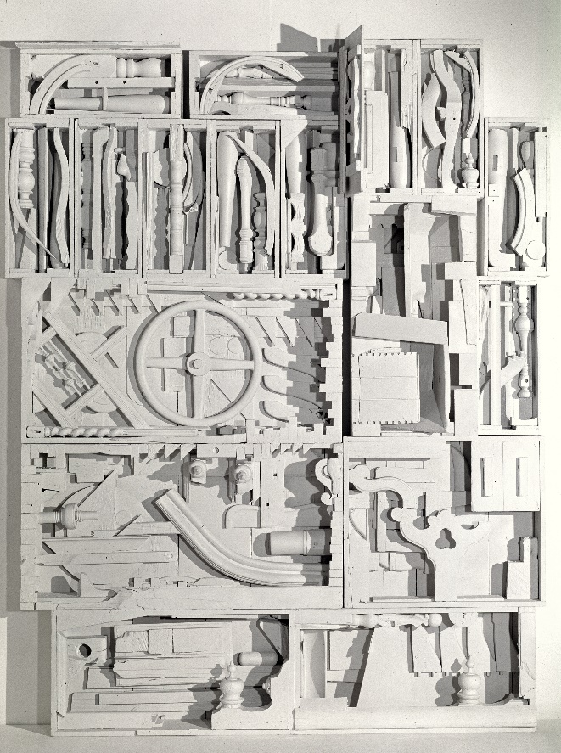
Value (2 of 2)
Compare the use of value in these two works.
Figure 2.20
Vilhelm Hammershøi, Moonlight, Strandgade 30, 1900–1906.
Figure 2.21. Louise Nevelson, Dawn’s Wedding Chapel IV, 1960.
Notes:
FIGURE 2.20 Vilhelm Hammershøi, Moonlight, Strandgade 30, 1900–1906. Oil on canvas, 16.125 × 20.125 in. Purchase, European Paintings Funds, and Annette de la Renta Gift, 2012. The Metropolitan Museum of Art, New York.
FIGURE 2.21 Louise Nevelson, Dawn’s Wedding Chapel IV, 1960. Painted wood, 109 × 87 × 13.5 in. Private collection.

Slide 27
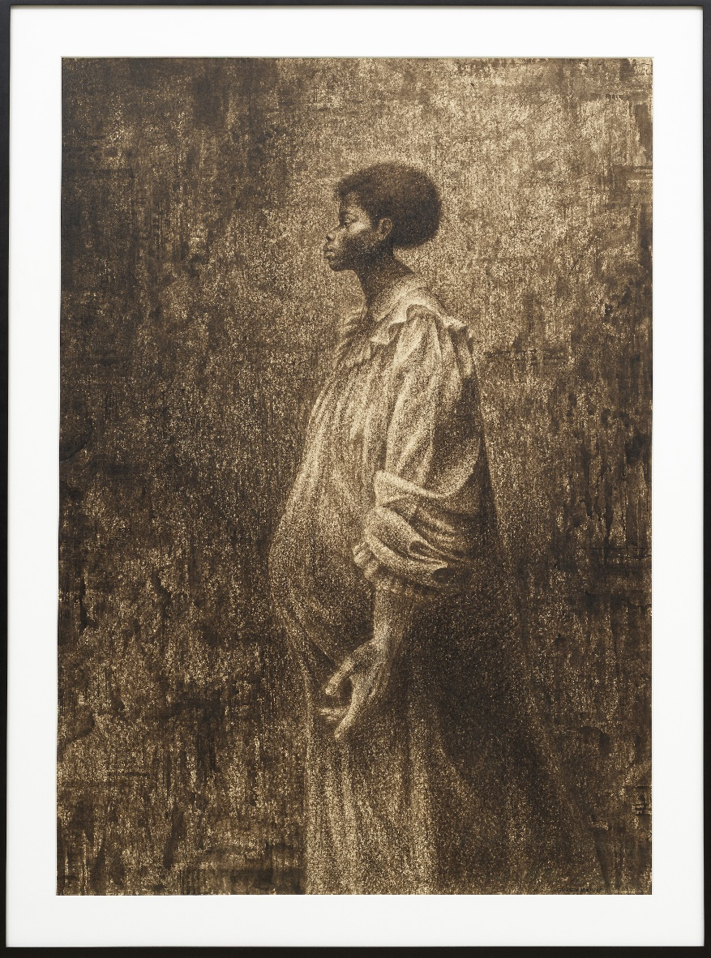

Simultaneous Contrast
Simultaneous contrast is an aspect of value in which the eye perceives lightness or darkness based on surroundings.
Can be used to create figure-ground relationship, such as in Seed of Love (Figure 2.23)
Figure 2.22. Illustration of simultaneous contrast in value.
Figure 2.23. Charles White, Seed of Love, 1969.
Notes:
FIGURE 2.22 Illustration of simultaneous contrast in value.
FIGURE 2.23 Charles White, Seed of Love, 1969. Black ink, 51 × 36 in. Los Angeles County Museum of Art.

Slide 28
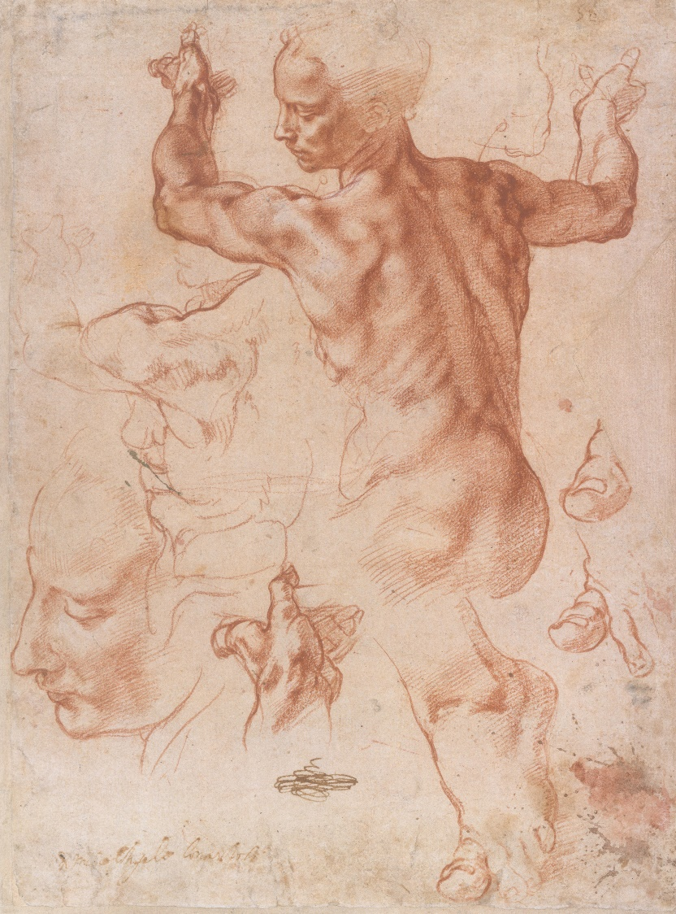
Chiaroscuro
From the Italian words for “light” and “dark,” chiaroscuro gives an object a solid appearance.
Creates light and shadow, giving a work a sense of weight and space.
Michelangelo’s Study of the Libyan Sibyl, Phemonoe, for the Sistine Chapel (Figure 2.24) uses this technique.
Figure 2.24. Michelangelo Buonarroti, detail of Studies for the Libyan Sibyl, ca. 1510–11.
Notes:
FIGURE 2.24 Michelangelo Buonarroti, detail of Studies for the Libyan Sibyl, ca. 1510–11. Red chalk, with small accents of white chalk on the shoulder of the figure in the main study, 11.375 × 8.437 in. Purchase, Joseph Pulitzer Bequest, 1924, The Metropolitan Museum of Art, New York.

Slide 29
Color (1 of 2)
Additive Color System:
Rays of red, green, and blue light combine to create a color
Used by computer screens, television displays, smartphones
Subtractive Color System:
Reflection of light off of surfaces, interpreted by eye and brain
Object’s surface absorbs light

Slide 30
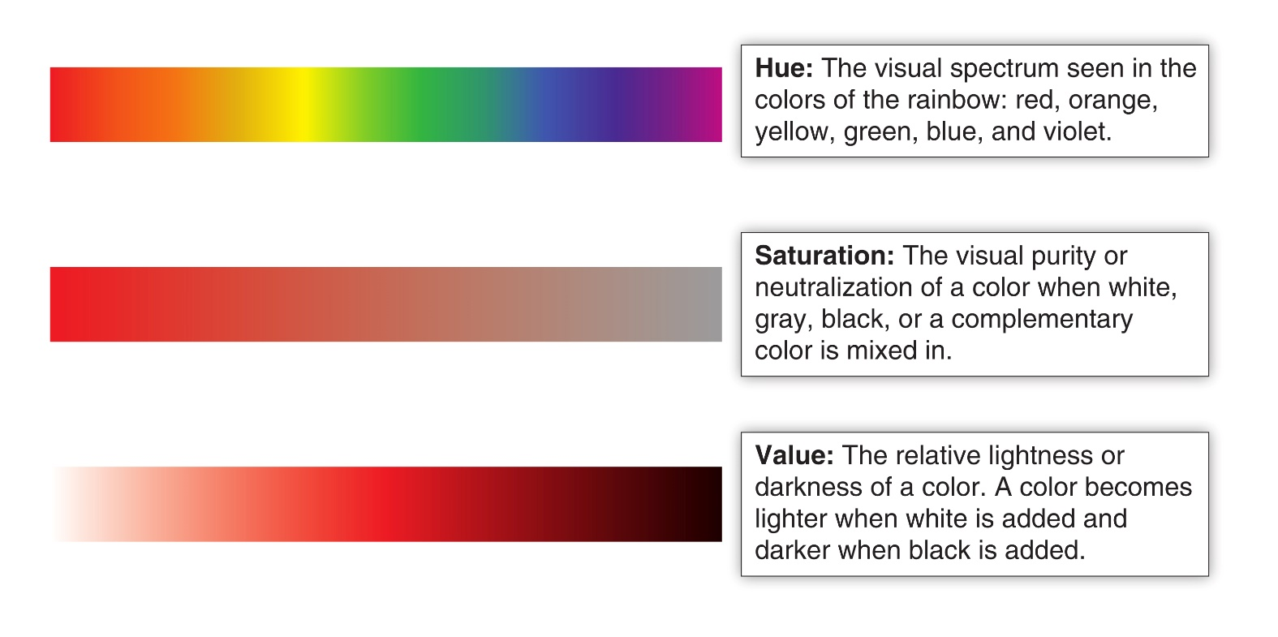
Color Attributes
The three basic attributes of color are hue, saturation, and value.
Figure 2.25. Color fundamentals of hue, saturation, and value. The sample here shows how the saturation and value of the red hue may be modified.
Notes:
FIGURE 2.25 Color fundamentals of hue, saturation, and value. The sample here shows how the saturation and value of the red hue may be modified.

Slide 31
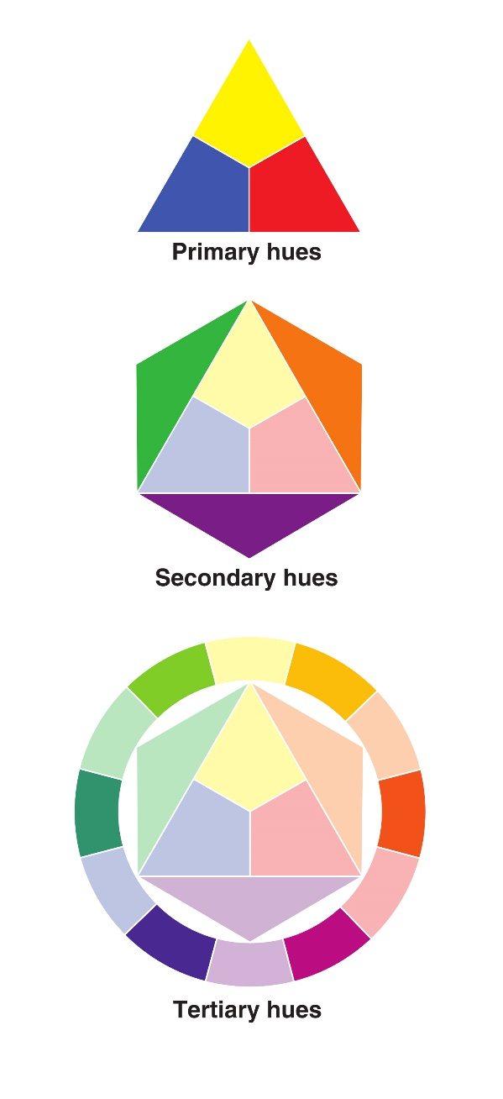
Twelve-Part Color Wheel
Figure 2.26. Example of primary, secondary, and intermediate (tertiary) hues.
Color wheel relationships include:
Primary hues: red, yellow, and blue
Secondary hues: green, orange, and violet
Tertiary hues: mix of primary and secondary colors
Complementary: opposites on the color wheel
Analogous: colors beside one another on the color wheel
Notes:
FIGURE 2.26 Example of primary, secondary, and intermediate (tertiary) hues.

Slide 32
Color Temperature and Color Schemes
Warm colors:
Side of color wheel with yellows, oranges, and reds
Cool colors:
Side of color wheel with greens, blues, and purples
Color schemes:
Groupings of colors that “play well together”
Create a consistent effect
Examples include monochromatic, complementary, and polychromatic color schemes

Slide 33
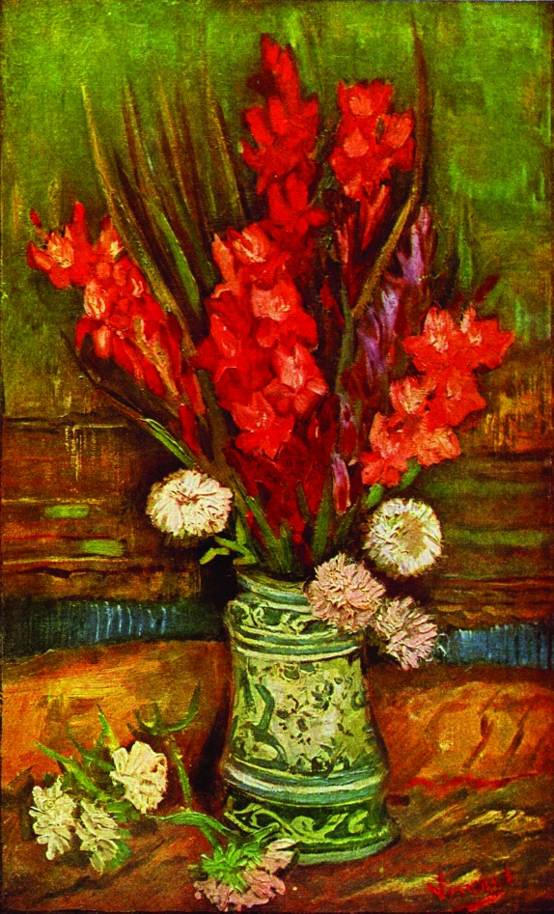
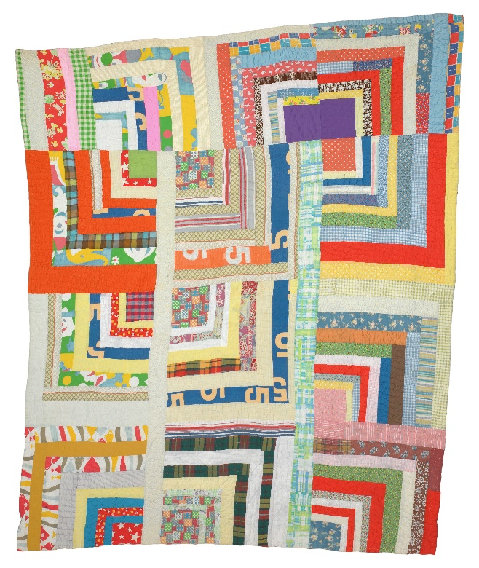
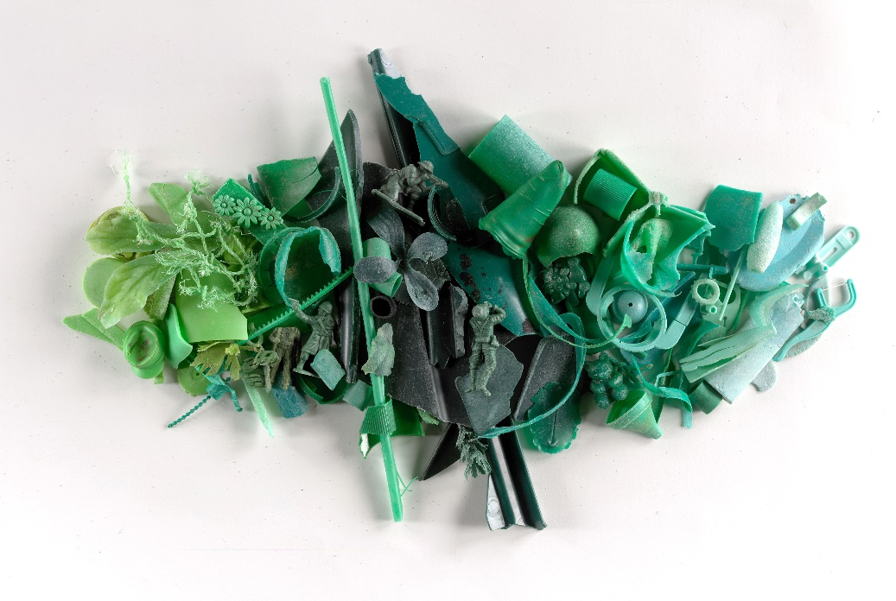
Color Schemes
Identify the color schemes associated with these works.
Figure 2.29.
Rita Mae Pettway, “Housetop,” twelve-block “Half-Log Cabin” variation, ca. 1975.
Figure 2.27. Judith Selby Lang, Chroma Green, plastic collected from Kehoe Beach Point Reyes National Seashore, 2012.
Figure 2.28. Vincent van Gogh, Vase with Red Gladioli, 1886.
Notes:
FIGURE 2.27 Judith Selby Lang, Chroma Green, plastic collected from Kehoe Beach Point Reyes National Seashore, 2012. Photograph, 18 × 36 in. Courtesy of the artist.
FIGURE 2.28 Vincent van Gogh, Vase with Red Gladioli, 1886. Oil on canvas, 25.6 × 15.7 in. Private collection.
FIGURE 2.29 Rita Mae Pettway, “Housetop” twelve-block “Half-Log Cabin” variation, ca. 1975. Cotton, cotton/polyester blend, corduroy, 84 × 70 in. Collection: Soul Grown Deep Foundations, Photograph by Stephan Pitkin.

Slide 34
Objective and Expressive Color
Objective color:
Realistic use of color as found in the natural world
Creates a piece that seems tangible
Not always needed or wanted by artist
Expressive color:
Unexpected use of color in ways that do not reproduce what is seen in the natural world
Can reflect the artist’s feelings

Slide 35
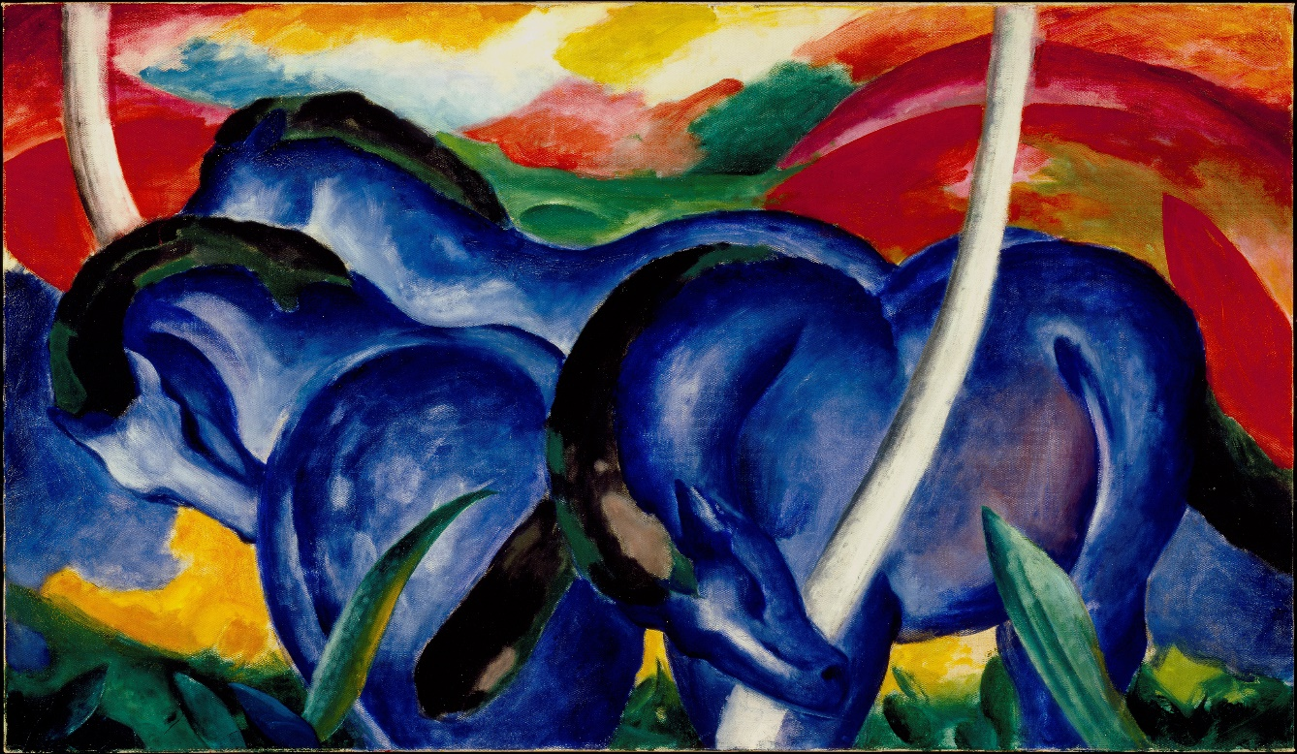
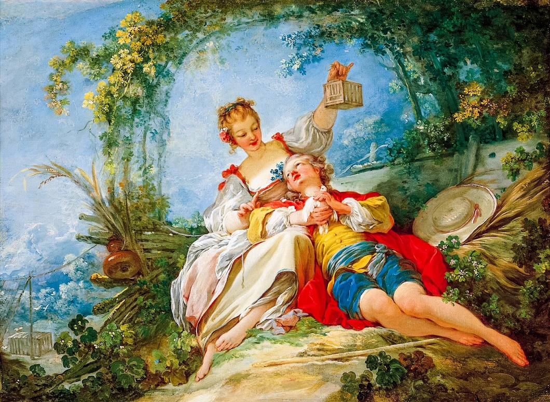
Color (2 of 2)
Describe the use of color in these two works.
Figure 2.30. Franz Marc, The Large Blue Horses, 1911.
Figure 2.31. Jean-Honoré Fragonard, The Happy Lovers, 1760–1765.
Notes:
FIGURE 2.30 Franz Marc, The Large Blue Horses, 1911. Oil on canvas, 41.6 × 71.3 in. Walker Art Center, Minneapolis, Minnesota.
FIGURE 2.31 Jean-Honoré Fragonard, The Happy Lovers, 1760–1765. Oil on canvas, 35.51 × 47.76 in. Norton Simon Museum, Pasadena, California.

Slide 36
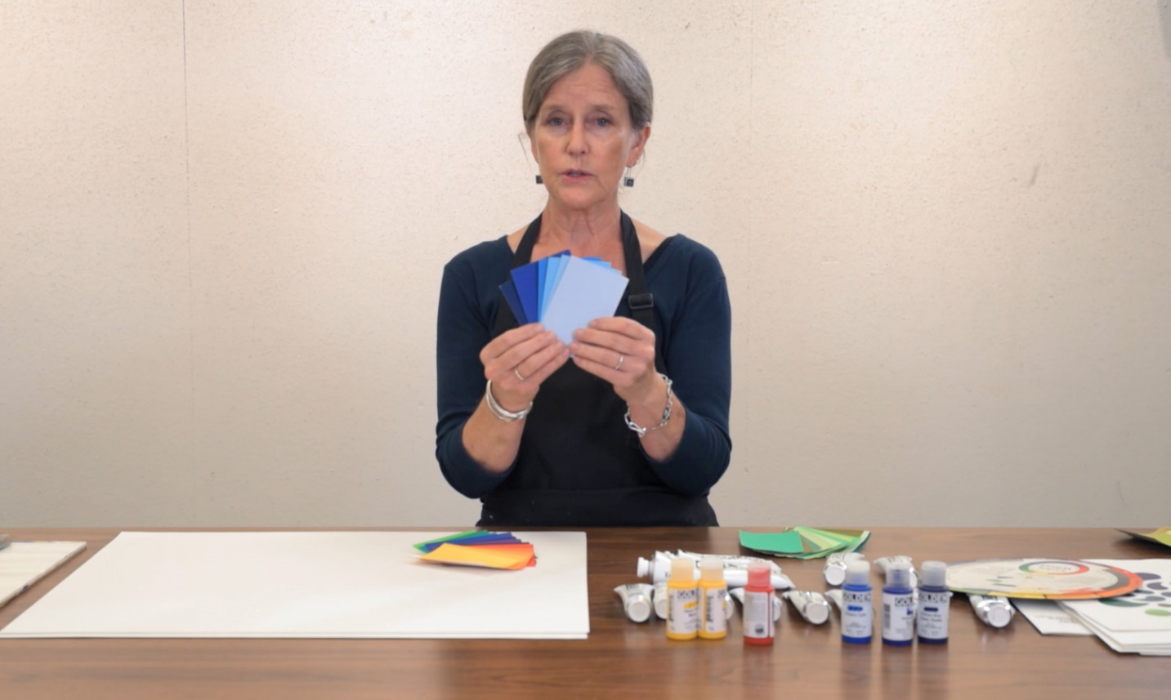
Art in Process: Color
Figure 2.32. In this video, art instructor Kay Bunnenberg Boehmer introduces color mixing.
Notes:
FIGURE 2.32 In this video, art instructor Kay Bunnenberg- Boehmer introduces color mixing, which allows artists to play with paints and better understand how color works. https://iws.oupsupport.com/video/access/content/chemeketa1e-student-resources/chemeketa1e-art-in-process-video-color

Slide 37
Texture
The texture of an object can be defined as how it feels when you touch it.
Can range from provocative to soothing
Might evoke emotional responses in the viewer
Tactile, or physical texture, is the direct feel of a surface under your hand or against your body
Visual texture is the implied texture of an object

Slide 38
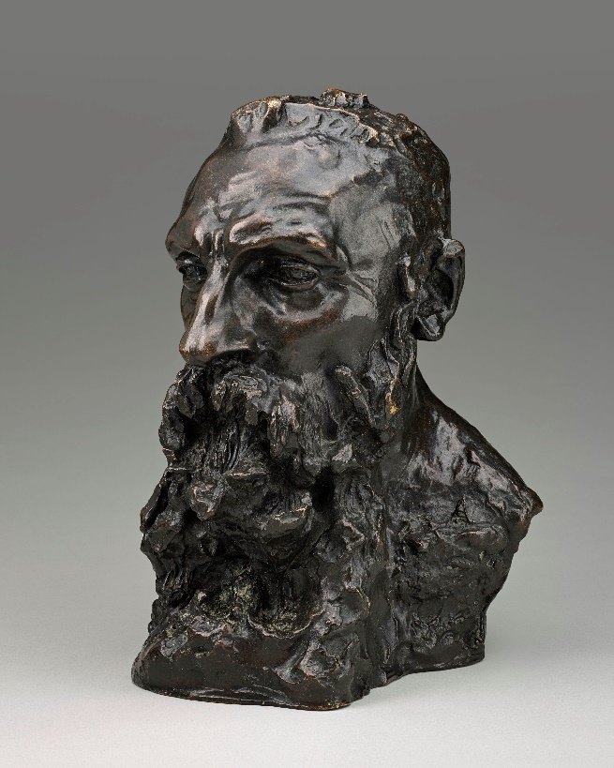
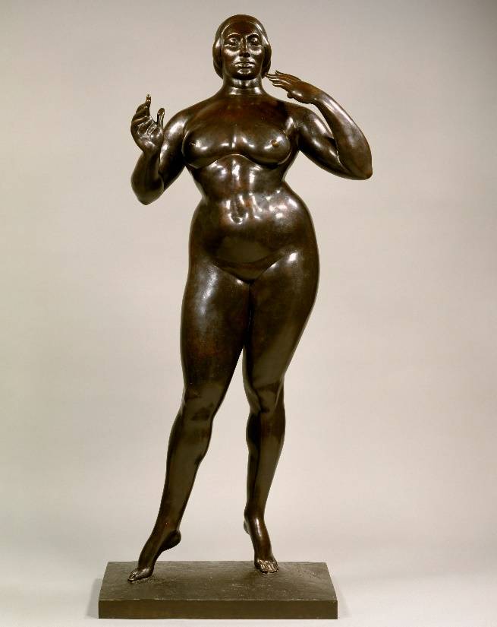
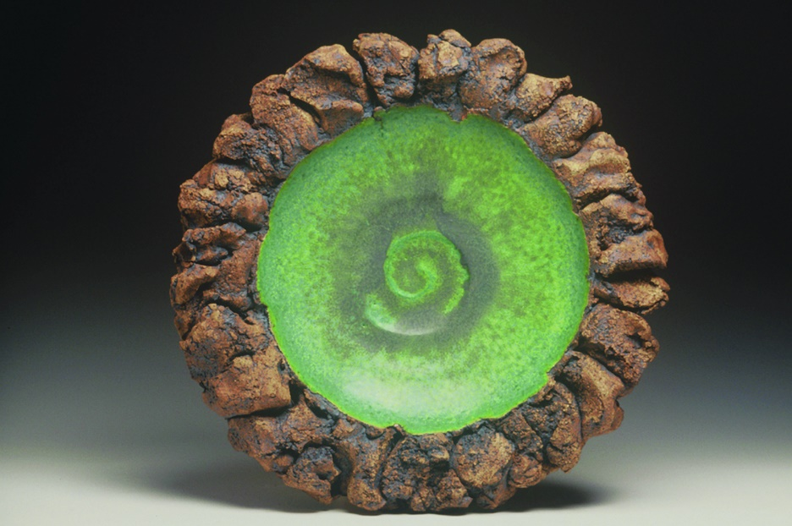
Tactile Texture
Compare the use of texture in these three works.
Figure 2.35. Ginny Marsh, Platter, 2010.
Figure 2.33. Camille Claudel,
Bust of Auguste Rodin, 1892 (cast) 1886–88 (modeled), bronze.
Figure 2.34. Gaston Lachaise, Standing Woman, 1912–15; cast 1930.
Notes:
FIGURE 2.33 Camille Claudel, Bust of Auguste Rodin, 1892 (cast) 1886–88 (modeled), bronze. 15.7 × 9.7 × 11 in. Musée d’art et d’archéologie, Guéret, France. Photograph by Benoît Touchard.
FIGURE 2.34 Gaston Lachaise, Standing Woman, 1912–15; cast 1930. Bronze, 73.875 × 32 × 17.75 in. The Metropolitan Museum of Art, New York.
FIGURE 2.35 Ginny Marsh, Platter, 2010. Stained and glazed stoneware, 3.5 × 18 × 18 in. Collection of the Haan Mansion Museum of Indiana Art.

Slide 39
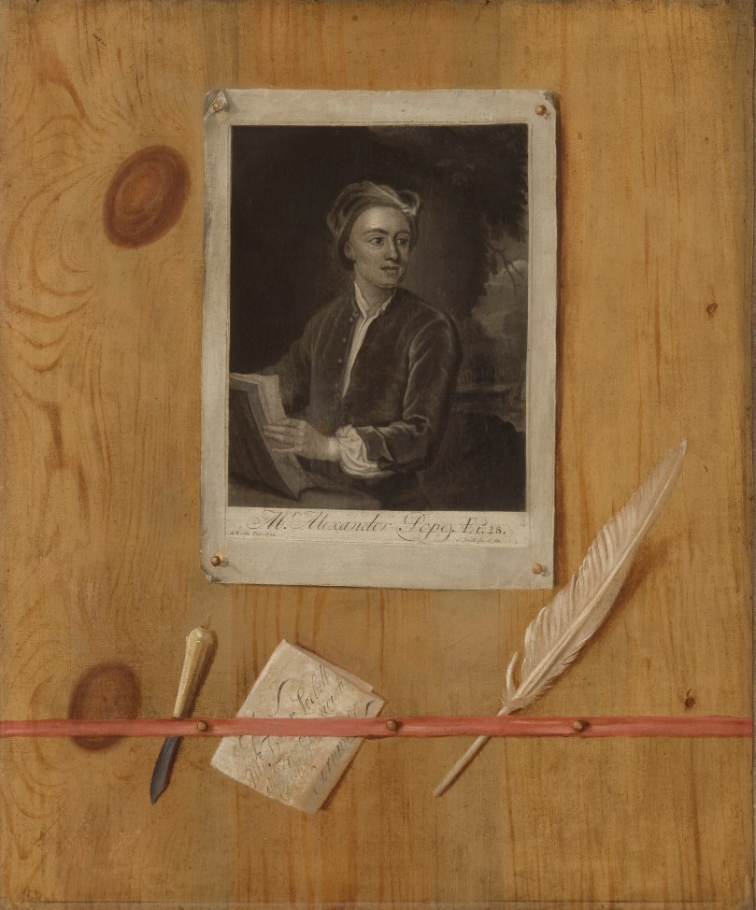
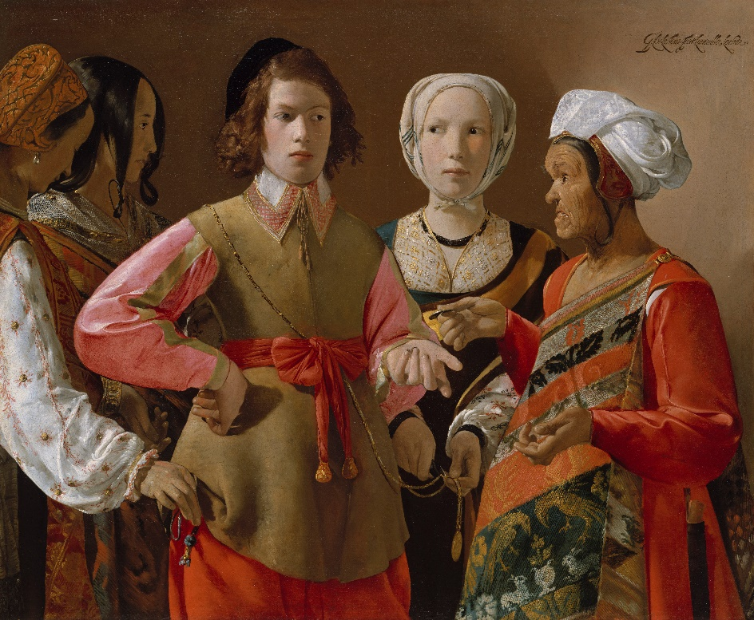
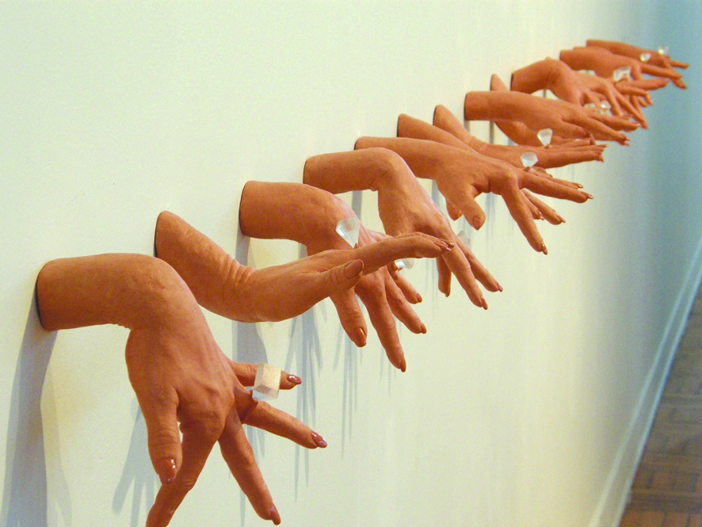
Visual Texture
Compare the use of texture in these three works.
Figure 2.38. Misty Gamble, detail of Tan Hands, from Primping and the Currency of Worth series, 2009.
Figure 2.36. Georges de la Tour, The Fortune Teller, ca. 1630.
Figure 2.37. Trompe L’oeil with a Print of Alexander Pope, ca. eighteenth century.
Notes:
FIGURE 2.36 Georges de la Tour, The Fortune Teller, ca. 1630. Oil on canvas, 40.125 × 48.625 in. The Metropolitan Museum of Art, New York.
FIGURE 2.37 Trompe L’oeil with a Print of Alexander Pope, ca. eighteenth century. Oil on canvas, 29.937 × 25.166 in. John G. Johnson Collection 1917, Philadelphia Museum of Art, Philadelphia.
FIGURE 2.38 Misty Gamble, detail of Tan Hands, from Primping and the Currency of Worth series, 2009. Ceramic and mixed media. Collection of Albrecht-Kemper Museum of Art, Saint Joseph, Missouri.

Slide 40
Space
Space can be defined as the empty area surrounding real or implied objects.
Like texture, space can be actual or visual.
In a sculpture, space surrounds the work and the work takes up space.
In a two-dimensional work, space surrounds the subject matter.
Artists can create an illusion of depth through visual techniques.

Slide 41
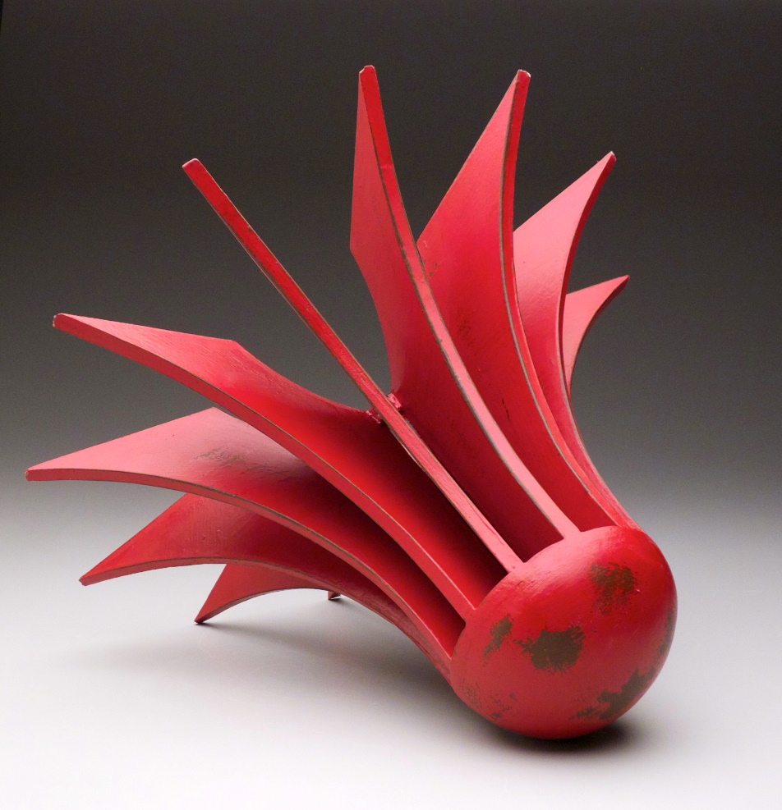
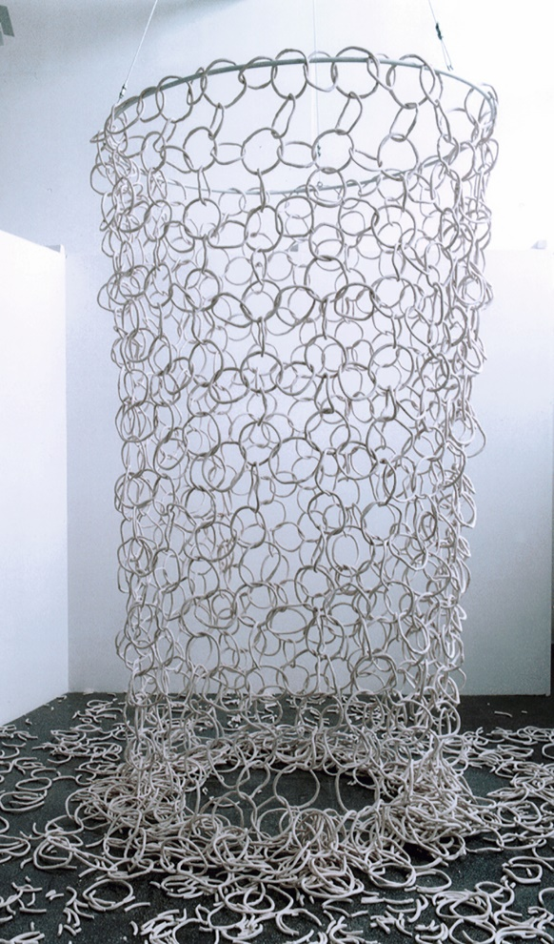
Constructing Three-Dimensional Space
Compare the use of three-dimensional space in these works.
Figure 2.39.
Peter Christian Johnson, Red Turbine, Construction Series, 2011.
Figure 2.40. Backa Carin Ivarsdotter, Self-destructive Porcelain Net, 2003.
Notes:
FIGURE 2.39 Peter Christian Johnson, Red Turbine, Construction Series, 2011. Ceramic, stains, linseed oil, tractor paint, 23.5 × 23.5 × 16.5 in. Collection of the artist.
FIGURE 2.40 Backa Carin Ivarsdotter, Self-destructive Porcelain Net, 2003. Moving installation of high fire hand built porcelain, 177 × 49 × 49 in. World Ceramic Biennial 2003, Icheon, Korea. Photograph by Jesper Hammarström.

Slide 42
Constructing Space on a Two-Dimensional Plane
The picture plane is the surface of a two-dimensional work of art.
Artists manipulate our perceptions of this area to recreate believable spaces and figures or intentionally make them appear unreal or disorienting.
Techniques used by the artist include the illusion of depth (through overlapping, making objects smaller in the distance, etc.), and the illusion of mass (such as through the use of chiaroscuro).

Slide 43
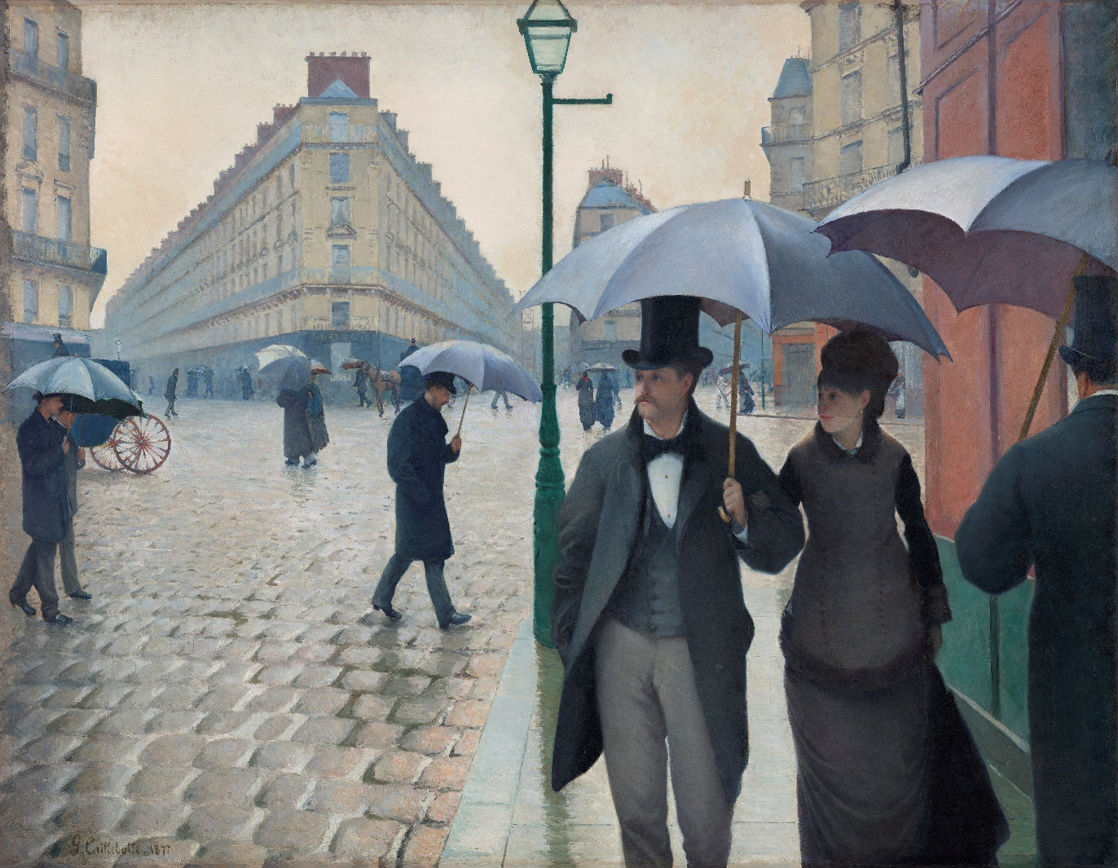
Illusion of Depth (1 of 2)
How does this painting use the illusion of depth?
Figure 2.41. Gustave Caillebotte, Paris Street; Rainy Day, 1877.
Notes:
FIGURE 2.41 Gustave Caillebotte, Paris Street; Rainy Day, 1877. Oil on canvas, 83.5 × 108.75 in. Charles H & Mary F.S. Worcester Collection, Art Institute of Chicago, Illinois.

Slide 44
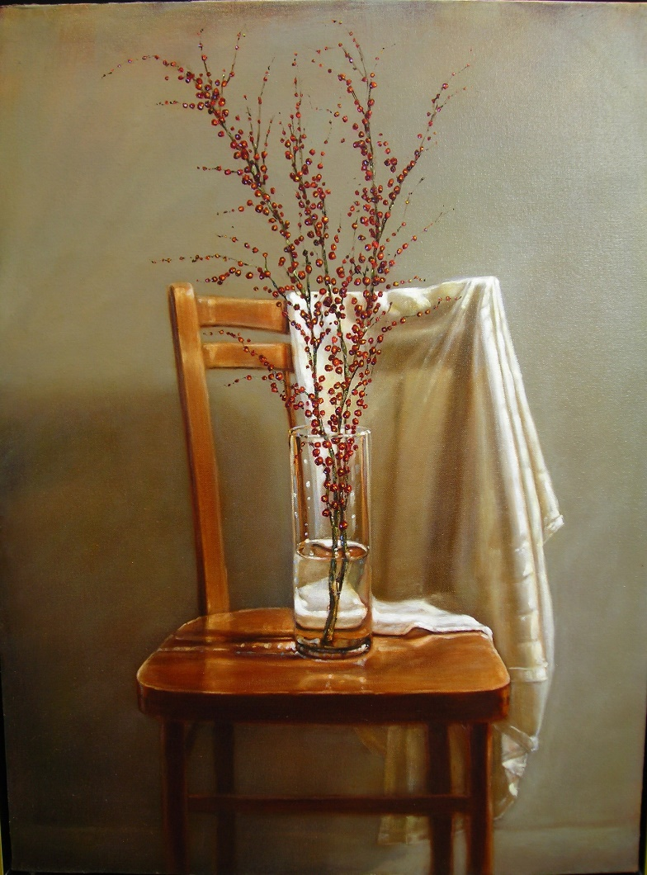
Illusion of Mass
How has the artist used chiaroscuro to create the illusion of mass in this piece?
Figure 2.42. John Van Dreal, Still Life with Chair, Berries and Cloth, 2010.
Notes:
FIGURE 2.42 John Van Dreal, Still Life with Chair, Berries and Cloth, 2010. Oil on canvas, 28 × 36 in. Private collection.

Slide 45
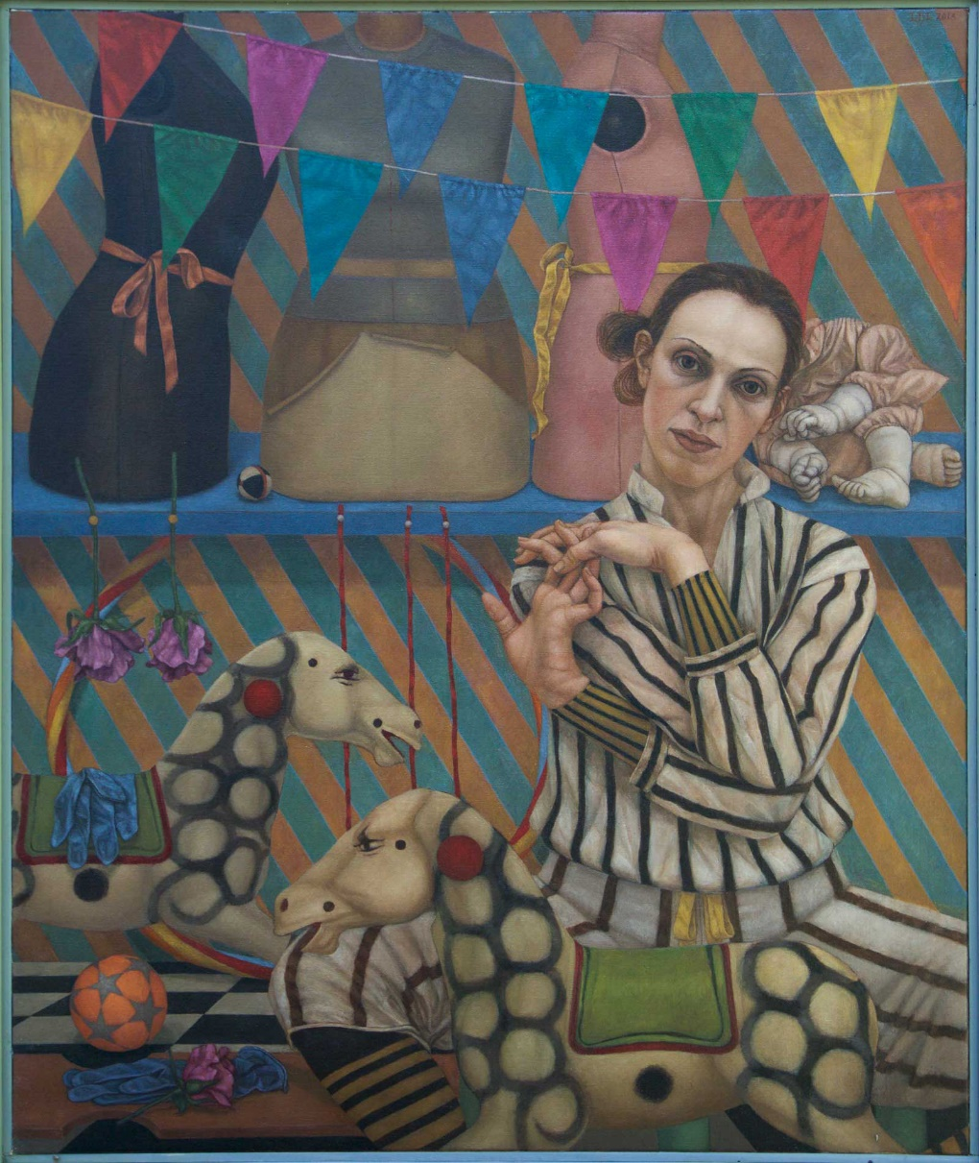
Illusion of Depth (2 of 2)
How does this piece exhibit object permanence and overlapping to support the illusion of depth?
Figure 2.43. Lani Irwin, Epona, 2013.
Notes:
FIGURE 2.43 Lani Irwin, Epona, 2013. Oil on linen, 47.24 × 39.37 in. Collection of the artist.

Slide 46
Atmospheric Perspective (1 of 2)
An artist can use atmospheric perspective by varying values and hues to create the illusion of deep space.
Items closest to our eyes tend to have full color saturation and darkest value.
Warm colors come forward and cool colors recede
Lightening a shape’s value and neutralizing its hue allows it to appear farther away
Frequently used in landscape paintings

Slide 47
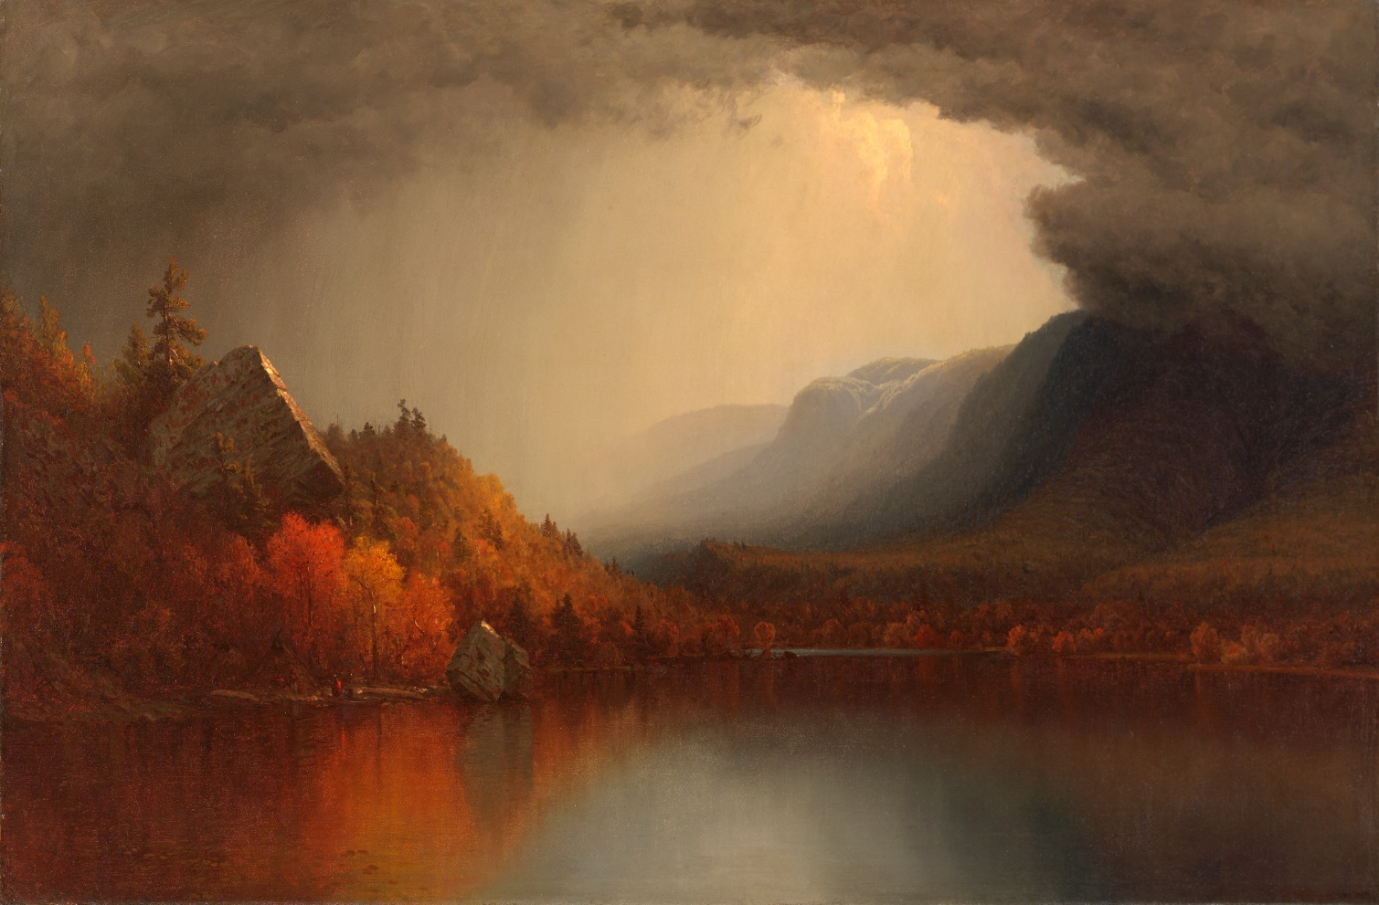
Atmospheric Perspective (2 of 2)
How is atmospheric perspective used in this work?
Figure 2.44. Sanford Gifford, A Coming Storm, 1863; retouched and redated in 1880.
Notes:
FIGURE 2.44 Sanford Gifford, A Coming Storm,1863; retouched and redated in 1880. Oil on canvas, 28 × 42 in. 125th Anniversary Acquisition. Gift of the McNeil Americana Collection, 2004. Philadelphia Museum of Art, Philadelphia.

Slide 48
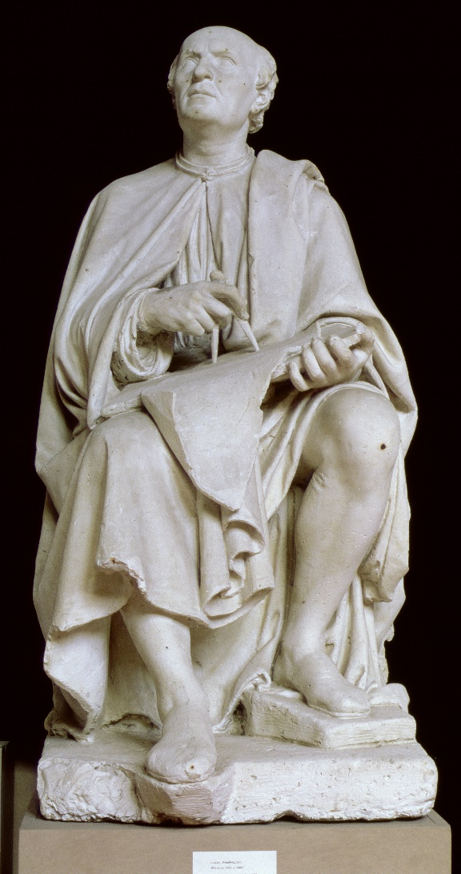
Linear Perspective (1 of 2)
Linear perspective can be defined as the use of a series of lines to guide a precise depiction of space.
Developed by fifteenth-century Italian architect Filippo Brunelleschi to depict three-dimensional buildings on a two-dimensional surface.
The artist locates images in decreasing size along a set of invisible lines that converge at the vanishing point.
Figure 2.45. Luigi Pampaloni,
Filippo Brunelleschi,
ca. 1830.
Notes:
FIGURE 2.45 Luigi Pampaloni, Filippo Brunelleschi, ca.1830. Marble, Piazza del Duomo, Florence, Italy.

Slide 49
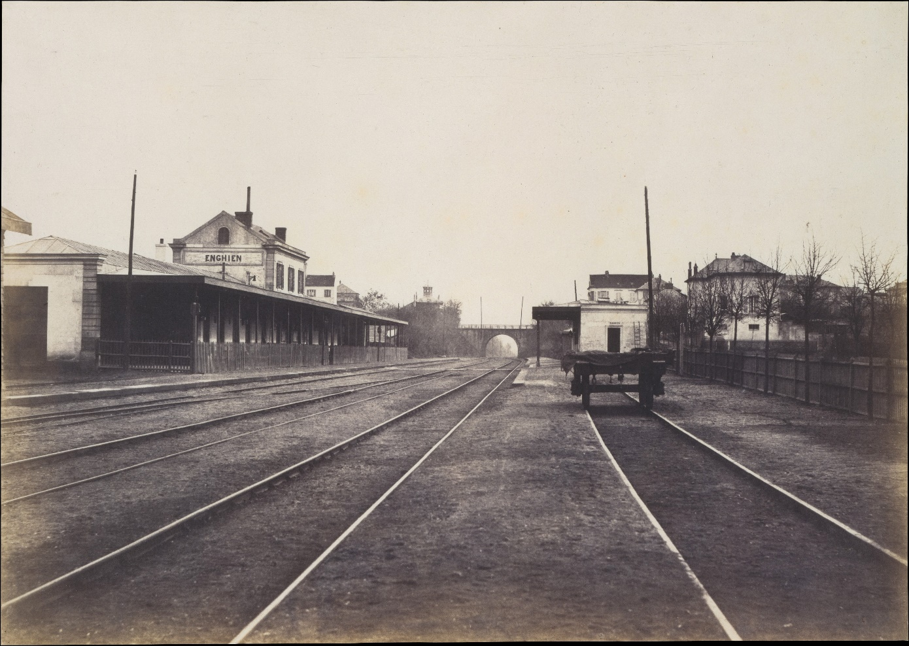
Linear Perspective (2 of 2)
Example of linear perspective in the real world.
Figure 2.46. Edouard Baldus, Gare d'Enghien, 1855.
Notes:
FIGURE 2.46 Example of real-world linear perspective. Edouard Baldus, Gare d’Enghien, 1855. Salted paper print from paper negative, 12.3 × 17.4 in. Louis V. Bell Fund, 1992. TheMetropolitan Museum of Art, New York.

Slide 50
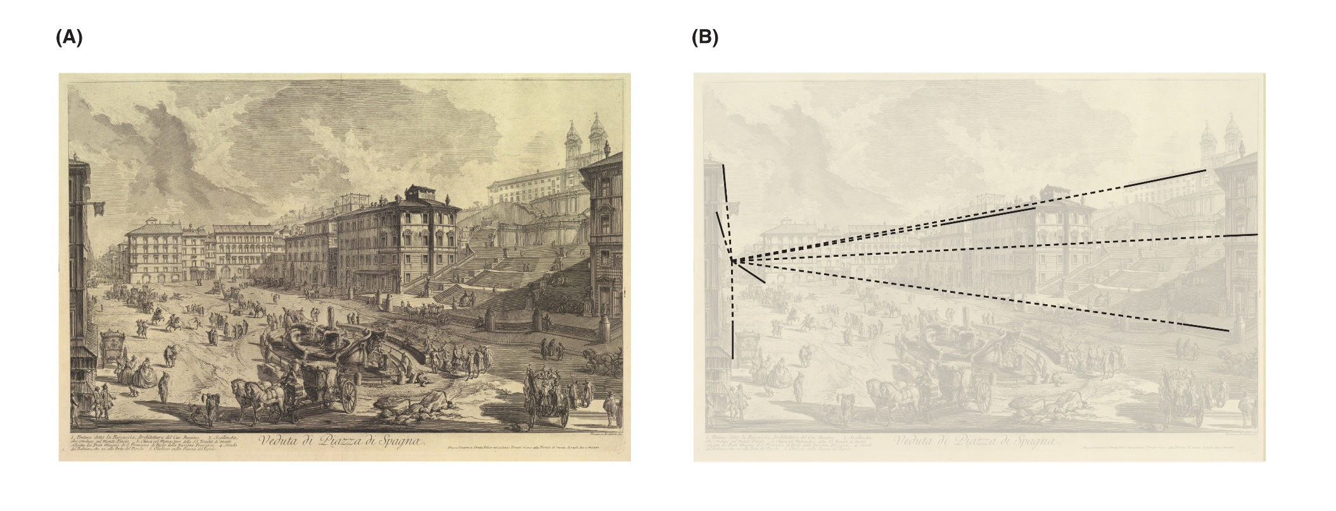
One-Point Perspective
Describe Giovanni Battista Piranesi’s use of one-point perspective in The Piazza di Spagna.
Figure 2.47A and B. (A) Giovanni Battista Piranesi, The Piazza di Spagna, ca. 1750-1758; (B) receding parallel building edges and vanishing point.
Notes:
FIGURE 2.47 (a) Giovanni Battista Piranesi, The Piazza di Spagna, ca. 1750–1758. Etching, 20.5 × 29.312 in. The Metropolitan Museum of Art, New York. (b) The solid lines show the receding parallel edges of the buildings, while the dotted lines show the vanishing point.

Slide 51
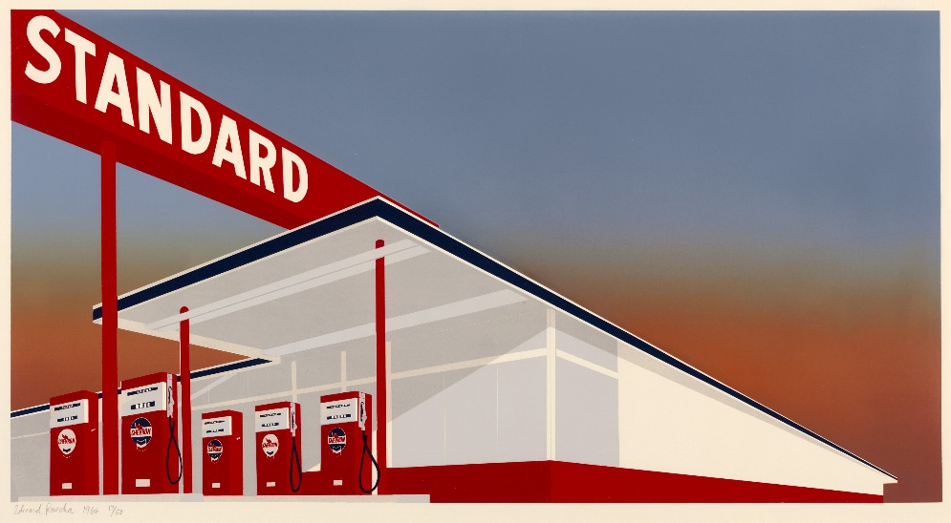
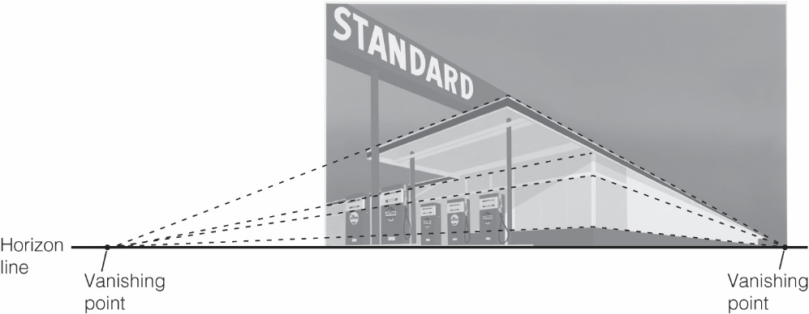
Two-Point Perspective
A work of art that has two vanishing points instead of one is an example of two-point perspective.
Figure 2.48A and B. (a) Illustration of two-point perspective. Edward Ruscha, Standard Station, 1966. (b) The dotted lines converging at separate vanishing points along the horizon line.
Notes:
FIGURE 2.48 (a) Illustration of two-point perspective. Edward Ruscha, Standard Station, 1966. Color screen print on ivory woven paper, 19.625 × 36.9 in. The Museum of Modern Art, New York. (b) The dotted lines converge at separate vanishing points along the horizon line.

Slide 52
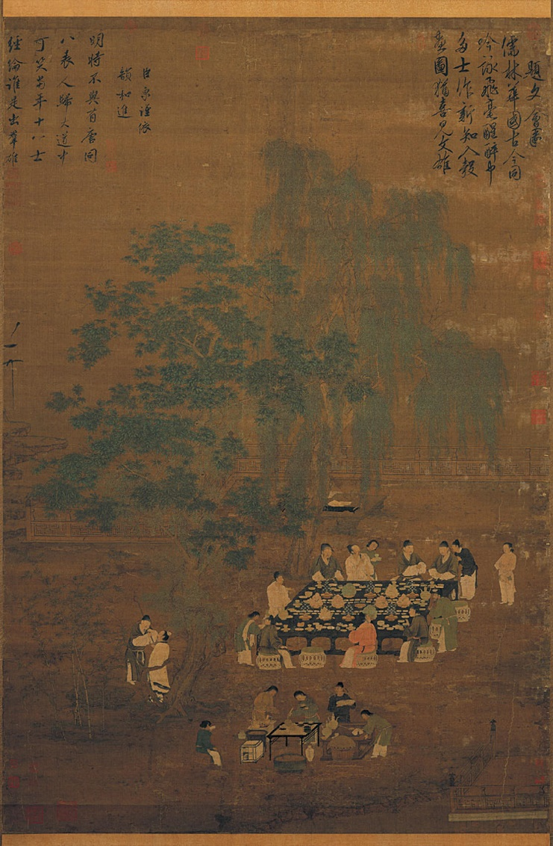
Isometric Perspective
Isometric perspective places distant images higher in the picture plane without making them smaller.
Also called rising perspective
“Isometric” means the images have equal dimensions
Figures have same size regardless of proximity to the viewer
Figure 2.49. Huizong (Zhao Ji) of Song, Literary Gathering, 1100–1125 CE.
Notes:
FIGURE 2.49 Huizong (Zhao Ji) of Song, Literary Gathering, 1100–1125 CE. Handscroll, ink and light color on silk, 72.6 × 48.8 in. National Palace Museum, Shilin district, Taipei, China.

Slide 53
Conclusion
Studying the formal elements of a work of art helps to grow one’s art vocabulary and understand the message behind a piece of art.
Not all formal elements are expressed equally in works of art.
Artists apply the “building blocks” to fit their needs and visions.
Viewers need to take the time to read a work’s use of formal elements.

Slide 54
Review and Do
Before moving on, take a minute to test your understanding of this chapter by answering the following:
What are the formal elements in art?
How do the formal elements in a work of art function like the wooden blocks that children use to build walls and towers?
What are the three attributes of any color?
What is the difference between actual and visual texture?
How can artists create the illusion of three-dimensional space on a two-dimensional picture plane?

Slide 55
Review of Learning Objectives (1 of 2)
List the different types of lines and explain the expressive qualities of each.
Using an example from the book, describe some of the ways artists use lines in their compositions.
Using examples from the book, identify the differences between two-dimensional and three- dimensional shape.
Explain value range and cite examples of high- and low-key value range from the book.
Explain how simultaneous contrast works.

Slide 56
Review of Learning Objectives (2 of 2)
Identify everyday examples of additive and subtractive color.
List the three main attributes of color and explain their relationship to each other.
Using examples from the chapter, describe the difference between tactile and visual texture.
Explain the difference between three dimensional and two-dimensional space.
Explain how the formal elements of value, color, shape, line, and texture help artists create an illusion of depth.

Slide 57
Additional Credits (by Figure Number)
2.1 Image copyright © The Metropolitan Museum of Art. Image source: Art Resource, NY;
2.4 Digital Image © The Museum of Modern Art/Licensed by SCALA / Art Resource, NY;
2.5 Courtesy of the National Gallery of Art, Washington, DC;
2.6 Gift of the Artist / Bridgeman Images;
2.7 Photograph © 2021 The Museum of Fine Arts, Boston;
2.8a, b, c © Marlene Lee / marleneleeart.com;
2.9 Image copyright © The Metropolitan Museum of Art. Image source: Art Resource, NY;
2.10 Image by artist / copyright Brian Caponi;
2.11 Smithsonian American Art Museum, Washington, DC / Art Resource, NY;
2.15 Courtesy the artist;
2.17 Image copyright © The Metropolitan Museum of Art. Image source: Art Resource, NY;
2.20 Image copyright © The Metropolitan Museum of Art. Image source: Art Resource, NY;
2.21 Private Collection / Bridgeman Images;
2.23 Digital Image © 2021 Museum Associates / LACMA. Licensed by Art Resource, NY;
2.24 Image copyright © The Metropolitan Museum of Art. Image source: Art Resource, NY;
2.27 Courtesy Richard Lang and Judith Selby Lang;

Slide 58
Additional Credits (by Figure Number, cont.)
2.29 Pitkin Studio / Art Resource, NY ART573710;
2.30 Courtesy the Walker Art Center, Minneapolis, Gift of the T. B. Walker Foundation, Gilbert M. Walker Fund, 1942;
2.31 Alamy Photo Stock;
2.33 © RMN-Grand Palais / Art Resource, NY;
2.34 Image copyright © The Metropolitan Museum of Art. Image source: Art Resource, NY;
2.36 Image copyright © The Metropolitan Museum of Art. Image source: Art Resource, NY;
2.37 The Philadelphia Museum of Art / Art Resource, NY;
2.38 ©Misty Gamble;
2.40 Photo Jesper Hammerström;
2.41 The Art Institute of Chicago / Art Resource, NY / Erich Lessing;
2.44 The Philadelphia Museum of Art / Art Resource, NY;
2.45 Galleria dell’Accademia & Museo degli Strumenti Musicali, Florence, Tuscany, Italy / Bridgeman Images;
2.47 Image copyright © The Metropolitan Museum of Art. Image source: Art Resource, NY;
2.49 The Picture Art Collection / Alamy Stock Photo

