Slide 1
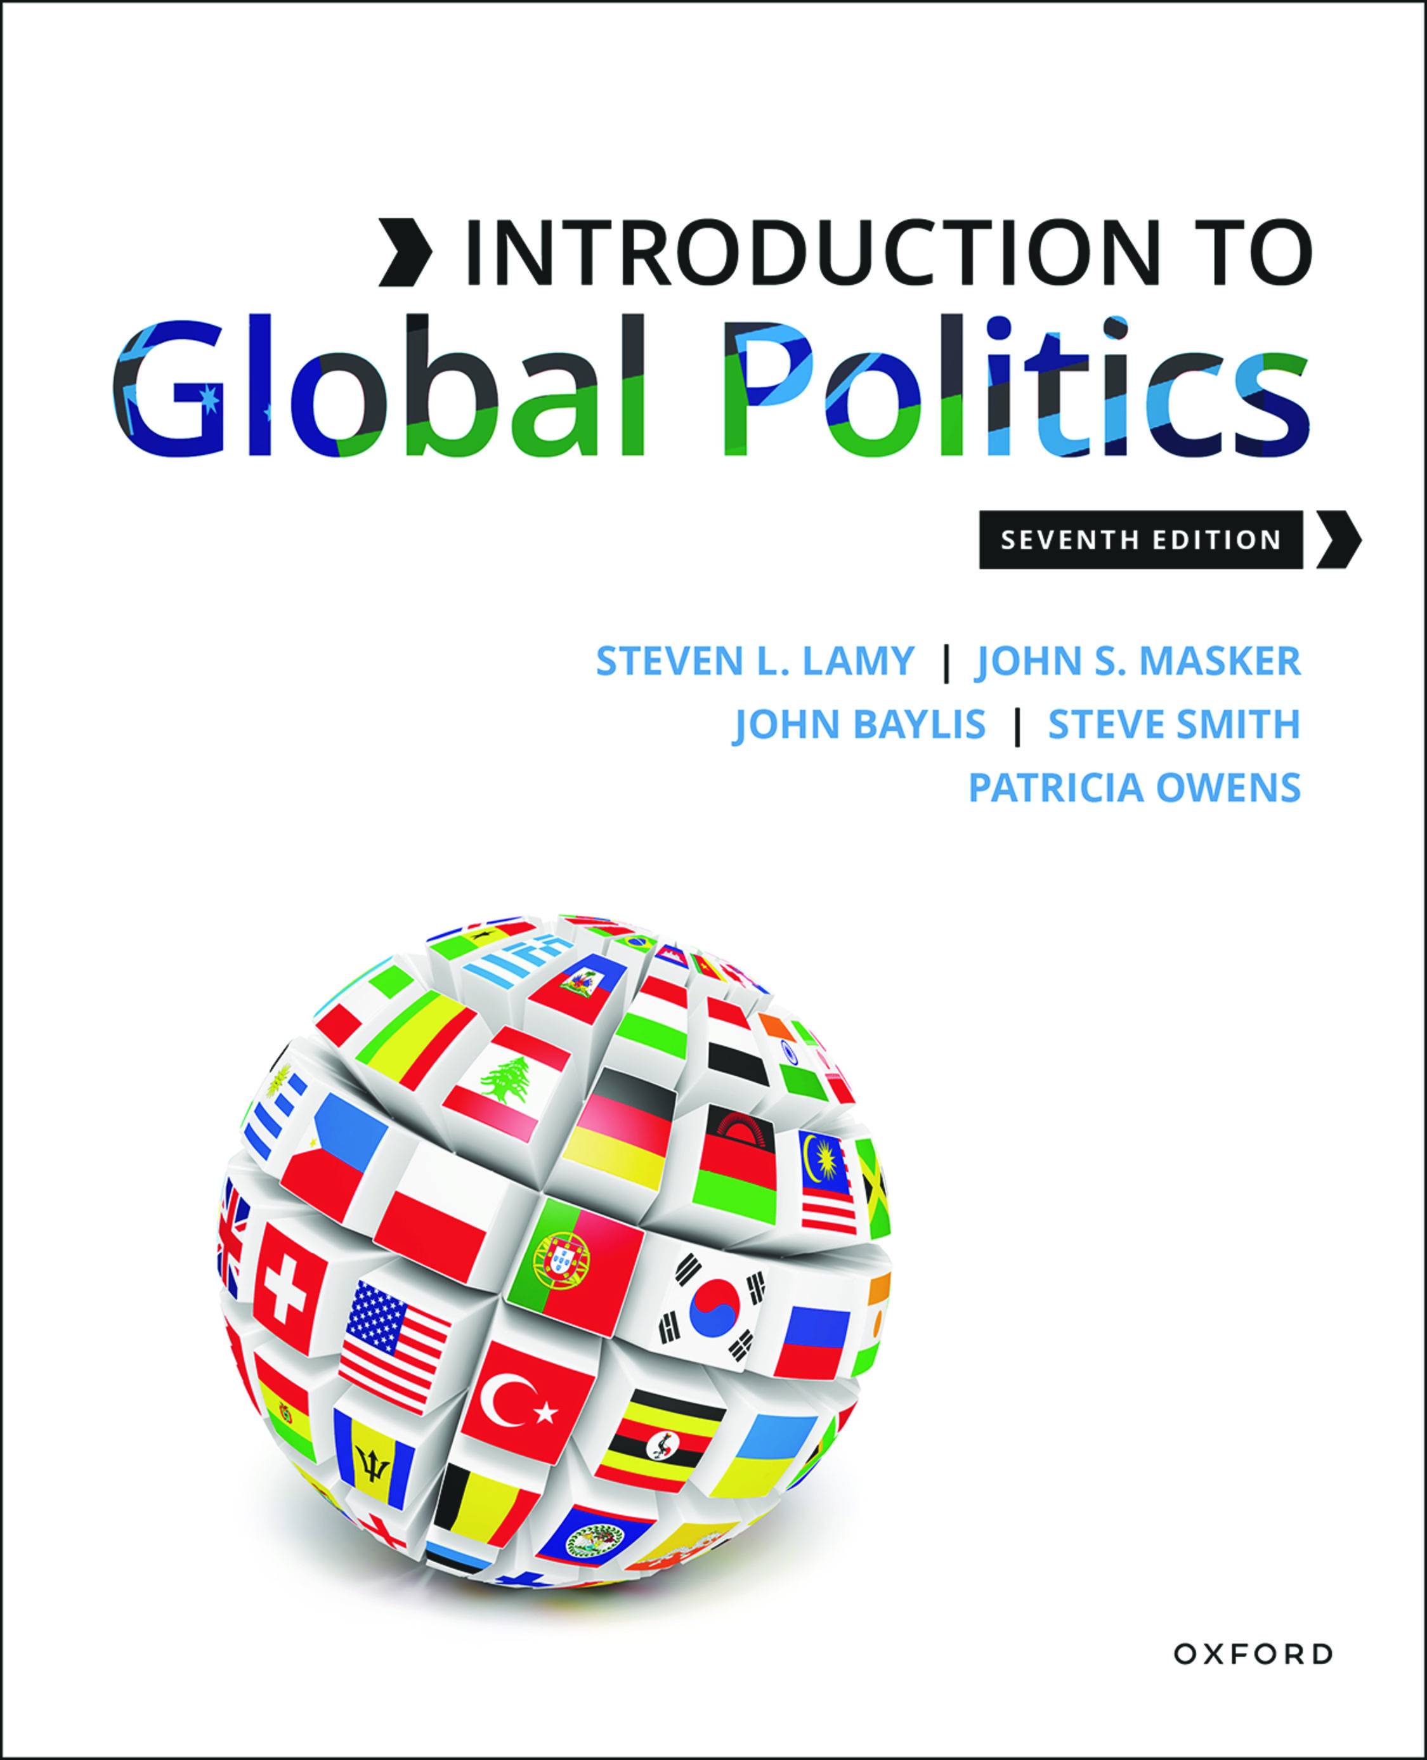
Introduction To Global Politics
by Steven L. Lamy, John S. Masker, John Baylis, Steve Smith and Patricia Owens

Slide 2
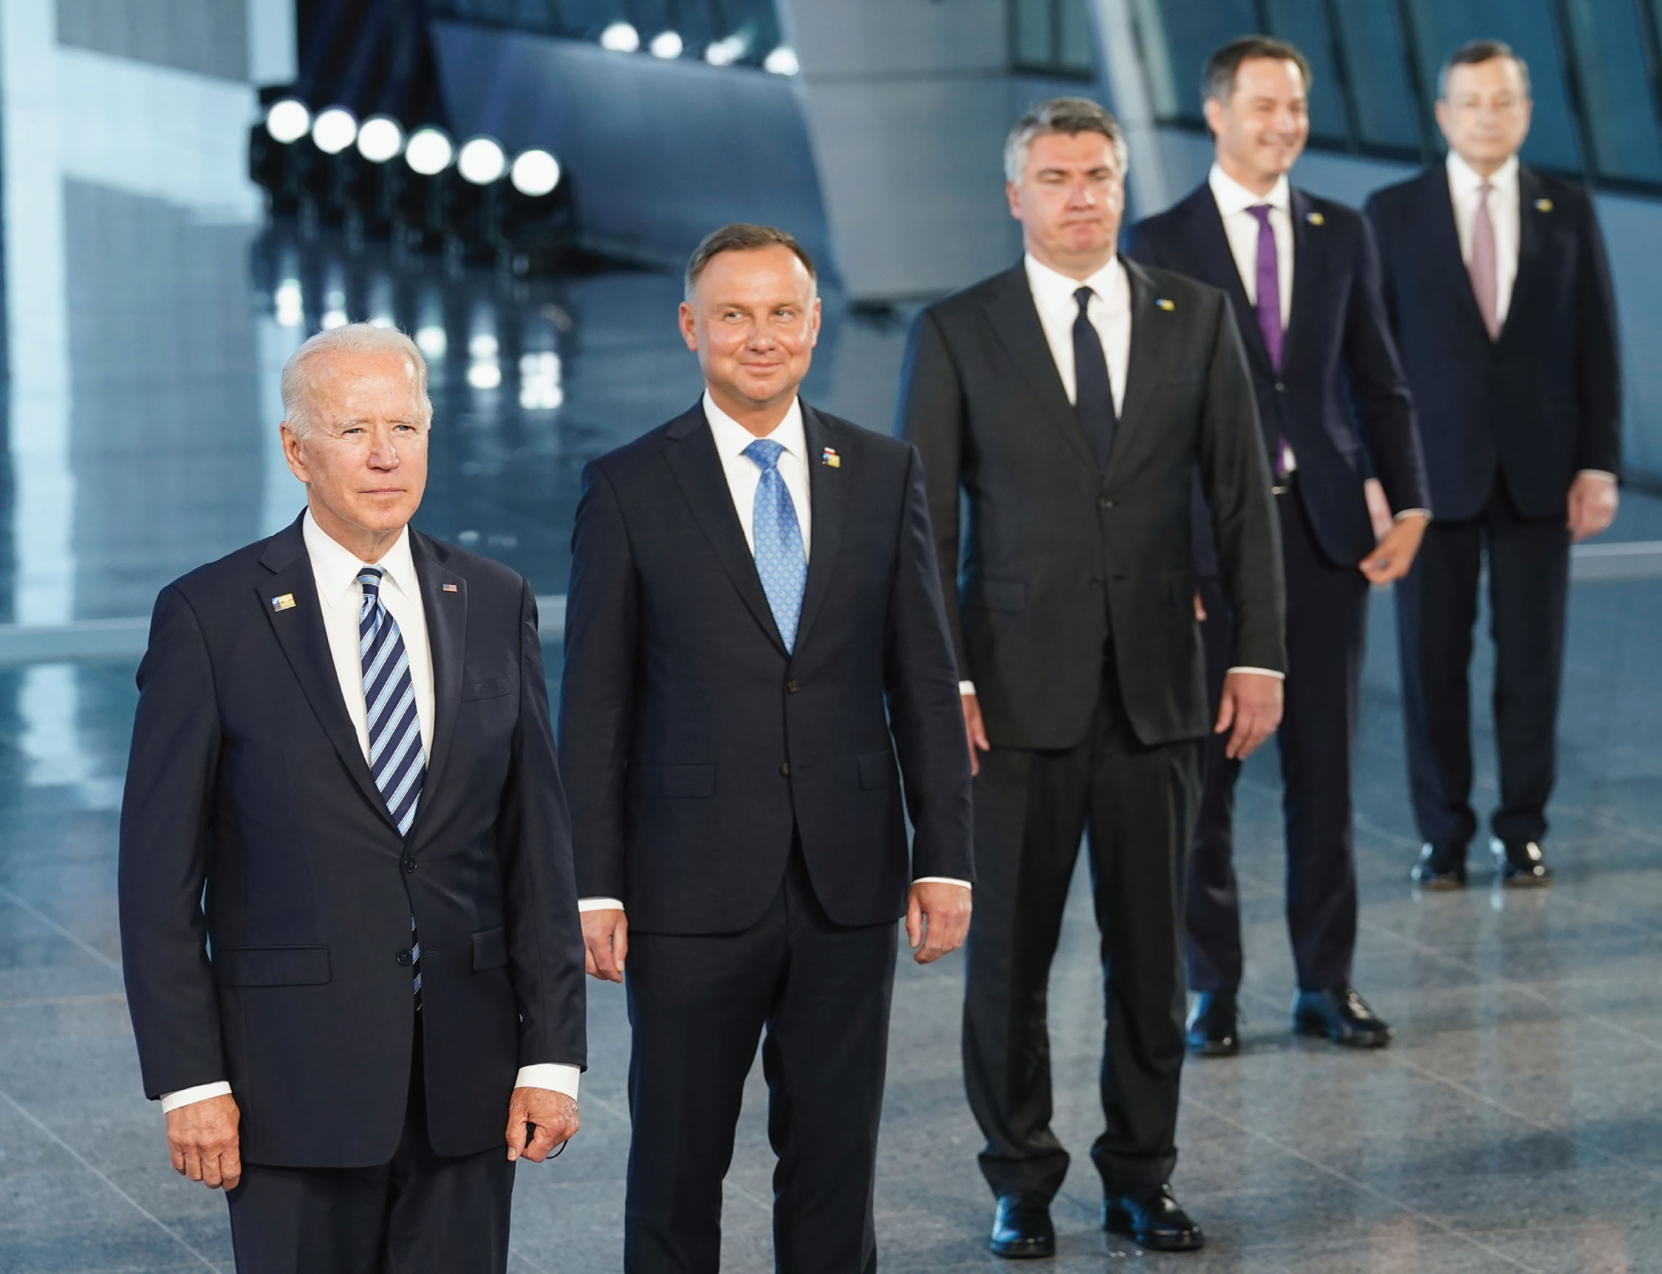
2
Notes:
President Joe Biden and other leaders from NATO countries pose for a family photo during the NATO summit at the Alliance’s headquarters, in Brussels, Belgium in June 2021. Biden’s message was that NATO has a mission to promote liberal internationalist values and norms and that the US was back as the leader of this multilateral regional organization. The biggest challenge may be defending democratic states and the idea of democracy. What do you think are other challenges NATO leaders might address?

Slide 3
3
Notes:
In late February 2022, Russia and its separatist supporters in the Donetsk People’s Republic invaded Ukraine. In this photo a pro-Russian fighter attempts to remove ammunition from a disabled tank in central Mariupol. Putin is motivated by his beliefs and his core beliefs are based on traditional realist assumptions about the world and how to secure national interests. With the EU and NATO promoting democratic values and liberal ideas, this is could be seen as a battle between realism and liberalism beliefs. Did liberalism fail?

Slide 4
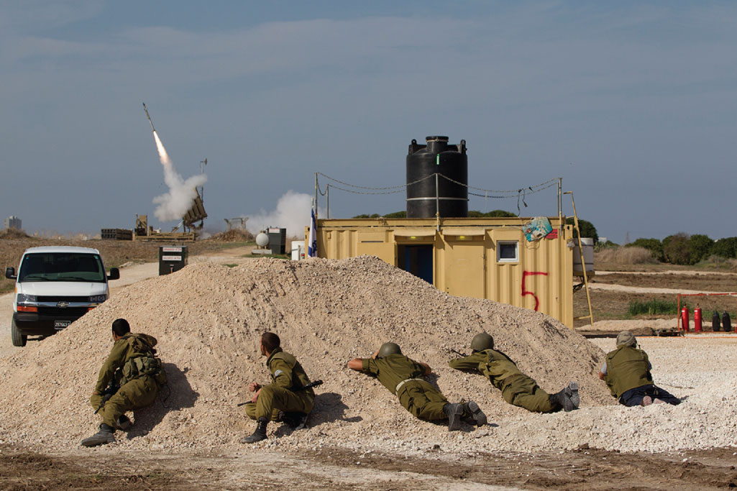
4
Notes:
Israeli soldiers look at an Iron Dome missile as it launched near the city of Ashdod, Israel, to intercept a rocket fired by Palestinians militants from Gaza Strip. Israel has used a variety of strategies, both military and non-military, to protect its borders and citizens but also maintain its independence and autonomy. In the process. some people suffer and are denied similar rights. Is this a primary story of international relations or just a middle east issue?

Slide 5
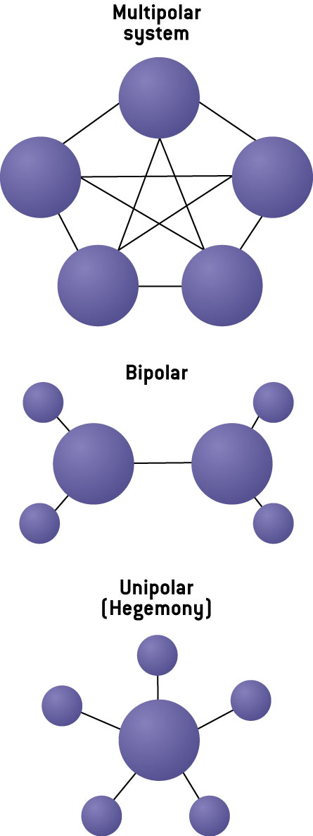
Figure 3.1 Power, Politics, and Polarity
Notes:
Figure 3.1 Power, Politics, and Polarity Which of these arrangements best represents the world today? What about the world of the early twentieth century? Nineteenth century? How does theory help us understand these global power dynamics?

Slide 6
TABLE 3.1 A Taxonomy of Realisms
Type of Realism | Key Thinkers | Key Texts | Big Idea
Classical Realism (Human Nature) | Thucydides (ca. 430–406 BCE) | The Peloponnesian War | International politics is driven by an endless strug- gle for power that has its roots in human nature. Justice, law, and society either have no place or are circumscribed.
 | Machiavelli (1532) | The Prince | Political realism recognizes that principles are sub- ordinated to policies; the ultimate skill of the state leader is to accept, and adapt to, the changing power-political configurations in global politics.
 | Morgenthau (1948) | Politics Among Nations | Politics is governed by laws that are created by human nature. The mechanism we use to under- stand international politics is the concept of inter- ests defined in terms of power.
Structural Realism (International System) | Rousseau (c. 1750) | The State of War | It is not human nature but the anarchical system that fosters fear, jealousy, suspicion, and insecurity.
 | Waltz (1979) | Theory of International Politics | Anarchy causes logic of self-help, in which states seek to maximize their security. The most stable distribution of power in the system is bipolarity.
 | Mearsheimer (2001) | Tragedy of Great Power Politics | The anarchic, self-help system compels states to maximize their relative power position.
Neoclassical Realism | Zakaria (1998) | From Wealth to Power | The systemic account of world politics provided by structural realism is incomplete. It needs to be sup- plemented with better accounts of unit-level vari- ables such as how power is perceived and how leadership is exercised.
Notes:
TABLE 3.1 A Taxonomy of Realisms

Slide 7
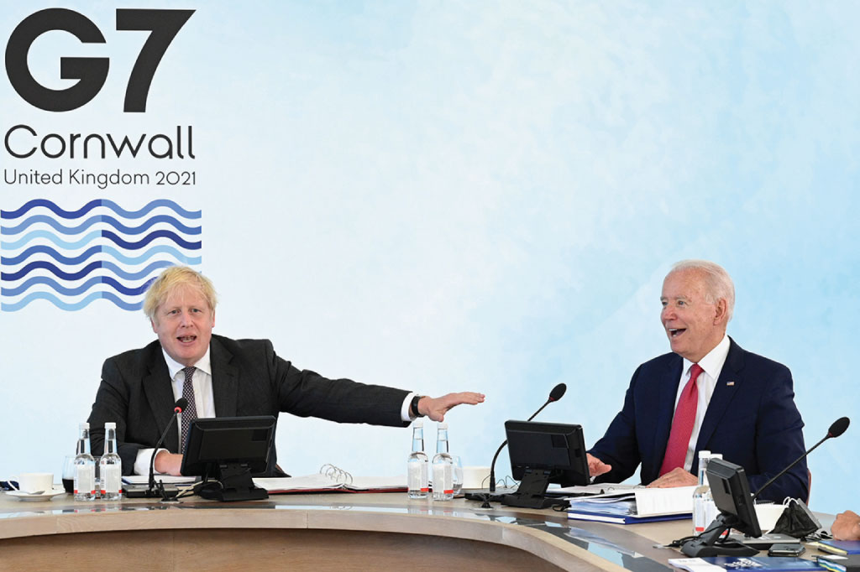
7
Notes:
You might call this photo the liberal world order returns. At the G7 Summit in June 2021 in England, the Biden Administration wanted to reassure the G7 members that the US was ready to support and, if necessary, lead collective efforts to address a variety of global problems from the pandemic to the global economy. The battle between democracies and authoritarian leaders was a major theme. In this photo, the host, Britain’s Prime Minister Boris Johnson, left, and US President Joe Biden, may have been talking about the global role Britain may play since it has left the European Union.

Slide 8
TABLE 3.2 A Taxonomy of Liberalism
Classical Liberals
Hugo Grotius | On the Law of War and Peace (1625) | Natural law gives way to international law where con- tracts, oaths, and a system of just war exist and must be abided.
John Locke | Two Treatises of Government (1689) | The State of Nature provides for the equality and free- dom of every man before the law, as well as the right to own property.
Immanuel Kant | Perpetual Peace (1795) | Peace is to be secured by the abolition of standing armies, the proliferation of democratic states, and respect for state sovereignty.
Richard Cobden | England, Ireland and America, by a Manchester Manufacturer (1835) | Free trade would create a more peaceful world order and lead to increased individual liberty, prosperity, and interdependency.
Contemporary Liberals
Woodrow Wilson | Fourteen Points (1918) | A liberal internationalists, he sought transparency among states, the proliferation of free trade, the reduction of arms, and the creation of a multinational institution to ensure the implementation of mutual agreements—considered by many to be idealism.
David Mitrany | The Functional Theory of Politics (1975) | Interstate trade and cooperation in common sectors are mutually beneficial and will spill over to include other sectors—functionalism.
Hedley Bull | The Anarchical Society (1977) | The state has control over its people and a certain territory and advocates a "society of states” bound by common rules and interests—pluralism.
Notes:
TABLE 3.2 A Taxonomy of Liberalism

Slide 9
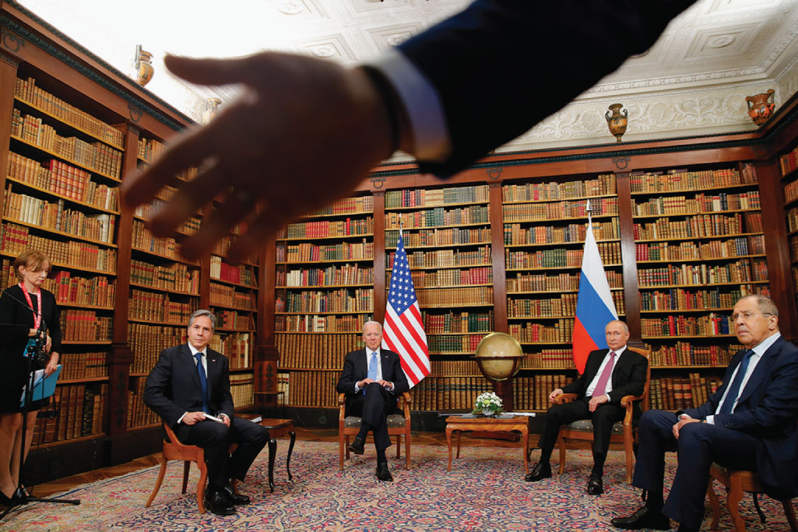
9
Notes:
In June 2021, President Biden and President Putin held a summit meeting to discuss a variety of critical topics in hopes of creating a common agenda for future talks. Both Secretary of State Blinken and Foreign Minister Lavrov played a critical role in these discussions. Russia was already beginning to raise concerns about NATO expansion and the Western encroachment on its “spheres of influence.” In less than a year, the hopes for more cooperation between these two powers have disappeared. Can the US and its allies in Europe restore a working relationship with Russia after it ends its war with Ukraine?

Slide 10
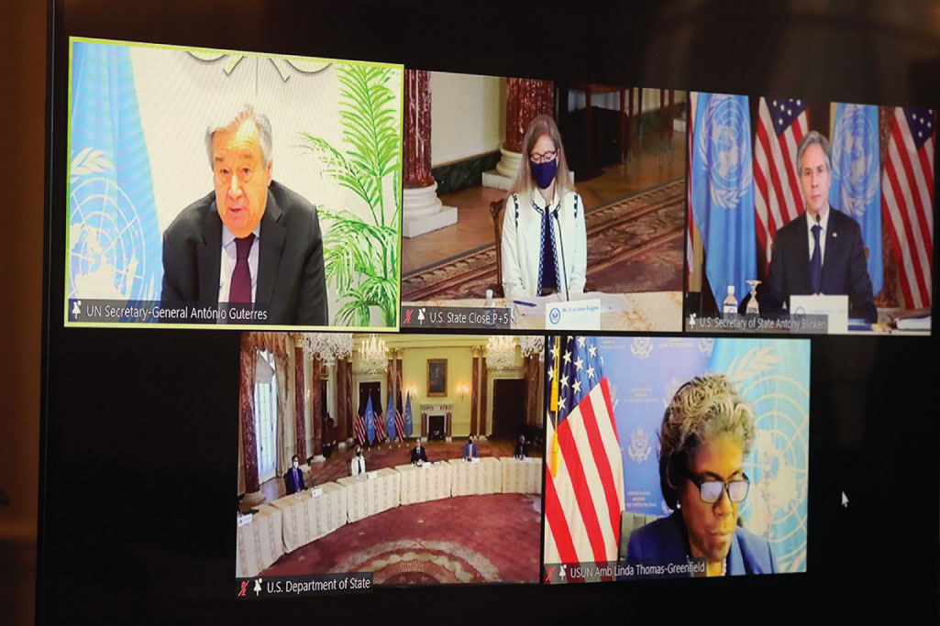
10
Notes:
Sometimes it seems that the only consistent advocate for humanitarian issues is the United Nations. Here U.S. Secretary of State Antony Blinken and the US UN Ambassador Linda Thomas-Greenfield speak during a virtual meeting with UN Secretary-General Antonio Guterres about the need for more humanitarian assistance for victims of war and violence in Syria. Consider how many major crises require our attention if we are to prevent more human suffering. Do we have the
resources and the commitment to act?

Slide 11
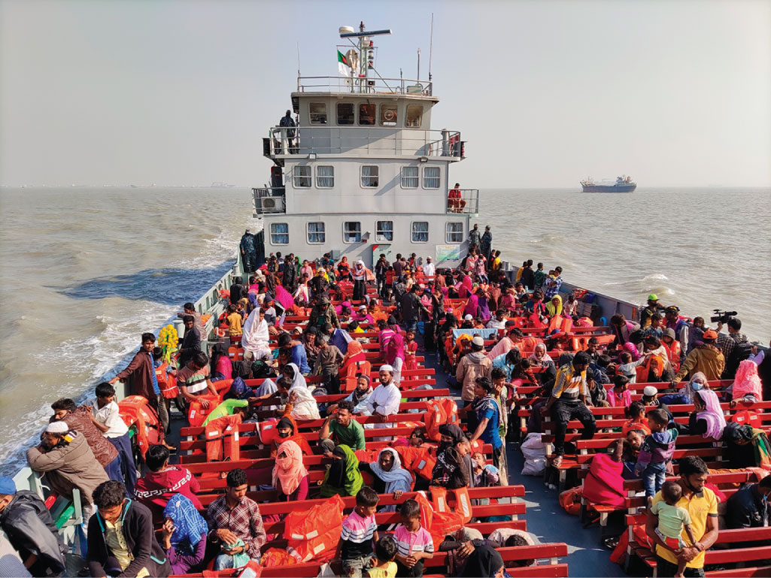
11
Notes:
NGOs and government officials have recently called the actions of the government of Myanmar against the Rohingya a genocide and people continue to flee the repressive military government. The world must find a way to protect the thousands of refugees but how? Here the refugees travel in a naval ship to be transported to an isolated island in the Bay of Bengal, near Bangladesh, in 2020. Officials in Bangladesh sent a second group of Rohingya refugees to the island despite calls by human rights groups for a halt to the process. The government of Bangladesh, a very poor country that has a large population and very little “extra space” has been accused of forcing refugees to this island located 21 miles from the mainland. Who should help? Can we expect a small and poor state like Bangladesh to handle this situation?

Slide 12
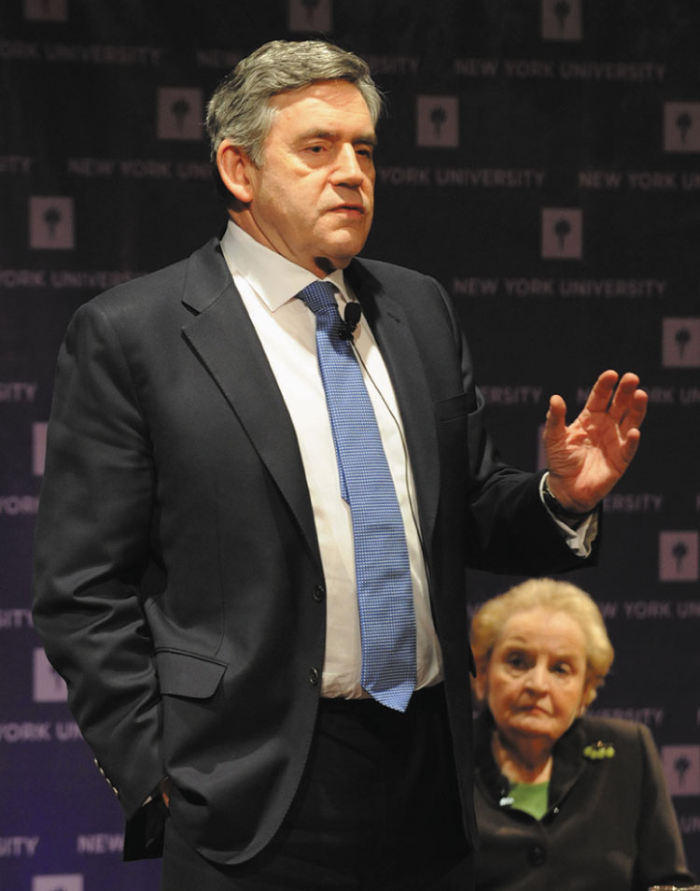
12
Notes:
Liberalism and multilateralism aimed at responding and solving global problems is still embraced by some world leaders. Here, former British prime minister Gordon Brown speaks about the new multilateralism with his colleague, former secretary of state, the late Madeleine Albright. Brown has recently been working with the United Nations on the Sustainable Development Goals. Can we respond to global challenges without cooperation?

Slide 13
TABLE 3.3 Realism, Liberalism, and Radical Liberalism/Utopianism: A Review of Core Assumptions
 | Realism | Liberalism | Radical Liberalism/ Utopianism
Main Actors | States | States, NGOs, and groups | States, NGOs, groups, and individuals
Central Concern | Relative power | Welfare and security | Peace, social justice, and human security
Typical Behavior | Self-help | Cooperation | Promotion of ideas
Basis for Power | Tangible resources (military/economic) | Issue specific, both hard and soft power | Political legitimacy and value of ideas
Nature of Interstate Relations | Unregulated competi- tion and limited alliances | Interest-based regimes, coordination and collaboration among states | Norm-based regimes
Ideal State of the World | Stability through balance of power | Equitable system managed by regional organizations/ international organizations | World community
Notes:
TABLE 3.3 Realism, Liberalism, and Radical Liberalism/Utopianism: A Review of Core Assumptions

Slide 14
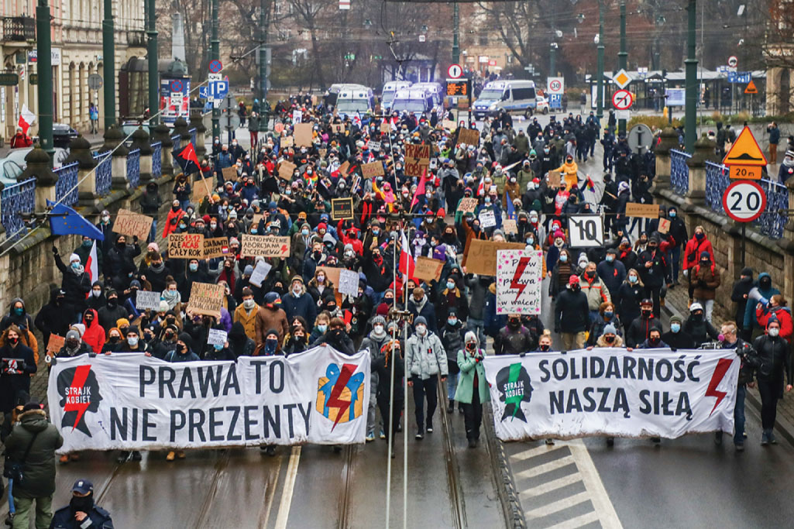
14
Notes:
The conservative government of Poland is challenging many of the liberal values and policies promoted by other European Union countries and the US. Some of their leaders feel that traditional Polish values need to be protected by government institutions. In this 2020 photo, Polish citizens with opposing views demonstrate during an antigovernment protest against restrictions on abortion law in Poland. It will be hard for conservative governments to ignore the power of transnational social movements promoting women’s rights and other progressive causes. What role does social media play in these situations?

Slide 15
TABLE 3.4 Critical International Relations Theories at the Beginning of the Twenty-First Century
 | Central Idea | View of International System | Key Authors
Marxism | Global capitalist system eliminates harmony of interestszof workers. | Core–periphery relation- ship. Unfair terms of international trade. Underdevelopment in periphery. | Prebisch, Frank, Cardoso, O’Donnell
Constructivism | Seeks to understand change. Ideas are social creations. Relationships result from historical processes. Ideas can evolve, replace older ways of thinking. | A process. Result of hegemonic ideas. Can change as a result of evolving ideas. | Onuf, Walker, Wendt
Liberal Feminism | Change women’s subordinate posi- tion in existing political systems. | Improve women’s representation in INGOs. End gender bias in INGOs and NGOs. | Caprioli, Enloe, Elshtain, Tickner, Tobias
Notes:
TABLE 3.4 Critical International Relations Theories at the Beginning of the Twenty-First Century

Slide 16
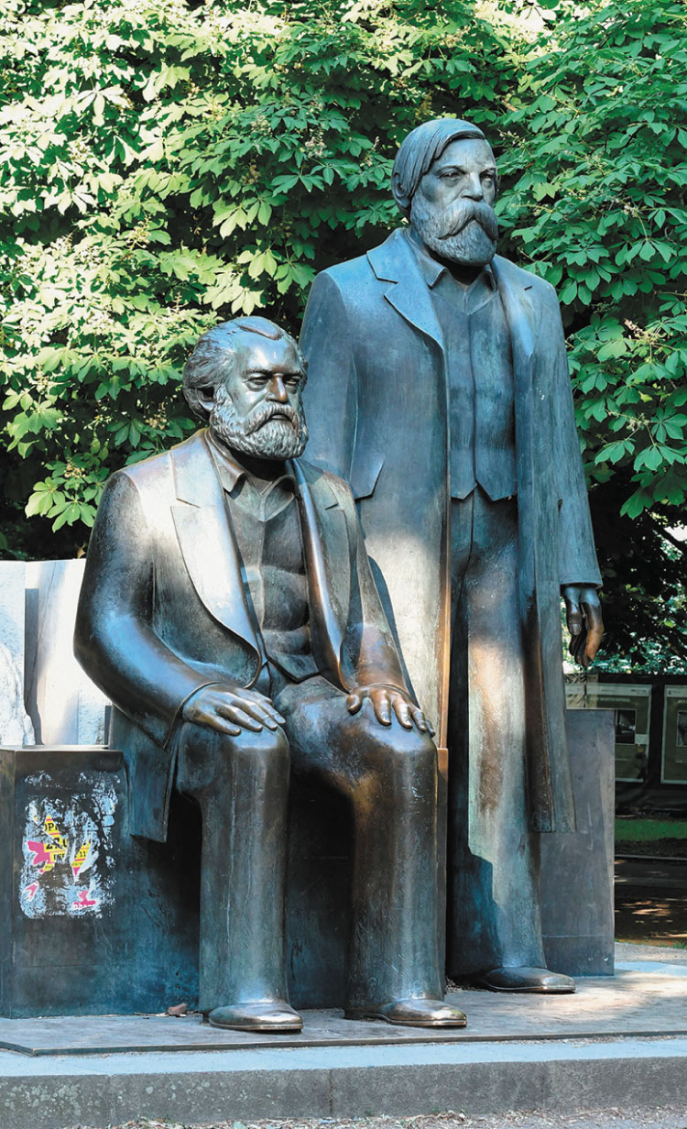
16
Notes:
Marx was a socialist, but not the first. Marxism is a critical theory—critical of the neoliberal capitalist system—and seeks radical transformation of the global power structure. The Soviet Union was Marxist in name only, so Marxism is not dead, and it still inspires many who seek radical change. Capitalism has not worked for everyone.

Slide 17
TABLE 3.5 J. Ann Tickner’s Reformulation of Hans Morgenthau’s Principles of Political Realism
Morgenthau’s Six Principles | Tickner’s Six Principles
Politics, like society in general, is governed by ob- jective laws that have their roots in human nature. which is unchanging; therefore, it is pos- sible to develop a rational theory that reflects these objective laws. | A feminist perspective believes that objectivity, as it is culturally defined, is associated with masculinity. Therefore, supposedly “objective” laws of human nature are based on a partial masculine view of human nature. Human nature is both masculine and feminine: It contains elements of social reproduction and devel- opment as well as political domination. Dynamic objec- tivity offers us a more connected view of objectivity with less potential for domination.
The main signpost of political realism is the con- cept of interest defined in terms of power which infuses rational order into the subject matter of politics, and thus makes the theoretical under- standing of politics possible. Political realism stresses the rational, objective, and unemotional. | A feminist perspective believes that the national inter- est is multidimensional and contextually contingent. Therefore, it cannot be defined solely in terms of power. In the contemporary world the national interest demands cooperative rather than zero-sum solutions to a set of interdependent global problems which in- clude nuclear war, economic well-being, and environ- mental degradation.
Realism assumes that interest defined as power is an objective category which is universally valid but not with a meaning that is fixed once and for all. Power is the control of man over man. | Power cannot be infused with meaning that is univer- sally valid. Power as domination and control privileges masculinity and ignores the possibility of collective empowerment, another aspect of power often associ- ated with femininity.
Notes:
TABLE 3.5 J. Ann Tickner’s Reformulation of Hans Morgenthau’s Principles of Political Realism

Slide 18
TABLE 3.5 Continued
Morgenthau’s Six Principles | Tickner’s Six Principles
Political realism is aware of the moral significance of political action. It is also aware of the tension between the moral command and the require- ments of successful political action. | A feminist perspective rejects the possibility of sepa- rating moral command from political action. All politi- cal action has moral significance. The realist agenda for maximizing order through power and control pri- oritizes the moral command of order over those of justice and the satisfaction of basic needs necessary to ensure social reproduction.
Political realism refuses to identify the moral aspi- rations of a particular nation with the moral laws that govern the universe. It is the concept of inter- est defined in terms of power that saves us from moral excess and political folly. | While recognizing that the moral aspirations of particu- lar nations cannot be equated with universal moral principles, a feminist perspective seeks to find common moral elements in human aspirations that could become the basis for de-escalating international conflict and building international community.
The political realist maintains the autonomy of the political sphere. He asks, “How does this policy affect the power of the nation?” Political realism is based on a pluralistic conception of human nature. A man who is nothing but “politi- cal man” would be a beast, for he would be com- pletely lacking in moral restraints. But, in order to develop an autonomous theory of political behav- ior, “political man” must be abstracted from other aspects of nature. | A feminist perspective denies the validity of the auton- omy of the political. Since autonomy is associated with masculinity in Western culture, disciplinary efforts to construct a worldview that does not rest on a pluralis- tic conception of human nature are partial and mascu- line. Building boundaries around a narrowly defined political realm defines political in a way that excludes the concerns and contributions of women.
Source: Tickner (1988: 430–431, 437–438).
Notes:
TABLE 3.5 Continued

Slide 19
TABLE 3.6 Percentage of Women in National Parliaments by Region
 |  | Regional Averages
 | Single House or Lower House | Upper House or Senate | Both Houses Combined
Nordic countries | 44.7% | — | 44.7%
Western Europe (excluding Nordic countries) | 36.7% | 32.2% | 35.2%
Americas | 34.6% | 34.6% | 34.6%
Sub-Saharan Africa | 26.3% | 25.2% | 26.2%
Oceania | 17.9% | 46.6% | 20.9%
Asia | 21.1% | 18.2% | 20.7%
Middle East and North Africa | 18.2% | 10.9% | 16.8%
Averages as of 1st April 2022
Source: Parline - global data on national parliaments https://data.ipu.org/women-averages (Accessed May, 11, 2022).
Notes:
TABLE 3.6 Percentage of Women in National Parliaments by Region

Slide 20
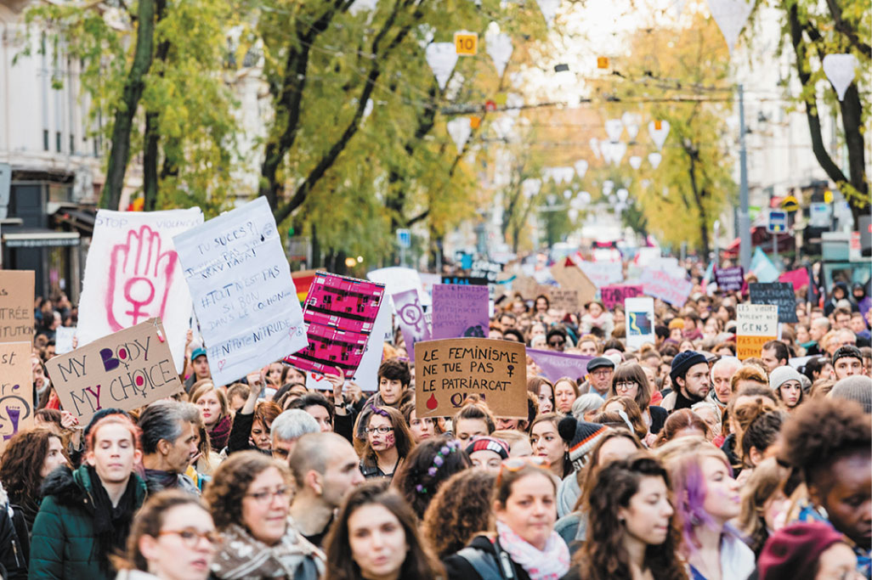
20
Notes:
Several thousand people wearing the color purple marched in the streets of Lyon, France, following the call of the Nous Toutes collective. The demonstrators were denouncing gender-based and sexual violence against women. This march was part of a national movement to mark the International Day for the Elimination of Violence Against Women in 2018. As many have suggested, women’s rights are human rights.

Slide 21
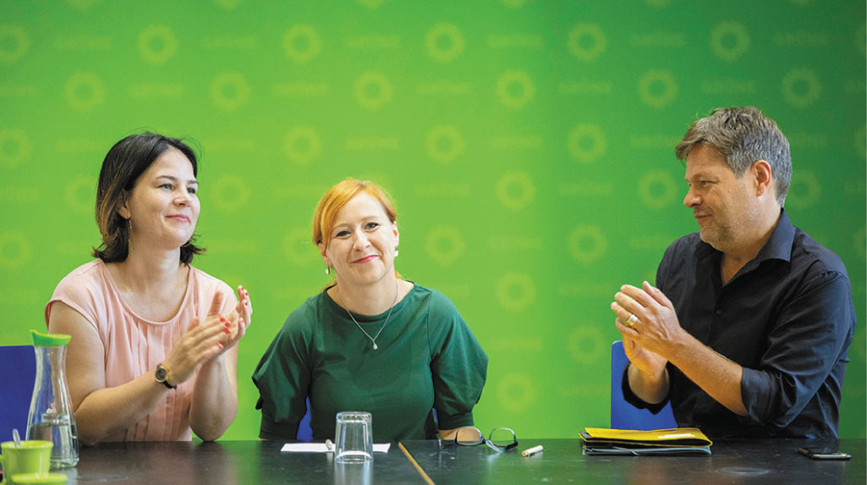
21
Notes:
One important theoretical perspective that we should not ignore is the ecotopian tradition. These can vary from the deep green critical ecotopians to the more reformist Green parties throughout Europe and much of the Western world. In this photo, Green party members from Germany at their party council meetings may be celebrating the fact that in the European parliamentary elections the party finished second. How do you explain the success of the Greens in Europe?

