Slide 1
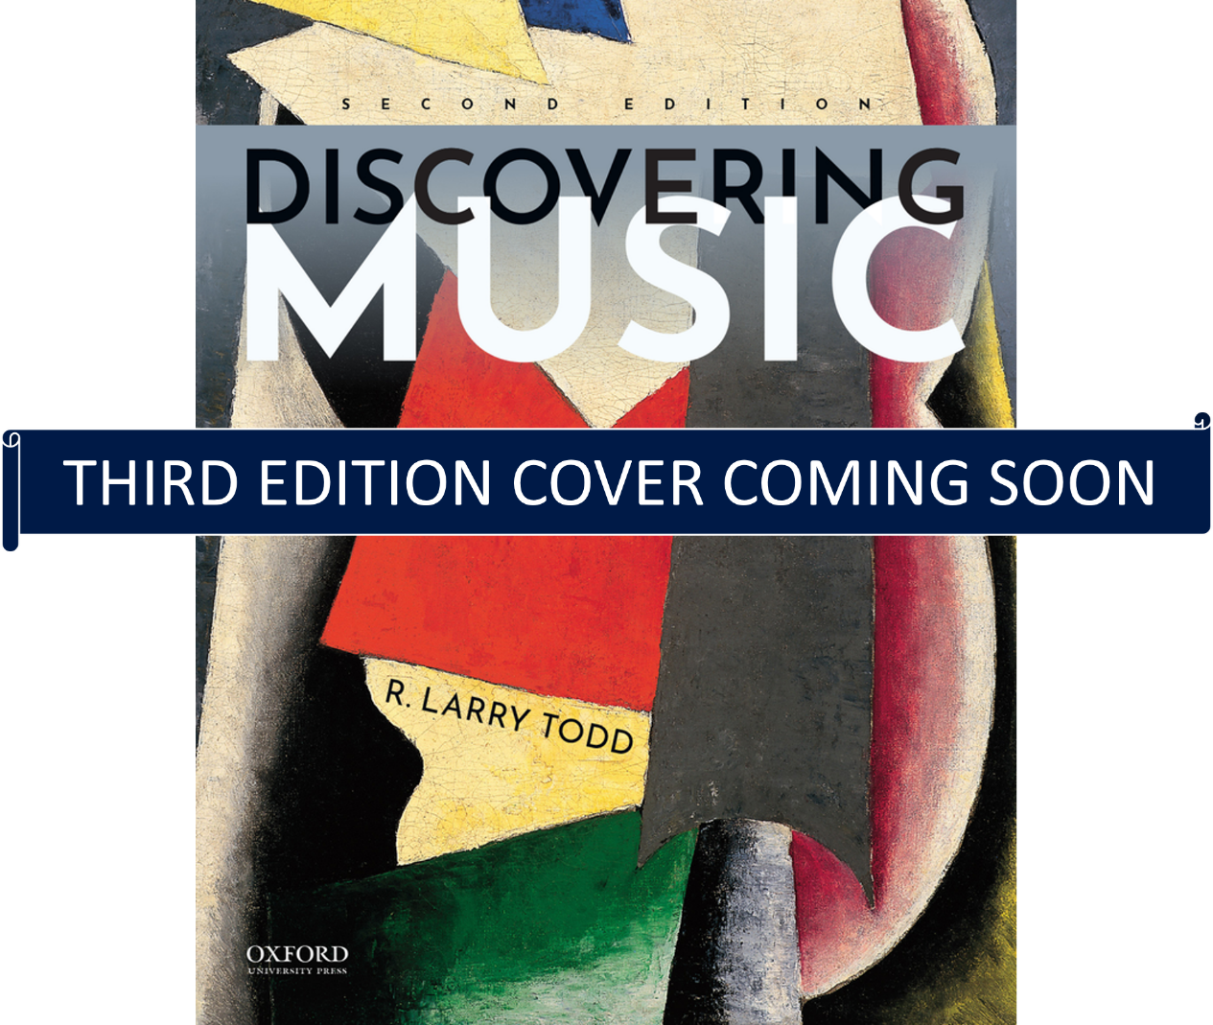
Discovering Music, Third Edition
by R. Larry Todd

Slide 2
Chapter 48: The Eclipse of Modernism: New Frontiers
Learning Objectives
  48.1 Explain the role new technologies played in the emergence of new styles after WWII.
  48.2 Recognize how total serialism developed.
  48.3 Identify what music concrete, aleatoric music, and minimalism are.
  48.4 Understand how women composers contributed to 20th century music.

Slide 3
Introduction
Developments since 1950
  Extension of 12-tone music to non-pitch elements
  Use of electronic media to explore unconventional musical sounds
  Introduction of random choices to produce change music
  Revival of tonality
  Increase in the number of women composers
  Development of minimalism
Post-modernism
  End of WWII- new experimentation in the arts
Technology

Slide 4
The New Order: Total Serialism
Serialism – technique of basing a composition on orderings of pitches, rhythms, or other musical elements
  Schoenberg’s 12-tone system in 1920s
  Olivier Messiaen (1908⎼1992)
Total serialism – style that treats all musical parameters (pitch and non-pitch elements) serially
  Pierre Boulez (b. 1925)
  Karlheinz Stockhausen (1928-2007)

Slide 5
New Resources in Sound (1 of 2)
1920: Russian physicist Léon Thérémin
  Theremin
1928: French scientist Maurice Martenot
  ondes martenot
Notes:
Photo 48.02: Léon Theremin playing the instrument he invented.

Slide 6
New Resources in Sound (2 of 2)
Electronic sounds
  1940s: French sound laboratory
    Musique concrète – music using natural sounds that are recorded and manipulated electronically
  Electronic music – music in which sound is partially or fully created electronically

Slide 7
An Early Electronic Studio
1957: RCA Mark II Sound Synthesizer installed at Columbia University
Leading experimental composers worked there to generate examples of electronic music
Charles Wuorinen’s Time Ecomium
  Won Pulitzer Prize in 1970
Notes:
Photo 48.03: The RCA Mark II at Columbia University (1957) was the first programmable electronic synthesizer. Shown in the photo are composers (l to r): Mario Davidovsky, Milton Babbitt, and Vladimir Ussacheskvy.

Slide 8
Edgard Varèse (1883–1965)
Exploited new musical resources
Followed no trend; dismissed Schoenberg’s approach
Brought unconventional sounds into his modernist scores
Used traditional instruments in unusual ways
Rejected traditional notions of thematic and harmonic development
Described his music as colliding sound masses that repelled each other
Notes:
Photo 48.04: Edgard Varèse (1883–1965).

Slide 9
LISTENING MAP 73:
Varèse, Poème électronique (Electronic Poem) (1958)
Brussels World’s Fair
Pavilion
Two million visitors heard his music broadcast through hundreds of speakers embedded in the walls
Notes:
Photo 48.05: Le Corbusier’s Philips Pavilion at the Brussels World’s Fair in 1958.

Slide 10
Further Developments in Electronic Music
Karlheinz Stockhausen - Gesang de Jünglinge (Song of Youths) (1956)
Early electronic music created as tape compositions
Live electronic music – draws on electronic musical instruments and computer-generated sounds without using pre-recorded or sampled material

Slide 11
Chance in Music (1 of 2)
John Cage (1912⎼1992)
  Explored the idea that music should use “any and all sounds that can be heard”
  1940s: series of works for “prepared piano”
  Studied Eastern philosophy and Zen Buddhism
  Rejected Western notions of musical order

Slide 12
LISTENING MAP 74
Cage, 4’33” (1952)
Premiered by pianist David Tudor
Tudor did not play the instrument at all bur signified the beginning and ending by closing and opening the keyboard lid
Silence filled by random noises of the surroundings, varied with each “performance”

Slide 13
Robert Rauschenberg’s White Paintings
Cage admitted influence of American painter, Rauschenberg
Controversial series of White Paintings
  Canvases painted white and seemingly devoid of content
  Responded to changes in ambient light, number of visitors

Slide 14
Chance in Music (2 of 2)
“Circus principle” – works where several different actions occur simultaneously
Performance art – random or coordinated; involves a performer(s) and audience; might combine visual, spoken, and musical elements
Chance music or aleatoric music
  Elements of chance determine shape or structure of a composition

Slide 15
Women and Contemporary Music
Lili Boulanger (1893–1918)
Ethyl Smyth (1858–1944)
Ruth Crawford Seeger (1901–1953)
Florence Price (1887–1953)
Joan Tower (b. 1938)

Slide 16
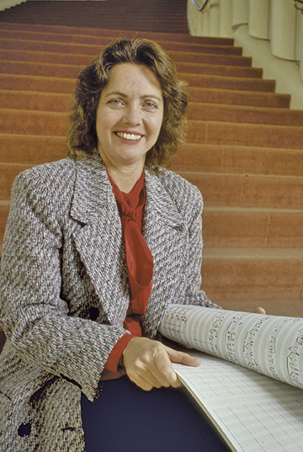
Ellen Taaffe Zwilich (b. 1939)
1983: first woman to win Pulitzer Prize in music for her Symphony No. 1
First Composer’s Chair at Carnegie Hall (1995–1999)
Early style: modernist, atonal idiom
1980s: turned efforts towards music that could communicate in a forceful, direct way
Notes:
Photo 48.10: Ellen Taaffe Zwilich (b. 1939).

Slide 17
LISTENING MAP 75
Zwilich, Concerto grosso, First Movement (1985)
Commissioned to celebrate the 300th anniversary of the birth of Handel
Five movements
Symmetrical scheme
Instrumentation: 1 flute, 2 oboes, 1 bassoon, 2 horns, strings, and harpsichords

Slide 18
Postmodernism
Postmodernism – departed from Modernism and freely mixed different styles
  Minimalism –
    Developed in the closing decades of the twentieth century from a related movement in the visual arts (1960s–1970s)
      Painters and sculptors embraced a reductive, simple style of art that avoided dramatic gestures or suggestions of emotional content
    Uses repetitions of short musical figures to construct compositions

Slide 19
Minimalist Composers (1 of 2)
Philip Glass (b. 1937)
  Studied with Nadia Boulanger
  Absorbed intricate rhythmic patterns of Indian music into his work
  Einstein on the Beach (1976)
  Satyagraha (1980)
  Appomattox (2007

Slide 20
Minimalist Composers (2 of 2)
Steve Reich (b. 1936)
  Phasing – technique in which several instruments play the same material that gradually moves out of phase, producing hypnotic, free blends of sound
  Music for 18 Musicians (1974)
  Different Trains (1988)
  WTC 9/11 (2011)

Slide 21
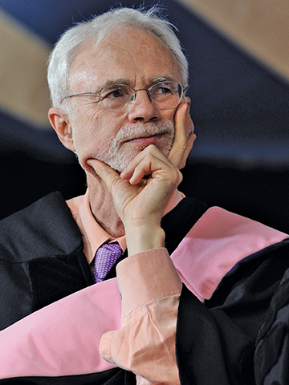
John Adams (b. 1947)
Reacted against the drudgery of “chasing” 12-tone rows in serial compositions
Embraced minimalist techniques early in his works
  Post-minimalism – music that employs some techniques of minimalism, but seeks as well other alternatives to questions of musical form and structure
Nixon in China (1987)
Dr. Atomic (2005)
On the Transmigration of the Souls (2002)- Pulitzer Prize
Notes:
Photo 48.12: John Adams (b. 1947). AP Photo/Jessica Hill

Slide 22
LISTENING MAP 76
Adams, Short Ride on a Fast Machine (1986)
Commissioned by the Pittsburgh Symphony
Scored for large orchestra with expanded percussion and keyboard synthesizers
Launched by the regular pulse of a woodblock
Work unfolds as series of crescendos
Music is about time

Slide 23
The Future Beckons
Polystylism – mixture of different styles and approaches
  Used to describe music of the 1990s and beyond
  Catch-all term to denote holding pattern until next revolution in classical tradition

Slide 24
Into the Twenty-First Century
Sofia Gubaidulina (b. 1931)
  Music influenced by Christian mysticism
  Often based on mathematical sequences; translated into rhythmic durations or metronome markings
Caroline Shaw (b. 1982)
  Violinist and singer, often performs own music
  In 2013 won Pulitzer Prize in music for Partita for 8 Voices

Slide 25
LISTENING MAP 77
Gubaidulina, Violin Concerto No. 2 (“In tempus praesens”) (2007)
Lasts half an hour, divided into five sections
Pits violinist (represents individual and wisdom) against orchestra (represents society)
Music alternates between soloist and orchestra
  Soloist - higher register
  Orchestra - lower registers

Slide 26
LISTENING MAP 78
Shaw, “The Orangery,” from Plan and Elevation: The Grounds of Dumbarton Oaks (2015)
Fourth of five movements
Inspired by a residency at the historic Dumbarton Oaks estate
String Quartet in neo-Baroque style
Free variations over a ground bass
Spatial music - creates a narrative about a physical location

Slide 27
Review of Learning Objectives
48.1 Explain the role new technologies played in the emergence of new styles after WWII.
48.2 Recognize how total serialism developed.
48.3 Identify what music concrete, aleatoric music, and minimalism are.
48.4 Understand how women composers contributed to 20th century music.

