Slide 1
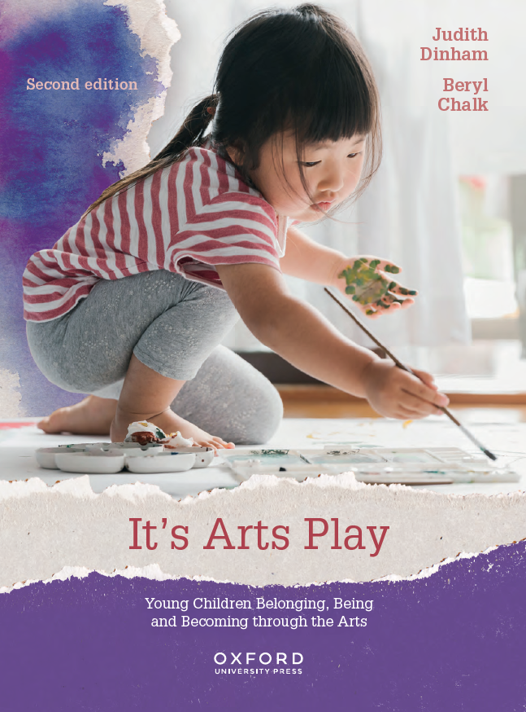
Image Bank
It’s Arts Play: Young Children Belonging, Being and Becoming through the Arts
Judith Dinham and Beryl Chalk
Chapter 1
COPYRIGHT NOTICE
This image bank is copyright protected. Contact Oxford University Press. It is intended for use only by lecturers prescribing It’s Arts Play, second edition, in their courses and should not be distributed or copied for any other purpose or for use with any other text.

Slide 2
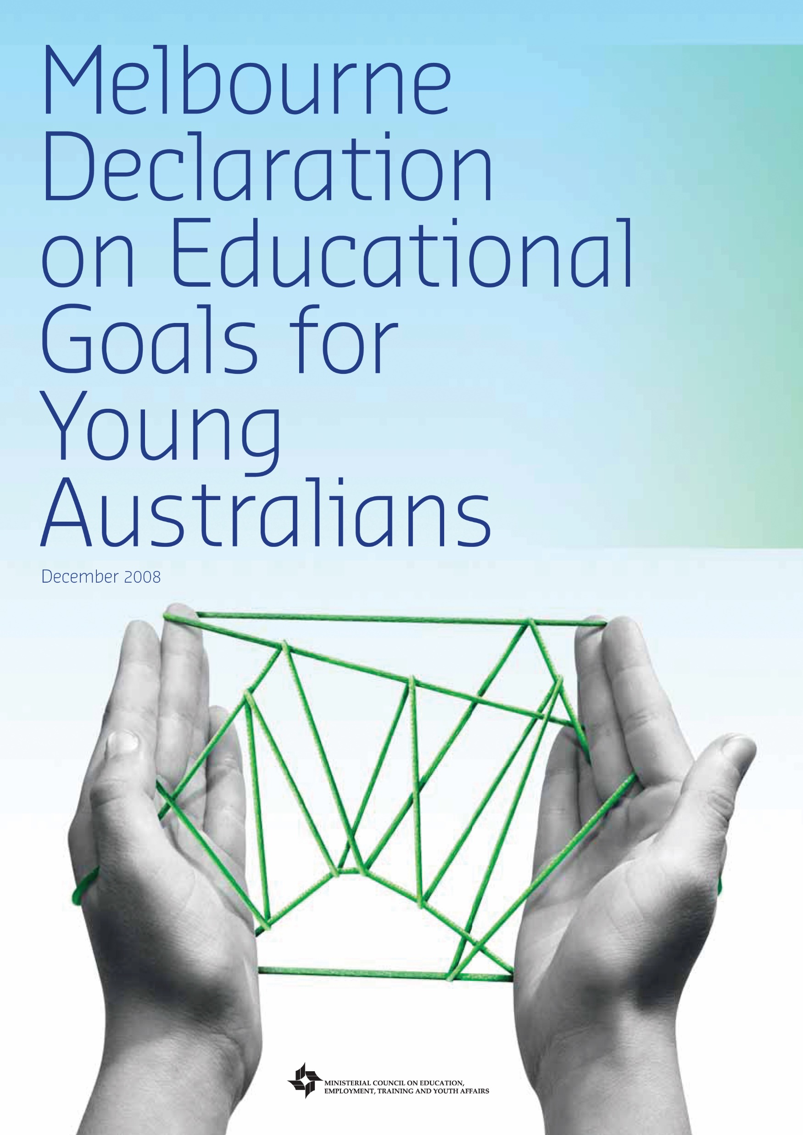
Table 1.1 Key documents that frame education in the early childhood sector
Alice Springs (Mparntwe) Education Declaration
Australian Professional Standards for Teachers
Australian Curriculum
Melbourne Declaration on Educational Goals for Young Australians
National Quality Standards (NQS)
Australian Early Years Learning Framework for Australia (EYLF)

Slide 3

FIGURE 1.1 Children require opportunities to interpret the quality of the music through movement.

Slide 4
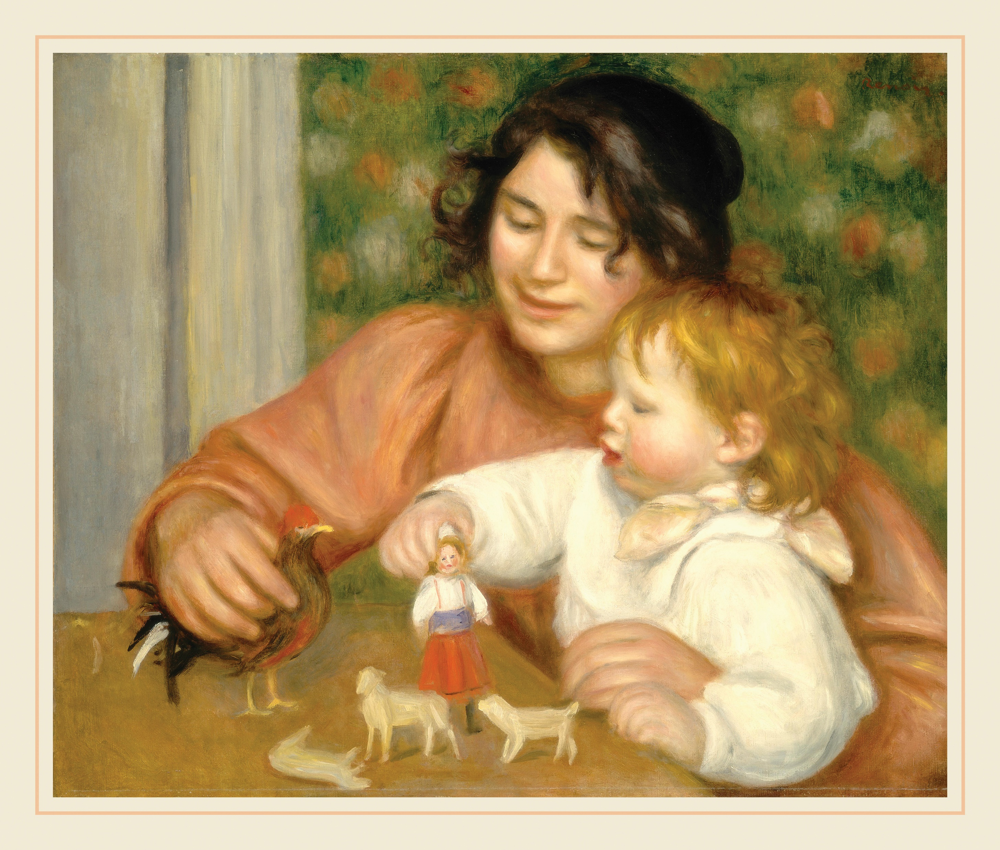
FIGURE 1.2 Auguste Renoir (1841–1919). Child with Toys—Gabrielle and the Artist’s Son, Jean, 1895–96. 54.3 × 65.4 cm. Oil on canvas.

Slide 5
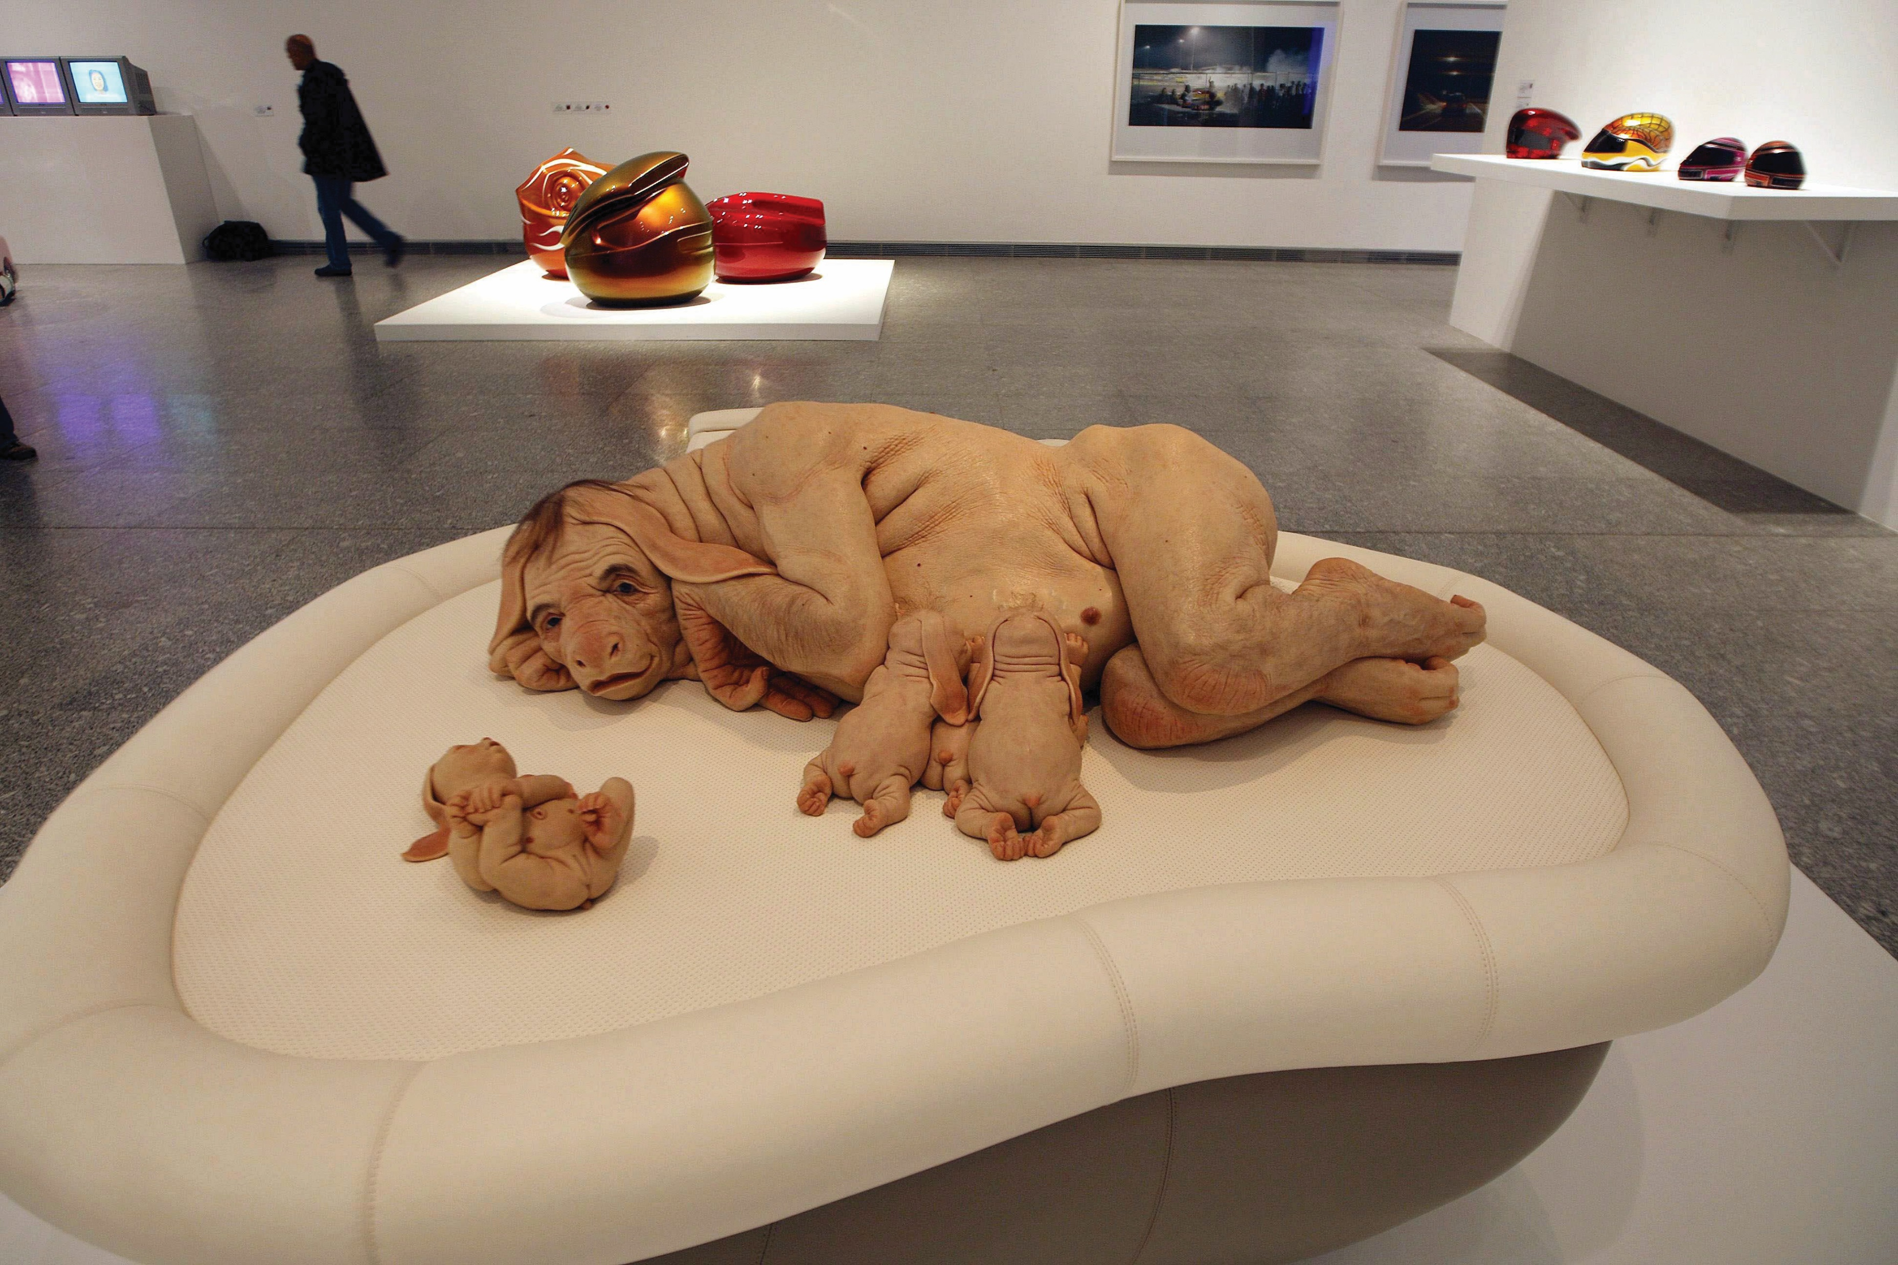
FIGURE 1.3 Patricia Piccinini (1965–). The Young Family, 2002. 85.1 × 149.9 × 120 cm. Silicone, fibreglass, leather, human hair, and plywood.

Slide 6
FIGURE 1.4 Julie Dowling (1969–), Badimaya people. Black Madonna: Omega, 2004. 120 × 100 cm. Synthetic polymer paint, red ochre, glitter and metallic paint on canvas.

Slide 7
FIGURE 1.5 Water puppetry shows in Vietnam originated in rice paddies where they were performed to celebrate the harvest.

Slide 8
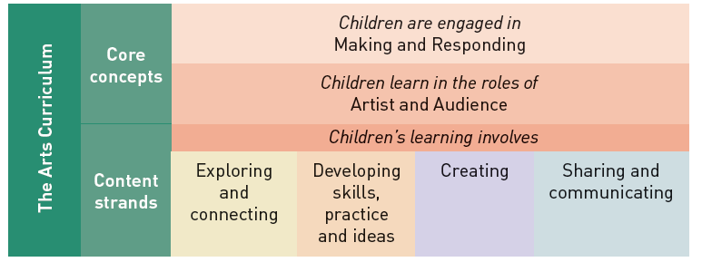
FIGURE 1.6 In the Arts Learning Area of the Australian Curriculum, core concepts underpin the content strands.

Slide 9
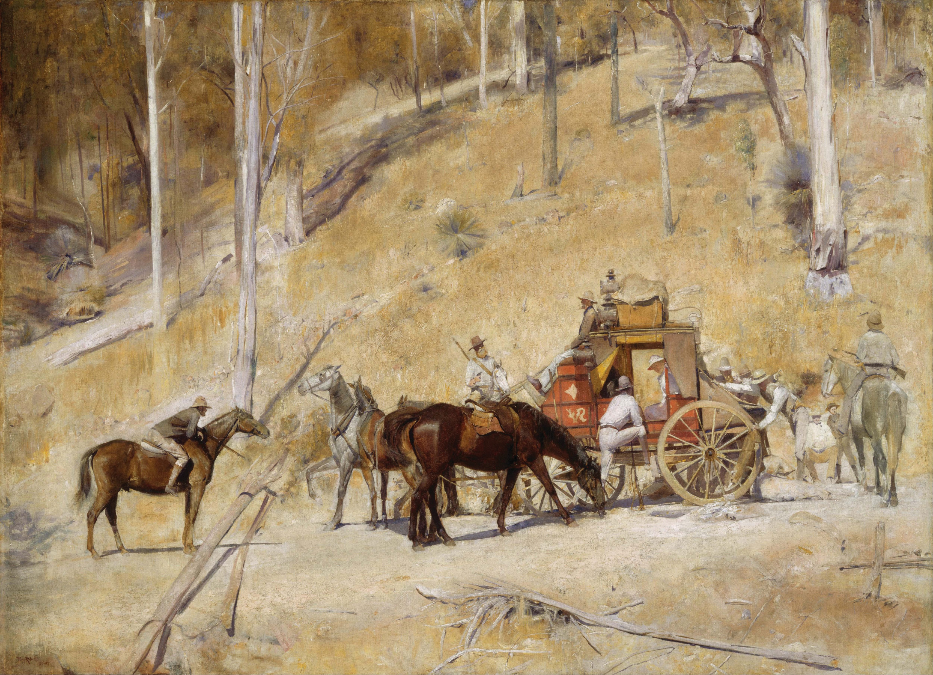
FIGURE 1.7 Tom Roberts (1856–1931). Bailed Up, 1895/1927. 134.5 × 182.8 cm. Oil on canvas.

