Slide 1
Organizational Behaviour – Chapter 2
Organizational structure, design, and bureaucracy: From control to flexibility

Slide 2
Learning outcomes: by the end of this chapter you should be able to…
explain how bureaucracy develops to control organizations as they grow and, drawing on the work of Henri Fayol and Charles Clinton Spaulding, explain how much systematic approaches to organization design have emerged through history
describe the key features of bureaucratic structure and explain how this delegates the control of workers through layers of hierarchy​
describe how rules, policies, and procedures standardize the behaviour of workers across an organizational structure​
explain the importance of paperwork and record-keeping for bureaucracy, and describe how these records have become digitalized​
explain the power that bureaucracy has to control large organizations and national populations​
describe Weber’s critiques of bureaucracy and analyse the impact that bureaucracy has on individuals and society​
describe the ways in which bureaucracy can be dysfunctional​
explain how organizations have adopted post-bureaucratic forms as a response to the dysfunctions of bureaucracy​
analyse the degree to which bureaucracy is still relevant in contemporary networked organizations, such as those found in the gig economy​

Slide 3
Bureaucracy: an introduction
The emergence of large-scale organizations​
Henri Fayol – five functions of management​
Charles Clinton Spaulding – the administration of big business​
Three aspects of bureaucratic control​
Hierarchy/organizational structure​
Rules, procedures, and policies​
Paperwork and records – the role of big data​
A double-edged sword?​
The power of bureaucracy – large-scale control​
Max Weber: negative effects and the ‘iron cage’​
Dysfunctions of bureaucracy​
Post-bureaucracy and control in the gig economy​

Slide 4
Bureaucracy
“Official aspects of an organization, such as the hierarchical structure, rules, procedures, and paperwork which allow control to be exerted over the whole organization.”​
      (King & Lawley, 2022)

Slide 5
Weber’s (1968) ‘ideal type’ of bureaucracy
Hierarchical chain of command​
Functional division of labour​
Rules, policies and procedures​
Unbiased decision-making​
Impersonality – separation of working and personal life

Slide 6
The emergence of large-scale organizations

Slide 7

Personal control is easy with a small group of people to manage…

Slide 8
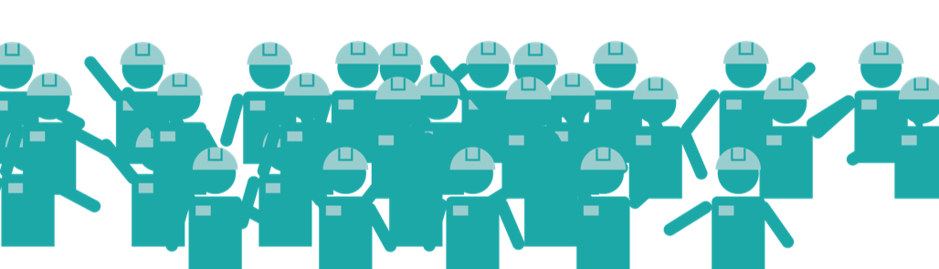
Personal control is easy with a small group of people to manage…
…but it is much more difficult when an organization grows in size

Slide 9
Personal control is easy with a small group of people to manage…
…but it is much more difficult when an organization grows in size
Growth of organizations during the Second Industrial Revolution
Managing large-scale organizations
  Henri Fayol
  Charles Clinton Spaulding

Slide 10
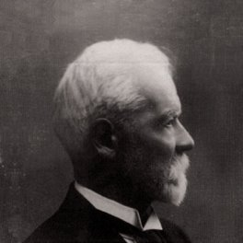
Henri Fayol (1841 – 1925)
Fayol, H (1949) ‘General and industrial management.’ Pitman, London.
(English translation, original French version published 1916).

Slide 11
Henry Fayol
Bureaucracy – achieving the organization’s aims in the most efficient manner possible
Classical Management School – emphasizes rationality and finding the ‘one best way’ to manage
14 principles of management – ensure efficient management whoever holds the office

Slide 12
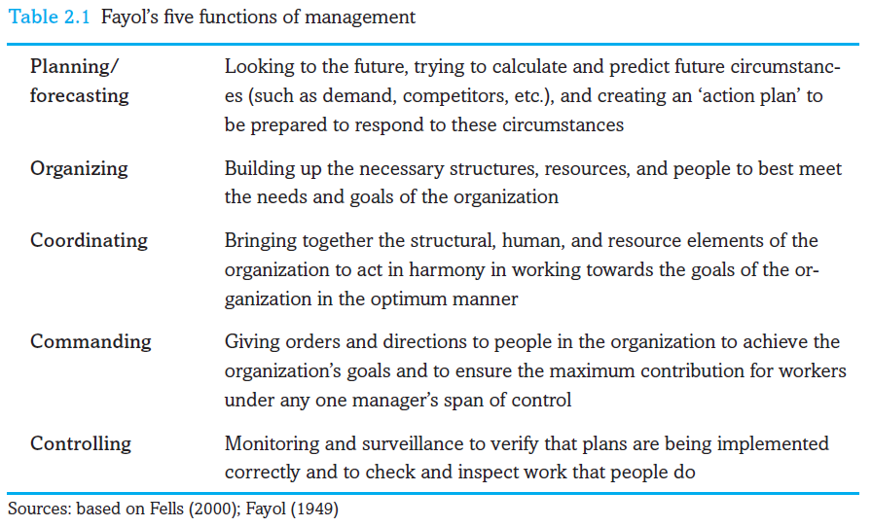
Fayol’s five functions of management

Slide 13
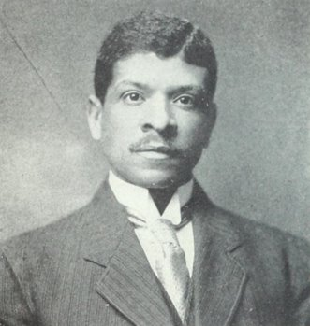
Charles Clinton Spaulding (1874 – 1952)
Spaulding, C. C. (1927) ‘The administration of big business.’ Pittsburgh Courier.

Slide 14
Charles Clinton Spaulding
Created North Carolina Mutual Life Insurance company in the United States in early 1900s
Developed it from a failing company and oversaw its successful expansion
Created the ‘eight necessities of management’ for managing large-scale organizations

Slide 15
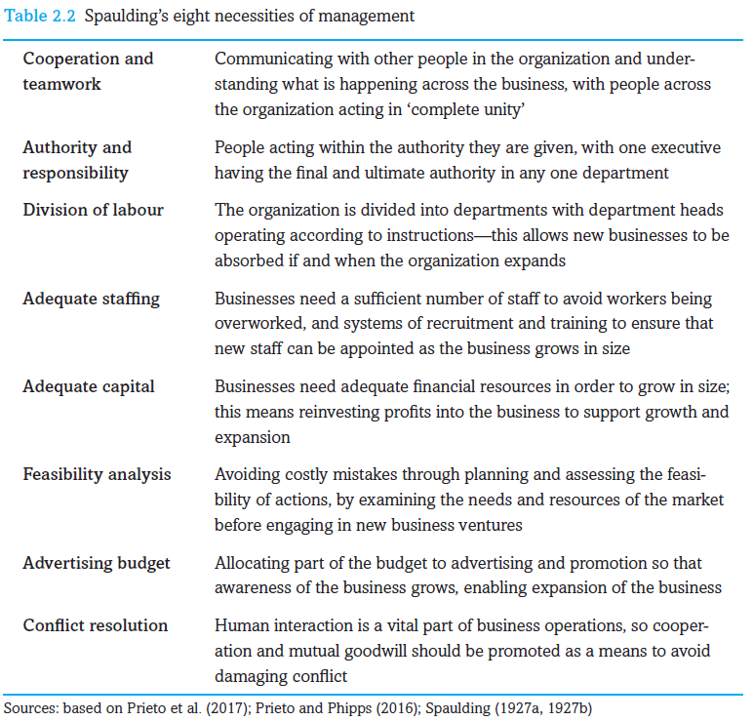
Spaulding’s ‘eight necessities of management’

Slide 16
The development of bureaucracy
How to carry out Fayol’s five functions and Spaulding’s eight necessities as an organization grows in size?
A systematic approach
From personal and direct control to impersonal and indirect control
Rational organizational design through bureaucracy:
  Bureaucratic structure and hierarchy
  Bureaucratic standardization: rules, policies and procedures
  Bureaucratic records and paperwork

Slide 17
Bureaucratic structure and hierarchy

Slide 18
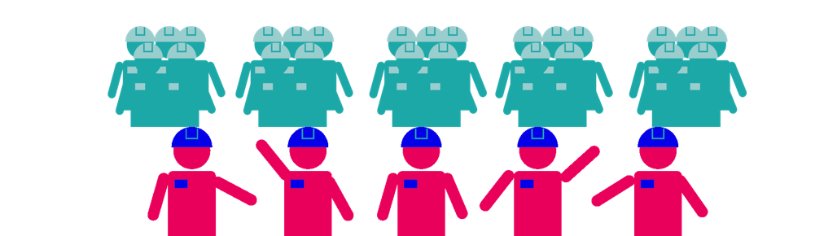
Bureaucratic structure and hierarchy

Slide 19
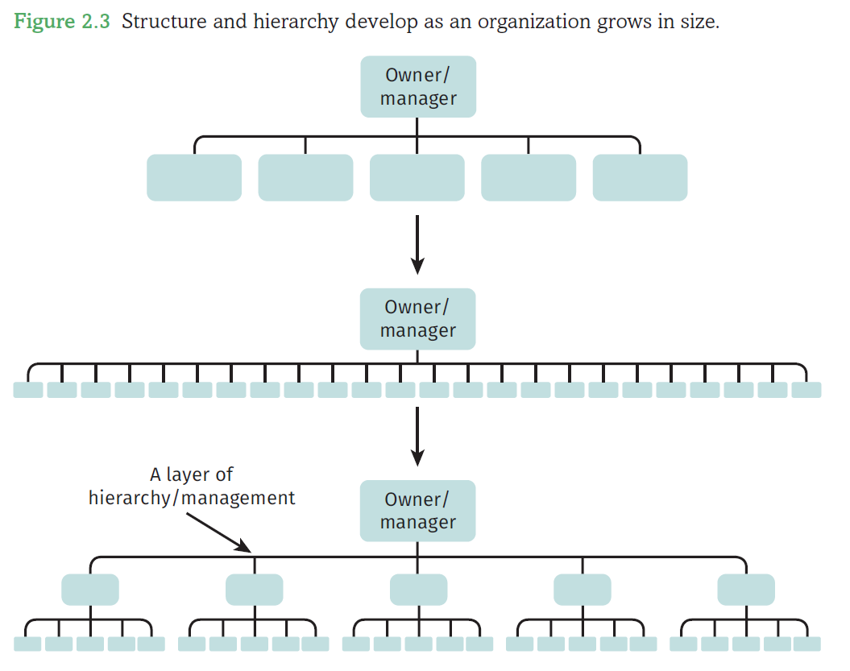
Bureaucratic structure and hierarchy

Slide 20
Features of bureaucratic hierarchy
Levels of management organised into a hierarchy or organizational structure
Control delegated through the hierarchy – from direct to indirect control
Manageable span of control at each level of the hierarchy
Personal face-to-face control remains at each level

Slide 21
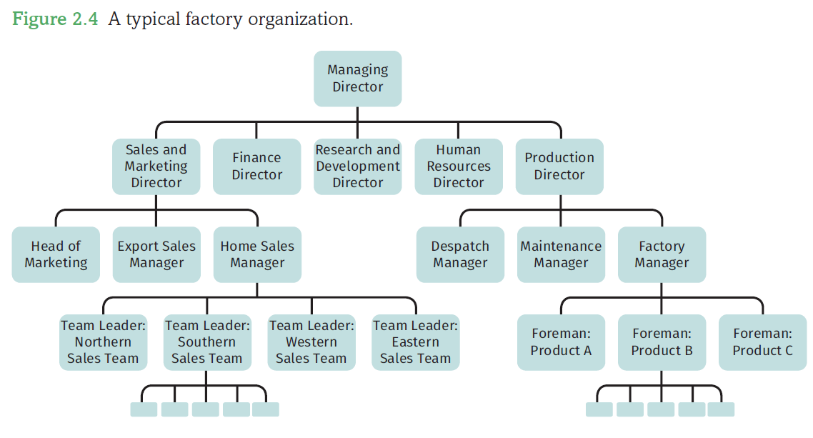
Vertical and horizontal differentiation
Each box in the hierarchy corresponds to a particular office or role
Organization chart shows lines of communication and authority – official relationships between workers
Job description – from broad structures to specific roles and relationships within the structure

Slide 22
Rules, policies, and procedures

Slide 23
Rules, policies, and procedures
Standardizing behaviour across an organizational structure – do all managers treat their subordinates in the same way?​
Bureaucracy and managerial discretion​
Standardization of behaviour through:​
Rules​
Policies​
Procedures

Slide 24
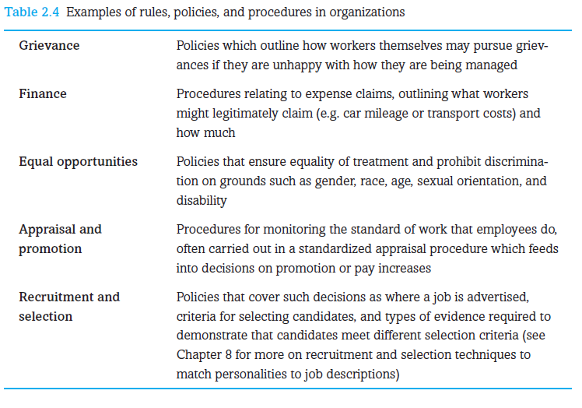
Examples of rules, policies, and procedures

Slide 25
Bureaucratic records and paperwork

Slide 26
Bureaucratic records
Information needed to facilitate bureaucratic rules and procedures
Pro-forma with pre-defined fields – standardizes information about employees
More efficient recording and retrieval of information through standardized records
Control and surveillance by monitoring information stored
Enhanced power and control from computerized record-keeping

Slide 27
Computers and bureaucracy
Files and folders in computer systems​
Increases the number of records that can be stored and the speed with which they can be processed​
Increases the power of bureaucracy​
How do organizations know you?​
A name or a number?

Slide 28

Shoshana Zuboff: the informated organization
‘Organizations have become databases’
Zuboff, S. (1988) ‘In the age of the smart machine: The future of work and power.’ Oxford: Heinemann
Notes:
Photo credit: Kirsten Holst licensed under CC BY-NC 2.0

Slide 29
Big data
Masses of data stored about processes, customers, employees etc.
Amazon is ‘driven by data’ (Kantour and Streitfeld, 2015)
Performance management
Amazon is ‘driven by a continual performance improvement algorithm’ (Kantor and Streitfeld, 2015)

Slide 30
Fayol’s five functions of management
How do big data and algorithms facilitate these?

Slide 31
The power of bureaucracy: large-scale control

Slide 32
The power of bureaucracy
Ordering and controlling power – over large organizations, even populations
Bureaucracy ‘ubiquitous and inevitable’ (Watson, 2002: 239)
Can any organization exist without some form of bureaucracy?
How much of your life today has been in some way ordered and controlled by bureaucracy?

Slide 33
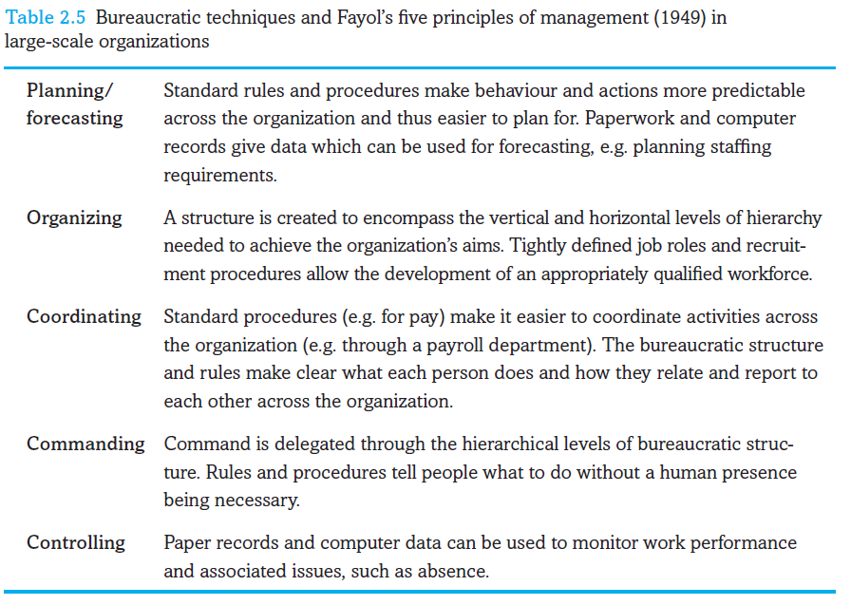
Bureaucracy and Fayol’s five functions

Slide 34
Weber’s critique of bureaucracy

Slide 35
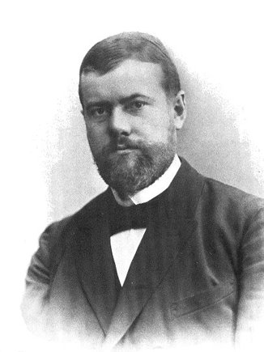
Max Weber and the critique of bureaucracy
Wrote in early 1900s, the same time as Fayol
Weber was a sociologist – not a manager nor a management theorist
Noted technical efficiency of bureaucracy – but critical of its effects on people and society
From traditional and charismatic authority to rational-legal authority

Slide 36
Problems with bureaucracy and rationality
Formal and substantive rationality (Weber)
  Modernity and the Holocaust (Bauman, 1989)
  Technical efficiency vs. ethics
  Responsibility of individuals following rules in large organisations
Disenchantment
  Loss of ‘magical elements’ (Weber, 1958)
  Dehumanization: rules and monotonous routines rather than people acting independently as individuals
The iron cage of rationality (Weber, 1958)

Slide 37
Modernity and the Holocaust
Bauman (1989) – How could individuals commit the atrocities of the Holocaust?
Nazi death camps were also highly efficient and impersonal bureaucracies
Workers were just one part in the overall bureaucracy – distant from the horrific final results
Technically efficient, but not substantively rational in Weber’s terms

Slide 38
Dysfunctions of bureaucracy

Slide 39
Dysfunctions and inflexibility of bureaucracy
Red tape – bureaucracy gets in the way rather than making work more efficient
Bureaucratic personality (Merton ,1940) – the ‘jobsworth’
‘Bending the rules’ to get work done (Blau, 1963)
Exercising discretion – ‘street-level bureaucracy’ (Lipsky, 1980)
Mock bureaucracy (Gouldner, 1954) – ‘we have a policy’

Slide 40
From bureaucracy to post-bureaucracy

Slide 41
Case: Accenture and performance review
Performance objectives measured through forms and paperwork
Problem 1 – People are blocked and stifled beneath a mass of metrics and objectives
Problem 2 – People work only to the objectives that are measured
Problem 3 – Bureaucratic burden of running performance review for 300,000 employees
Performance review did not improve performance. Accenture ditched it.

Slide 42
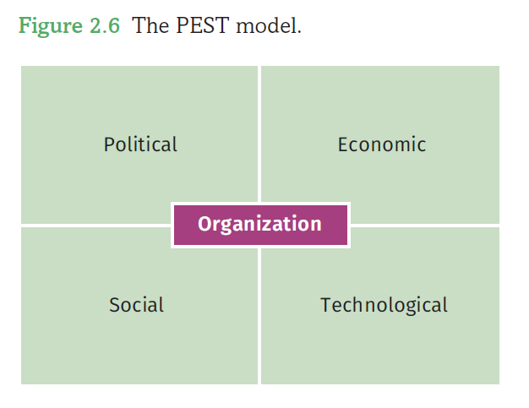
The contemporary environment
Rationalization – formed in a time of stable environments
The contemporary environment – fluid, dynamic, changeable, turbulent, uncertain
Liquid modernity (Bauman, 2000)
VUCA – volatility, uncertainty, complexity and ambiguity

Slide 43
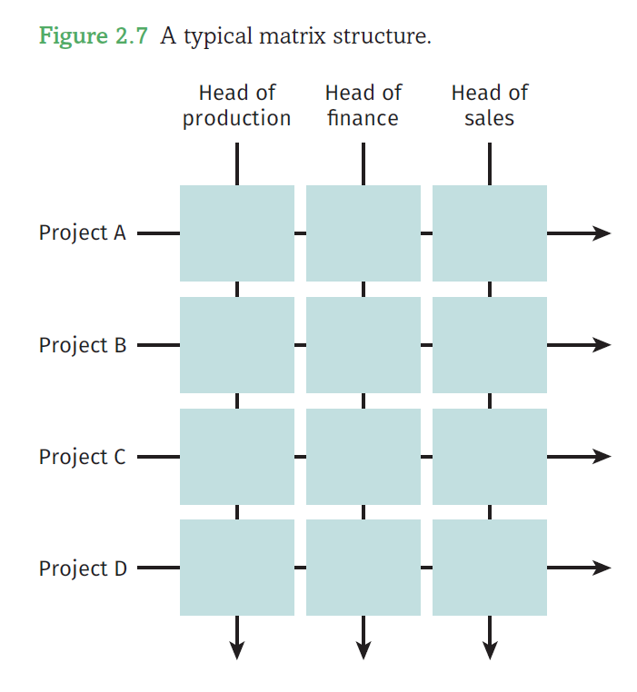
From bureaucracy to post-bureaucracy
The ‘coming death of bureaucracy’ (Bennis, 1966)
Contingency theory – no ‘one best way’ – design organizations to fit environment
Matrix structures – away from rigid hierarchies and central command
Post-bureaucratic ‘structureless’ organization – minimizing rules and structures to promote creativity and innovation, e.g. Oticon, Google, Virgin UK

Slide 44
Bureaucratic control and coordination in digitized organizations

Slide 45
Digitalization – the implosion and explosion of organizations
Organizations ‘imploding’ into code and ‘exploding’ into computer networks (Blackler, 1995)
Organizations and geographical reach – where does the boundary end?
  Between organizations and customers (e.g. digitization at Lloyds Bank)
  Between work and home – teleworking and telecommuting

Slide 46
Organizations as rhizomes
Static structures vs random connections
Cyberspace as a rhizome
Organizations in cyberspace – rhizomes or root trees?

Slide 47
The gig economy
An issue of control and coordination over a large scale
Control at a distance
Use of big data and algorithms

Slide 48
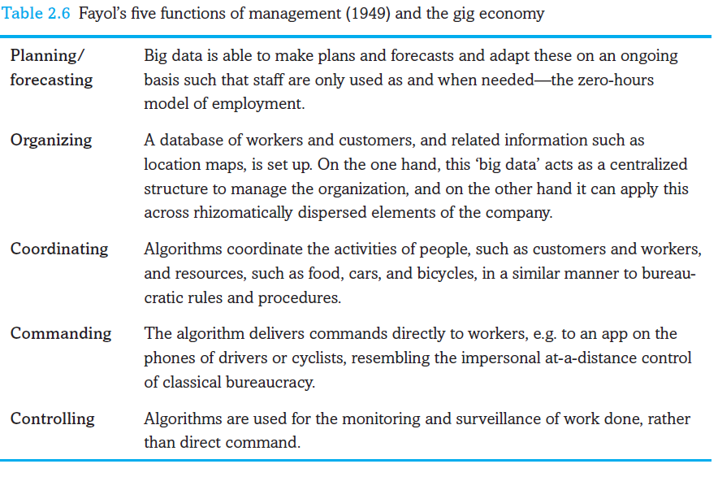
The gig economy and Fayol’s five functions

