Slide 1
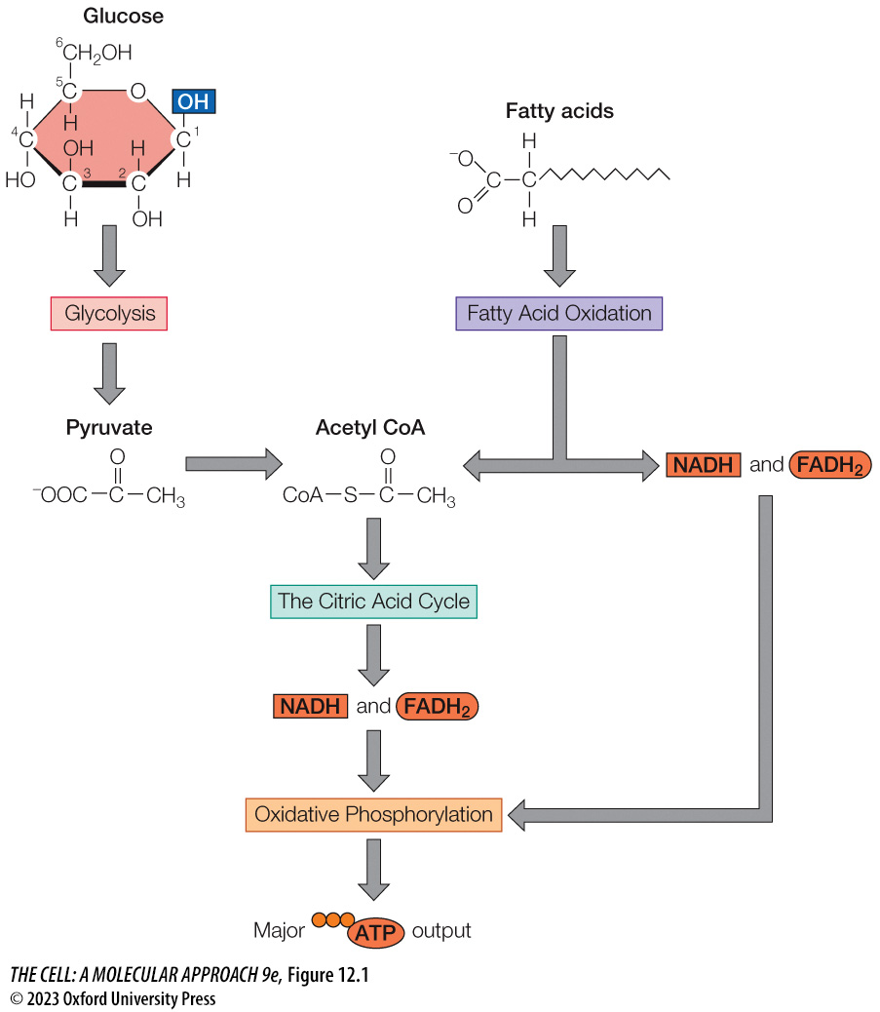
FIGURE 12.1 Overview of the catabolic pathways for ATP production
Notes:
FIGURE 12.1 Overview of the catabolic pathways for ATP production
ATP is produced from the catabolism of glucose and fatty acids. Glucose catabolism begins with a series of reactions that make up glycolysis, which generates pyruvate. Pyruvate is converted to acetyl CoA, which is further catabolized through a series of reactions that comprise the citric acid cycle. The citric acid cycle produces several molecules of NADH and FADH₂ that are then oxidized during oxidative phosphorylation, which provides the major output of ATP production. Fatty acid oxidation yields several molecules of acetyl CoA, NADH, and FADH₂, which also contributes to ATP production through the citric acid cycle and oxidative phosphorylation.

Slide 2
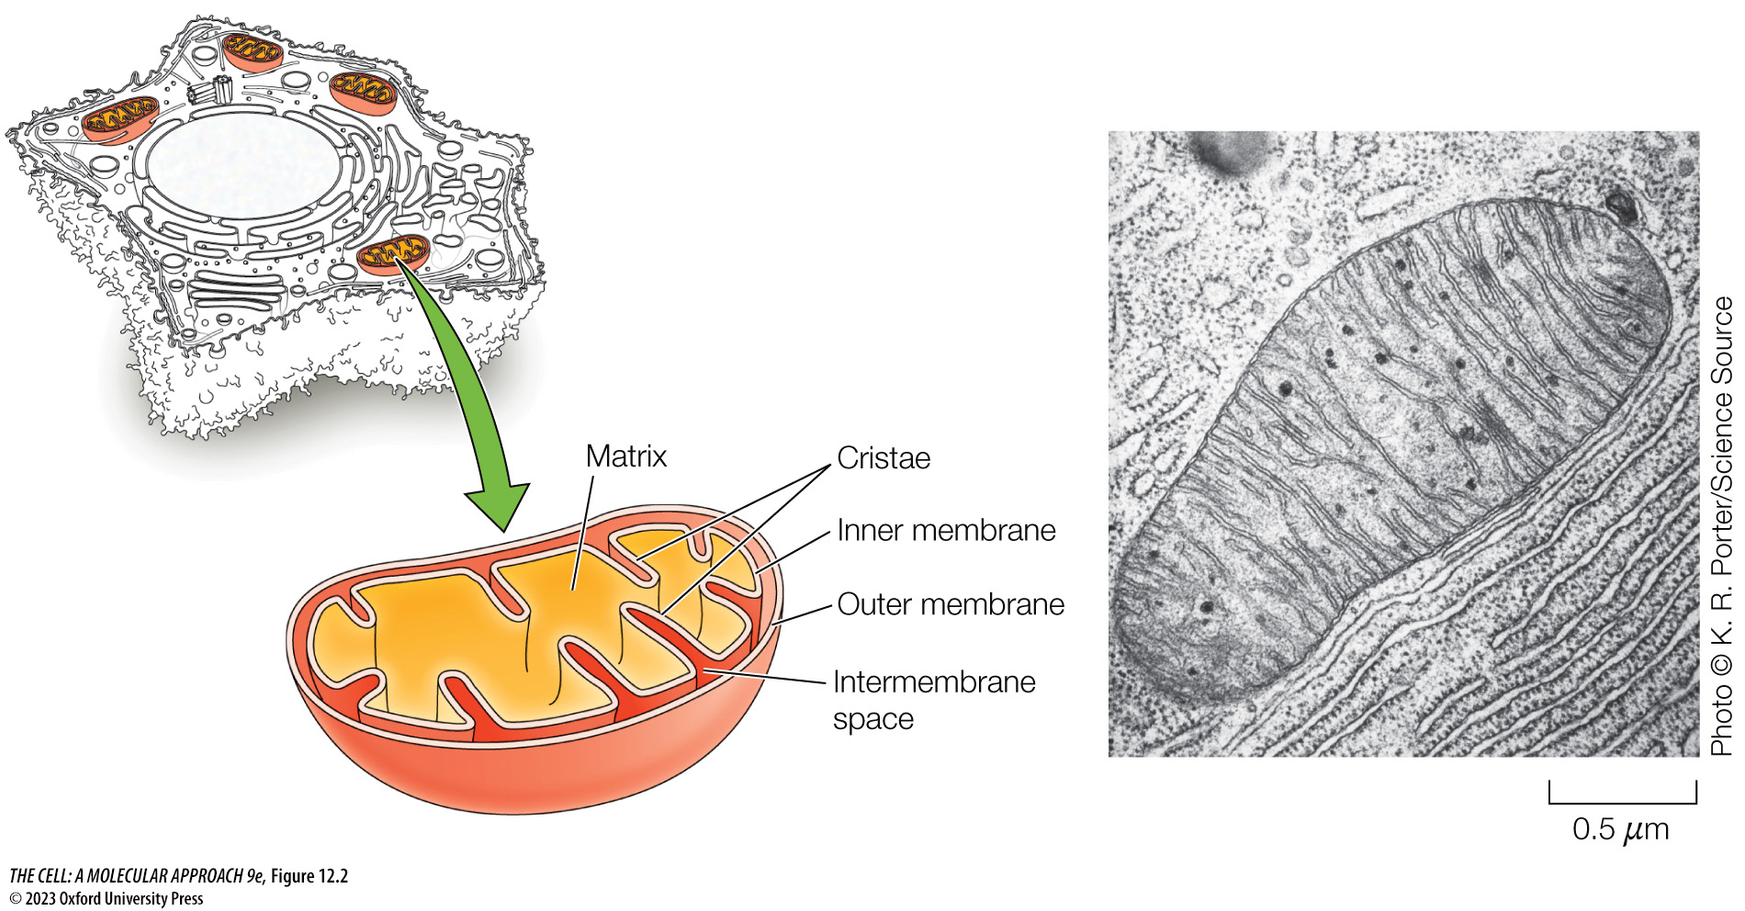
FIGURE 12.2 Structure of a mitochondrion
Notes:
FIGURE 12.2 Structure of a mitochondrion
Mitochondria are bounded by a double-membrane system, consisting of inner and outer membranes. Folds of the inner membrane (cristae) extend into the matrix.

Slide 3
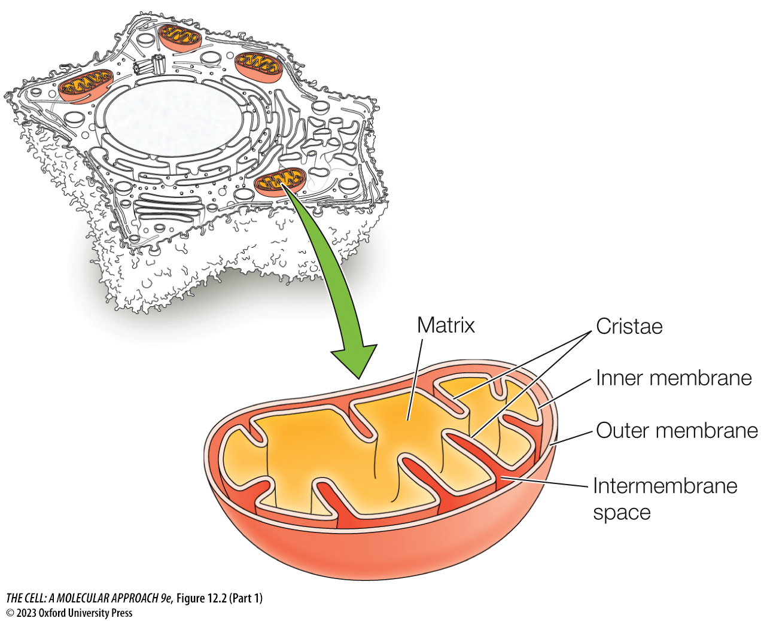
FIGURE 12.2 Structure of a mitochondrion (Part 1)
Notes:
FIGURE 12.2 Structure of a mitochondrion
Mitochondria are bounded by a double-membrane system, consisting of inner and outer membranes. Folds of the inner membrane (cristae) extend into the matrix.

Slide 4
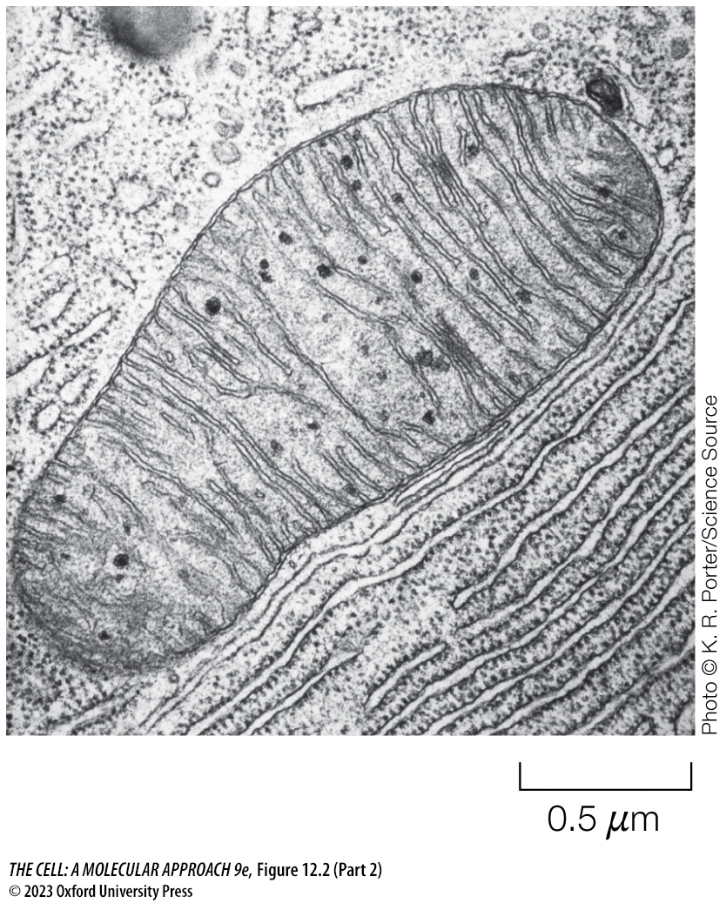
FIGURE 12.2 Structure of a mitochondrion (Part 2)
Notes:
FIGURE 12.2 Structure of a mitochondrion
Mitochondria are bounded by a double-membrane system, consisting of inner and outer membranes. Folds of the inner membrane (cristae) extend into the matrix.

Slide 5
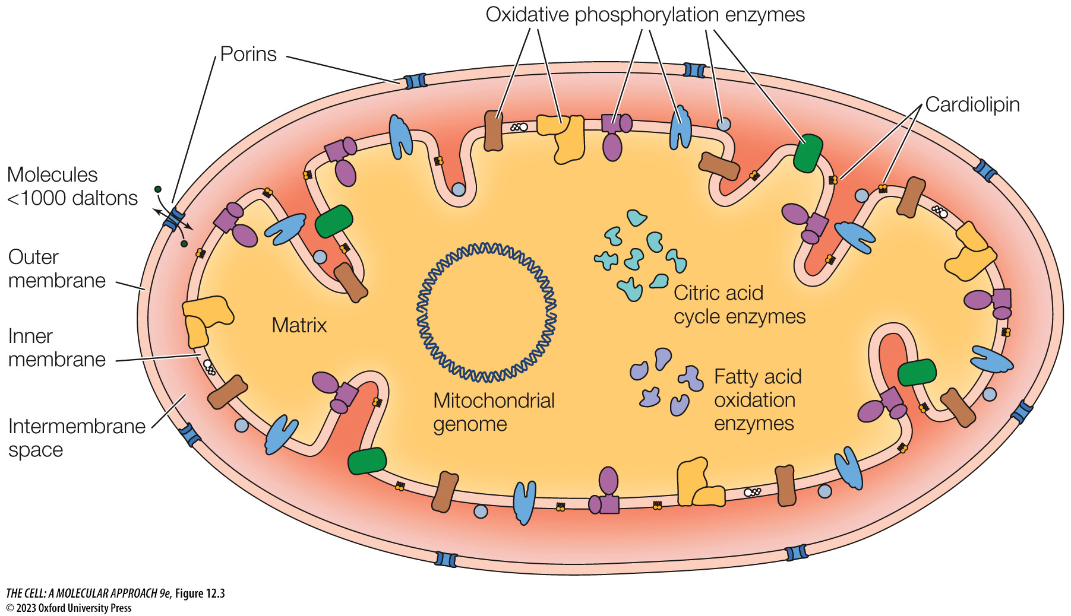
FIGURE 12.3 Mitochondrial composition
Notes:
FIGURE 12.3 Mitochondrial composition
Mitochondria contain their own genome and genetic system within their matrix as well as enzymes that carry out metabolic pathways such as the citric acid cycle and fatty acid oxidation. The mitochondrial inner membrane is associated with enzymes that carry out oxidative phosphorylation. While the inner membrane is impermeable to most small molecules and ions, the outer membrane is permeable to most molecules less than 1000 daltons in size due to transmembrane porins through which those molecules can pass via passive diffusion. Mitochondrial membranes also contain a unique lipid composition, including a unique phospholipid called cardiolipin that is localized to the inner membrane.

Slide 6
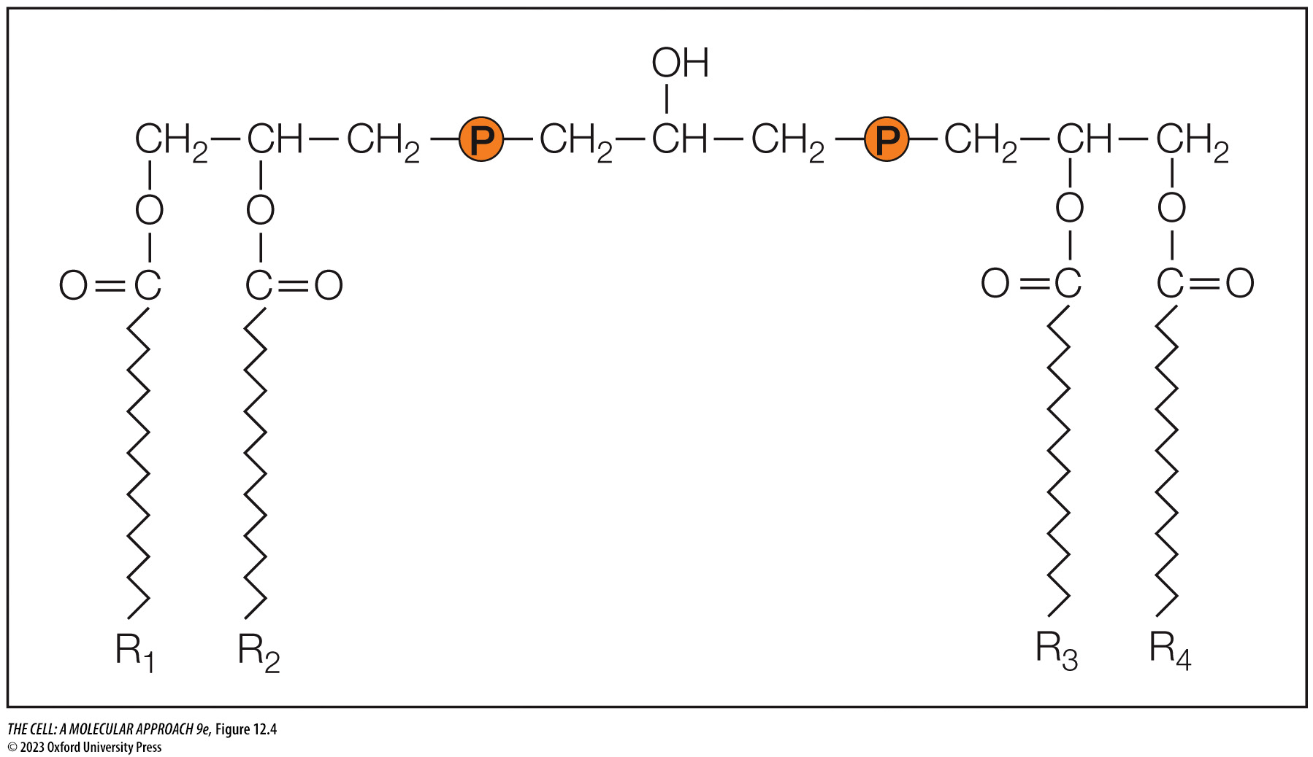
FIGURE 12.4 Structure of cardiolipin
Notes:
FIGURE 12.4 Structure of cardiolipin
Cardiolipin, an unusual “double” phospholipid containing four fatty acid chains, is found primarily in the inner mitochondrial membrane.

Slide 7
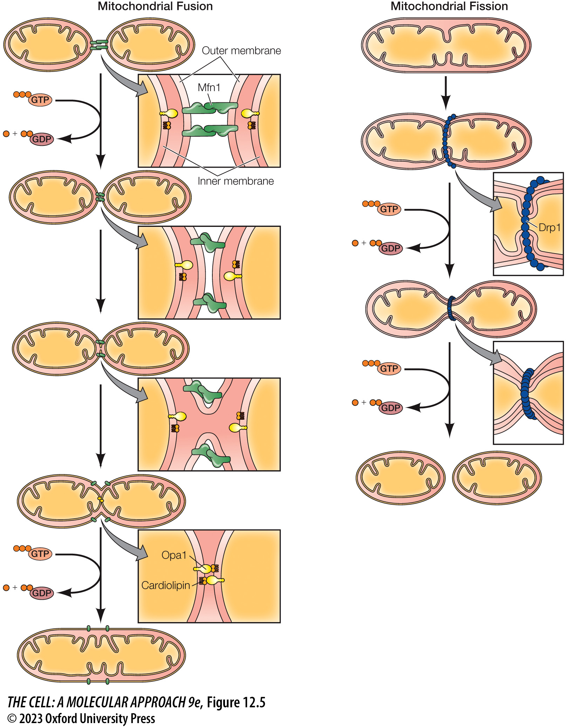
FIGURE 12.5 Mitochondrial fusion and fission
Notes:
FIGURE 12.5 Mitochondrial fusion and fission
Mitochondrial fusion is driven by Mfn1 and Opa1. Mfn1 forms homotypic protein–protein interactions in between separate mitochondria, whereupon GTP hydrolysis results in a conformational change that drives the outer membranes together, resulting in outer membrane fusion. Opa1 then mediates fusion of the respective inner membranes through interactions with cardiolipin within the opposite membrane and GTP hydrolysis. Mitochondrial fission is mediated by Drp1, which assembles into a ring structure around a mitochondrion, whereupon GTP hydrolysis drives contraction of the Drp1 ring, resulting in pinching and fission of the mitochondrion.

Slide 8
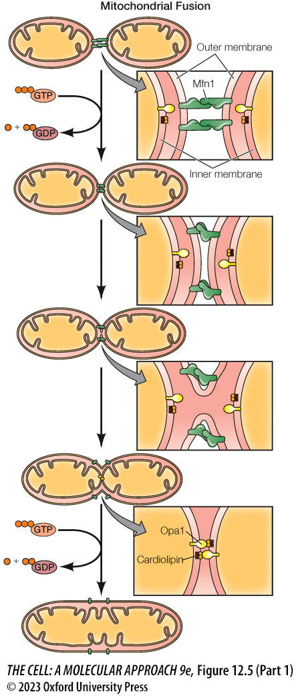
FIGURE 12.5 Mitochondrial fusion and fission (Part 1)
Notes:
FIGURE 12.5 Mitochondrial fusion and fission
Mitochondrial fusion is driven by Mfn1 and Opa1. Mfn1 forms homotypic protein–protein interactions in between separate mitochondria, whereupon GTP hydrolysis results in a conformational change that drives the outer membranes together, resulting in outer membrane fusion. Opa1 then mediates fusion of the respective inner membranes through interactions with cardiolipin within the opposite membrane and GTP hydrolysis. Mitochondrial fission is mediated by Drp1, which assembles into a ring structure around a mitochondrion, whereupon GTP hydrolysis drives contraction of the Drp1 ring, resulting in pinching and fission of the mitochondrion.

Slide 9
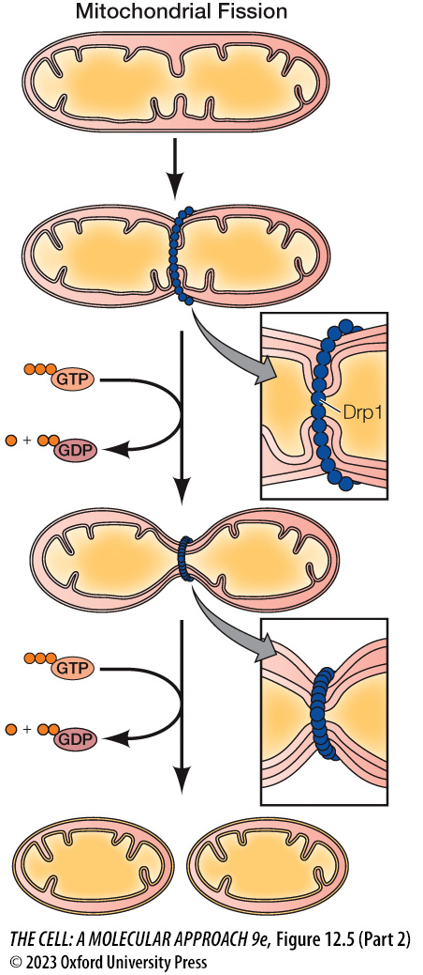
FIGURE 12.5 Mitochondrial fusion and fission (Part 2)
Notes:
FIGURE 12.5 Mitochondrial fusion and fission
Mitochondrial fusion is driven by Mfn1 and Opa1. Mfn1 forms homotypic protein–protein interactions in between separate mitochondria, whereupon GTP hydrolysis results in a conformational change that drives the outer membranes together, resulting in outer membrane fusion. Opa1 then mediates fusion of the respective inner membranes through interactions with cardiolipin within the opposite membrane and GTP hydrolysis. Mitochondrial fission is mediated by Drp1, which assembles into a ring structure around a mitochondrion, whereupon GTP hydrolysis drives contraction of the Drp1 ring, resulting in pinching and fission of the mitochondrion.

Slide 10
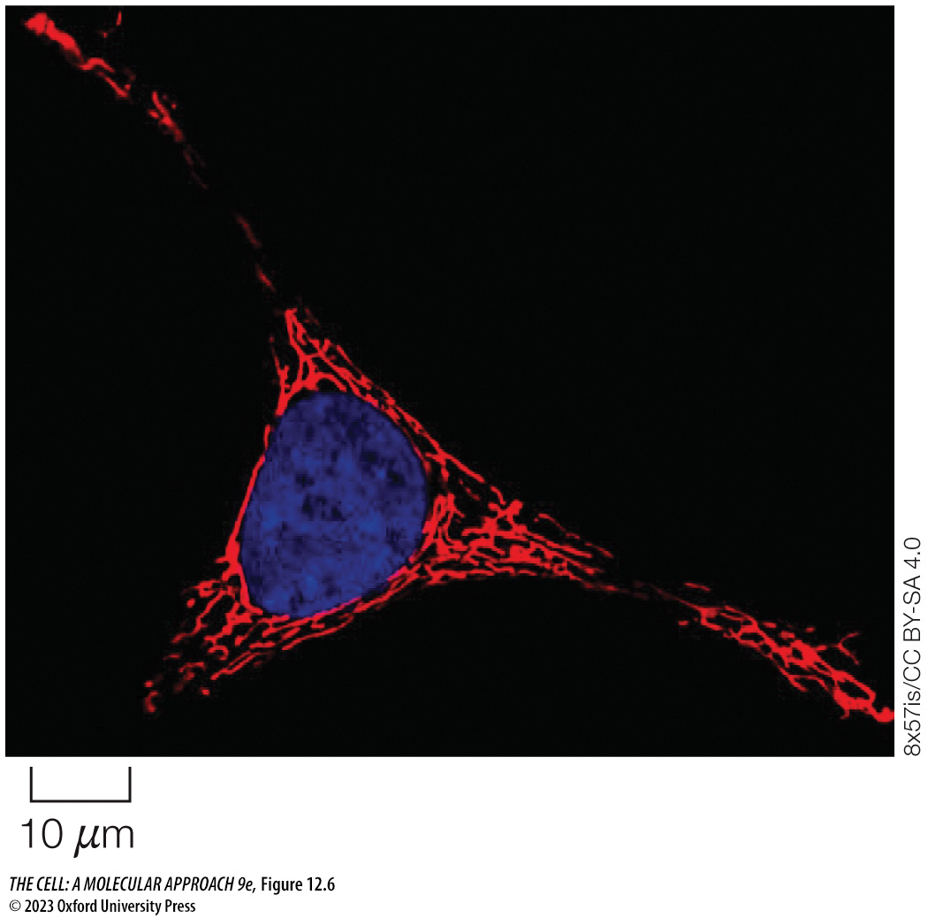
FIGURE 12.6 A mitochondrial network
Notes:
FIGURE 12.6 A mitochondrial network
Fluorescence micrograph of a HeLa cell treated with a red fluorescent dye (MitoTracker Red) that accumulates specifically in mitochondria and a blue fluorescent dye (DAPI) that binds DNA. The mitochondria are in the form of an interconnected network.

Slide 11
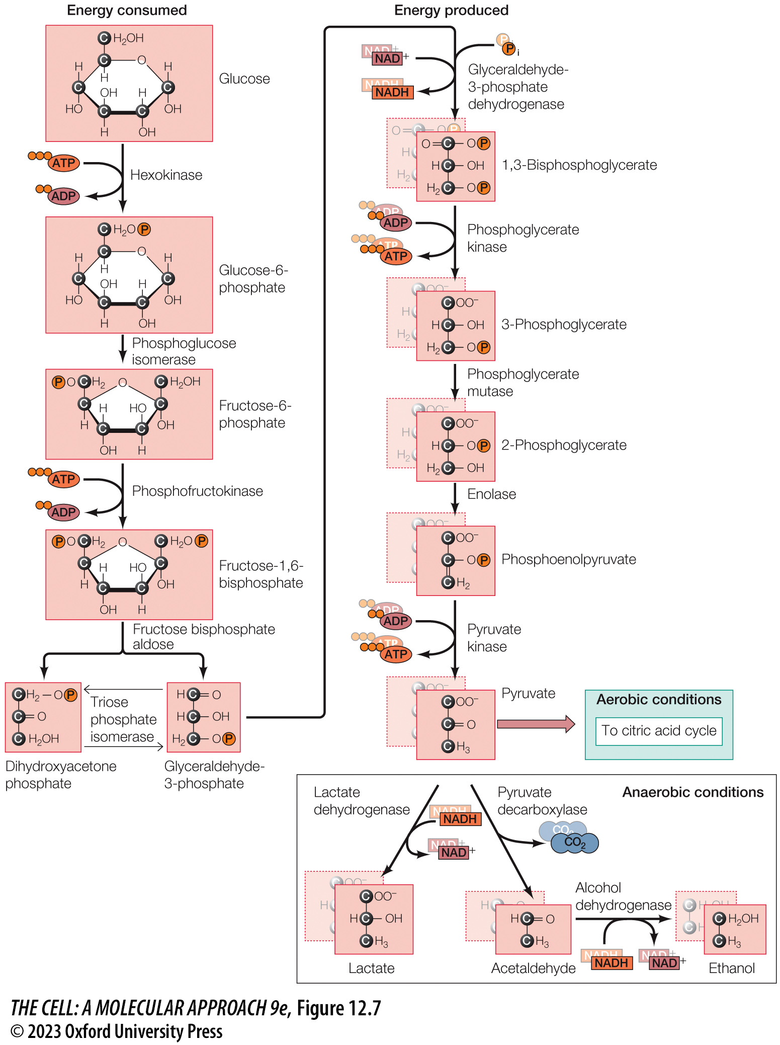
FIGURE 12.7 Reactions of glycolysis
Notes:
FIGURE 12.7 Reactions of glycolysis
Glucose is catabolized to pyruvate, with the net formation of two molecules each of ATP and NADH. Under aerobic conditions, pyruvate is further metabolized by the citric acid cycle. Under anaerobic conditions, NADH is reoxidized by the conversion of pyruvate to ethanol or lactate. Note that a single molecule of glucose yields two molecules each (shadow boxes) of the energy-producing three-carbon derivatives.

Slide 12
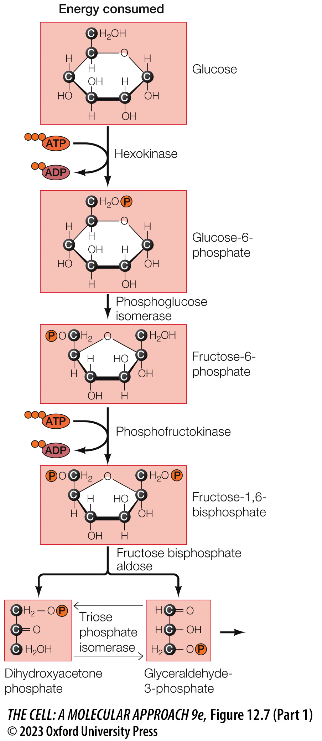
FIGURE 12.7 Reactions of glycolysis (Part 1)
Notes:
FIGURE 12.7 Reactions of glycolysis
Glucose is catabolized to pyruvate, with the net formation of two molecules each of ATP and NADH. Under aerobic conditions, pyruvate is further metabolized by the citric acid cycle. Under anaerobic conditions, NADH is reoxidized by the conversion of pyruvate to ethanol or lactate. Note that a single molecule of glucose yields two molecules each (shadow boxes) of the energy-producing three-carbon derivatives.

Slide 13
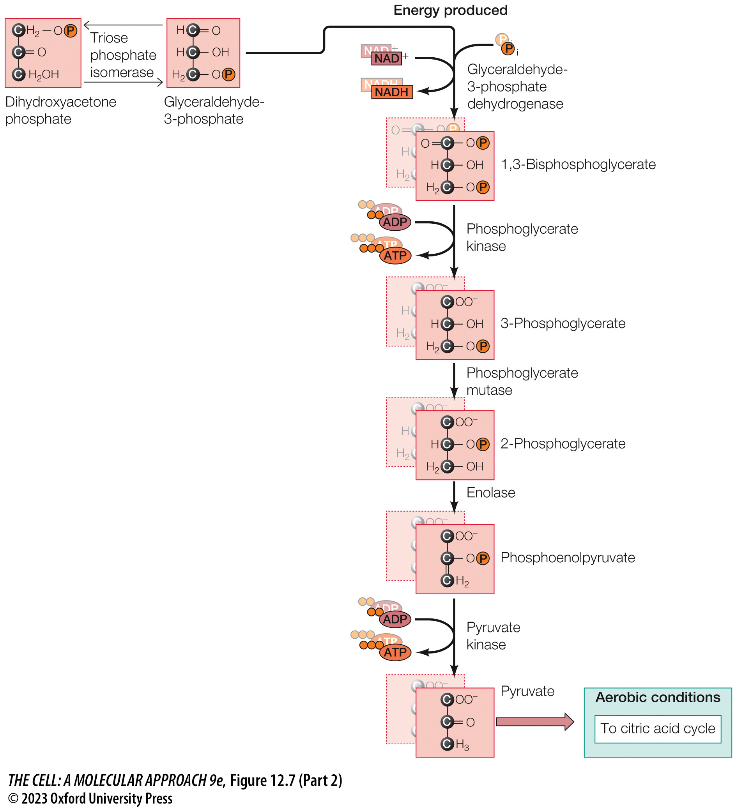
FIGURE 12.7 Reactions of glycolysis (Part 2)
Notes:
FIGURE 12.7 Reactions of glycolysis
Glucose is catabolized to pyruvate, with the net formation of two molecules each of ATP and NADH. Under aerobic conditions, pyruvate is further metabolized by the citric acid cycle. Under anaerobic conditions, NADH is reoxidized by the conversion of pyruvate to ethanol or lactate. Note that a single molecule of glucose yields two molecules each (shadow boxes) of the energy-producing three-carbon derivatives.

Slide 14
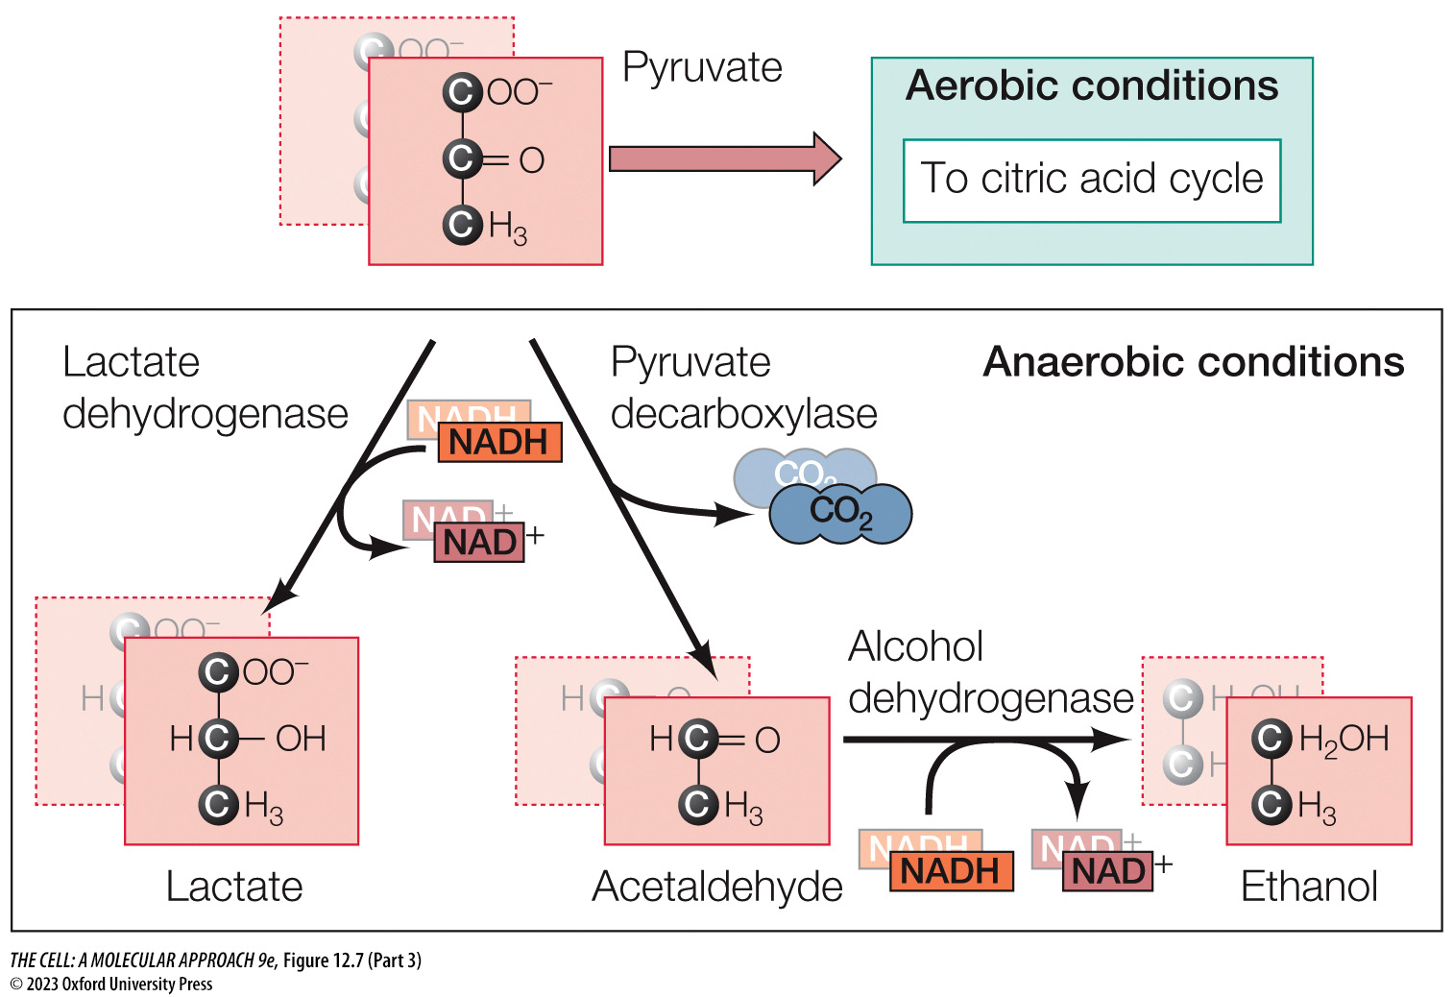
FIGURE 12.7 Reactions of glycolysis (Part 3)
Notes:
FIGURE 12.7 Reactions of glycolysis
Glucose is catabolized to pyruvate, with the net formation of two molecules each of ATP and NADH. Under aerobic conditions, pyruvate is further metabolized by the citric acid cycle. Under anaerobic conditions, NADH is reoxidized by the conversion of pyruvate to ethanol or lactate. Note that a single molecule of glucose yields two molecules each (shadow boxes) of the energy-producing three-carbon derivatives.

Slide 15
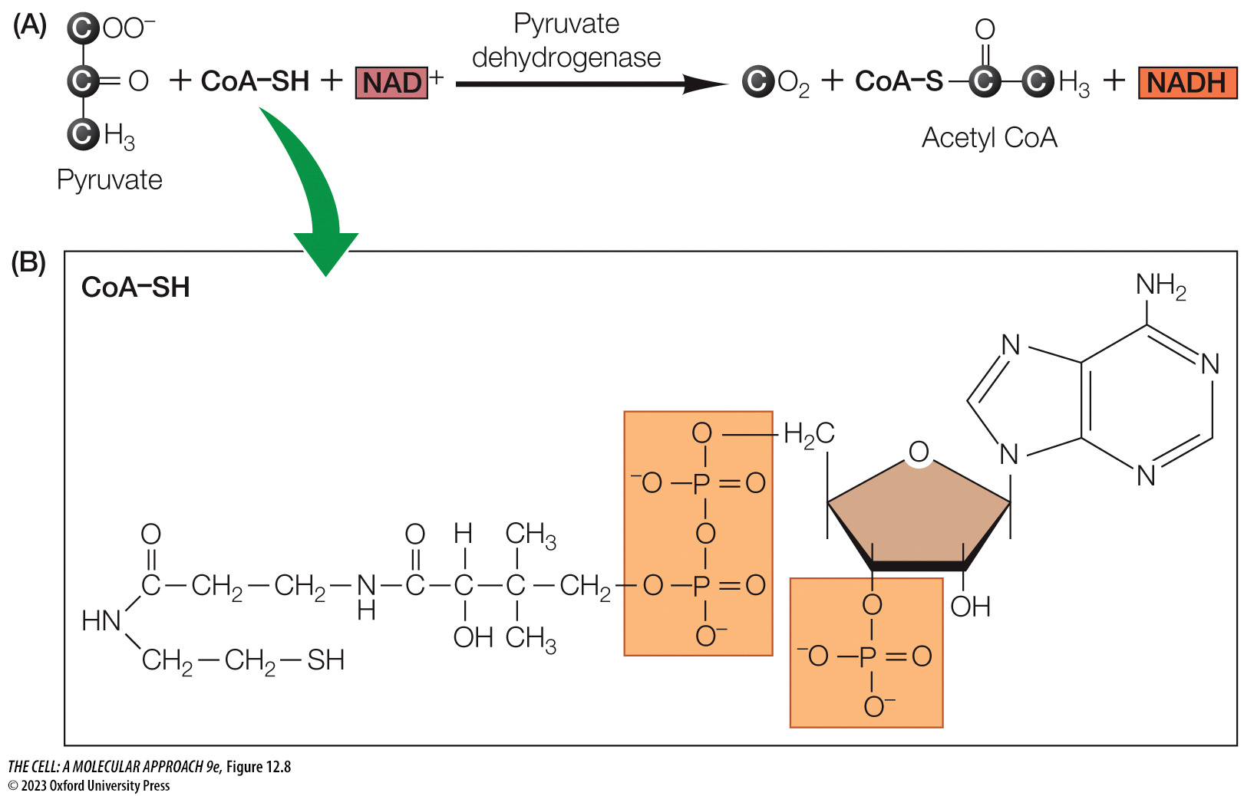
FIGURE 12.8 Oxidative decarboxylation of pyruvate
Notes:
FIGURE 12.8 Oxidative decarboxylation of pyruvate
(A) Pyruvate is converted to CO₂ and acetyl CoA, and one molecule of NADH is produced in the process. (B) Coenzyme A (CoA–SH) is a general carrier of activated acyl groups in a variety of reactions.

Slide 16
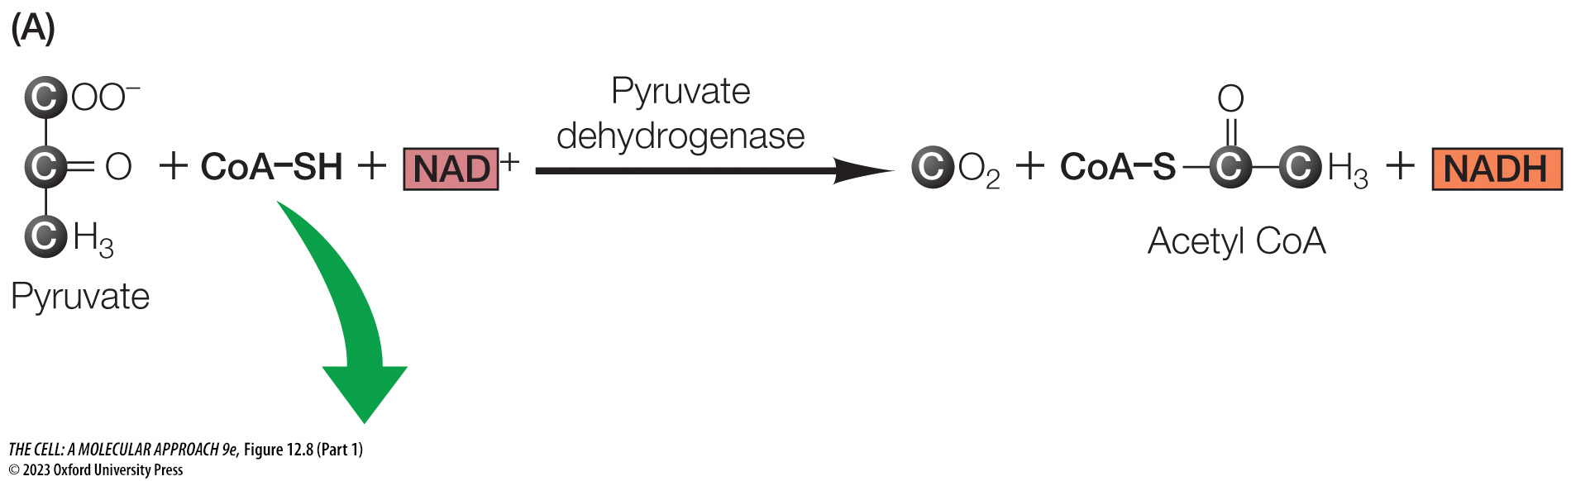
FIGURE 12.8 Oxidative decarboxylation of pyruvate (Part 1)
Notes:
FIGURE 12.8 Oxidative decarboxylation of pyruvate
(A) Pyruvate is converted to CO₂ and acetyl CoA, and one molecule of NADH is produced in the process. (B) Coenzyme A (CoA–SH) is a general carrier of activated acyl groups in a variety of reactions.

Slide 17
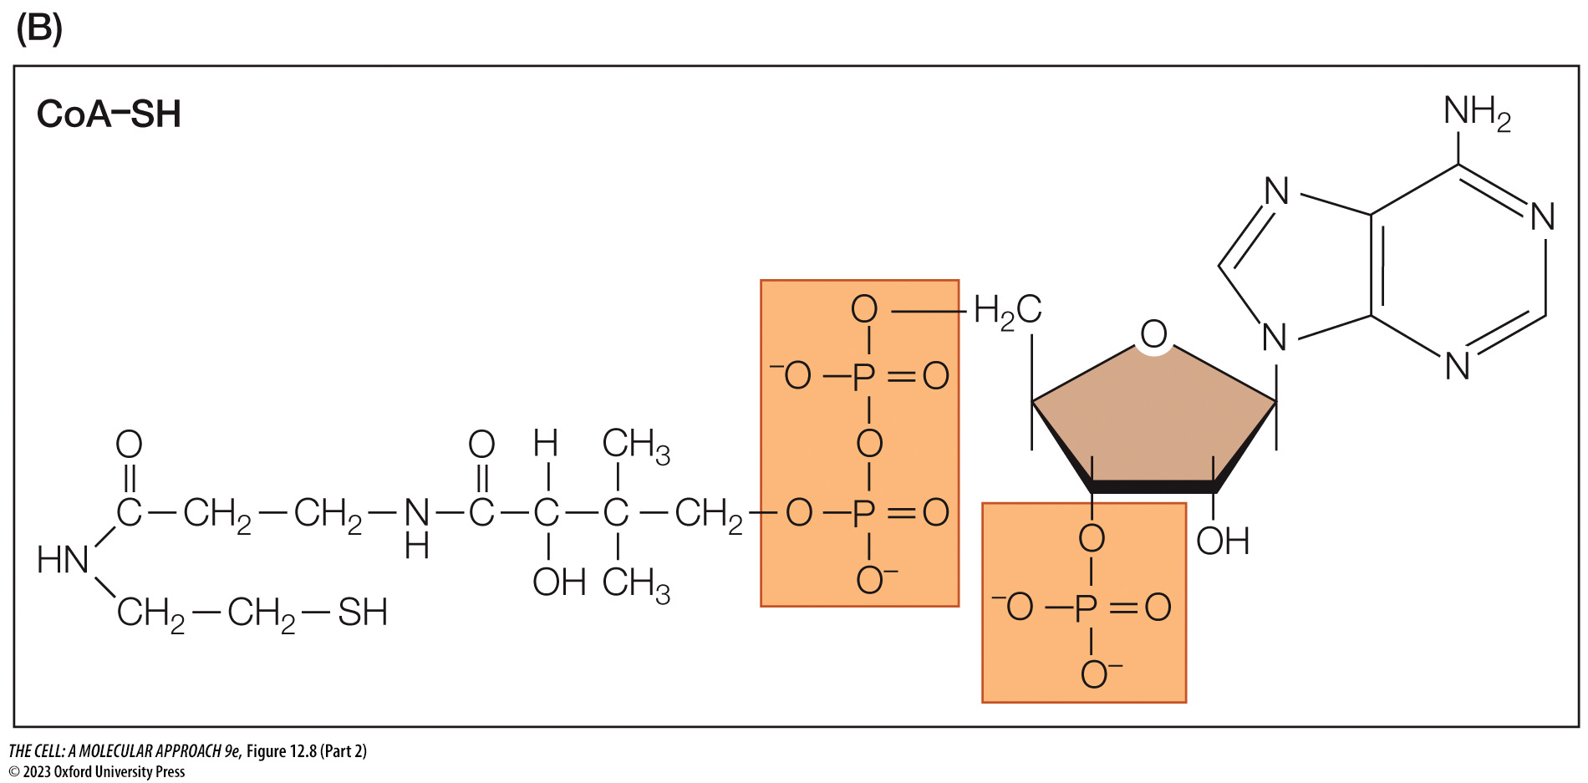
FIGURE 12.8 Oxidative decarboxylation of pyruvate (Part 2)
Notes:
FIGURE 12.8 Oxidative decarboxylation of pyruvate
(A) Pyruvate is converted to CO₂ and acetyl CoA, and one molecule of NADH is produced in the process. (B) Coenzyme A (CoA–SH) is a general carrier of activated acyl groups in a variety of reactions.

Slide 18
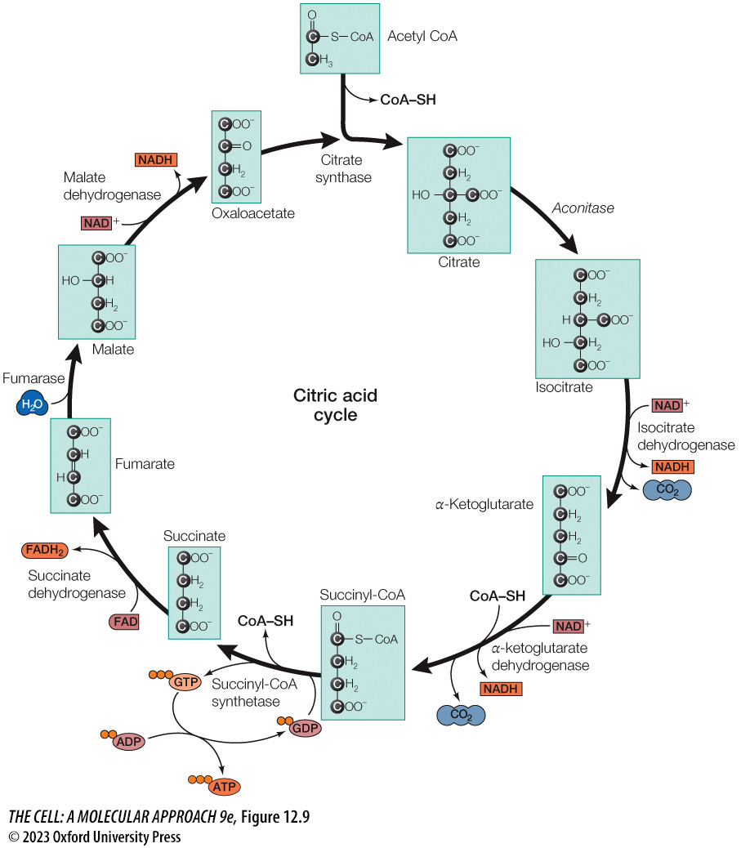
FIGURE 12.9 The citric acid cycle
Notes:
FIGURE 12.9 The citric acid cycle
A two-carbon acetyl group is transferred from acetyl CoA to oxaloacetate, forming citrate. Two carbons of citrate are then oxidized to CO₂ and oxaloacetate is regenerated. Each turn of the cycle yields one molecule of GTP (subsequently hydrolyzed to produce one ATP), three molecules of NADH, and one molecule of FADH₂.

Slide 19
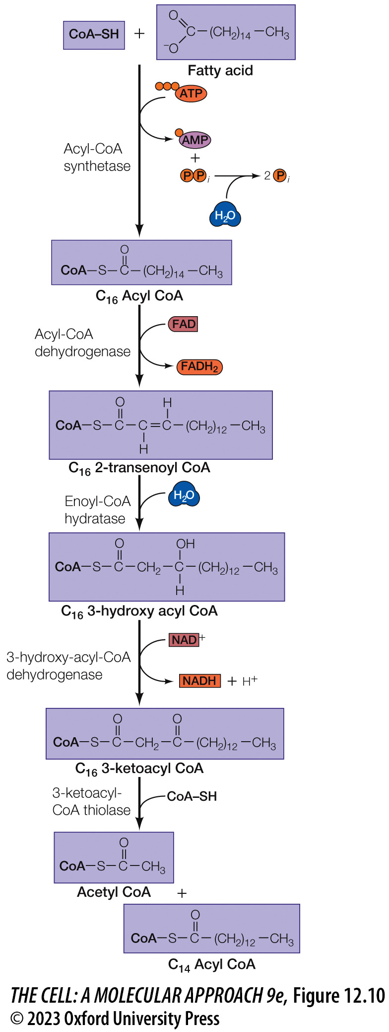
FIGURE 12.10 Oxidation of fatty acids
Notes:
FIGURE 12.10 Oxidation of fatty acids
The fatty acid (e.g., the 16-carbon saturated fatty acid palmitate) is initially joined to coenzyme A (CoA–SH) at the cost of one molecule of ATP. Degradation of the fatty acid then proceeds by stepwise oxidation (coupled to the formation of FADH₂ and NADH) and removal of a two-carbon unit as acetyl CoA.

Slide 20
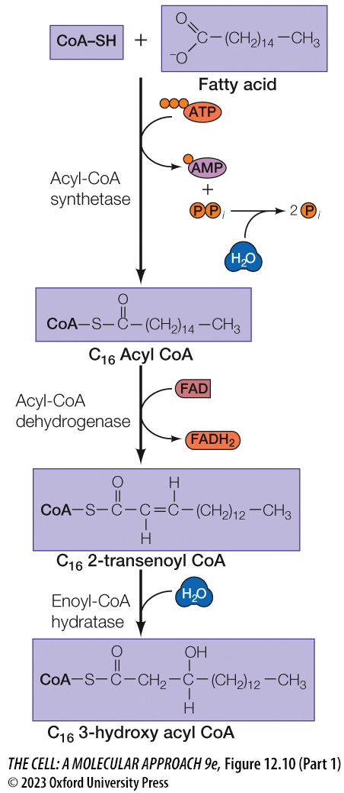
FIGURE 12.10 Oxidation of fatty acids (Part 1)
Notes:
FIGURE 12.10 Oxidation of fatty acids
The fatty acid (e.g., the 16-carbon saturated fatty acid palmitate) is initially joined to coenzyme A (CoA–SH) at the cost of one molecule of ATP. Degradation of the fatty acid then proceeds by stepwise oxidation (coupled to the formation of FADH₂ and NADH) and removal of a two-carbon unit as acetyl CoA.

Slide 21
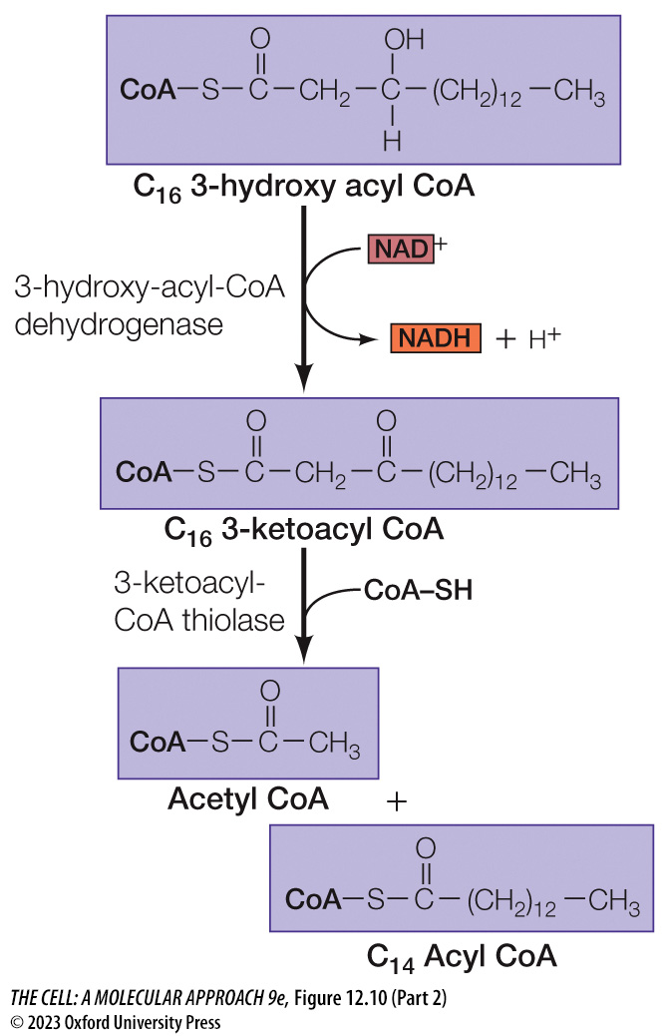
FIGURE 12.10 Oxidation of fatty acids (Part 2)
Notes:
FIGURE 12.10 Oxidation of fatty acids
The fatty acid (e.g., the 16-carbon saturated fatty acid palmitate) is initially joined to coenzyme A (CoA–SH) at the cost of one molecule of ATP. Degradation of the fatty acid then proceeds by stepwise oxidation (coupled to the formation of FADH₂ and NADH) and removal of a two-carbon unit as acetyl CoA.

Slide 22
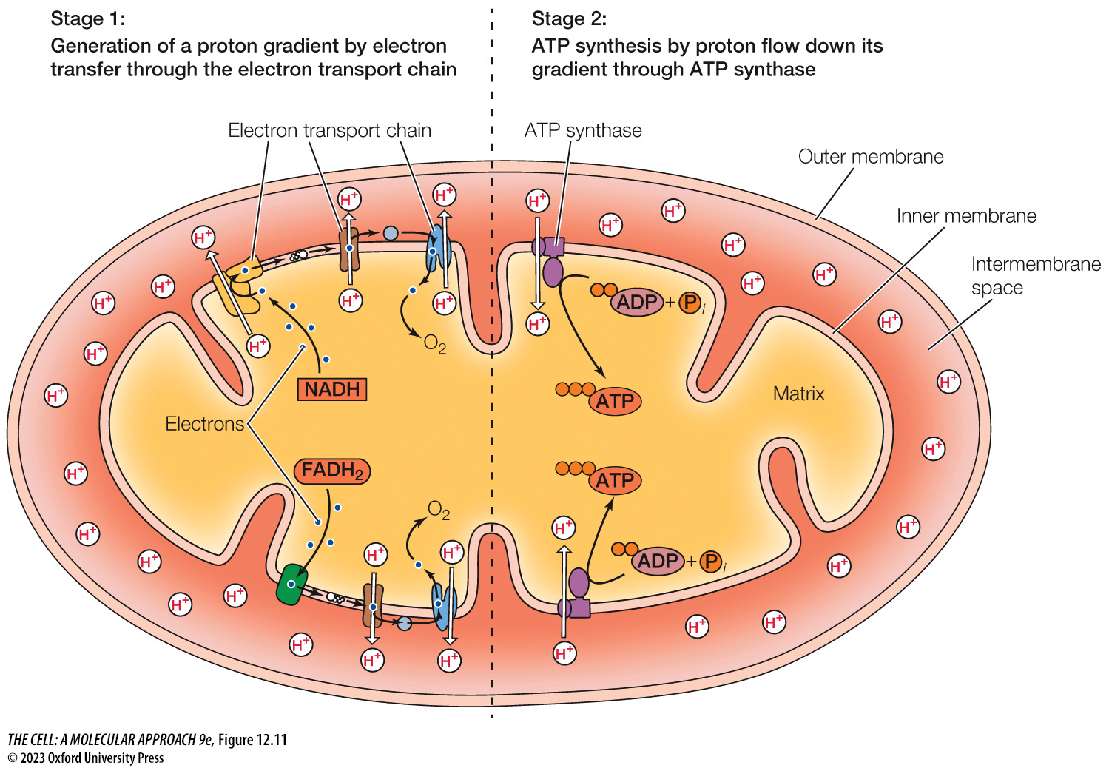
FIGURE 12.11 Overview of oxidative phosphorylation
Notes:
FIGURE 12.11 Overview of oxidative phosphorylation
Oxidative phosphorylation can be described as two concurrent stages. Stage 1 entails the generation of a proton gradient across the mitochondrial inner membrane by the electron transport chain (ETC). The ETC transfers electrons from NADH and FADH₂ to O₂, which releases energy that the ETC couples to pump protons from the matrix to the intermembrane space. Stage 2 entails the production of ATP driven by the flow of protons down their gradient through ATP synthase. The proton gradient generated by the ETC provides a source of potential energy. ATP synthase serves as a channel for the flow of protons down their gradient as well as a motor that couples proton flow from the intermembrane space to the matrix to the production of ATP from ADP + inorganic phosphate (P_{i}).

Slide 23
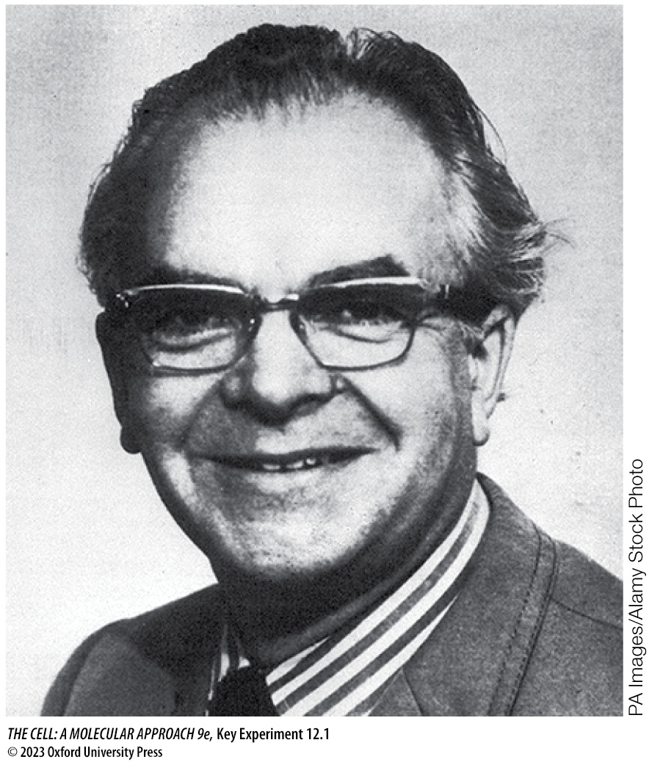
KEY EXPERIMENT The Chemiosmotic Theory (1)
Notes:
KEY EXPERIMENT The Chemiosmotic Theory
Peter Mitchell

Slide 24
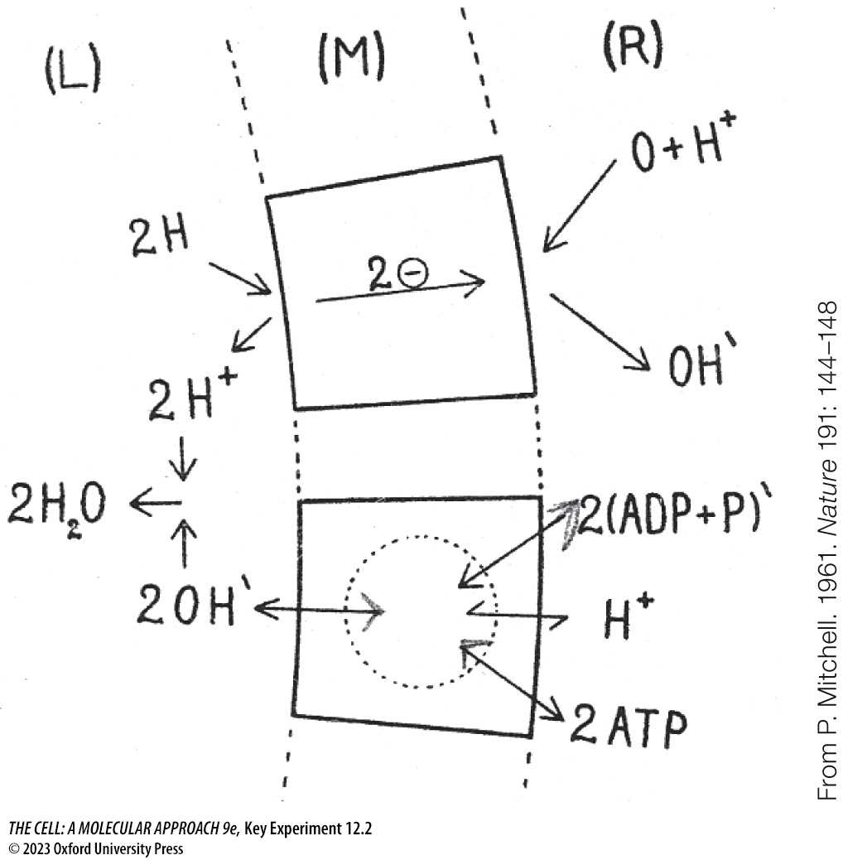
KEY EXPERIMENT The Chemiosmotic Theory (2)
Notes:
KEY EXPERIMENT The Chemiosmotic Theory
Mitchell’s representation of chemiosmotic coupling between an electron transport system (top) and an ATP-generating system (bottom) in a membrane (M) enclosing aqueous phase L within aqueous phase R.

Slide 25
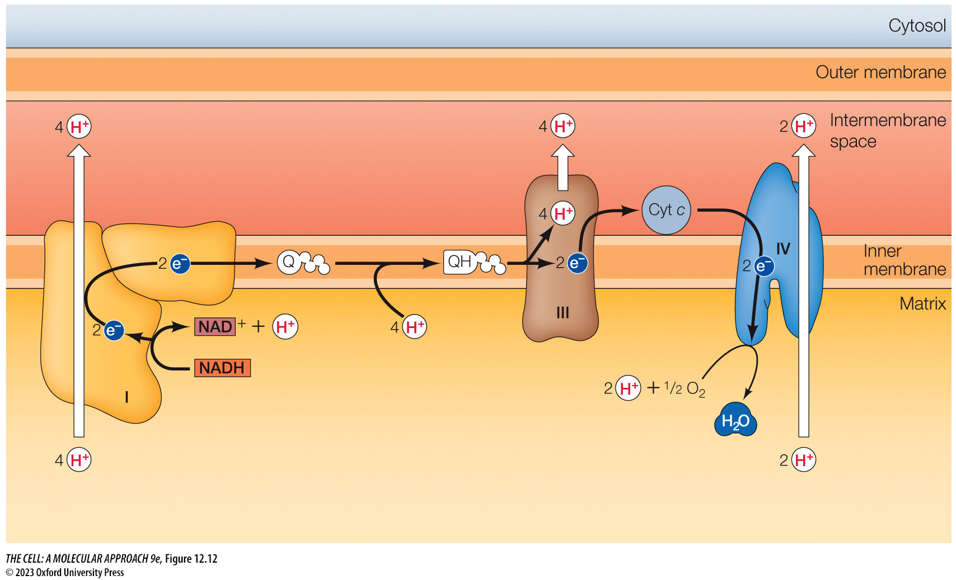
FIGURE 12.12 The electron transport chain in mitochondria
Notes:
FIGURE 12.12 The electron transport chain in mitochondria
Electron pairs from NADH enter the electron transport chain at complex I and are then transferred to coenzyme Q, releasing free energy that complex I couples to pump four protons out of the matrix. The reduced coenzyme Q (QH) transfers the electron pair along with four protons from the matrix to complex III. Complex III transfers the electrons to cytochrome c, which releases energy that complex III couples to release the four protons into the intermembrane space. Cytochrome c transfers the electrons to complex IV, which transfers them to O₂, again releasing energy that complex IV couples to pump two protons out of the matrix. Two additional protons are removed from the matrix through the formation of H₂O. This establishes a proton gradient across the inner membrane.

Slide 26
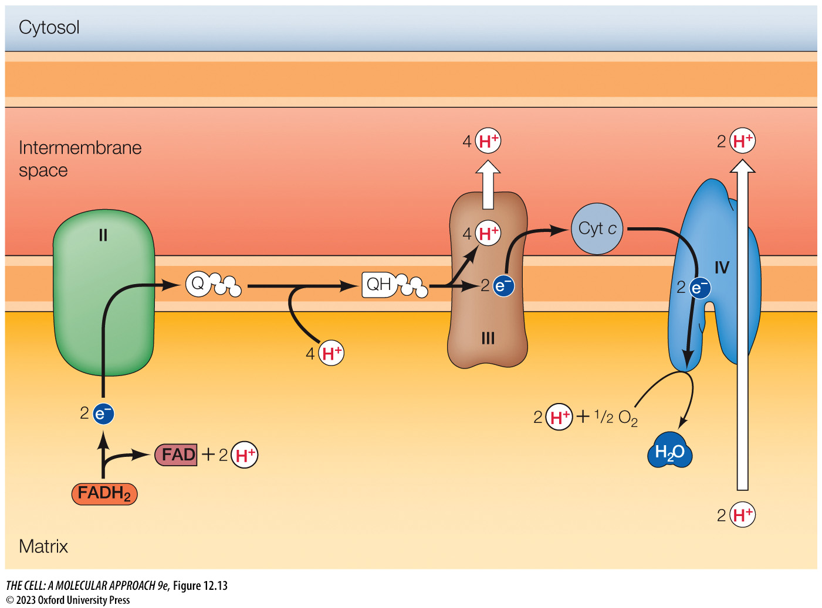
FIGURE 12.13 Transport of electrons from FADH₂
Notes:
FIGURE 12.13 Transport of electrons from FADH₂
Electrons from FADH₂ enter the electron transport chain at complex II. They are then transferred to coenzyme Q, which is not associated with a significant decrease in free energy, so protons are not pumped across the membrane at complex II. Free energy is released only at complexes III and IV and coupled to pump protons out of the matrix as described for Figure 12.12.

Slide 27
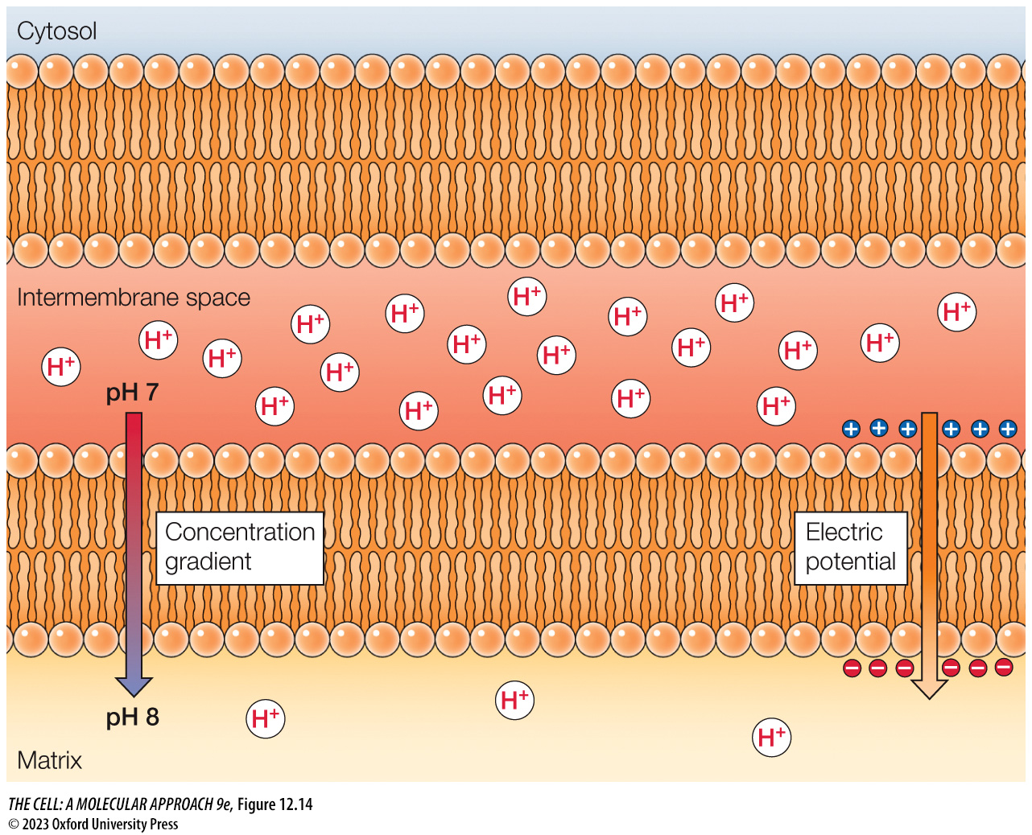
FIGURE 12.14 The electrochemical nature of the proton gradient
Notes:
FIGURE 12.14 The electrochemical nature of the proton gradient
Since protons are positively charged, the proton gradient established across the inner mitochondrial membrane has both chemical and electric components. The chemical component is the proton concentration (or pH) gradient, which corresponds to about a tenfold higher concentration of protons on the cytosolic side of the inner mitochondrial membrane (a difference of one pH unit). In addition, there is an electric potential across the membrane, resulting from the net increase in positive charge on the cytosolic side.

Slide 28
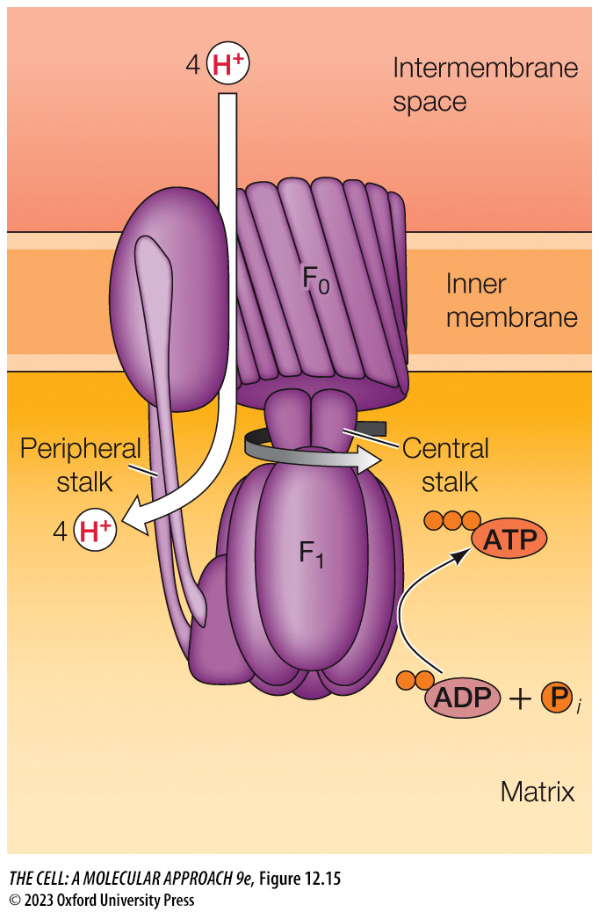
FIGURE 12.15 Structure of ATP synthase
Notes:
FIGURE 12.15 Structure of ATP synthase
The mitochondrial ATP synthase (complex V) consists of two multi-subunit components, F₀ and F₁, which are linked by a slender peripheral stalk. F₀ spans the lipid bilayer, forming a channel through which protons cross the membrane. F₁ contains a central stalk that spins due to proton flow through F₀, through which F₁ harvests the free energy derived from proton movement down its gradient to catalyze synthesis of ATP.

Slide 29
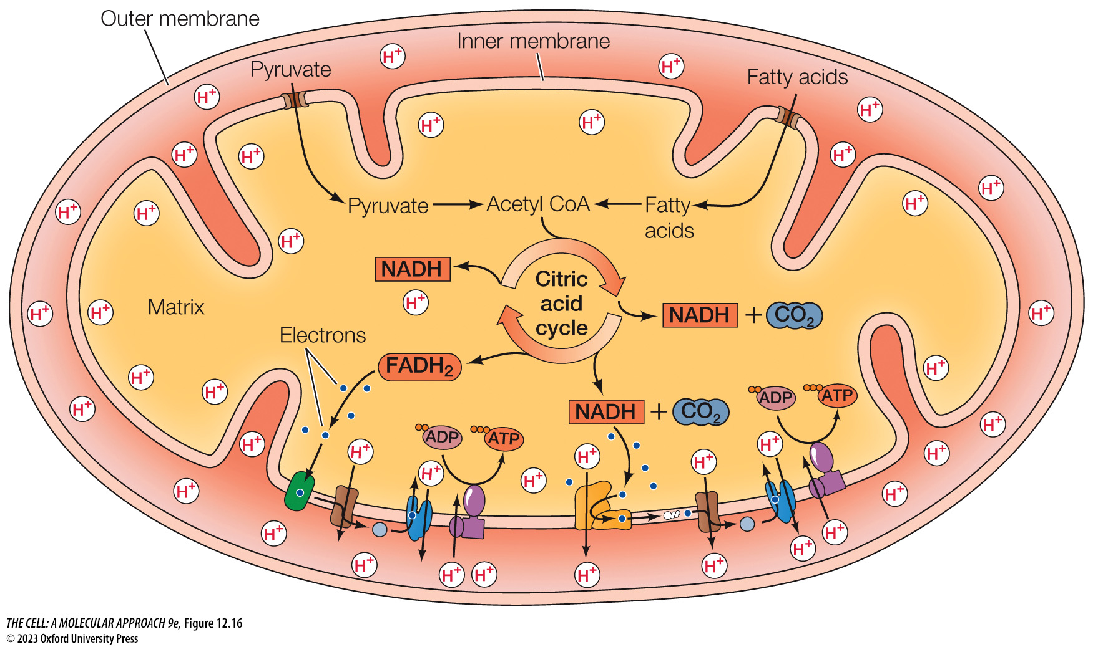
FIGURE 12.16 Summary of oxidative metabolism in mitochondria
Notes:
FIGURE 12.16 Summary of oxidative metabolism in mitochondria
Pyruvate and fatty acids are imported from the cytosol and converted to acetyl CoA in the mitochondrial matrix. Acetyl CoA is then oxidized to CO₂ via the citric acid cycle, coupled to the reduction of NAD⁺ and FAD to NADH and FADH₂, respectively. The high-energy electrons from NADH and FADH₂ are transferred through the electron transport chain in the inner membrane to molecular oxygen, coupled to the generation of a proton gradient across the membrane. Energy stored in the proton gradient is then coupled by ATP synthase to drive ATP synthesis.

Slide 30
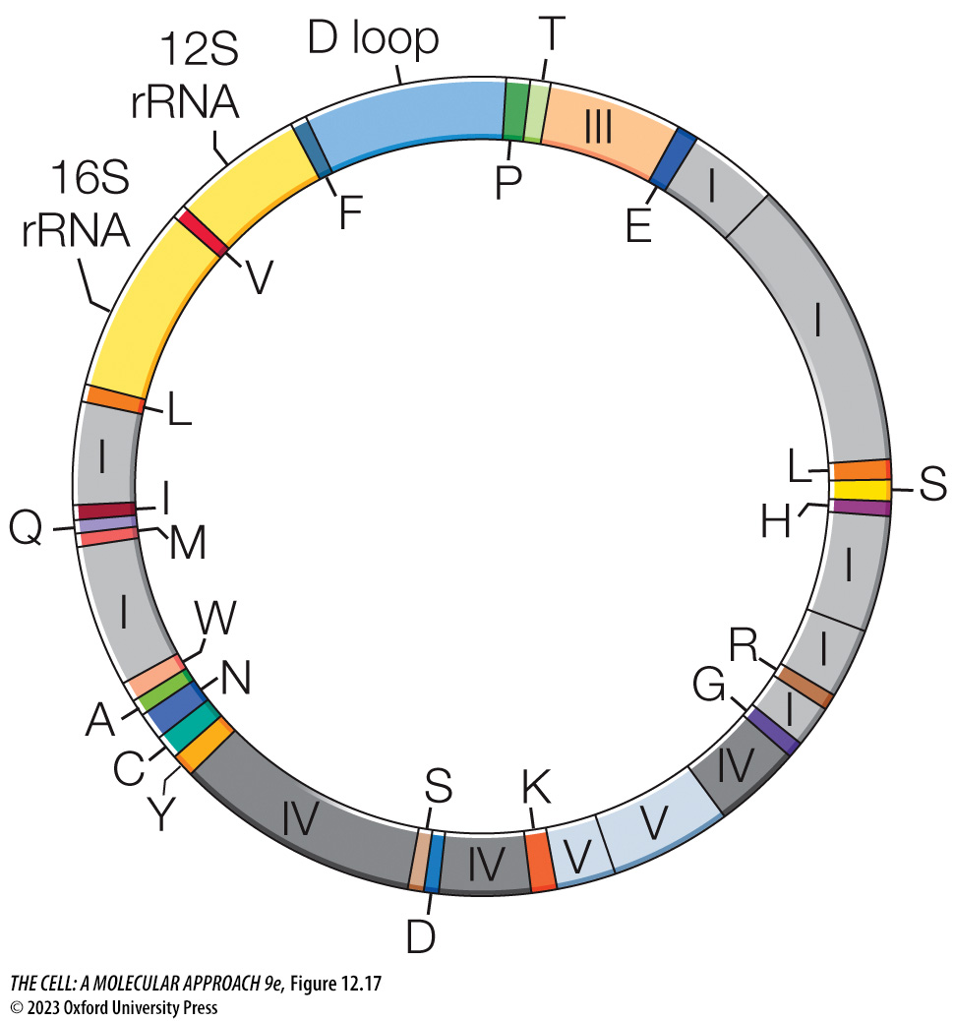
FIGURE 12.17 The human mitochondrial genome
Notes:
FIGURE 12.17 The human mitochondrial genome
The genome contains 13 protein coding sequences, which are designated as components of respiratory complexes I, III, IV, or V. In addition, the genome contains genes for 16S and 12S rRNAs and for 22 tRNAs, which are designated by the one-letter code for the corresponding amino acid. The region of the genome designated “D loop” contains an origin of DNA replication and transcriptional promoter sequences.

Slide 31
TABLE 12.1 Differences between the Universal and Mitochondrial Genetic Codes3
Codon | Universal code | Human mitochondrial code
UGA | Stop | Trp
AGA | Arg | Stop
AGG | Arg | Stop
AUA | Ile | Met
Note: Other codons vary from the universal code in yeast and plant mitochondria.

Slide 32
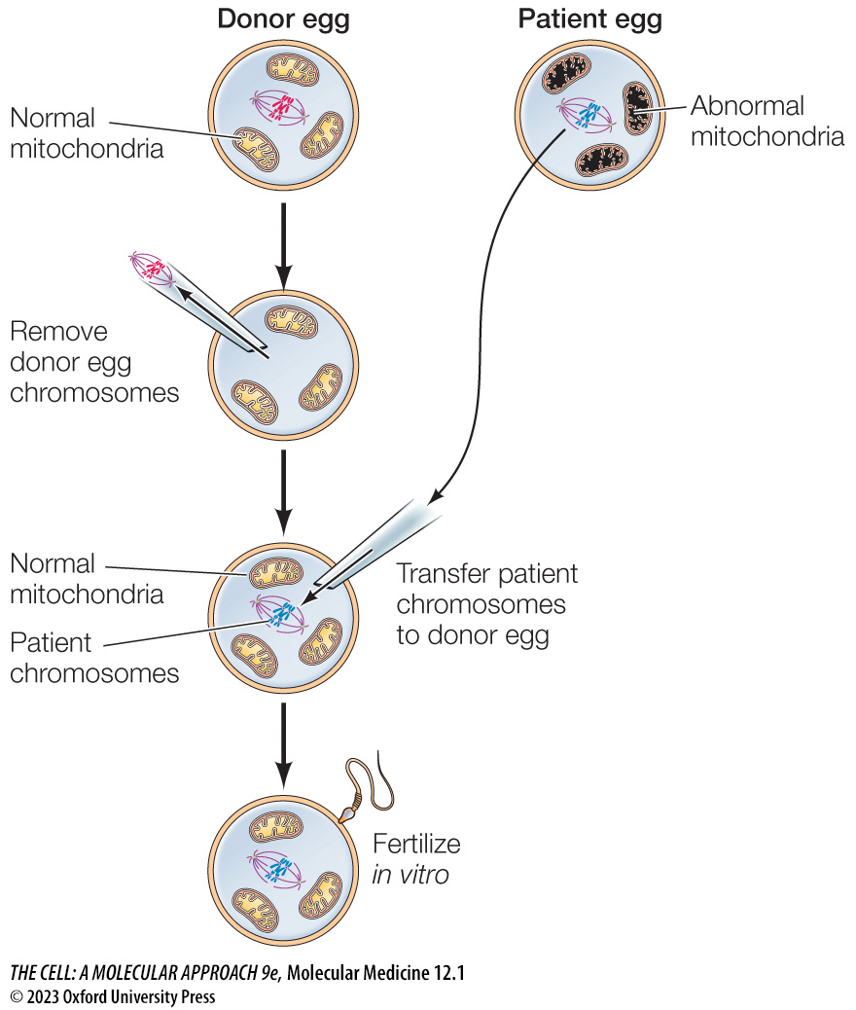
MOLECULAR MEDICINE Mitochondrial Replacement Therapy
Notes:
MOLECULAR MEDICINE Mitochondrial Replacement Therapy

Slide 33
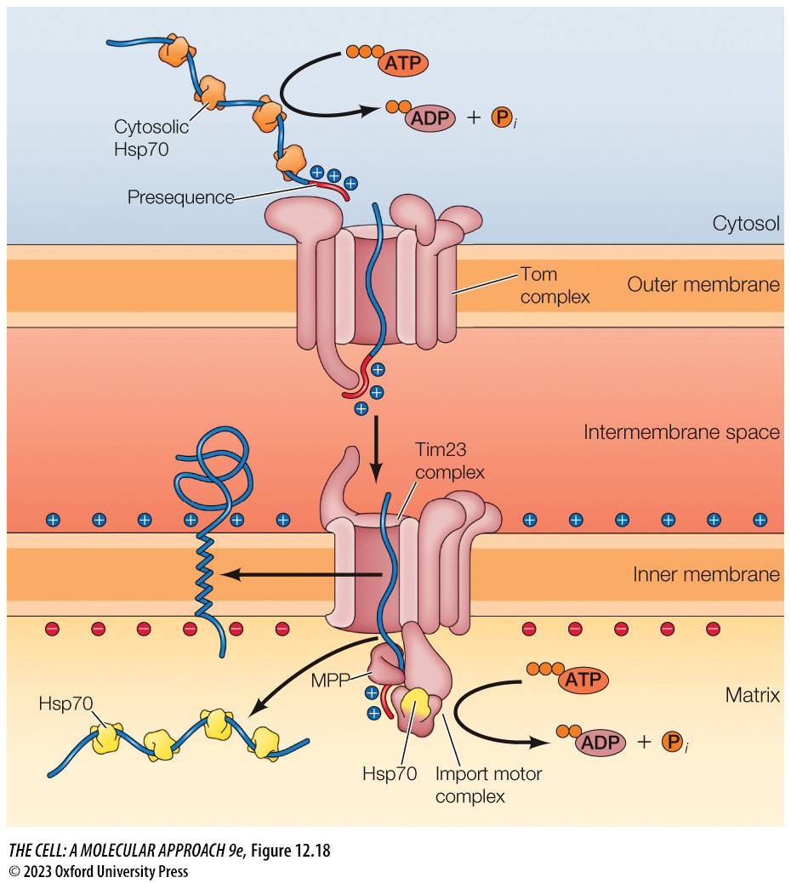
FIGURE 12.18 Import of mitochondrial proteins with presequences
Notes:
FIGURE 12.18 Import of mitochondrial proteins with presequences
Proteins are targeted to the Tom complex in the mitochondrial outer membrane by amino-terminal presequences containing positively charged amino acids. Following passage through the Tom complex, the presequence binds to the Tim23 complex in the inner membrane. In the matrix, an import motor complex containing an Hsp70 chaperone uses ATP hydrolysis to drive translocation of the protein across the inner membrane. Some proteins with transmembrane domains exit Tim23 laterally into the inner membrane. Proteins destined for the mitochondrial matrix associate with soluble Hsp70 chaperones that assist in their folding. Presequences are removed by the mitochondrial matrix processing peptidase (MPP).

Slide 34
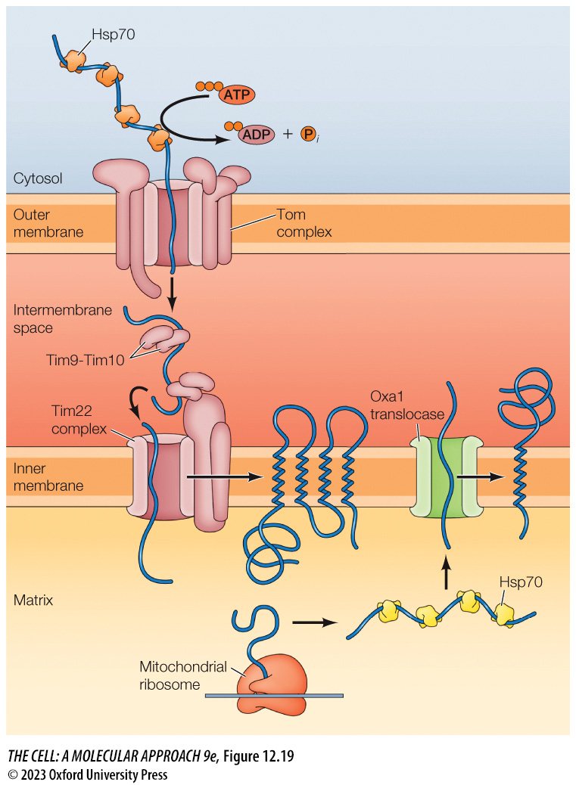
FIGURE 12.19 Presequence-independent protein targeting to the mitochondrial inner membrane
Notes:
FIGURE 12.19 Presequence-independent protein targeting to the mitochondrial inner membrane
Inner membrane proteins with multiple transmembrane domains have internal signal sequences rather than N-terminal presequences. Following translocation across the outer membrane, these proteins are bound by mobile Tim9-Tim10 chaperones in the intermembrane space, which transfer the protein to the Tim22 complex in the inner membrane. Internal transmembrane sequences halt translocation, and the protein is transferred laterally into the inner membrane. Some inner membrane proteins are encoded by the mitochondrial genome. These proteins are translated on mitochondrial ribosomes in the matrix and targeted to the inner membrane via the Oxa1 translocase.

Slide 35
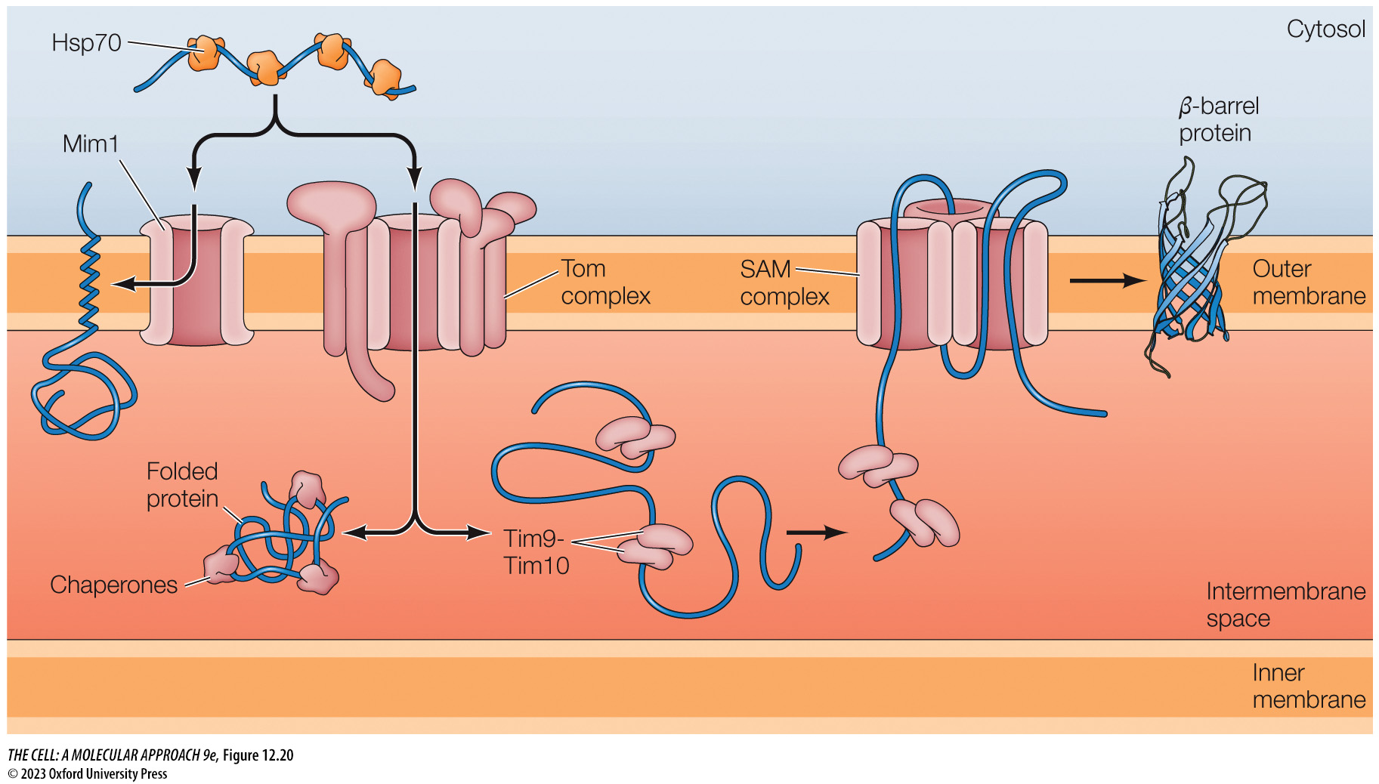
FIGURE 12.20 Sorting of proteins to the outer membrane and intermembrane space
Notes:
FIGURE 12.20 Sorting of proteins to the outer membrane and intermembrane space
Single transmembrane domain proteins destined for the outer membrane are inserted via the outer membrane protein Mim1. Precursors of β-barrel proteins of the outer membrane are transferred through the Tom complex and bound by Tim9-Tim10 chaperone proteins in the intermembrane space. They are then directed to a second translocon complex, called the SAM (sorting and assembly machinery) complex, and inserted into the outer membrane. Proteins destined for the intermembrane space are translocated through the Tom complex and recognized by specific intermembrane space chaperones.

Slide 36
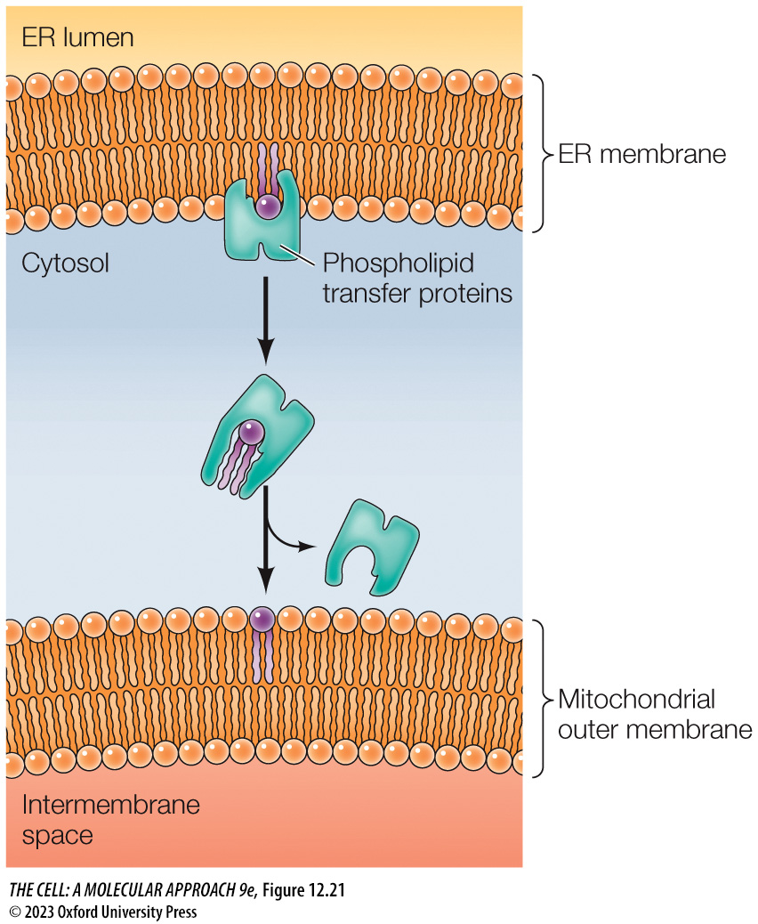
FIGURE 12.21 Phospholipid transfer proteins
Notes:
FIGURE 12.21 Phospholipid transfer proteins
Phospholipid transfer proteins extract phospholipid molecules from the endoplasmic reticulum (ER) membrane and transport them to the mitochondrial outer membrane at sites of close contact between the two membranes.

Slide 37
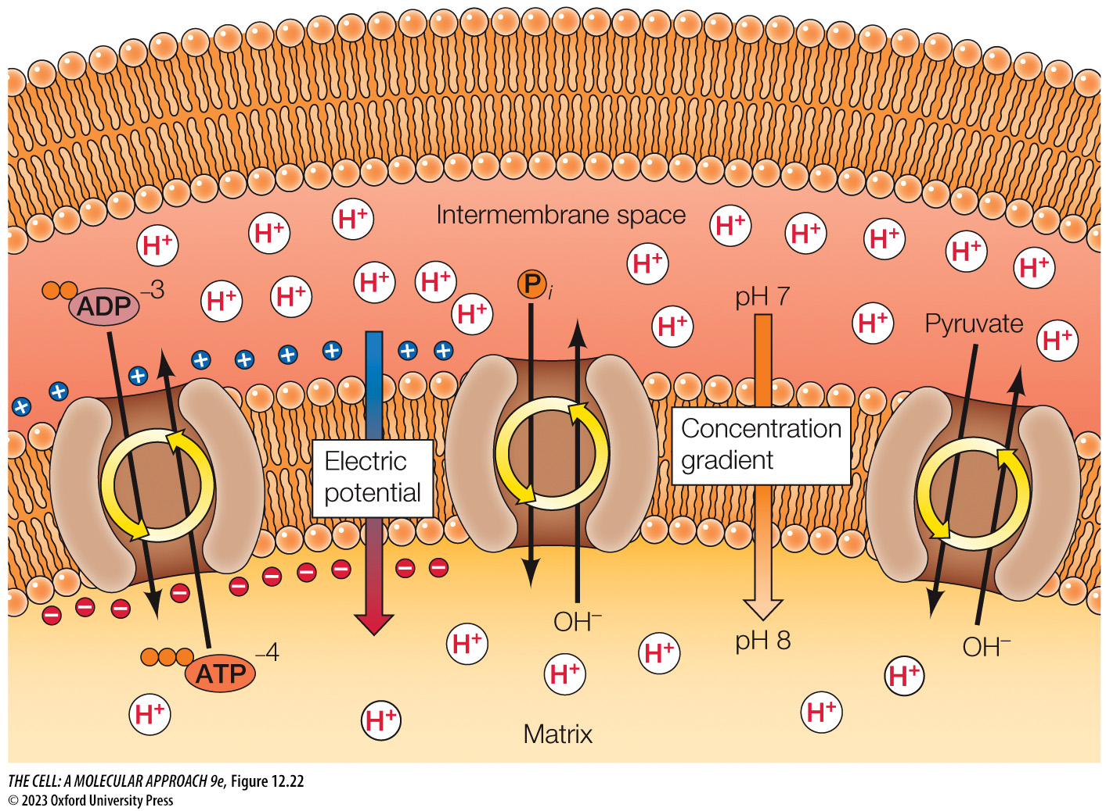
FIGURE 12.22 Transport of metabolites across the mitochondrial inner membrane
Notes:
FIGURE 12.22 Transport of metabolites across the mitochondrial inner membrane
The transport of small molecules across the inner membrane of mitochondria is mediated by membrane-spanning proteins and driven by the electrochemical gradient. For example, ATP is exported from the matrix by a transporter that exchanges it for ADP. The voltage component of the electrochemical gradient drives this exchange: ATP carries a greater negative charge (–4) than ADP (–3), so ATP is exported from the mitochondrial matrix, while ADP is imported into the matrix. In contrast, the transport of phosphate (P_{i}) and pyruvate is coupled to an exchange for hydroxyl ions (OH–); in this case, the pH component of the electrochemical gradient drives the export of hydroxyl ions, coupled to the transport of P_{i} and pyruvate into the matrix.

Slide 38
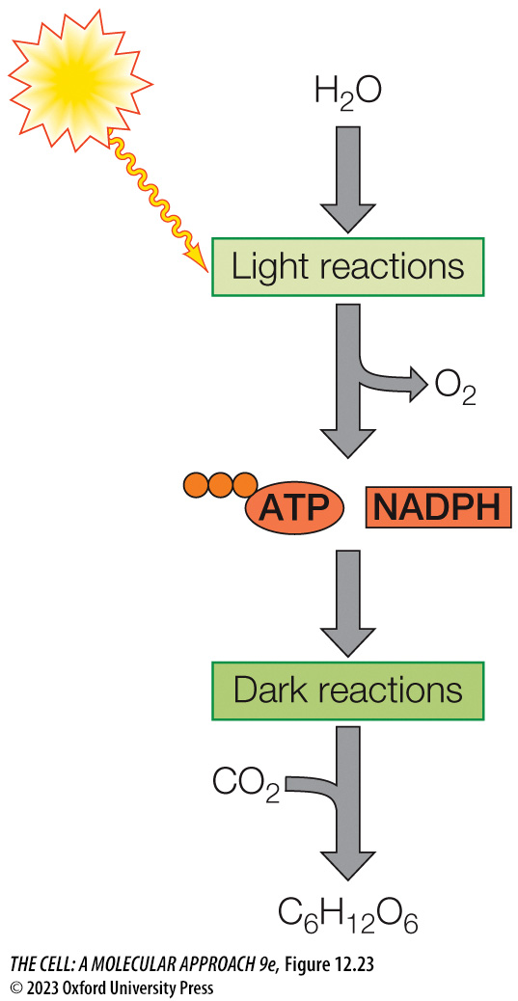
FIGURE 12.23 Overview of photosynthesis
Notes:
FIGURE 12.23 Overview of photosynthesis
Photosynthesis takes place through of two sequential stages referred to as the light reactions and the dark reactions. During the light reactions, light energy is coupled to generate ATP and NADPH through a series of reactions that consume H₂O and produce O₂. The dark reactions then couple energy released during ATP hydrolysis and NADPH oxidation to produce glucose from CO₂.

Slide 39
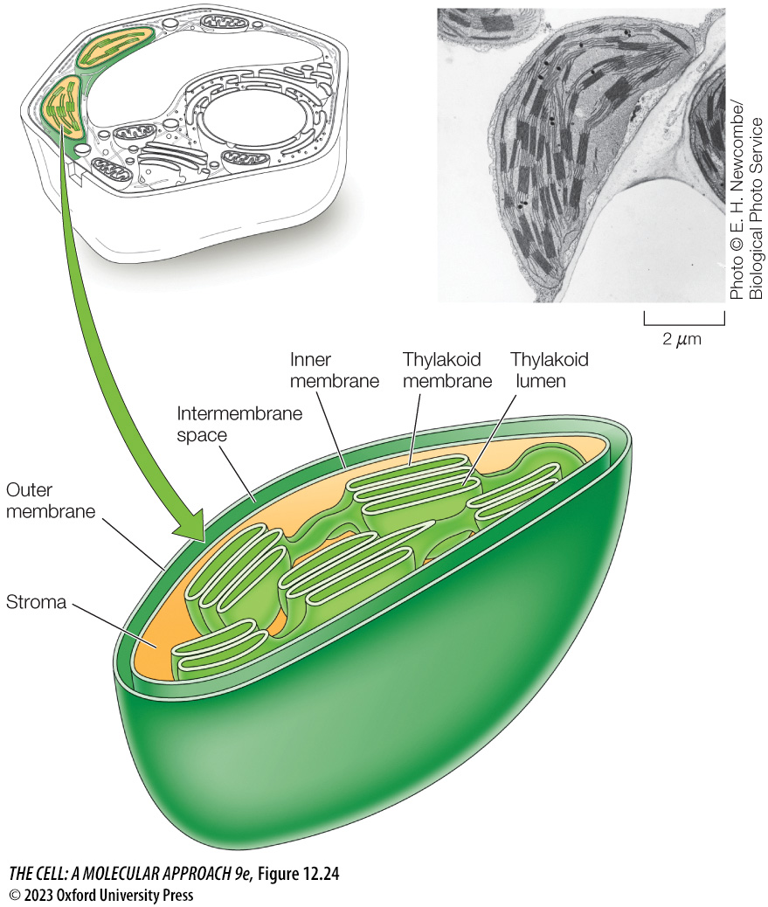
FIGURE 12.24 Structure of a chloroplast
Notes:
FIGURE 12.24 Structure of a chloroplast
In addition to the inner and outer membranes of the envelope, chloroplasts contain a third internal membrane system: the thylakoid membrane. These membranes divide chloroplasts into three internal compartments: the intermembrane space, stroma, and thylakoid lumen.

Slide 40
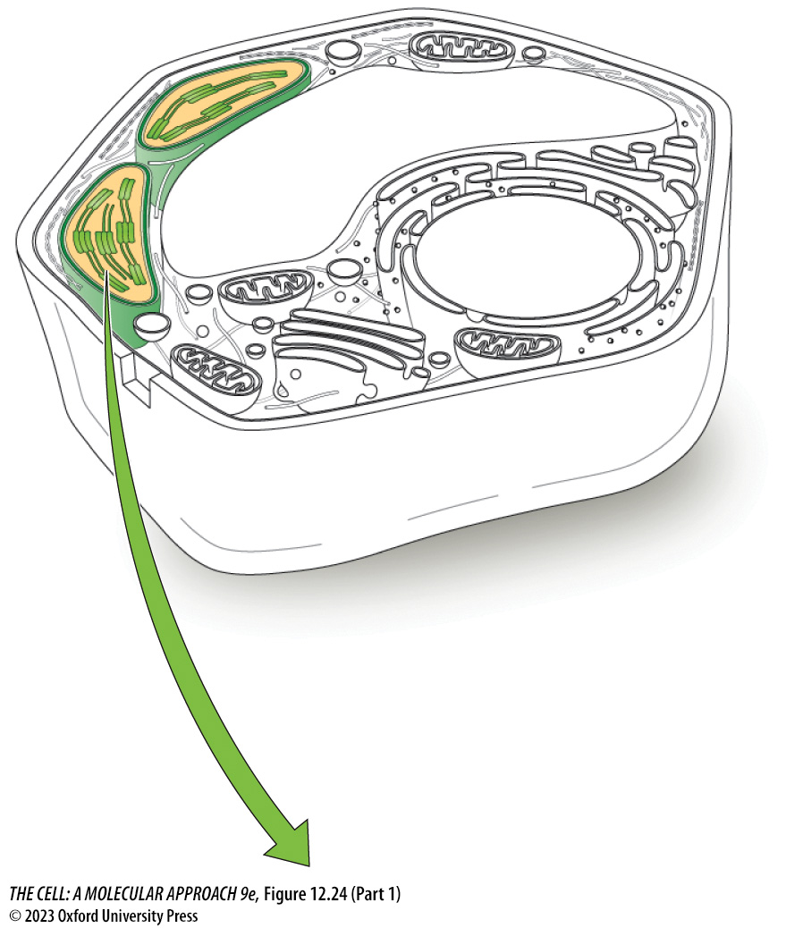
FIGURE 12.24 Structure of a chloroplast (Part 1)
Notes:
FIGURE 12.24 Structure of a chloroplast
In addition to the inner and outer membranes of the envelope, chloroplasts contain a third internal membrane system: the thylakoid membrane. These membranes divide chloroplasts into three internal compartments: the intermembrane space, stroma, and thylakoid lumen.

Slide 41
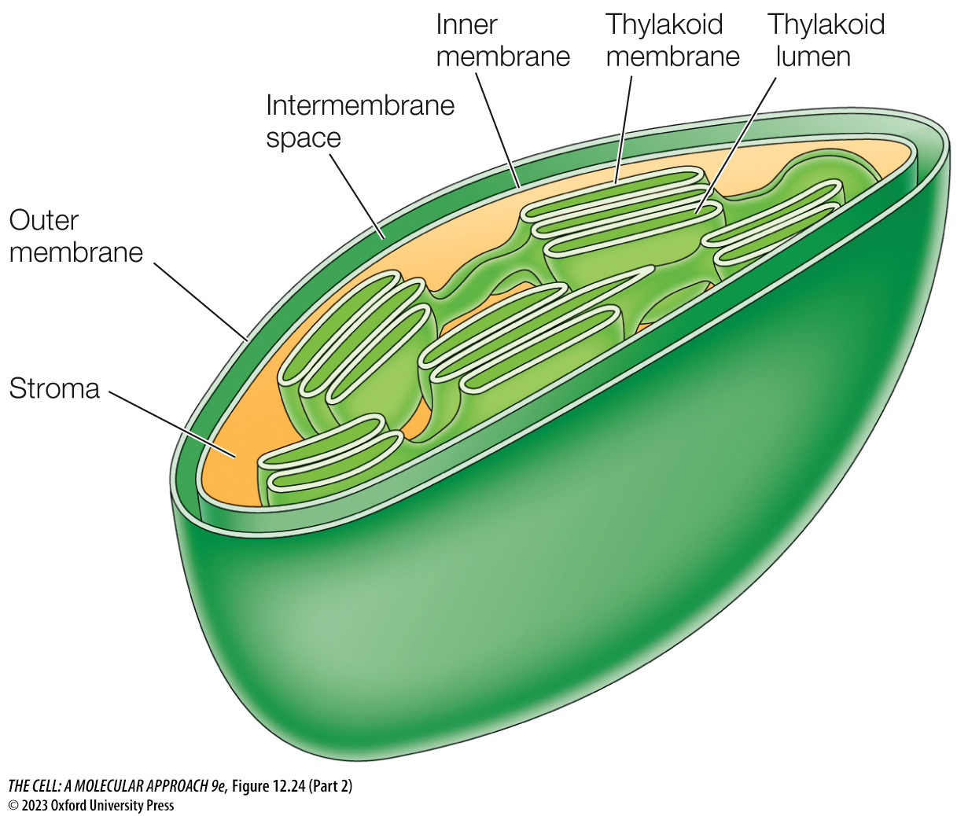
FIGURE 12.24 Structure of a chloroplast (Part 2)
Notes:
FIGURE 12.24 Structure of a chloroplast
In addition to the inner and outer membranes of the envelope, chloroplasts contain a third internal membrane system: the thylakoid membrane. These membranes divide chloroplasts into three internal compartments: the intermembrane space, stroma, and thylakoid lumen.

Slide 42
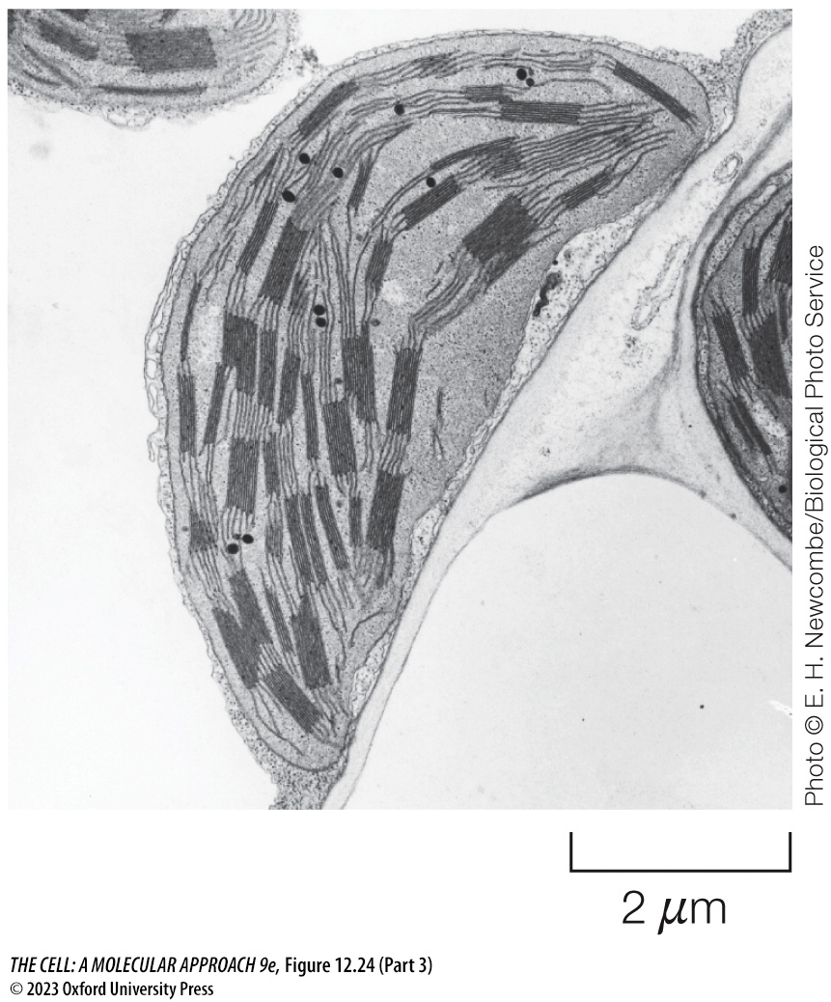
FIGURE 12.24 Structure of a chloroplast (Part 3)
Notes:
FIGURE 12.24 Structure of a chloroplast
In addition to the inner and outer membranes of the envelope, chloroplasts contain a third internal membrane system: the thylakoid membrane. These membranes divide chloroplasts into three internal compartments: the intermembrane space, stroma, and thylakoid lumen.

Slide 43
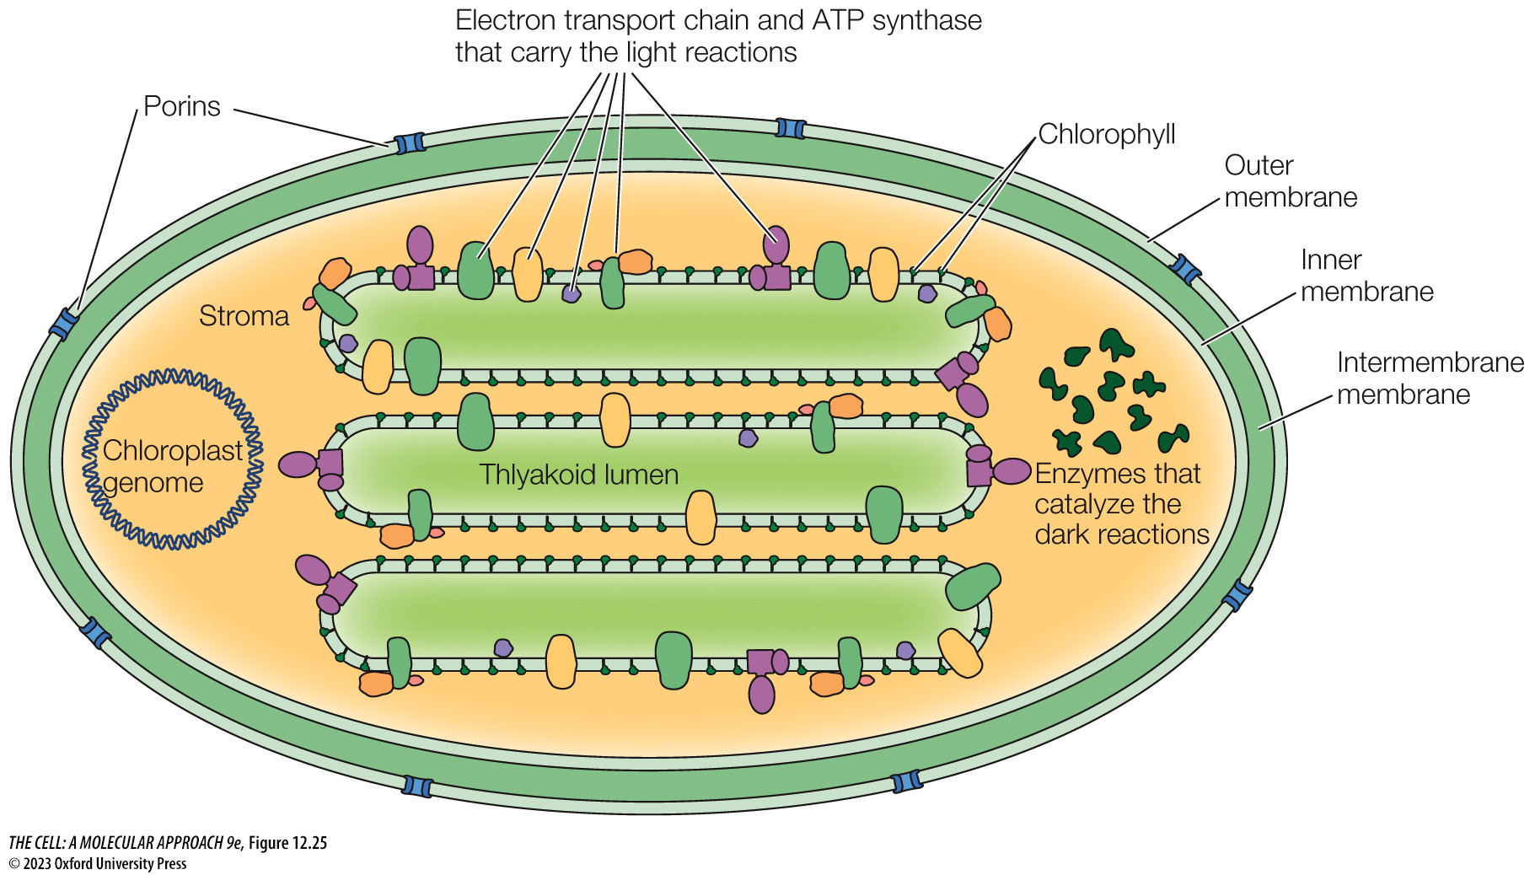
FIGURE 12.25 Chloroplast composition
Notes:
FIGURE 12.25 Chloroplast composition
The outer membrane of the chloroplast envelope contains porins that permit the passage of small molecules, whereas passage of molecules across the inner membrane is more restrictive and mediated by selective transporters. The stroma houses the chloroplast genome as well as the enzymes that catalyze the dark reactions. An electron transport chain and ATP synthase, which carry out the light reactions, are associated with the thylakoid membrane.

Slide 44
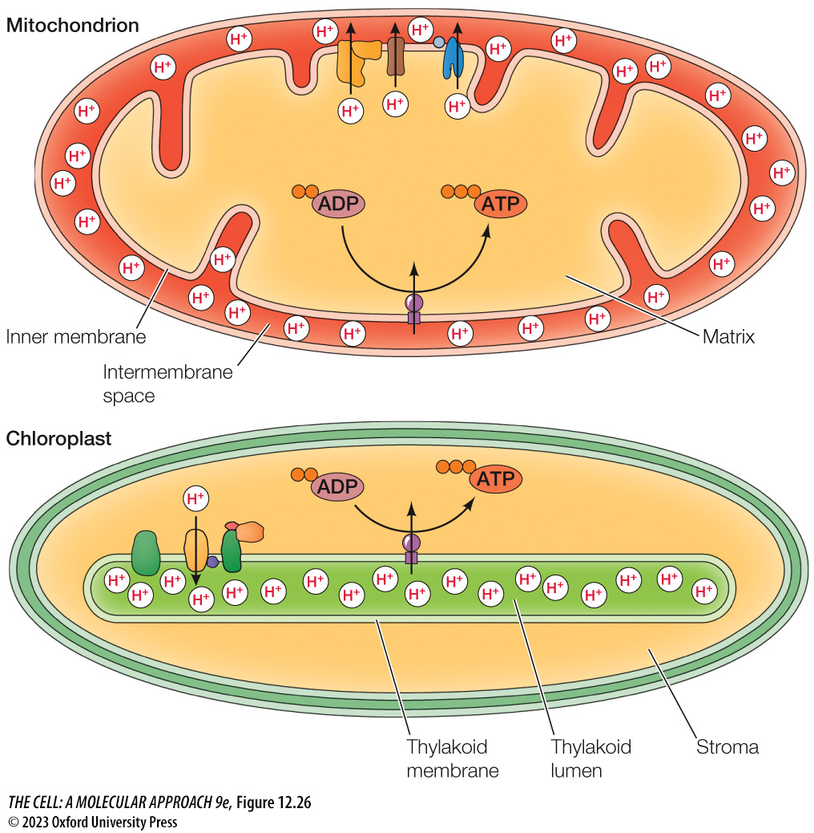
FIGURE 12.26 Chemiosmotic generation of ATP in chloroplasts and mitochondria
Notes:
FIGURE 12.26 Chemiosmotic generation of ATP in chloroplasts and mitochondria
In mitochondria, electron transport generates a proton gradient across the inner membrane, which is then used to drive ATP synthesis in the matrix. In chloroplasts, the proton gradient is generated across the thylakoid membrane and used to drive ATP synthesis in the stroma.

Slide 45
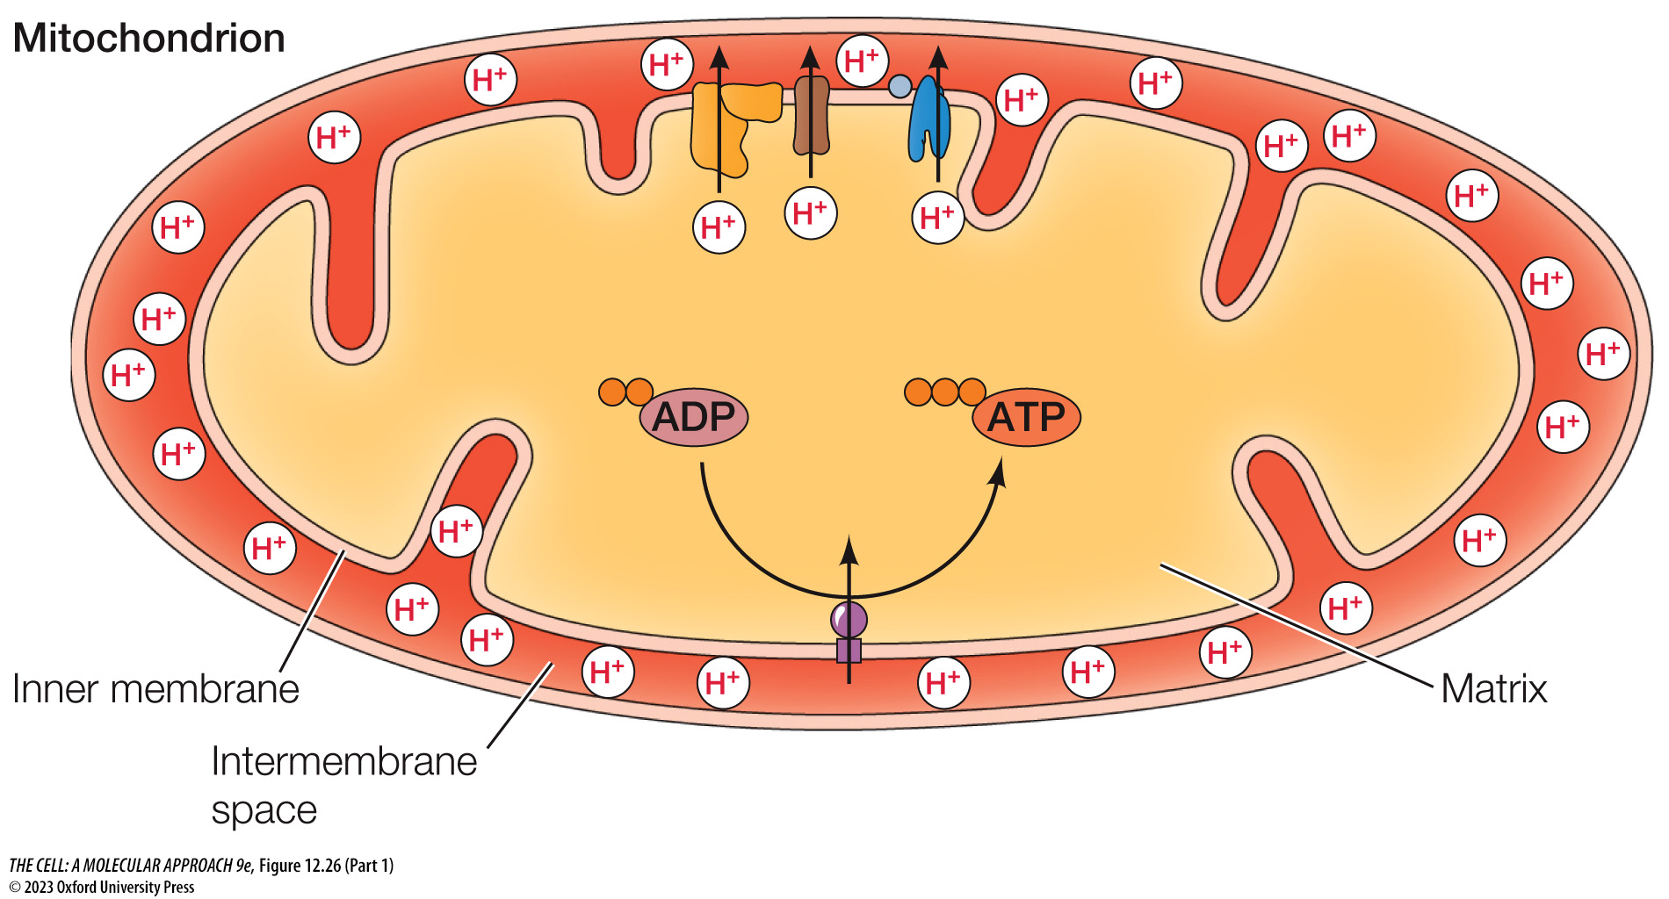
FIGURE 12.26 Chemiosmotic generation of ATP in chloroplasts and mitochondria (Part 1)
Notes:
FIGURE 12.26 Chemiosmotic generation of ATP in chloroplasts and mitochondria
In mitochondria, electron transport generates a proton gradient across the inner membrane, which is then used to drive ATP synthesis in the matrix. In chloroplasts, the proton gradient is generated across the thylakoid membrane and used to drive ATP synthesis in the stroma.

Slide 46
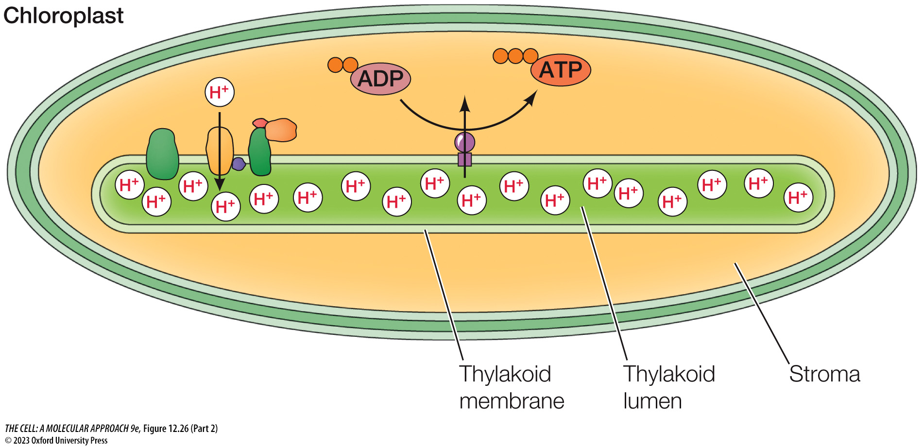
FIGURE 12.26 Chemiosmotic generation of ATP in chloroplasts and mitochondria (Part 2)
Notes:
FIGURE 12.26 Chemiosmotic generation of ATP in chloroplasts and mitochondria
In mitochondria, electron transport generates a proton gradient across the inner membrane, which is then used to drive ATP synthesis in the matrix. In chloroplasts, the proton gradient is generated across the thylakoid membrane and used to drive ATP synthesis in the stroma.

Slide 47
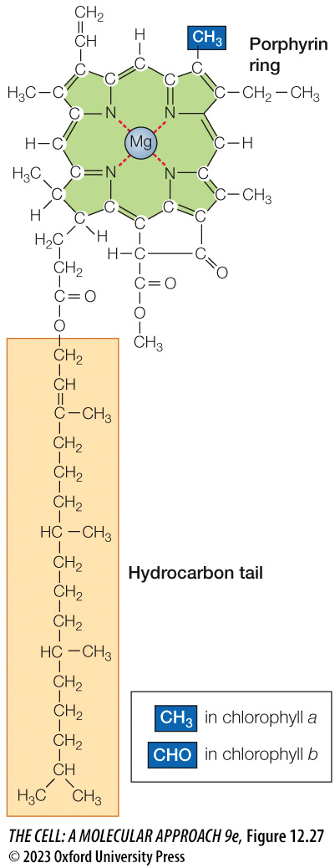
FIGURE 12.27 The structure of chlorophyll a
Notes:
FIGURE 12.27 The structure of chlorophyll a
Chlorophylls consist of porphyrin ring structures linked to hydrocarbon tails. Chlorophyll a (shown here) differs by a single functional group in the porphyrin ring from chlorophyll b.

Slide 48
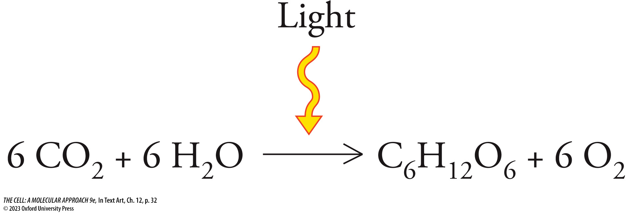
In Text Art, Ch. 12, p. 32
Notes:
In Text Art, Ch. 12, p. 32

Slide 49
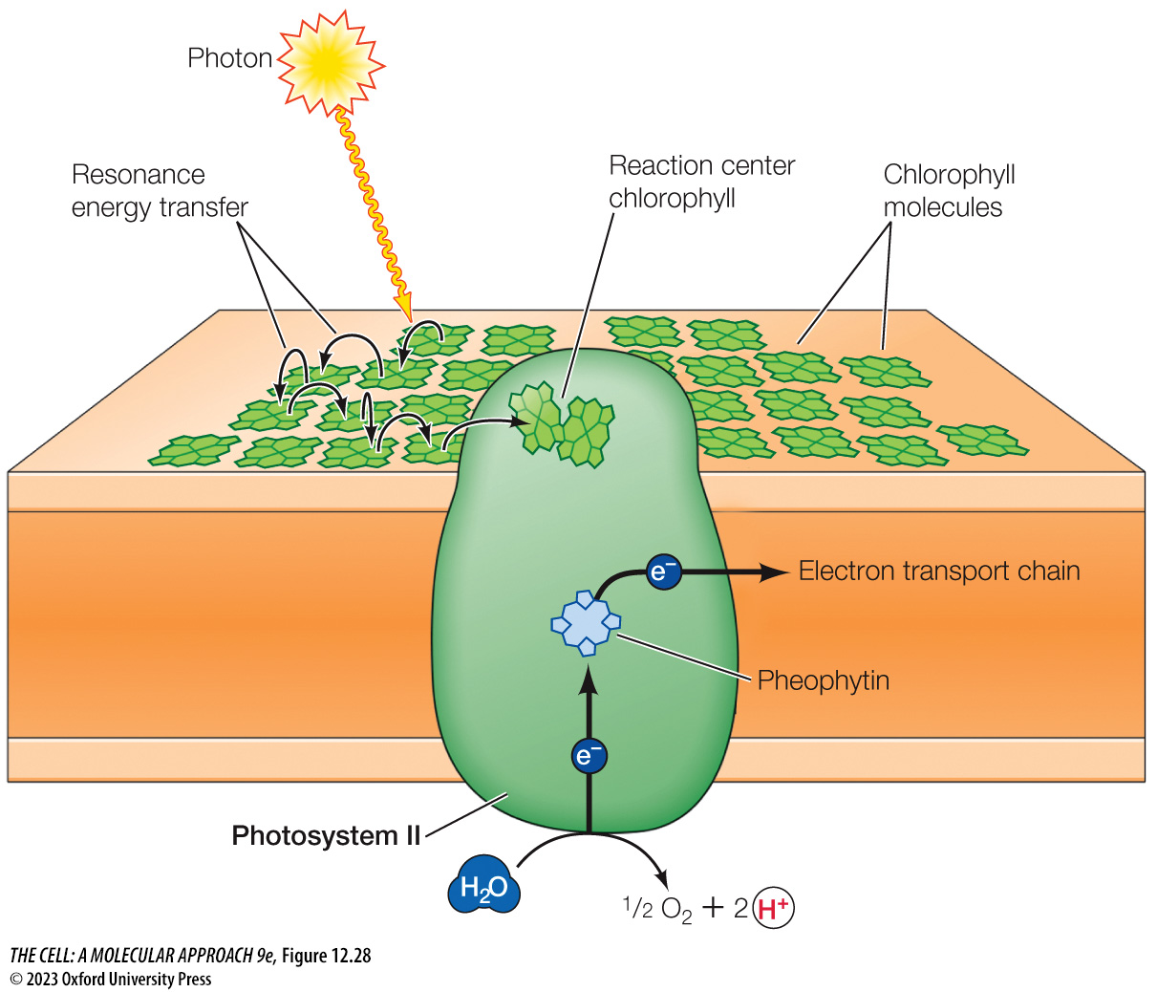
FIGURE 12.28 Organization of a photocenter
Notes:
FIGURE 12.28 Organization of a photocenter
Each photocenter consists of hundreds of chlorophyll molecules, which absorb photons and transfer energy to a pair of chlorophyll molecules located with the reaction center of a photosystem complex. In photosystem II (shown here), the reaction center couples the energy to split H₂O to ½ O₂ + 2 protons + 2 electrons, during which the electrons are elevated to an excited energy state. The excited electrons are then transferred through an acceptor (pheophytin) to the next component of the electron transport chain.

Slide 50
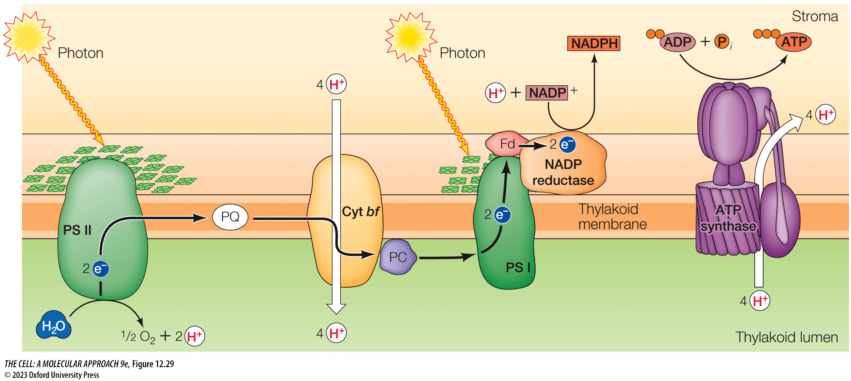
FIGURE 12.29 Electron transport and synthesis of ATP and NADPH by the light reactions in chloroplasts
Notes:
FIGURE 12.29 Electron transport and synthesis of ATP and NADPH by the light reactions in chloroplasts
Four protein complexes in the thylakoid membrane function in electron transport and the synthesis of ATP and NADPH. Photons are absorbed by chlorophyll molecules within photocenters, which transfer energy to the associated photosystems I and II (PS I and PS II). At photosystem II, energy derived from photon absorption is used to split a water molecule within the thylakoid lumen. The electrons from the water molecules are excited in the process and then carried by plastoquinone (PQ) to the cytochrome bf complex, which couples a drop in the electrons’ energy state to pump protons into the thylakoid lumen. The electrons are then transferred to photosystem I by plastocyanin (PC). At photosystem I, energy derived from light absorption re-excites the electrons’ energy state before they are transferred through ferredoxin (Fd) to NADP reductase, which uses them to reduce NADP⁺ to NADPH in the stroma. ATP synthase then uses the energy stored in the proton gradient to convert ADP + P_{i} to ATP.

Slide 51
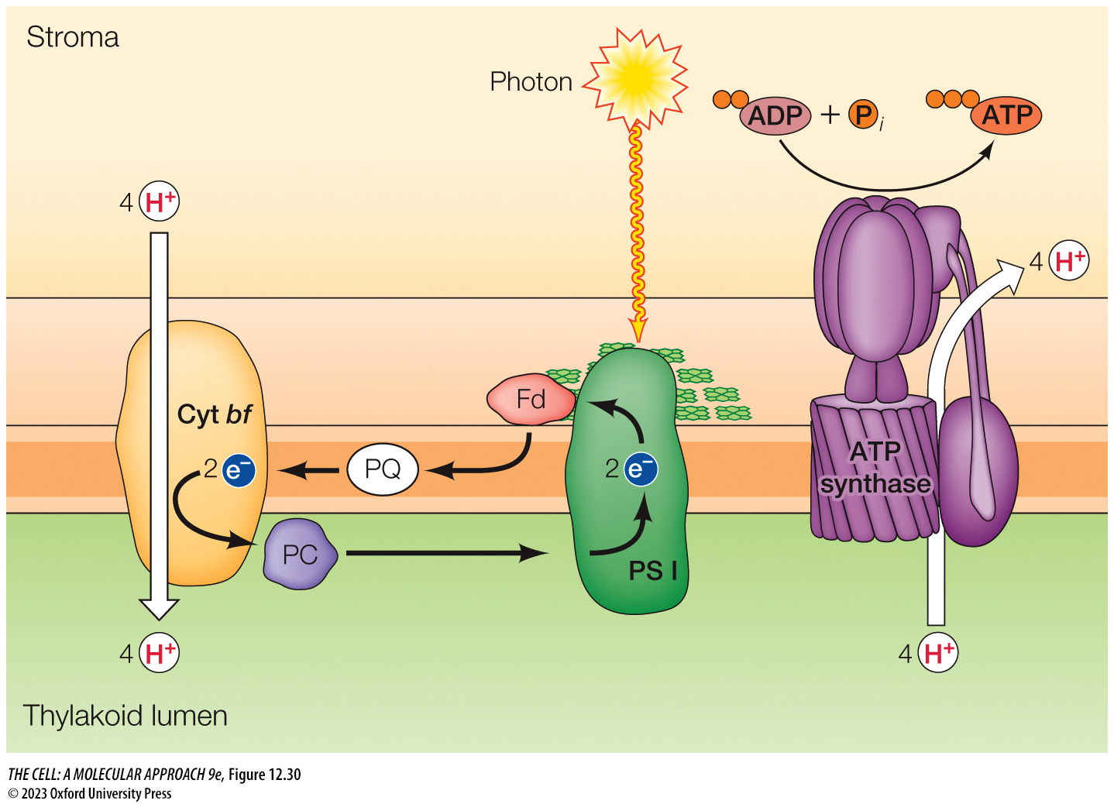
FIGURE 12.30 Cyclic electron flow
Notes:
FIGURE 12.30 Cyclic electron flow
Light energy absorbed at photosystem I (PS I) is used for ATP synthesis rather than NADPH synthesis. High-energy electrons generated by photon absorption are transferred via ferredoxin (Fd) and plastoquinone (PQ) to the cytochrome bf complex rather than to NADP⁺. At the cytochrome bf complex, the electrons’ energy state drops, releasing energy that is coupled by the complex to pump protons into the thylakoid lumen. The electrons are then returned to photosystem I by plastocyanin (PC). As previously discussed, ATP synthase couples the flow of protons from the thylakoid lumen to the stroma to synthesis of ATP.

Slide 52

FIGURE 12.31 The Calvin cycle
Notes:
FIGURE 12.31 The Calvin cycle
Shown here is the synthesis of one molecule of glucose from six molecules of CO₂. Each molecule of CO₂ is added to ribulose-1,5-bisphosphate to yield two molecules each of 3-phosphoglycerate. These 6 molecules of CO₂ thus lead to the formation of 12 molecules of 3-phosphoglycerate, which are converted to 12 molecules of glyceraldehyde-3-phosphate at the cost of 12 molecules each of ATP and NADPH. Two molecules of glyceraldehyde-3-phosphate are then used for synthesis of glucose and ten molecules continue in the Calvin cycle to form six molecules of ribulose-5-phosphate. The cycle is then completed by the use of six additional ATP molecules for the synthesis of ribulose-1,5-bisphosphate.

Slide 53
TABLE 12.2 Genes Encoded by Chloroplast DNA
Function | Number of genes
Gene Expression
RNAs (23S, 16S, 5S) | 3
tRNAs | 30
Ribosomal proteins | 40
RNA polymerase subunits | 4
Photosynthesis
Photosystem I | 8
Photosystem II | 18
Cytochrome bf complex | 18
ATP synthase | 8
NADP reductase | 11
Metabolism | 11
Protein folding and membrane insertion | 14

Slide 54

FIGURE 12.32 Import of proteins into the chloroplast stroma
Notes:
FIGURE 12.32 Import of proteins into the chloroplast stroma
Proteins with N-terminal transit peptides are targeted to the Toc complex in the chloroplast outer membrane. Passage through the outer membrane requires ATP hydrolysis by Hsp70 and hydrolysis of GTP by Toc proteins. Once through the chloroplast outer membrane, the transit peptide is passed to the Tic complex in the inner membrane, which is associated with the Toc complex via binding of a Tic subunit to the Toc complex. The protein is drawn through the Tic complex by the action of an Hsp93 chaperone and the transit peptide is removed by the chloroplast stromal processing peptidase (SPP).

Slide 55

FIGURE 12.33 Import of proteins into the thylakoid lumen and membrane
Notes:
FIGURE 12.33 Import of proteins into the thylakoid lumen and membrane
In the twin-arginine translocation (Tat) pathway, a thylakoid signal sequence containing two arginines near the amino terminus forms multivalent interactions with intrinsically disordered regions of SST1 and 2, which induce liquid–liquid phase separation. The resulting biomolecular condensate recruits the substrate to the Tat translocon. Interactions between Tat subunits and SST1 and 2 destabilize the condensate, releasing the substrate, which is transferred into the thylakoid lumen using energy derived from the proton gradient across the thylakoid membrane. In the lumen, the thylakoid signal sequences are cleaved by a thylakoid processing protease (TPP). Alternatively, in the Sec pathway, the SecA protein recognizes a thylakoid signal sequence and targets the protein to the Sec translocon, using energy derived from ATP hydrolysis to transfer the protein to the lumen. Some transmembrane proteins exit the Sec translocase laterally for incorporation into the thylakoid membrane. Other transmembrane proteins, which may be either imported into the stroma or synthesized by chloroplast ribosomes within the stroma, are recognized by the chloroplast signal recognition particle (cpSRP) and inserted into the thylakoid membrane by the Alb3 translocase.

Slide 56

FIGURE 12.34 Electron micrographs of chromoplasts and amyloplasts
Notes:
FIGURE 12.34 Electron micrographs of chromoplasts and amyloplasts
(A) Chromoplasts contain lipid droplets in which carotenoids are stored. (B) Amyloplasts contain large starch granules.

Slide 57

FIGURE 12.34 Electron micrographs of chromoplasts and amyloplasts (Part 1)
Notes:
FIGURE 12.34 Electron micrographs of chromoplasts and amyloplasts
(A) Chromoplasts contain lipid droplets in which carotenoids are stored. (B) Amyloplasts contain large starch granules.

Slide 58

FIGURE 12.34 Electron micrographs of chromoplasts and amyloplasts (Part 2)
Notes:
FIGURE 12.34 Electron micrographs of chromoplasts and amyloplasts
(A) Chromoplasts contain lipid droplets in which carotenoids are stored. (B) Amyloplasts contain large starch granules.

Slide 59

FIGURE 12.35 Interconversions of plastids
Notes:
FIGURE 12.35 Interconversions of plastids
Proplastids can develop into chloroplasts, chromoplasts, etioplasts, elaioplasts, and amyloplasts. Different plastids can also convert to other types.

Slide 60

FIGURE 12.36 Electron micrograph of peroxisomes
Notes:
FIGURE 12.36 Electron micrograph of peroxisomes
Three peroxisomes from rat liver are shown. Two contain dense regions, which are paracrystalline arrays of the enzyme urate oxidase.

Slide 61

FIGURE 12.37 Fatty acid oxidation in peroxisomes
Notes:
FIGURE 12.37 Fatty acid oxidation in peroxisomes
The oxidation of a fatty acid is accompanied by the production of hydrogen peroxide (H₂O₂) from oxygen. The hydrogen peroxide is decomposed by catalase, either by conversion to water and oxygen or by oxidation of another organic compound (represented as AH₂).

Slide 62

FIGURE 12.38 Structure of a plasmalogen
Notes:
FIGURE 12.38 Structure of a plasmalogen
The plasmalogen shown is analogous to phosphatidylcholine. However, one of the fatty acid chains is joined to glycerol by an ether, rather than by an ester, bond.

Slide 63

FIGURE 12.39 Assembly of peroxisomes
Notes:
FIGURE 12.39 Assembly of peroxisomes
Peroxisomal transmembrane proteins are derived from the peroxisomal ER. Two different types of vesicles (designated V₁ and V₂) carrying distinct transmembrane proteins fuse to form a functional peroxisome. The combination of these different proteins forms the machinery (importomer) through which internal peroxisome proteins synthesized on cytosolic ribosomes can be imported.

Slide 64

FIGURE 12.40 Import of peroxisomal matrix protein
Notes:
FIGURE 12.40 Import of peroxisomal matrix proteins
Peroxisomal matrix proteins containing the targeting signal PTS1 are recognized by the cytosolic receptor Pex5. The Pex5/cargo complex then binds to a docking complex (Pex13, Pex14, and Pex17) on the peroxisome membrane. Pex5 and Pex14 form a pore in the membrane and the cargo protein is translocated into the peroxisome. Pex5 is then recycled to the cytosol.

Slide 65

FIGURE 12.41 Formation of new peroxisomes
Notes:
FIGURE 12.41 Formation of new peroxisomes
New peroxisomes can be formed de novo by the fusion of vesicles budding from the peroxisomal ER followed by the import of cytosolic proteins. In addition, new peroxisomes can be formed by the growth and division of old ones.

Slide 66

Interactive Data Analysis Problem 12.1
Notes:
Interactive Data Analysis Problem 12.1

Slide 67

Interactive Data Analysis Problem 12.1 (Part 1)
Notes:
Interactive Data Analysis Problem 12.1

Slide 68

Interactive Data Analysis Problem 12.1 (Part 2)
Notes:
Interactive Data Analysis Problem 12.1

Slide 69

Interactive Data Analysis Problem 12.1 (Part 3)
Notes:
Interactive Data Analysis Problem 12.1

