Slide 1
Land Law by Chris Bevan

Slide 2
Chapter 14 Land Law and Human Rights

Slide 3
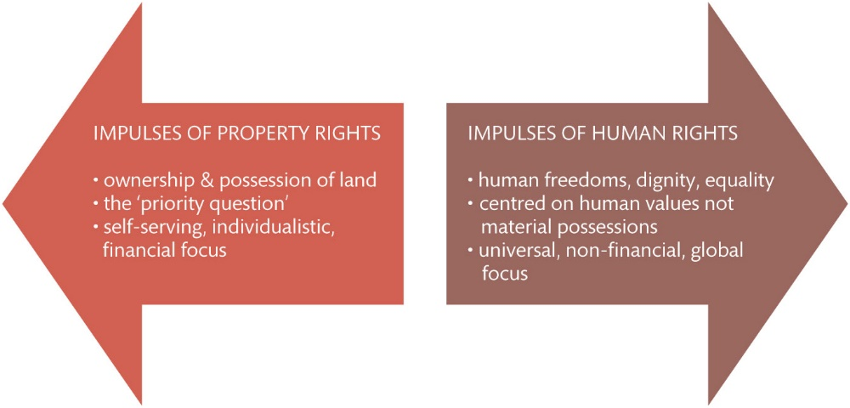
Figure 14.1 The apparent divergence of property rights versus human rights

Slide 4
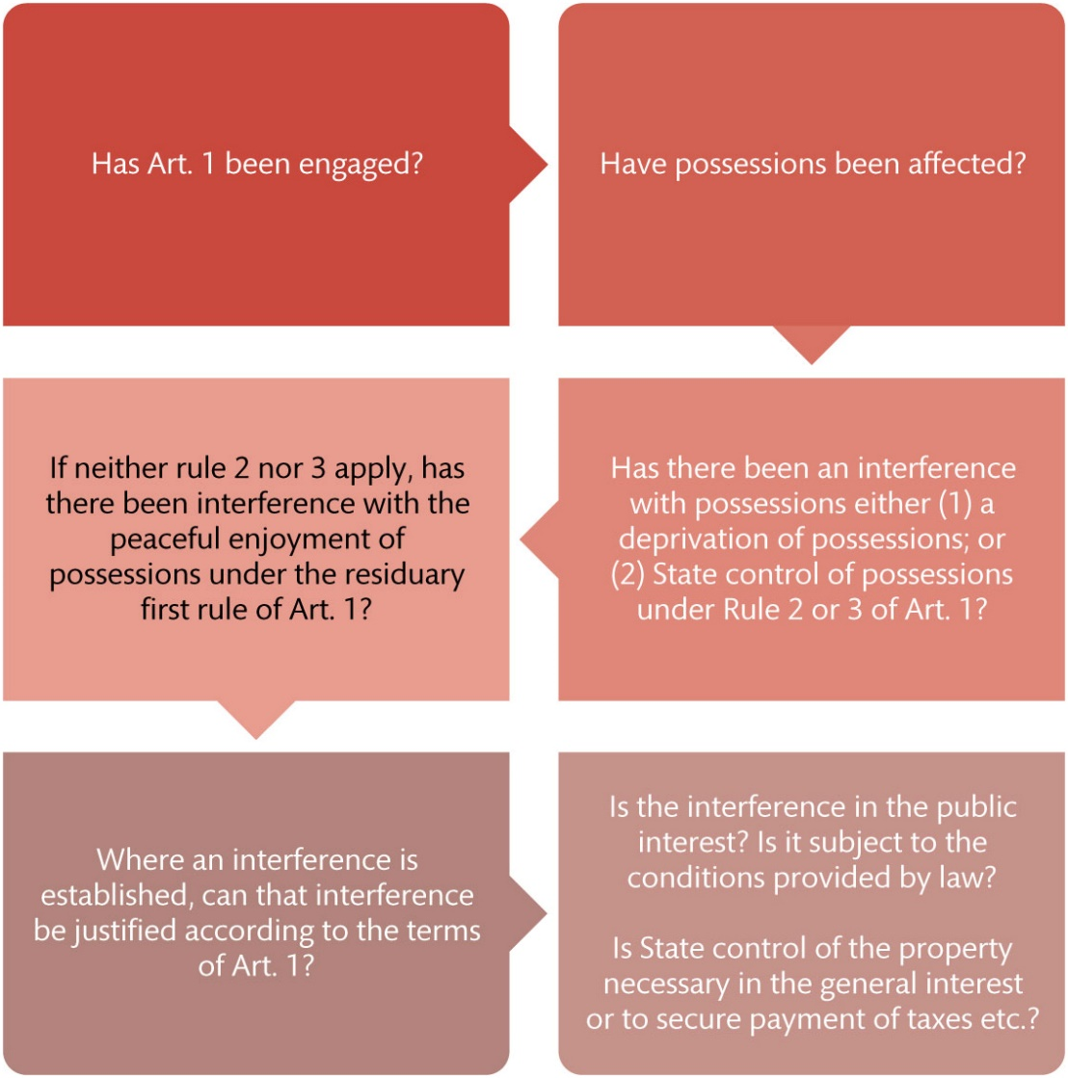
Figure 14.2 Analysis of a potential action under Art. 1 of Protocol 1

Slide 5
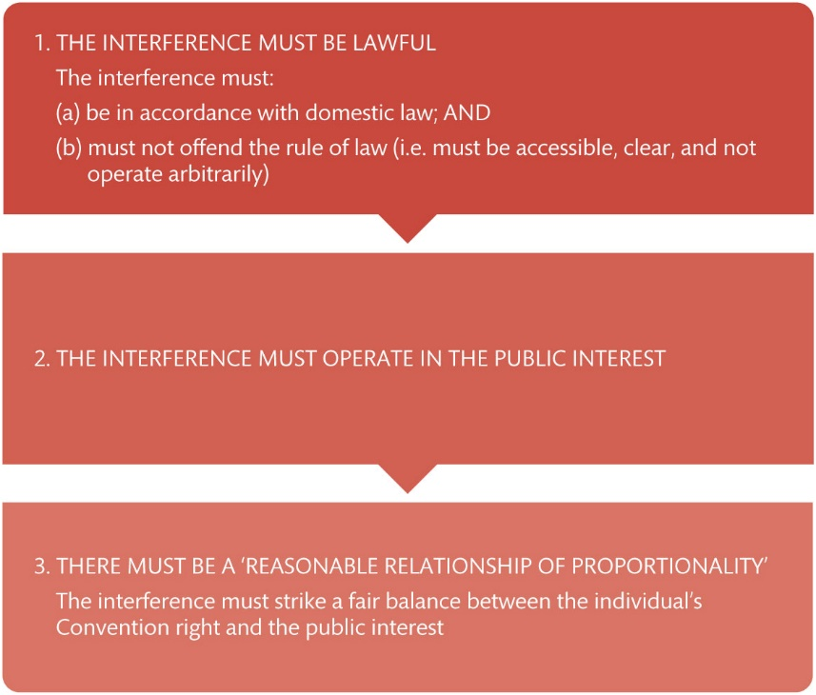
Figure 14.3 Justifying an interference with possessions under Art. 1 of Protocol 1

Slide 6
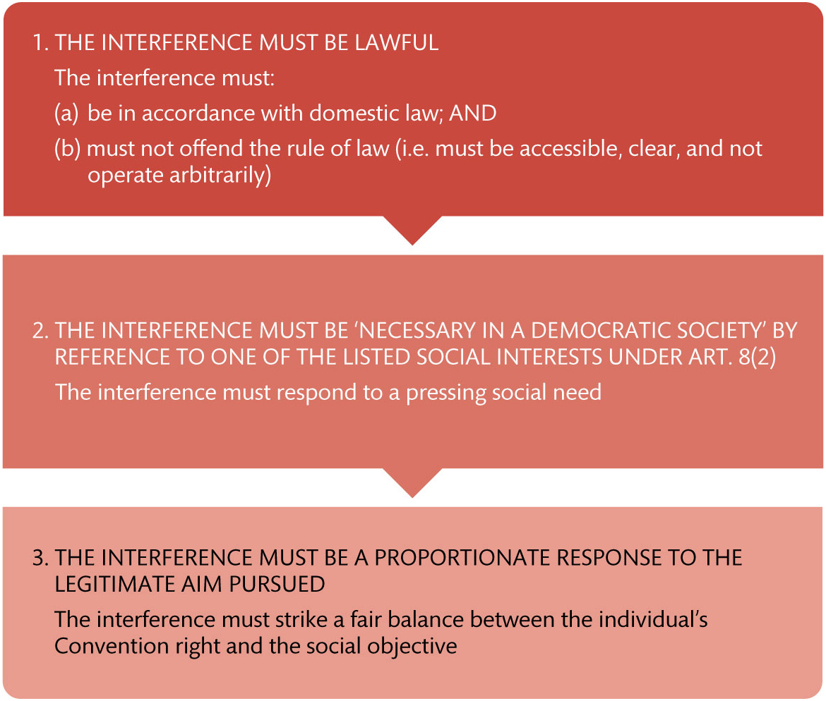
Figure 14.4 Justifying an interference with Art. 8

