Slide 1
Land Law by Chris Bevan

Slide 2
Chapter 13 Mortgages

Slide 3
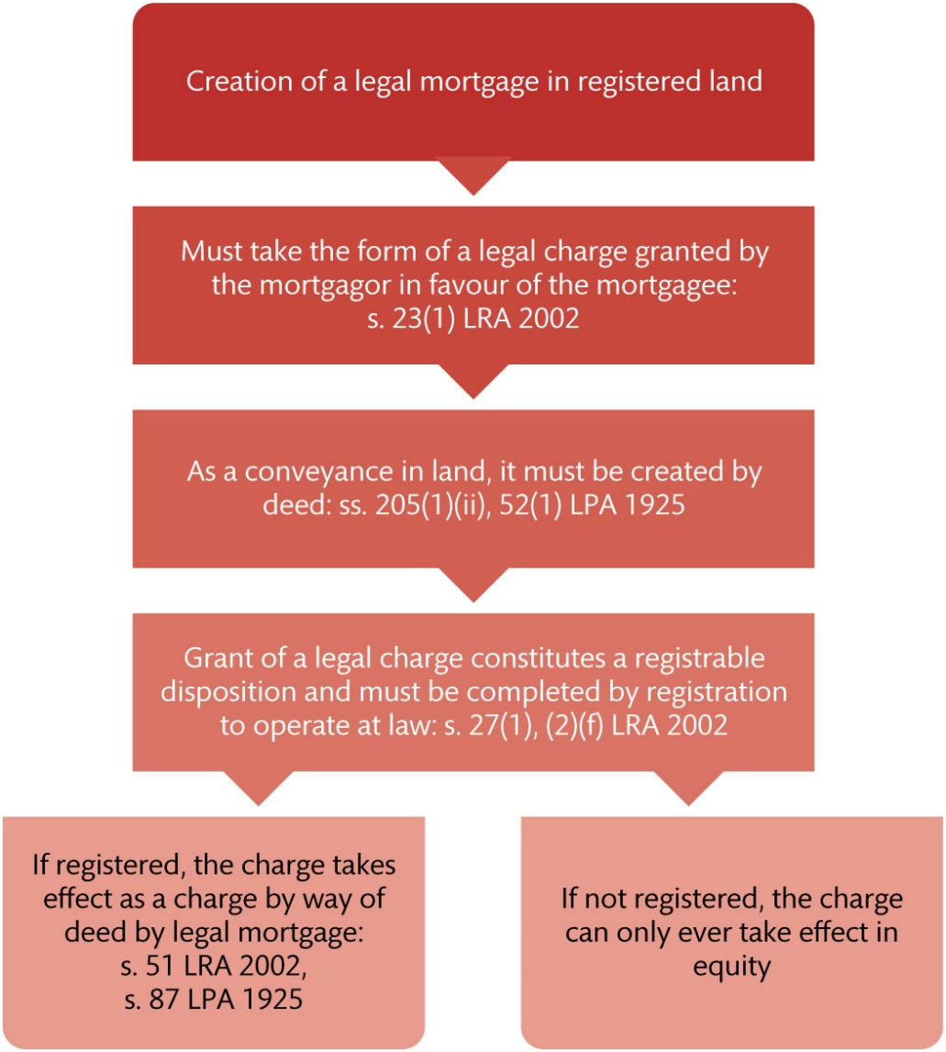
Figure 13.1 Creation of a legal mortgage in registered land

Slide 4
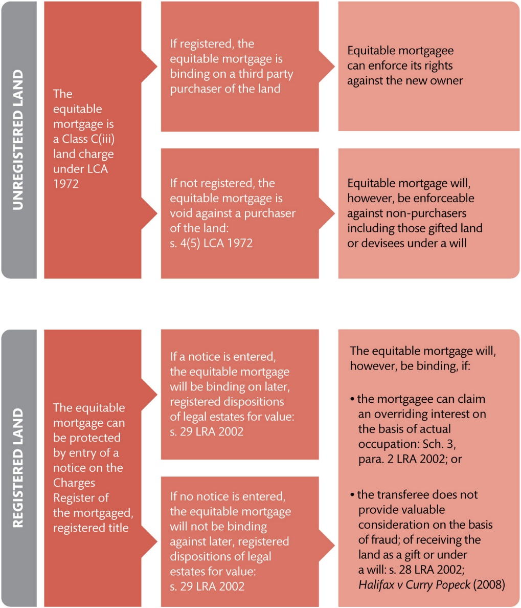
Figure 13.2 Protecting equitable mortgages in registered and unregistered land

Slide 5
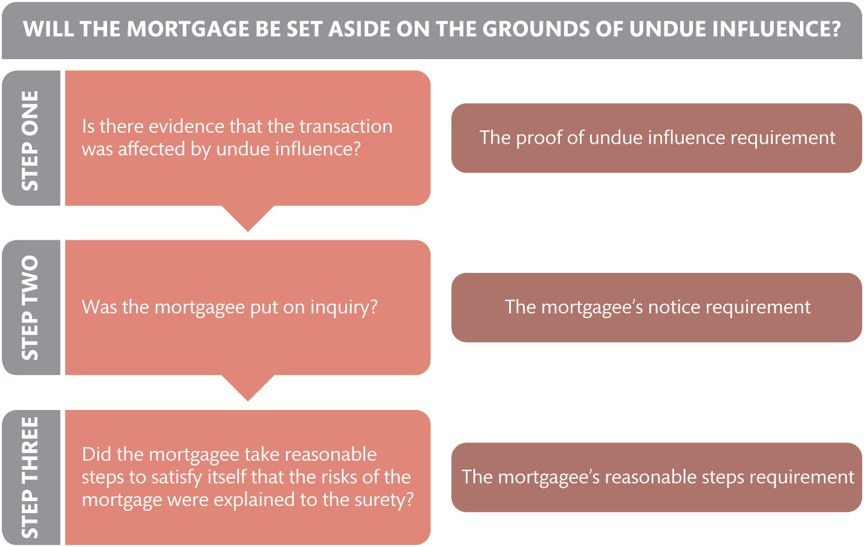
Figure 13.3 When a mortgage will be set aside on the grounds of undue influence

Slide 6
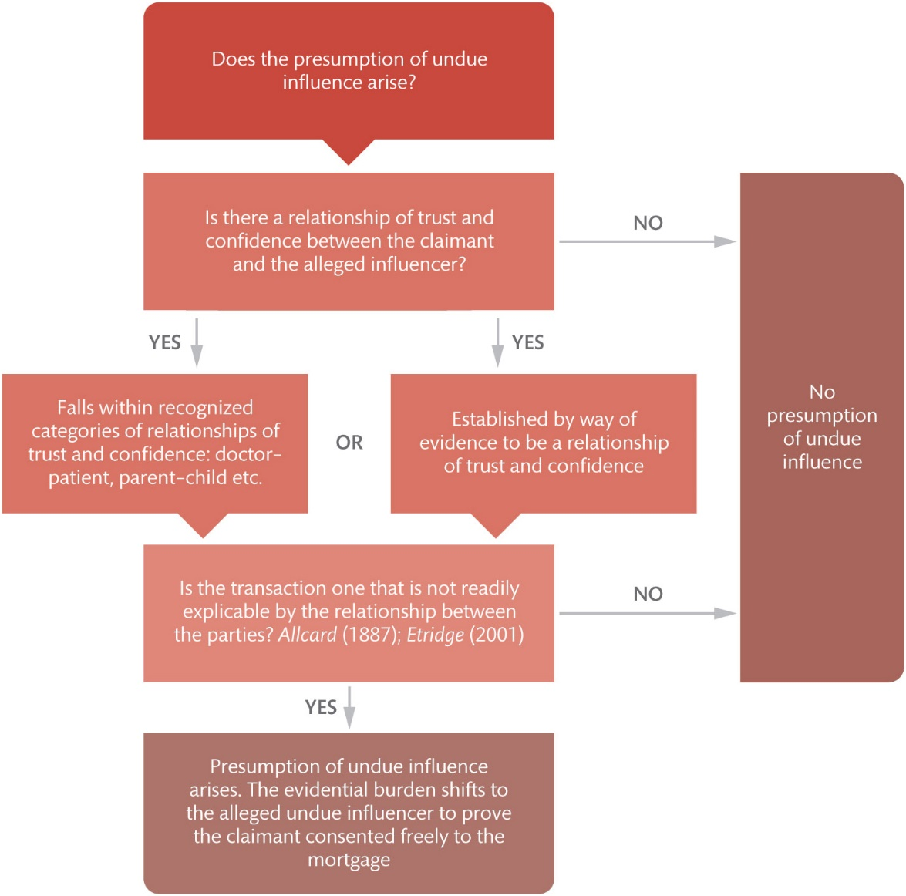
Figure 13.4 When the presumption of undue influence arises

Slide 7
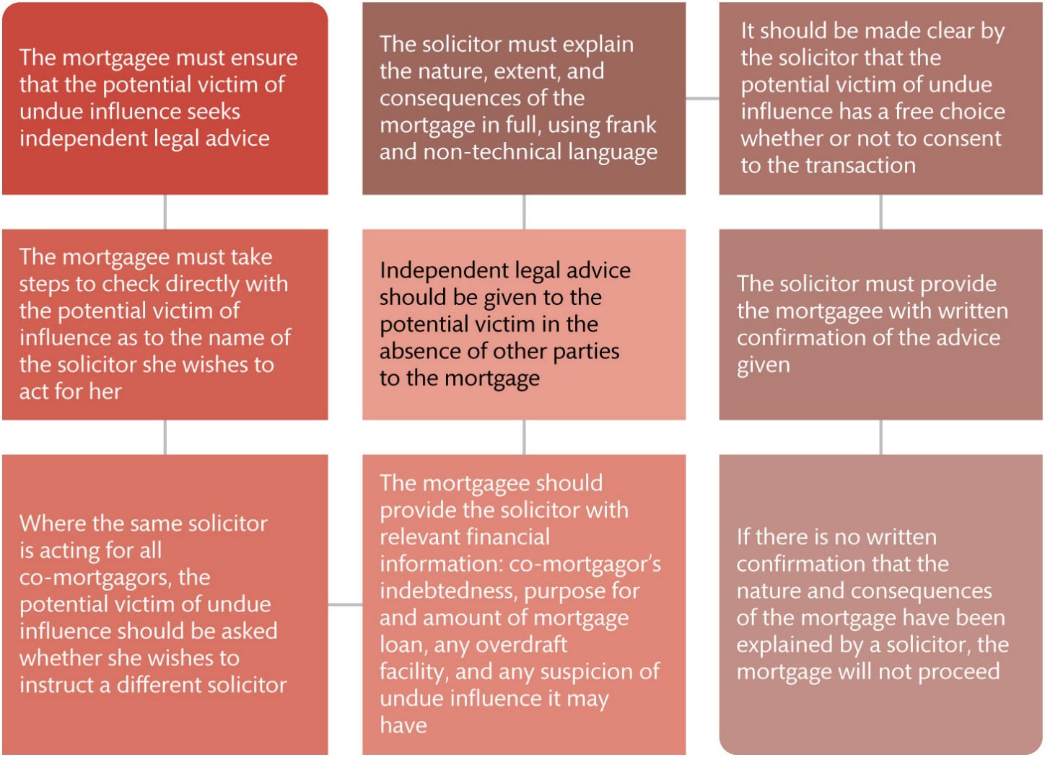
Figure 13.5 The Etridge ‘reasonable steps’ protocol

Slide 8
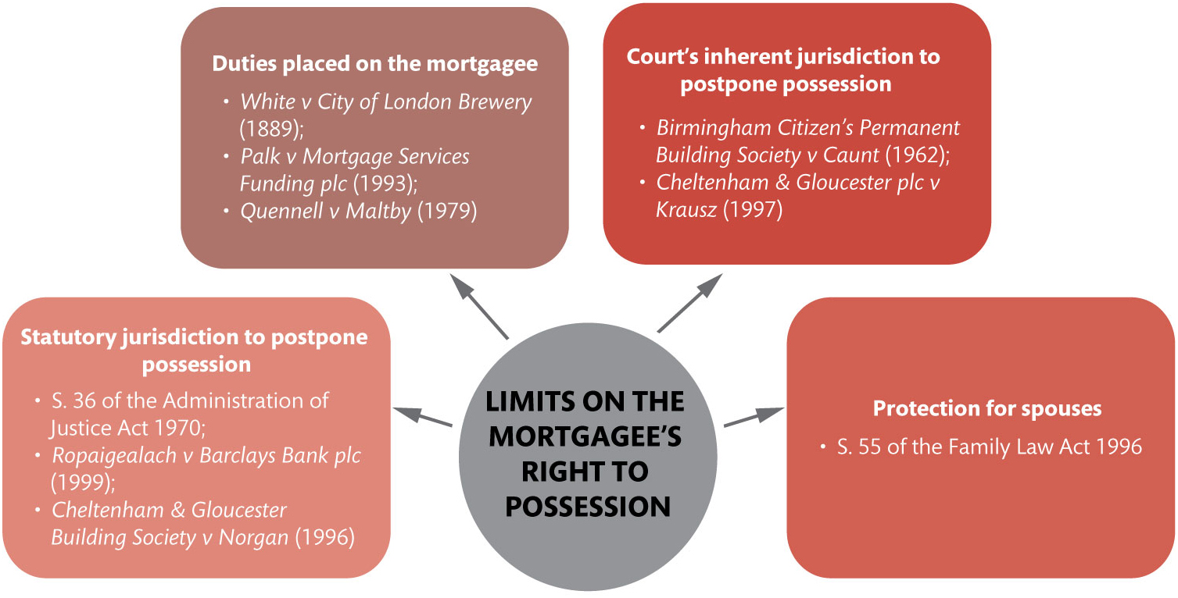
Figure 13.6 Limits on the mortgagee’s right to possession

Slide 9
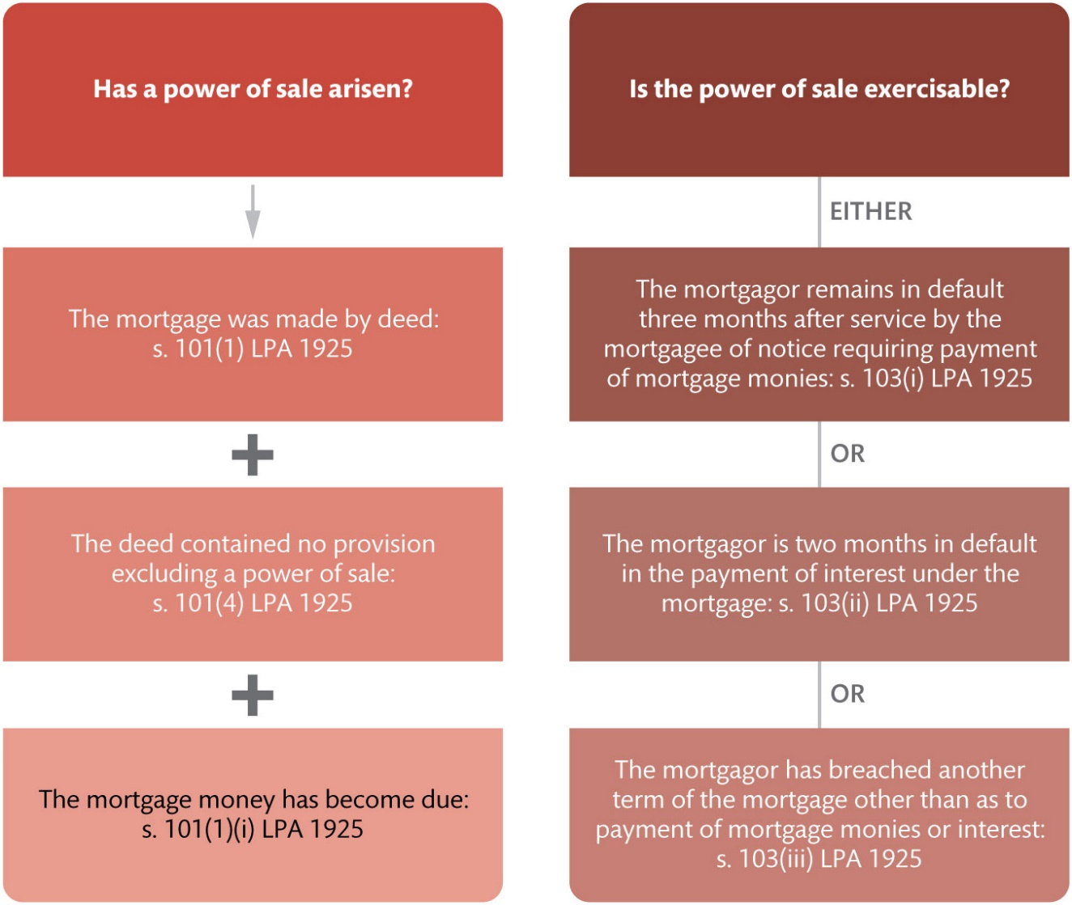
Figure 13.7 When the power of sale arises and becomes exercisable under ss. 101 and 103 of the LPA 1925

