Slide 1
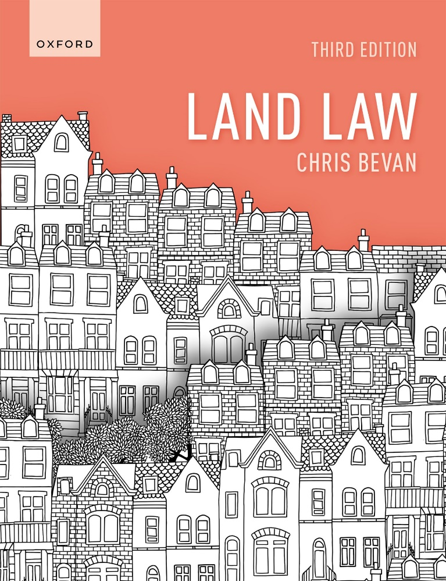
Land Law by Chris Bevan

Slide 2
Chapter 12 Freehold Covenants

Slide 3
Figure 12.1 Where there is an original covenantor and original covenantee

Slide 4
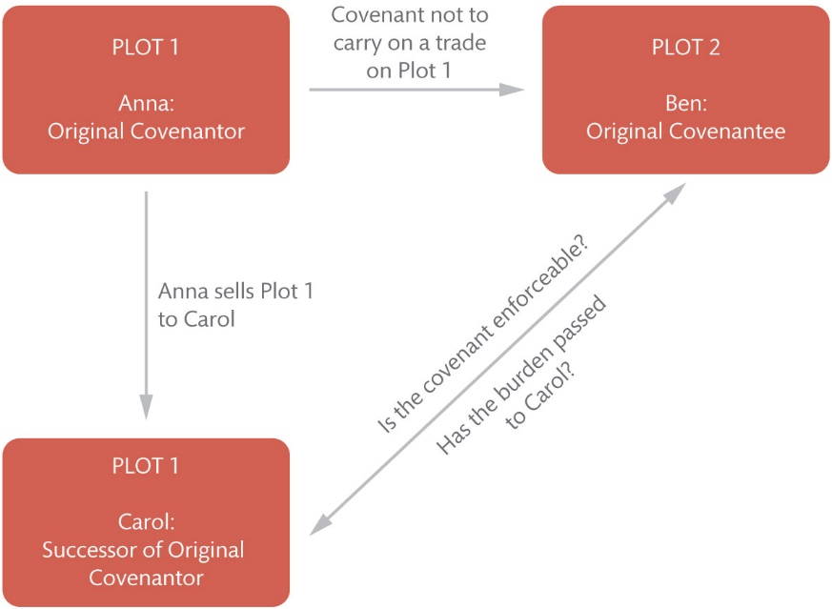
Figure 12.2 Where there is a successor of the original covenantor’s land

Slide 5
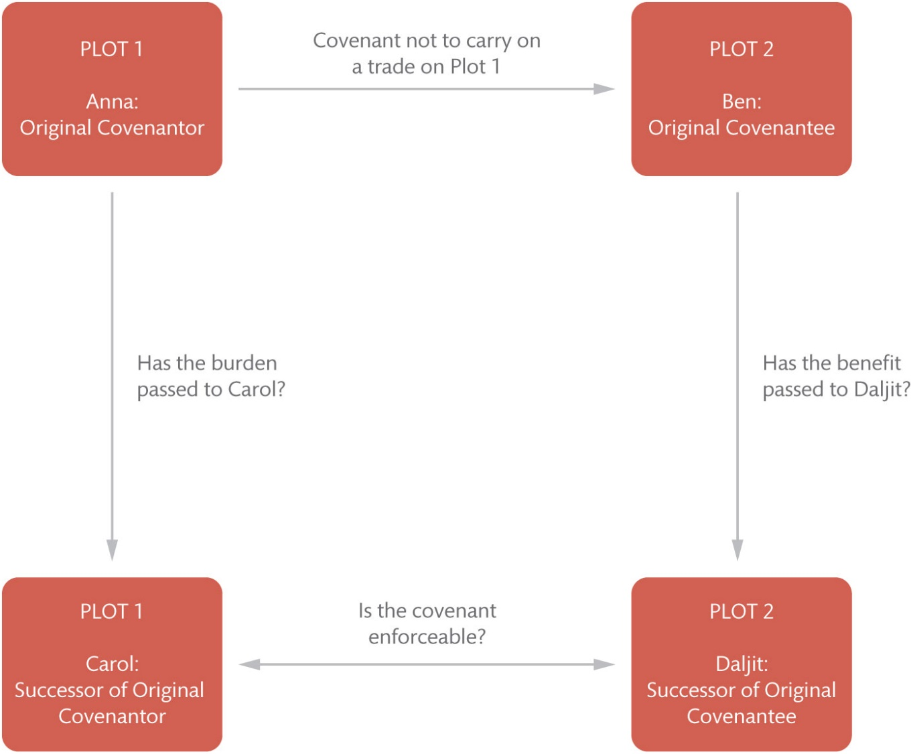
Figure 12.3 Where there is a successor both of the original covenantor and original covenantee’s land

Slide 6
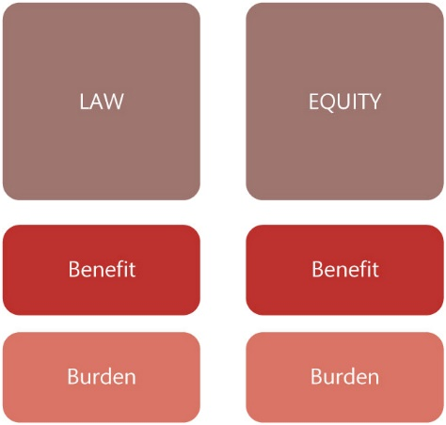
Figure 12.4 The ‘four dimensions’ of covenants: (1) law; (2) equity; (3) benefit; and (4) burden

Slide 7
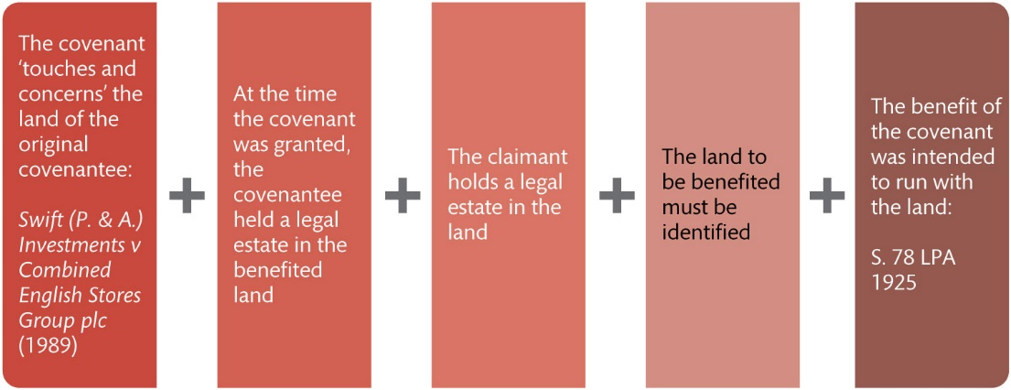
Figure 12.5 Passing the benefit of a covenant at law

Slide 8
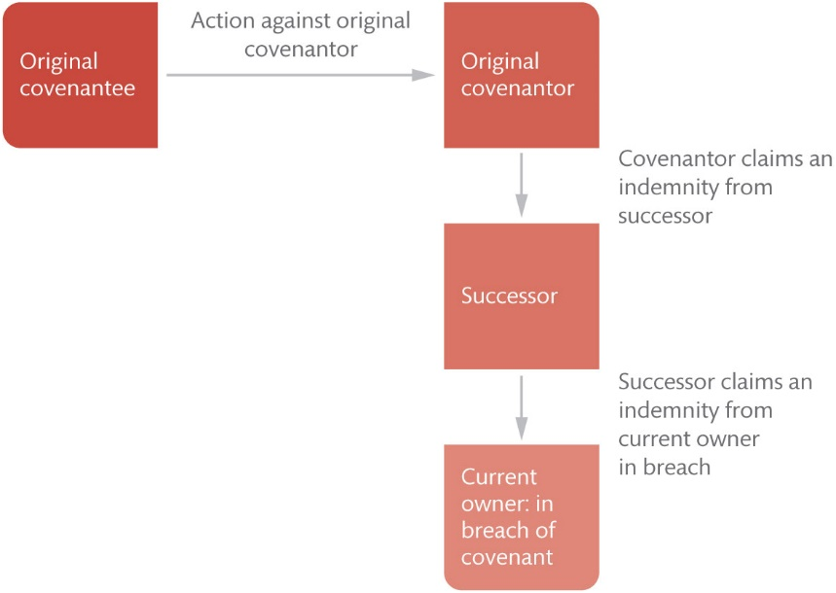
Figure 12.6 Unbroken chain of indemnity covenants

Slide 9
Figure 12.7 The Tulk v Moxhay conditions

Slide 10
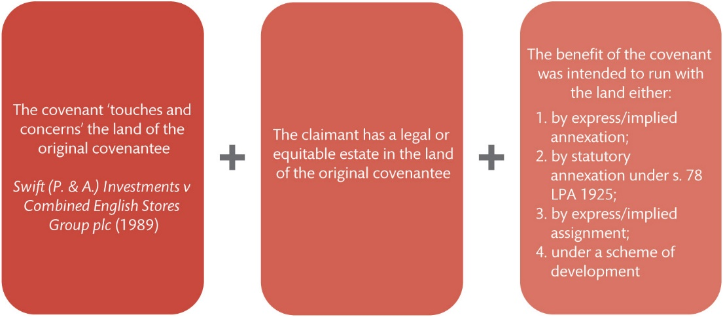
Figure 12.8 Passing the benefit of a covenant in equity

Slide 11
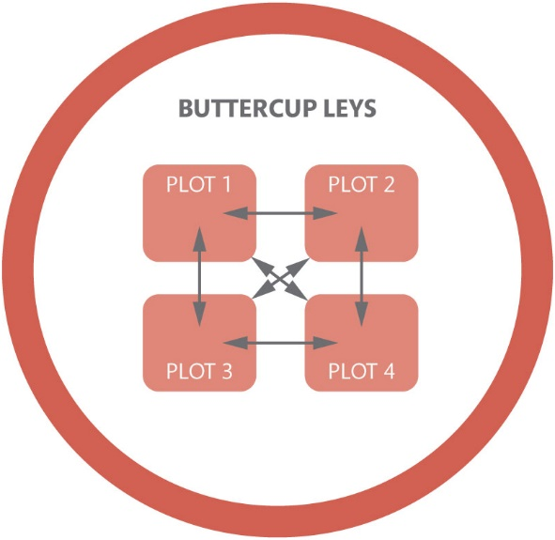
Figure 12.9 A scheme of development: covenants are mutually enforceable between all plot owners within the defined area

Slide 12
Table 12.1 Summary of the rules for the passing of benefit and burden at law and in equity

