Slide 1
Land Law by Chris Bevan

Slide 2
Chapter 11 Easements and Profits

Slide 3
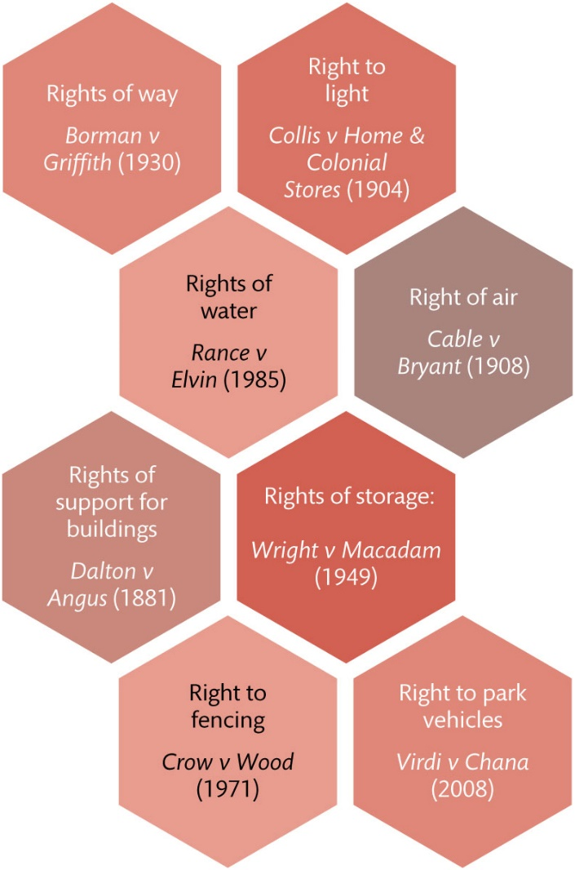
Figure 11.1 Some common examples of modern easement

Slide 4
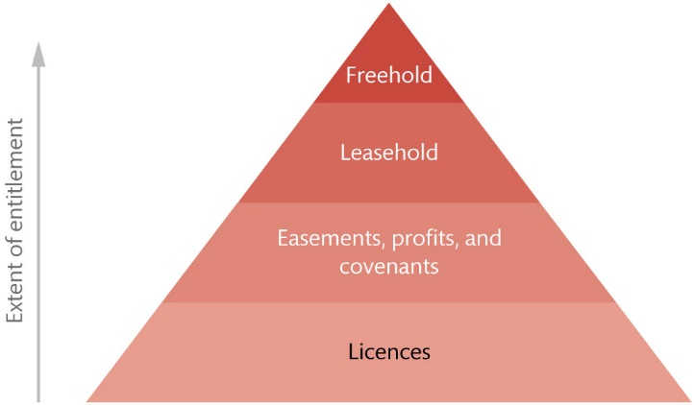
Figure 11.2 A hierarchy of rights in and over land

Slide 5
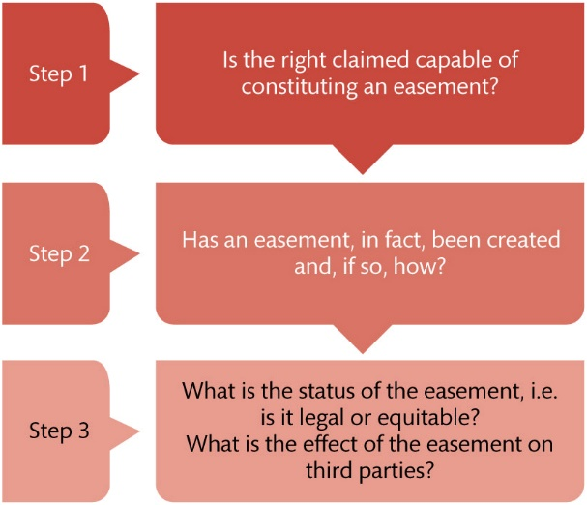
Figure 11.3 Framework for how to approach analysis of an easements scenario

Slide 6
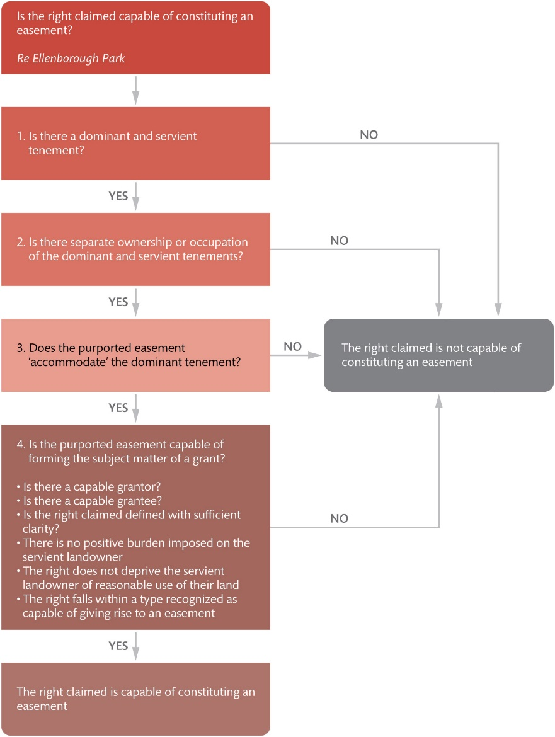
Figure 11.4 The essential characteristics of an easement

Slide 7
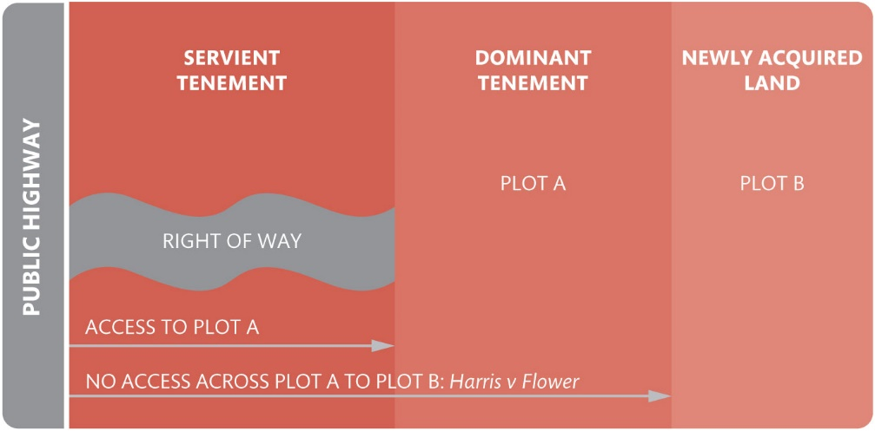
Figure 11.5 The rule in Harris v Flower (1904)

Slide 8
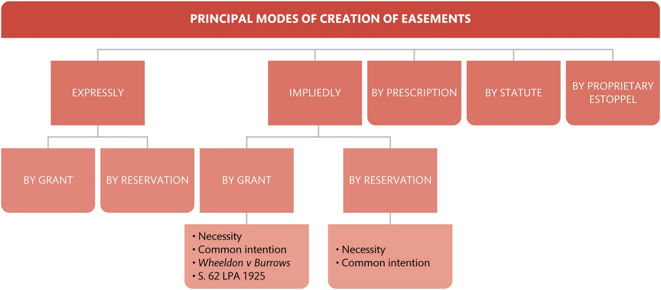
Figure 11.6 Modes of creation of easements

Slide 9
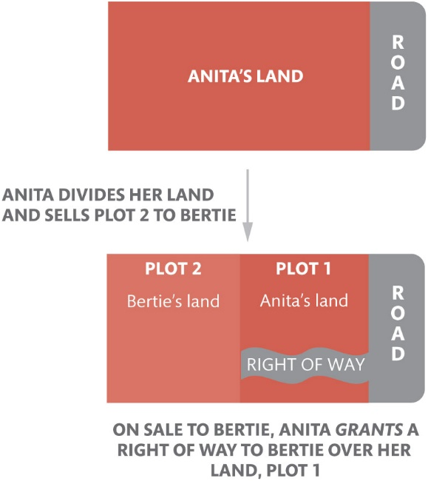
Figure 11.7 Grant of an easement

Slide 10
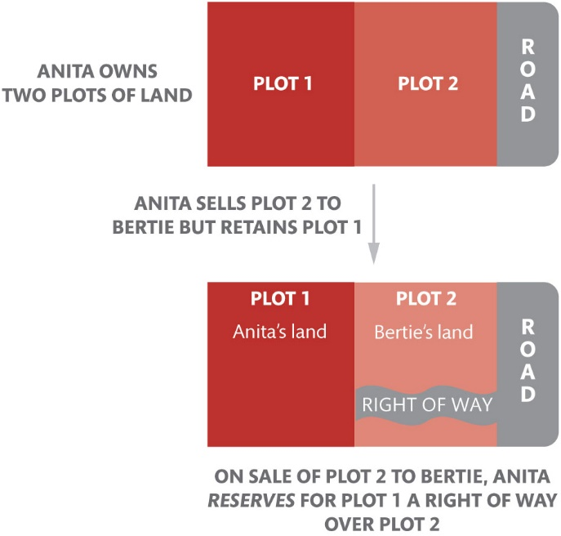
Figure 11.8 Reservation of an easement

Slide 11
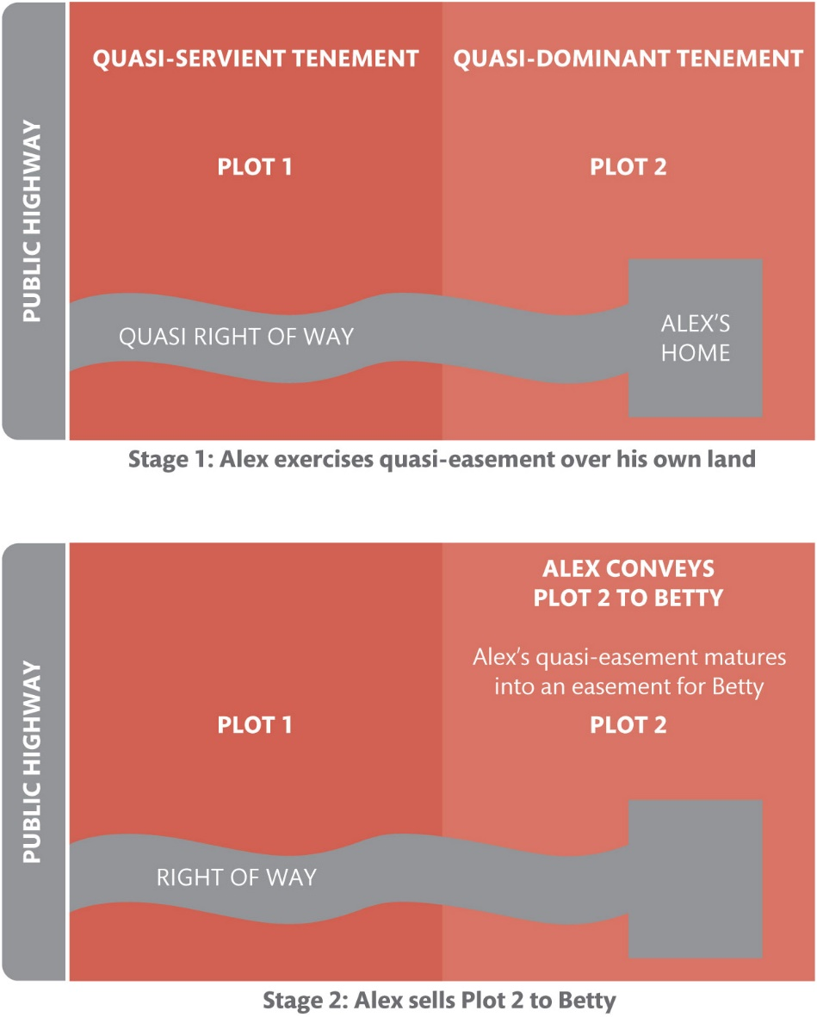
Figure 11.9 The rule in Wheeldon v Burrows

Slide 12
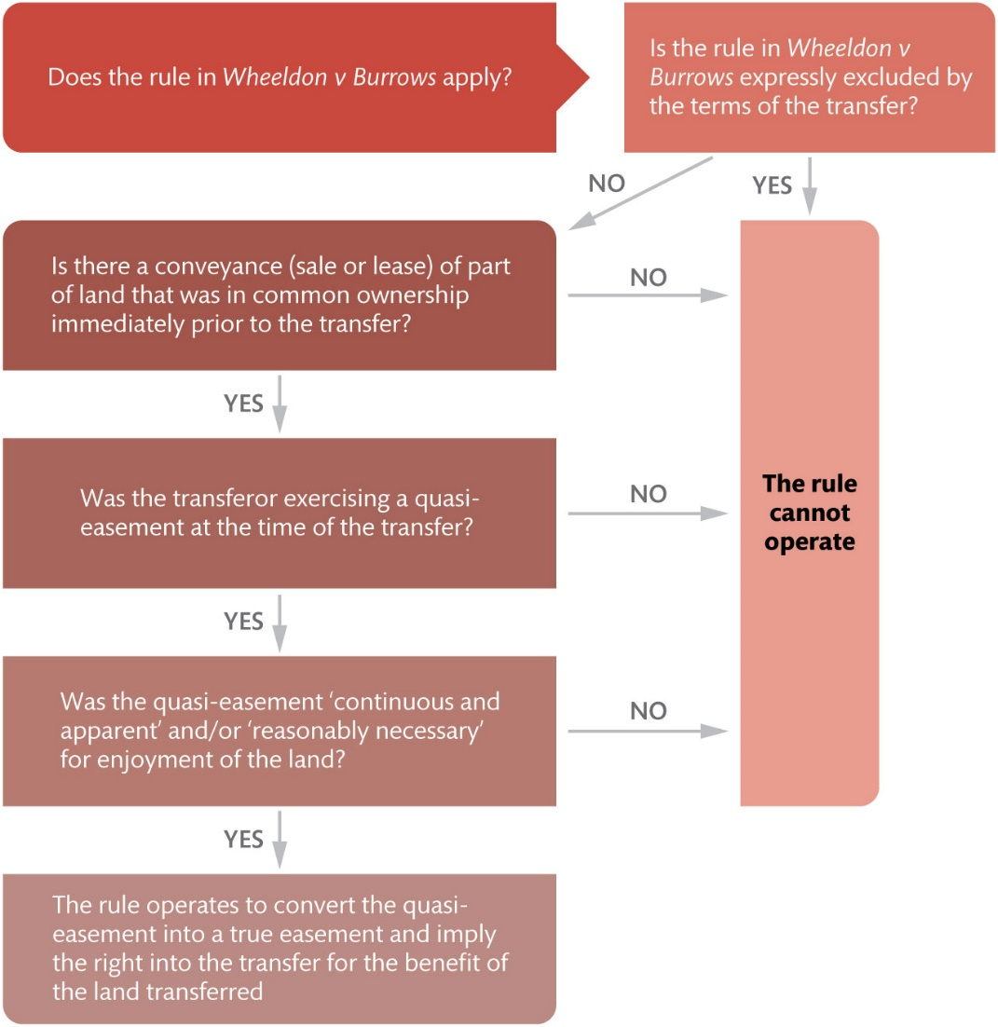
Figure 11.10 How the rule in Wheeldon v Burrows works

Slide 13
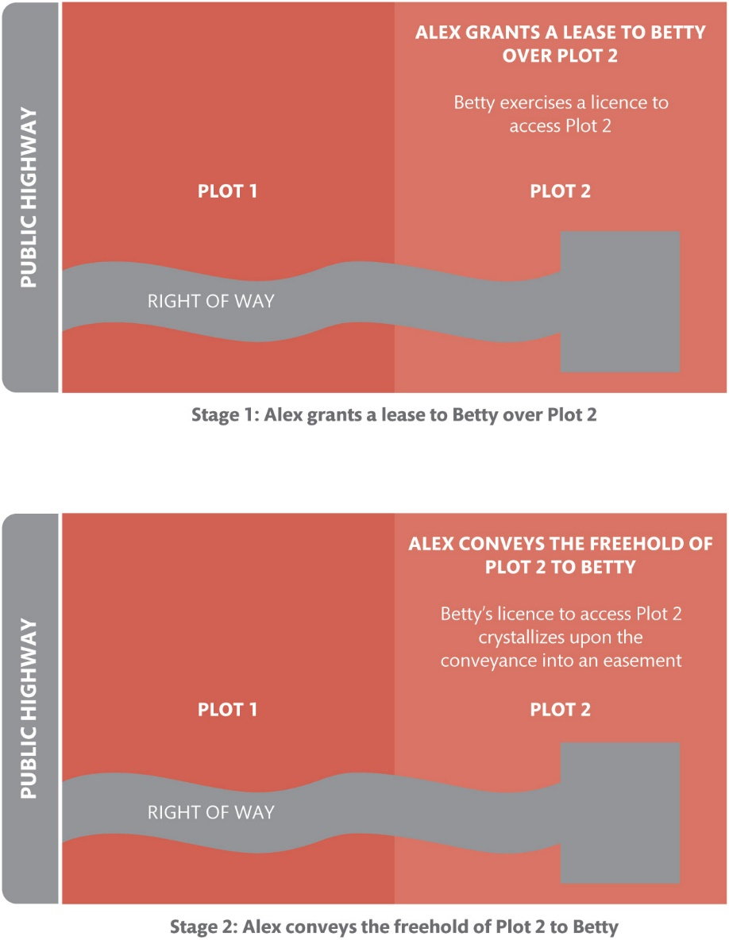
Figure 11.11 The operation of s. 62 of the LPA 1925

Slide 14
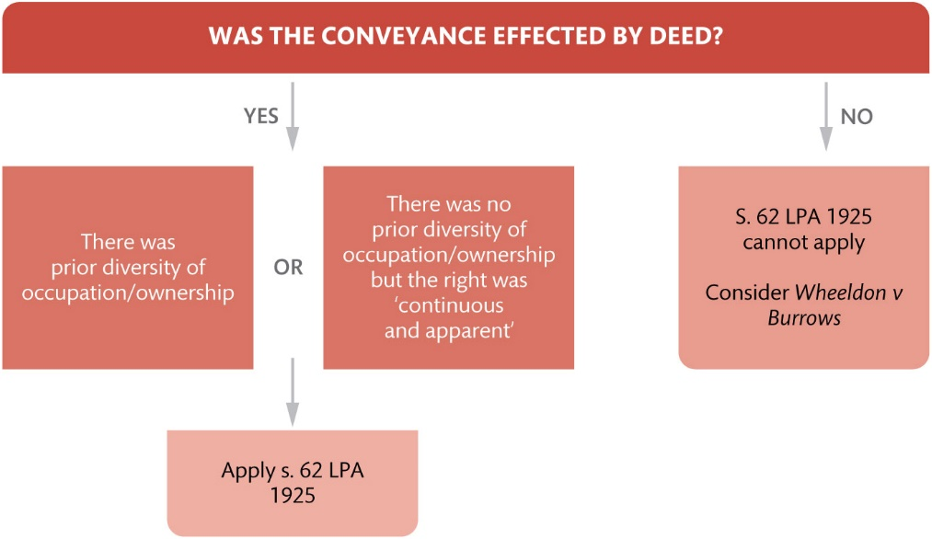
Figure 11.12 After Wood, the application of s. 62 and the rule in Wheeldon v Burrows

Slide 15
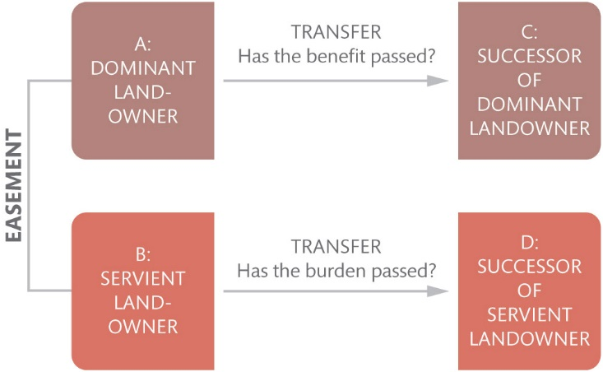
Figure 11.13 Effect of easements on successors

Slide 16
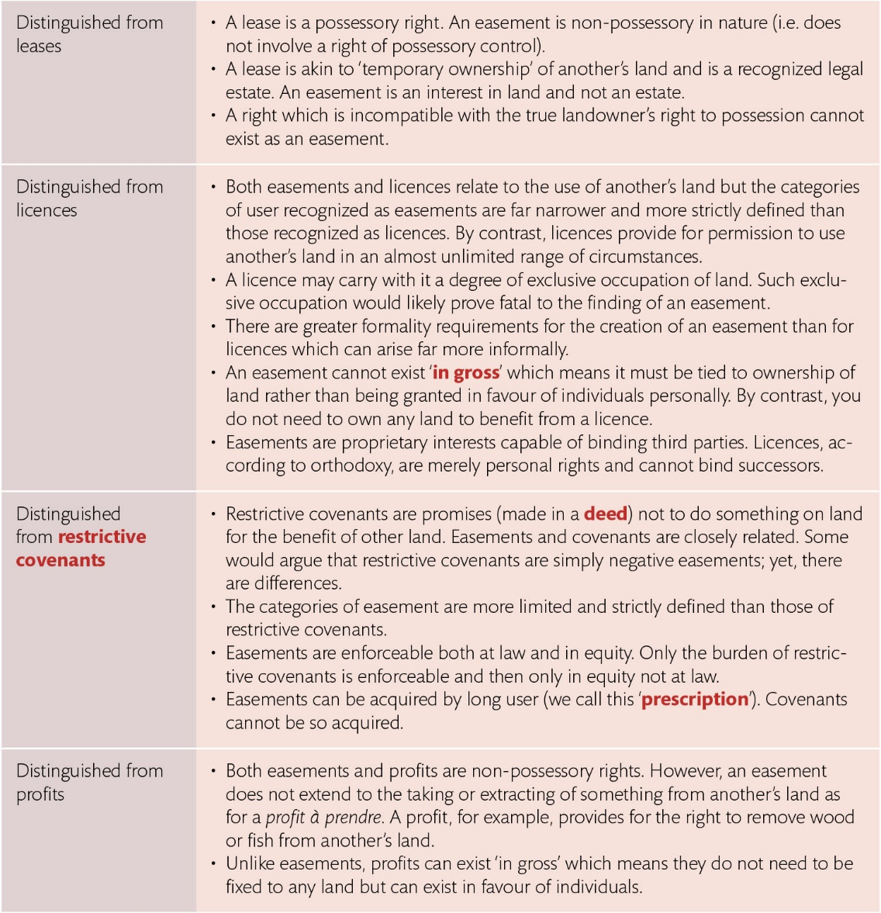
Table 11.1 Easements distinguished from leases, licences, covenants, and profits

Slide 17
Table 11.2 The distinction between dominant and servient tenements

Slide 18
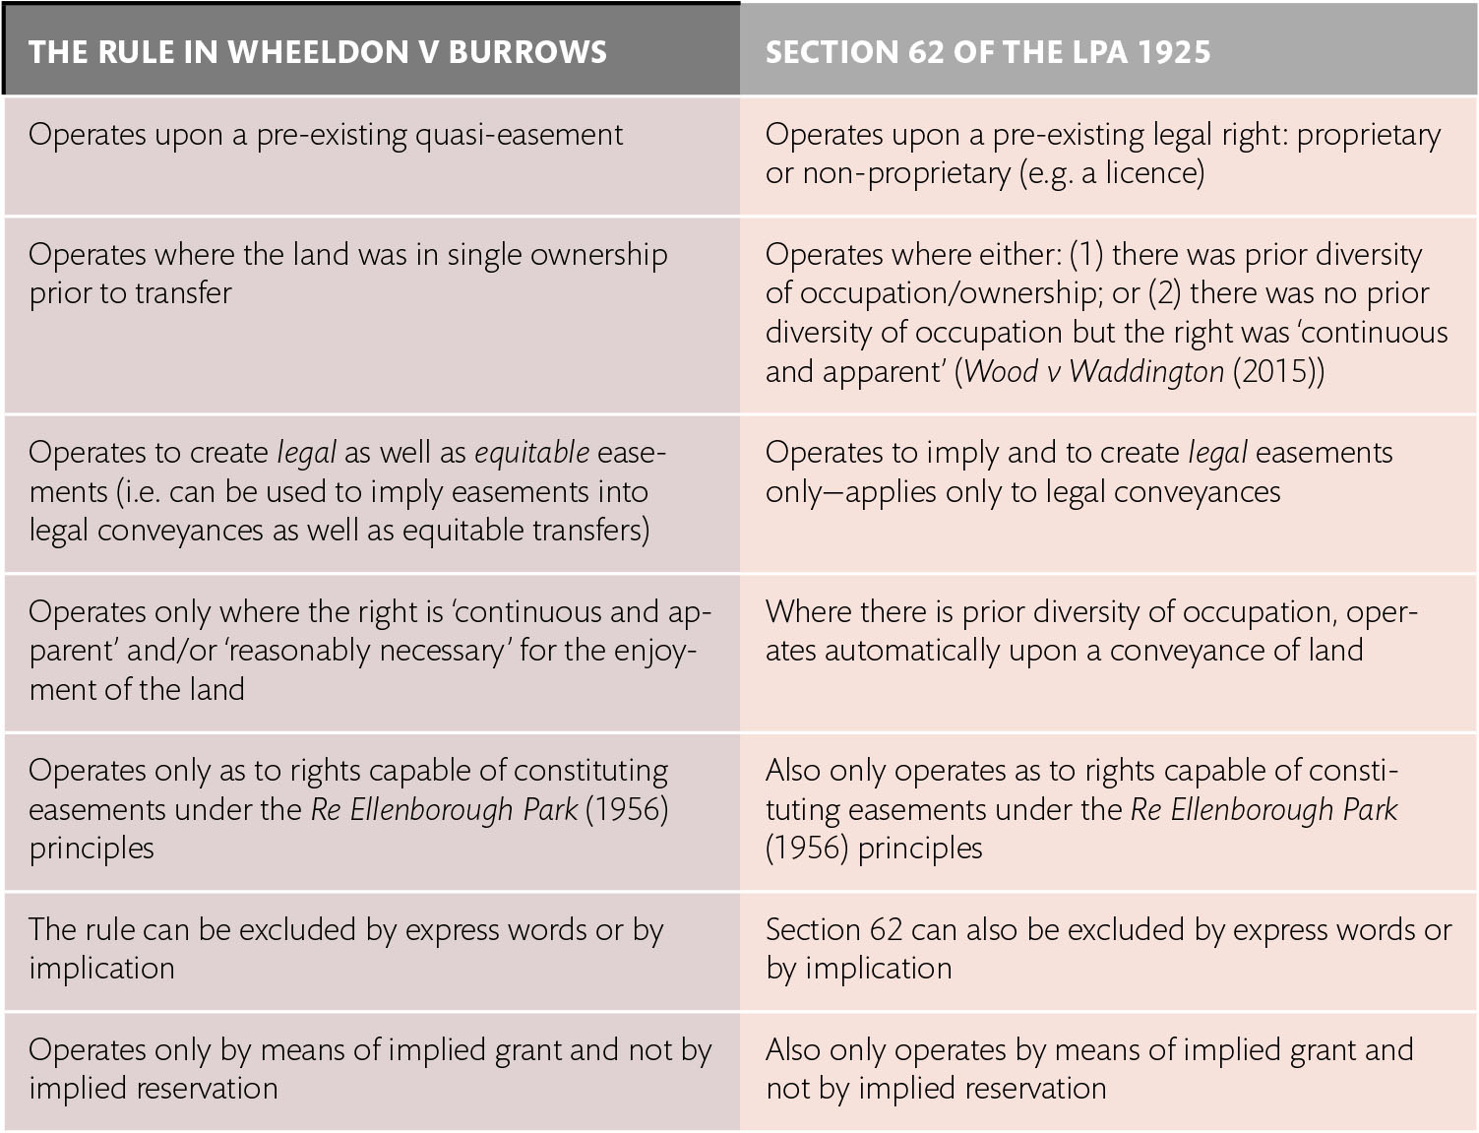
Table 11.3 Wheeldon v Burrows and s. 62 of the LPA 1925 compared

