Slide 1
Land Law by Chris Bevan

Slide 2
Chapter 10 Leasehold Covenants

Slide 3
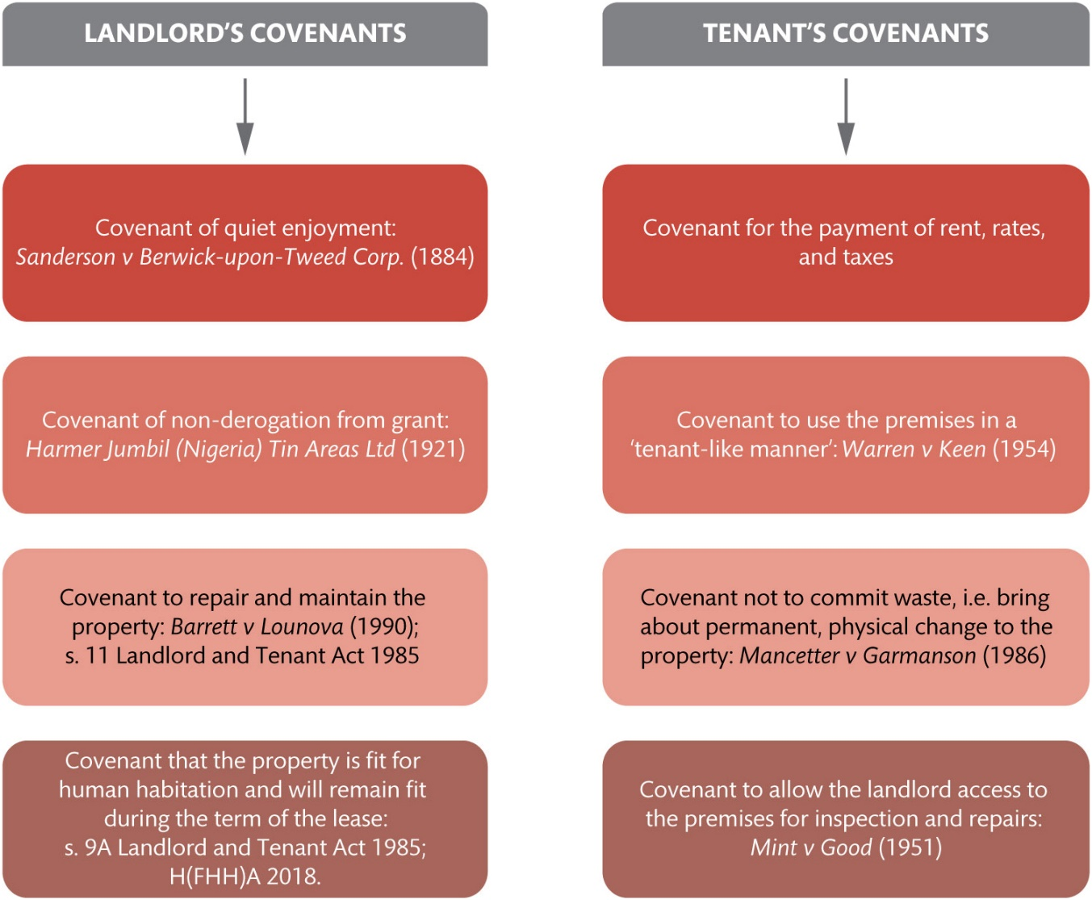
Figure 10.1 Examples of commonly encountered leasehold covenants

Slide 4
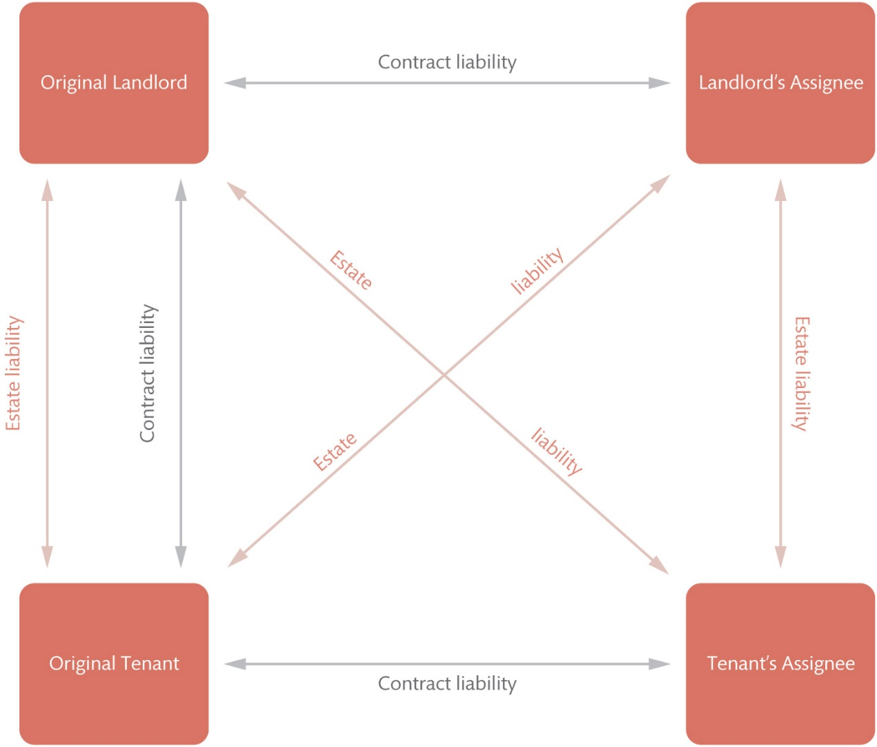
Figure 10.2 Privity of contract and privity of estate in leasehold dealings

Slide 5
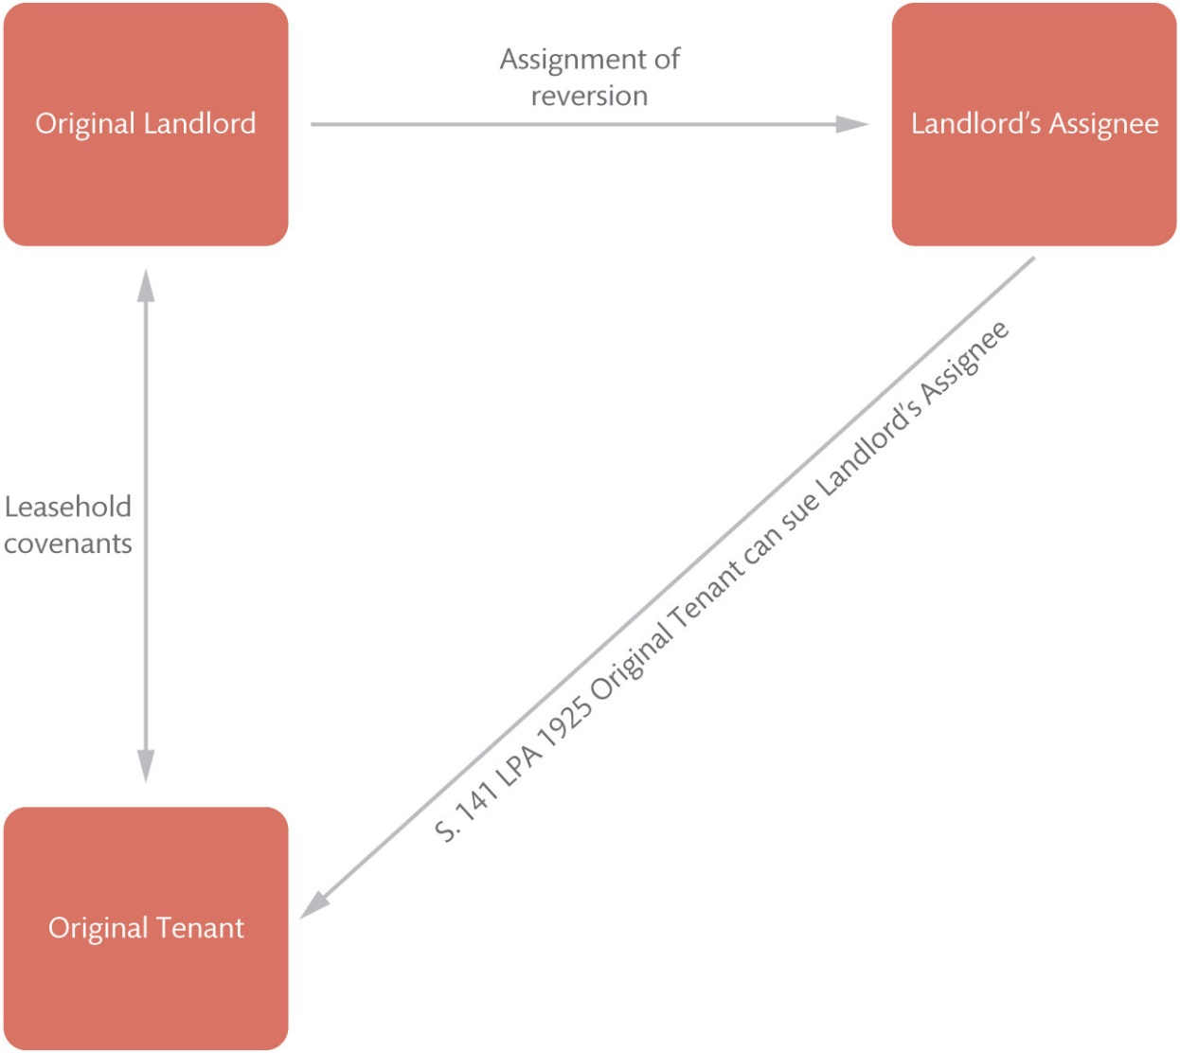
Figure 10.3 The operation of s. 141 of the LPA 1925 upon assignment of the landlord’s reversion

Slide 6
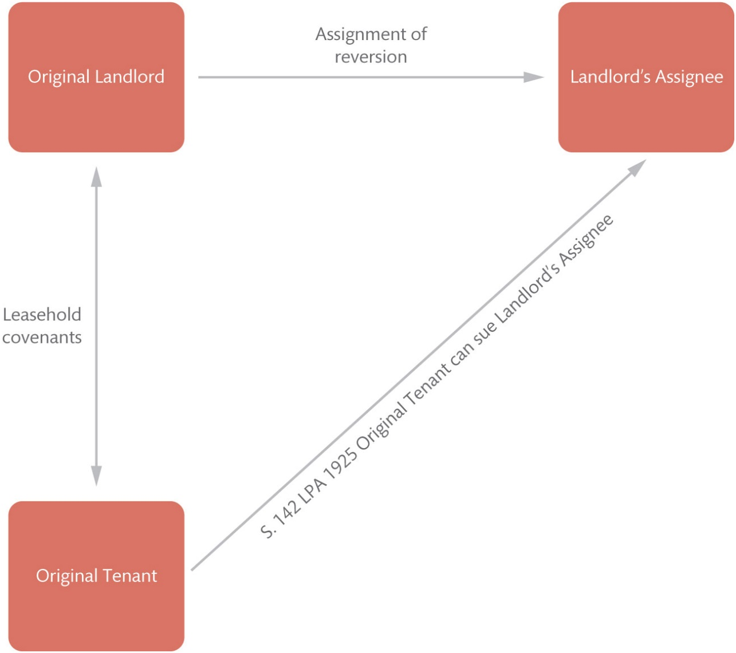
Figure 10.4 The operation of s. 142 of the LPA 1925 upon assignment of the landlord’s reversion

Slide 7
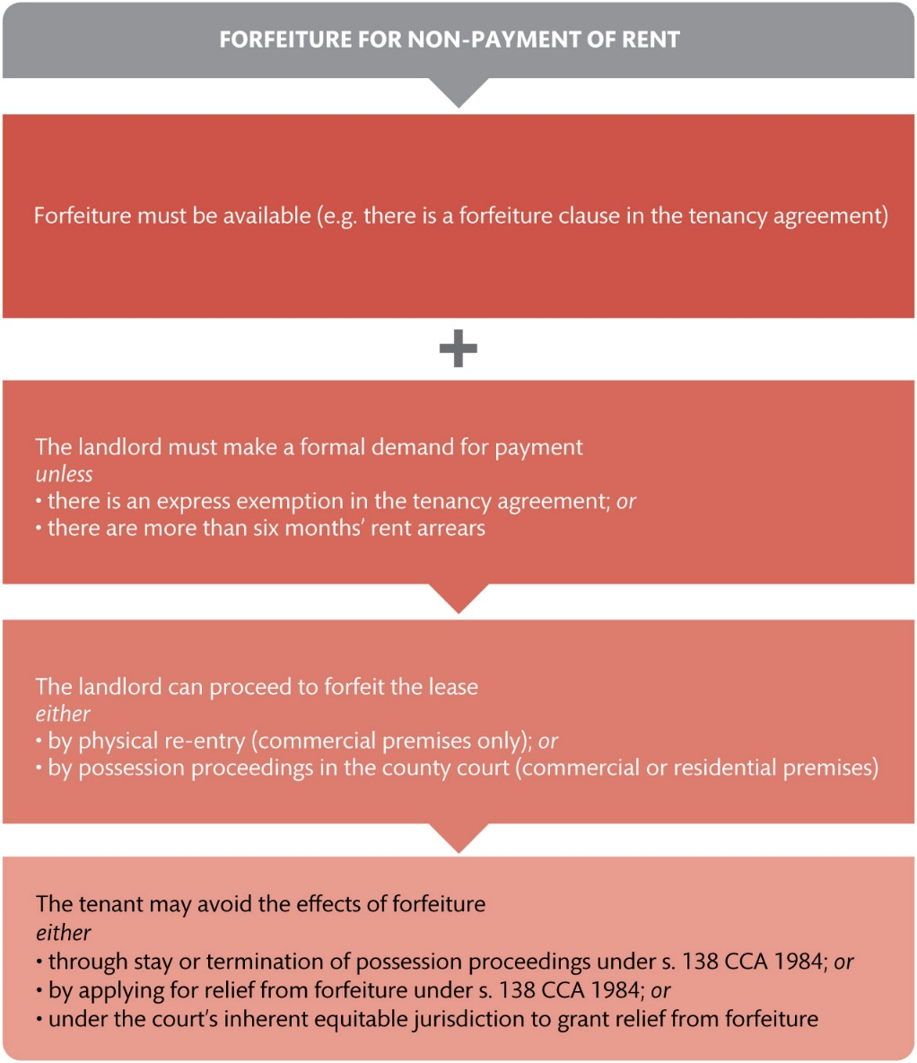
Figure 10.5 Forfeiture for breach of covenant as to non-payment of rent

Slide 8
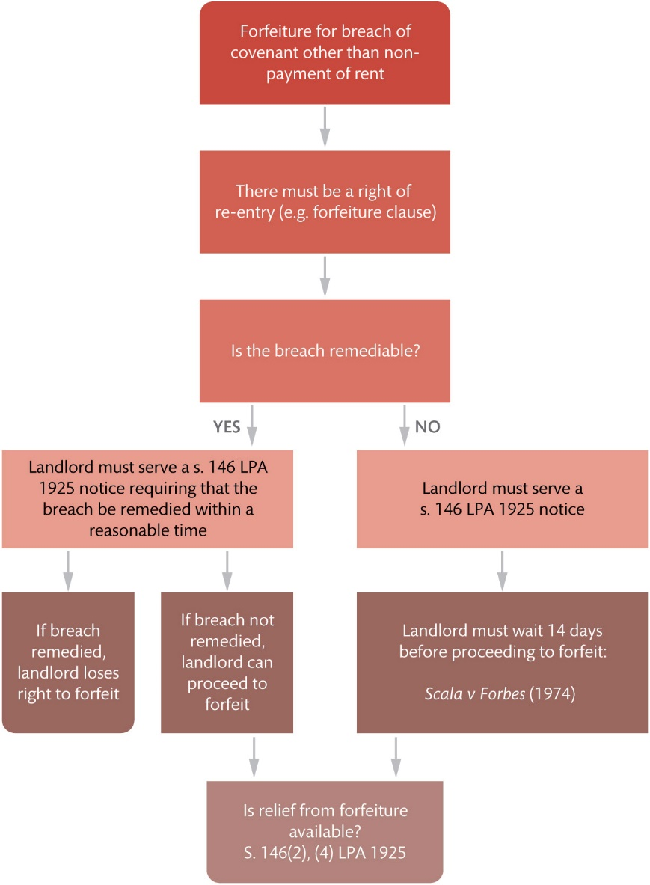
Figure 10.6 Forfeiture for breach of covenant other than for non-payment of rent

Slide 9
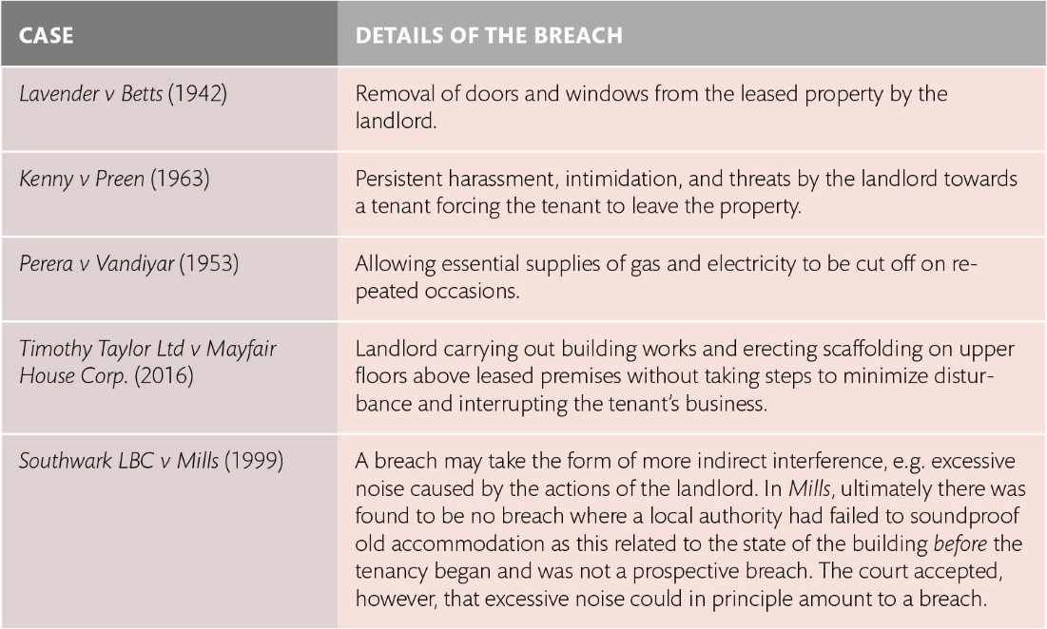
Table 10.1 Examples of breaches of the covenant of quiet enjoyment

Slide 10
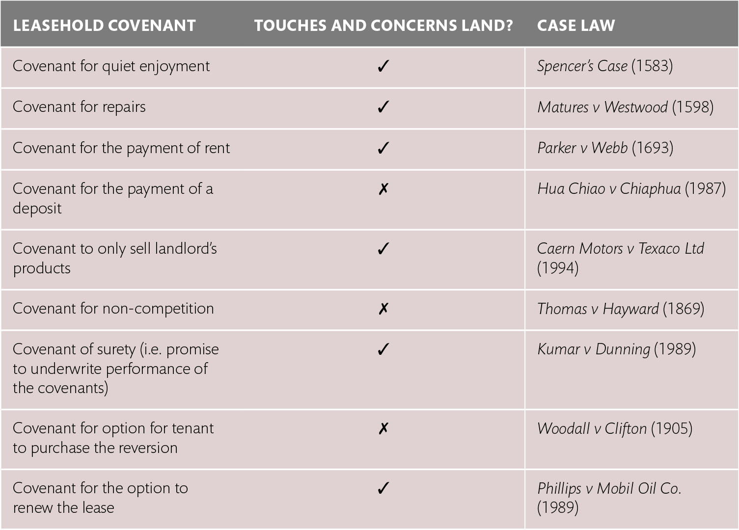
Table 10.2 Covenants that do and do not ‘touch and concern land’

