Slide 1
Land Law by Chris Bevan

Slide 2
Chapter 09 Leases

Slide 3
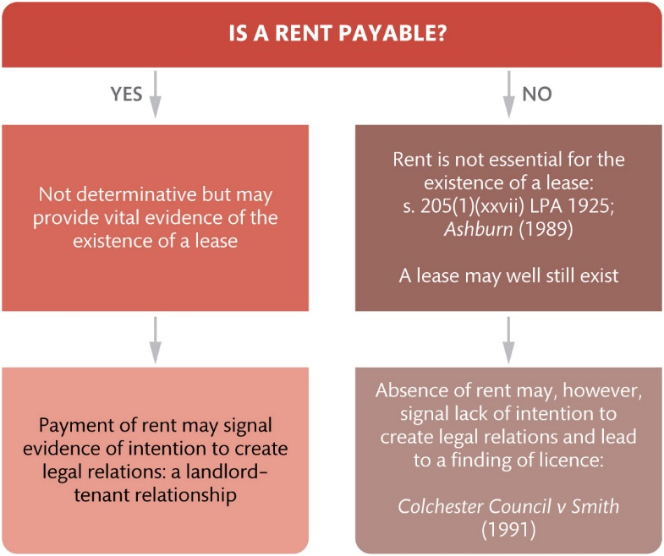
Figure 9.1 The evidential value of the payment or non-payment of rent

Slide 4
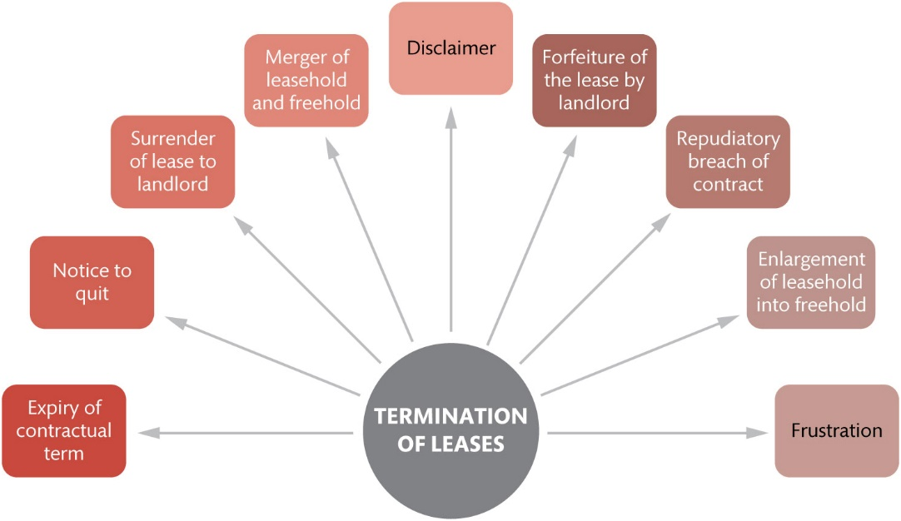
Figure 9.2 Methods of termination of leases

Slide 5
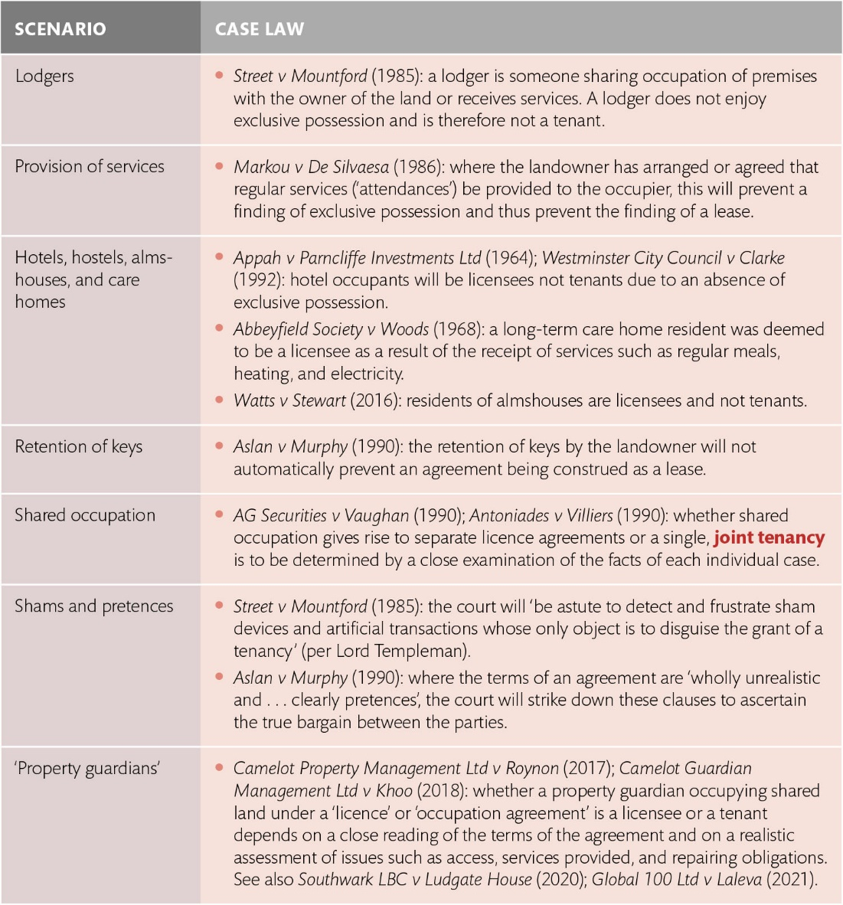
Table 9.1 Exclusive possession: some common scenarios

Slide 6
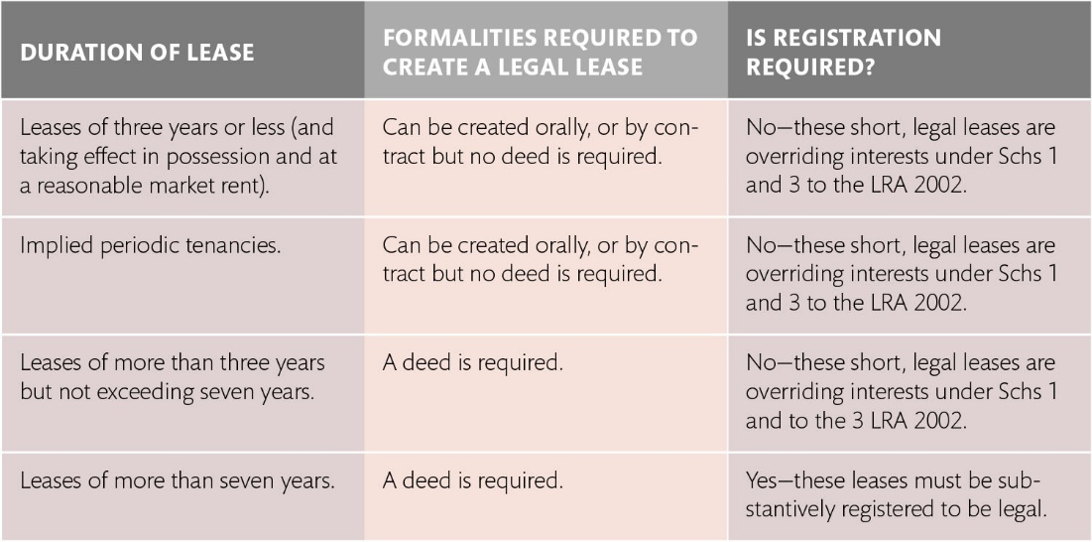
Table 9.2 Formality and registration requirements for legal leases in registered land

Slide 7
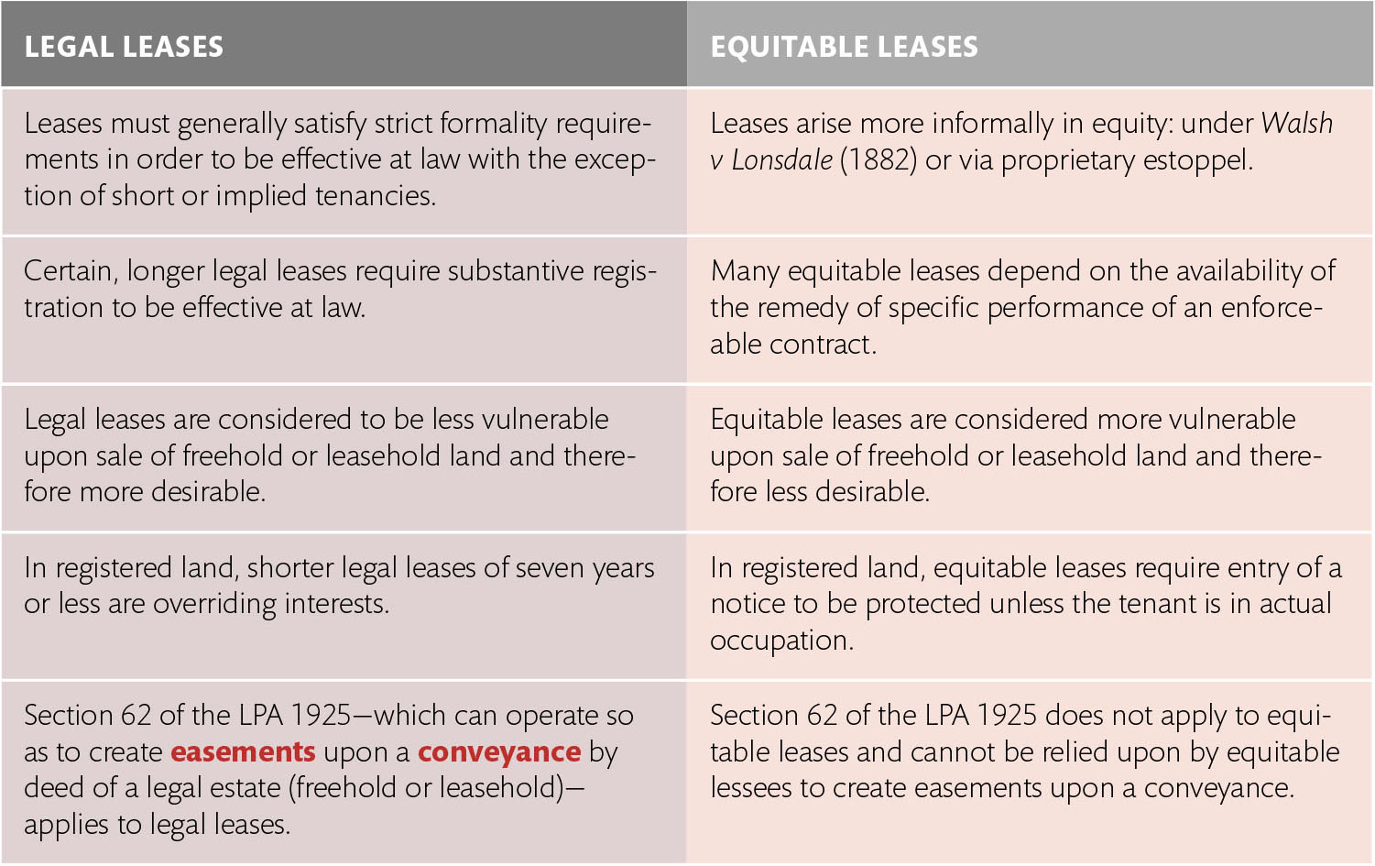
Table 9.3 Distinguishing legal and equitable leases

