Slide 1
Land Law by Chris Bevan

Slide 2
Chapter 07 Licences

Slide 3
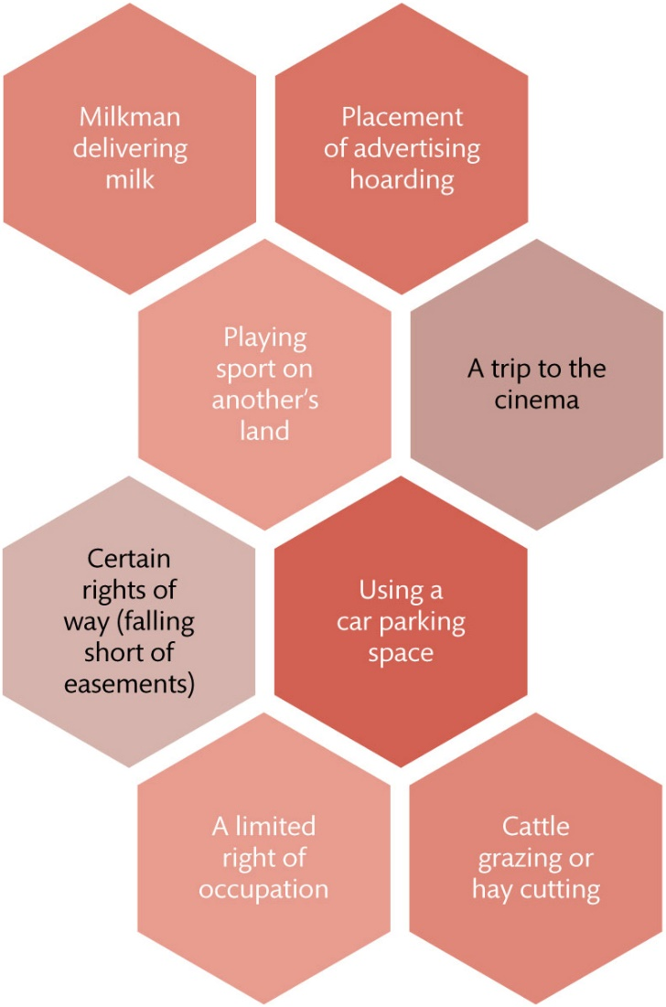
Figure 7.1 Examples of licences arising over land

Slide 4
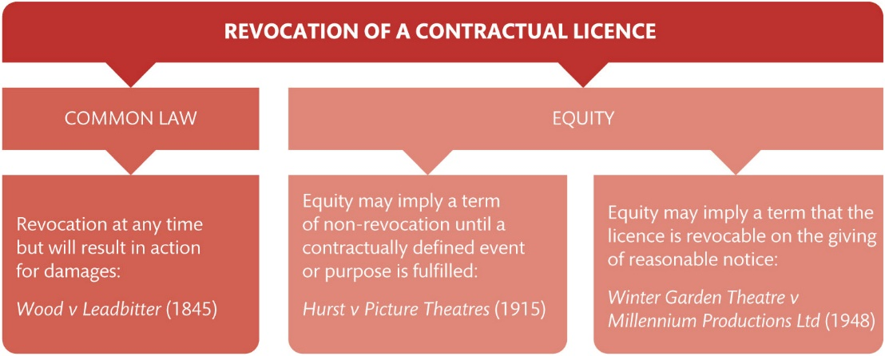
Figure 7.2 Revocation of contractual licences at common law and in equity

Slide 5
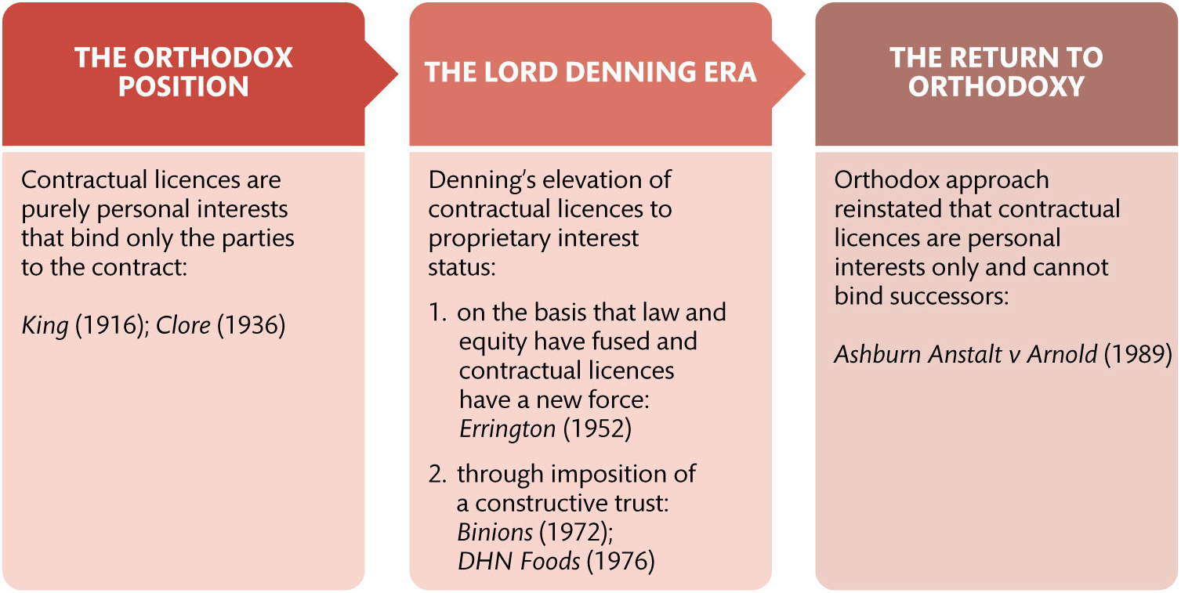
Figure 7.3 Three ‘stages’ in the status of contractual licences

Slide 6
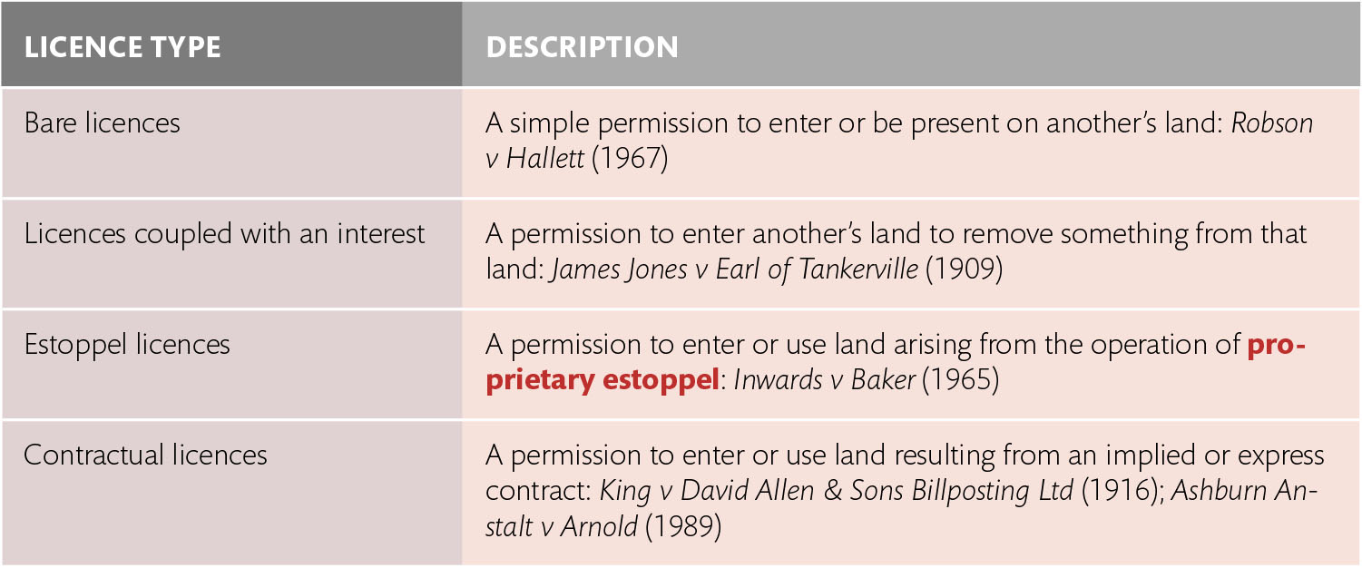
Table 7.1 The four forms of licences

