Slide 1
Land Law by Chris Bevan

Slide 2
Chapter 06 Interests in the Family Home

Slide 3
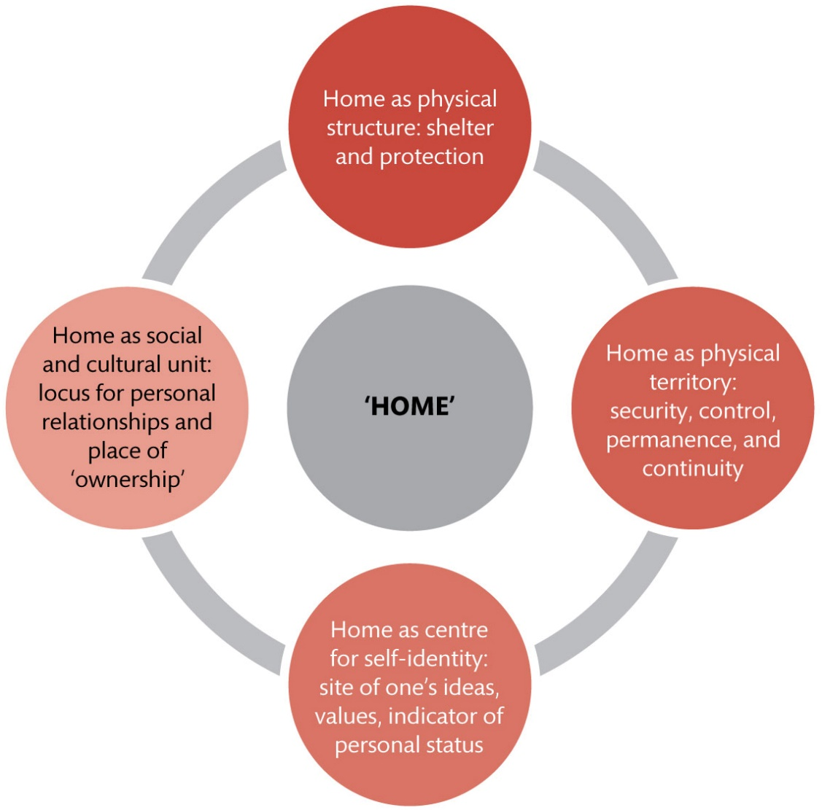
Figure 6.1 The four cluster value types to be attributed to ‘home’

Slide 4
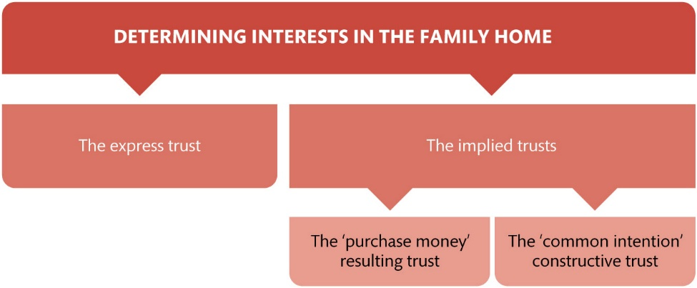
Figure 6.2 Determining interests in the family home

Slide 5
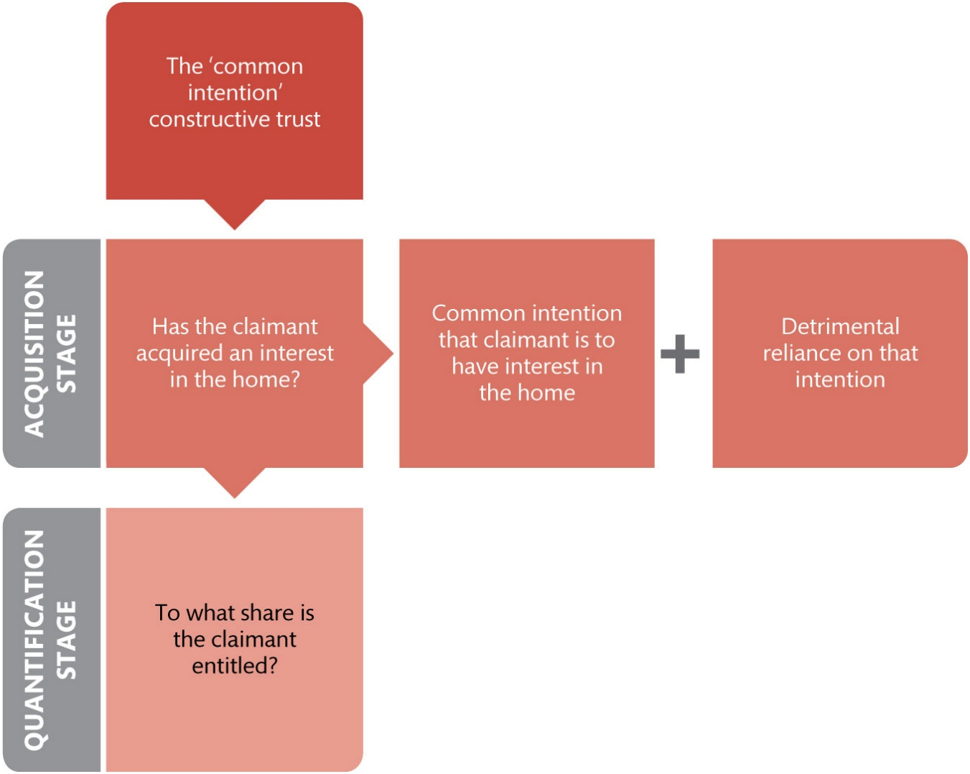
Figure 6.3 The acquisition and quantification stages

Slide 6
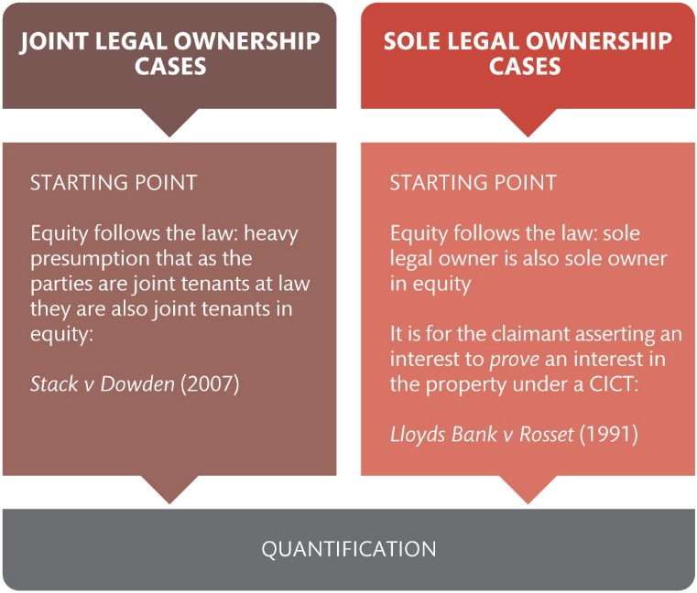
Figure 6.4 The differing ‘starting points’ in joint and sole legal ownership cases

Slide 7
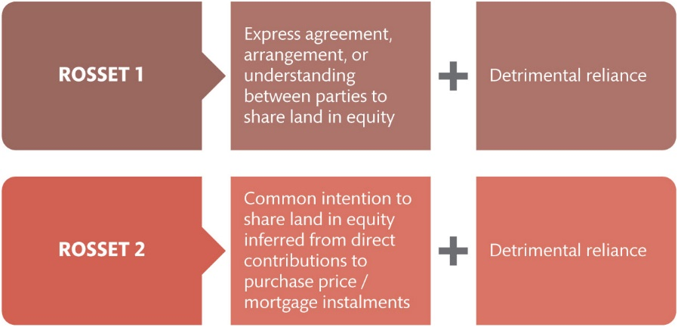
Figure 6.5 Acquiring an interest in the family home in sole ownership cases: Rosset 1 and 2

Slide 8
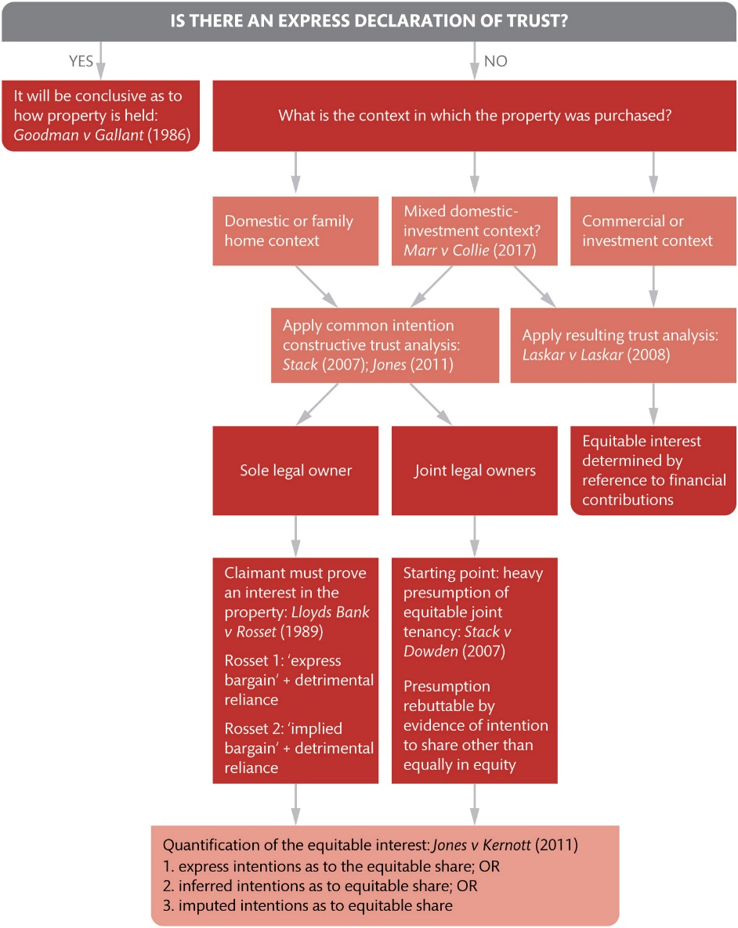
Figure 6.6 Bringing it all together: A suggested structure for analysing interests in the home

Slide 9
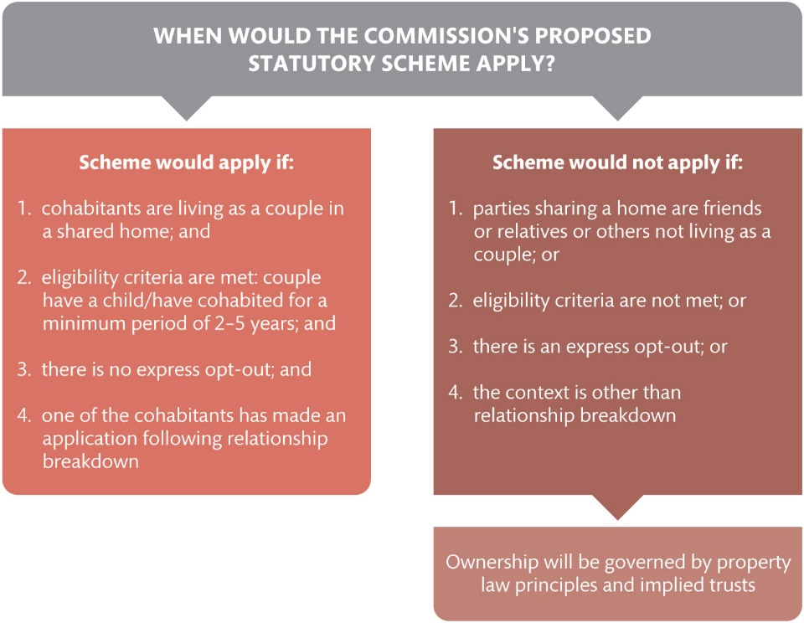
Figure 6.7 When would the Law Commission’s proposed statutory scheme apply?

Slide 10
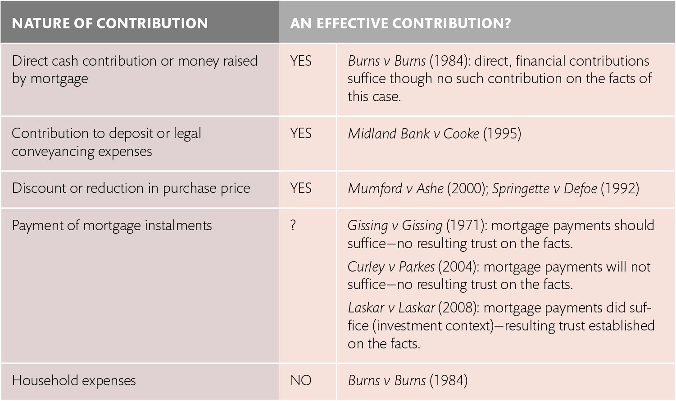
Table 6.1 Contributions giving rise to presumption of resulting trust

Slide 11
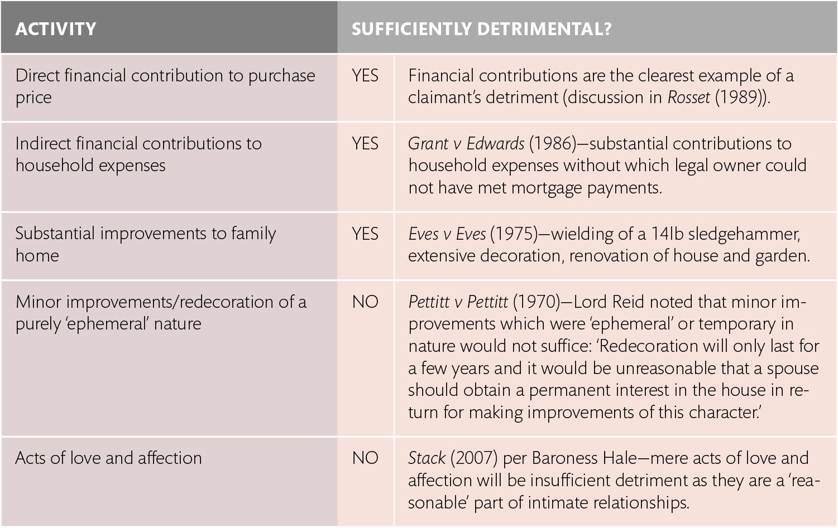
Table 6.2 What constitutes detriment?

