Slide 1
Land Law by Chris Bevan

Slide 2
Chapter 05 Co-ownership

Slide 3
Figure 5.1 Distinguishing concurrent co-ownership from successive ownership

Slide 4
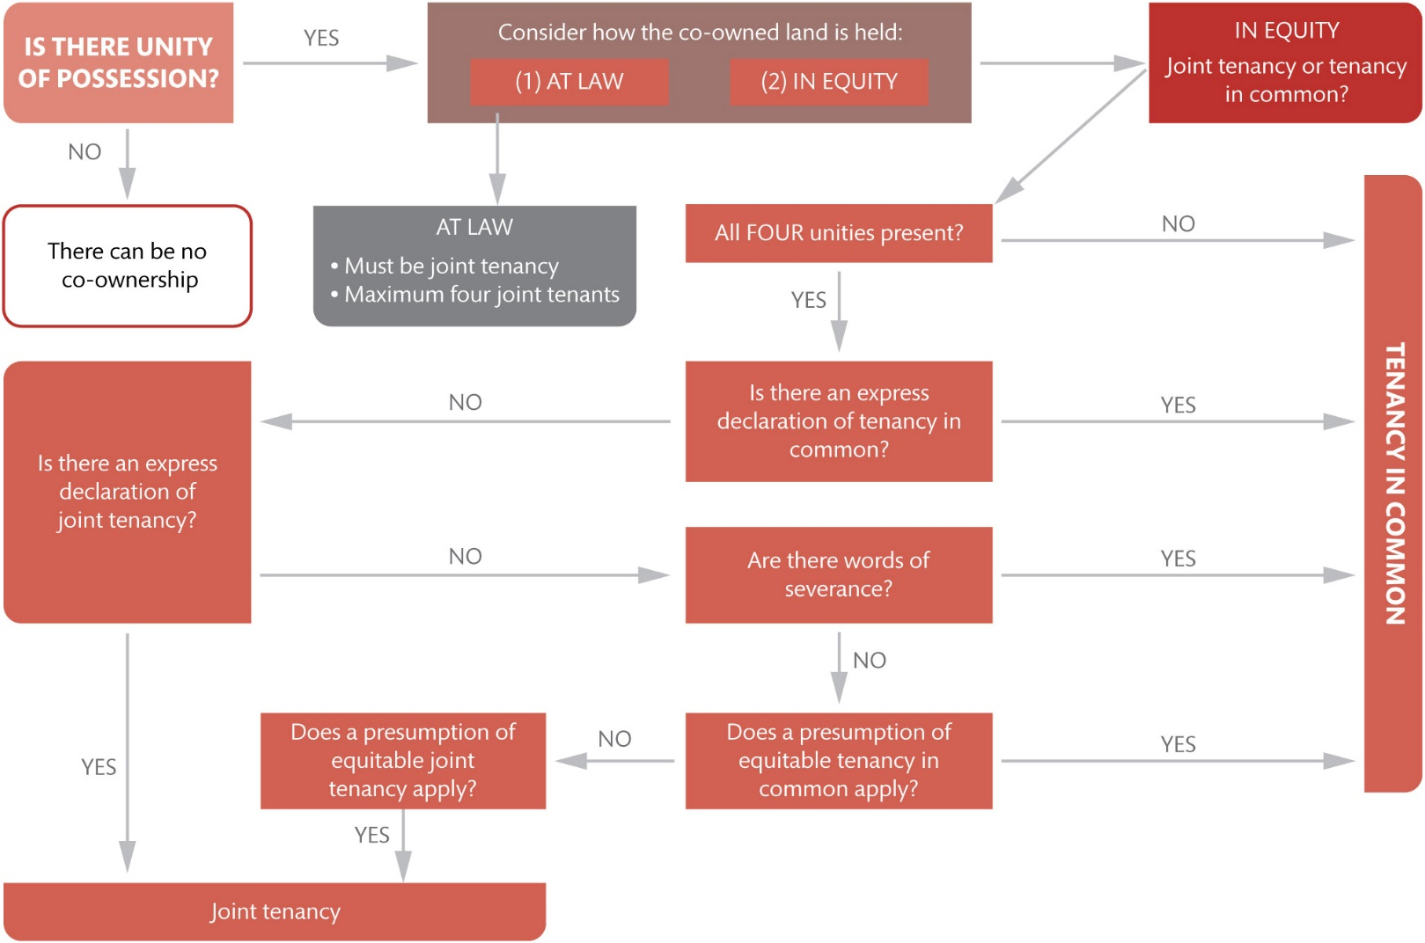
Figure 5.2 Bringing it all together: determining how co-owned land is held at law and in equity

Slide 5
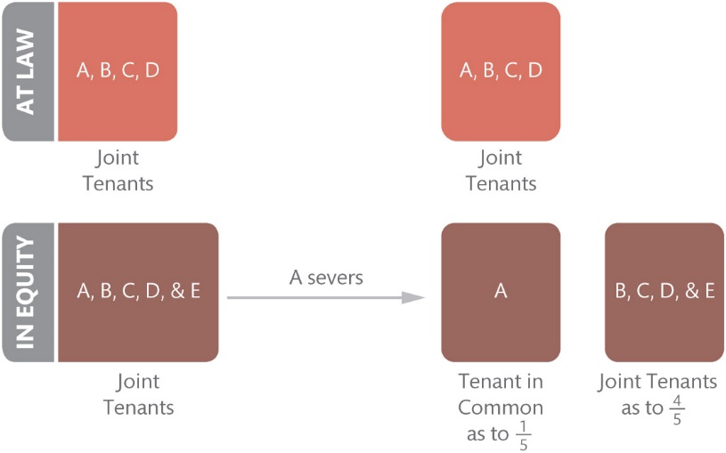
Figure 5.3 The effect of severance

Slide 6
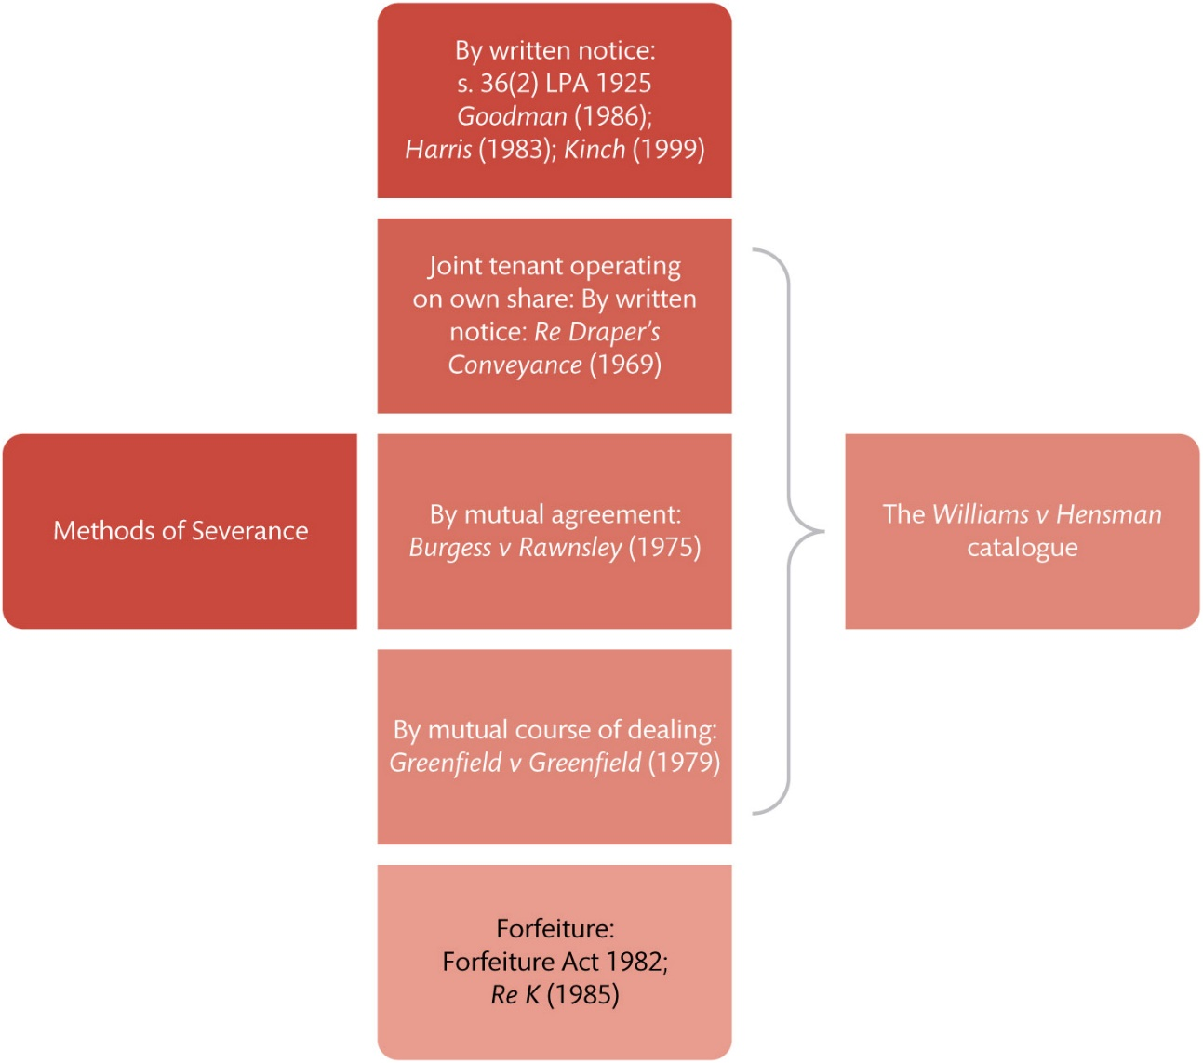
Figure 5.4 The methods of severance

Slide 7
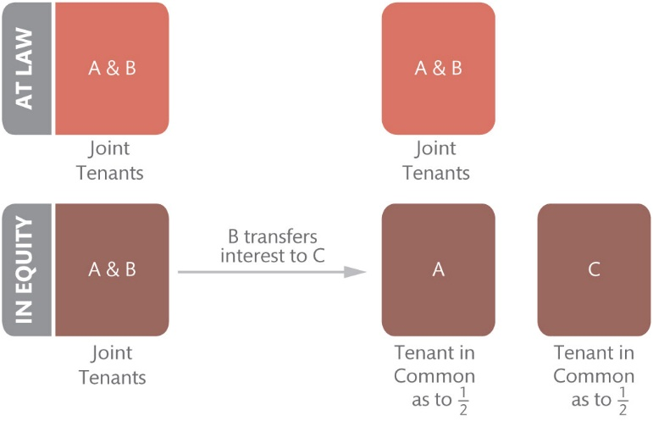
Figure 5.5 Scenario 1

Slide 8
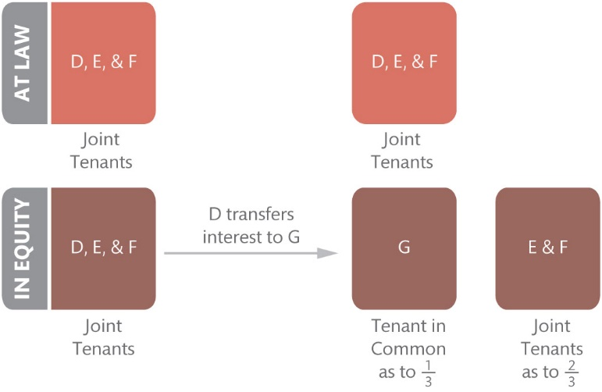
Figure 5.6 Scenario 2

Slide 9
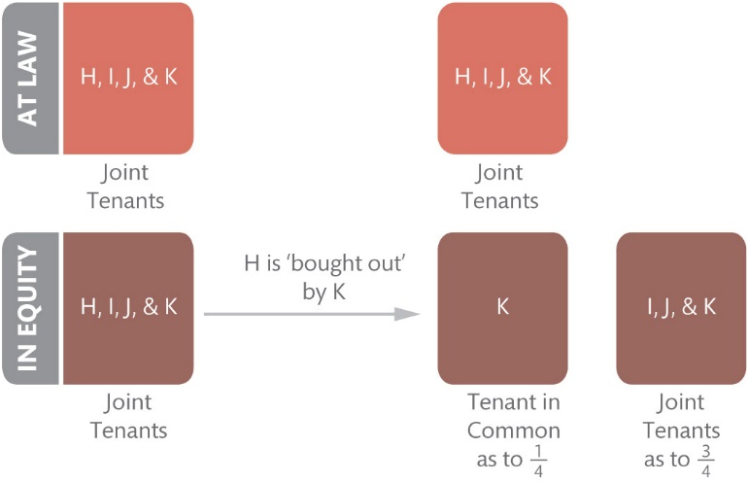
Figure 5.7 Joint tenant bought out by fellow joint tenant

Slide 10
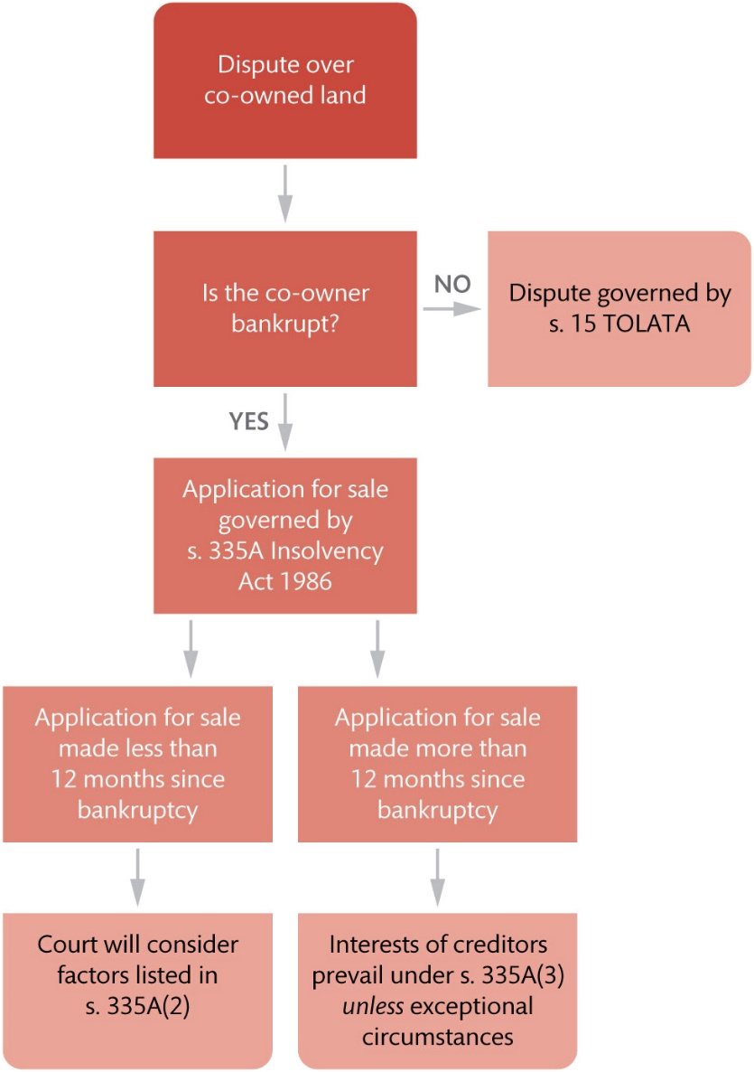
Figure 5.8 Disputes involving a bankrupt co-owner

Slide 11
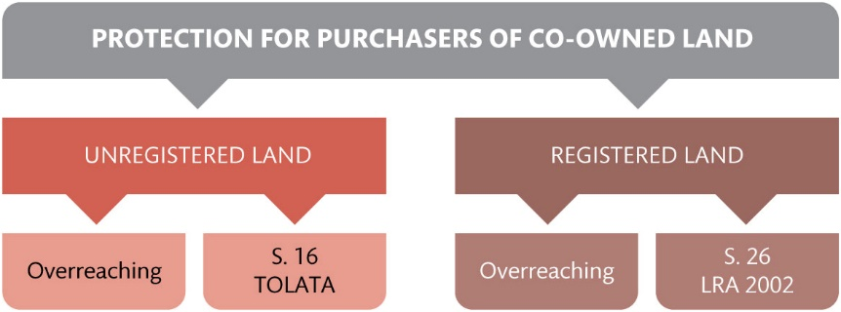
Figure 5.9 Protection for purchasers in unregistered and registered land

Slide 12
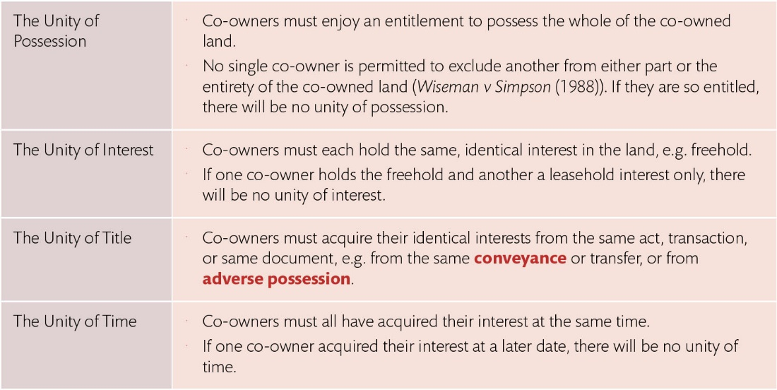
Table 5.1 The four unities

Slide 13
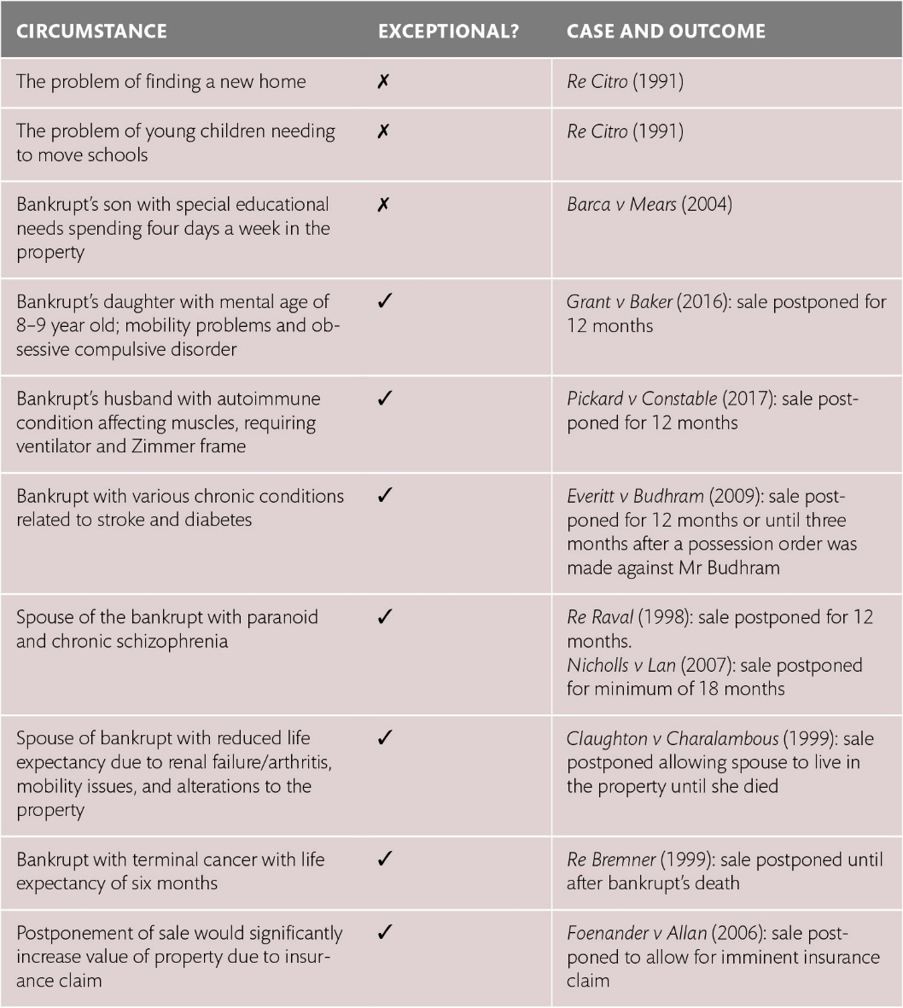
Table 5.2 What amounts to ‘exceptional circumstances’?

