Slide 1
Land Law by Chris Bevan

Slide 2
Chapter 04 Adverse Possession

Slide 3
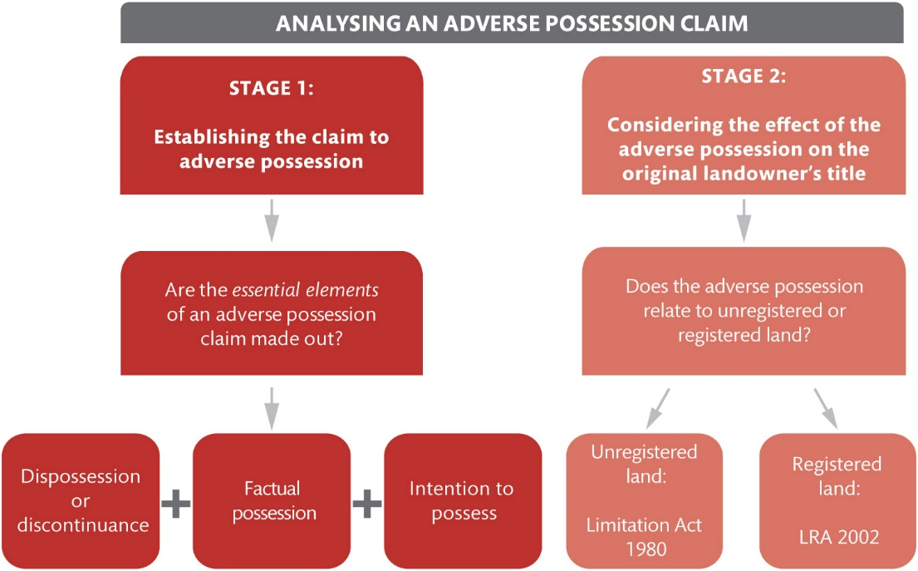
Figure 4.1 The two stages for analysing a claim to adverse possession

Slide 4
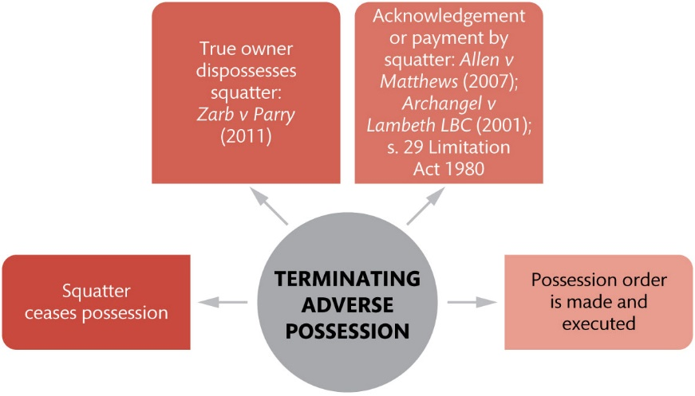
Figure 4.2 Methods for terminating or interrupting a period of adverse possession

Slide 5
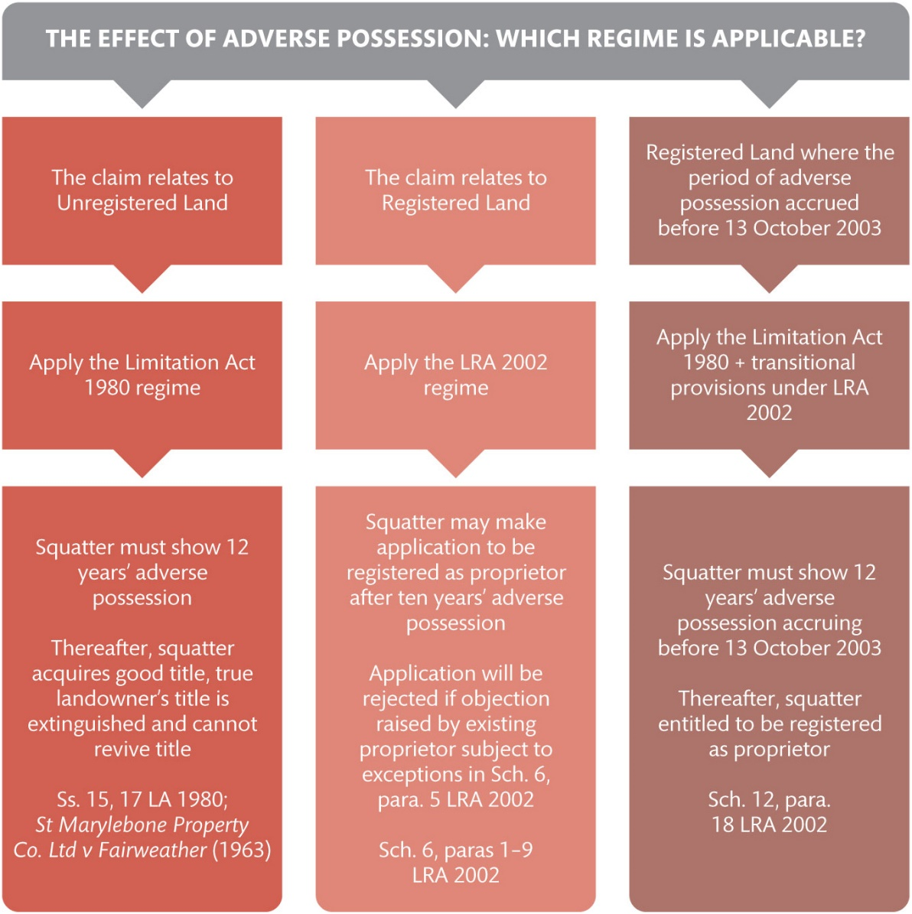
Figure 4.3 The effect of adverse possession: the different regimes

Slide 6
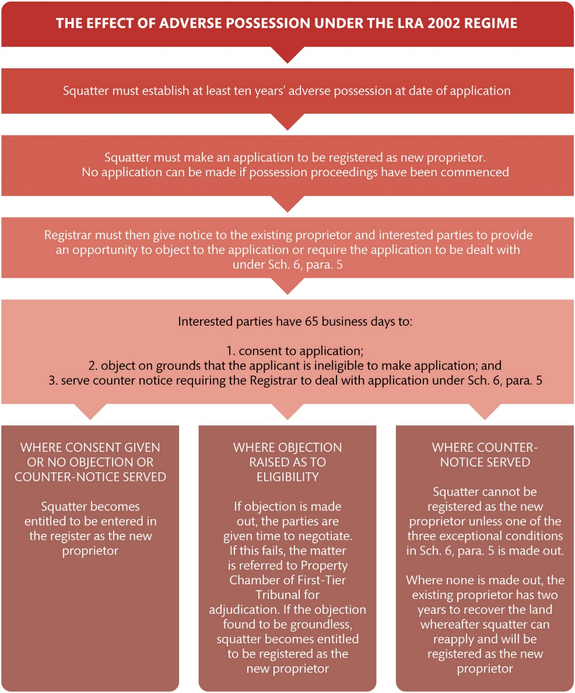
Figure 4.4 The new regime under Sch. 6 to the LRA 2002

Slide 7
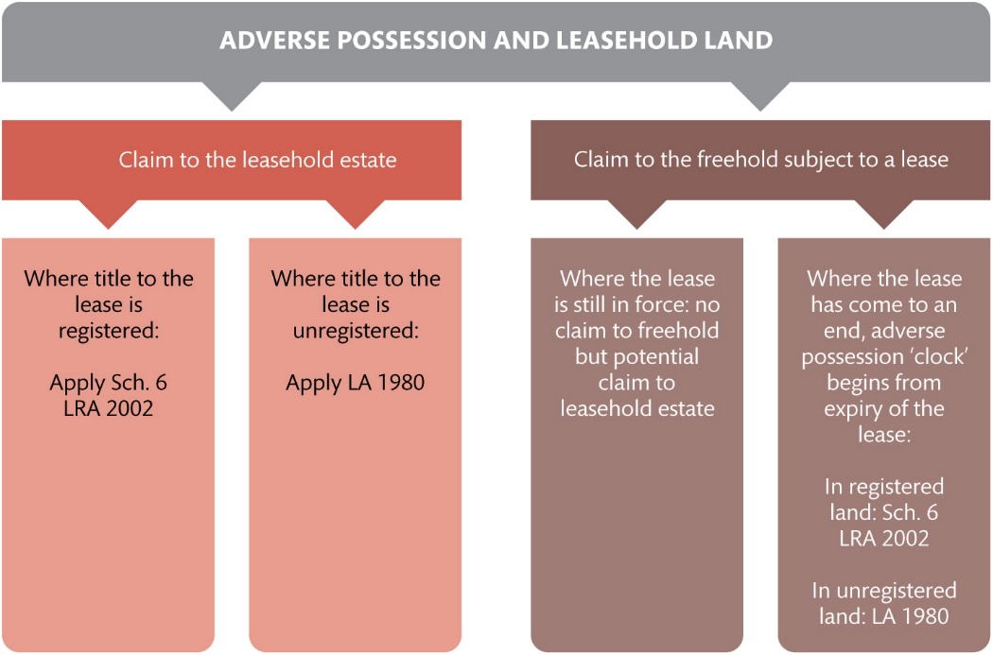
Figure 4.5 Claims to adverse possession concerning leasehold land

Slide 8
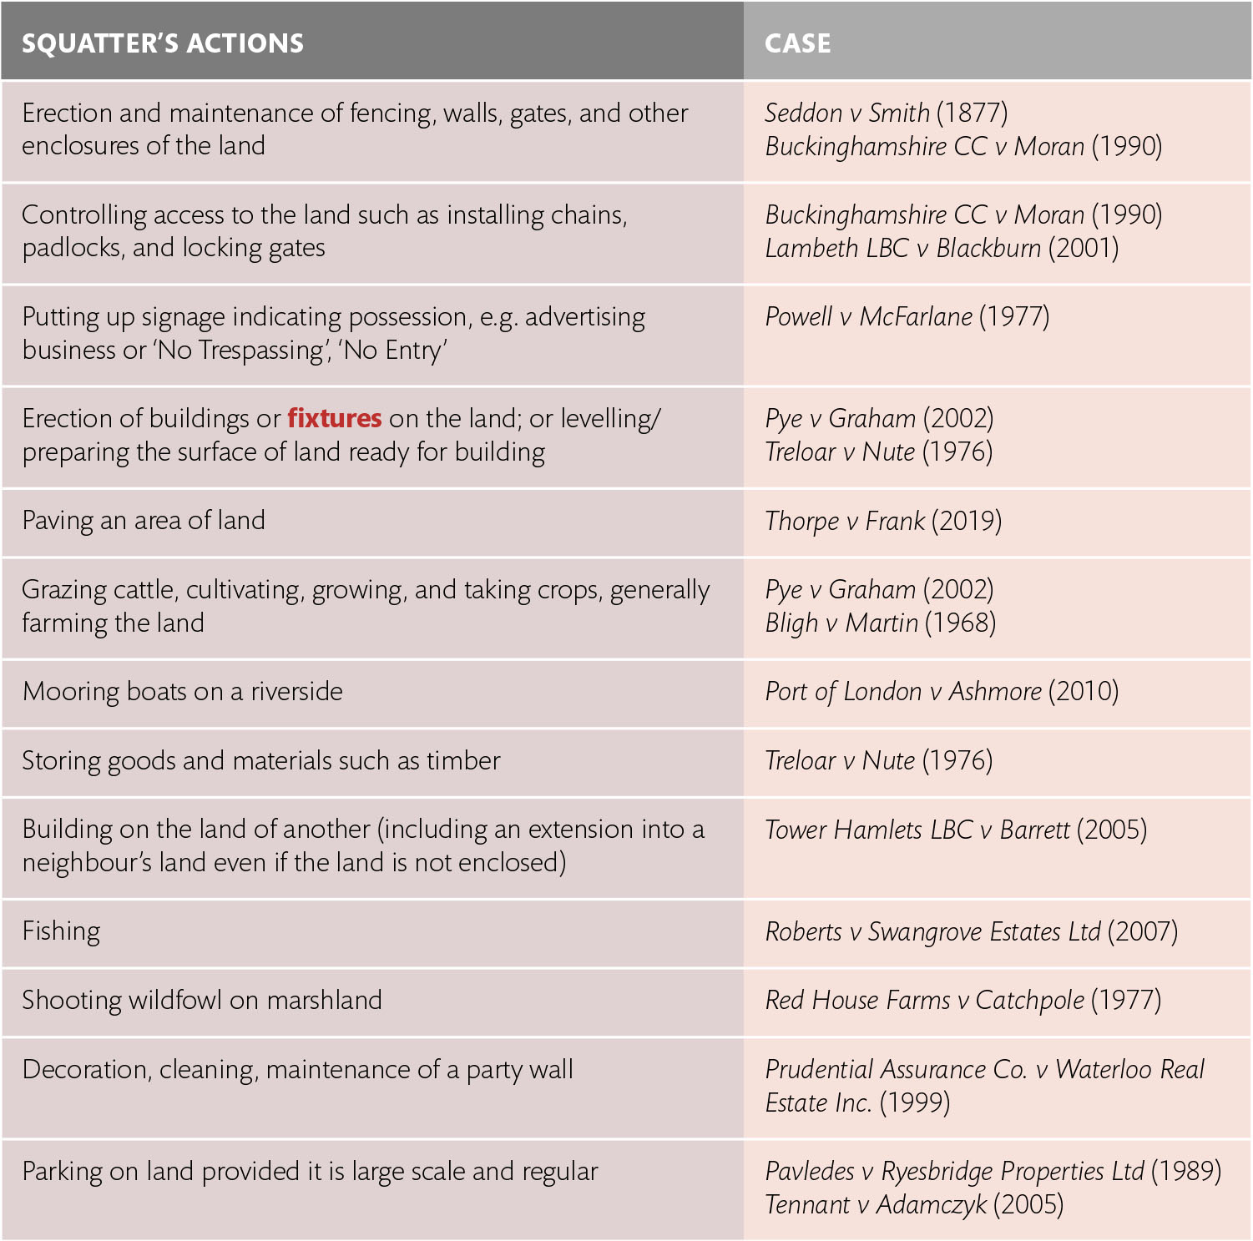
Table 4.1 Common examples of factual possession

