Slide 1
Land Law by Chris Bevan

Slide 2
Chapter 03 Unregistered Land

Slide 3
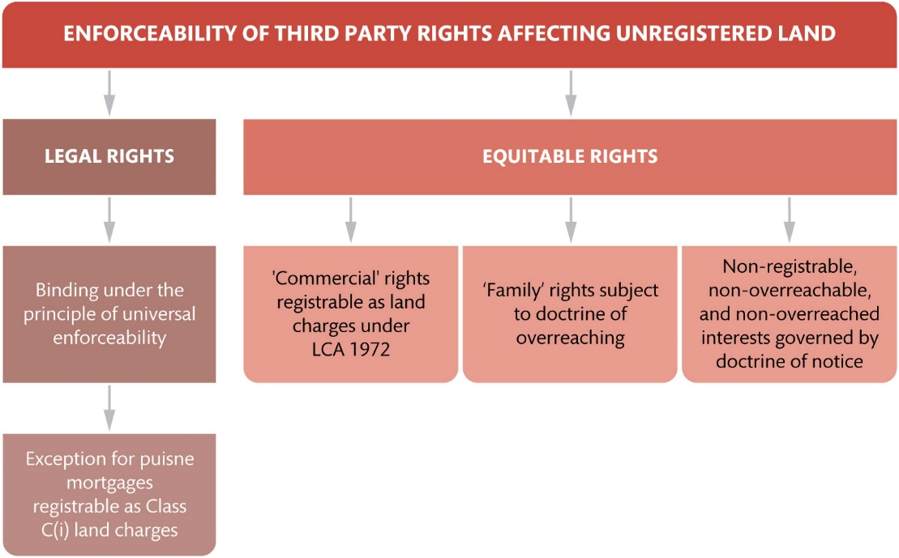
Figure 3.1 Enforceability of third party rights in unregistered land

Slide 4
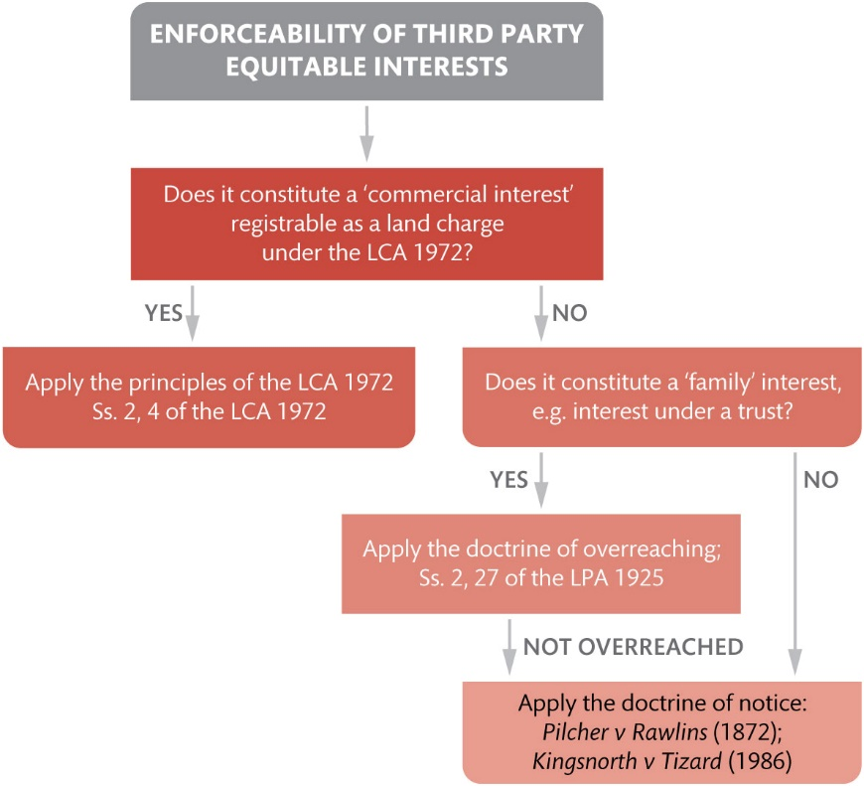
Figure 3.2 Enforceability of equitable rights in unregistered land

Slide 5
Figure 3.3 The four constituent elements of the doctrine of notice

Slide 6
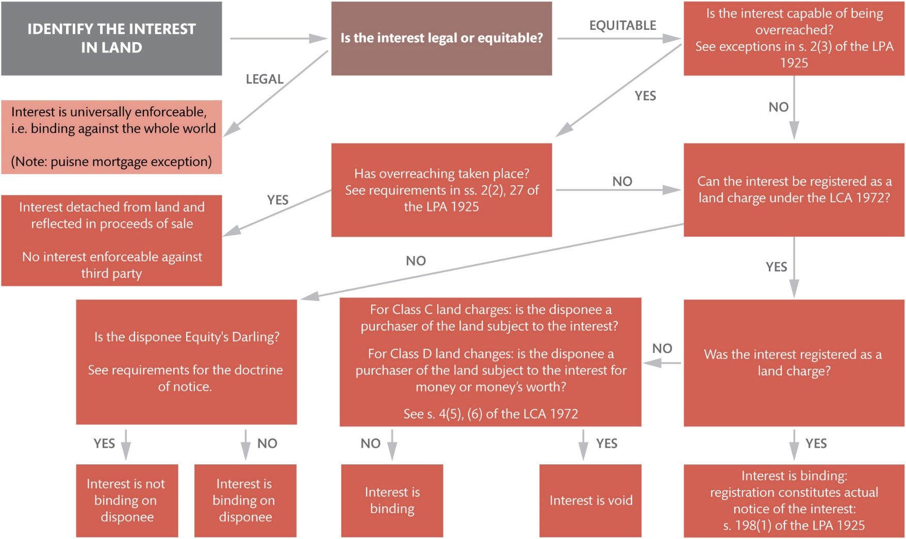
Figure 3.4 Bringing it all together: priority of interests in unregistered land

Slide 7
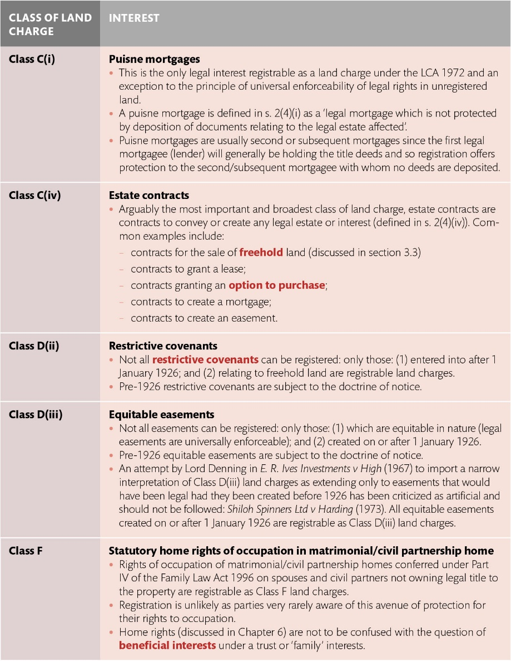
Table 3.1 Classes C, D, and F land charges under s. 2 of the LCA 1972

