Slide 1
Land Law by Chris Bevan

Slide 2
Chapter 02 Registered Land

Slide 3
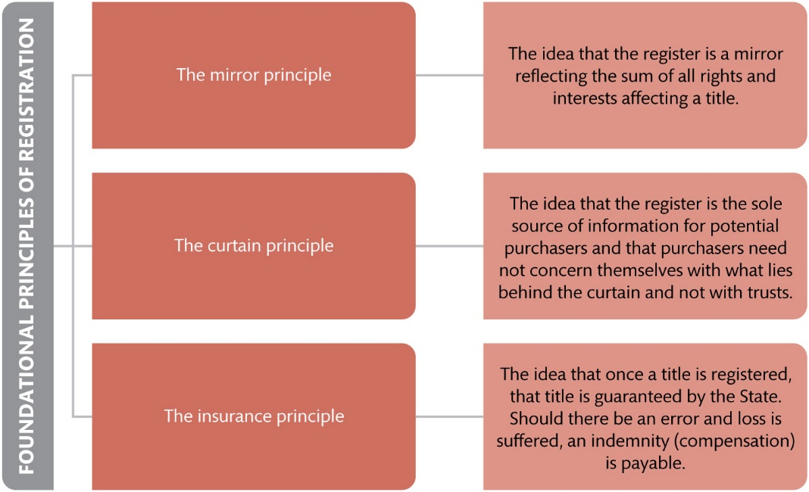
Figure 2.1 Ruoff’s three foundational principles of a system of registered title

Slide 4
Figure 2.2 The four-group categorization of proprietary rights under the LRA 2002

Slide 5
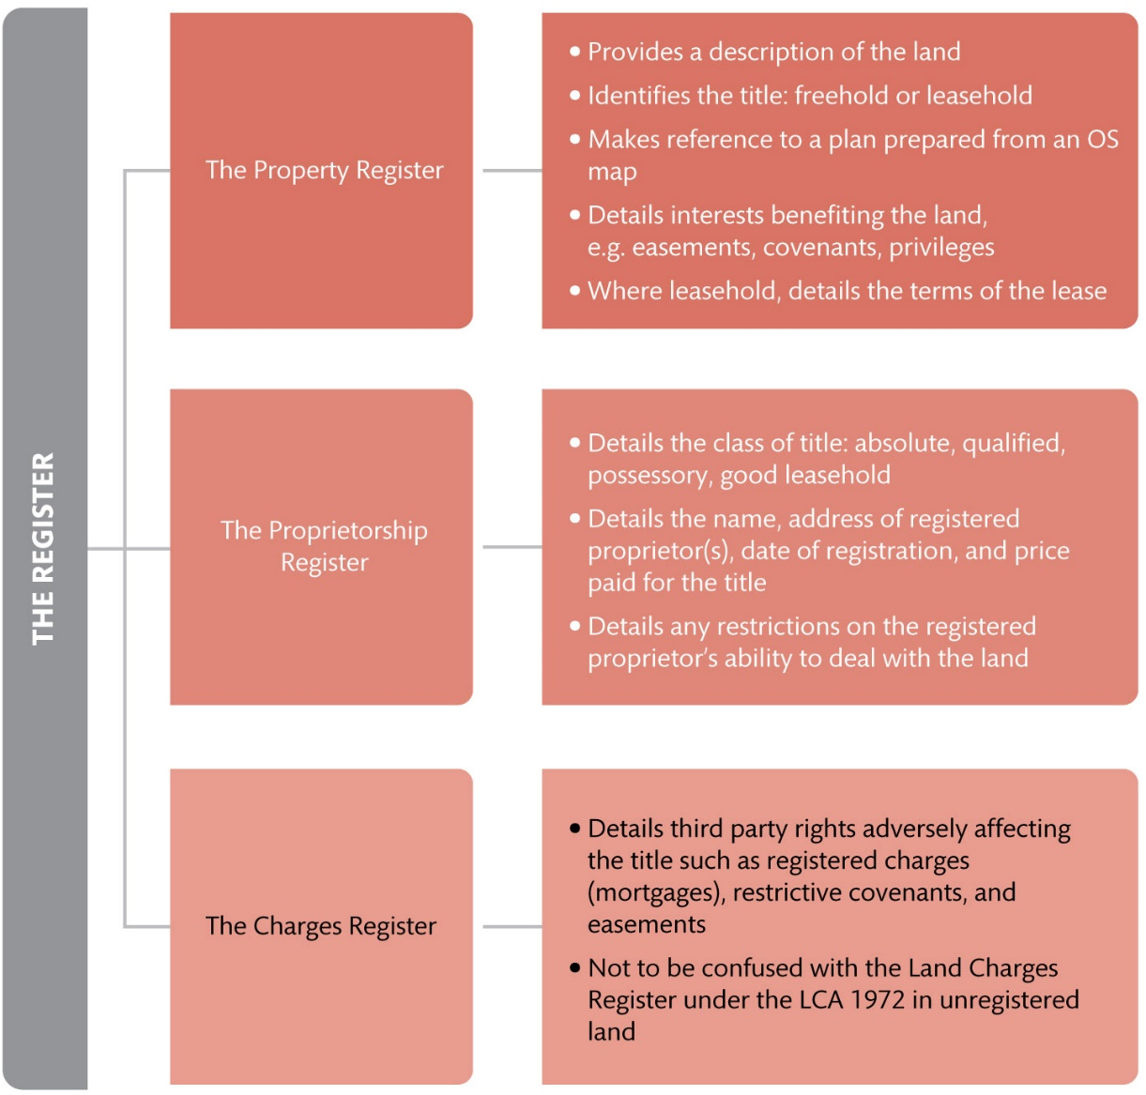
Figure 2.3 Details of the register held by Land Registry

Slide 6
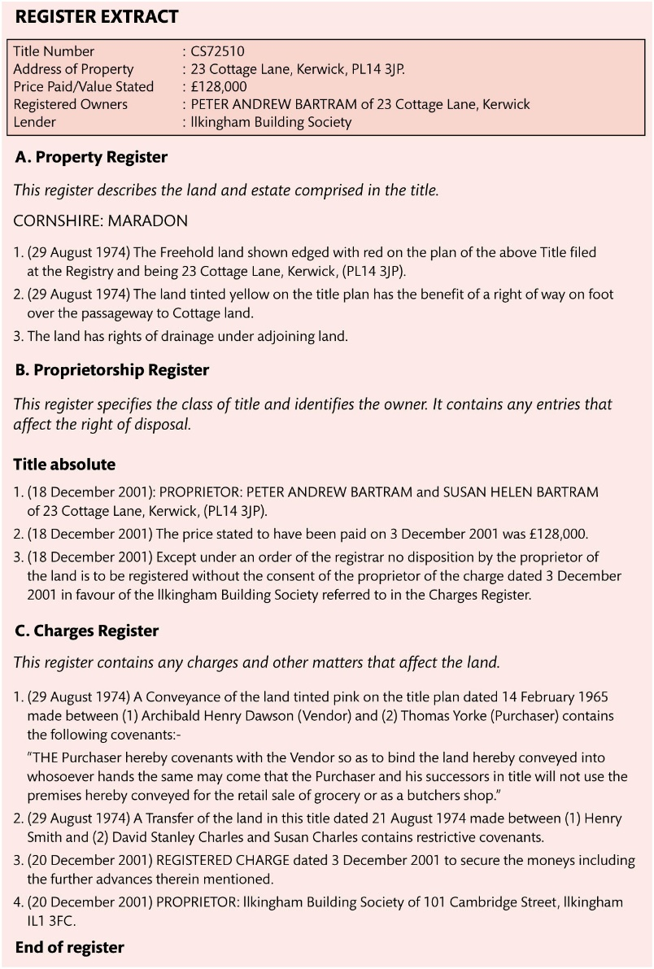
Figure 2.4 Sample register

Slide 7
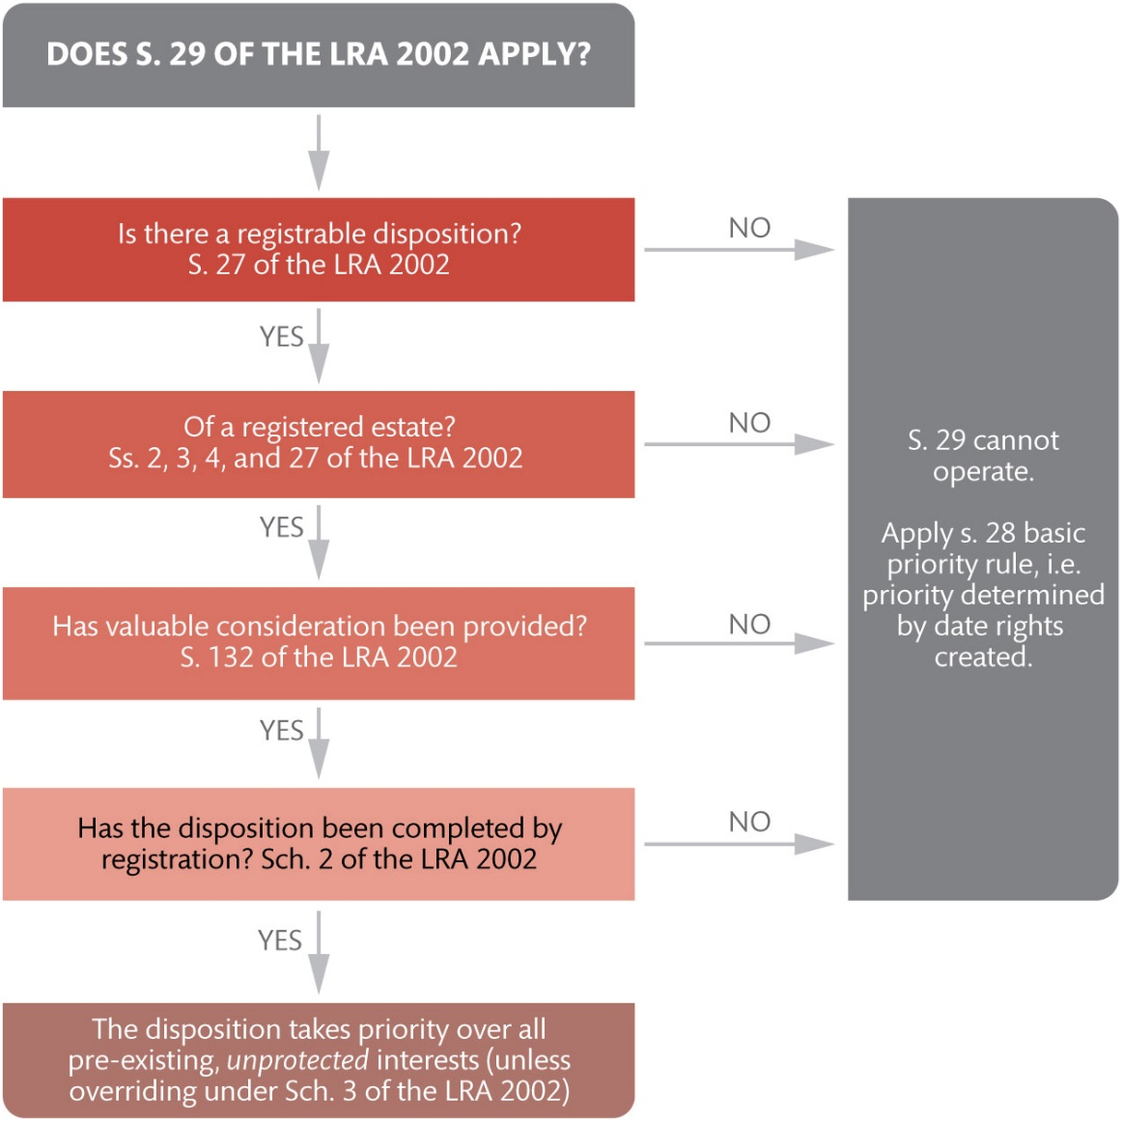
Figure 2.5 The operation of s. 29 of the LRA 2002

Slide 8
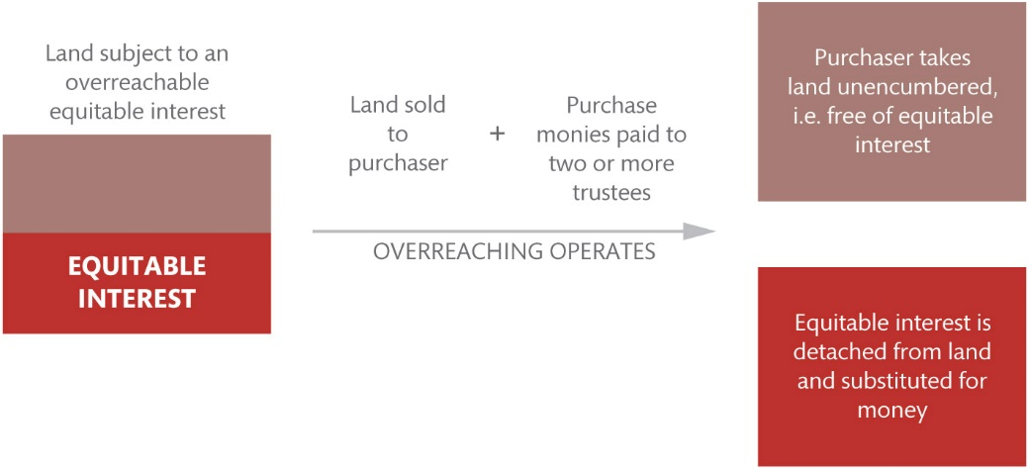
Figure 2.6 How overreaching works

Slide 9
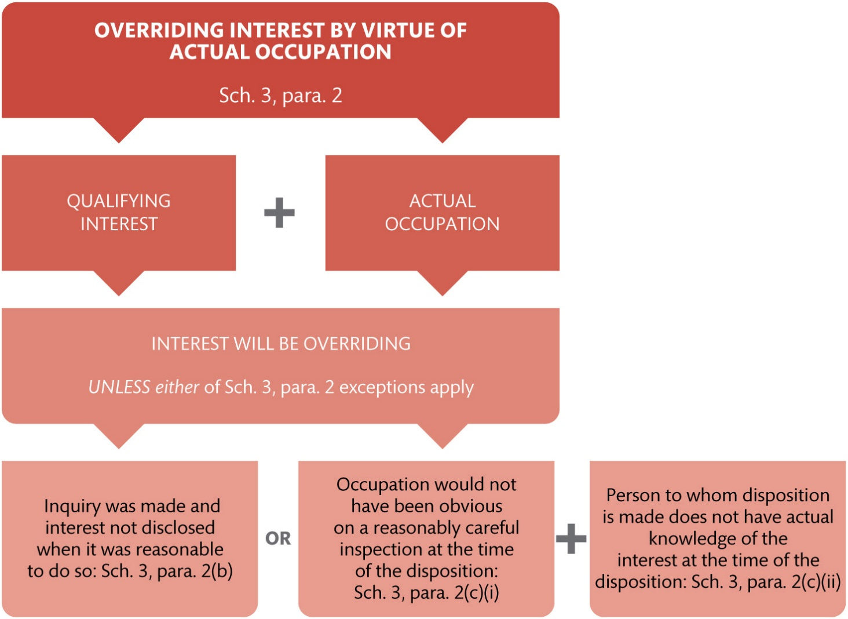
Figure 2.7 Establishing an overriding interest by virtue of actual occupation under Sch. 3, para. 2.

Slide 10
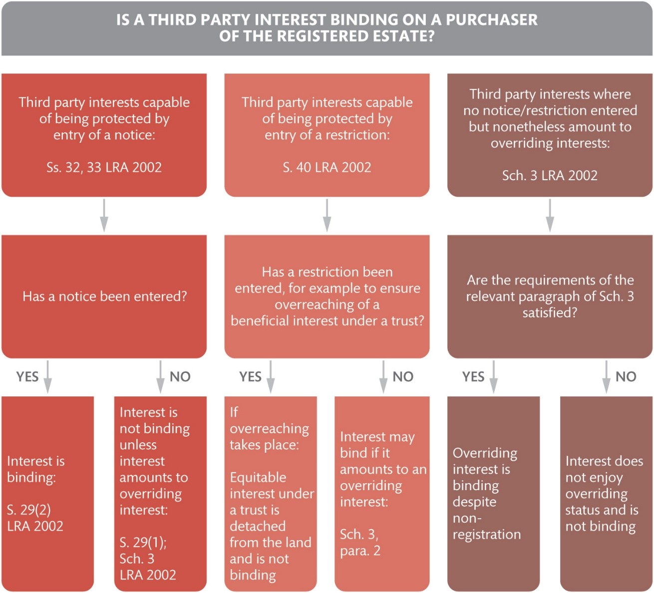
Figure 2.8 The priority of third party rights in registered land

Slide 11
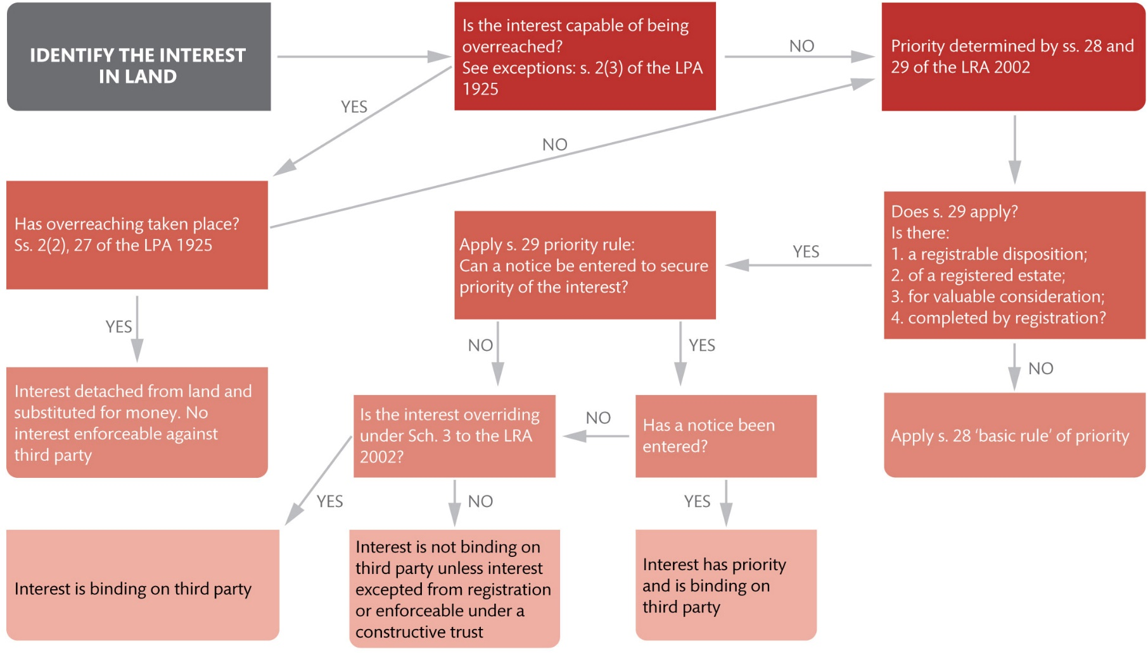
Figure 2.9 Bringing it all together: determining priority in registered land

Slide 12
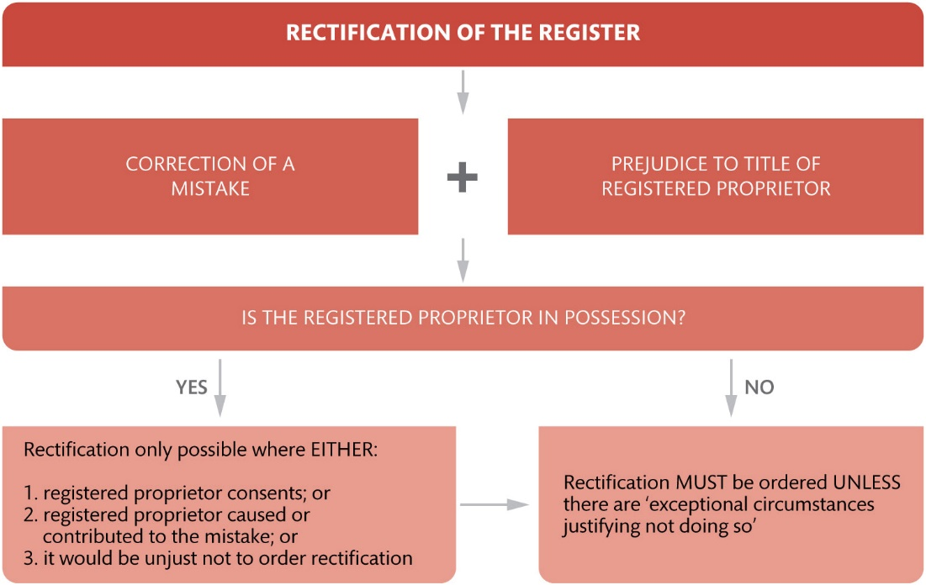
Figure 2.10 When rectification will be ordered under Sch. 4

Slide 13
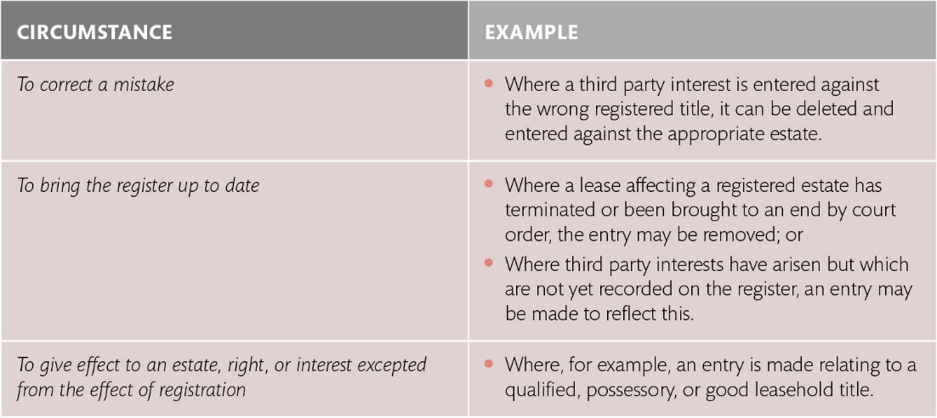
Table 2.1 Administrative alterations to the register

Slide 14
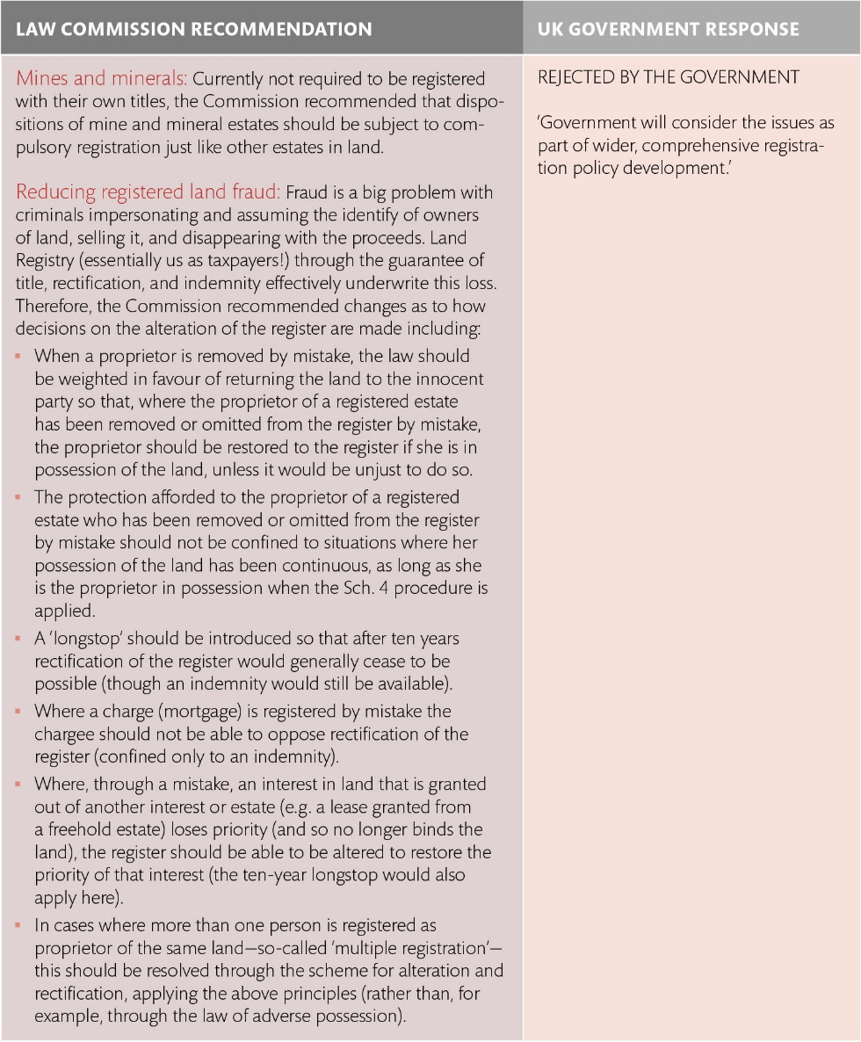
Table 2.2 Law Commission recommendations for reform and UK government response

Slide 15
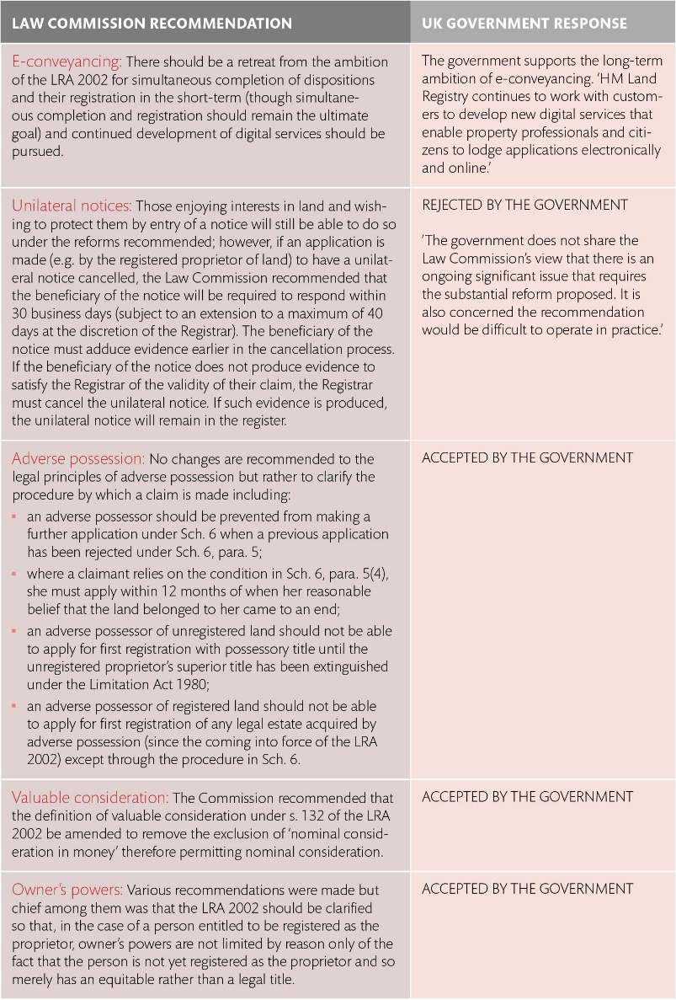
Table 2.2 (Continued)

Slide 16
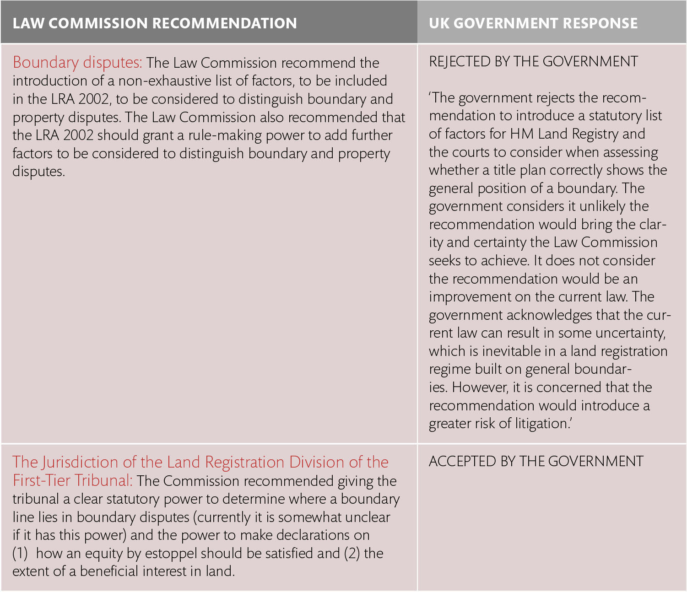
Table 2.2 (Continued)

