Slide 1
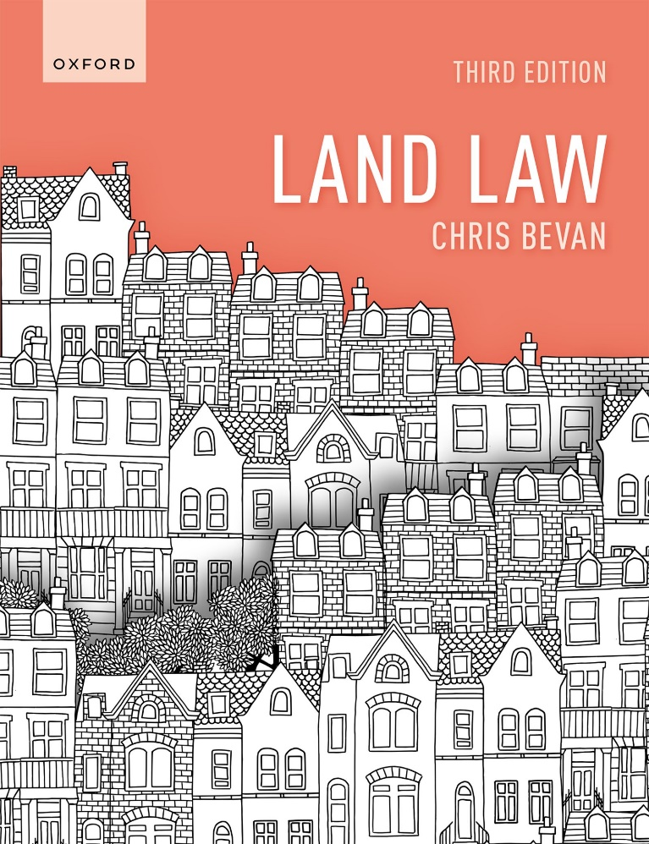
Land Law by Chris Bevan

Slide 2
Chapter 01 Introduction to Land Law

Slide 3
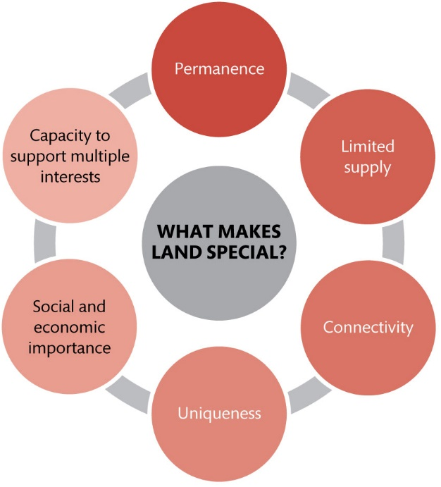
Figure 1.1 The features that make land special

Slide 4
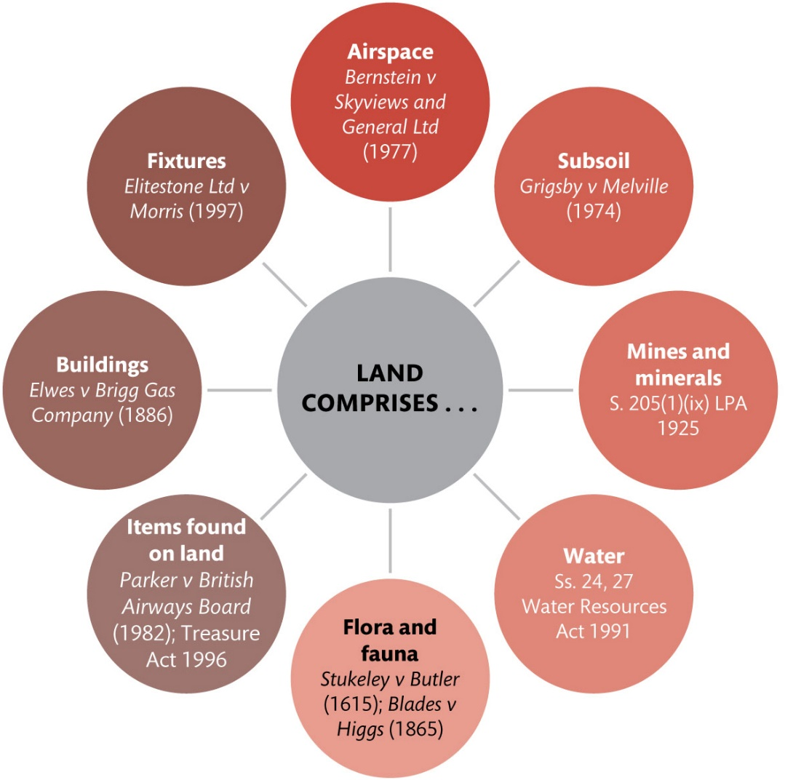
Figure 1.2 The expansive meaning of land

Slide 5
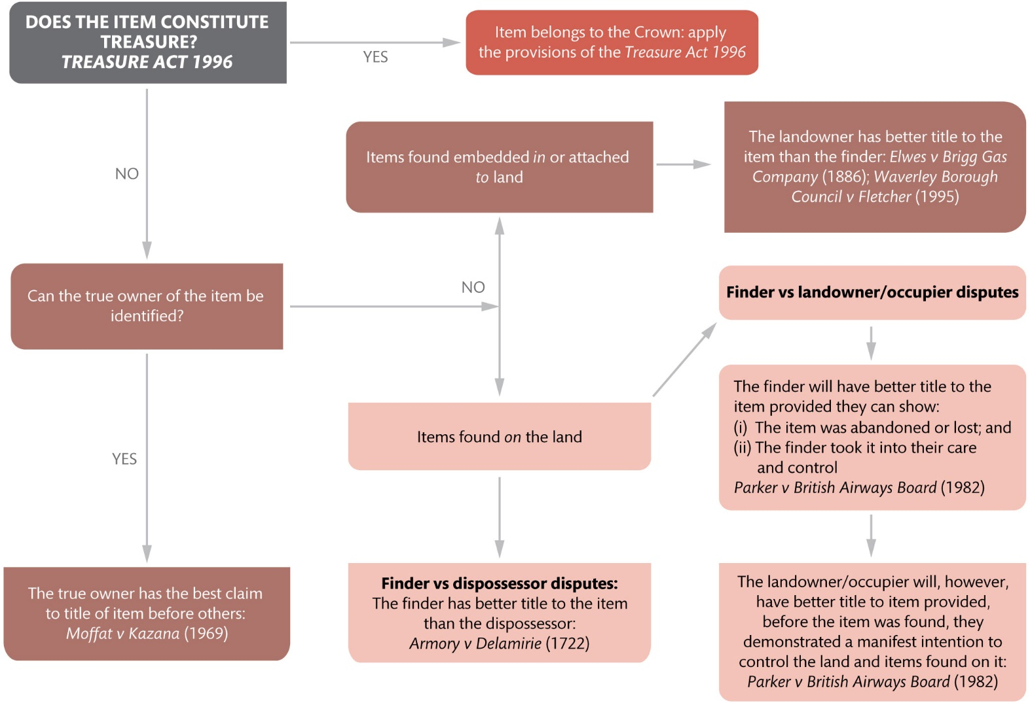
Figure 1.3 Items found in or on land

Slide 6
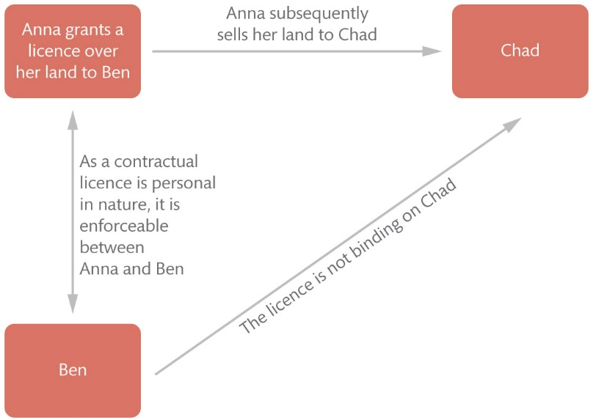
Figure 1.4 The nature of personal rights in land

Slide 7
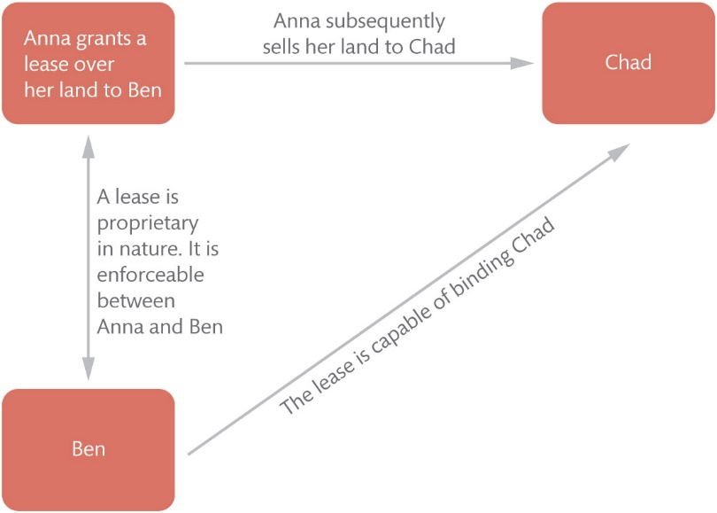
Figure 1.5 The nature of proprietary rights in land

Slide 8
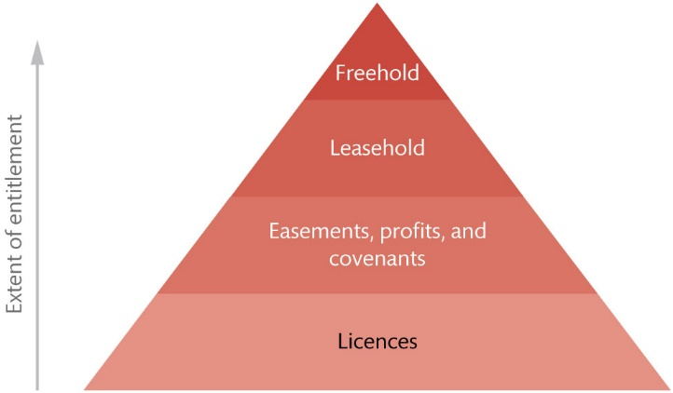
Figure 1.6 Hierarchy of rights in and over land

Slide 9
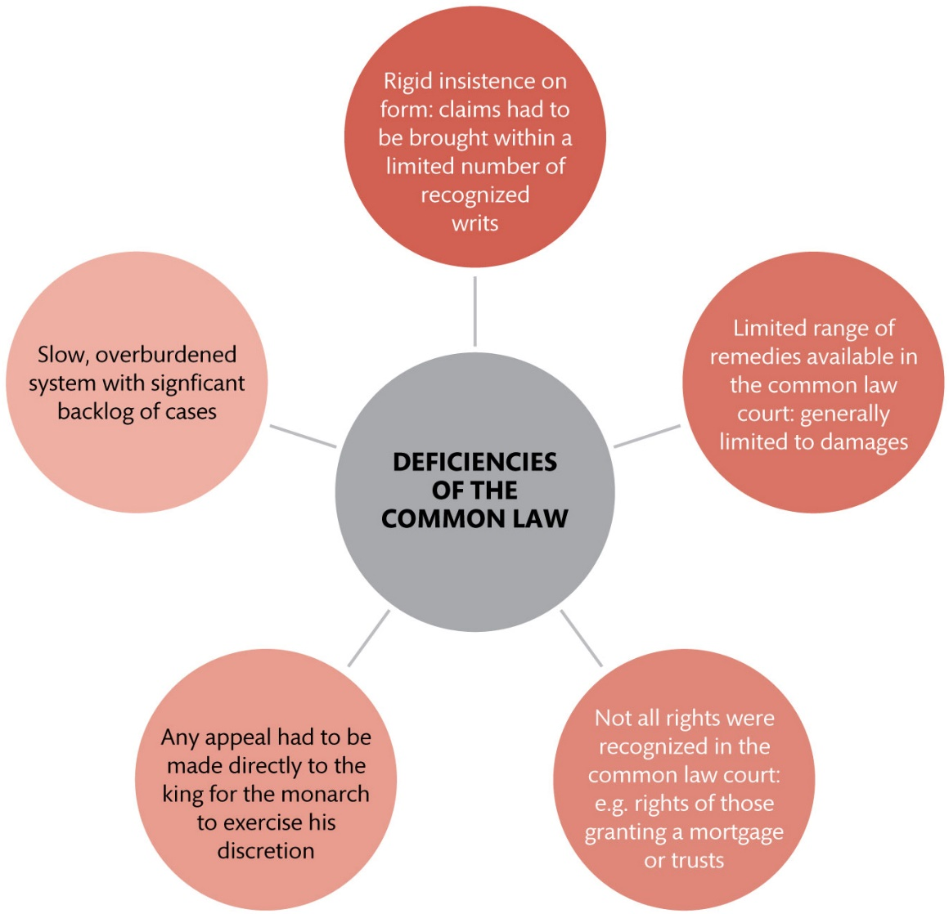
Figure 1.7 Deficiencies of the common law system

Slide 10
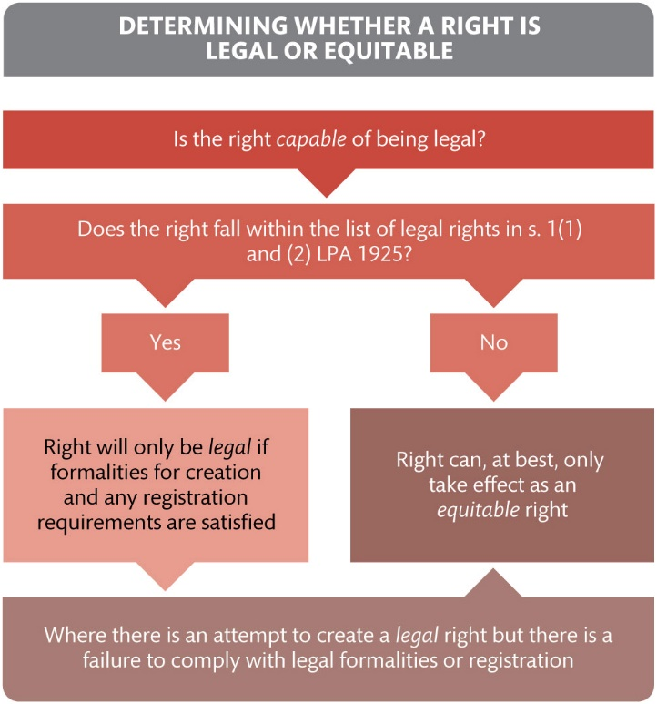
Figure 1.8 Determining whether a right is legal or equitable

Slide 11
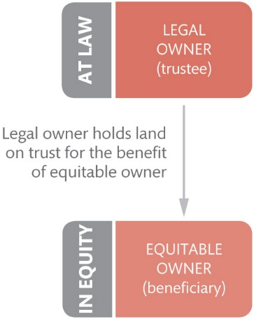
Figure 1.9 The basic idea of the ‘trust of land’

Slide 12
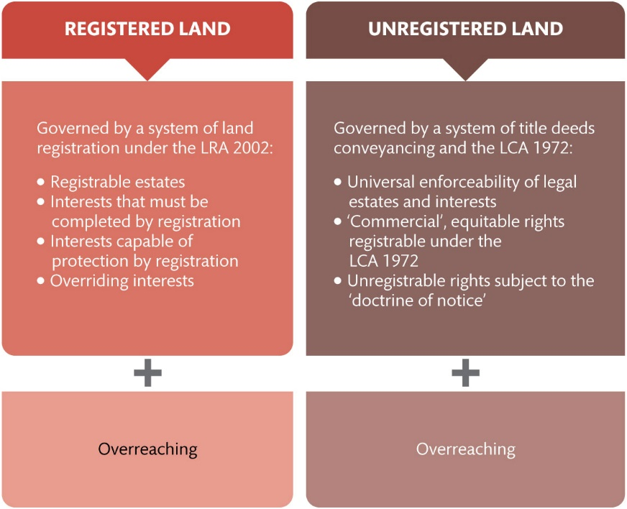
Figure 1.10 Registered and unregistered land

Slide 13
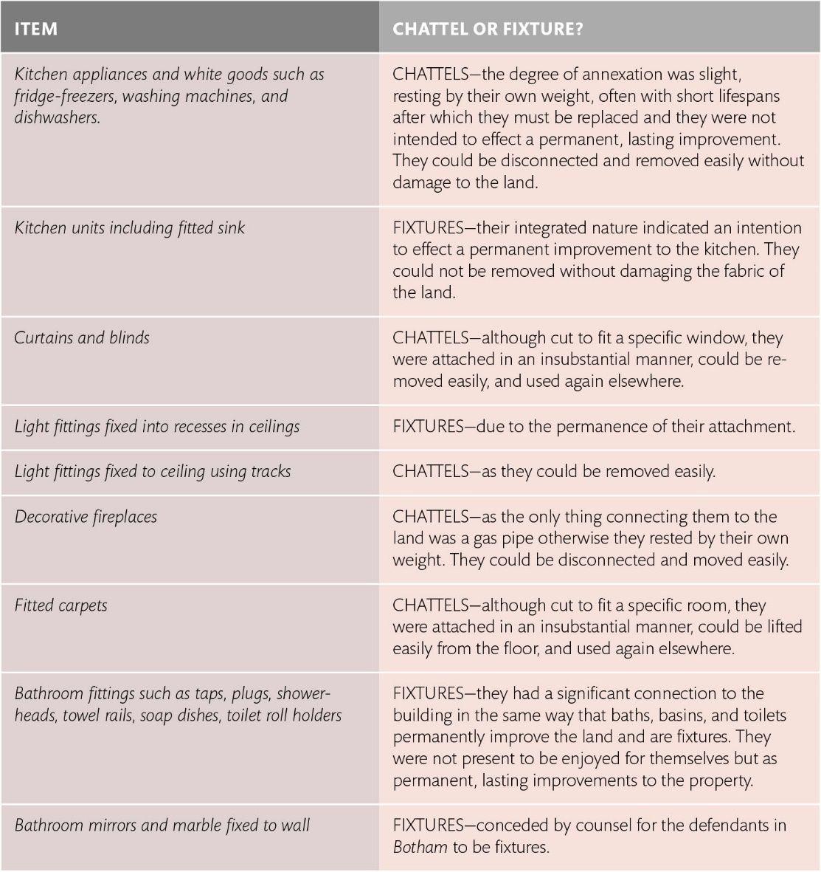
Table 1.1 The classification of everyday household items in Botham: Chattel or fixture?

Slide 14
Table 1.2 The categories of rights in land capable of being legal and equitable

