Slide 1
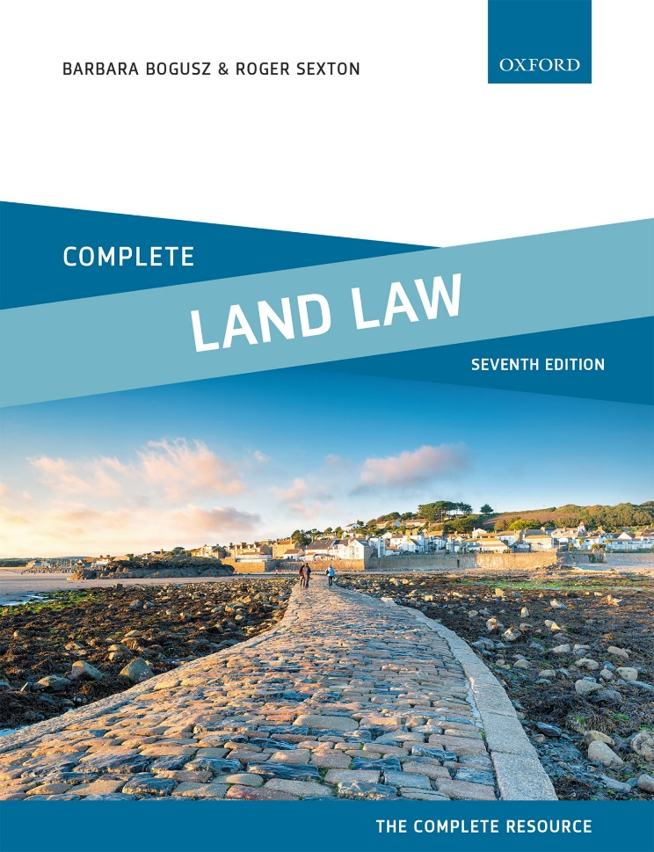
COMPLETE LAND LAW
Text, Cases, and Materials by Barbara Bogusz and Roger Sexton

Slide 2
Part 1
Introduction: Estates and Interests In Land
Chapter 03
Creation of Legal and Equitable Rights in Land

Slide 3
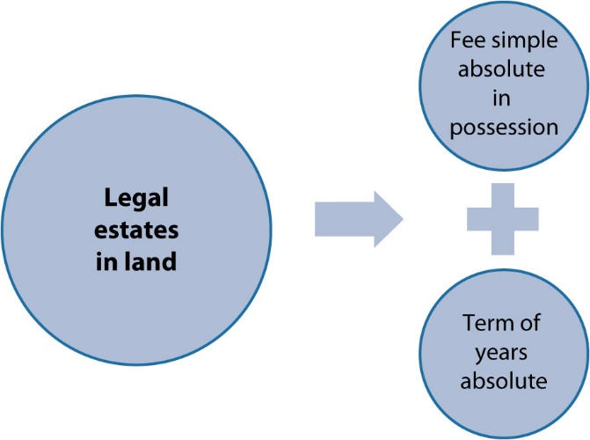
Diagram 3.1 Legal estates in land after 1925

Slide 4
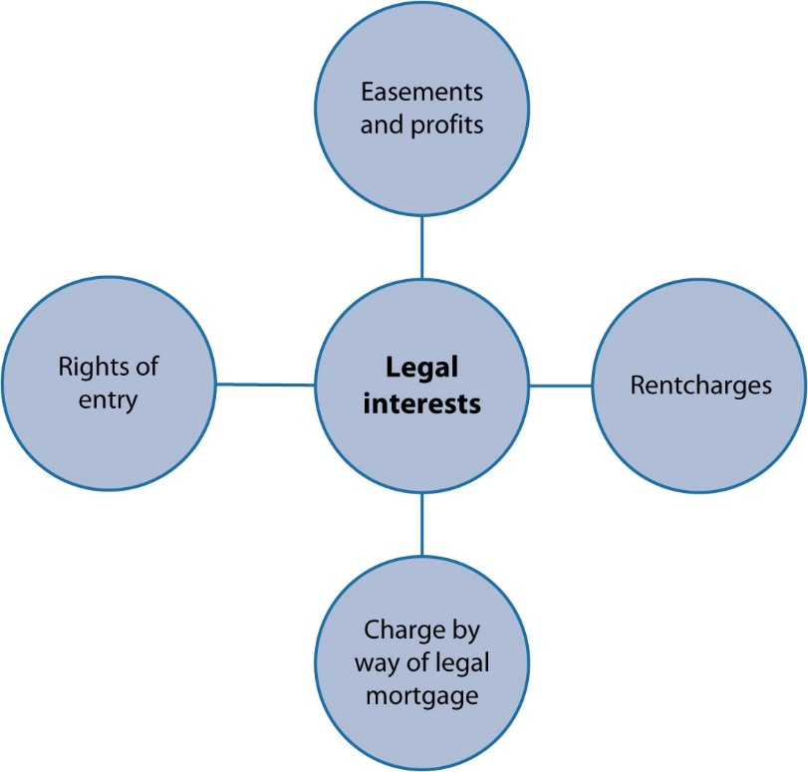
Diagram 3.2 interests capable of being legal

Slide 5
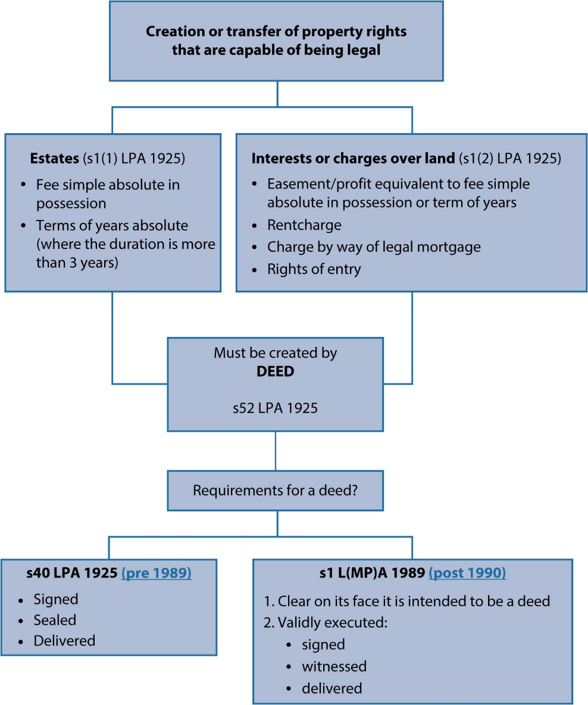
Diagram 3.3 Creation or transfer of legal property rights

Slide 6
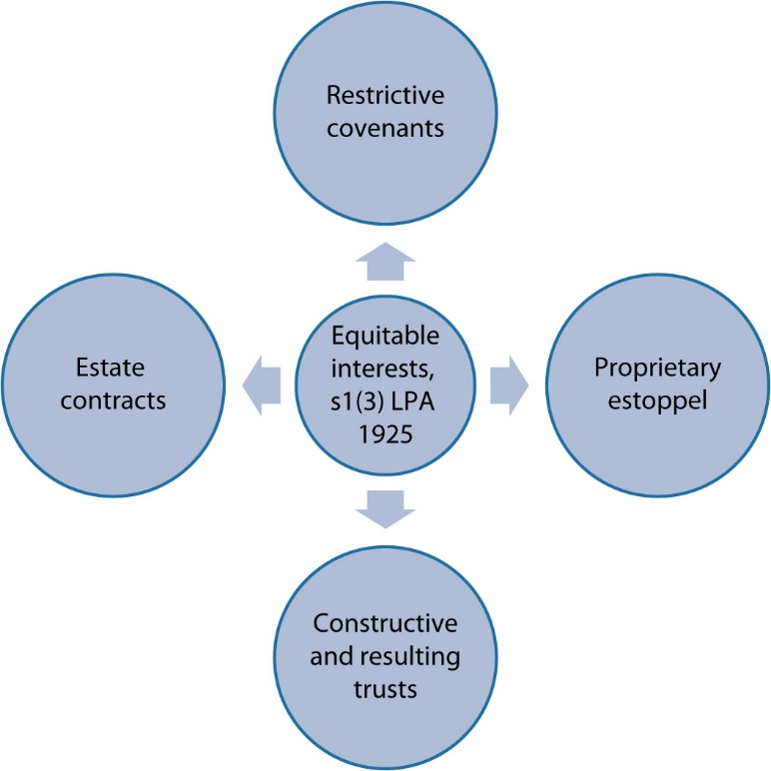
Diagram 3.4 Equitable interests: there is no legal equivalent

Slide 7
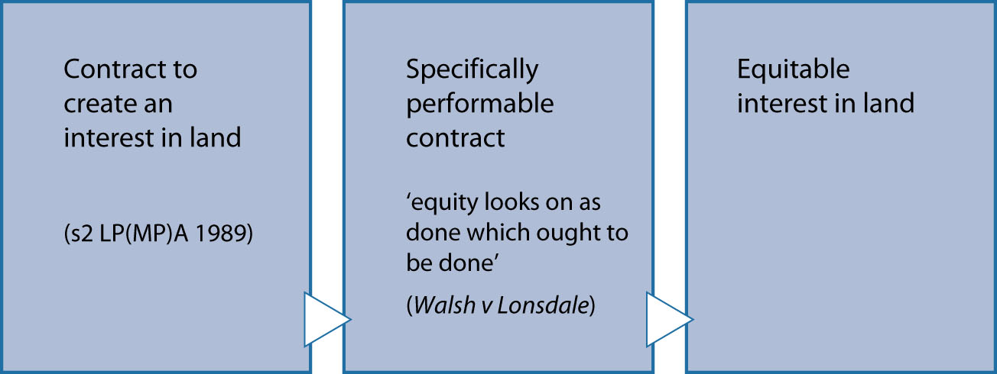
Diagram 3.5 Contract to create rights in land can be an equitable interest

