Slide 1

An Introduction to Behavioral Endocrinology, Sixth Edition
by Randy J. Nelson and Lance J. Kriegsfeld

Slide 2
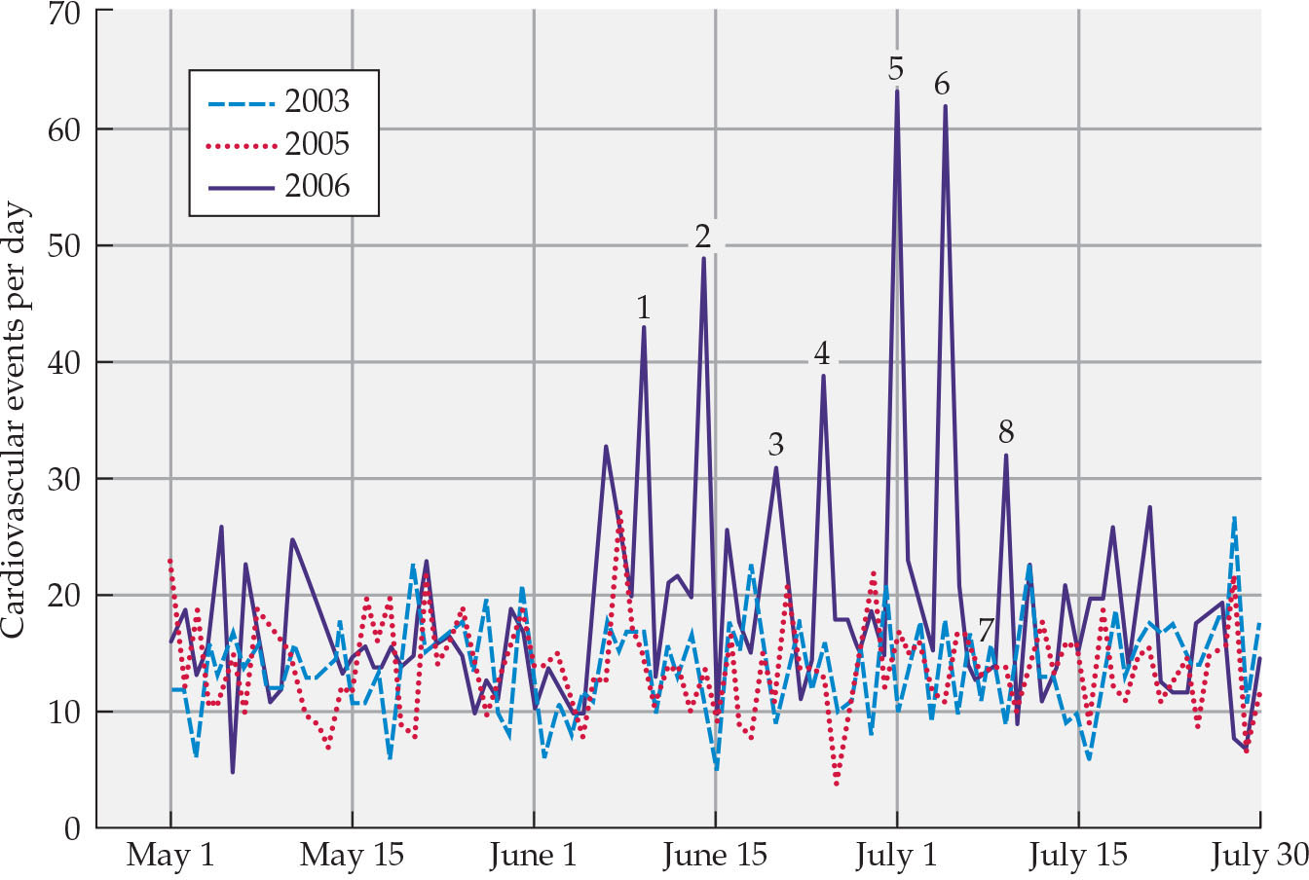
Figure 11.1 Daily cardiovascular events in a German study population from May 1 to July 31 in 2003, 2005, and 2006
Notes:
Figure 11.1 Daily cardiovascular events in a German study population from May 1 to July 31 in 2003, 2005, and 2006 The FIFA World Cup 2006 in Germany began on June 9, 2006, and ended on July 9, 2006. The 2006 World Cup matches with German participation are indicated by numbers 1 through 7: match 1, Germany versus Costa Rica; match 2, Germany versus Poland; match 3, Germany versus Ecuador; match 4, Germany versus Sweden; match 5, Germany versus Argentina; match 6, Germany versus Italy; and match 7, Germany versus Portugal (for third-place standing). Match 8 was the final match, Italy versus France. After U. Wilbert-Lampen et al. 2008. N Engl J Med 358: 475.

Slide 3
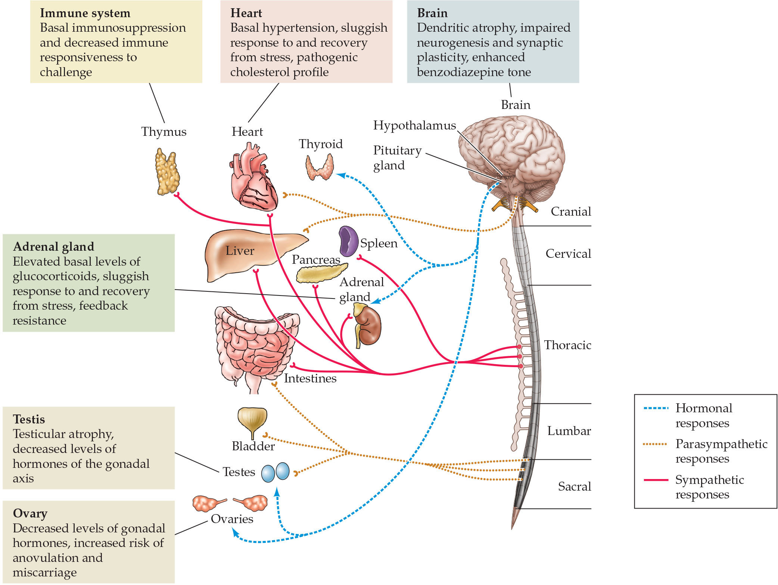
Figure 11.2 Physiological systems and endocrine glands affected by chronic stress
Notes:
Figure 11.2 Physiological systems and endocrine glands affected by chronic stress After S. M. Breedlove and N. V. Watson. 2019. Behavioral Neuroscience, 9th ed. Sunderland, MA: Oxford University Press/Sinauer and R. M. Sapolsky. 2005. Science 308: 648. https://doi. org/10.1126/science.1106477

Slide 4
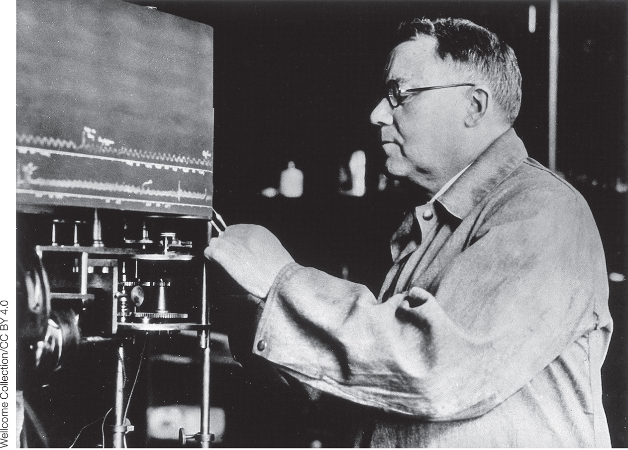
Figure 11.3 Walter B. Cannon
Notes:
Figure 11.3 Walter B. Cannon, a pioneer in stress research, is seen in this photo working in his lab. Cannon established the concept of homeostasis.

Slide 5
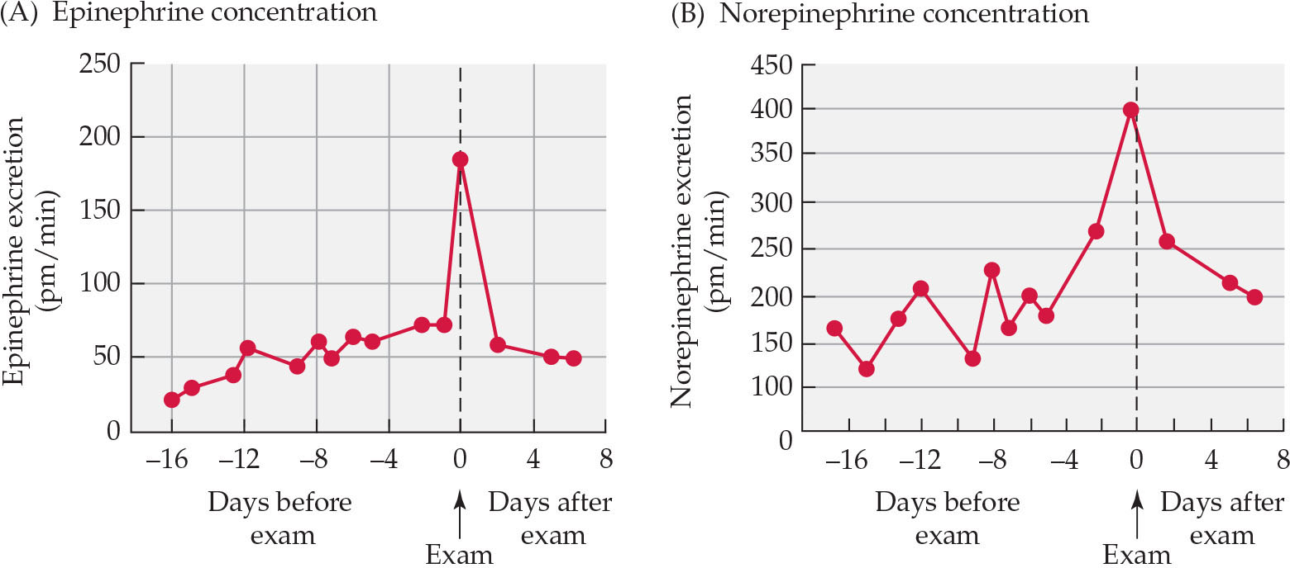
Figure 11.4 Catecholamine concentrations peaked on the day of a PhD exam
Notes:
Figure 11.4 Catecholamine concentrations peaked on the day of a PhD exam after showing a consistent elevation in the days prior to the exam. Epinephrine (A) and norepinephrine (B) concentrations both peaked on the day of the exam and returned to baseline after successful coping with the stressor (passing the exam). After M. Frankenhaeuser. 1978. In R. A. Dienstbier (ed.), Nebraska Symposium on Motivation 1978: Human Emotion, pp. 123–161. Lincoln, NE: Nebraska University Press.

Slide 6
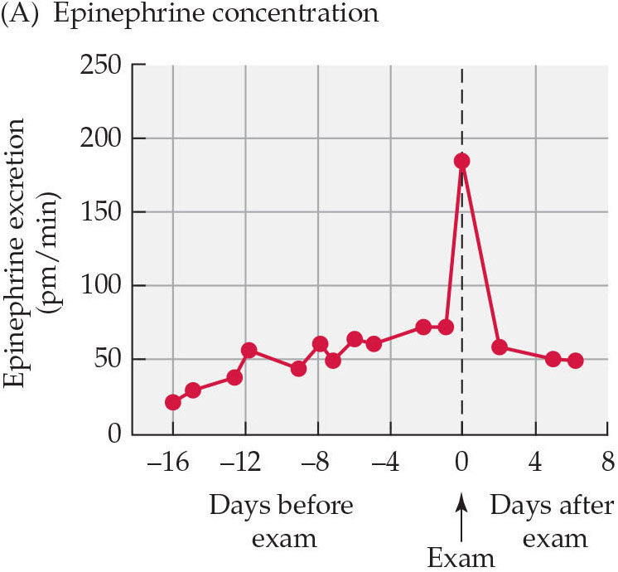
Figure 11.4(a) Catecholamine concentrations peaked on the day of a PhD exam
Notes:
Figure 11.4 Catecholamine concentrations peaked on the day of a PhD exam after showing a consistent elevation in the days prior to the exam. Epinephrine (A) and norepinephrine (B) concentrations both peaked on the day of the exam and returned to baseline after successful coping with the stressor (passing the exam). After M. Frankenhaeuser. 1978. In R. A. Dienstbier (ed.), Nebraska Symposium on Motivation 1978: Human Emotion, pp. 123–161. Lincoln, NE: Nebraska University Press.

Slide 7
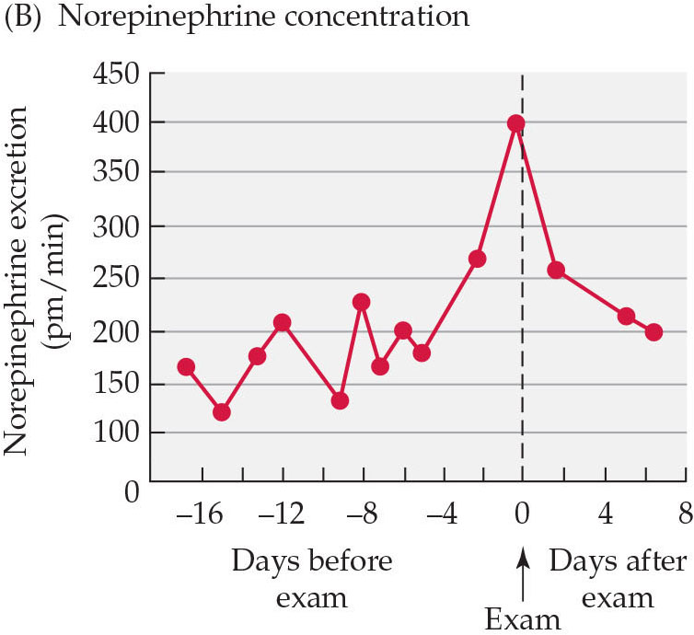
Figure 11.4(b) Catecholamine concentrations peaked on the day of a PhD exam
Notes:
Figure 11.4 Catecholamine concentrations peaked on the day of a PhD exam after showing a consistent elevation in the days prior to the exam. Epinephrine (A) and norepinephrine (B) concentrations both peaked on the day of the exam and returned to baseline after successful coping with the stressor (passing the exam). After M. Frankenhaeuser. 1978. In R. A. Dienstbier (ed.), Nebraska Symposium on Motivation 1978: Human Emotion, pp. 123–161. Lincoln, NE: Nebraska University Press.

Slide 8
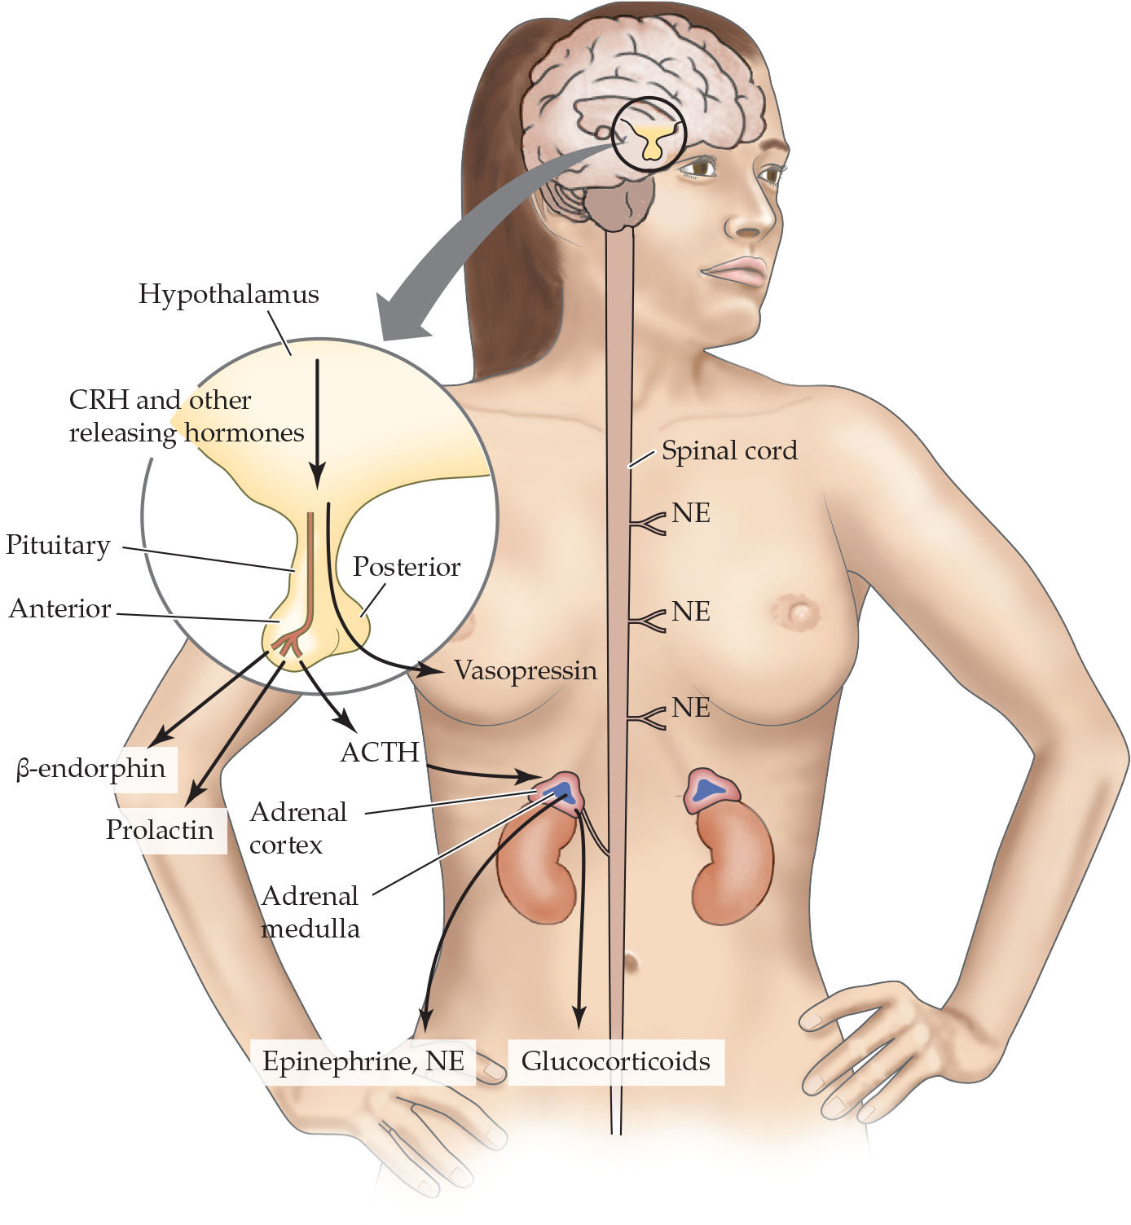
Figure 11.5 The hypothalamic-pituitaryadrenal axis releases several hormones in response to stress
Notes:
Figure 11.5 The hypothalamic-pituitaryadrenal axis releases several hormones in response to stress Initially, stress causes the release of epinephrine from the adrenal medulla and of norepinephrine (NE) from the sympathetic nervous system. Moments later, the hypothalamus releases CRH and other releasing hormones, which stimulate ACTH and β-endorphin release from the anterior pituitary gland. ACTH stimulates corticosterone secretion from the adrenal cortex. Prolactin is often released from the anterior pituitary during stress as well. Vasopressin is released from the posterior pituitary.

Slide 9
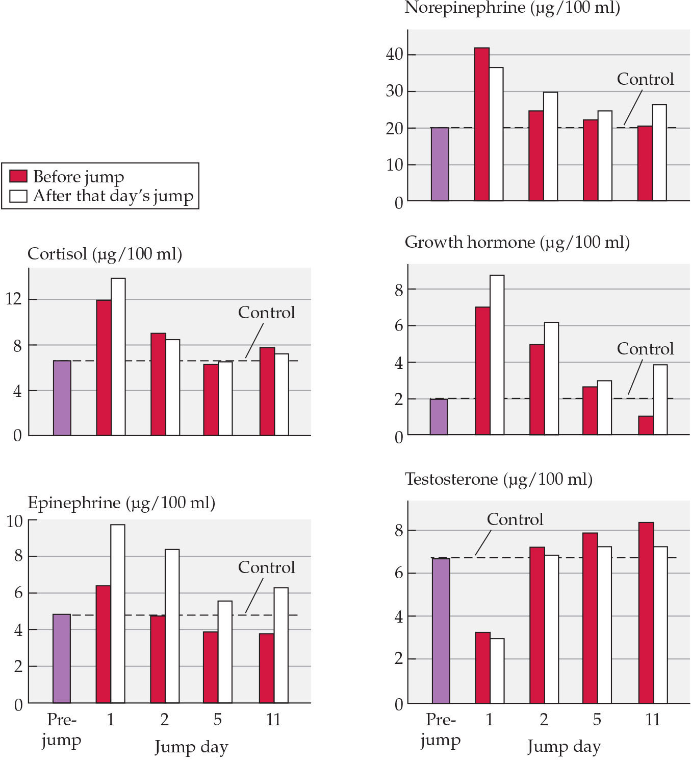
Figure 11.6 Blood hormone concentrations are altered by the stress of parachute jumps
Notes:
Figure 11.6 Blood hormone concentrations are altered by the stress of parachute jumps Note that on jump days, cortisol, epinephrine, norepinephrine, and growth hormone concentrations were elevated above the trainees’ own baseline (prejump) values and above values for control individuals who were not engaged in parachute jump training (dashed line). Testosterone decreased on the day of the first jump but rebounded the next day to basal concentrations. After H. Ursin (ed.). 2012. Psychobiology of Stress: A Study of Coping Men. New York: Academic Press/Elsevier.

Slide 10
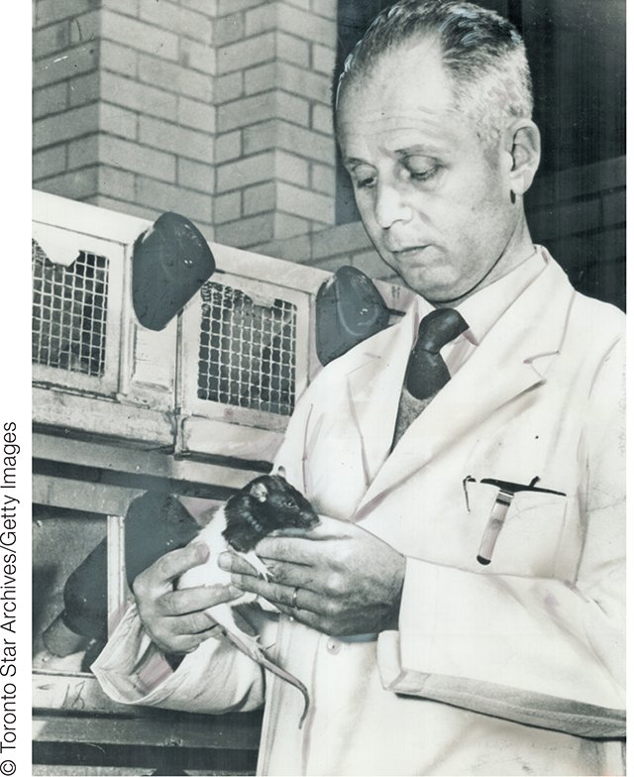
Figure 11.7 Hans Selye
Notes:
Figure 11.7 Hans Selye (1907–1982) is considered the founder of modern stress research.

Slide 11
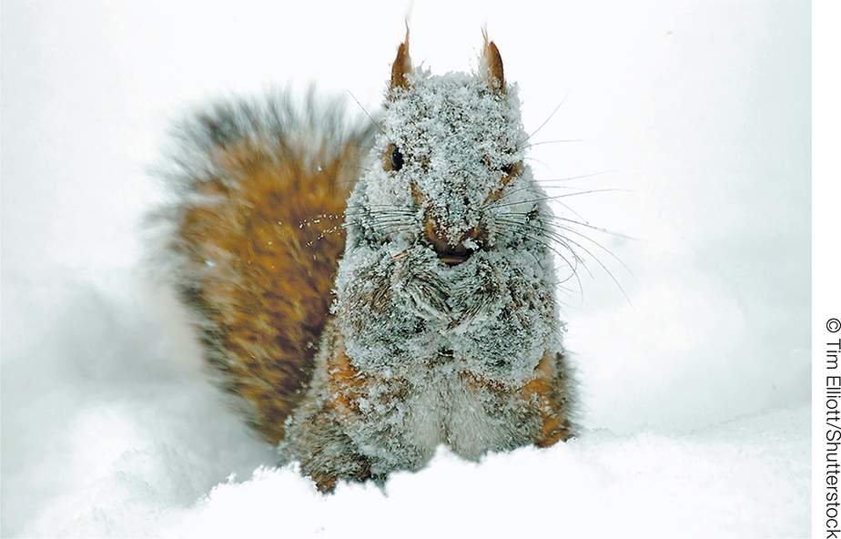
Box 11.1 This squirrel looks miserable
Notes:
This squirrel looks miserable but is probably not experiencing allostatic overload, because it appears well-nourished.

Slide 12
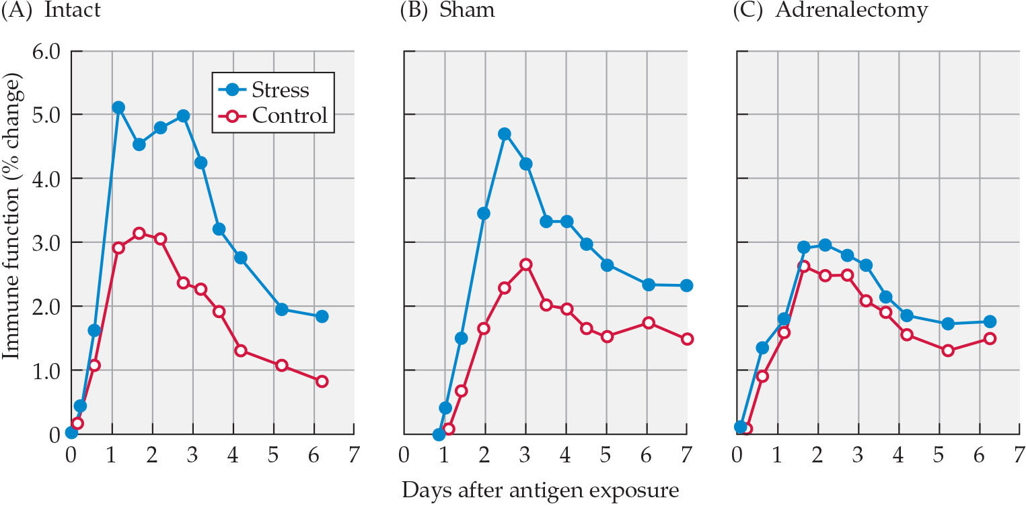
Figure 11.8 Acute stress can improve immune function
Notes:
Figure 11.8 Acute stress can improve immune function Although we often think of stress as only suppressing immune function, acute stressors can enhance some immune functions. For example, restraint stress (blue circles) enhanced a type of immune response in adrenal-intact rodents and in animals receiving a sham adrenalectomy. This effect was abolished by adrenalectomy, suggesting that it was mediated by glucocorticoids. After F. S. Dhabar and B. S. McEwen. 1999. Proc Natl Acad Sci USA 96: 1059. © 1999 National Academy of Sciences, USA.

Slide 13
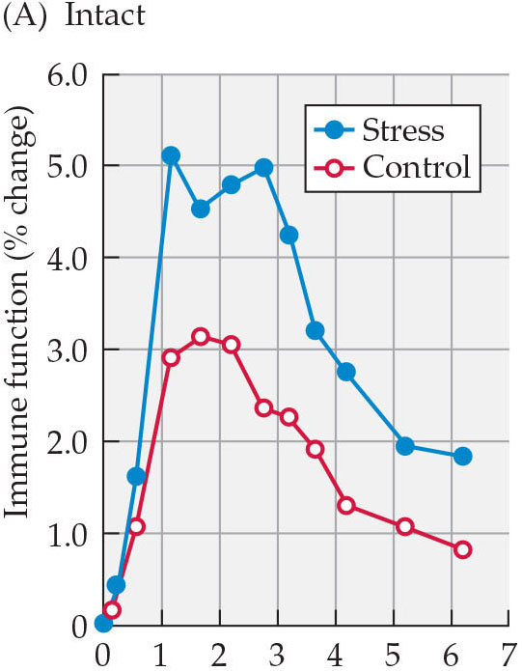
Figure 11.8(a) Acute stress can improve immune function
Notes:
Figure 11.8 Acute stress can improve immune function Although we often think of stress as only suppressing immune function, acute stressors can enhance some immune functions. For example, restraint stress (blue circles) enhanced a type of immune response in adrenal-intact rodents and in animals receiving a sham adrenalectomy. This effect was abolished by adrenalectomy, suggesting that it was mediated by glucocorticoids. After F. S. Dhabar and B. S. McEwen. 1999. Proc Natl Acad Sci USA 96: 1059. © 1999 National Academy of Sciences, USA.

Slide 14
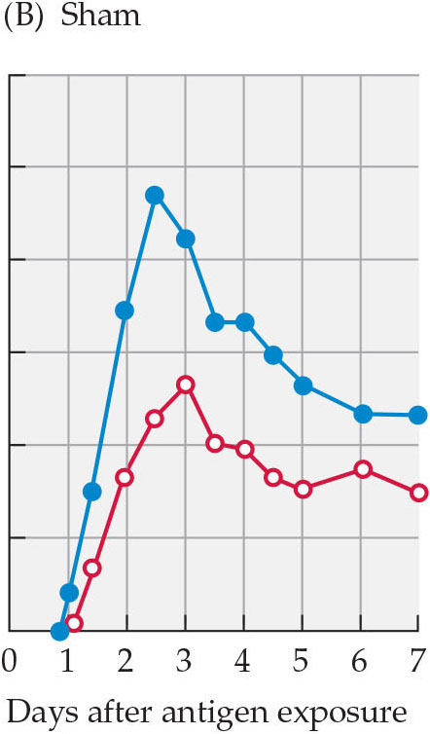
Figure 11.8(b) Acute stress can improve immune function
Notes:
Figure 11.8 Acute stress can improve immune function Although we often think of stress as only suppressing immune function, acute stressors can enhance some immune functions. For example, restraint stress (blue circles) enhanced a type of immune response in adrenal-intact rodents and in animals receiving a sham adrenalectomy. This effect was abolished by adrenalectomy, suggesting that it was mediated by glucocorticoids. After F. S. Dhabar and B. S. McEwen. 1999. Proc Natl Acad Sci USA 96: 1059. © 1999 National Academy of Sciences, USA.

Slide 15
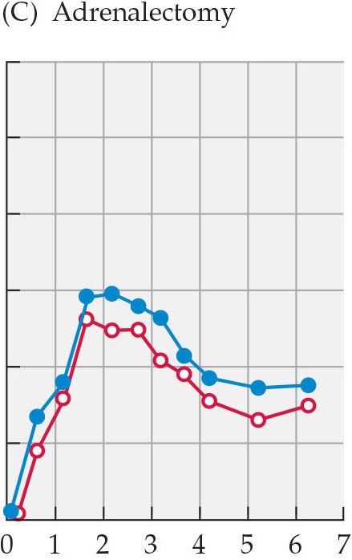
Figure 11.8(c) Acute stress can improve immune function
Notes:
Figure 11.8 Acute stress can improve immune function Although we often think of stress as only suppressing immune function, acute stressors can enhance some immune functions. For example, restraint stress (blue circles) enhanced a type of immune response in adrenal-intact rodents and in animals receiving a sham adrenalectomy. This effect was abolished by adrenalectomy, suggesting that it was mediated by glucocorticoids. After F. S. Dhabar and B. S. McEwen. 1999. Proc Natl Acad Sci USA 96: 1059. © 1999 National Academy of Sciences, USA.

Slide 16
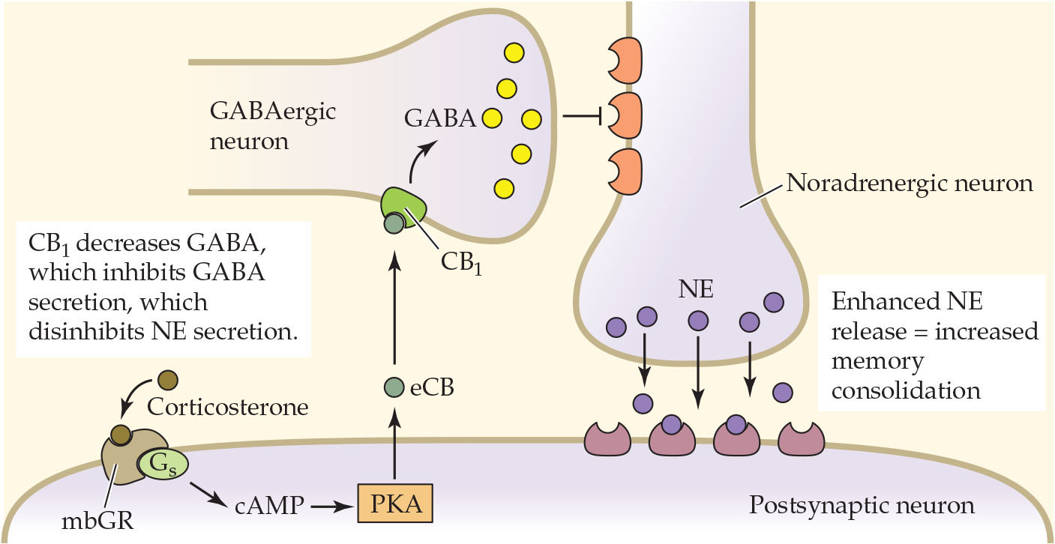
Figure 11.9 Model of rapid effects of corticosterone on GABA inhibition and enhanced noradrenaline secretion
Notes:
Figure 11.9 Model of rapid effects of corticosterone on GABA inhibition and enhanced noradrenaline secretion Corticosterone binds to a membrane-bound G protein-coupled receptor (mbGR), which activates the Gs-cAMP/PKA signal transduction pathway to induce the release of endocannabinoids (eCB) into the synapse. The eCBs bind to CB1 receptors on GABA-ergic terminals, which inhibits GABA secretion. Inhibition of the inhibitory neurotransmitter, GABA, in turn disinhibits norepinephrine (NE), which is then released. After M. N. Hill and B. S. McEwen. 2010. Prog Neuropsychopharmacol Biol Psychiatry 34: 791.

Slide 17
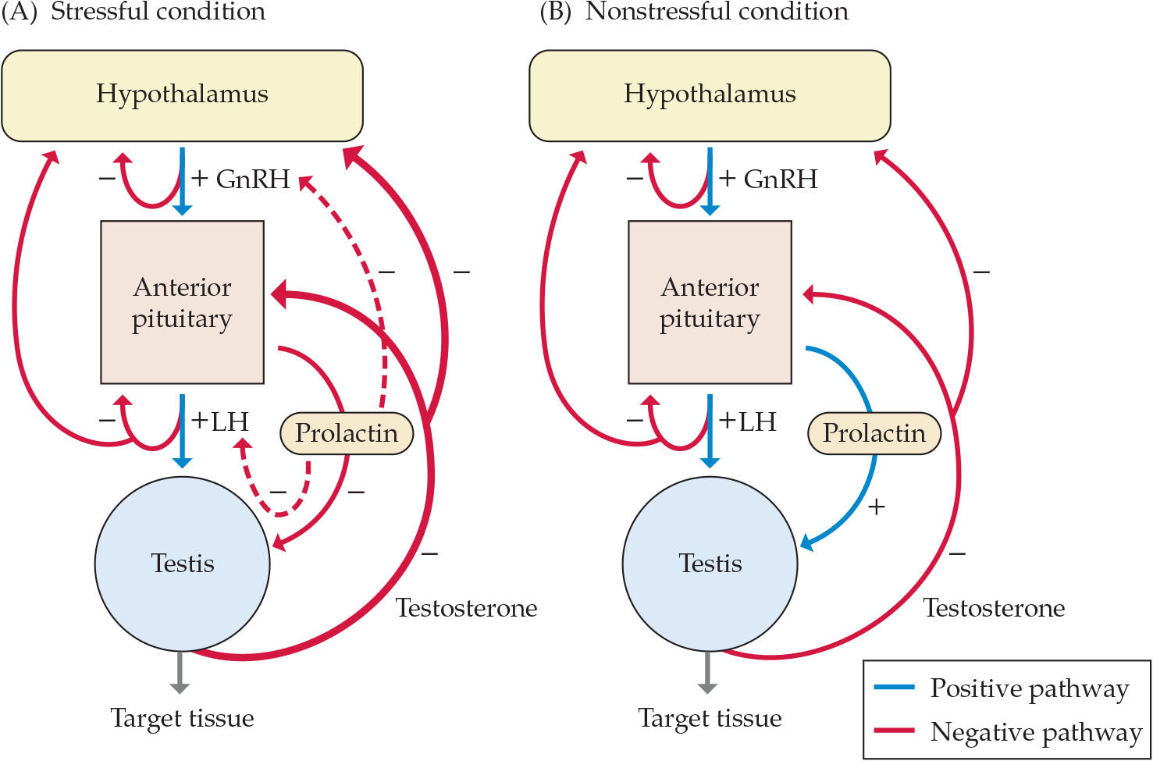
Figure 11.10 Prolactin inhibits reproductive function
Notes:
Figure 11.10 Prolactin inhibits reproductive function temporarily during stressful conditions by acting at multiple sites within the hypothalamic-pituitary-gonadal (HPG) axis. (A) Under the influence of prolactin, the Leydig cells become less responsive to luteinizing hormone (LH) and produce less testosterone, and the negative feedback mechanisms in the pituitary and hypothalamus are accentuated, so any testosterone produced causes further reductions in GnRH and gonadotropin secretion. (B) Normally, prolactin at low concentrations facilitates testosterone production.

Slide 18
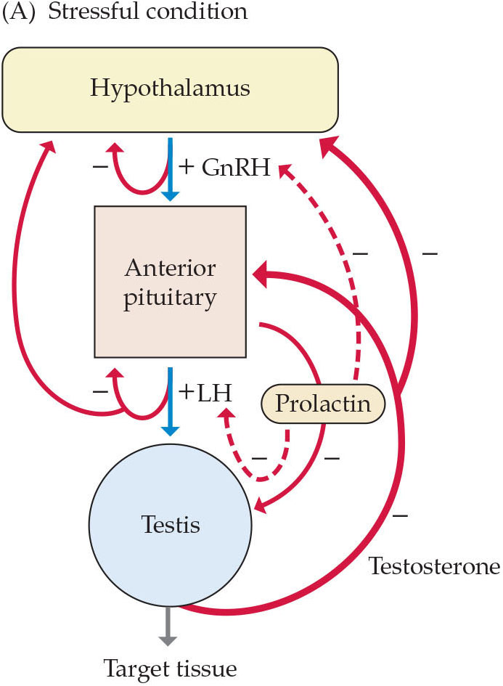
Figure 11.10(a) Prolactin inhibits reproductive function
Notes:
Figure 11.10 Prolactin inhibits reproductive function temporarily during stressful conditions by acting at multiple sites within the hypothalamic-pituitary-gonadal (HPG) axis. (A) Under the influence of prolactin, the Leydig cells become less responsive to luteinizing hormone (LH) and produce less testosterone, and the negative feedback mechanisms in the pituitary and hypothalamus are accentuated, so any testosterone produced causes further reductions in GnRH and gonadotropin secretion. (B) Normally, prolactin at low concentrations facilitates testosterone production.

Slide 19
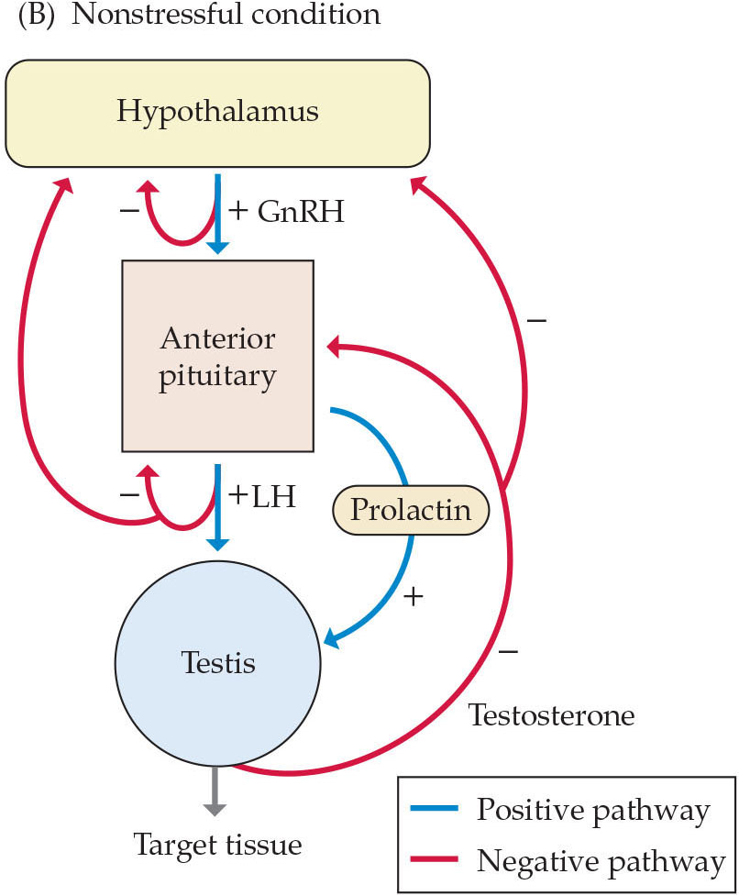
Figure 11.10(b) Prolactin inhibits reproductive function
Notes:
Figure 11.10 Prolactin inhibits reproductive function temporarily during stressful conditions by acting at multiple sites within the hypothalamic-pituitary-gonadal (HPG) axis. (A) Under the influence of prolactin, the Leydig cells become less responsive to luteinizing hormone (LH) and produce less testosterone, and the negative feedback mechanisms in the pituitary and hypothalamus are accentuated, so any testosterone produced causes further reductions in GnRH and gonadotropin secretion. (B) Normally, prolactin at low concentrations facilitates testosterone production.

Slide 20
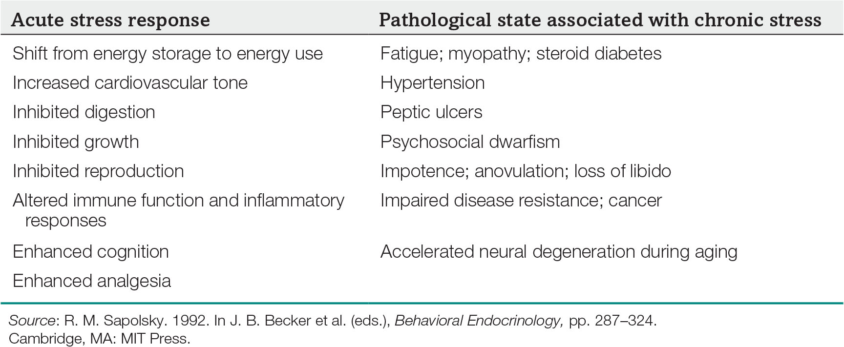
Table 11.1 Pathological effects of long-term stress responses
Notes:
Table 11.1 Pathological effects of long-term stress responses

Slide 21
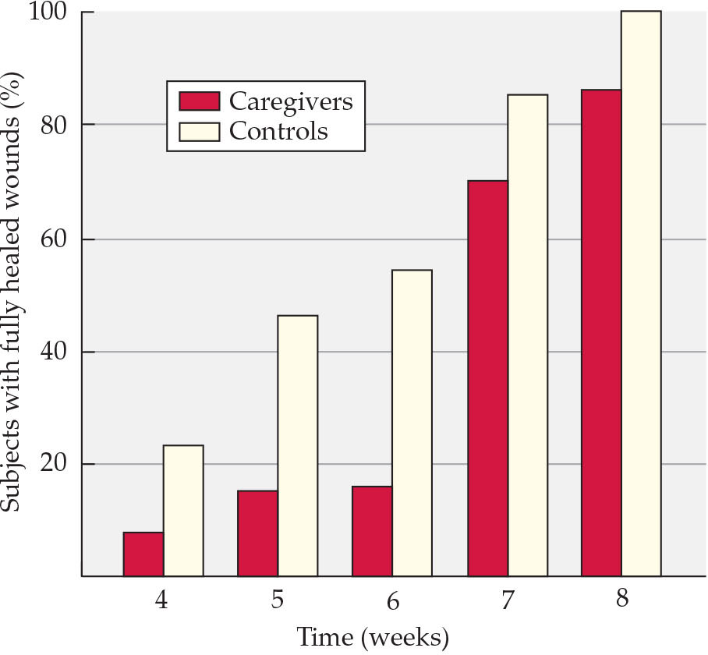
Figure 11.11 Wound healing is impaired in stressed caregivers
Notes:
Figure 11.11 Wound healing is impaired in stressed caregivers This graph depicts healing times for a standard-sized punch biopsy wound on the arm in two groups: postmenopausal women who served as caregivers for chronically ill spouses, and control women of the same age. Slower healing increases the risk of infection. After J. K. Kiecolt-Glaser et al. 1995. Lancet 346: 1194.

Slide 22
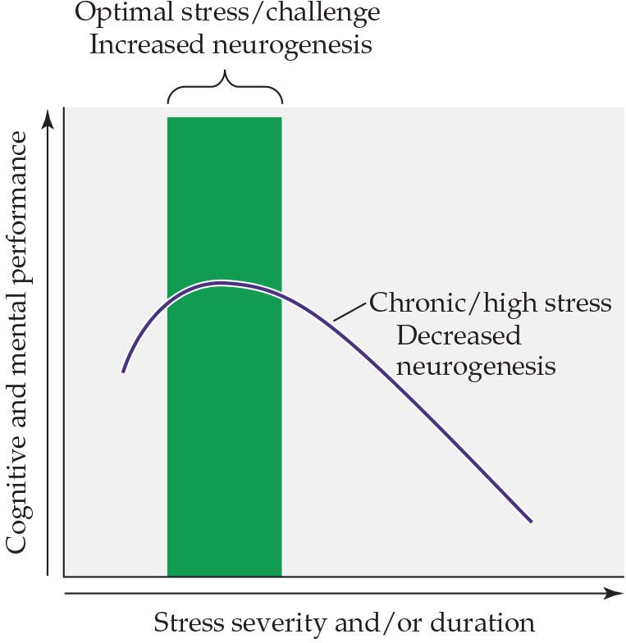
Figure 11.12 Neurogenesis is maintained by optimal stress levels
Notes:
Figure 11.12 Neurogenesis is maintained by optimal stress levels As with immune function, there are optimal levels of stressors to maintain neurogenesis and cognitive function. However, if stressors persist chronically, then neurogenesis is impaired and learning and memory performance are reduced. Courtesy of D. Kaufer, University o NELSON and KRIEGSFEf LCDalifornia, Berkeley.

Slide 23
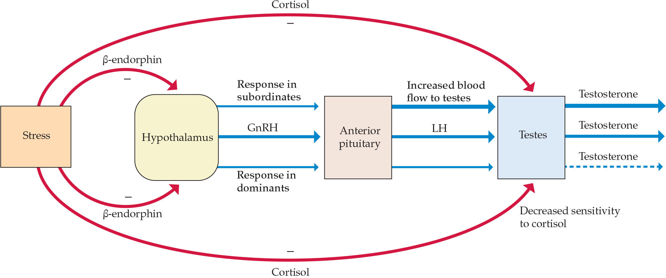
Figure 11.13 Stress has different effects on dominant or subordinate baboons
Notes:
Figure 11.13 Stress has different effects on dominant or subordinate baboons After a stressful experience, dominant animals display an elevated cortisol response, but because they possess an efficient HPA axis feedback system, the cortisol concentrations are returned to baseline faster than in subordinate animals. Because of blunted sensitivity of the anterior pituitary to CRH and related hormones among subordinate animals, a similar stressful stimulus results in an initial low cortisol response to stress, but also because of the poor HPA axis feedback regulation, subordinate individuals display long-term elevation of glucocorticoids, which may ultimately harm those individuals. The thickness of the green arrows corresponds to the intensity of the responses. After R. M. Sapolsky. 1990. Sci Am 262: 116.

Slide 24
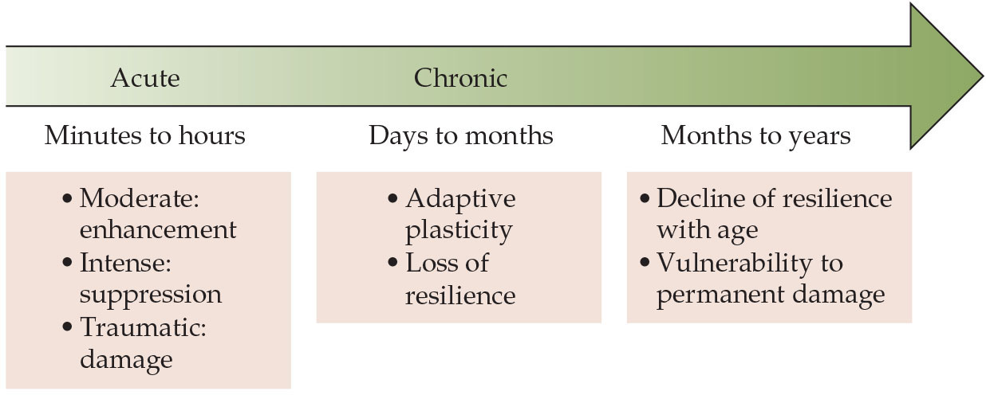
Figure 11.14 Acute versus chronic stressors
Notes:
Figure 11.14 Acute versus chronic stressors Acute stressors have many beneficial effects, whereas chronic stressors typically produce detrimental effects. Thus far, only broad temporal parameters have been determined to predict when stressors begin to impair, rather than improve, physiology and behavior. Presumably, there are individual differences in this timing, as well as differences in the types of stressors, but additional research is necessary to understand this switch.

Slide 25
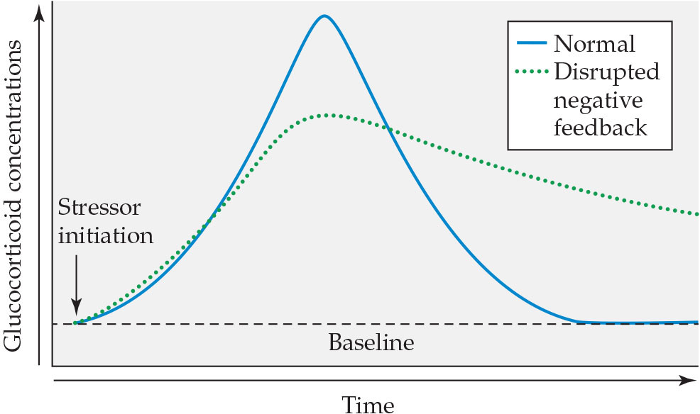
Figure 11.15 Glucocorticoid responses to stressors are altered in animals with disrupted negative feedback
Notes:
Figure 11.15 Glucocorticoid responses to stressors are altered in animals with disrupted negative feedback In this model, you can see that despite a lower maximal response among disrupted animals, the amount of glucocorticoid they release over time is increased compared with the amount released by animals with typical negative feedback processes. This response has been observed in both dominant and subordinate wild freeliving olive baboons.

Slide 26
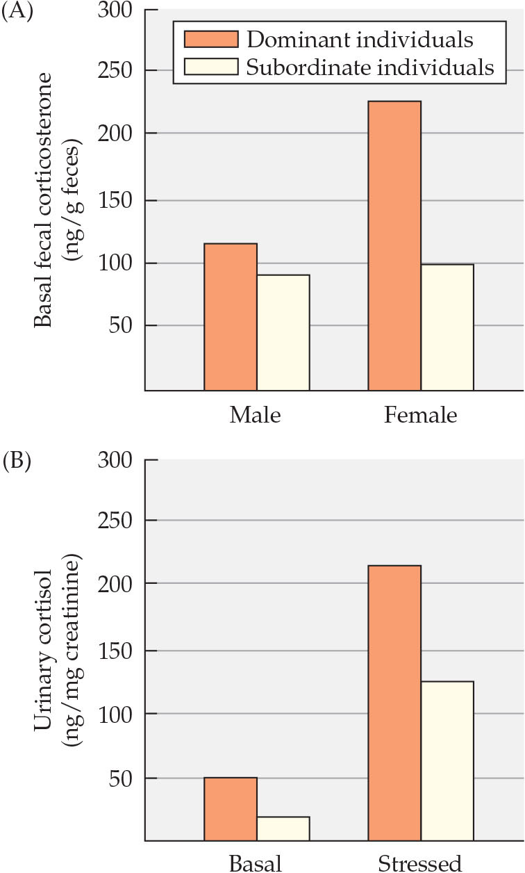
Figure 11.16 Corticosterone concentrations are elevated in dominant wild dogs and mongooses
Notes:
Figure 11.16 Corticosterone concentrations are elevated in dominant wild dogs and mongooses In contrast to the findings in most laboratory animals, the alpha individuals (orange bars) in groups of (A) free-living African wild dogs and (B) captive mongooses have higher corticosterone values than subordinate animals (white bars). In other words, the dominant individuals appear to be more stressed than subordinate individuals. After S. Creel et al. 1997. Behav Ecol 8: 298.

Slide 27
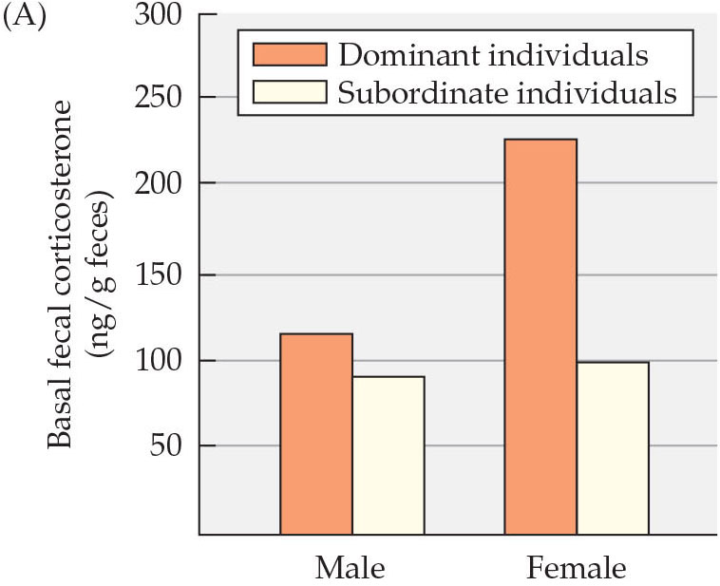
Figure 11.16 Corticosterone concentrations are elevated in dominant wild dogs and mongooses
Notes:
Figure 11.16 Corticosterone concentrations are elevated in dominant wild dogs and mongooses In contrast to the findings in most laboratory animals, the alpha individuals (orange bars) in groups of (A) free-living African wild dogs and (B) captive mongooses have higher corticosterone values than subordinate animals (white bars). In other words, the dominant individuals appear to be more stressed than subordinate individuals. After S. Creel et al. 1997. Behav Ecol 8: 298.

Slide 28
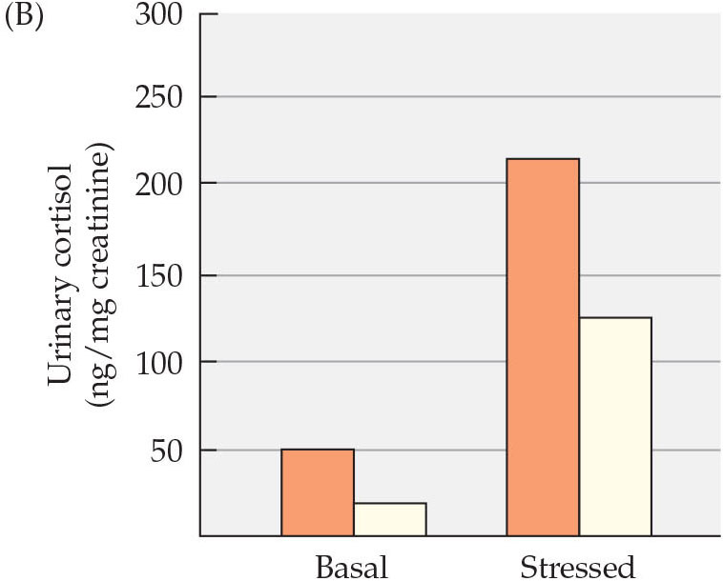
Figure 11.16 Corticosterone concentrations are elevated in dominant wild dogs and mongooses
Notes:
Figure 11.16 Corticosterone concentrations are elevated in dominant wild dogs and mongooses In contrast to the findings in most laboratory animals, the alpha individuals (orange bars) in groups of (A) free-living African wild dogs and (B) captive mongooses have higher corticosterone values than subordinate animals (white bars). In other words, the dominant individuals appear to be more stressed than subordinate individuals. After S. Creel et al. 1997. Behav Ecol 8: 298.

Slide 29
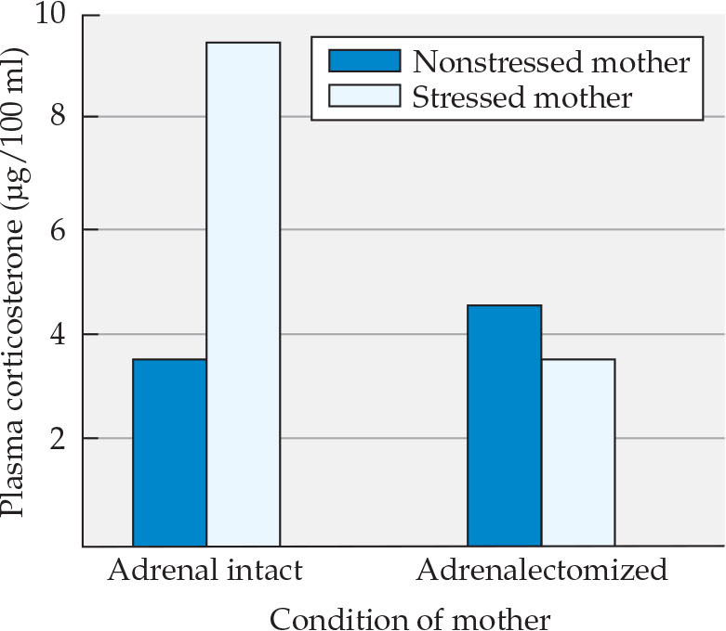
Figure 11.17 Adrenalectomy in the dam alters the stress response of offspring stressed in utero
Notes:
Figure 11.17 Adrenalectomy in the dam alters the stress response of offspring stressed in utero Adult rats whose mothers were stressed while pregnant had elevated corticosterone concentrations in response to restraint. Adrenalectomy prevented this elevated stress response. After A. Barbazanges et al. 1996. J Neurosci 16: 3943. © 1996 Society for Neuroscience.

Slide 30
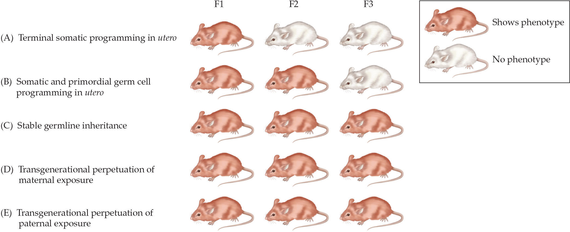
Figure 11.18 Modes of transgenerational epigenetic transmission
Notes:
Figure 11.18 Modes of transgenerational epigenetic transmission A number of mechanisms for transgenerational epigenetic transmission have been identified. In this figure, a red mouse indicates the phenotype observed in a particular generation. (A) Somatic programming in utero can affect tissue and brain development in the fetus that initiates a developmental trajectory that results in an adult phenotype in the first (F1) generation. This phenotype, however, is not transmitted to the next generation because the germ cell is not involved. (B) In this case, somatic in utero programming occurs in concert with primordial germ cell changes, and the phenotype will be transmitted to a second (F2) generation. This mode of transmission requires that the germ cells must be exposed to a maternal stressor during gestation. (C) If in utero stressor exposure alters epigenetic marks in the germline of the F1 offspring and this reprogramming withstands erasure and reestablishment during germ cell development among subsequent generations, then the phenotype will be perpetuated across generations without the need for reexposure to the original stressor.
This represents true transgenerational epigenetic programming. (D) Transgenerational phenotypes may also occur through a repeated maternal effect by which programming during gestation or through exposure to altered maternal responses drives an adult phenotype that only occurs in the maternal lineage. In order for this to occur, the offspring must experience the stressor themselves in each generation for the dams’ phenotype to continue. This trait would not pass via the paternal lineage. (E) Transgenerational programming through the paternal lineage requires exposure of males to epigenetic marks in the sperm. After T. L. Bale. 2015. Nat Rev Neurosci 16: 332 and G. A. Dunn et al. 2011. Horm Behav 59: 290.

Slide 31
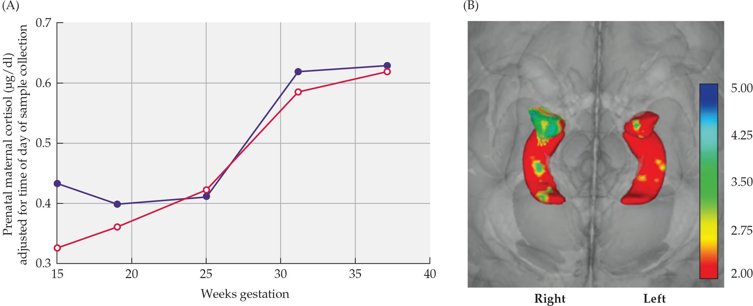
Figure 11.19 Elevated cortisol values during early pregnancy were associated with increased right amygdalar development and poor emotional development in girls, but not boys, before puberty
Notes:
Figure 11.19 Elevated cortisol values during early pregnancy were associated with increased right amygdalar development and poor emotional development in girls, but not boys, before puberty Cortisol values were elevated at 15 weeks of gestation (purple line) in some mothers. These high values were correlated with larger right amygdala size (B). The brain scan shows increased amygdalar, but not hippocampal, volumes of girls, indicated by cooler (green) colors. After C. A. Sandman et al. 2016. In N. Reissland and B. S. Kisilevsky (eds.), Fetal Development. Springer, pp. 229–265. Basel: Springer.

Slide 32
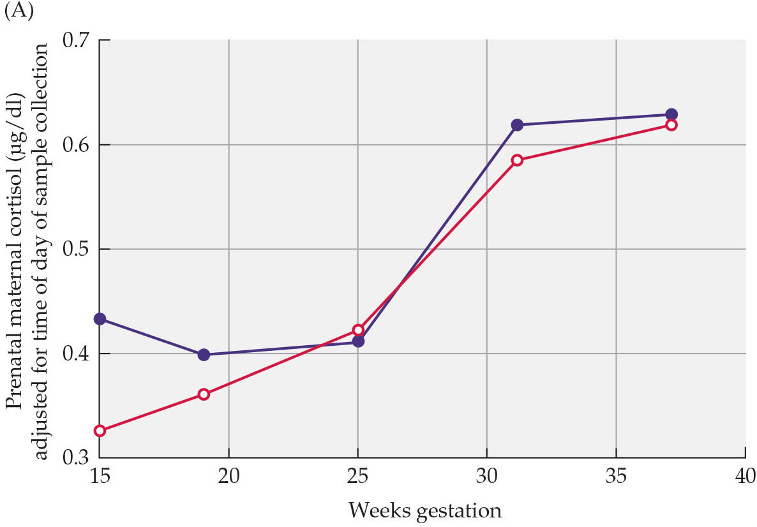
Figure 11.19(a) Elevated cortisol values during early pregnancy were associated with increased right amygdalar development and poor emotional development in girls, but not boys, before puberty
Notes:
Figure 11.19 Elevated cortisol values during early pregnancy were associated with increased right amygdalar development and poor emotional development in girls, but not boys, before puberty Cortisol values were elevated at 15 weeks of gestation (purple line) in some mothers. These high values were correlated with larger right amygdala size (B). The brain scan shows increased amygdalar, but not hippocampal, volumes of girls, indicated by cooler (green) colors. After C. A. Sandman et al. 2016. In N. Reissland and B. S. Kisilevsky (eds.), Fetal Development. Springer, pp. 229–265. Basel: Springer.

Slide 33
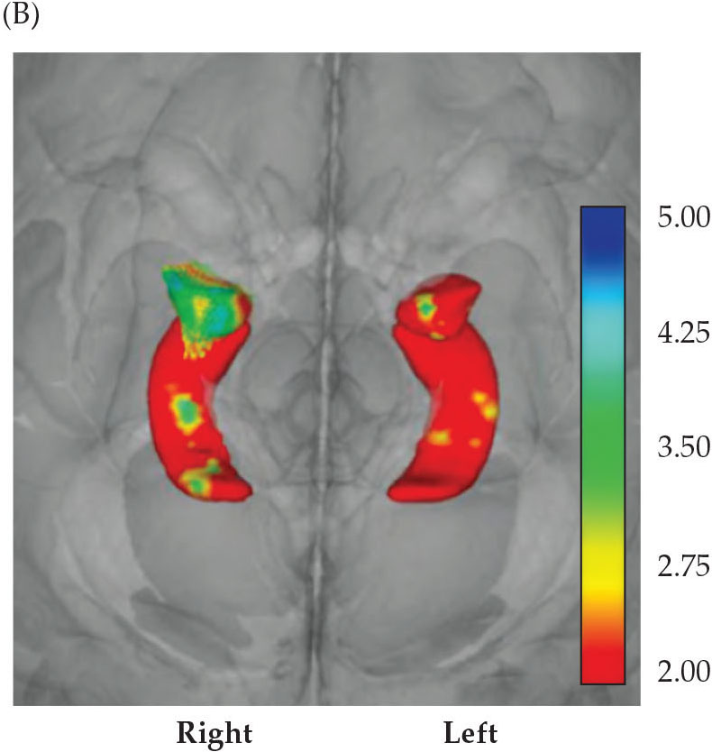
Figure 11.19(b) Elevated cortisol values during early pregnancy were associated with increased right amygdalar development and poor emotional development in girls, but not boys, before puberty
Notes:
Figure 11.19 Elevated cortisol values during early pregnancy were associated with increased right amygdalar development and poor emotional development in girls, but not boys, before puberty Cortisol values were elevated at 15 weeks of gestation (purple line) in some mothers. These high values were correlated with larger right amygdala size (B). The brain scan shows increased amygdalar, but not hippocampal, volumes of girls, indicated by cooler (green) colors. After C. A. Sandman et al. 2016. In N. Reissland and B. S. Kisilevsky (eds.), Fetal Development. Springer, pp. 229–265. Basel: Springer.

Slide 34
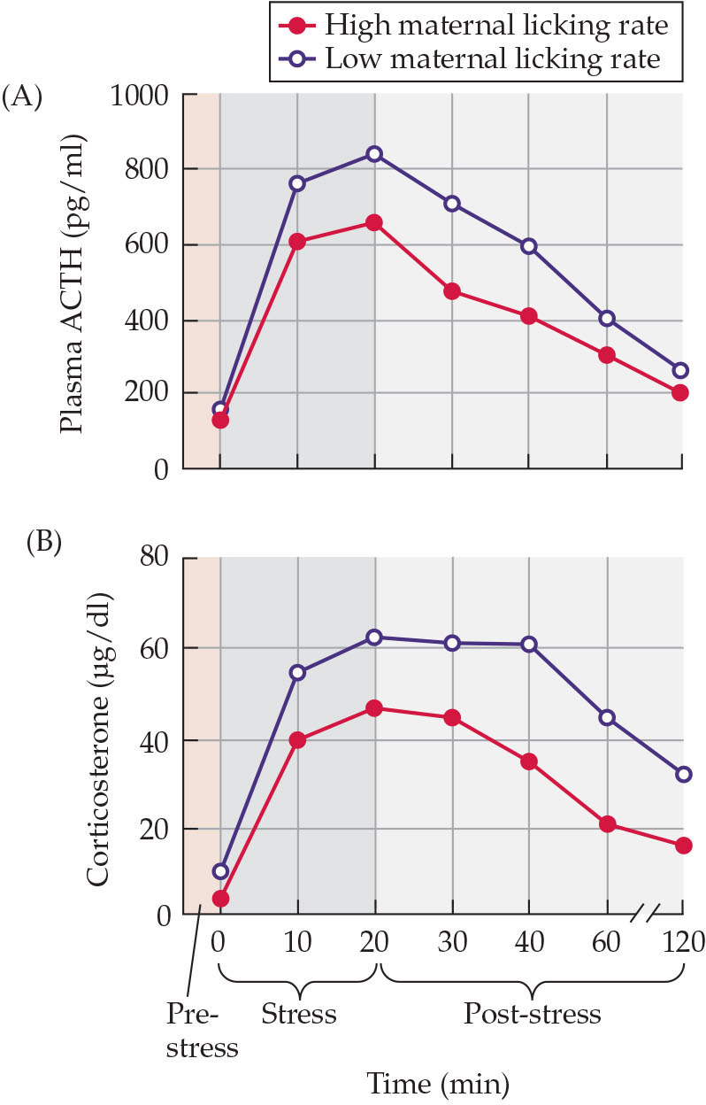
Figure 11.20 Stress responses are reduced in rats that received more maternal attention as pups
Notes:
Figure 11.20 Stress responses are reduced in rats that received more maternal attention as pups ACTH (A) and corticosterone (B) concentrations were measured before, during, and after a 20-minute restraint stress (dark gray shaded area). The concentrations were lower in rats that had received a large amount of maternal licking as pups (red circles) than in rats that had received a small amount (open circles). After D. Liu et al. 1997. Science 277: 1659.

Slide 35
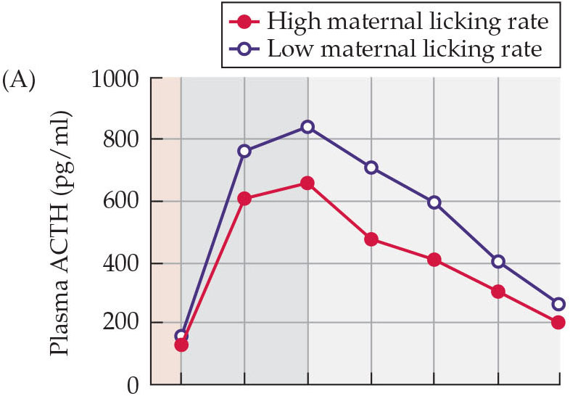
Figure 11.20(a) Stress responses are reduced in rats that received more maternal attention as pups
Notes:
Figure 11.20 Stress responses are reduced in rats that received more maternal attention as pups ACTH (A) and corticosterone (B) concentrations were measured before, during, and after a 20-minute restraint stress (dark gray shaded area). The concentrations were lower in rats that had received a large amount of maternal licking as pups (red circles) than in rats that had received a small amount (open circles). After D. Liu et al. 1997. Science 277: 1659.

Slide 36
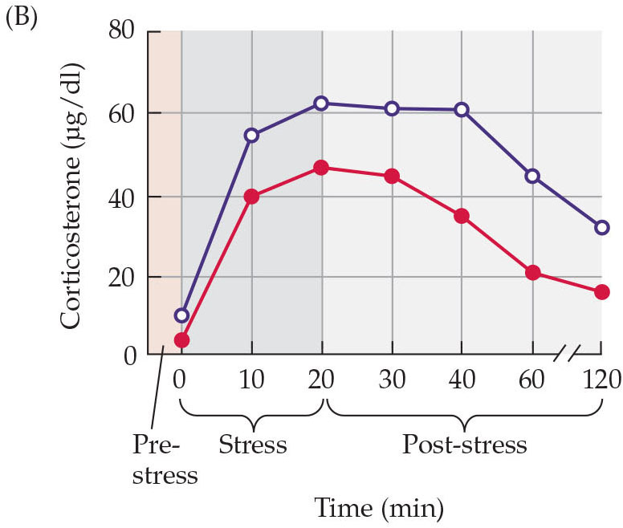
Figure 11.20(b) Stress responses are reduced in rats that received more maternal attention as pups
Notes:
Figure 11.20 Stress responses are reduced in rats that received more maternal attention as pups ACTH (A) and corticosterone (B) concentrations were measured before, during, and after a 20-minute restraint stress (dark gray shaded area). The concentrations were lower in rats that had received a large amount of maternal licking as pups (red circles) than in rats that had received a small amount (open circles). After D. Liu et al. 1997. Science 277: 1659.

Slide 37
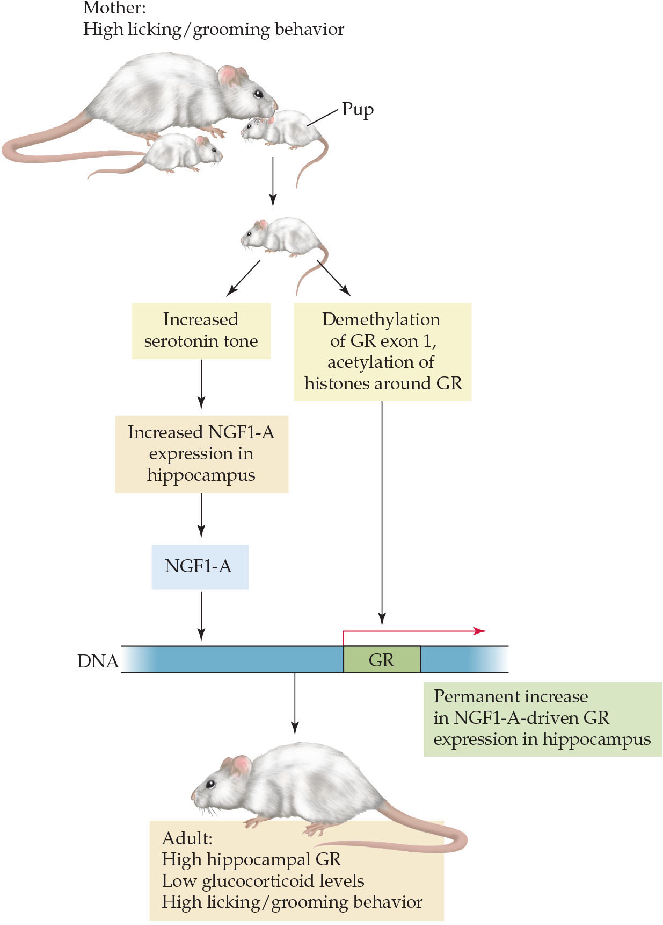
Figure 11.21 Epigenetic influences of maternal behavior on offspring
Notes:
Figure 11.21 Epigenetic influences of maternal behavior on offspring The rat maternal style that includes high rates of licking and grooming as well as arched-back nursing causes changes in two molecular pathways of the pups. First, it increases serotonergic tone in the hippocampus, which increases expression of a transcription factor (NGF1-A). Second, it causes demethylation of the first exon of the glucocorticoid receptor (GR) gene, as well as acetylation of histones adjoining the GR gene in the hippocampus. The net result of these actions is a GR gene that is more readily accepting of the NGF1-A transcription factor, which leads to more GRs in the hippocampus of the offspring as adults and the adoption by the females of their mother’s maternal style. After R. Sapolsky. 2004. Nat Neurosci 7: 791.

Slide 38
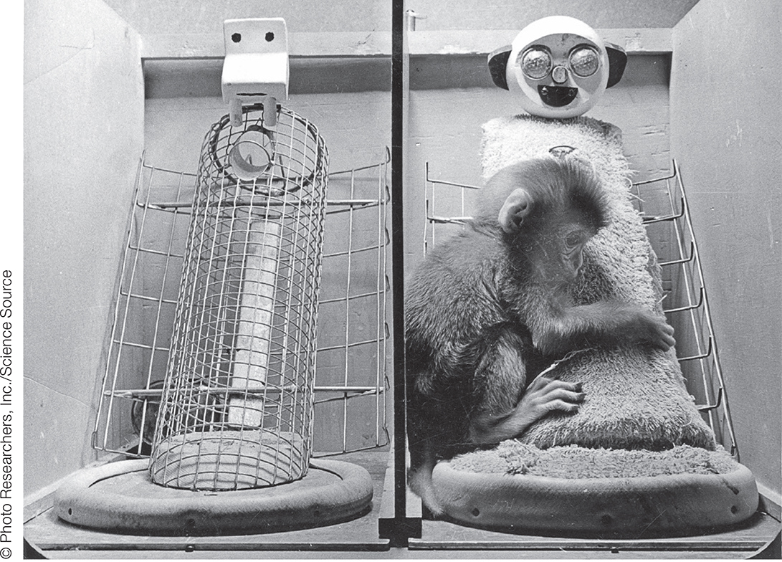
Figure 11.22 Infant rhesus monkeys cling to a cloth “mother” for contact comfort when stressed by a novel toy
Notes:
Figure 11.22 Infant rhesus monkeys cling to a cloth “mother” for contact comfort when stressed by a novel toy These infants were reared with two surrogate mothers: a wire mother that provided nutrition, and a cloth-covered wire mother that provided no nutrition but had a soft surface.

Slide 39
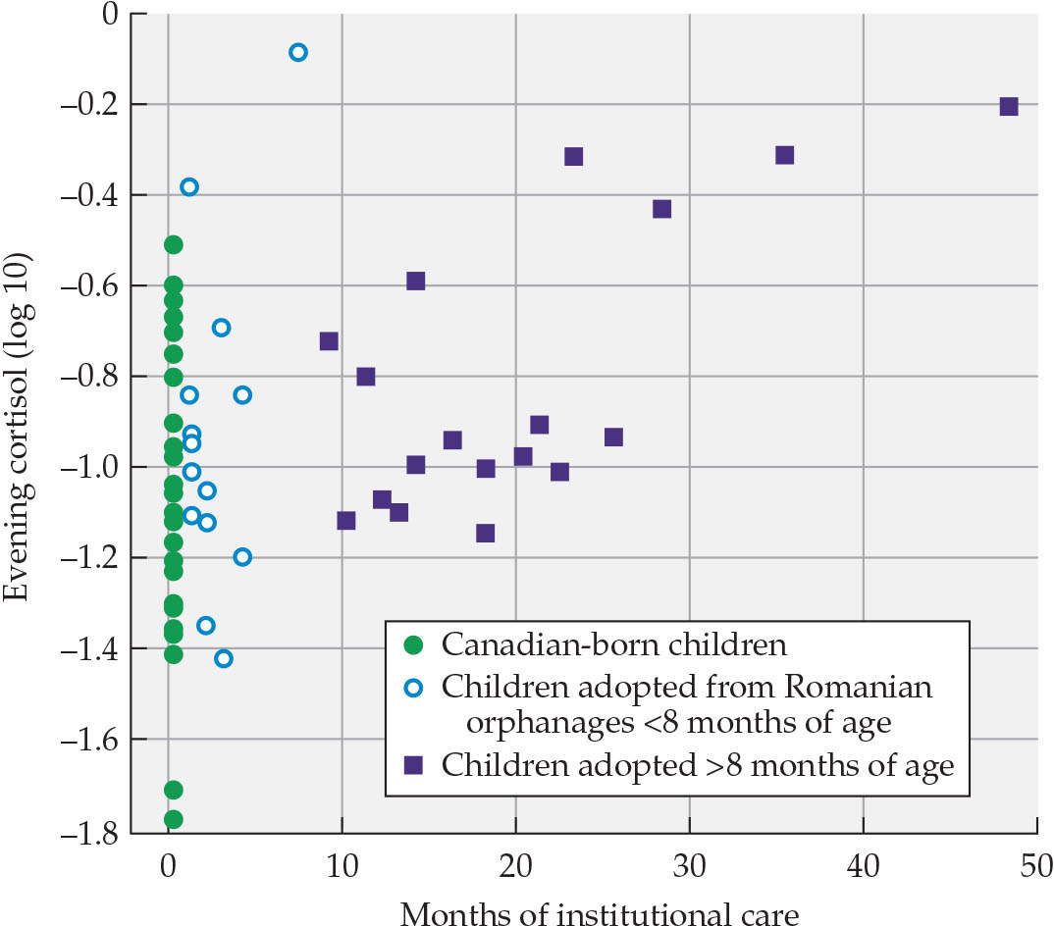
Figure 11.23 Cortisol concentrations increase as a function of time in an orphanage
Notes:
Figure 11.23 Cortisol concentrations increase as a function of time in an orphanage Log scale values of cortisol are depicted for Canadian-born children and for children adopted by Canadian parents from Romanian orphanages, either prior to 8 months of age or after 8 months of age. Hormone concentrations were obtained at 6–12 years of age. Children who spent any time in the Romanian orphanages had higher cortisol levels than Canadian-born children, and the longer the children remained institutionalized, the higher their cortisol concentrations were 6 or more years later. After M. R. Gunnar et al. 2001. Dev Psychopathol 13: 611.

Slide 40
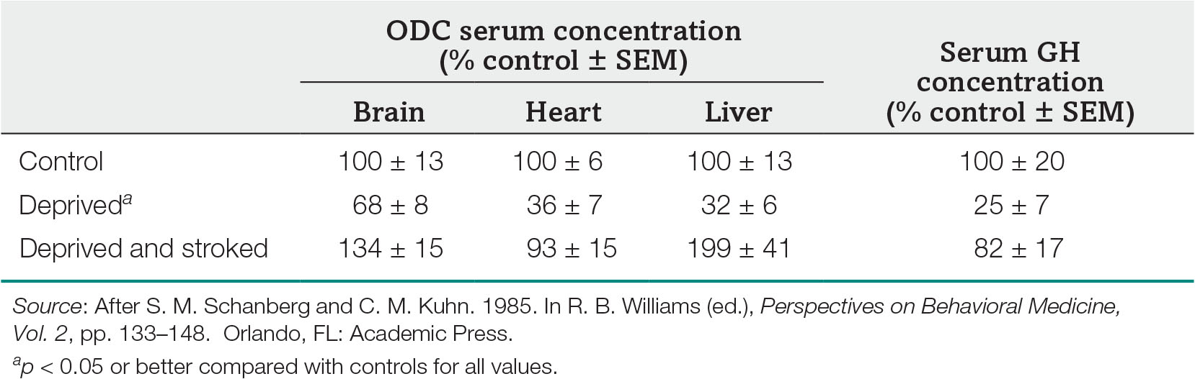
Table 11.2 Effect of stroking on ODC activity and serum GH concentrations in maternally deprived rat pups
Notes:
Table 11.2 Effect of stroking on ODC activity and serum GH concentrations in maternally deprived rat pups

Slide 41
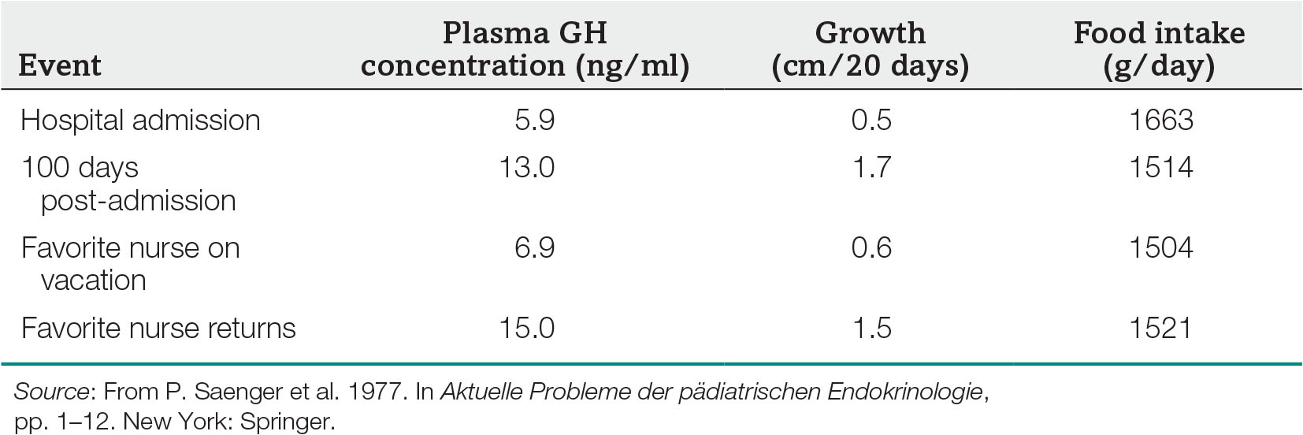
Table 11.3 Effects of external events on growth in a child with psychosocial dwarfism
Notes:
Table 11.3 Effects of external events on growth in a child with psychosocial dwarfism

Slide 42
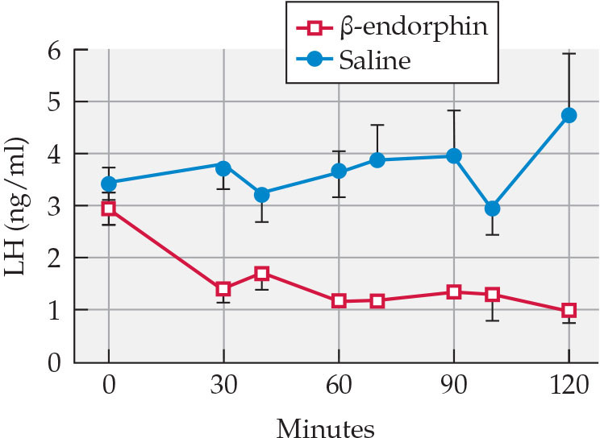
Figure 11.24 Opioids suppress LH production.
Notes:
Figure 11.24 Opioids suppress LH production. Treatment of ovariectomized rats suppresses LH secretion (red squares) compared to saline treatment. After J. J. Bonavera et al. 1993. Endocrinology 133: 178.

Slide 43
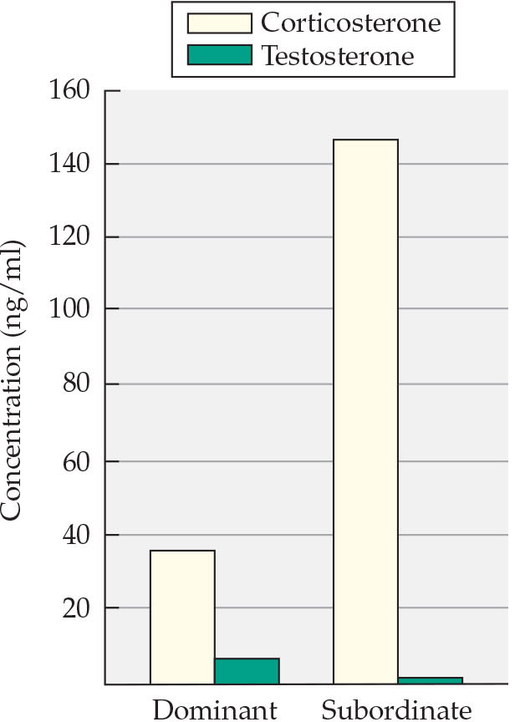
Figure 11.25 Dominant male rats have lower corticosterone and higher testosterone concentrations when stressed than subordinate rats
Notes:
Figure 11.25 Dominant male rats have lower corticosterone and higher testosterone concentrations when stressed than subordinate rats For this experiment, rats were housed in a special seminatural apparatus that allowed investigators to see their social interactions. After D. C. Blanchard et al. 1995. Psychoneuroendocrinology 20: 117.

Slide 44
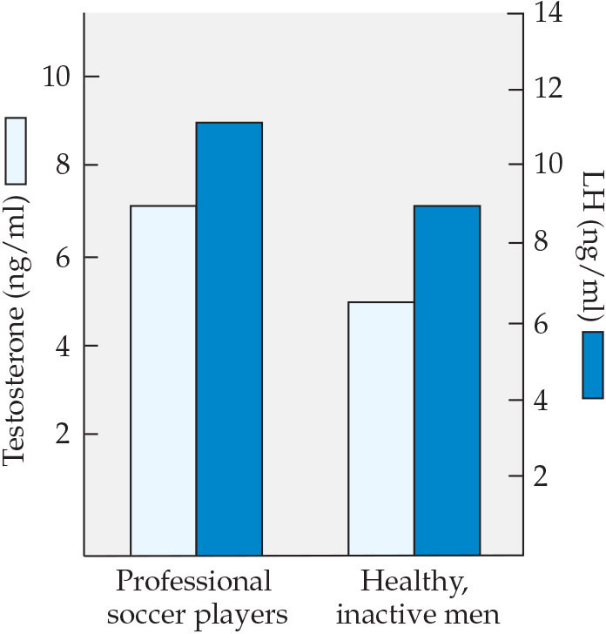
Figure 11.26 Exercise elevates testosterone in men
Notes:
Figure 11.26 Exercise elevates testosterone in men Professional soccer players display significantly higher testosterone and LH concentrations than healthy but inactive men. However, it remains to be determined whether this statistically significant elevation in hormone concentration is behaviorally significant; that is, do increased testosterone values of 1–2 ng/ml in men make a difference in the number of their aggressive encounters, mating partners, or babies sired? After M. Grandi and M. Celani. 1990. Exp Clin Endocrinol Diabetes 96: 253 and M. Celani and M. Grandi. 1989. Exp Clin Endocrinol 94: 244.

Slide 45
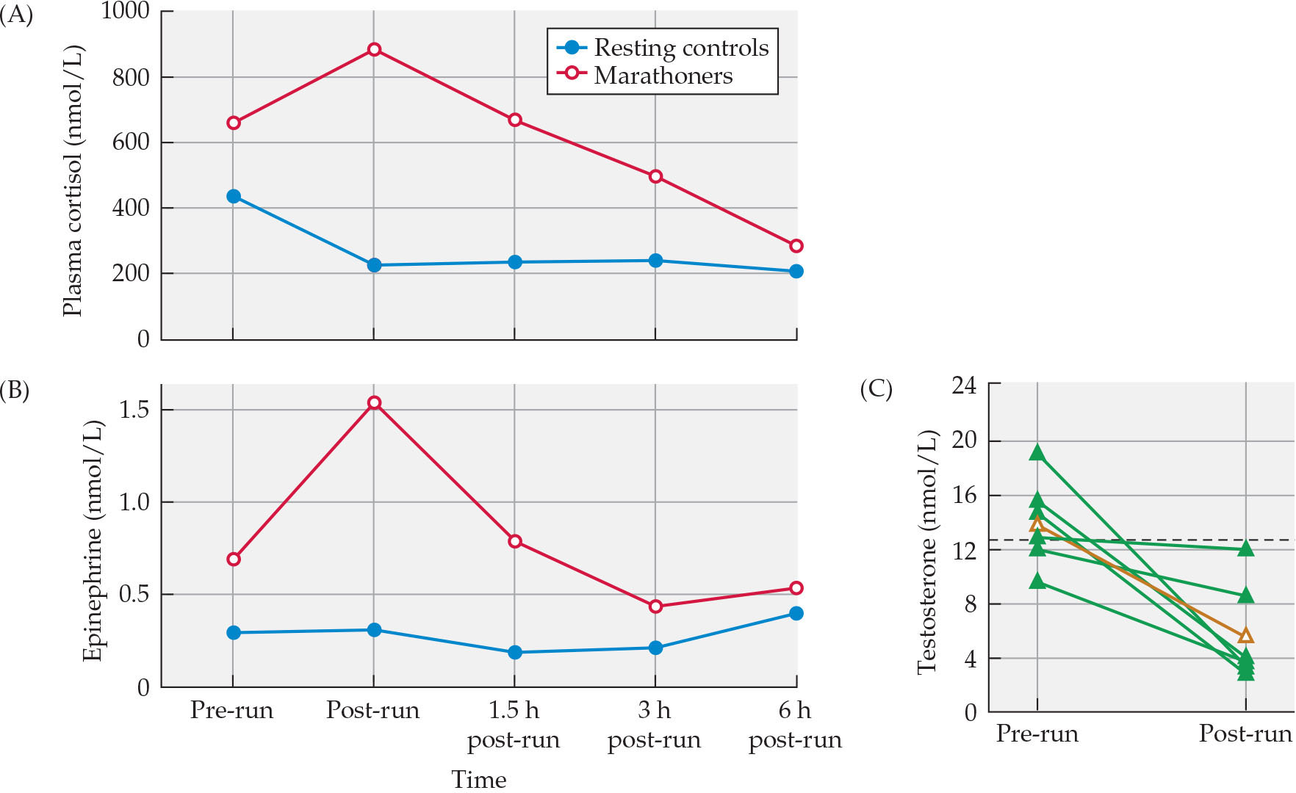
Figure 11.27 Prolonged exercise changes hormone concentrations
Notes:
Figure 11.27 Prolonged exercise changes hormone concentrations Male marathon runners have elevated plasma cortisol (A) and epinephrine (B), but their testosterone levels (C) are decreased by half. In (C) the results for individual runners are shown in green; the brown plot shows the mean. A and B after D. Nieman. 1997. J Appl Physiol 82: 1385. Based on D. Nieman et al. 1995. J Appl Physiol 79: 748 and D. Nieman et al. 1995. Int J Sports Med 16: 404. C after W. J. Kraemer et al. 2008. Br J Sports Med 42: 116.

Slide 46
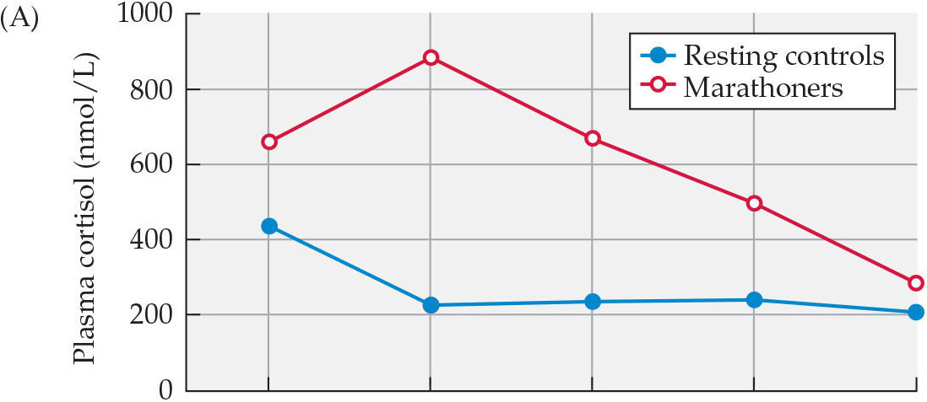
Figure 11.27(a) Prolonged exercise changes hormone concentrations
Notes:
Figure 11.27 Prolonged exercise changes hormone concentrations Male marathon runners have elevated plasma cortisol (A) and epinephrine (B), but their testosterone levels (C) are decreased by half. In (C) the results for individual runners are shown in green; the brown plot shows the mean. A and B after D. Nieman. 1997. J Appl Physiol 82: 1385. Based on D. Nieman et al. 1995. J Appl Physiol 79: 748 and D. Nieman et al. 1995. Int J Sports Med 16: 404. C after W. J. Kraemer et al. 2008. Br J Sports Med 42: 116.

Slide 47
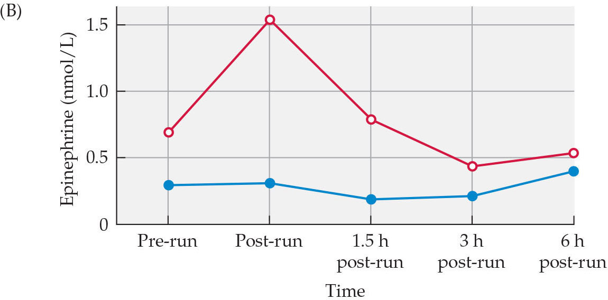
Figure 11.27(b) Prolonged exercise changes hormone concentrations
Notes:
Figure 11.27 Prolonged exercise changes hormone concentrations Male marathon runners have elevated plasma cortisol (A) and epinephrine (B), but their testosterone levels (C) are decreased by half. In (C) the results for individual runners are shown in green; the brown plot shows the mean. A and B after D. Nieman. 1997. J Appl Physiol 82: 1385. Based on D. Nieman et al. 1995. J Appl Physiol 79: 748 and D. Nieman et al. 1995. Int J Sports Med 16: 404. C after W. J. Kraemer et al. 2008. Br J Sports Med 42: 116.

Slide 48
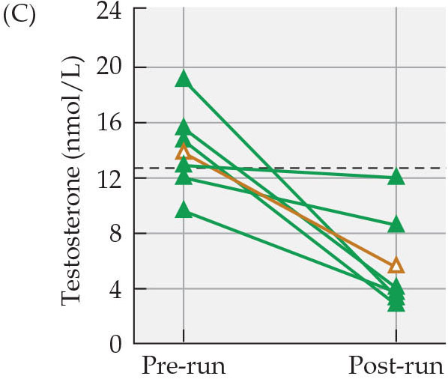
Figure 11.27(c) Prolonged exercise changes hormone concentrations
Notes:
Figure 11.27 Prolonged exercise changes hormone concentrations Male marathon runners have elevated plasma cortisol (A) and epinephrine (B), but their testosterone levels (C) are decreased by half. In (C) the results for individual runners are shown in green; the brown plot shows the mean. A and B after D. Nieman. 1997. J Appl Physiol 82: 1385. Based on D. Nieman et al. 1995. J Appl Physiol 79: 748 and D. Nieman et al. 1995. Int J Sports Med 16: 404. C after W. J. Kraemer et al. 2008. Br J Sports Med 42: 116.

Slide 49
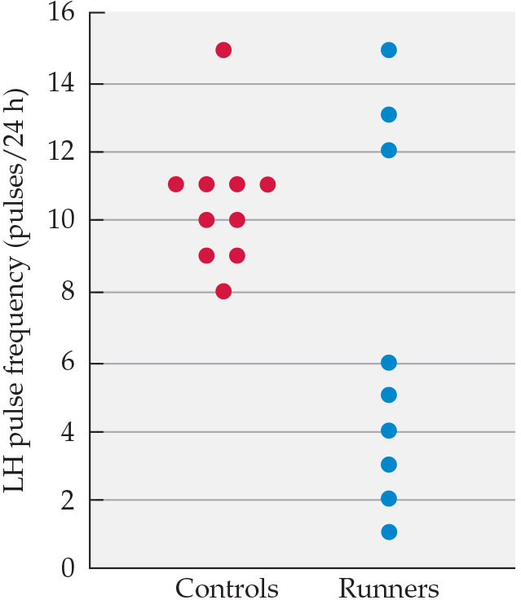
Figure 11.28 Effects of exercise on LH pulse frequency
Notes:
Figure 11.28 Effects of exercise on LH pulse frequency LH pulses are less frequent in women who are long-distance runners, which may be related to the high reported incidence of amenorrhea among such women. After J. D. Veldhuis et al. 1985. J Clin Endocrinol Metab 61: 557.

Slide 50
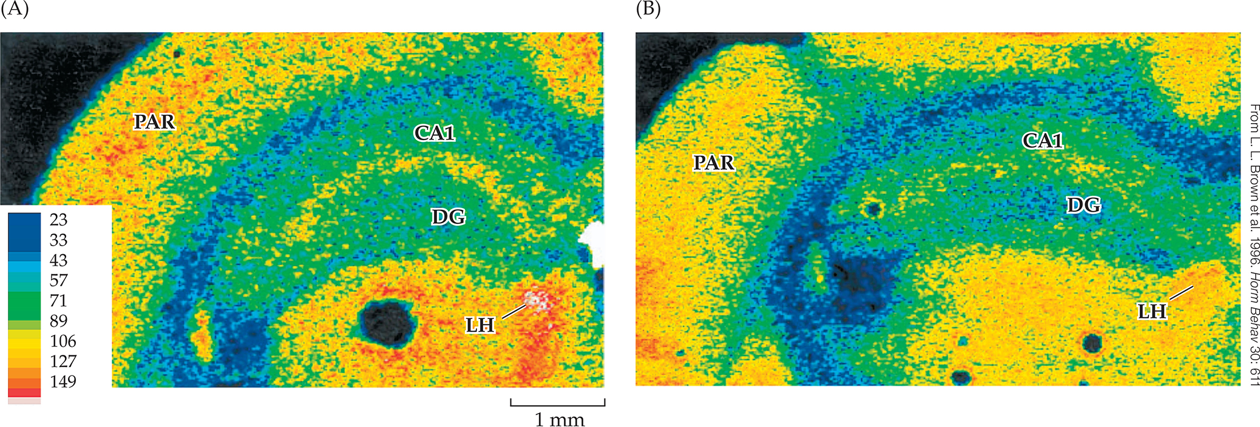
Figure 11.29 Sex differences in glucose utilization under stress
Notes:
Figure 11.29 Sex differences in glucose utilization under stress Females (A) show greater brain utilization of glucose than males (B) under stress. Higher glucose utilization is indicated by warmer colors in these false-color images. This difference is seen in all brain regions but is especially prominent in the CA1 region and dentate gyrus (DG) of the hippocampus.

Slide 51
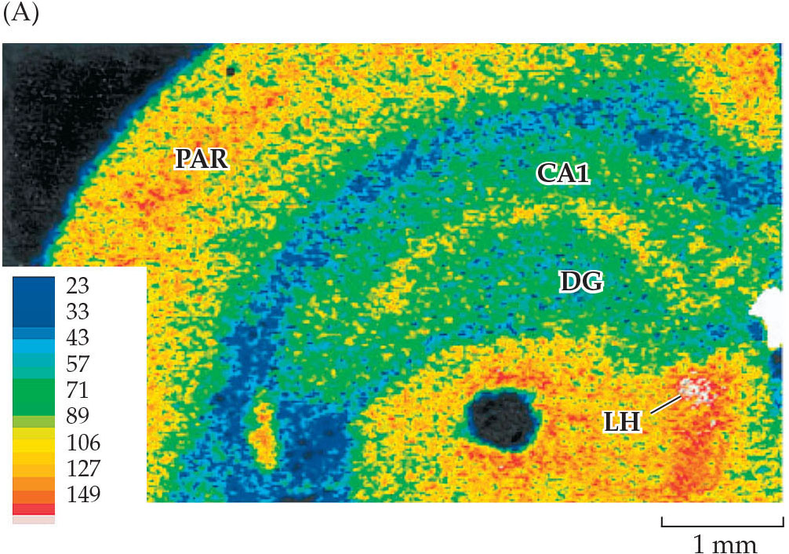
Figure 11.29(a) Sex differences in glucose utilization under stress
Notes:
Figure 11.29 Sex differences in glucose utilization under stress Females (A) show greater brain utilization of glucose than males (B) under stress. Higher glucose utilization is indicated by warmer colors in these false-color images. This difference is seen in all brain regions but is especially prominent in the CA1 region and dentate gyrus (DG) of the hippocampus.

Slide 52

Figure 11.29(b) Sex differences in glucose utilization under stress
Notes:
Figure 11.29 Sex differences in glucose utilization under stress Females (A) show greater brain utilization of glucose than males (B) under stress. Higher glucose utilization is indicated by warmer colors in these false-color images. This difference is seen in all brain regions but is especially prominent in the CA1 region and dentate gyrus (DG) of the hippocampus.

Slide 53

Figure 11.30 Juvenile male mice that experienced social defeat at 32 days of age
Notes:
Figure 11.30 Juvenile male mice that experienced social defeat at 32 days of age have levels of social interaction with a target mouse that are similar to those of young males that did not experience defeat (controls) at 32 days of age (P32). (A) The same mice tested again as adults (P62) display two different phenotypes: one subset of mice continue to display a susceptible phenotype characterized by social avoidance, whereas a second subset, of resilient mice, show much more social interaction, similar to nondefeated mice. (B) Mice that maintain the resistance in adulthood (P62) displayed significantly elevated corticosterone during social interaction when tested as juveniles (P32). Resistant mice had elevated corticosterone at P32 compared with their baseline values at P23 or compared with susceptible and undefeated mice. After M. S. Latsko et al. 2016. Horm Behav 82: 38.

Slide 54

Figure 11.30(a) Juvenile male mice that experienced social defeat at 32 days of age
Notes:
Figure 11.30 Juvenile male mice that experienced social defeat at 32 days of age have levels of social interaction with a target mouse that are similar to those of young males that did not experience defeat (controls) at 32 days of age (P32). (A) The same mice tested again as adults (P62) display two different phenotypes: one subset of mice continue to display a susceptible phenotype characterized by social avoidance, whereas a second subset, of resilient mice, show much more social interaction, similar to nondefeated mice. (B) Mice that maintain the resistance in adulthood (P62) displayed significantly elevated corticosterone during social interaction when tested as juveniles (P32). Resistant mice had elevated corticosterone at P32 compared with their baseline values at P23 or compared with susceptible and undefeated mice. After M. S. Latsko et al. 2016. Horm Behav 82: 38.

Slide 55

Figure 11.30(b) Juvenile male mice that experienced social defeat at 32 days of age
Notes:
Figure 11.30 Juvenile male mice that experienced social defeat at 32 days of age have levels of social interaction with a target mouse that are similar to those of young males that did not experience defeat (controls) at 32 days of age (P32). (A) The same mice tested again as adults (P62) display two different phenotypes: one subset of mice continue to display a susceptible phenotype characterized by social avoidance, whereas a second subset, of resilient mice, show much more social interaction, similar to nondefeated mice. (B) Mice that maintain the resistance in adulthood (P62) displayed significantly elevated corticosterone during social interaction when tested as juveniles (P32). Resistant mice had elevated corticosterone at P32 compared with their baseline values at P23 or compared with susceptible and undefeated mice. After M. S. Latsko et al. 2016. Horm Behav 82: 38.

Slide 56

Figure 11.31 Neural degeneration associated with stress
Notes:
Figure 11.31 Neural degeneration associated with stress The numbers of black spots in the hippocampal region between the arrows illustrate the normal condition of an unstressed vervet monkey (A) and the large deficit in pyramidal cells in a monkey subjected to stress (B).

Slide 57

Figure 11.31(a) Neural degeneration associated with stress
Notes:
Figure 11.31 Neural degeneration associated with stress The numbers of black spots in the hippocampal region between the arrows illustrate the normal condition of an unstressed vervet monkey (A) and the large deficit in pyramidal cells in a monkey subjected to stress (B).

Slide 58

Figure 11.31(b) Neural degeneration associated with stress
Notes:
Figure 11.31 Neural degeneration associated with stress The numbers of black spots in the hippocampal region between the arrows illustrate the normal condition of an unstressed vervet monkey (A) and the large deficit in pyramidal cells in a monkey subjected to stress (B).

Slide 59

Figure 11.32 Correlations of hippocampal volume and severity of PTSD symptoms
Notes:
Figure 11.32 Correlations of hippocampal volume and severity of PTSD symptoms reveal similar relationships in Vietnam combat veterans (A) and their non-combat-experienced twin brothers (B). The results suggest that having a small hippocampus might be a risk factor for PTSD, rather than a result of PTSD. After M. W. Gilbertson et al. 2002. Nat Neurosci 5: 1242.

Slide 60

Figure 11.32(a) Correlations of hippocampal volume and severity of PTSD symptoms
Notes:
Figure 11.32 Correlations of hippocampal volume and severity of PTSD symptoms reveal similar relationships in Vietnam combat veterans (A) and their non-combat-experienced twin brothers (B). The results suggest that having a small hippocampus might be a risk factor for PTSD, rather than a result of PTSD. After M. W. Gilbertson et al. 2002. Nat Neurosci 5: 1242.

Slide 61

Figure 11.32(b) Correlations of hippocampal volume and severity of PTSD symptoms
Notes:
Figure 11.32 Correlations of hippocampal volume and severity of PTSD symptoms reveal similar relationships in Vietnam combat veterans (A) and their non-combat-experienced twin brothers (B). The results suggest that having a small hippocampus might be a risk factor for PTSD, rather than a result of PTSD. After M. W. Gilbertson et al. 2002. Nat Neurosci 5: 1242.

Slide 62

Figure 11.33 Veterans with post-traumatic stress disorder (PTSD)
Notes:
Figure 11.33 Veterans with post-traumatic stress disorder (PTSD) showed less GABA_{A}-benzodiazepine binding (yellow areas) in a PET scan throughout the brain, but especially in the hippocampus, insula, and thalamus and the prefrontal, temporal, and parietal cortices.

Slide 63

Figure 11.34 Predictability of shock determines pathological stress responses in rats
Notes:
Figure 11.34 Predictability of shock determines pathological stress responses in rats This graph depicts the lengths of gastric ulcerations in rats that were given electric shocks, either signaled or unsignaled by a warning bell. Although rats in both conditions heard the same number of warning bells and received the same number of electric shocks, the contingency of the bell and shocks provided a psychological factor that mediated the physical response to stress. After J. M. Weiss. 1972. Sci Am 226: 104. Reproduced with permission. © 1972. Scientific American, Inc. All rights reserved.

Slide 64

Figure 11.35 Proximity to the World Trade Center on 9/11/01 reduced gray matter
Notes:
Figure 11.35 Proximity to the World Trade Center on 9/11/01 reduced gray matter throughout the brains of otherwise healthy adults. Brain regions with smaller gray matter volumes included the hippocampus, insula, and amygdala and the anterior cingulate and medial prefrontal cortices. In this brain scan, yellow color highlights the left amygdala (A), one area that showed a significant decrease in exposed adults (B). After B. L. Ganzel et al. 2008. Neuroimage 40: 788.

Slide 65

Figure 11.35(a) Proximity to the World Trade Center on 9/11/01 reduced gray matter
Notes:
Figure 11.35 Proximity to the World Trade Center on 9/11/01 reduced gray matter throughout the brains of otherwise healthy adults. Brain regions with smaller gray matter volumes included the hippocampus, insula, and amygdala and the anterior cingulate and medial prefrontal cortices. In this brain scan, yellow color highlights the left amygdala (A), one area that showed a significant decrease in exposed adults (B). After B. L. Ganzel et al. 2008. Neuroimage 40: 788.

Slide 66

Figure 11.35(b) Proximity to the World Trade Center on 9/11/01 reduced gray matter
Notes:
Figure 11.35 Proximity to the World Trade Center on 9/11/01 reduced gray matter throughout the brains of otherwise healthy adults. Brain regions with smaller gray matter volumes included the hippocampus, insula, and amygdala and the anterior cingulate and medial prefrontal cortices. In this brain scan, yellow color highlights the left amygdala (A), one area that showed a significant decrease in exposed adults (B). After B. L. Ganzel et al. 2008. Neuroimage 40: 788.

Slide 67

Figure 11.36 Leg swinging as a displacement activity reduces heart rate
Notes:
Figure 11.36 Leg swinging as a displacement activity reduces heart rate Leg swinging by first-grade children engages the parasympathetic system, which reduces heart rate, regardless of whether the children are involved (active) or uninvolved (passive) in learning activities. After R. Soussignan and P. Koch. 1985. Biol Psychol 21: 161.

Slide 68

Table 11.4 Interventions to reduce the effects of stress on the brain
Notes:
Table 11.4 Interventions to reduce the effects of stress on the brain

