Slide 1
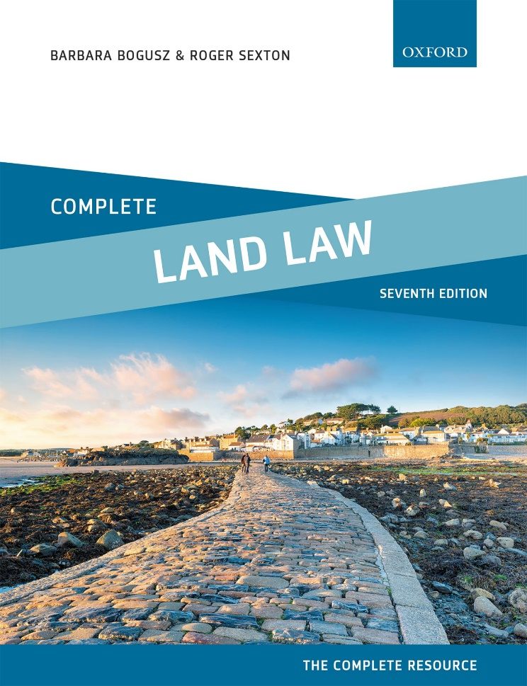
COMPLETE LAND LAW Text, Cases, and Materials by Barbara Bogusz and Roger Sexton

Slide 2
Part 11 Mortgages Chapter 23 The Remedies of Mortgagees

Slide 3
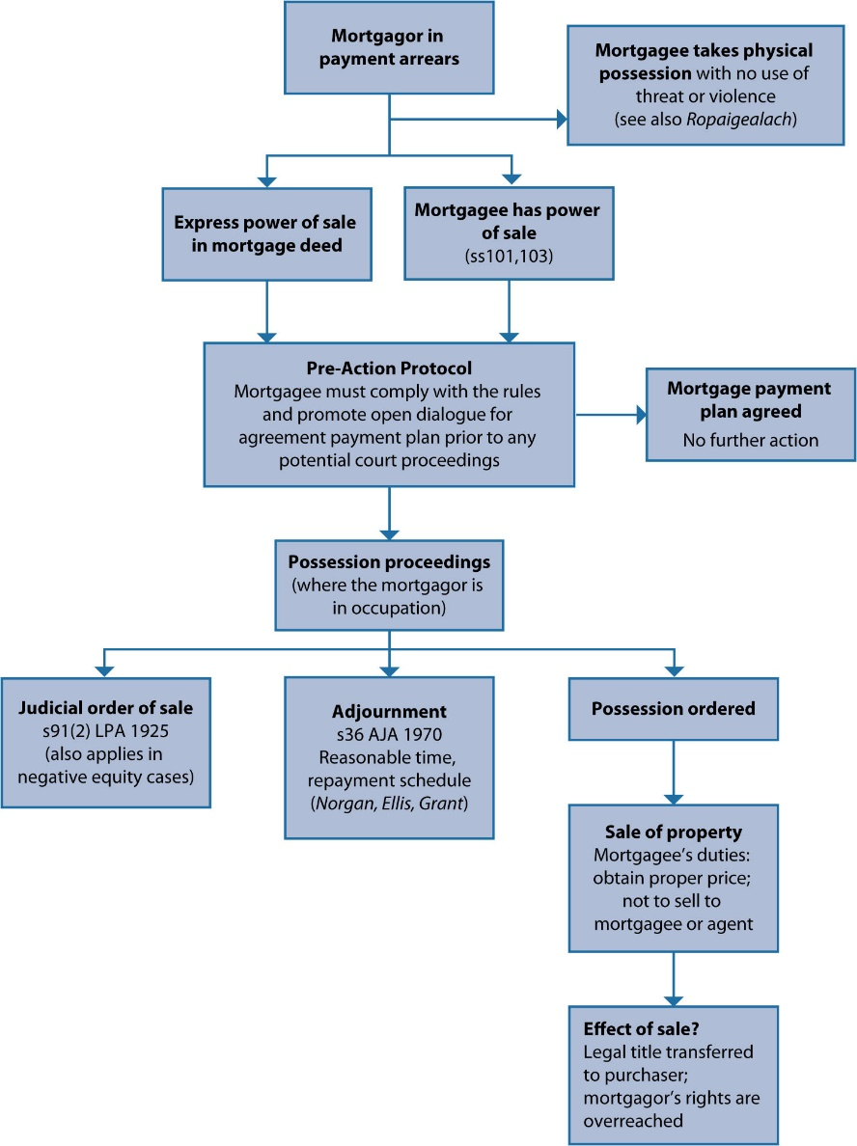
Diagram 23.1 Position where the mortgagee is wishing to sell the residential property

