Slide 1
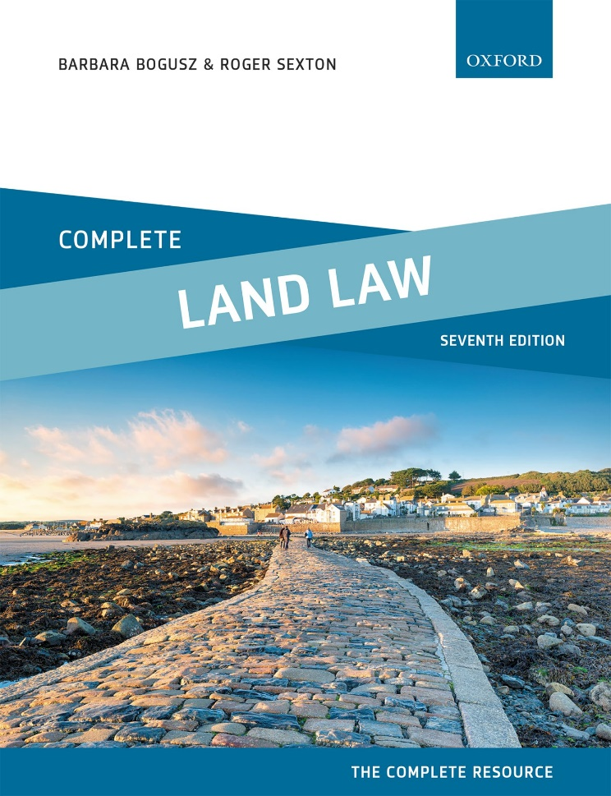
COMPLETE LAND LAW Text, Cases, and Materials by Barbara Bogusz and Roger Sexton

Slide 2
Part 10 Freehold Covenants: Restrictive and Positive Covenants Chapter 20 Freehold Covenants

Slide 3
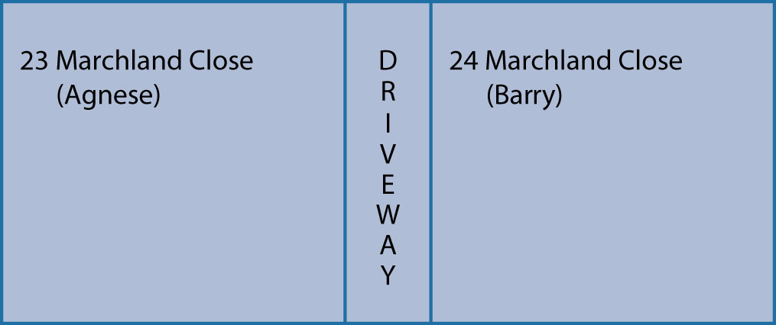
Diagram 20.1 23 and 24 Marchland Close

Slide 4
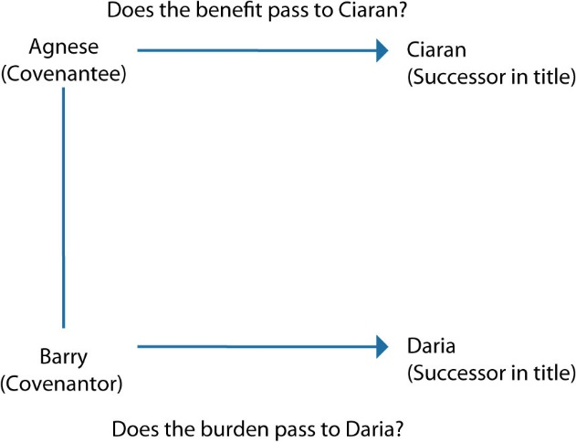
Diagram 20.2 Do the benefits and burdens of the covenants run with the land?

Slide 5
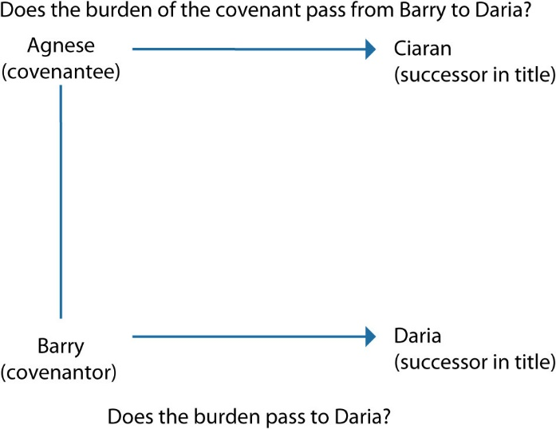
Diagram 20.3 Does the burden of the covenant pass from Barry to Daria?

Slide 6
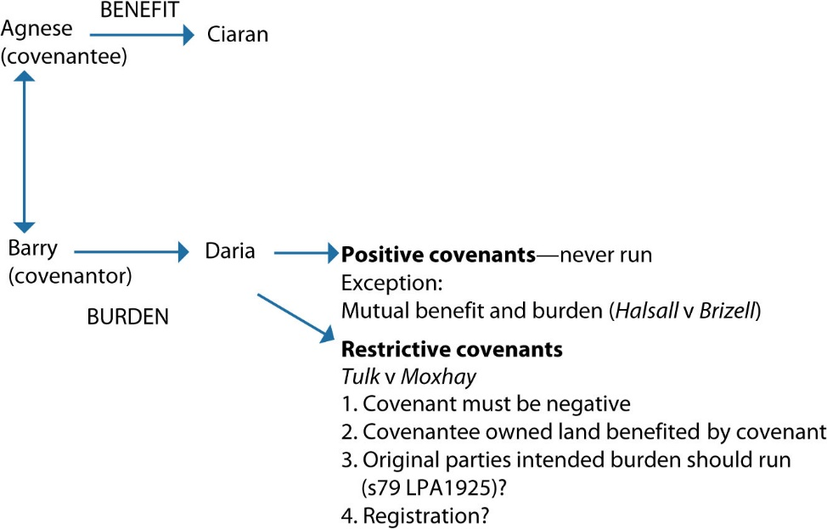
Diagram 20.4 Equity—do the burdens of the covenants pass to Daria?

Slide 7
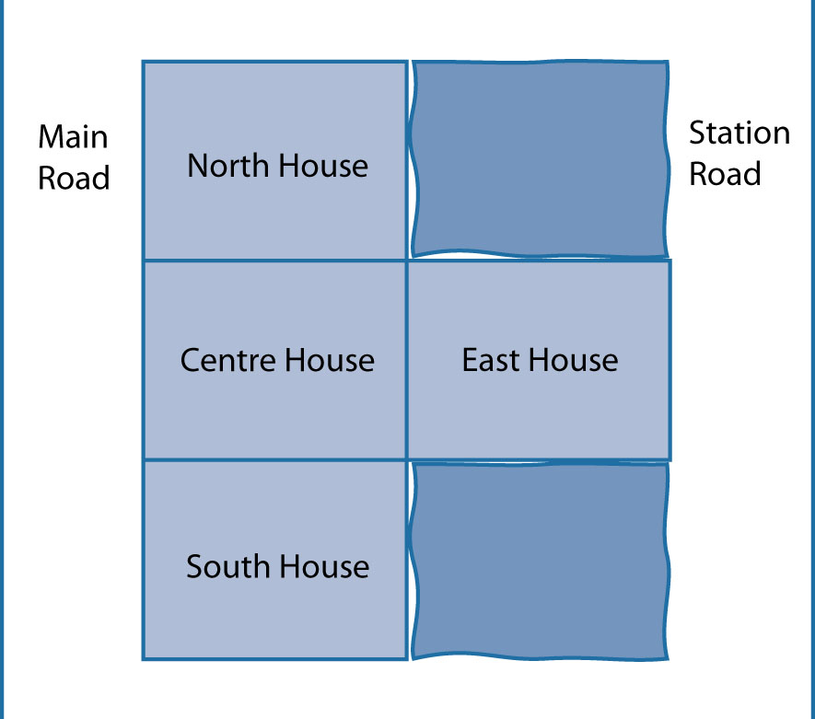
Diagram 20.5 Centre house and neighbouring properties

Slide 8
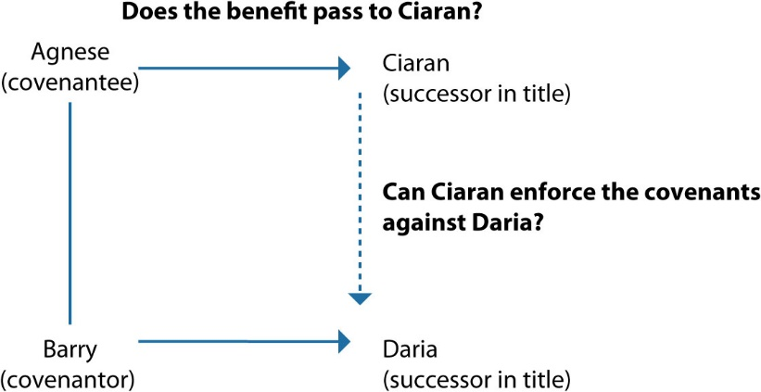
Diagram 20.6 Can Ciaran claim the benefit of the covenants and enforce them against Daria?

Slide 9
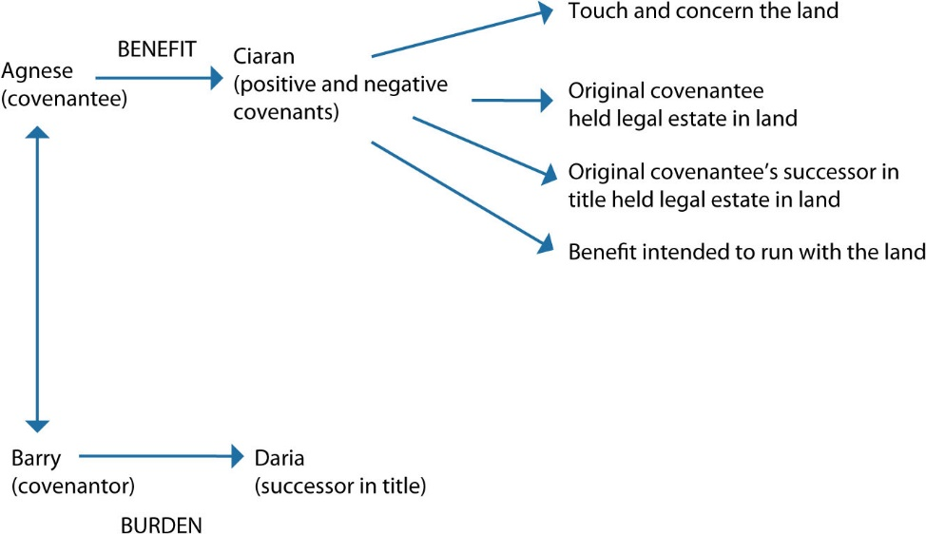
Diagram 20.7 Common law—passing of the benefit of positive and negative covenants

Slide 10
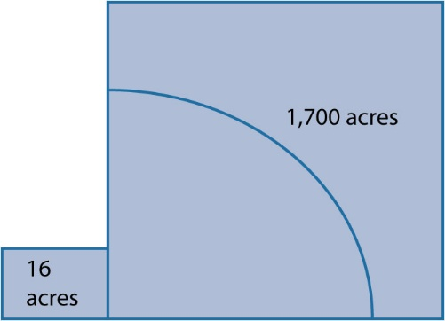
Diagram 20.8 The dominant and servient land in Re Ballard’s Conveyance

Slide 11
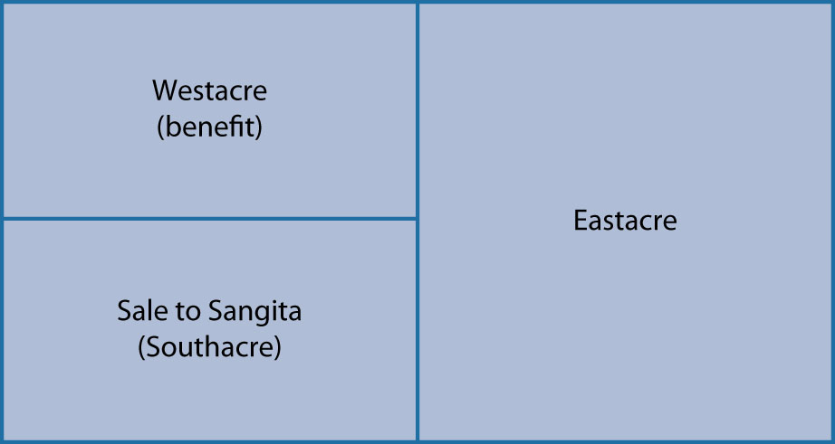
Diagram 20.9 Annexation destroyed where dominant land is subdivided

Slide 12
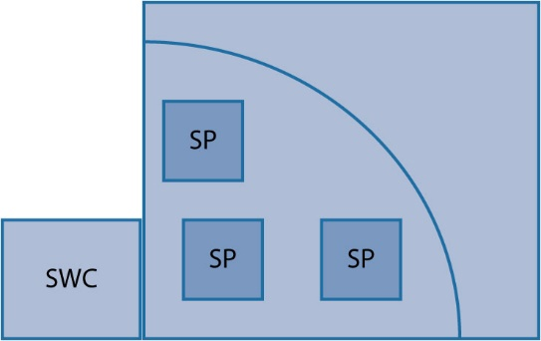
Diagram 20.10 Annexation to each and every part of Bigpots Estate

Slide 13
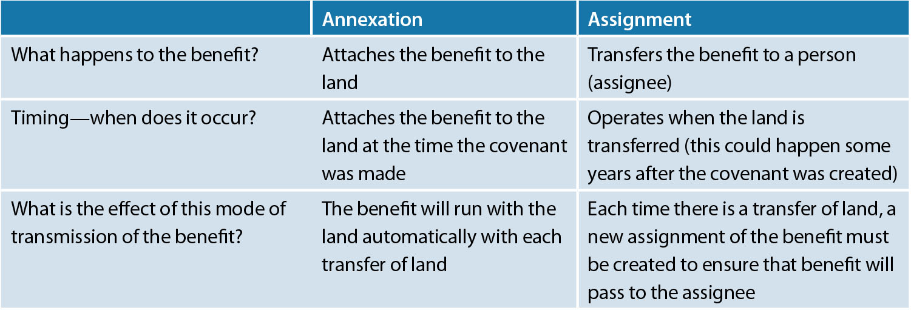
Table 20.1 Comparison between annexation and assignment

Slide 14
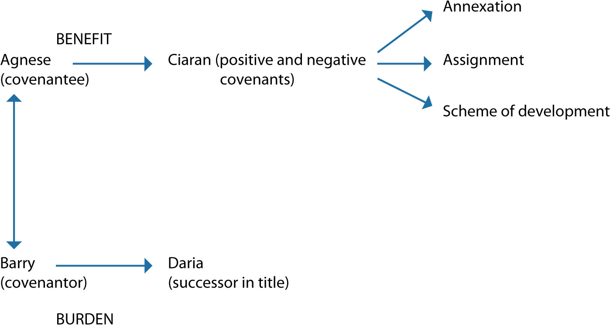
Diagram 20.11 Does the benefit of the covenant pass to Ciaran in equity?

Slide 15
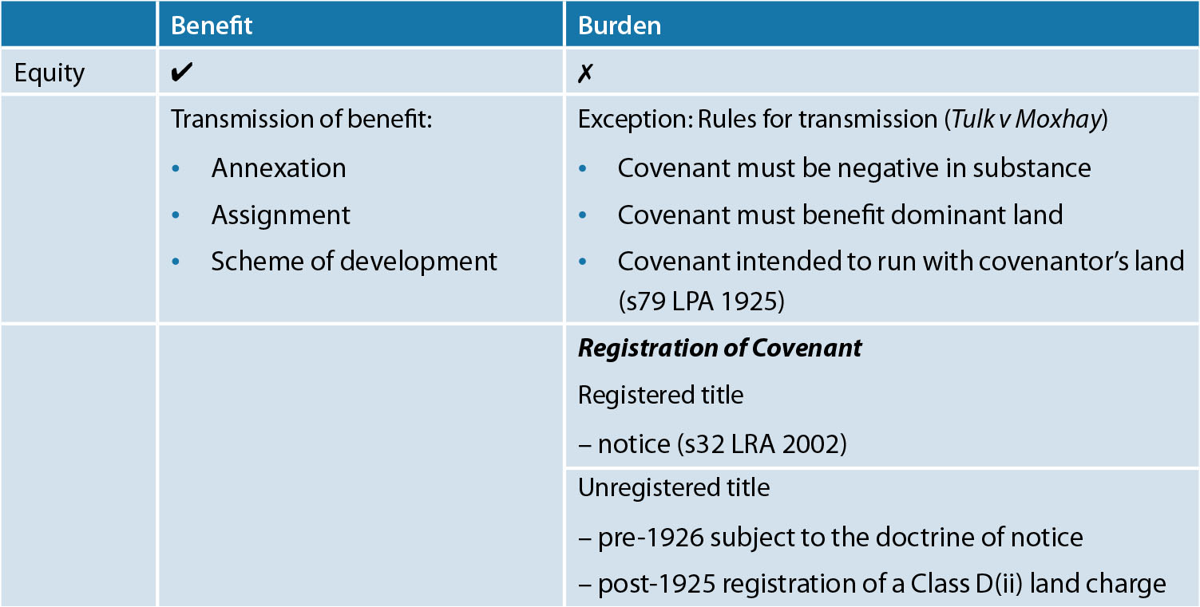
Table 20.2 Does the benefit and burden run with the land in equity?

