Slide 1
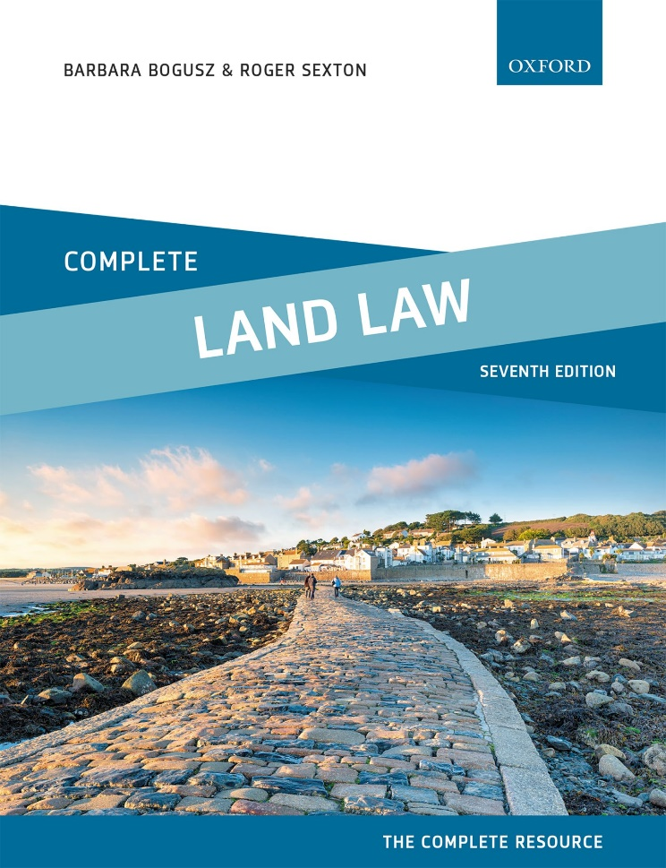
COMPLETE LAND LAW Text, Cases, and Materials by Barbara Bogusz and Roger Sexton

Slide 2
Part 9 Easements Chapter 18 The Creation of Express and Implied Grant of Easements

Slide 3
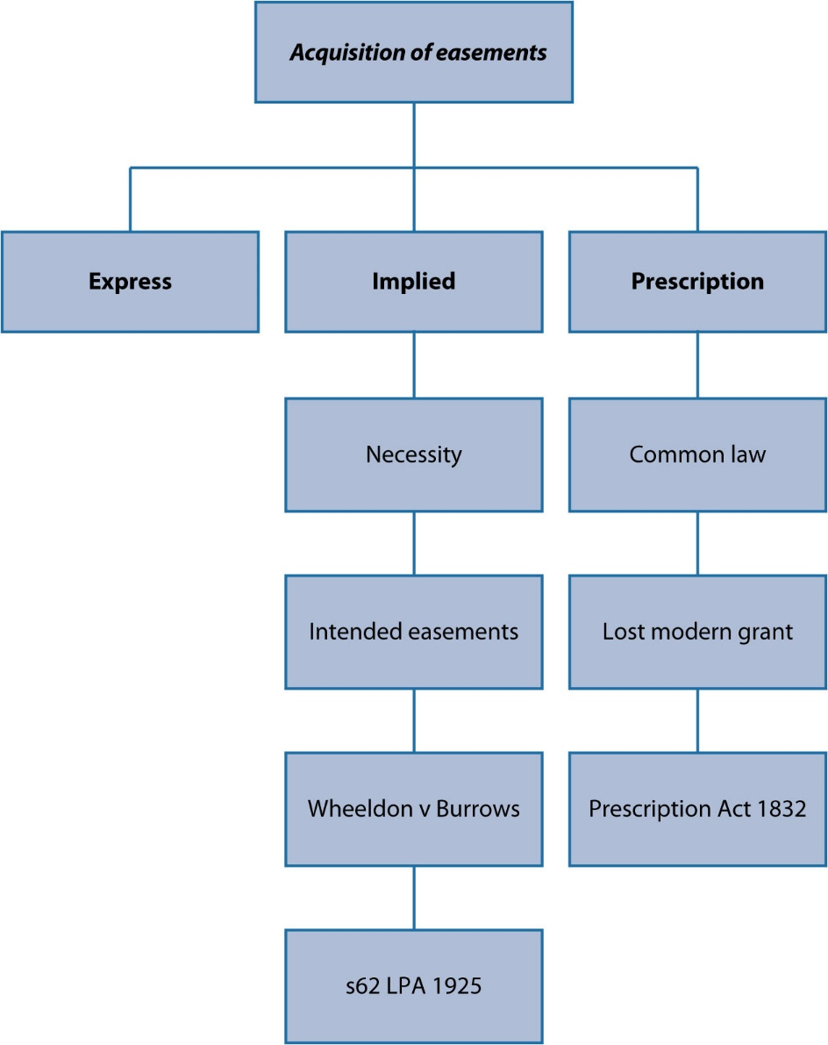
Diagram 18.1 Summary of the various ways an easement may be acquired

Slide 4
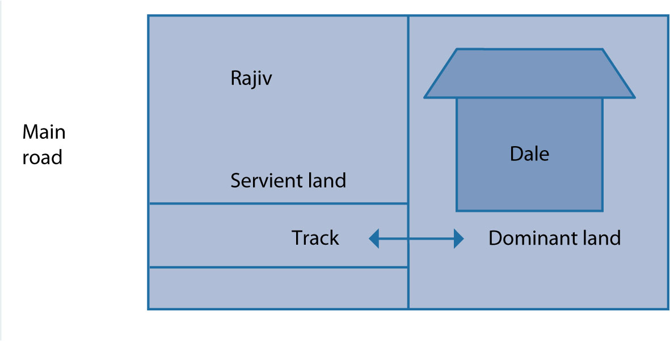
Diagram 18.2 Rajiv grants Dale an easement

Slide 5
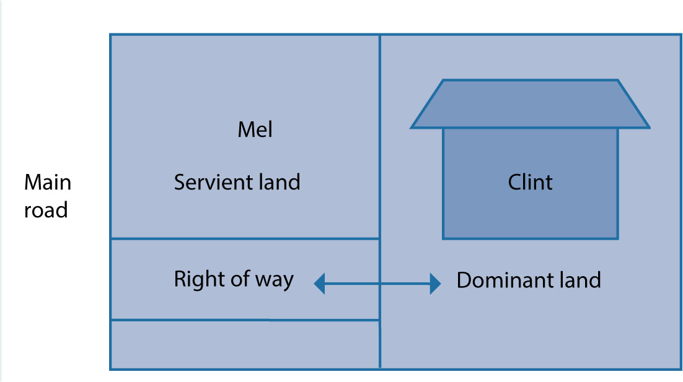
Diagram 18.3 Clint retains the right to cross Mel’s plot

Slide 6
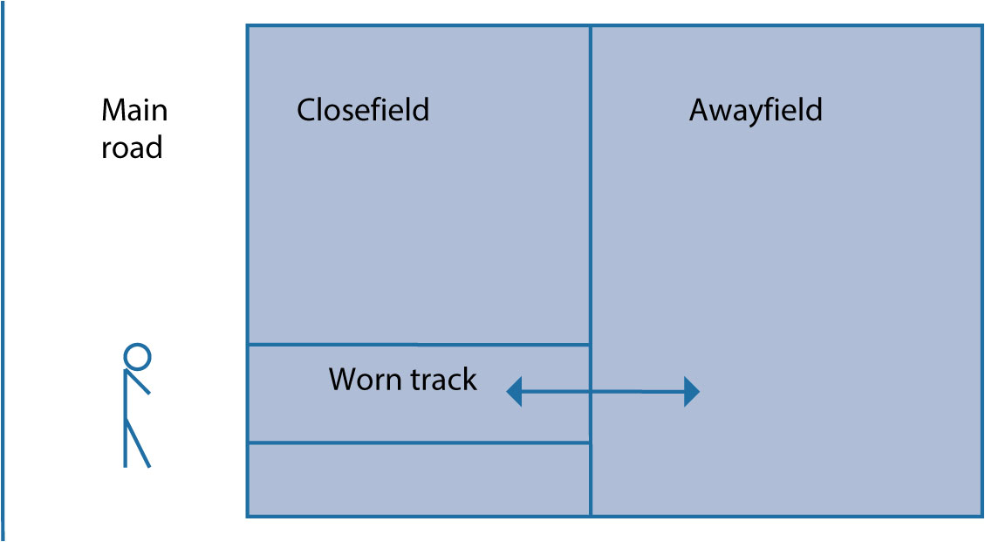
Diagram 18.4 Two plots owned by the same person

Slide 7
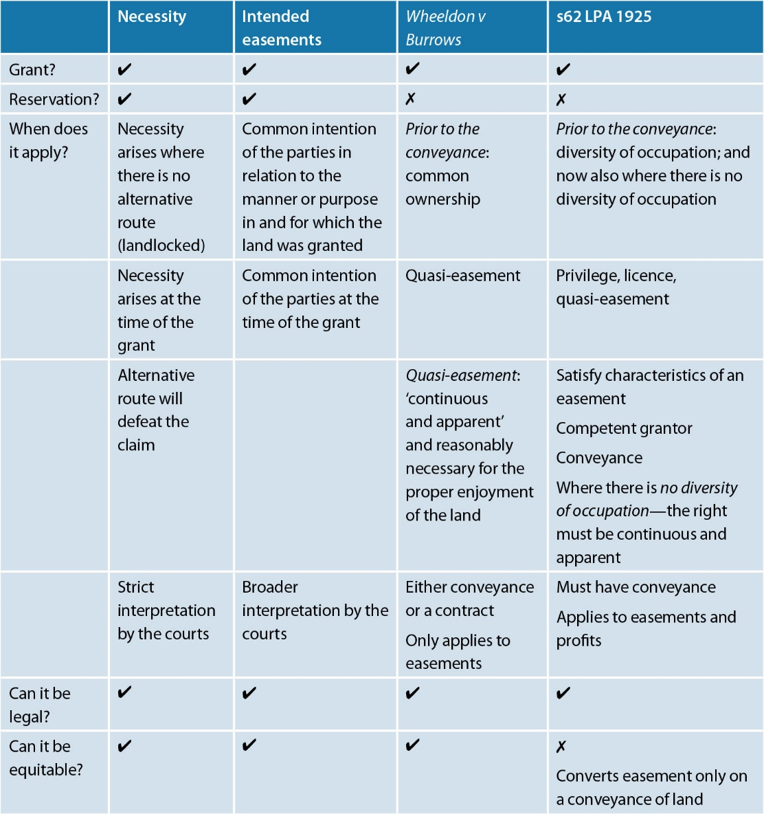
Table 18.1 Summary of the key points relating to implied easements

