Slide 1
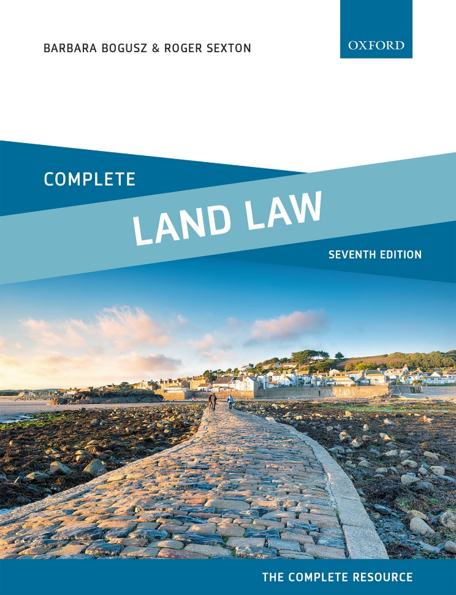
COMPLETE LAND LAW
Text, Cases, and Materials by Barbara Bogusz and Roger Sexton

Slide 2
Part 8
Protection for the Purchaser of Registered Land
Chapter 16
Rectification of the Register of Title

Slide 3
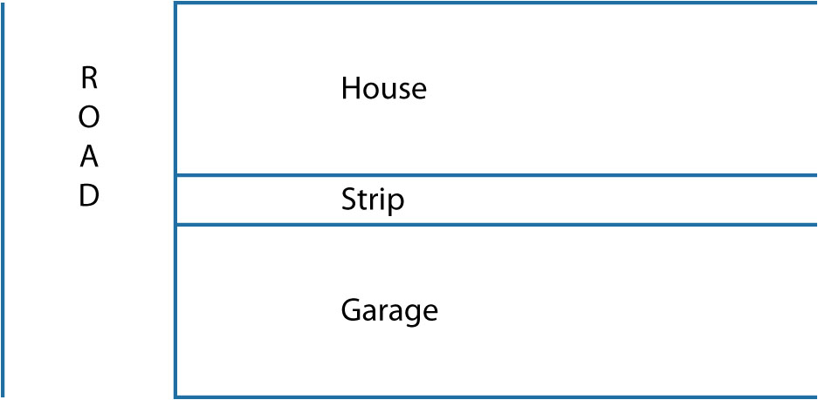
Diagram 16.1 The land in dispute in Epps v Esso [1973]

