Slide 1
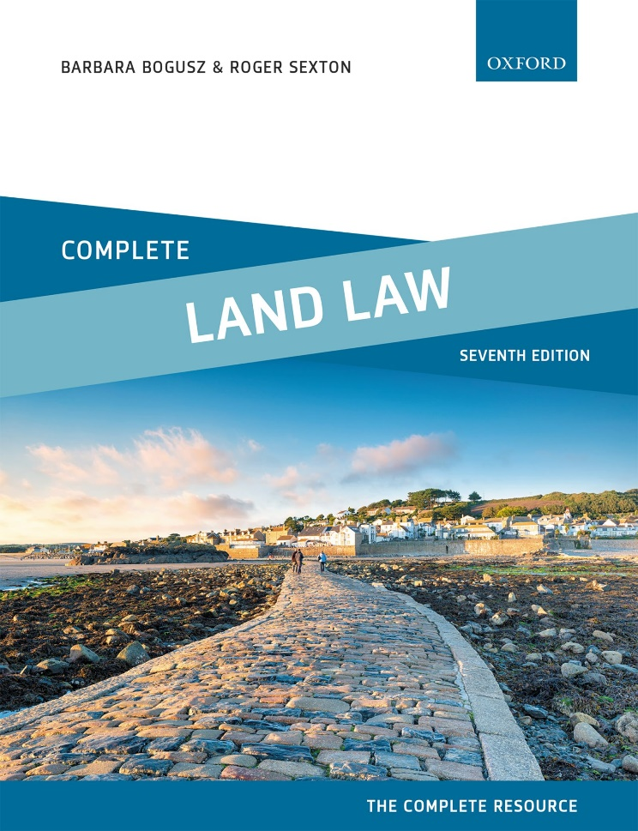
COMPLETE LAND LAW Text, Cases, and Materials by Barbara Bogusz and Roger Sexton

Slide 2
Part 4 Acquisition of Interests in Land (I) Chapter 08 Co-Ownership of Land—the Basic Principles

Slide 3
Diagram 8.1 Joint tenancy

Slide 4
Diagram 8.2 Right of survivorship

Slide 5
Diagram 8.3 Aidan, Ben, and callum are tenants in common of Lodge farm

Slide 6
Diagram 8.4 Aidan dies and leaves his one-third share to Donatella. Ben dies intestate and his share passes to Elspeth.

Slide 7
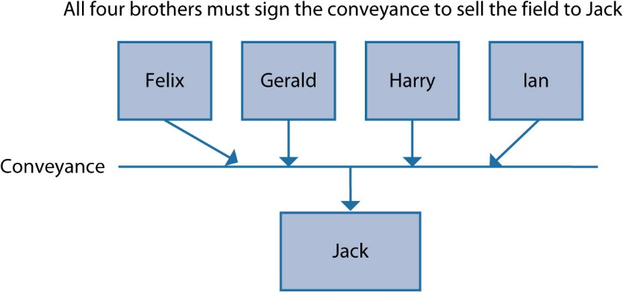
Diagram 8.5 Felix, Gerald, Harry, and Ian are tenants in common; Jack has bought a field from them

Slide 8
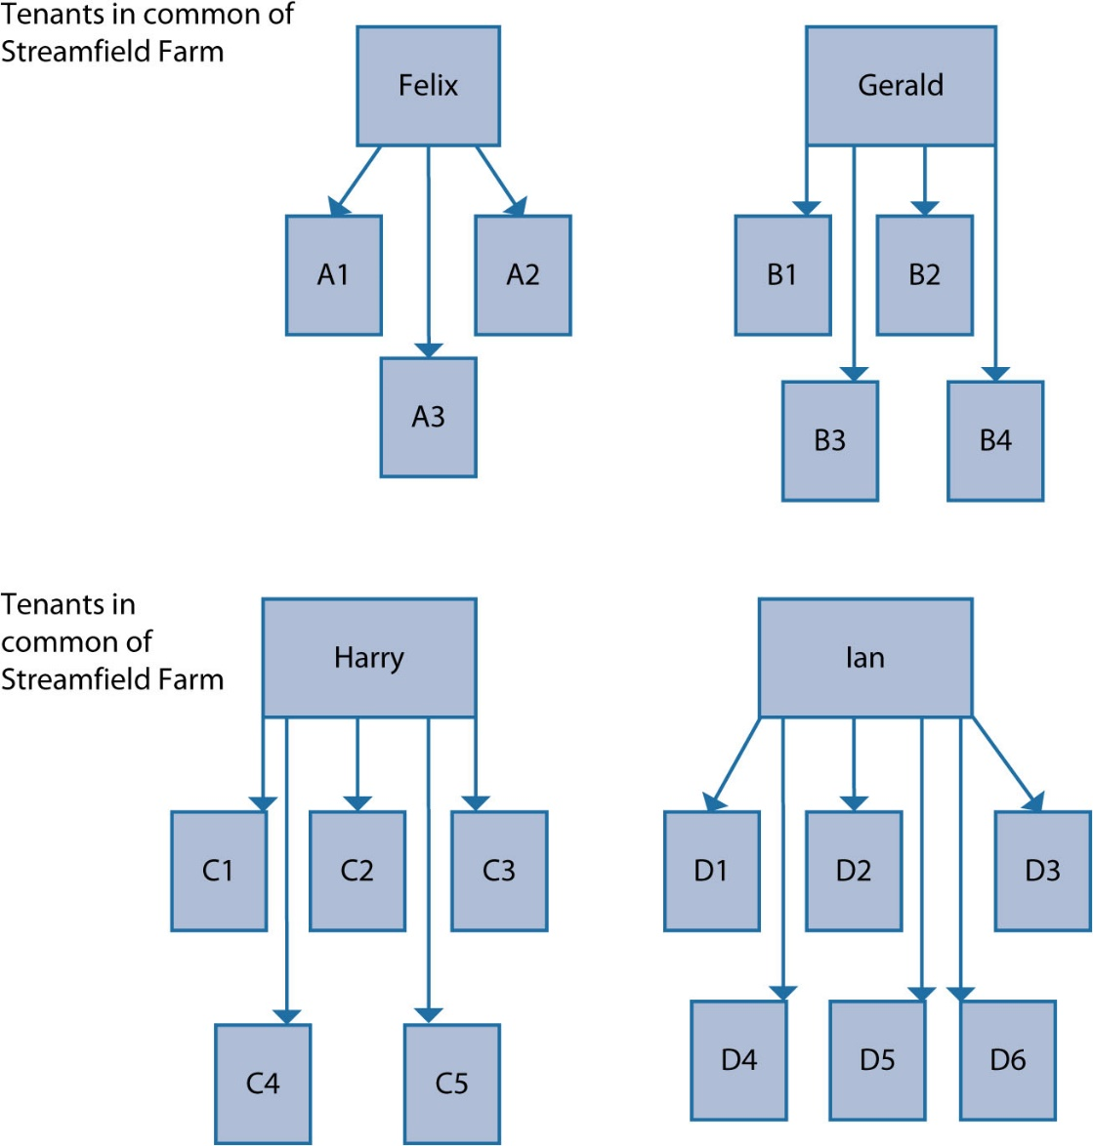
Diagram 8.6 Streamfield Farm in the early 1920s

Slide 9
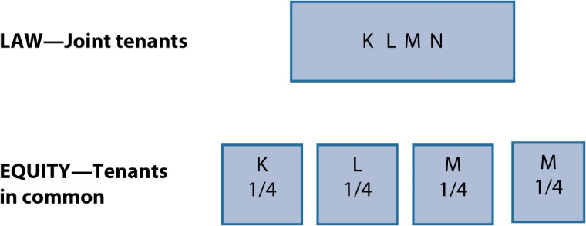
Diagram 8.7 Co-ownership of Stoneygate Farm—2000 conveyance

Slide 10
Diagram 8.8 Co-ownership of Stoneygate Farm following Keith’s death in 2020

Slide 11
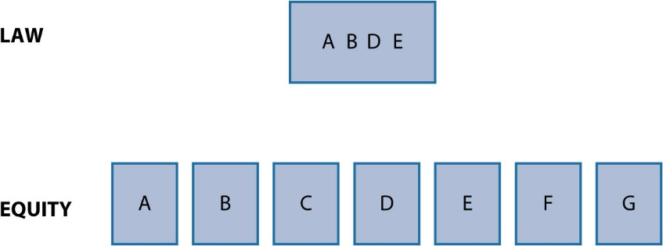
Diagram 8.9 Co-ownership of property where there are more than four tenants

Slide 12
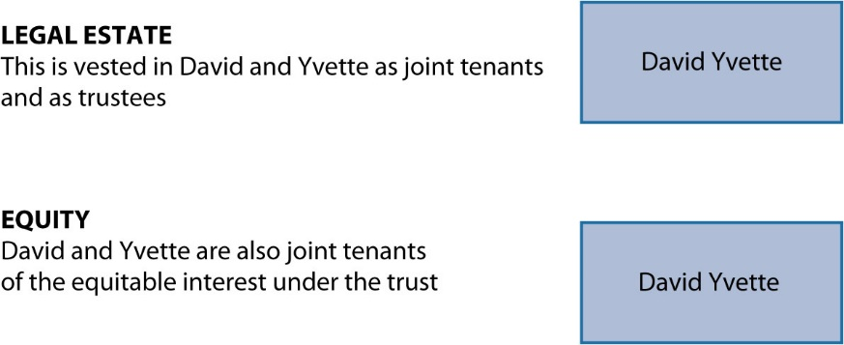
Diagram 8.10 23 Eden Roc Avenue—co-ownership in law and in equity

Slide 13
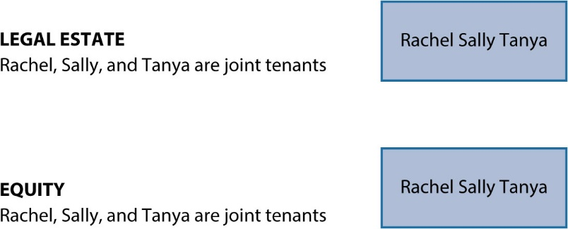
Diagram 8.11 Quickthornes—co-ownership in law and in equity

Slide 14
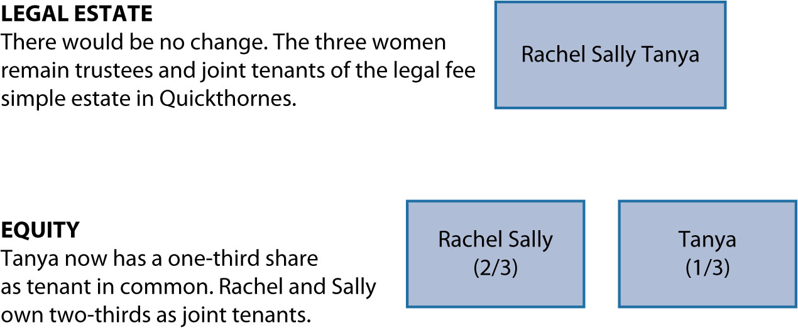
Diagram 8.12 Quickthornes—tanya’s severance of the joint tenancy

Slide 15
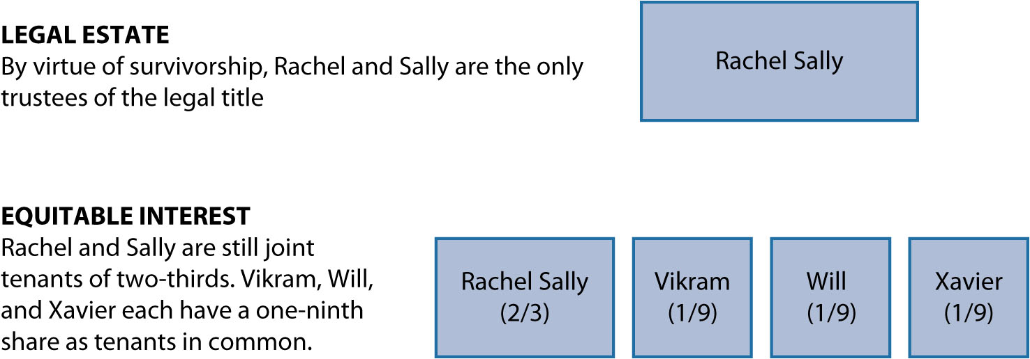
Diagram 8.13 Quickthornes—co-ownership following tanya’s death

Slide 16
Diagram 8.14 Legal and equitable co-ownership following Beth’s contribution

Slide 17
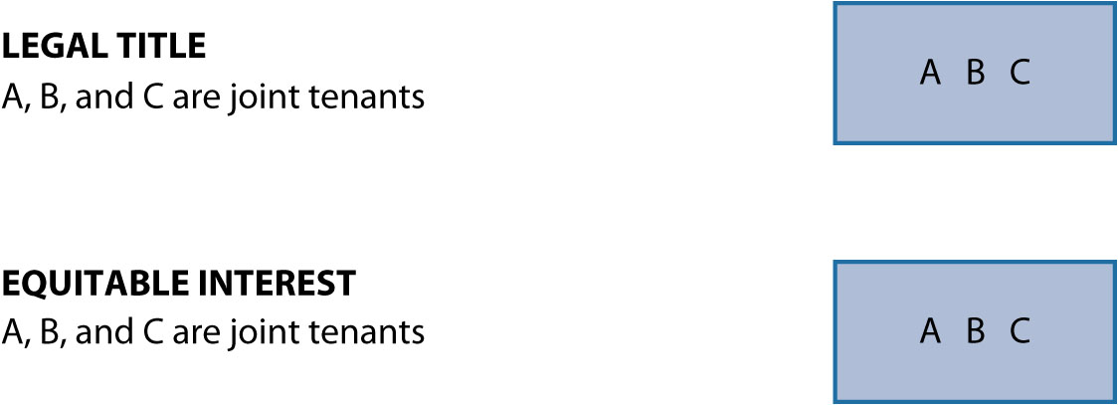
Diagram 8.15 A, B, and c are joint tenants in law and equity

Slide 18
Diagram 8.16 A severs the joint tenancy

Slide 19
Diagram 8.17 C dies

Slide 20
Diagram 8.18 Modes of severance in equity

Slide 21
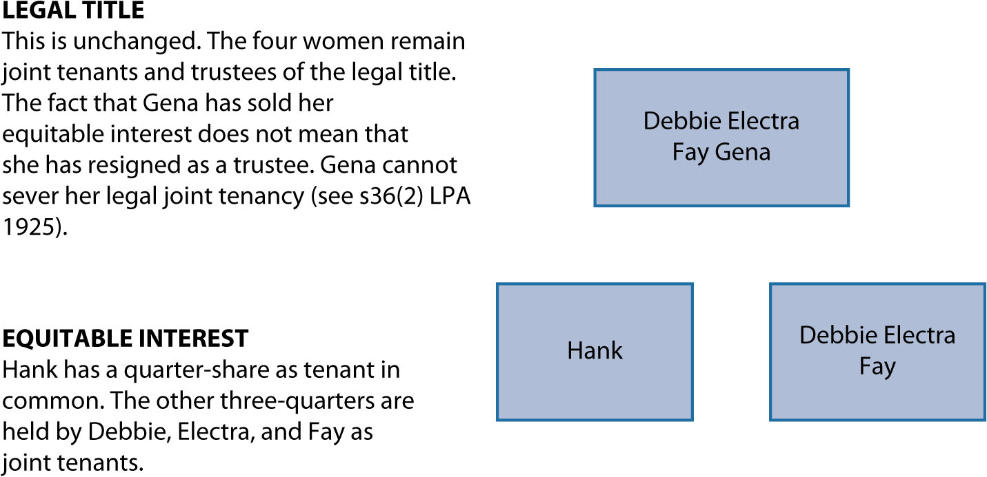
Diagram 8.19 Lodge Farm Barn—co-ownership following severance

Slide 22
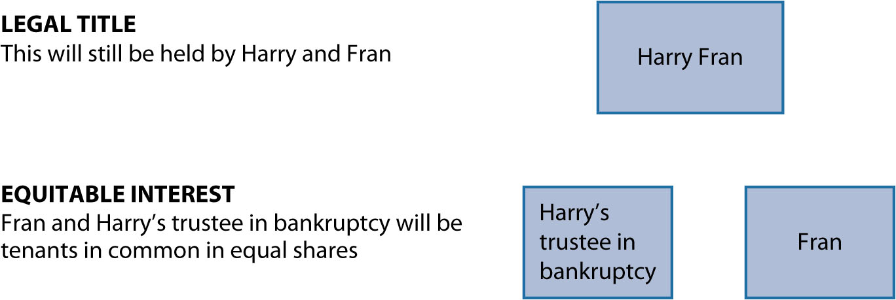
Diagram 8.20 Co-ownership and bankruptcy

