Slide 1
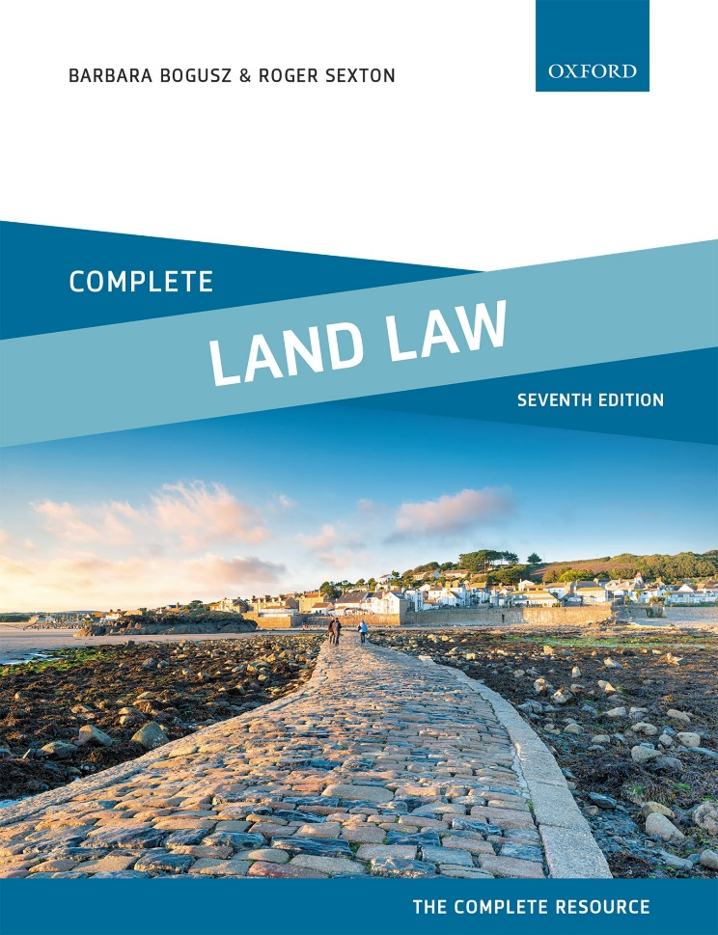
COMPLETE LAND LAW
Text, Cases, and Materials by Barbara Bogusz and Roger Sexton

Slide 2
Part 6
Leases
Chapter 13
The Running of Covenants in a Lease

Slide 3
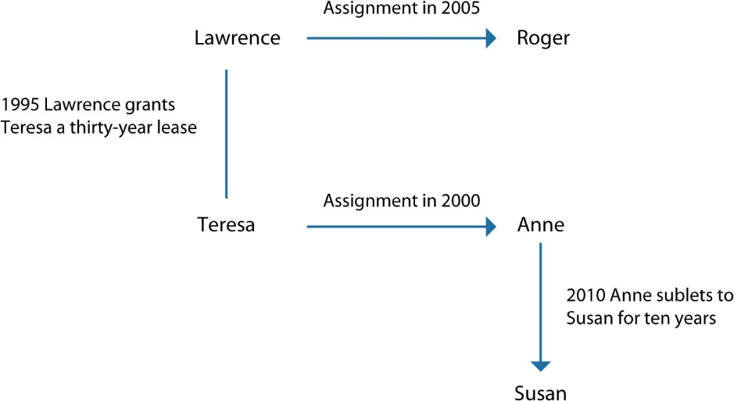
Diagram 13.1 The letting of Kirby House

Slide 4
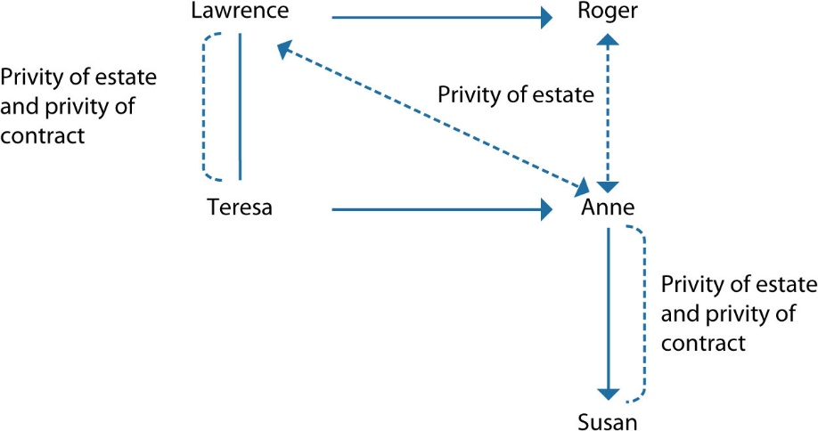
Diagram 13.2 Overview of Kirby House—privity of estate and contract

Slide 5
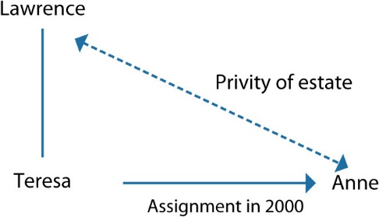
Diagram 13.3 Privity of estate between Lawrence and Anne (2000–2005)

Slide 6
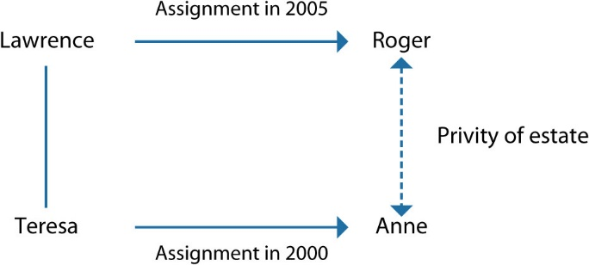
Diagram 13.4 Privity of estate between Roger and Anne (2005–2010)

Slide 7
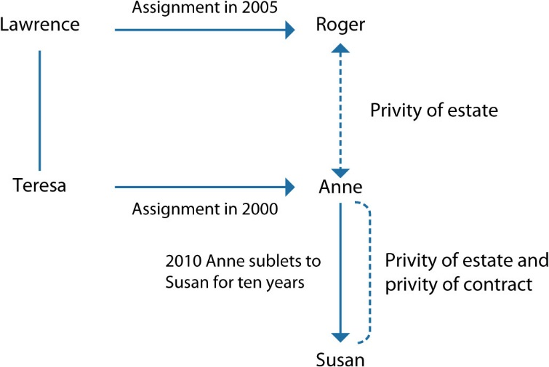
Diagram 13.5 Privity of estate from 2010

Slide 8
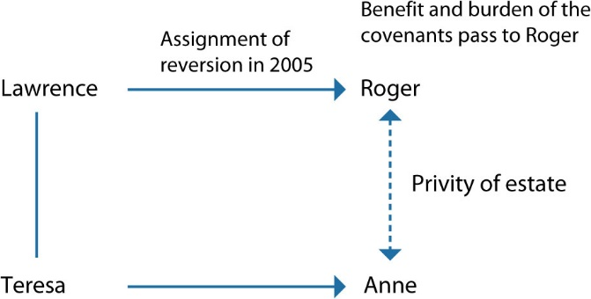
Diagram 13.6 Lawrence sells the fee simple to Roger

Slide 9
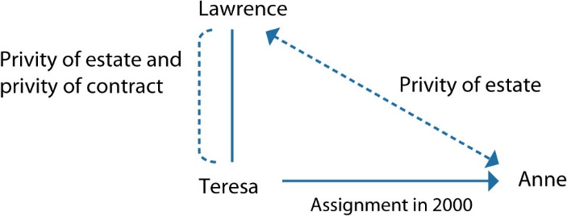
Diagram 13.7 Teresa assigns the lease to Anne in 2000

Slide 10
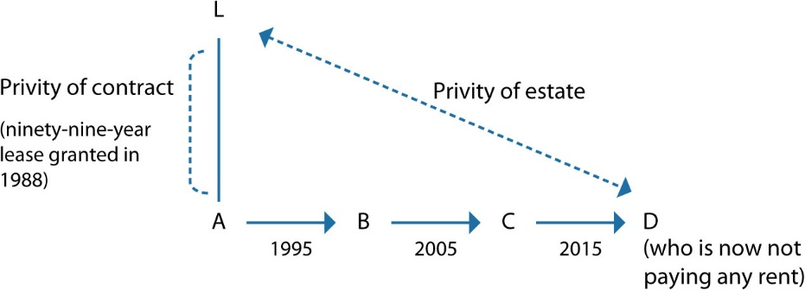
Diagram 13.8 Indemnity

Slide 11
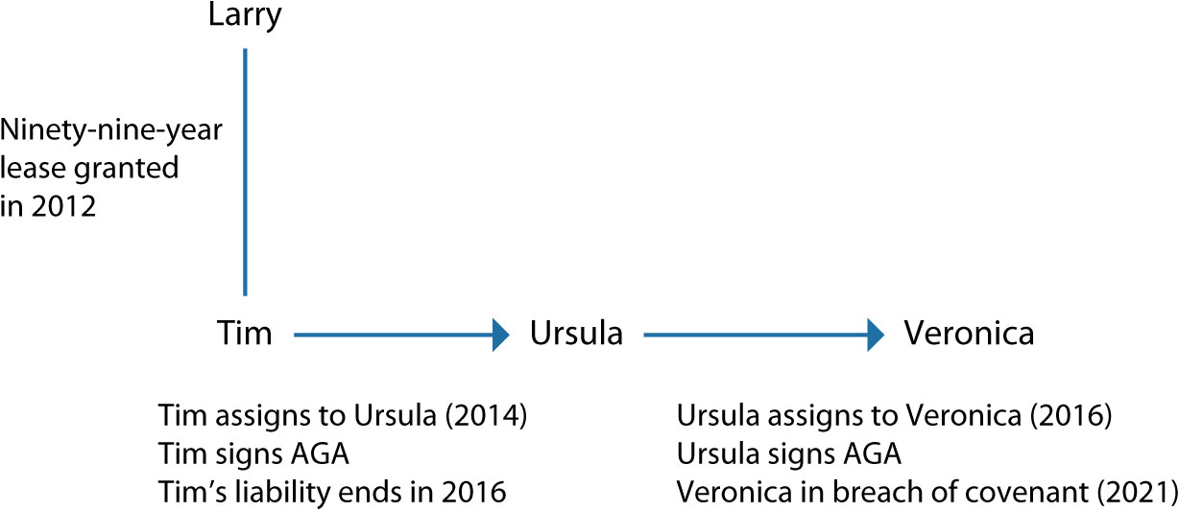
Diagram 13.9 Guaranteeing the performance of covenants by the assignee

Slide 12
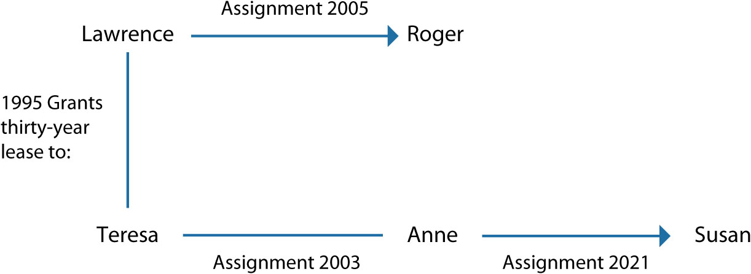
Diagram 13.10 The letting of Kirby House with assignment to Susan

