Slide 1
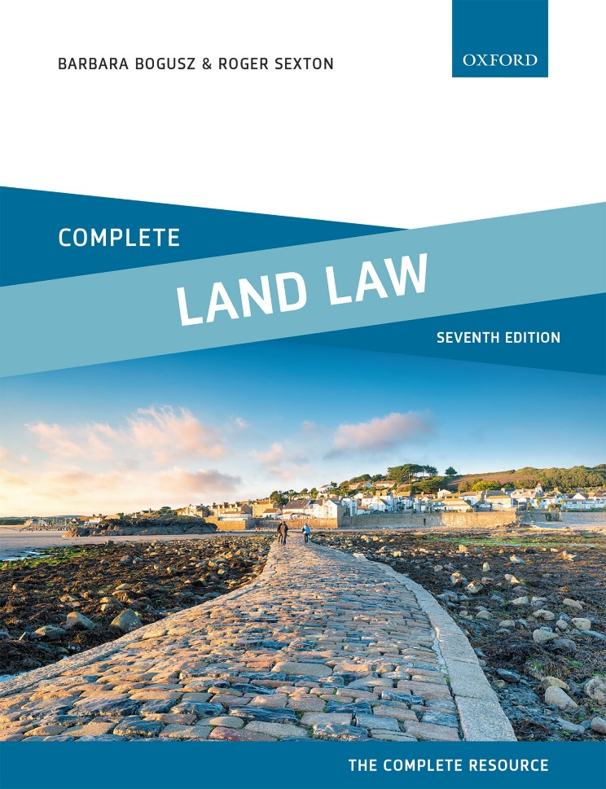
COMPLETE LAND LAW
Text, Cases, and Materials by Barbara Bogusz and Roger Sexton

Slide 2
Part 6
Leases
Chapter 12
Obligations in Leases

Slide 3
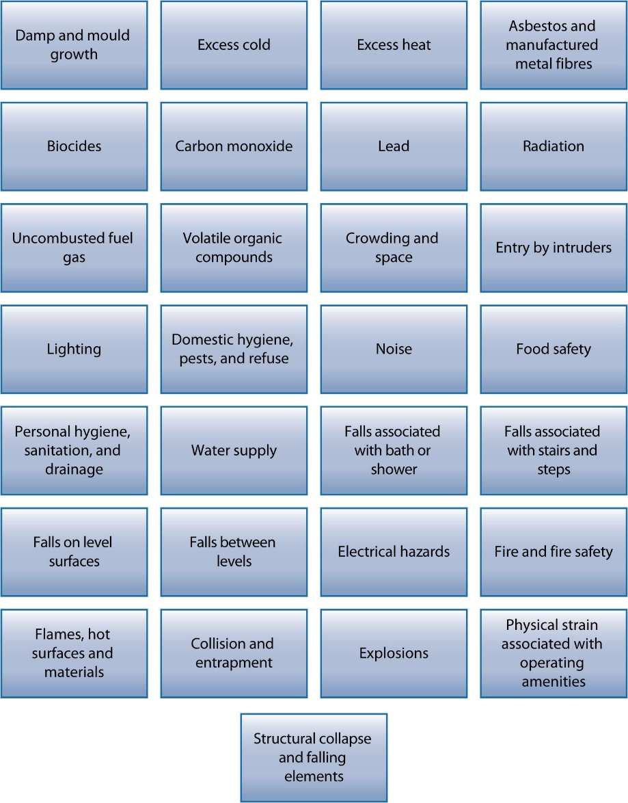
Diagram 12.1 List of prescribed hazards

