Slide 1
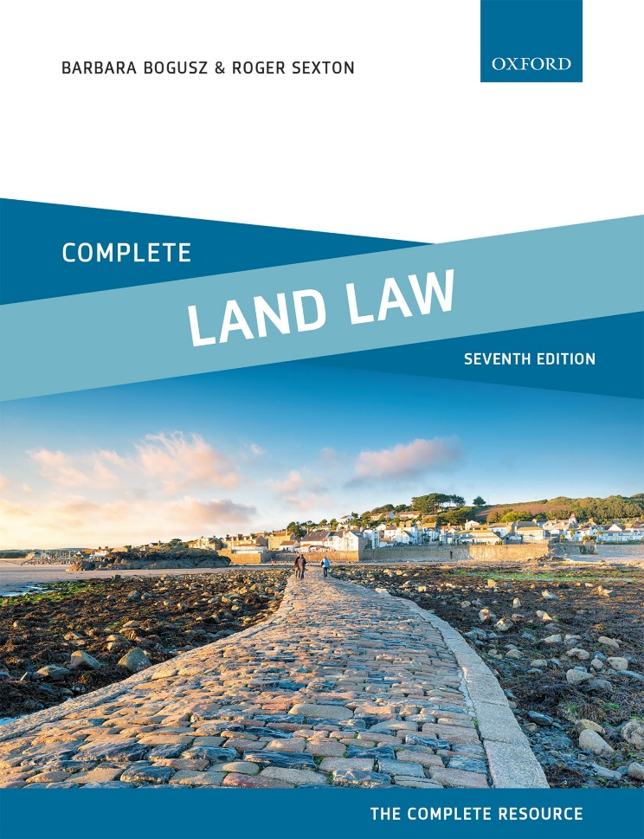
COMPLETE LAND LAW
Text, Cases, and Materials by Barbara Bogusz and Roger Sexton

Slide 2
Part 4
Acquisition of Interests in Land (I)
Chapter 09
Co-Ownership—the Resolution of Disputes

Slide 3
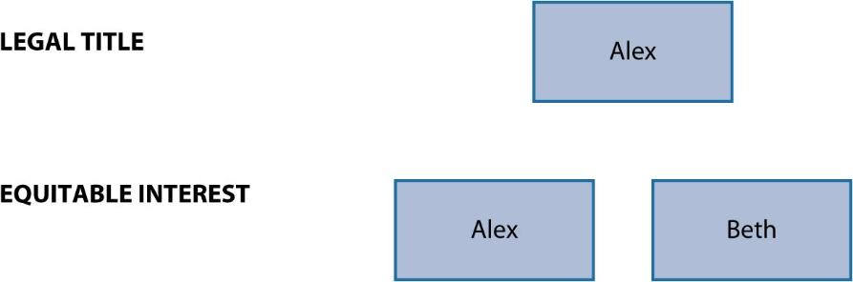
Diagram 9.1 Beth, through her contributions, becomes a tenant in common

Slide 4
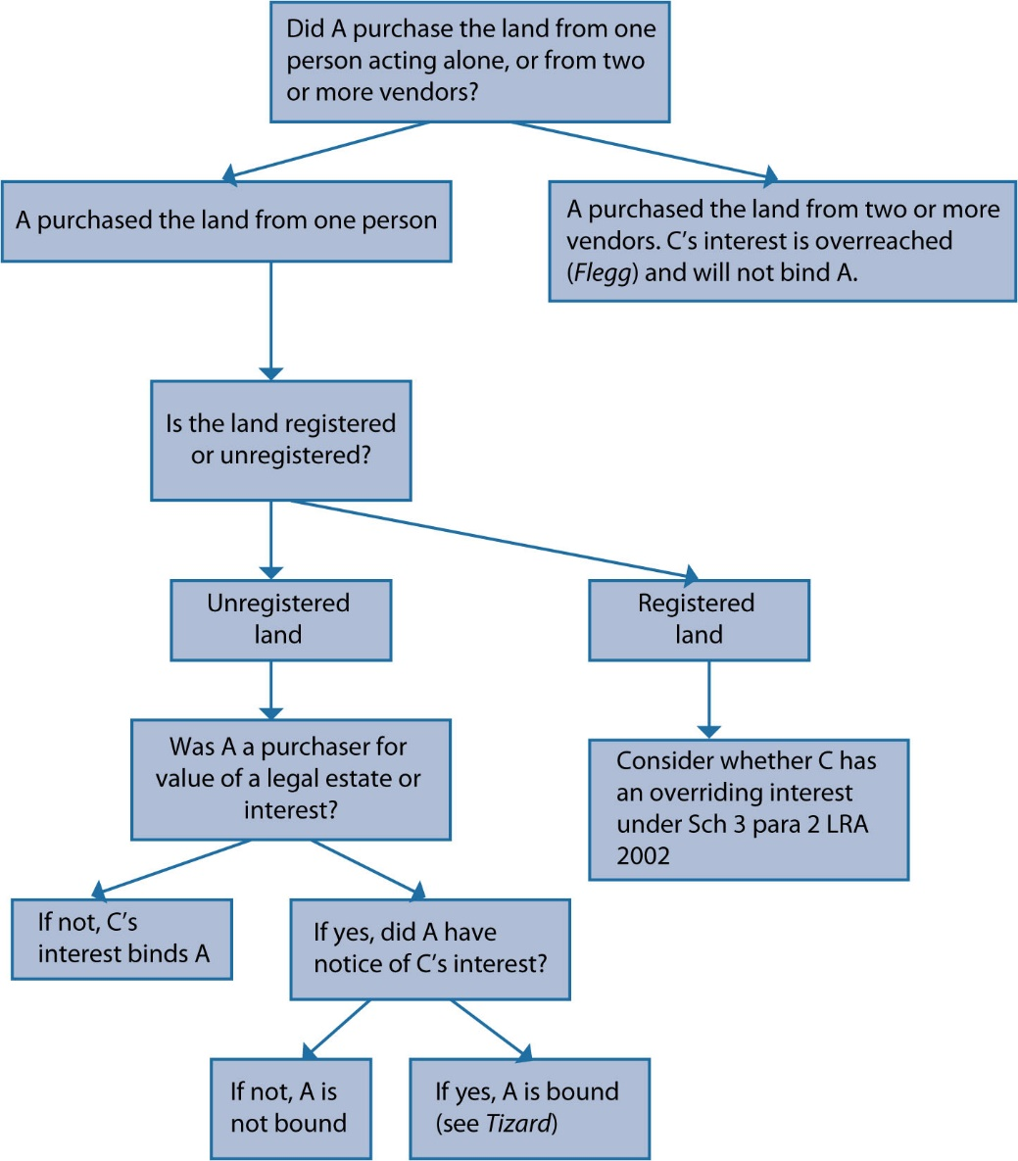
Diagram 9.2 Does a trust share belonging to a claimant (C) bind a purchaser (A)?

Slide 5
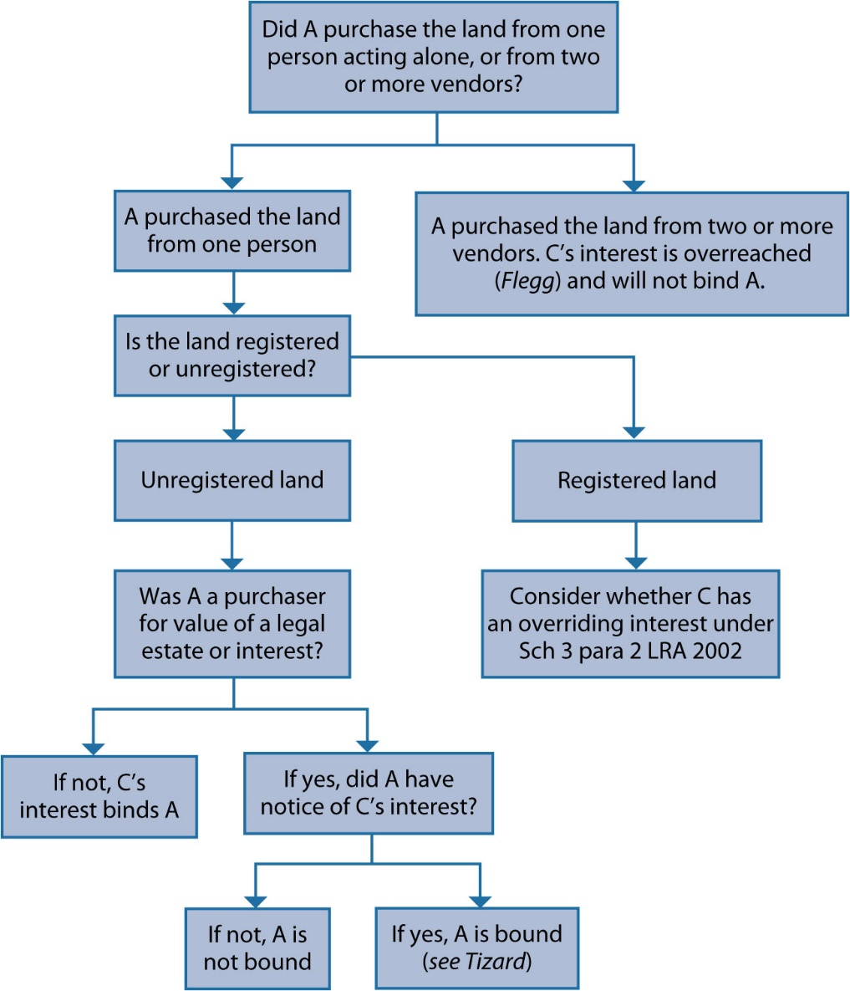
Diagram 9.3 Does a trust share belonging to a claimant (C) bind a purchaser (A)?

