Slide 1
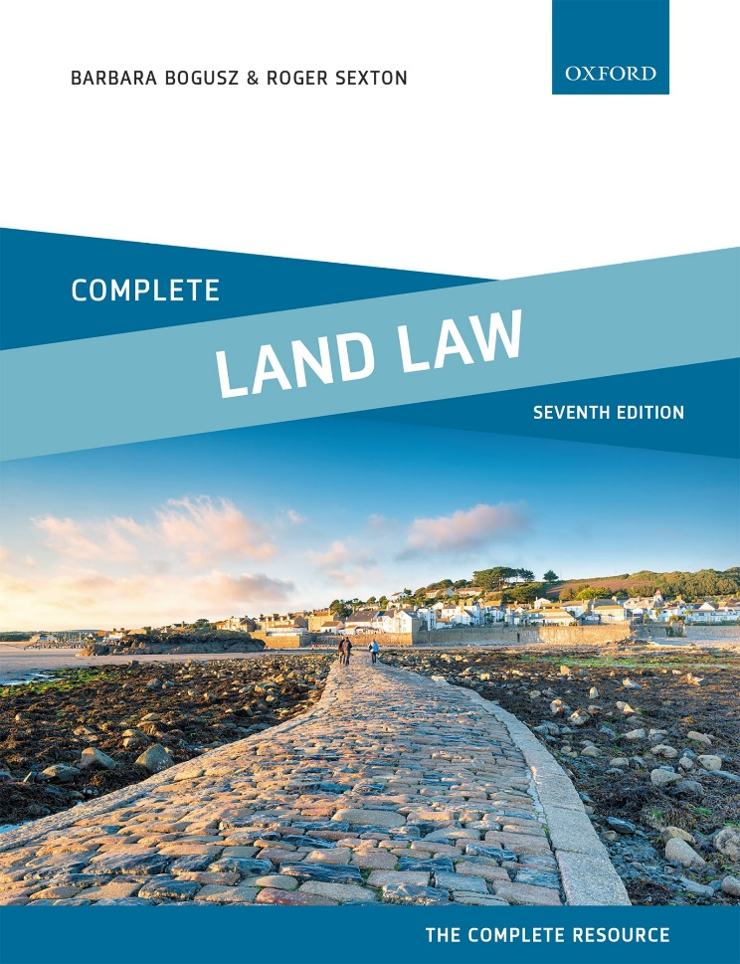
COMPLETE LAND LAW
Text, Cases, and Materials by Barbara Bogusz and Roger Sexton

Slide 2
Part 1
Introduction: Estates and Interests In Land
Chapter 02
Tenures and Estates

Slide 3
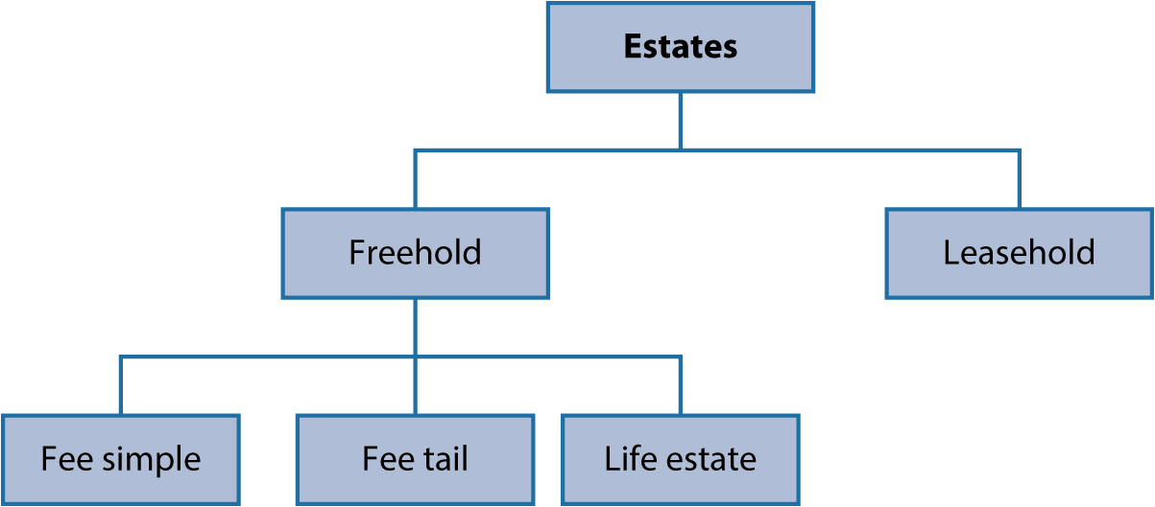
Diagram 2.1 Estates in common law

Slide 4
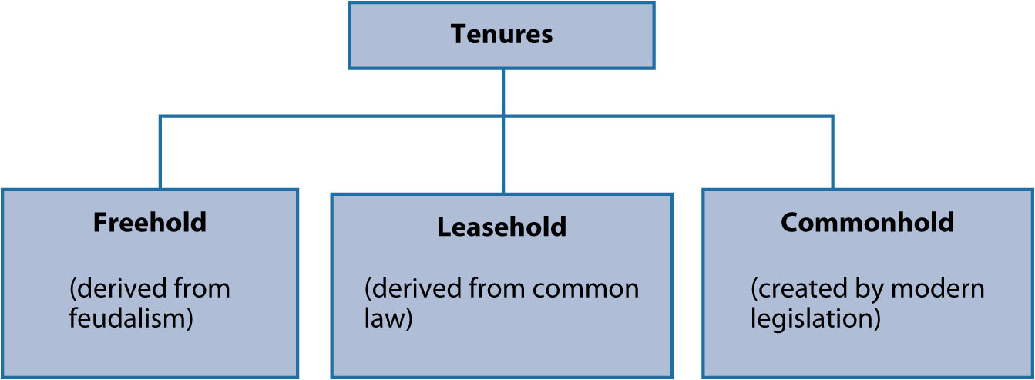
Diagram 2.2 Tenures

Slide 5
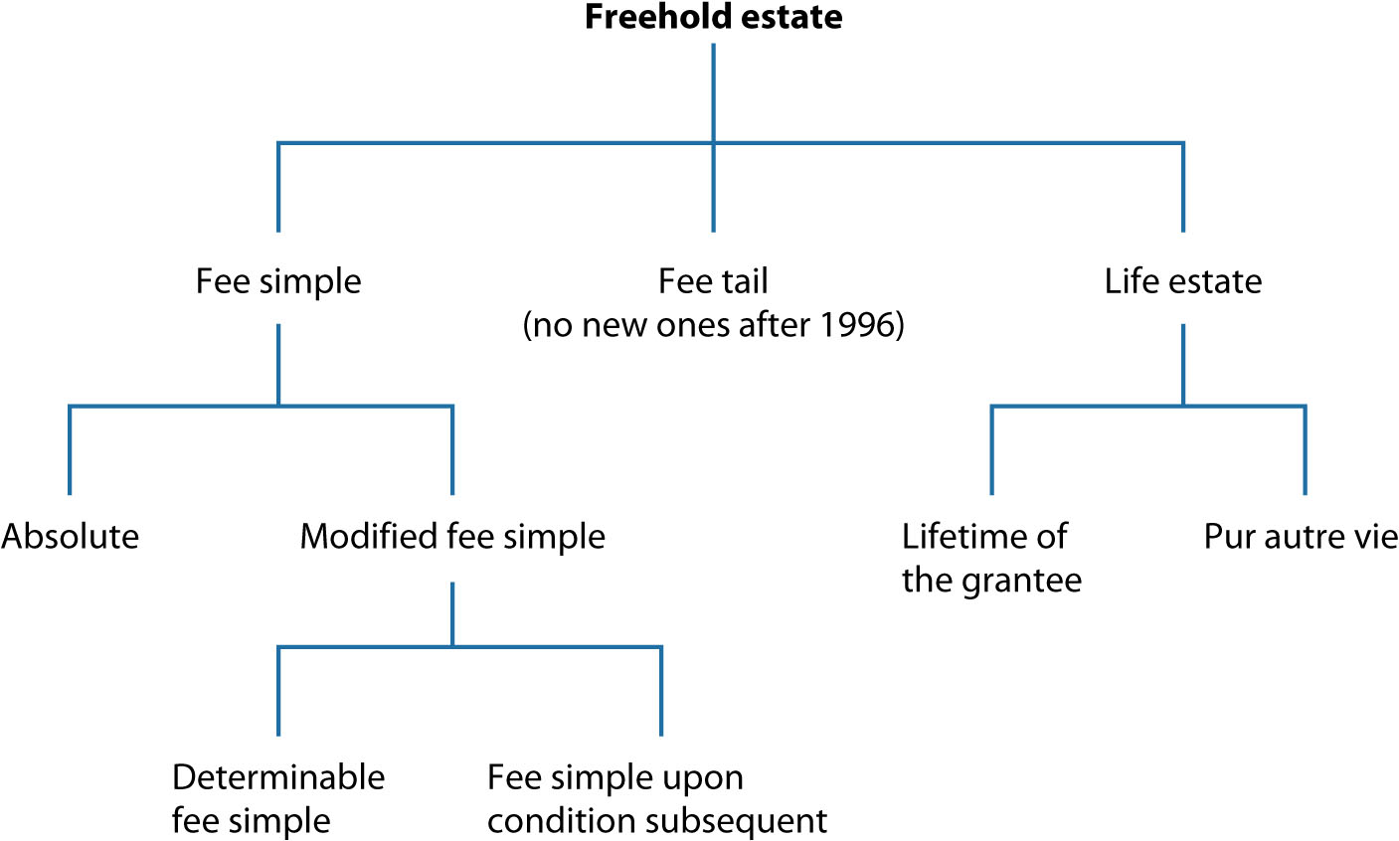
Diagram 2.3 Three types of freehold estate in land in common law

