Slide 1
Social Research Methods, Sixth Canadian Edition
Edward Bell, Alan Bryman, and Steven Kleinknecht

Slide 2
Chapter 1: General Research Orientations
Notes:
LeonWang/Shutterstock

Slide 3
BOX 1.2 A young person painting graffiti on a wall (Box 1.2)
Notes:
A young person painting graffiti on a wall. Some call this behaviour vandalism, while others consider it art. What social theories might you invoke to explain what this person is doing? How might the young person explain it? Do you think his explanation would have anything in common with your social theories?
unflowerey/123RF

Slide 4
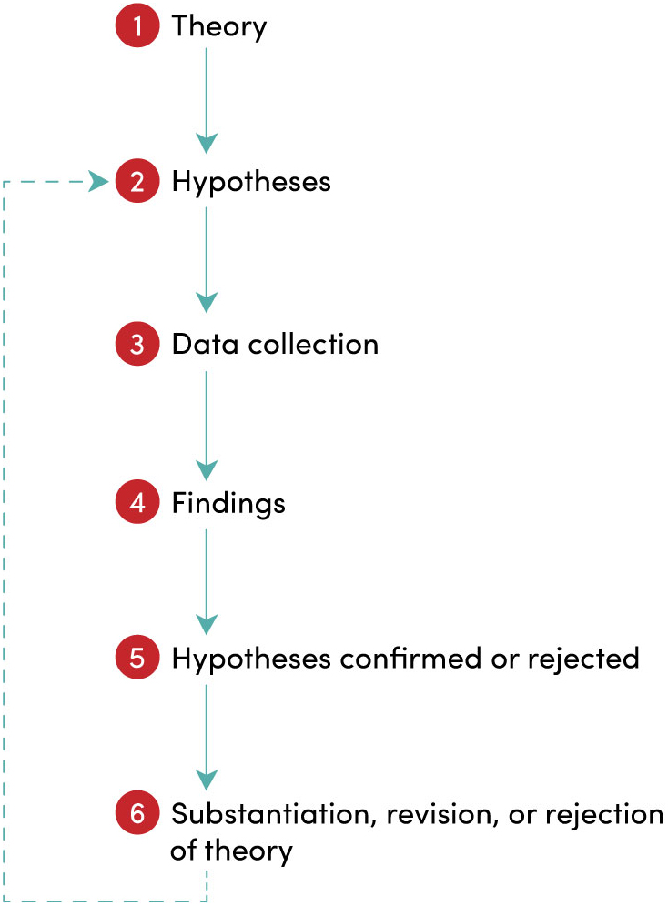
FIGURE 1.1 The process of deduction

Slide 5
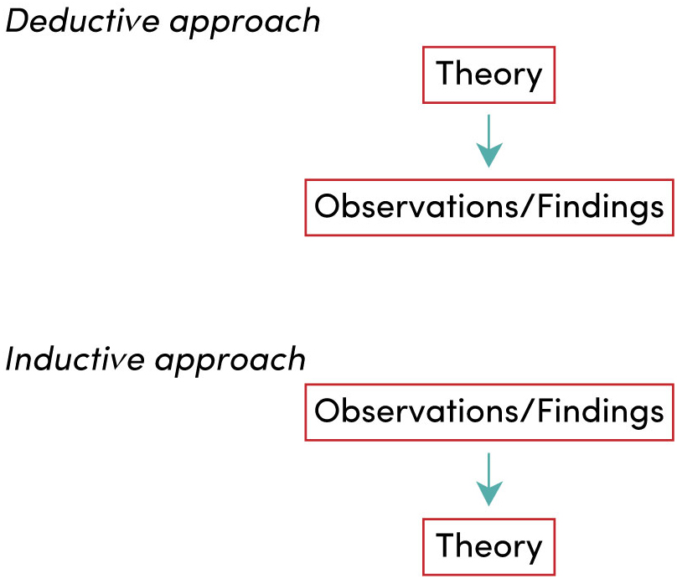
FIGURE 1.2 Deductive and inductive approaches to the relationship between theory and research

Slide 6
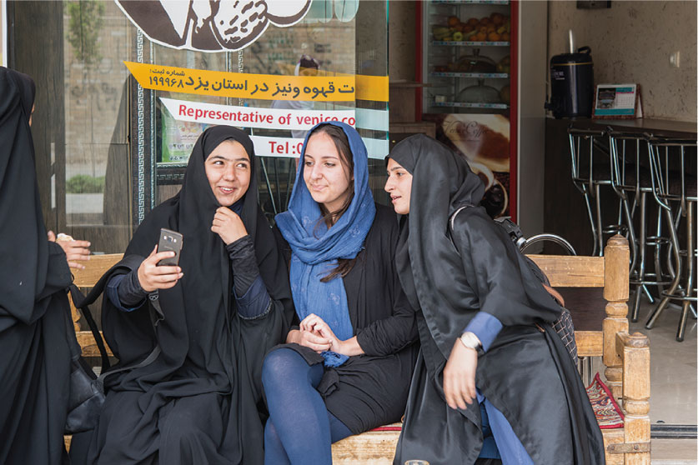
BOX 1.3 Women wearing headscarves in Iran, a society that has experienced far less secularization than many Western countries
Notes:
Women wearing headscarves in Iran, a society that has experienced far less secularization than many Western countries. Do you think that some of the theories examined in Hay's (2014) research can help to explain the high levels of religiosity found in Iran? For example, could the acceptance of religious beliefs and practices there be related to cultural factors that favour societal cohesion over personal autonomy? Could low levels of religious pluralism be a factor?
Guenter Guni/iStockphoto

Slide 7
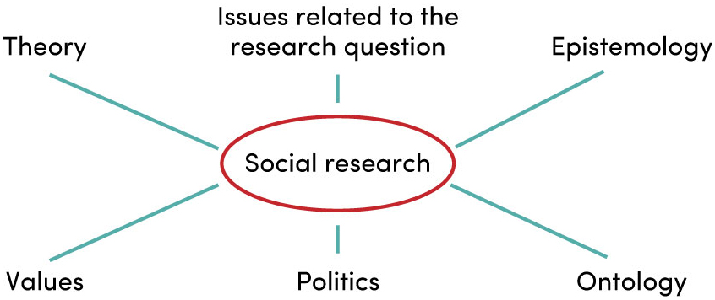
FIGURE 1.3 Influences on social research

