Slide 1
Social Research Methods, Sixth Canadian Edition
Edward Bell, Alan Bryman, and Steven Kleinknecht

Slide 2
Chapter 1: General Research Orientations
Theory and research
Deductive and inductive approaches
Epistemological considerations
Ontological considerations
General orientations: Quantitative and qualitative research
Influences on the conduct of social research

Slide 3
Learning Objectives
Explain the relationship between theory in the broad sense and data gathering; in particular, you should be able to recognize that the purpose of collecting data may be to test theories or to create theories.
Discuss the positivist, interpretivist, and critical approaches to social science, including their key assumptions regarding the purposes of social research and how it should be conducted.
Describe the distinctions between qualitative and quantitative research.
Identify how different factors, including values, politics, and issues related to the research question(s) may influence social research.

Slide 4
Theory and Research 1 of 3
What is theory?
An explanation of observed regularities or patterns
Common components of a theory
Definitions: What are the key terms?
Descriptions: What are the characteristics?
Relational statements: How are variables related?
Deterministic
Probabilistic

Slide 5
Theory and Research 2 of 3
Middle range theories
Limited in scope
Testable
e.g., Merton’s theory of anomie
Grand theories
General and abstract
Provide ways to look at the world
e.g., structural functionalism

Slide 6
Theory and Research 3 of 3
What is the relationship between theory and research?
Theory can guide research
Research can test theory

Slide 7
Deductive and Inductive Approaches 1 of 2
Deductive method
The most common approach to social research
Begins with theory
Understand specific phenomenon through background research
Develop hypotheses
Test with empirical data
Revise if necessary

Slide 8
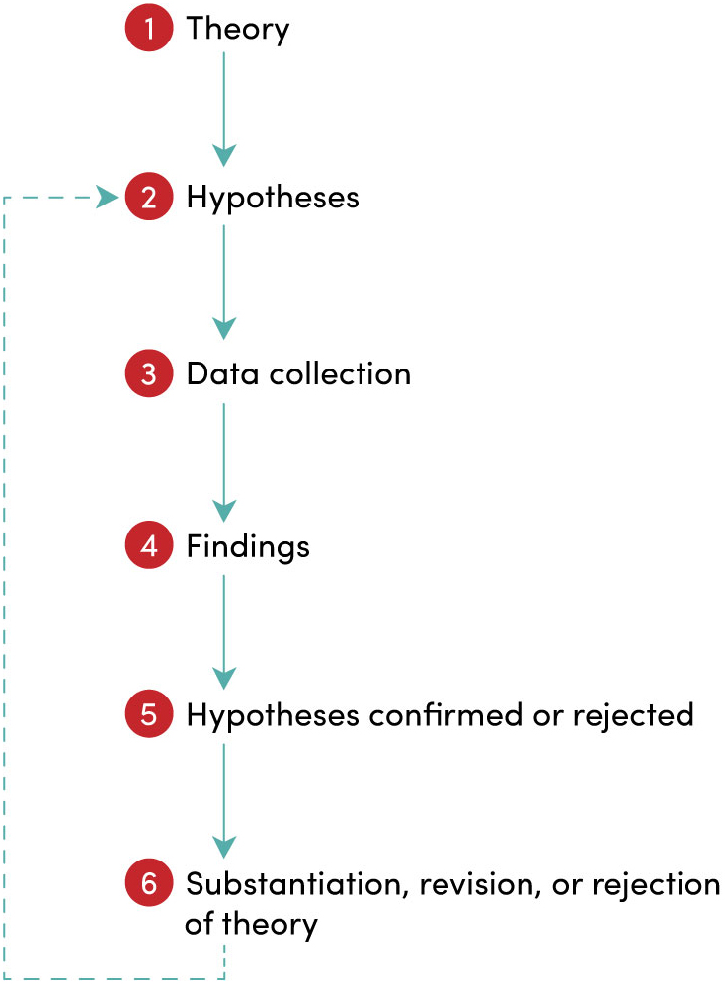
FIGURE 1.1 The process of deduction
Notes:
FIGURE 1.1 The process of deduction

Slide 9
Deductive and Inductive Approaches 2 of 2
Inductive method
Theories and interpretations are the outcome of theory
Gather and examine data first
Then create theory from the observations
Grounded theory
Deriving theory from observations
Used by qualitative researchers
Notes:
Instructor Notes:
Another way to conduct inquiry is by using induction.
Here one begins by gathering or examining data and then tries to derive a theory or explanation from the data.
Sometimes inductive research is iterative:
The researcher goes back and forth from the data to the theory or explanation
Problem: sometimes leads only to empirical generalization
Deriving theories or explanations from qualitative data is sometimes called grounded theory.
It is grounded because:
The data has primacy over theory because the theme and the concepts emerge from looking at the data after it has been collected
Created concepts and themes are applied to new data and refined

Slide 10
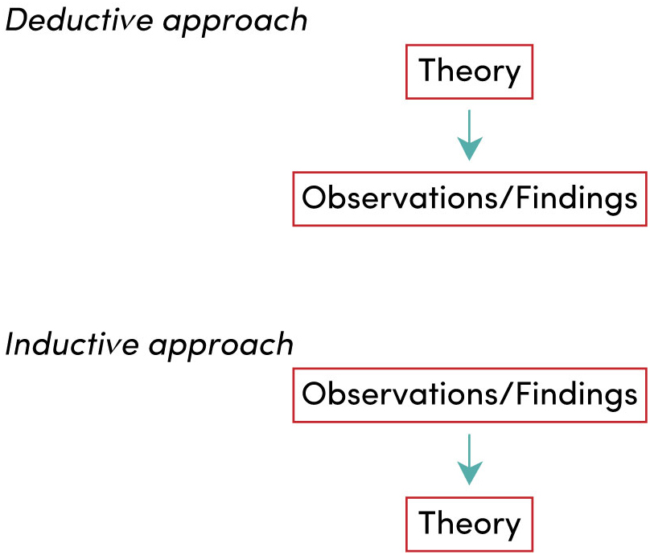
FIGURE 1.2 Deductive and inductive approaches to the relationship between theory and research
Notes:
FIGURE 1.2 Deductive and inductive approaches to the relationship between theory and research

Slide 11
Epistemological Considerations
Epistemology
How do we know the world?
How does knowledge become acquired?
Three broad positions on knowing the world:
Positivism
Interpretivism
Critical approaches

Slide 12
Positivism
Positivism follows the natural sciences
Uses the principal of empiricism (use of the senses for knowledge)
Generate hypotheses to test (uses deduction)
Can provide foundation for induction, too
Science is value-free
Formerly “objectivity”
Currently intersubjectivity
Scientific statements are of key importance
Notes:
Instructor Notes:
Social scientists should use the same methods of inquiry that are used in the natural sciences.
Empiricism:
Knowledge must be based on information gathered through the senses
Positivism takes a deductive approach to acquiring knowledge.
The purpose of positivism is to uncover social laws governing social reality.
Positivism relies on scientific statements not normative statements.
Scientific statements can be tested empirically and therefore supported or rejected
Normative statements are a question of belief and are not testable.

Slide 13
Interpretivism 1 of 2
Interpretivism is a critique of positivism
Goal is to grasp the subjective meaning of people’s lives
People interpret the reality of their own lives (social construction of reality)
Views the social world from the point of view of the social actor
Empathetic understanding
Interpretation of existence
Notes:
Instructor Notes:
Methods of natural sciences are very limited in producing knowledge of social world since it is created by individuals.
The goal of social science should not be to uncover social laws but to grasp the subjective meanings of people’s actions.
Actions should be viewed from the point of view of the social actors, i.e., the people studied.
Researchers should develop an empathetic understanding of the people studied, sometimes referred to as Verstehen (Weber)
Symbolic interactionism is an example of interpretivism.
Individual self-understanding emerges only through appreciation of the perception of others, or by “taking the role of the others” (Mead)
People take part in interaction by constantly interpreting the symbolic meaning of their environment
Social scientists should “catch” (understand) the interpretation by which actors construct their action (Bulmer)

Slide 14
Interpretivism 2 of 2
Symbolic interactionism: major perspective in sociology that uses interpretivism
e.g., George Herbert Mead, Irving Goffman

Slide 15
Critical Approaches to Social Science
Critical theories are critiques of positivism, too
Critical researchers use many kinds of research methods
Both deductive and inductive approaches
Reject “value-free” science
Anti-oppressive in practice and political in nature
e.g., Karl Marx and conflict theory
Involves praxis: putting one’s theoretical positions into practice
Notes:
Instructor Notes:
Joins interpretivism in criticism of positivism, but goes further
There is no value-neutral research: social scientists should take a position of active support towards those studied
Knowledge should not be used to only “understand” the social reality but to change it (Marx)
Social research should be practice-oriented
Participatory action research
A critical approach to research closest to social activism

Slide 16
Ontological Considerations 1 of 2
Two ontological debates:
Objectivist perspective:
Social phenomena have an objective reality, independent of our perceptions
Constructionist perspective:
Constructionist (hard)
Reality is merely a set of mental constructions.
e.g., Nietzsche: there are no facts, only interpretations
Constructionist (soft): more middle ground
There is an objective social reality that is marred by human interpretation

Slide 17
Ontological Considerations 2 of 2
Relationship to social research
Ontological assumptions about reality affect:
Research question formulation
The way research is carried out

Slide 18
General Orientations: Quantitative and Qualitative Research 1 of 2
Quantitative research
Uses numbers and statistics in the collection and analysis of data
Qualitative research
Uses mainly words and other non-numeric symbols in the collection and analysis of data

Slide 19
General Orientations: Quantitative and Qualitative Research 2 of 2
Are these differences irreconcilable?
Does real-life research cluster neatly into these two camps?
Notes:
TABLE 1.1 Fundamental differences between quantitative and qualitative research strategies

Slide 20
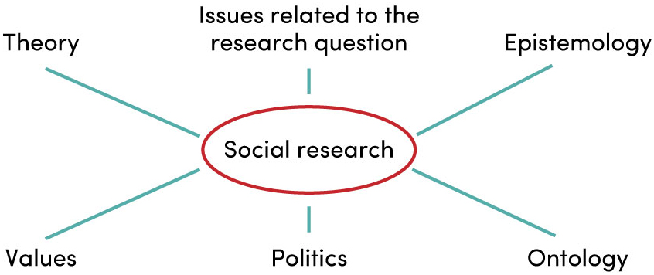
FIGURE 1.3 Influences on social research
Notes:
FIGURE 1.3 Influences on social research

Slide 21
Influences on the Conduct of Social Research: Values 1 of 3
A researcher’s values can contribute to bias in research:
Choice of topic
Formulation of the research question
Choice of method
Formulation of research design and data collection methods
Actual data collection
Analysis of data
Interpretation of data
Conclusions

Slide 22
Influences on the Conduct of Social Research: Values 2 of 3
Reflexivity
Researchers’ awareness that their values and decisions have an impact on the research
Personal biases are made explicit

Slide 23
Influences on the Conduct of Social Research: Values 3 of 3
Three different positions on values in social research:
Research should be value-free
Research cannot be value-free, but researchers should be open and explicit about their values
Researchers should use their values to direct and interpret their investigations: value commitment is a good thing for researchers to have

Slide 24
Politics in Social Research 1 of 2
Researchers sometimes “take sides”
Funding:
Who gets it? Are strings attached?
Government may fund research to benefit them politically

Slide 25
Politics in Social Research 2 of 2
Research subjects/participants
Gatekeepers
Who gets access? Are strings attached?
Research findings
What sorts of findings are “acceptable” to those who fund or publish research?

Slide 26
Issues Related to the Research Question
When little or no research has been done:
A qualitative, exploratory approach may be preferable
Typically associated with the generation of theory rather than theory testing
Relatively unstructured approach to the research process
When a researcher wants to study individuals involved in illicit activities:
Need to develop rapport with subjects
Qualitative strategy

Slide 27
Formulating a Research Question 1 of 4
The choice of research orientation, design, and method must match the question being asked
Is it a brand-new phenomenon?
Measuring impact?
World views?
Hypothesis testing?

Slide 28
Formulating a Research Question 2 of 4
The choice of research method should match the research question
A research question states the purpose of the study in the form of a question
For example:
What social factors make people enjoy smoking marijuana?
What explains differential rates of suicide in societies?
What is it like to be a member of the furry fandom?

Slide 29
Formulating a Research Question 3 of 4
The form of the research question will be shaped by the qualitative or quantitative orientations of the study
Qualitative:
Less specific research question
Inductive
No hypothesis
Quantitative:
Can test causal models
Deductive
Narrowed research question to make a testable hypothesis

Slide 30
Formulating a Research Question 4 of 4
Research questions should
be clear
be researchable
relate to established theory and research
be linked or closely related to each other
allow the researcher to make a contribution to existing knowledge
be neither too broad nor too narrow

