Slide 1
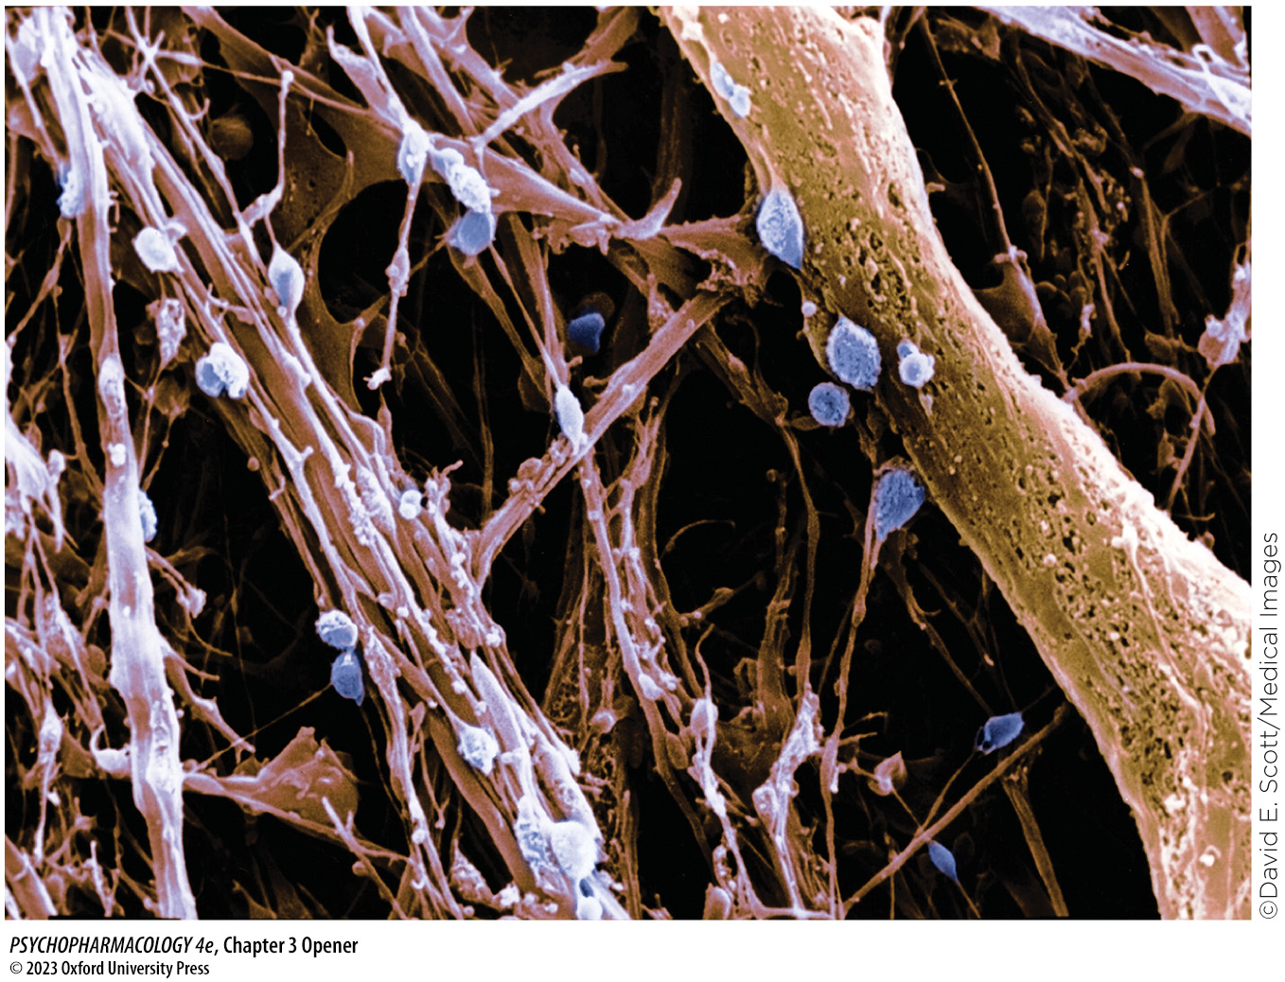
Chapter 3 Opener
Notes:
Scanning electron micrograph showing sites of axoaxonic and axodendritic synaptic contacts (in blue) within the hypothalamus.

Slide 2
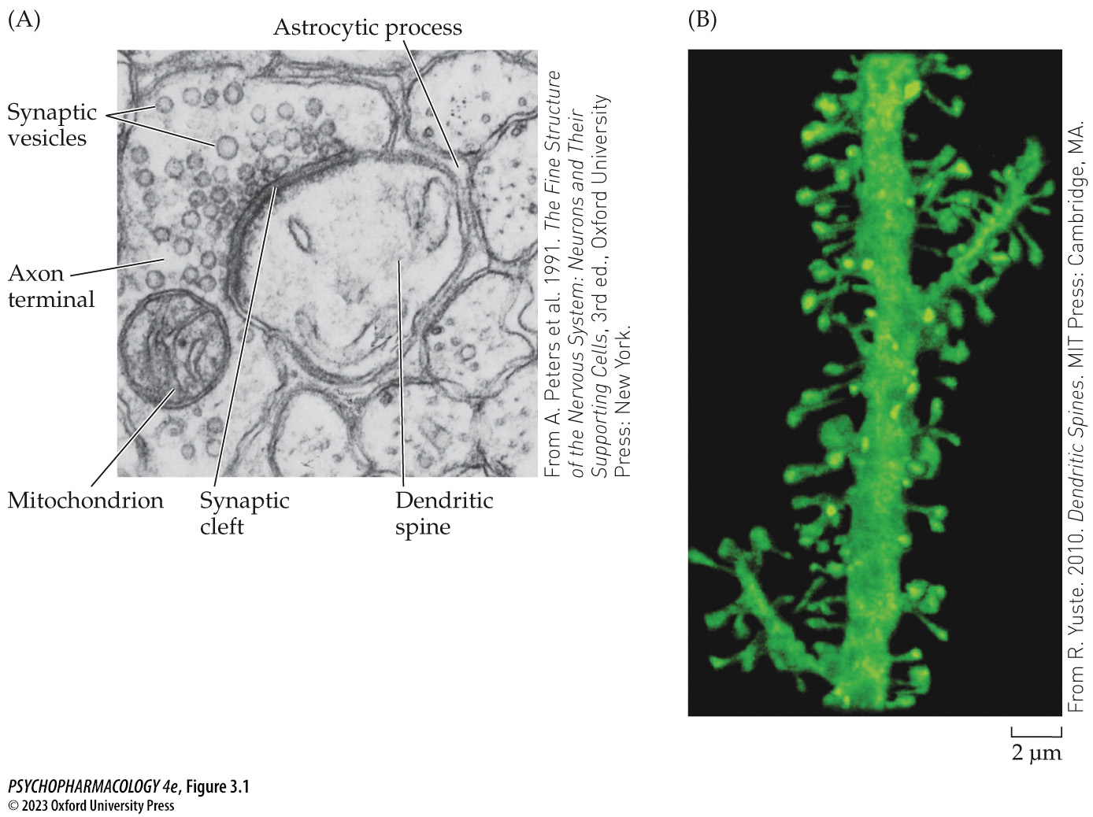
Figure 3.1 Structure of synapses
Notes:
Figure 3.1 Structure of synapses
(A) An electron micro­graph of an axodendritic synapse illustrating the major features of a typical connection between an axon terminal of the presynaptic cell and a dendritic spine of the postsynaptic cell. (B) Microscopic view of dendritic spines on a pyramidal neuron from human cerebral cortex. The dendrite and spines were visualized by means of a fluorescent dye and a confocal microscope.

Slide 3
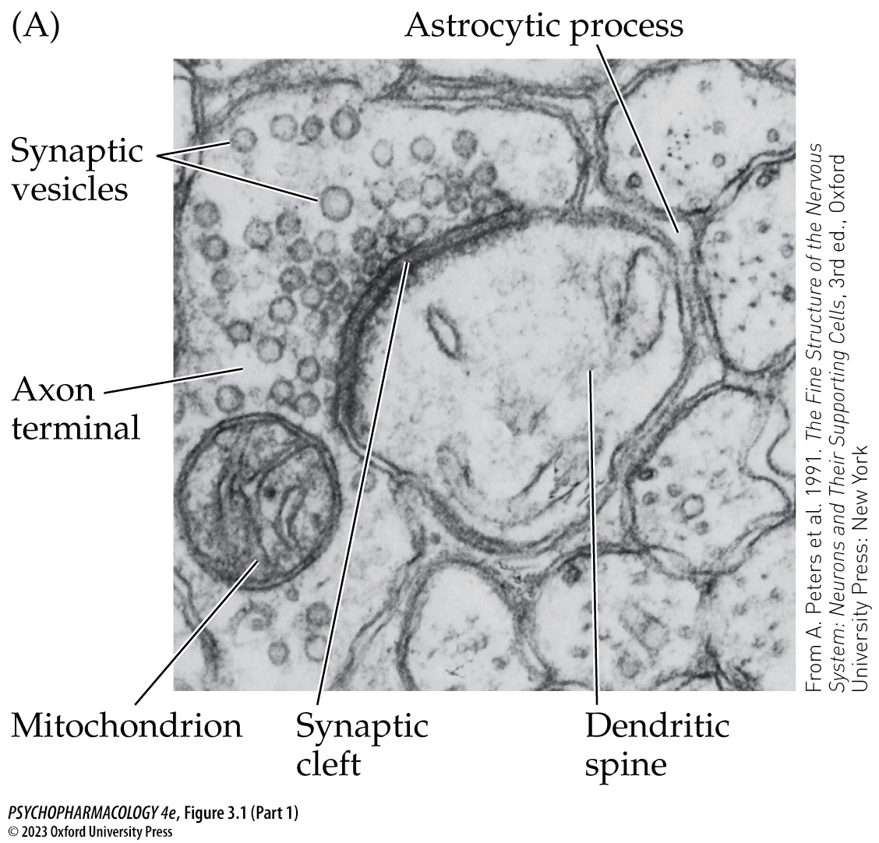
Figure 3.1 Structure of synapses (Part 1)
Notes:
Figure 3.1 Structure of synapses
(A) An electron micro­graph of an axodendritic synapse illustrating the major features of a typical connection between an axon terminal of the presynaptic cell and a dendritic spine of the postsynaptic cell. (B) Microscopic view of dendritic spines on a pyramidal neuron from human cerebral cortex. The dendrite and spines were visualized by means of a fluorescent dye and a confocal microscope.

Slide 4
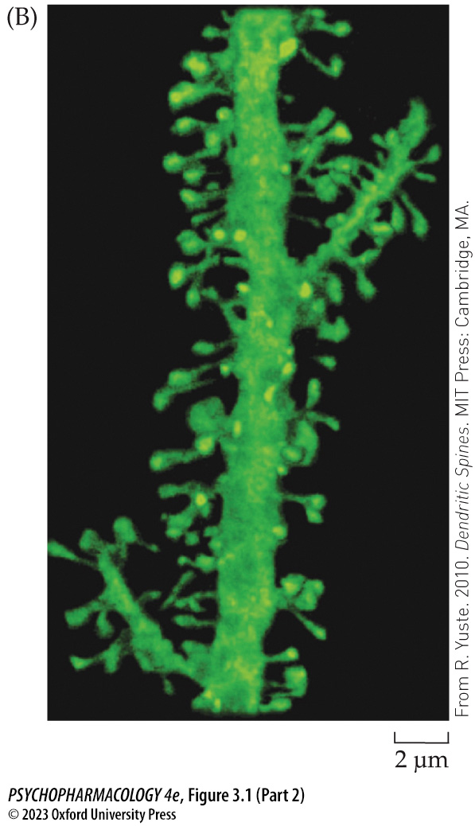
Figure 3.1 Structure of synapses (Part 2)
Notes:
Figure 3.1 Structure of synapses
(A) An electron micro­graph of an axodendritic synapse illustrating the major features of a typical connection between an axon terminal of the presynaptic cell and a dendritic spine of the postsynaptic cell. (B) Microscopic view of dendritic spines on a pyramidal neuron from human cerebral cortex. The dendrite and spines were visualized by means of a fluorescent dye and a confocal microscope.

Slide 5
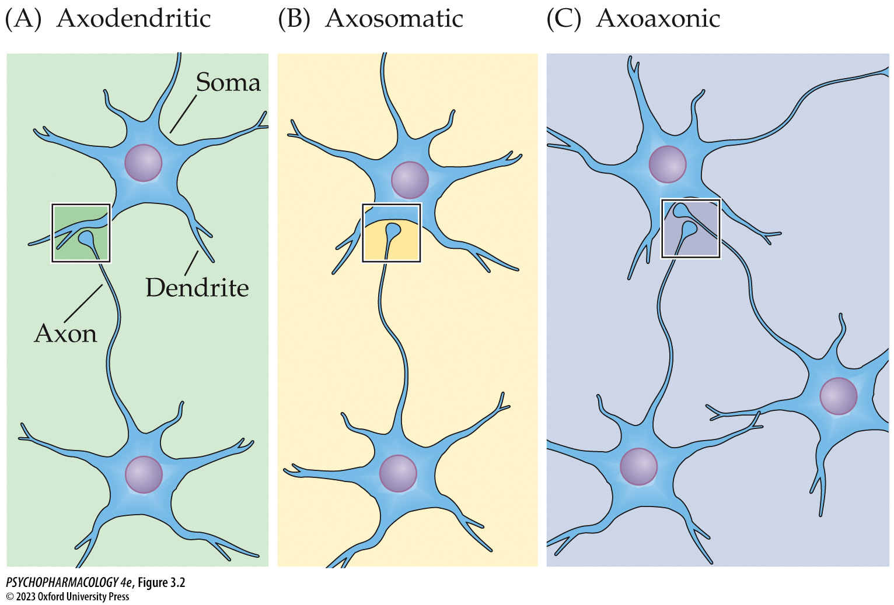
Figure 3.2 The three types of synaptic connections between neurons
Notes:
Figure 3.2 The three types of synaptic connections between neurons

Slide 6
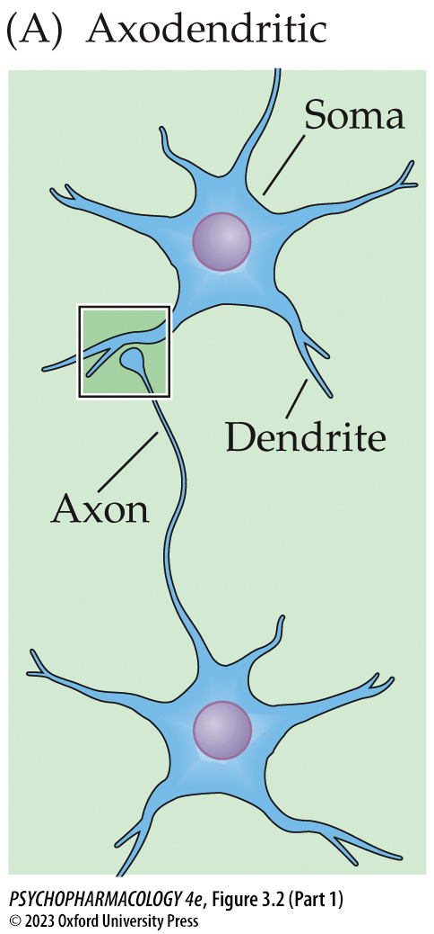
Figure 3.2 The three types of synaptic connections between neurons (Part 1)
Notes:
Figure 3.2 The three types of synaptic connections between neurons

Slide 7
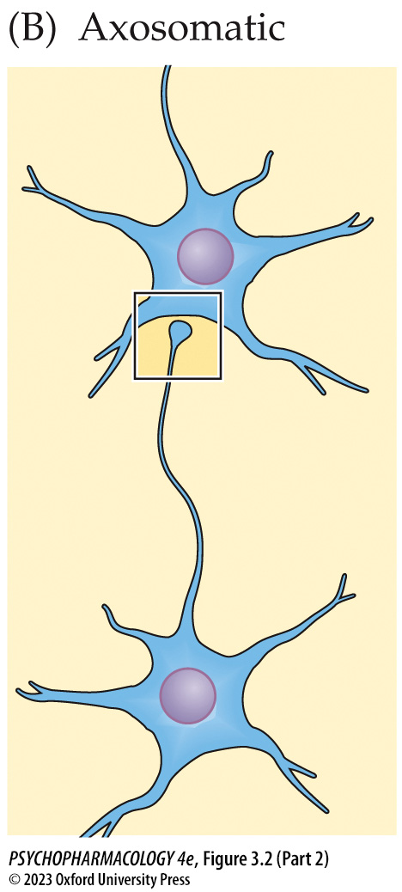
Figure 3.2 The three types of synaptic connections between neurons (Part 2)
Notes:
Figure 3.2 The three types of synaptic connections between neurons

Slide 8
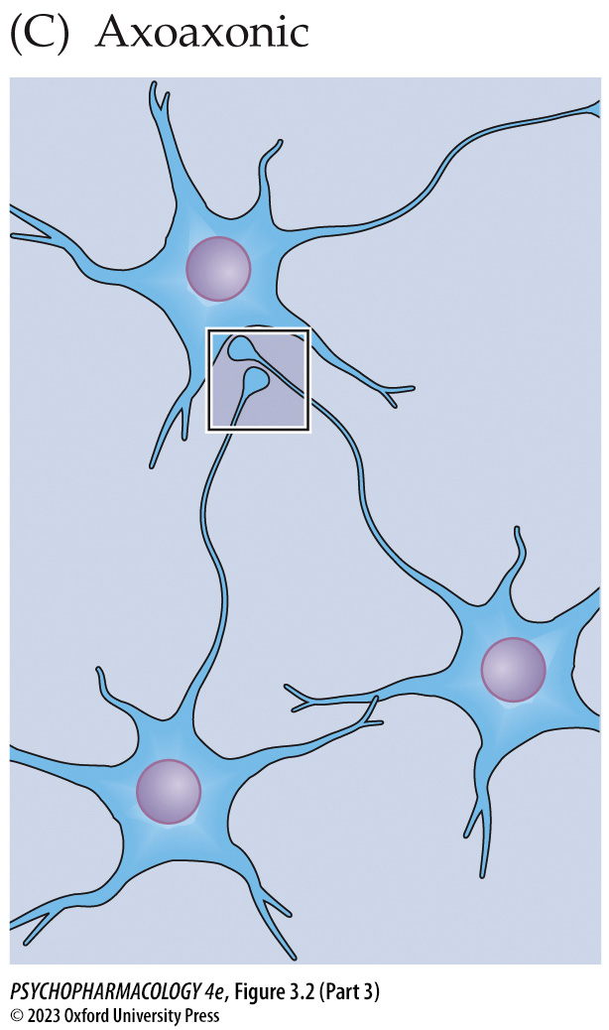
Figure 3.2 The three types of synaptic connections between neurons (Part 3)
Notes:
Figure 3.2 The three types of synaptic connections between neurons

Slide 9
Table 3.1 (1) Major Categories of Neurotransmitters
Classical neurotransmitters
Amino acids
  Glutamate
  γ-aminobutyric acid (GABA)
  Glycine
Monoamines
  Dopamine (DA)
  Norepinephrine (NE)
  Serotonin (5-HT)
  Histamine (HA)
Acetylcholine (ACh)
Purines
  Adenosine triphosphate (ATP)
  Adenosine

Slide 10
Table 3.1 (2) Major Categories of Neurotransmitters
Nonclassical neurotransmitters
Neuropeptides
  Endorphins and enkephalins
  Corticotropin-releasing factor (CRF or CRH)
  Orexin
  Brain-derived neurotrophic factor (BDNF)
  Vasopressin
  Oxytocin
  Many others
Lipids
  Anandamide
  2-Arachidonoylglycerol
Gases
  Nitric oxide (NO)
  Carbon monoxide (CO)
  Hydrogen sulfide (H₂S)

Slide 11
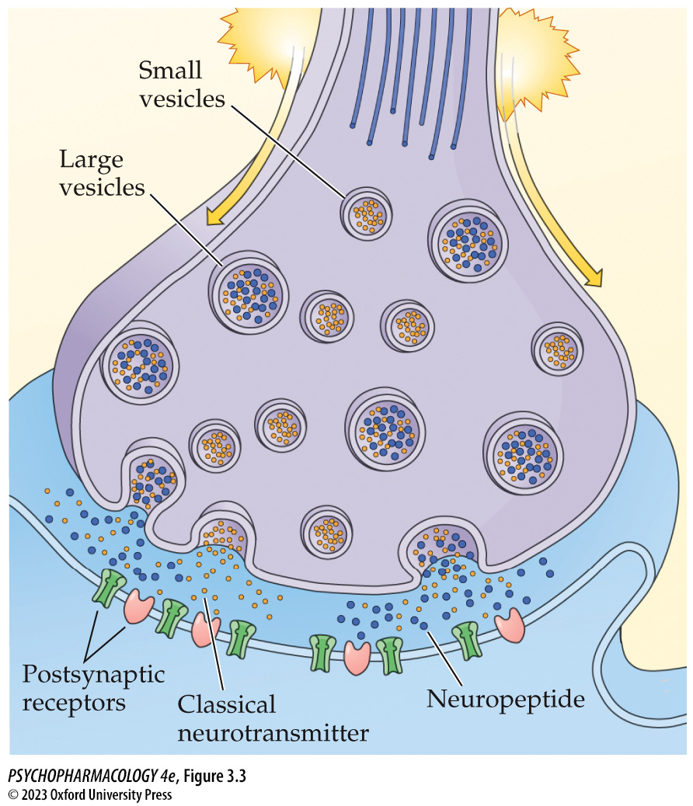
Figure 3.3 Axon terminal of a neuron that synthesizes both a classical neurotransmitter and a neuropeptide
Notes:
Figure 3.3 Axon terminal of a neuron that synthesizes both a classical neurotransmitter and a neuropeptide
The small vesicles contain only the classical transmitter, whereas the large vesicles contain the neuropeptide and the classical neurotransmitter, which are stored and released together.

Slide 12
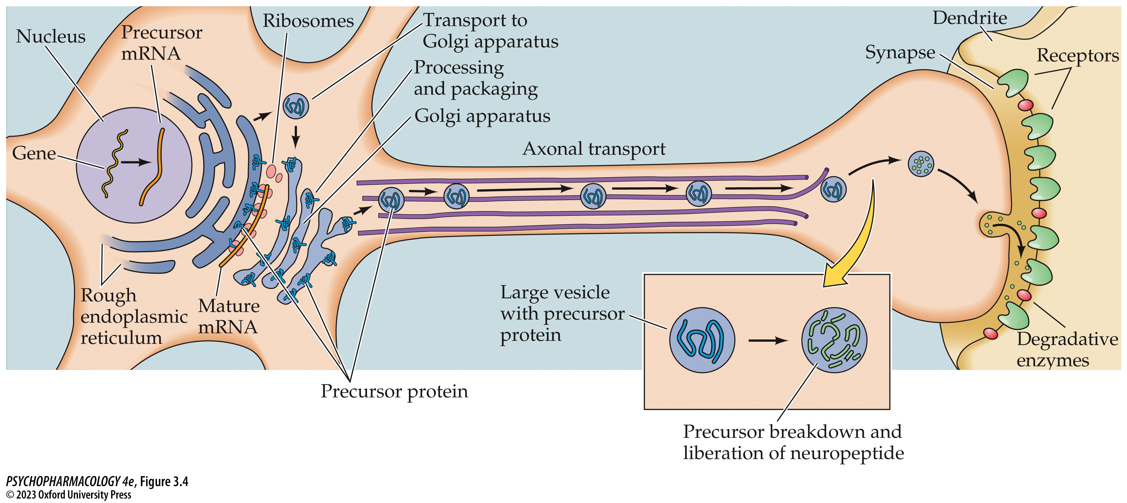
Figure 3.4 Features of neurotransmission using neuro­peptides
Notes:
Figure 3.4 Features of neurotransmission using neuro­peptides
Neuropeptides are synthesized from larger precursor proteins, which are packaged into large vesicles by the Golgi apparatus. During transport from the cell body to the axon terminal, enzymes that have been packaged within the vesicles break down the precursor protein to liberate the neuro­peptide. After it is released at the synapse and stimulates postsynaptic receptors, the neuropeptide is inactivated by degradative enzymes.

Slide 13
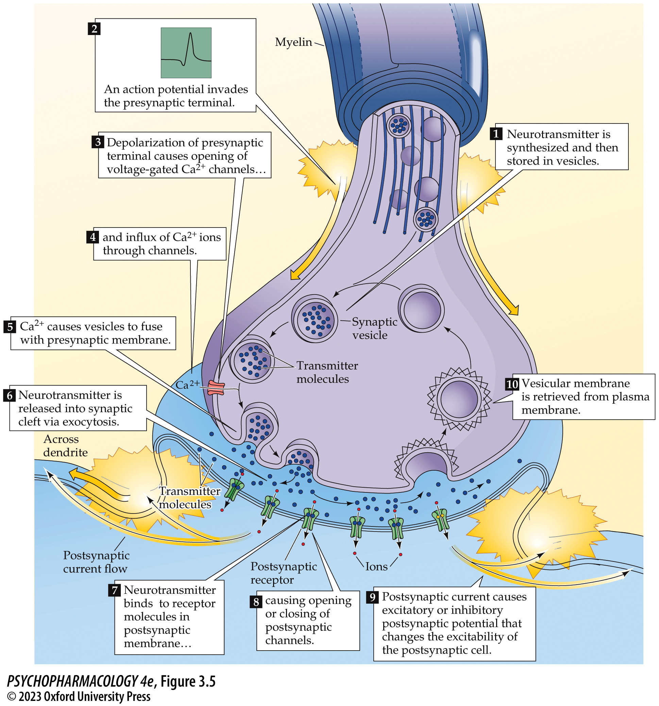
Figure 3.5 Processes involved in neurotransmission at a typical synapse using a classical neurotransmitter (1)
Notes:
Figure 3.5 Processes involved in neurotransmission at a typical synapse using a classical neurotransmitter

Slide 14
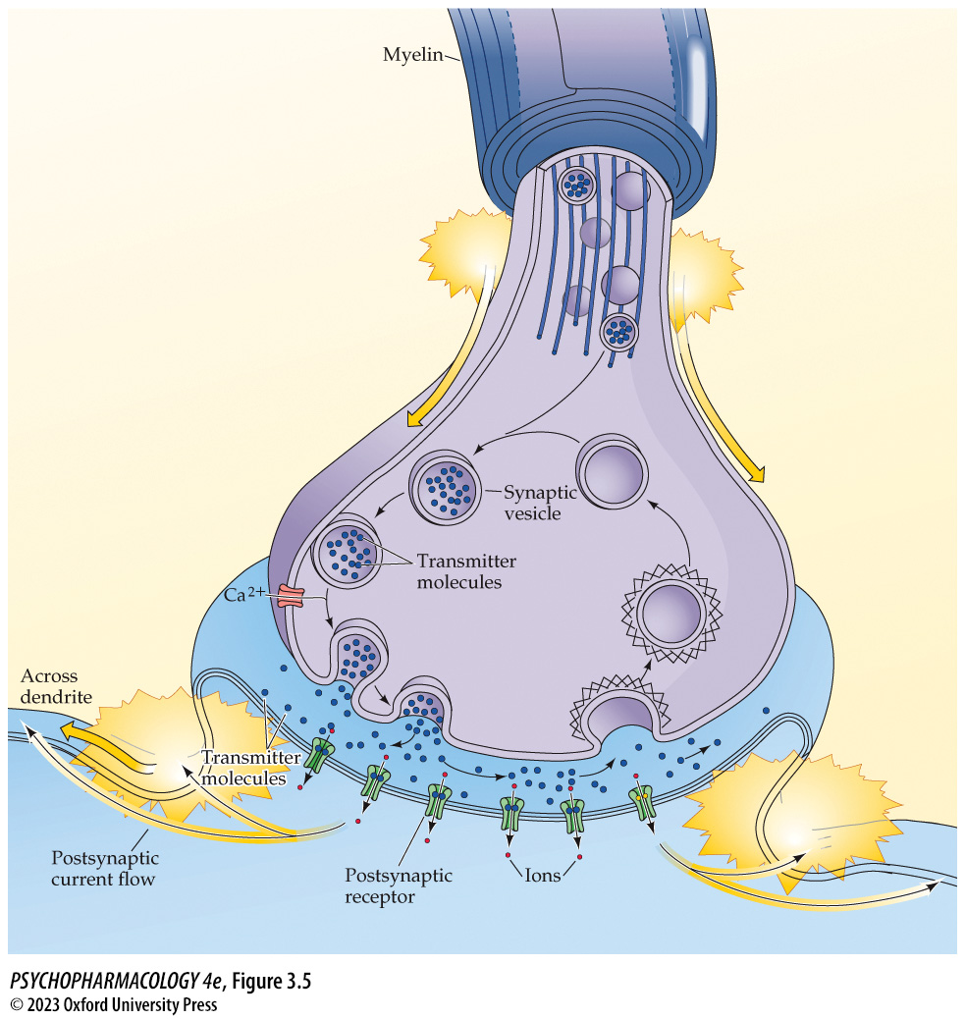
Figure 3.5 Processes involved in neurotransmission at a typical synapse using a classical neurotransmitter (2)
Notes:
Figure 3.5 Processes involved in neurotransmission at a typical synapse using a classical neurotransmitter

Slide 15
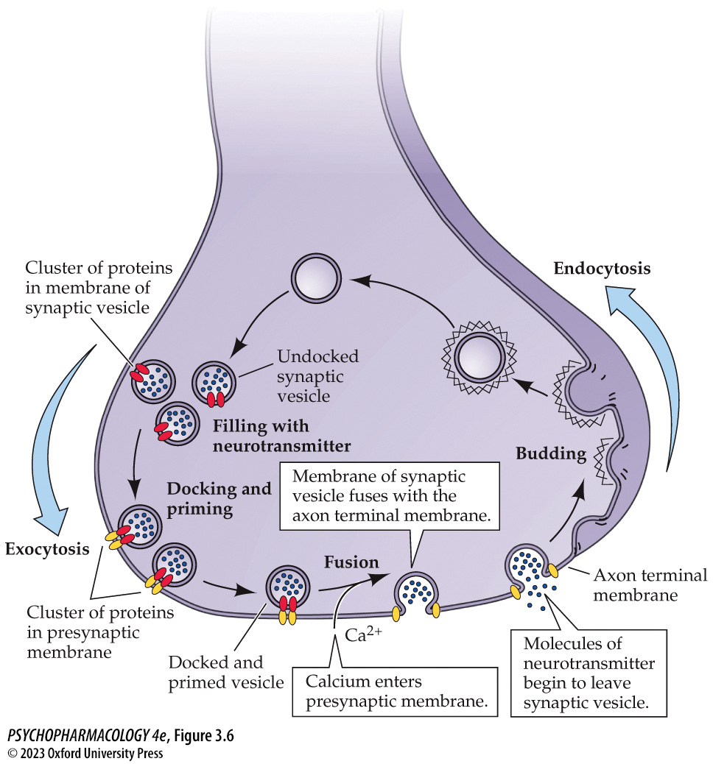
Figure 3.6 The life cycle of the synaptic vesicle (1)
Notes:
Figure 3.6 The life cycle of the synaptic vesicle
Small vesicles containing classical neurotransmitters are constantly being recycled in the axon terminal. Vesicles are filled with neurotransmitter molecules, after which they are transported to the vicinity of release sites in the terminal and undergo processes of docking and priming. Ca²⁺-dependent fusion with the axon terminal membrane, called exocytosis, permits release of the contents of the vesicle into the synaptic cleft. The vesicle membrane is retrieved by a process of invagination (budding) from the terminal membrane, endocytosis, and transmitter refilling, thus completing the cycle.

Slide 16
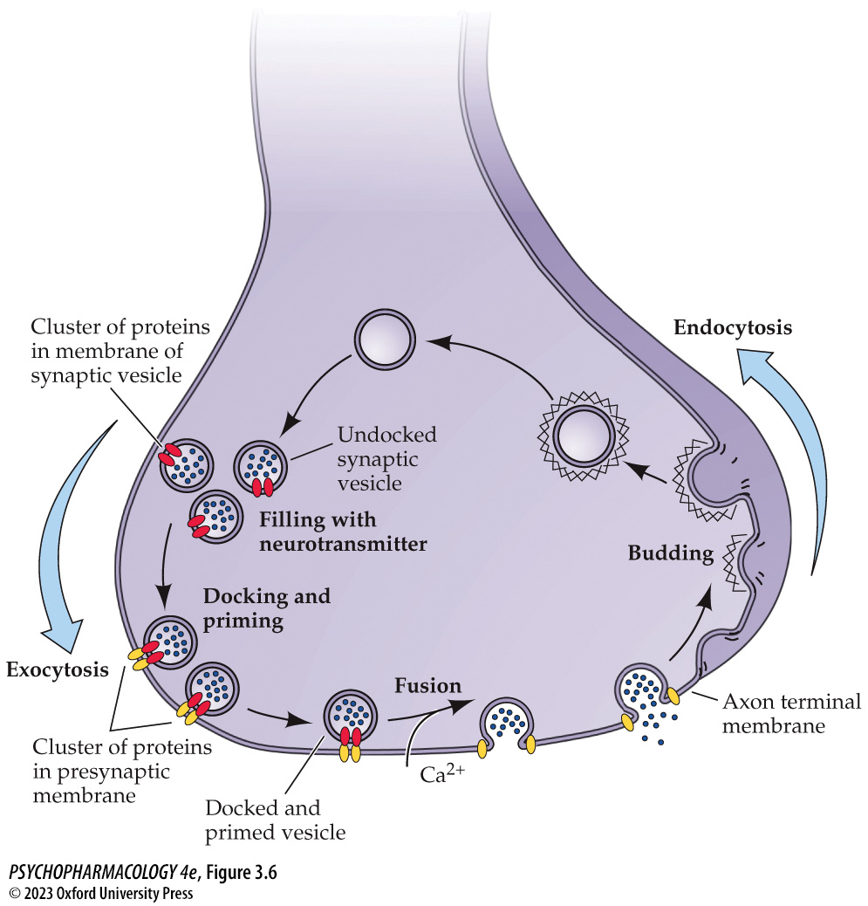
Figure 3.6 The life cycle of the synaptic vesicle (2)
Notes:
Figure 3.6 The life cycle of the synaptic vesicle
Small vesicles containing classical neurotransmitters are constantly being recycled in the axon terminal. Vesicles are filled with neurotransmitter molecules, after which they are transported to the vicinity of release sites in the terminal and undergo processes of docking and priming. Ca²⁺-dependent fusion with the axon terminal membrane, called exocytosis, permits release of the contents of the vesicle into the synaptic cleft. The vesicle membrane is retrieved by a process of invagination (budding) from the terminal membrane, endocytosis, and transmitter refilling, thus completing the cycle.

Slide 17
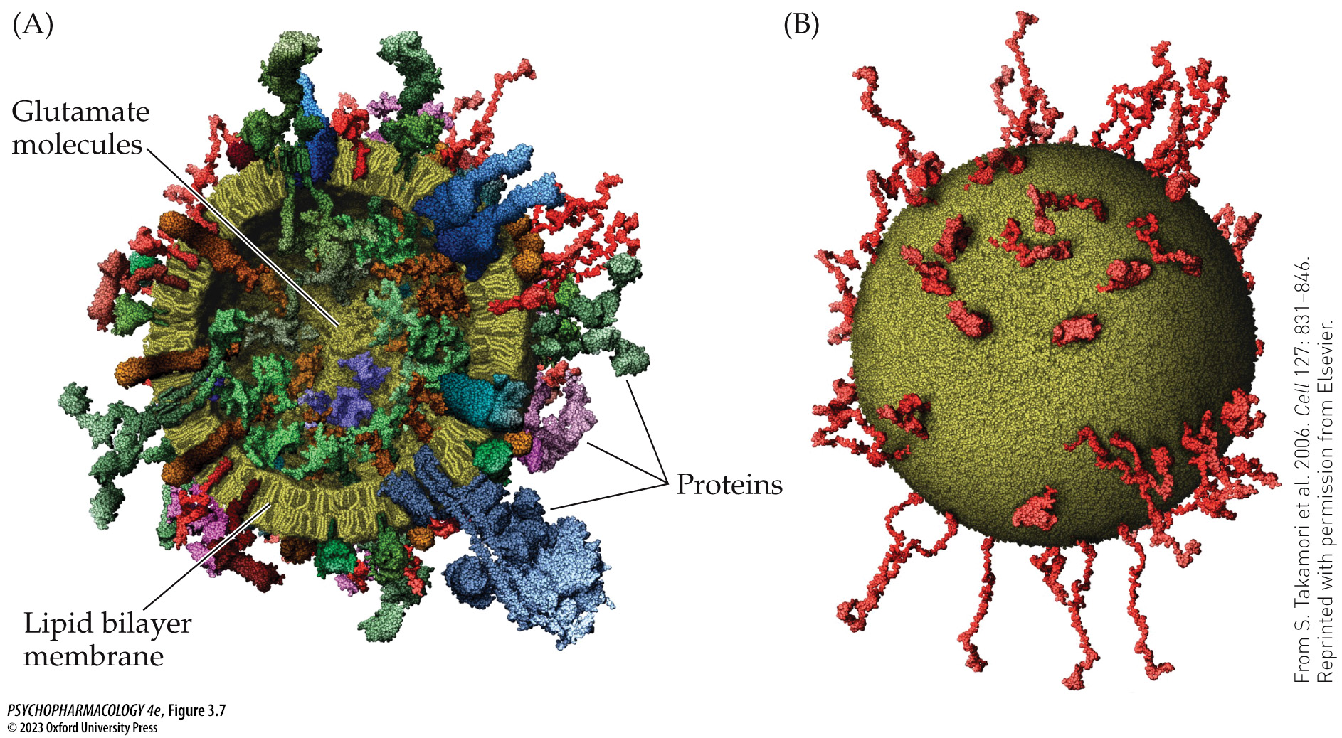
Figure 3.7 Molecular model of a glutamate synaptic vesicle
Notes:
Figure 3.7 Molecular model of a glutamate synaptic vesicle
This model depicts a synaptic vesicle used to store and release the neurotransmitter glutamate from nerve terminals. The model can be considered representative of all classical transmitter vesicles. (A) A cutaway view of the vesicle shows the lipid bilayer membrane in yellow along with many different proteins (drawn with different shapes and colors) inserted into or passing completely through the vesicle membrane. The small particles in the interior of the vesicle depict molecules of glutamate, several thousand of which are packed tightly within that space. (B) A simplified view of the exterior of the vesicle only shows a protein called synaptobrevin. This protein is the most abundant one found in synaptic vesicles. It helps vesicles to fuse with the axon terminal membrane during exocytosis. (From S. Takamori et al. 2006. Cell 127: 831–846. Reprinted with permission from Elsevier.)

Slide 18
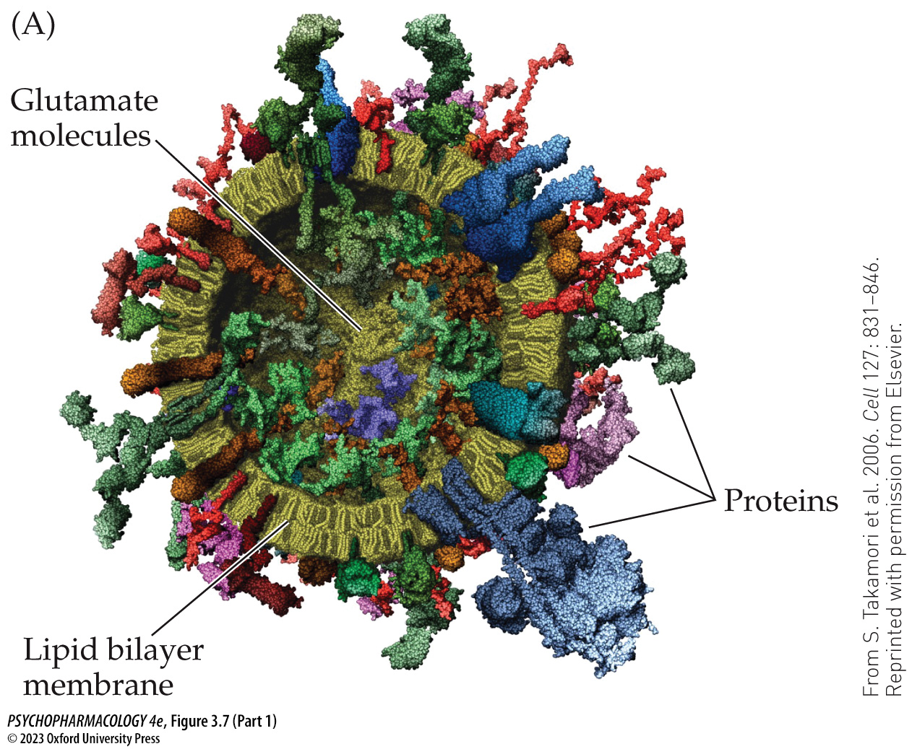
Figure 3.7 Molecular model of a glutamate synaptic vesicle (Part 1)
Notes:
Figure 3.7 Molecular model of a glutamate synaptic vesicle
This model depicts a synaptic vesicle used to store and release the neurotransmitter glutamate from nerve terminals. The model can be considered representative of all classical transmitter vesicles. (A) A cutaway view of the vesicle shows the lipid bilayer membrane in yellow along with many different proteins (drawn with different shapes and colors) inserted into or passing completely through the vesicle membrane. The small particles in the interior of the vesicle depict molecules of glutamate, several thousand of which are packed tightly within that space. (B) A simplified view of the exterior of the vesicle only shows a protein called synaptobrevin. This protein is the most abundant one found in synaptic vesicles. It helps vesicles to fuse with the axon terminal membrane during exocytosis. (From S. Takamori et al. 2006. Cell 127: 831–846. Reprinted with permission from Elsevier.)

Slide 19
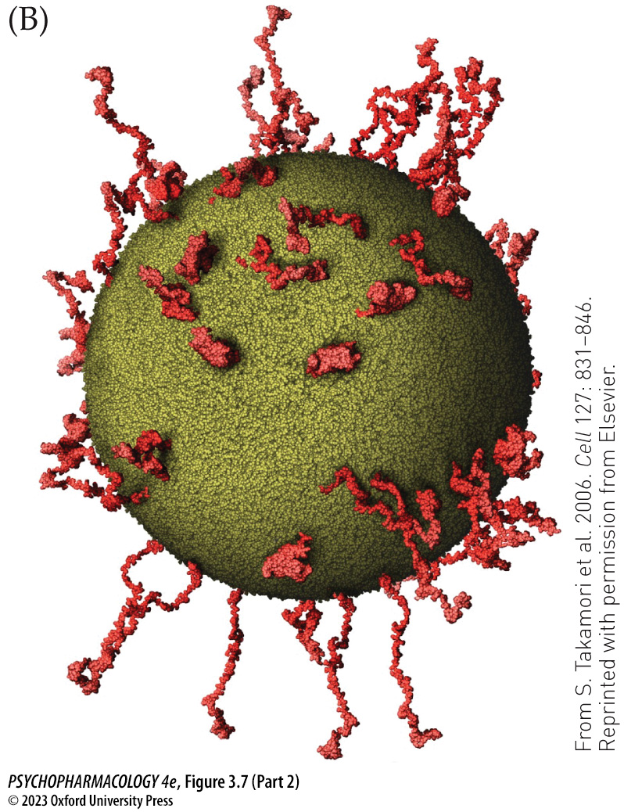
Figure 3.7 Molecular model of a glutamate synaptic vesicle (Part 2)
Notes:
Figure 3.7 Molecular model of a glutamate synaptic vesicle
This model depicts a synaptic vesicle used to store and release the neurotransmitter glutamate from nerve terminals. The model can be considered representative of all classical transmitter vesicles. (A) A cutaway view of the vesicle shows the lipid bilayer membrane in yellow along with many different proteins (drawn with different shapes and colors) inserted into or passing completely through the vesicle membrane. The small particles in the interior of the vesicle depict molecules of glutamate, several thousand of which are packed tightly within that space. (B) A simplified view of the exterior of the vesicle only shows a protein called synaptobrevin. This protein is the most abundant one found in synaptic vesicles. It helps vesicles to fuse with the axon terminal membrane during exocytosis. (From S. Takamori et al. 2006. Cell 127: 831–846. Reprinted with permission from Elsevier.)

Slide 20
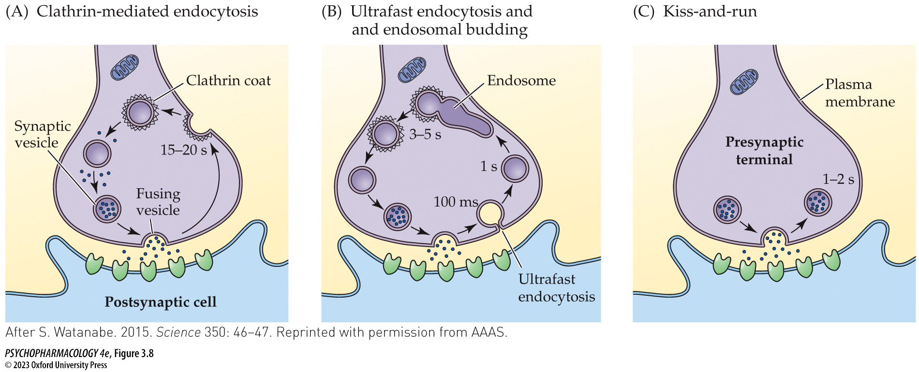
Figure 3.8 Models of synaptic vesicle recycling
Notes:
Figure 3.8 Models of synaptic vesicle recycling
(A) In the well-established clathrin-mediated endocytosis model, the vesicle fully collapses after fusing with the plasma membrane. The vesicle membrane is subsequently retrieved at a point distant from the release site, using a process that requires the protein clathrin. (B) In the more recently proposed model called ultrafast endocytosis and endosomal budding, the vesicle membrane is retrieved extremely rapidly at a point near the release site. Clathrin is not required for membrane retrieval according to this model. The vesicle membrane fuses with an endosome, after which new vesicles bud off from the endosome in a clathrin-dependent mechanism. (C) In the kiss-and-run model, the vesicle membrane briefly fuses with the plasma membrane of the nerve terminal without collapsing. After the vesicle has released its contents into the synaptic cleft, it reforms and detaches from the plasma membrane. Neither clathrin nor endosomes play a role in this model. (After S. Watanabe. 2015. Science 350: 46–47. Reprinted with permission from AAAS.)

Slide 21
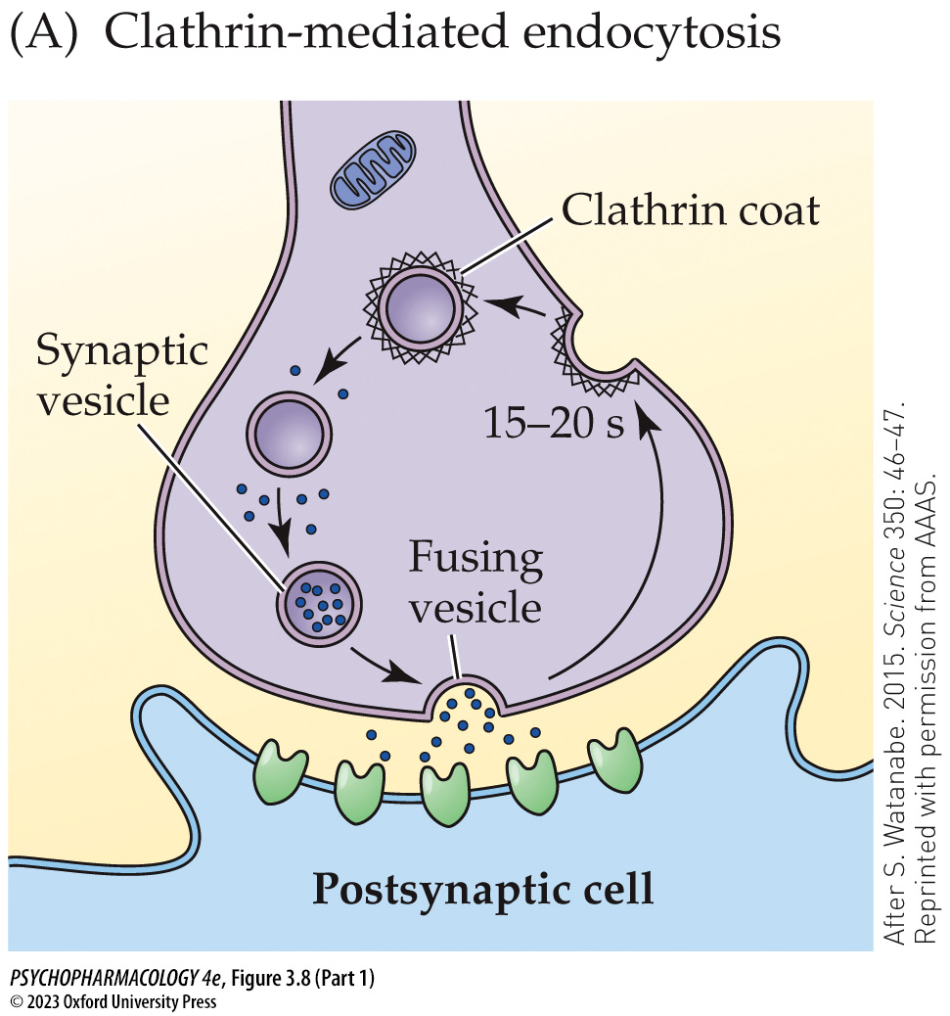
Figure 3.8 Models of synaptic vesicle recycling (Part 1)
Notes:
Figure 3.8 Models of synaptic vesicle recycling
(A) In the well-established clathrin-mediated endocytosis model, the vesicle fully collapses after fusing with the plasma membrane. The vesicle membrane is subsequently retrieved at a point distant from the release site, using a process that requires the protein clathrin. (B) In the more recently proposed model called ultrafast endocytosis and endosomal budding, the vesicle membrane is retrieved extremely rapidly at a point near the release site. Clathrin is not required for membrane retrieval according to this model. The vesicle membrane fuses with an endosome, after which new vesicles bud off from the endosome in a clathrin-dependent mechanism. (C) In the kiss-and-run model, the vesicle membrane briefly fuses with the plasma membrane of the nerve terminal without collapsing. After the vesicle has released its contents into the synaptic cleft, it reforms and detaches from the plasma membrane. Neither clathrin nor endosomes play a role in this model. (After S. Watanabe. 2015. Science 350: 46–47. Reprinted with permission from AAAS.)

Slide 22
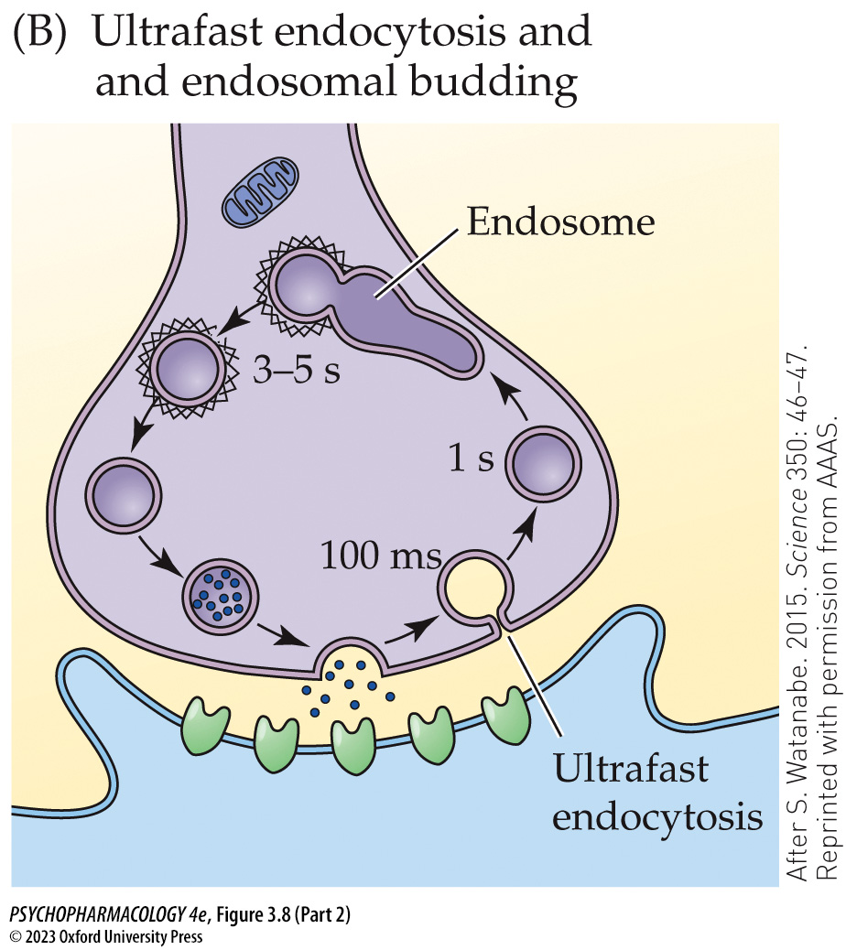
Figure 3.8 Models of synaptic vesicle recycling (Part 2)
Notes:
Figure 3.8 Models of synaptic vesicle recycling
(A) In the well-established clathrin-mediated endocytosis model, the vesicle fully collapses after fusing with the plasma membrane. The vesicle membrane is subsequently retrieved at a point distant from the release site, using a process that requires the protein clathrin. (B) In the more recently proposed model called ultrafast endocytosis and endosomal budding, the vesicle membrane is retrieved extremely rapidly at a point near the release site. Clathrin is not required for membrane retrieval according to this model. The vesicle membrane fuses with an endosome, after which new vesicles bud off from the endosome in a clathrin-dependent mechanism. (C) In the kiss-and-run model, the vesicle membrane briefly fuses with the plasma membrane of the nerve terminal without collapsing. After the vesicle has released its contents into the synaptic cleft, it reforms and detaches from the plasma membrane. Neither clathrin nor endosomes play a role in this model. (After S. Watanabe. 2015. Science 350: 46–47. Reprinted with permission from AAAS.)

Slide 23
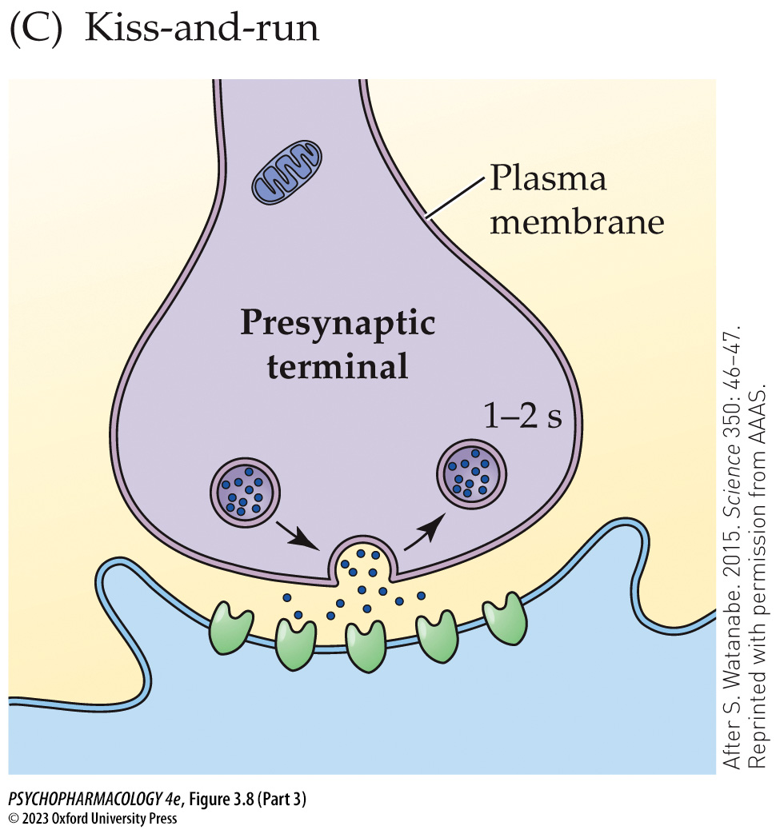
Figure 3.8 Models of synaptic vesicle recycling (Part 3)
Notes:
Figure 3.8 Models of synaptic vesicle recycling
(A) In the well-established clathrin-mediated endocytosis model, the vesicle fully collapses after fusing with the plasma membrane. The vesicle membrane is subsequently retrieved at a point distant from the release site, using a process that requires the protein clathrin. (B) In the more recently proposed model called ultrafast endocytosis and endosomal budding, the vesicle membrane is retrieved extremely rapidly at a point near the release site. Clathrin is not required for membrane retrieval according to this model. The vesicle membrane fuses with an endosome, after which new vesicles bud off from the endosome in a clathrin-dependent mechanism. (C) In the kiss-and-run model, the vesicle membrane briefly fuses with the plasma membrane of the nerve terminal without collapsing. After the vesicle has released its contents into the synaptic cleft, it reforms and detaches from the plasma membrane. Neither clathrin nor endosomes play a role in this model. (After S. Watanabe. 2015. Science 350: 46–47. Reprinted with permission from AAAS.)

Slide 24
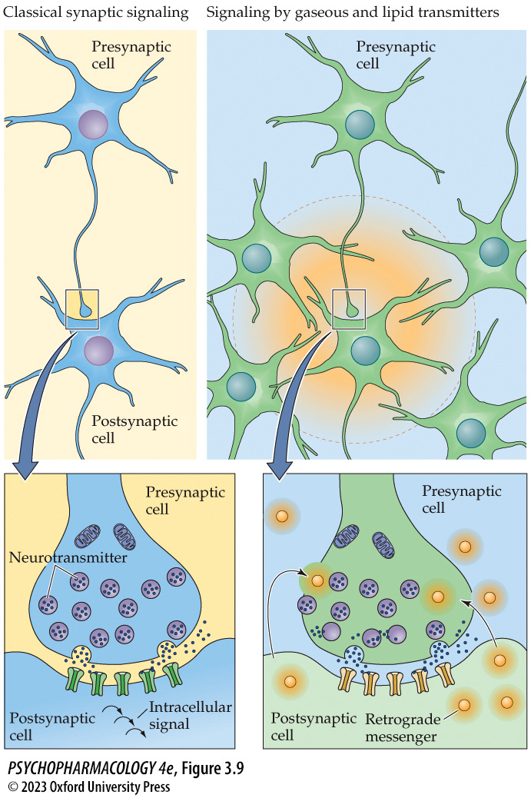
Figure 3.9 Signaling by classical versus gaseous and lipid transmitters
Notes:
Figure 3.9 Signaling by classical versus gaseous and lipid transmitters
In contrast to signaling by classical neurotransmitters (left), gaseous and lipid transmitters (right) are not released from synaptic vesicles. Gases and lipids cannot be stored within vesicles and therefore must be synthesized enzymatically when needed. Synthesis of gaseous and lipid transmitters usually occurs in the postsynaptic cell following release of a classical transmitter from the presynaptic cell and postsynaptic receptor activation. The newly formed gas or lipid subsequently diffuses across the membrane and acts as a retrograde messenger on the presynaptic cell as well as other neurons close enough to receive the signal.

Slide 25
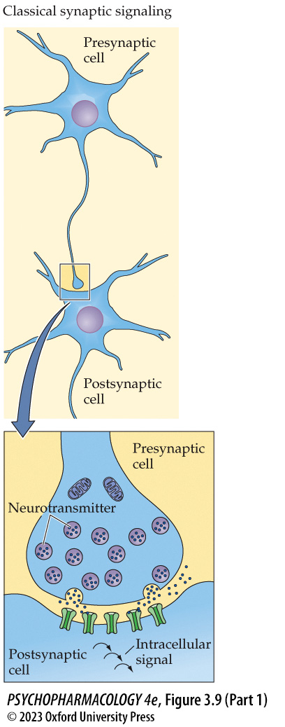
Figure 3.9 Signaling by classical versus gaseous and lipid transmitters (Part 1)
Notes:
Figure 3.9 Signaling by classical versus gaseous and lipid transmitters
In contrast to signaling by classical neurotransmitters (left), gaseous and lipid transmitters (right) are not released from synaptic vesicles. Gases and lipids cannot be stored within vesicles and therefore must be synthesized enzymatically when needed. Synthesis of gaseous and lipid transmitters usually occurs in the postsynaptic cell following release of a classical transmitter from the presynaptic cell and postsynaptic receptor activation. The newly formed gas or lipid subsequently diffuses across the membrane and acts as a retrograde messenger on the presynaptic cell as well as other neurons close enough to receive the signal.

Slide 26
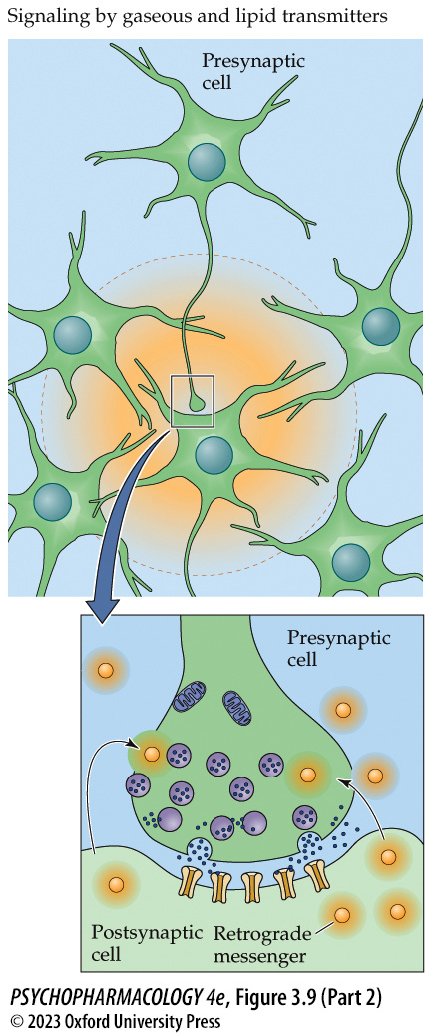
Figure 3.9 Signaling by classical versus gaseous and lipid transmitters (Part 2)
Notes:
Figure 3.9 Signaling by classical versus gaseous and lipid transmitters
In contrast to signaling by classical neurotransmitters (left), gaseous and lipid transmitters (right) are not released from synaptic vesicles. Gases and lipids cannot be stored within vesicles and therefore must be synthesized enzymatically when needed. Synthesis of gaseous and lipid transmitters usually occurs in the postsynaptic cell following release of a classical transmitter from the presynaptic cell and postsynaptic receptor activation. The newly formed gas or lipid subsequently diffuses across the membrane and acts as a retrograde messenger on the presynaptic cell as well as other neurons close enough to receive the signal.

Slide 27
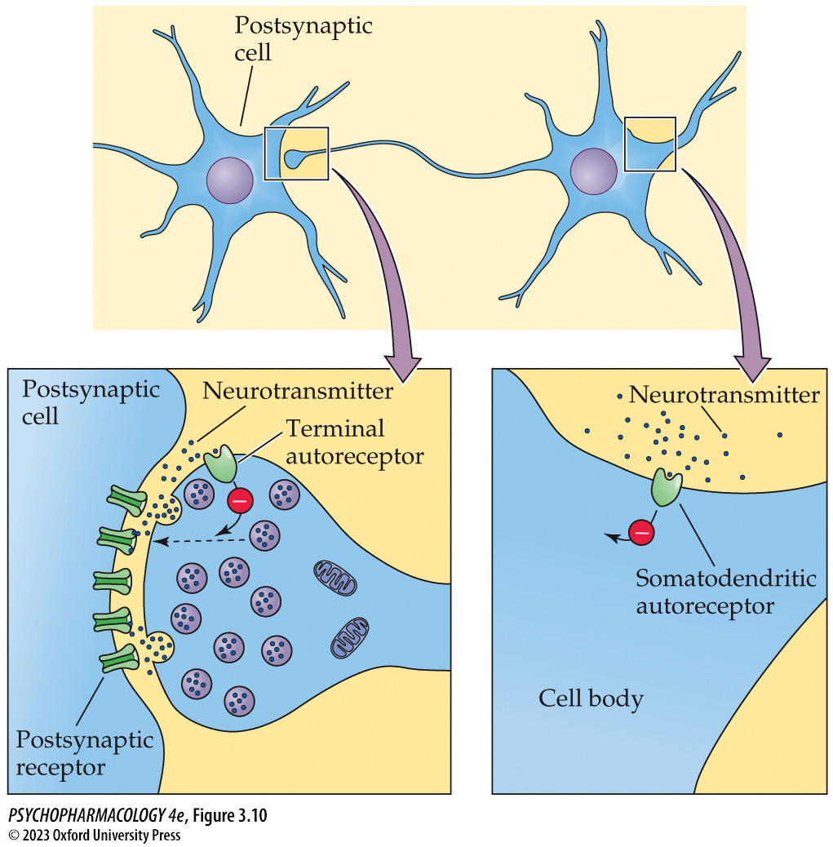
Figure 3.10 Terminal and somatodendritic autoreceptors
Notes:
Figure 3.10 Terminal and somatodendritic autoreceptors
Many neurons possess autoreceptors on their axon terminals and/or on their cell bodies and dendrites. Terminal autoreceptors inhibit neurotransmitter release, whereas somatodendritic autoreceptors reduce the rate of cell firing.

Slide 28
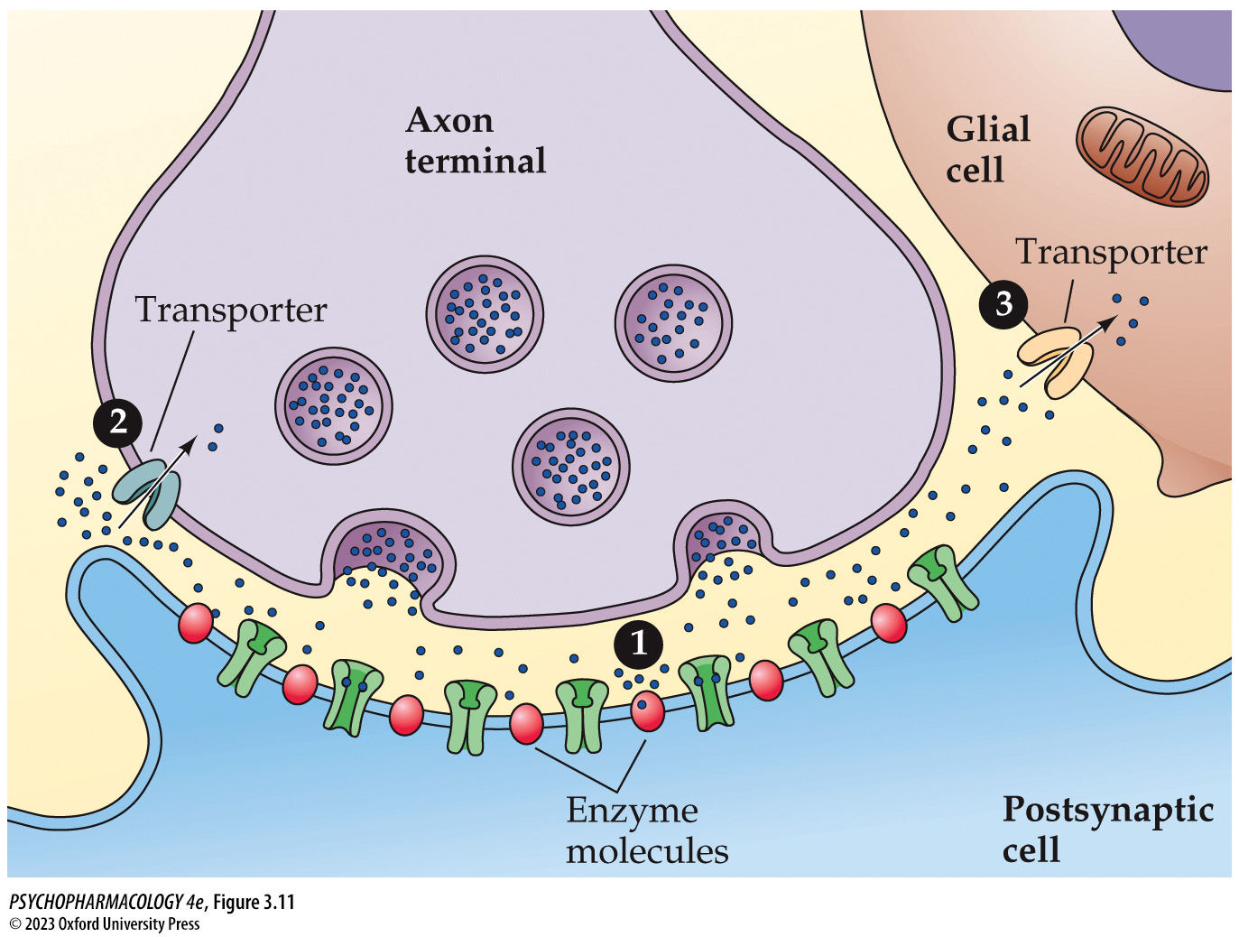
Figure 3.11 Neurotransmitter inactivation
Notes:
Figure 3.11 Neurotransmitter inactivation
Neurotransmitter molecules can be inactivated by (1) enzymatic breakdown, (2) reuptake by the axon terminal, or (3) uptake by nearby glial cells. Cellular uptake is mediated by specific membrane transporters for each neurotransmitter.

Slide 29
Table 3.2 Comparison of Ionotropic and Metabotropic Receptors
Characteristics | Ionotropic receptors | Metabotropic receptors
Structure | 4 or 5 subunits that are assembled and then inserted into the cell membrane | 1 subunit
Mechanism of action | Contain an intrinsic ion channel that opens in response to neurotransmitter or drug binding | Activate G proteins in response to neurotransmitter or drug binding
Coupled to second messengers? | No | Yes
Speed of action | Fast | Slower

Slide 30
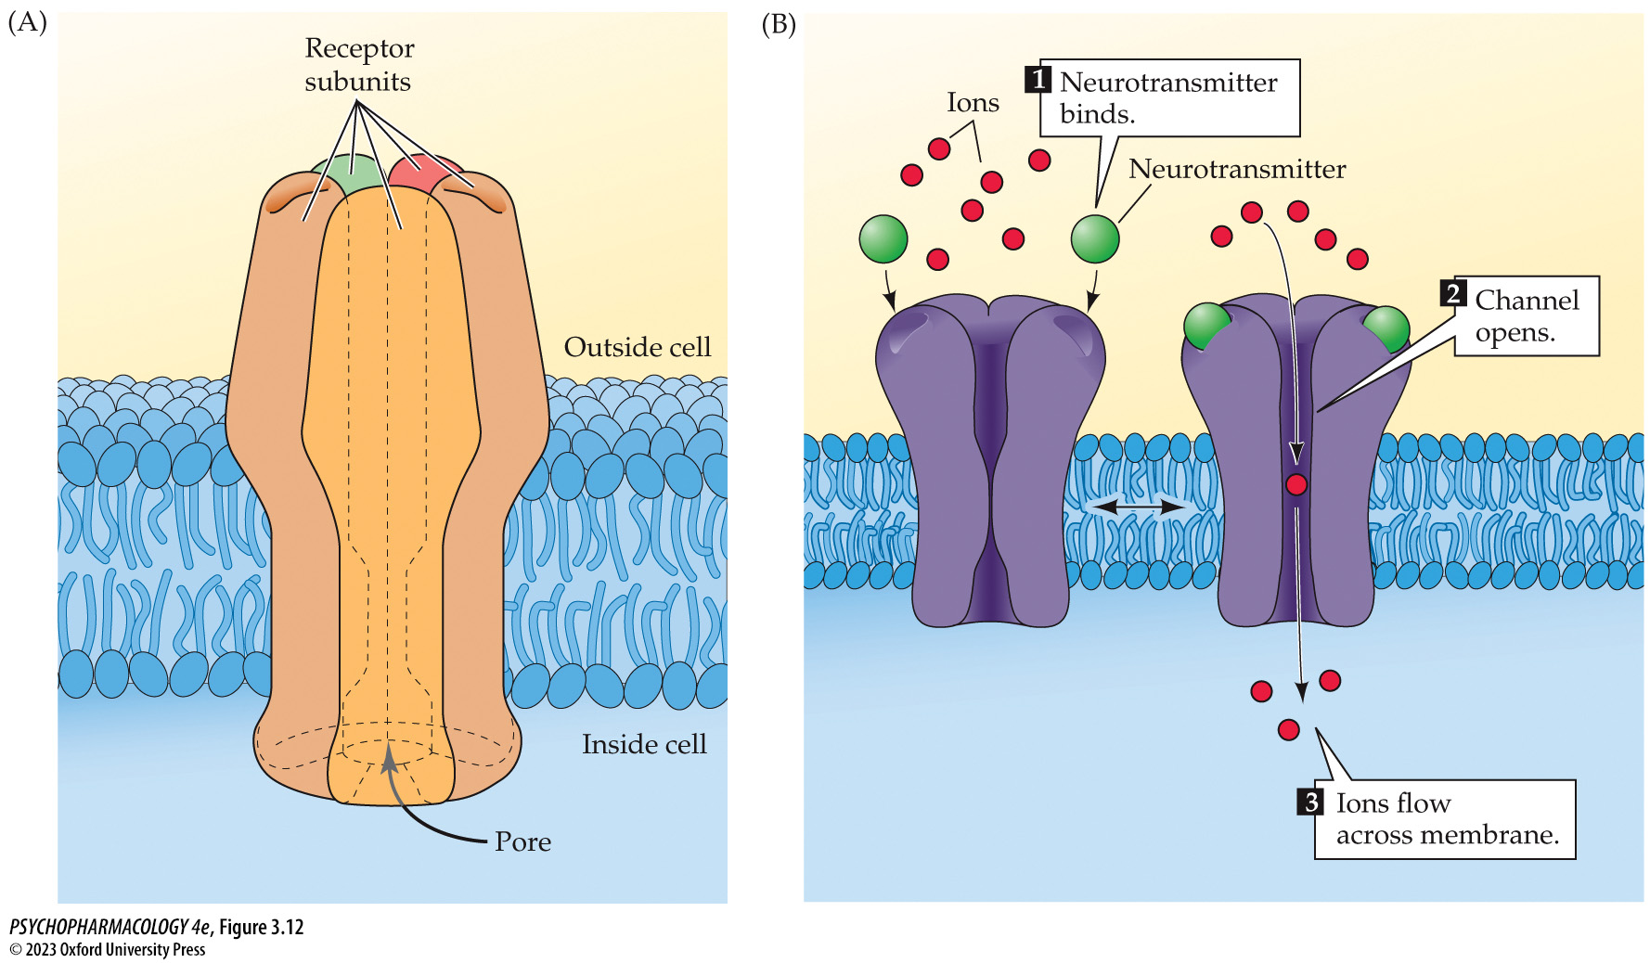
Figure 3.12 Structure and function of ionotropic receptors (1)
Notes:
Figure 3.12 Structure and function of ionotropic receptors
(A) Each receptor complex comprises either five (as shown) or four protein subunits that form a channel or a pore in the cell membrane. (B) Binding of the neurotransmitter to the receptor triggers channel opening and the flow of ions across the membrane.

Slide 31
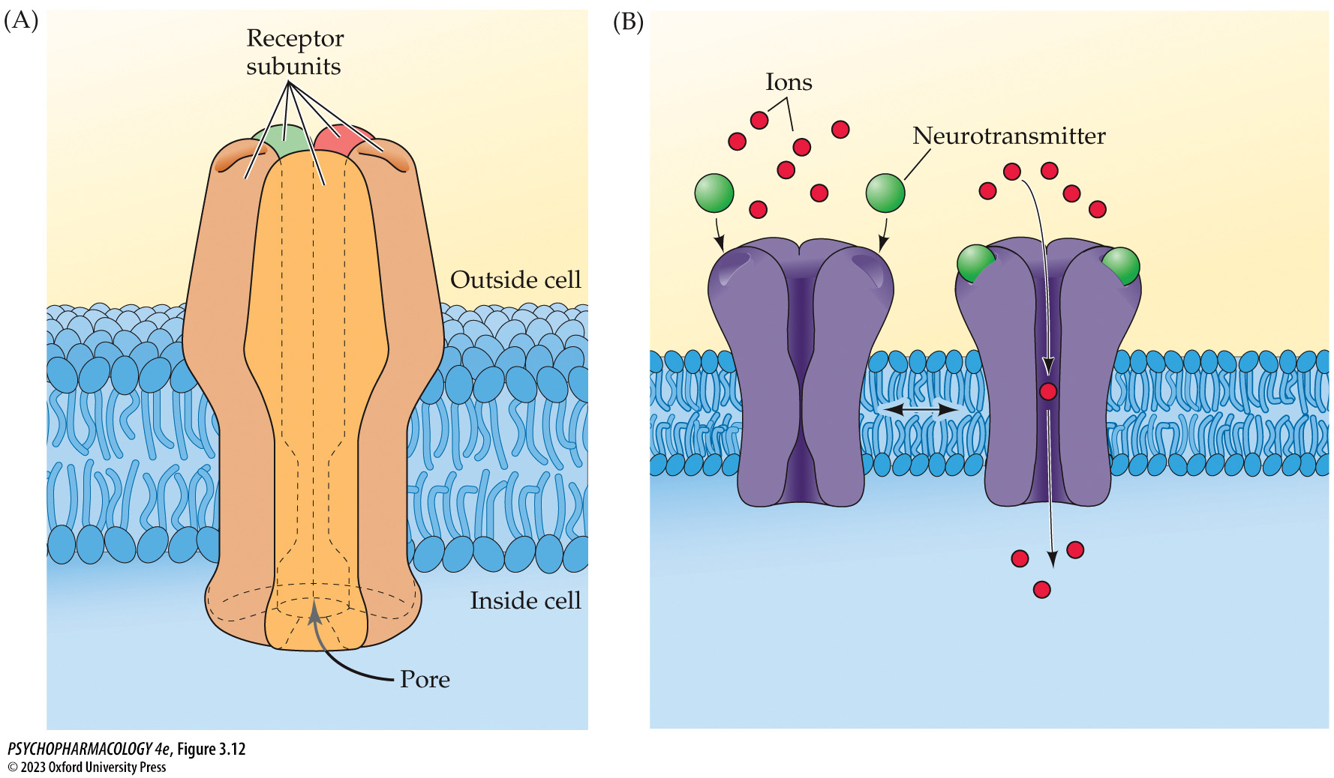
Figure 3.12 Structure and function of ionotropic receptors (2)
Notes:
Figure 3.12 Structure and function of ionotropic receptors
(A) Each receptor complex comprises either five (as shown) or four protein subunits that form a channel or a pore in the cell membrane. (B) Binding of the neurotransmitter to the receptor triggers channel opening and the flow of ions across the membrane.

Slide 32
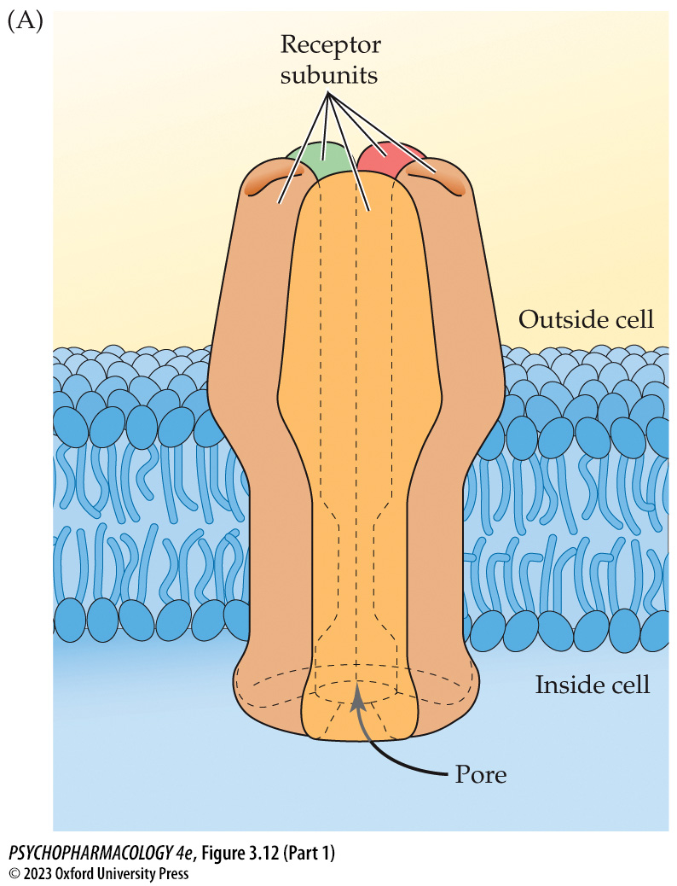
Figure 3.12 Structure and function of ionotropic receptors (Part 1)
Notes:
Figure 3.12 Structure and function of ionotropic receptors
(A) Each receptor complex comprises either five (as shown) or four protein subunits that form a channel or a pore in the cell membrane. (B) Binding of the neurotransmitter to the receptor triggers channel opening and the flow of ions across the membrane.

Slide 33
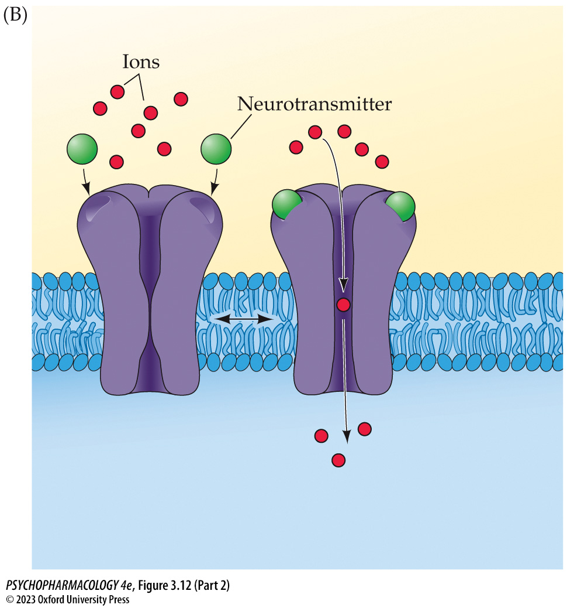
Figure 3.12 Structure and function of ionotropic receptors (Part 2)
Notes:
Figure 3.12 Structure and function of ionotropic receptors
(A) Each receptor complex comprises either five (as shown) or four protein subunits that form a channel or a pore in the cell membrane. (B) Binding of the neurotransmitter to the receptor triggers channel opening and the flow of ions across the membrane.

Slide 34
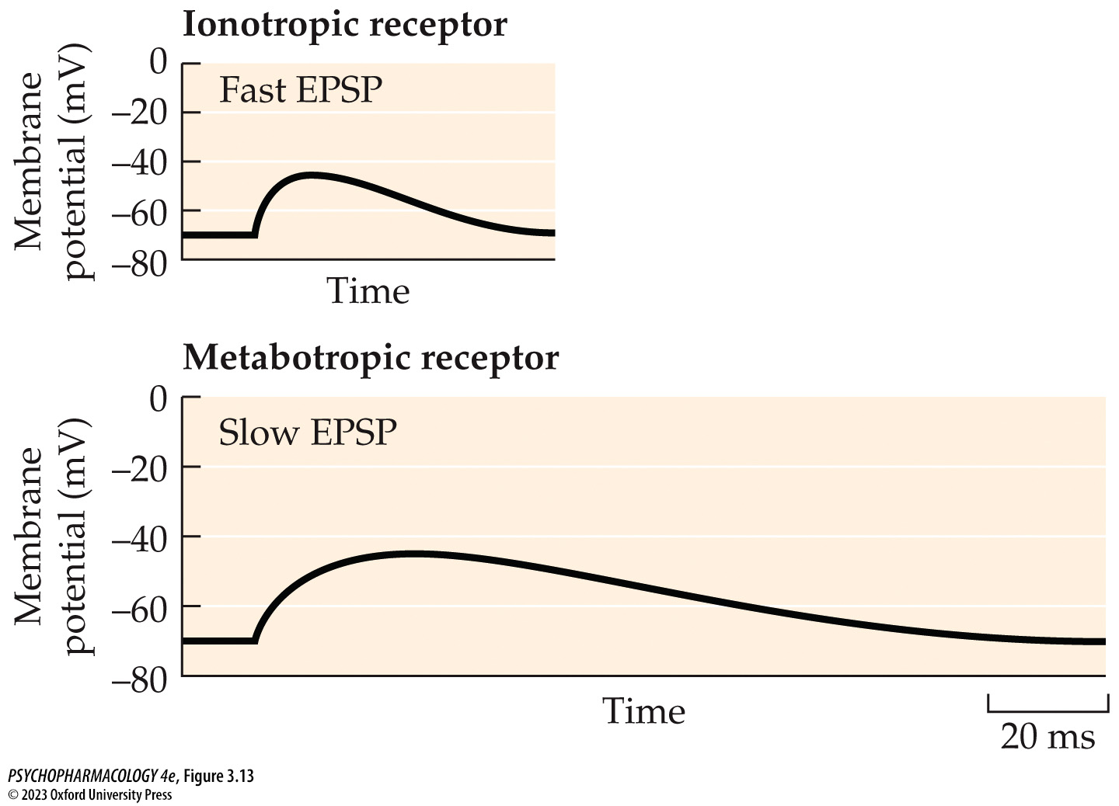
Figure 3.13 Fast and slow excitatory postsynaptic potentials (EPSPs) elicited by ionotropic versus metabotropic receptors
Notes:
Figure 3.13 Fast and slow excitatory postsynaptic potentials (EPSPs) elicited by ionotropic versus metabotropic receptors
As shown in this representative figure, activation of metabotropic receptors elicits responses that are slower to develop but last much longer than ionotropic receptor–mediated responses. Note the time scale on the lower right measured in milliseconds (ms). (After J. H. Byrne. 2014. In From Molecules to Networks, An Introduction to Cellular and Molecular Neuroscience, 3rd ed., J. H. Byrne et al. [Eds.], pp. 489–507. Academic Press: San Diego. © 2014. Reprinted with permission from Elsevier.)

Slide 35
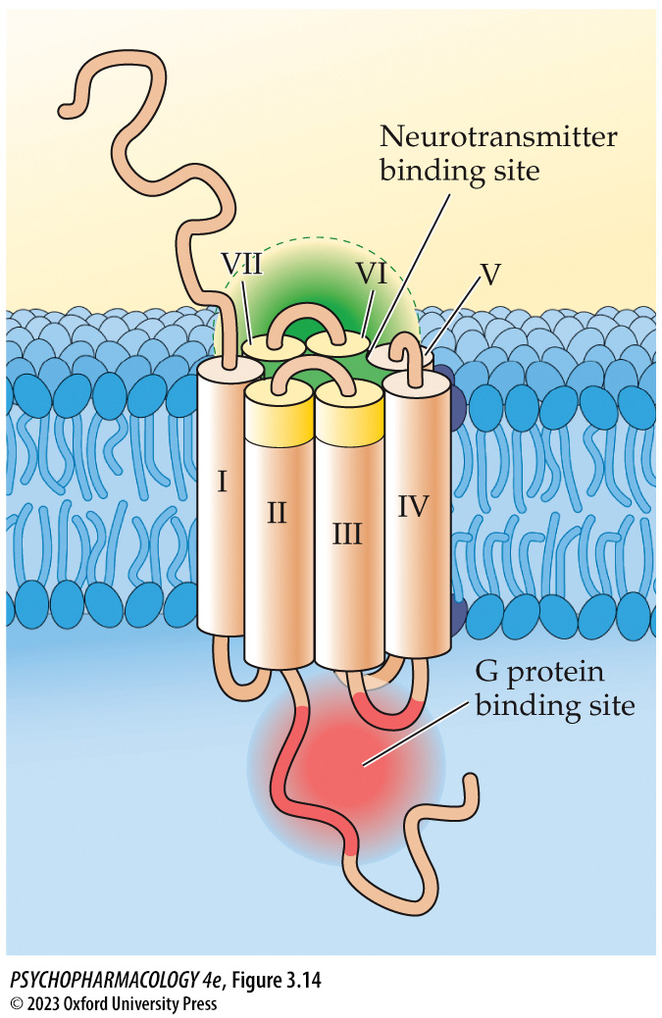
Figure 3.14 Structure of metabotropic receptors
Notes:
Figure 3.14 Structure of metabotropic receptors
Each receptor comprises a single protein subunit with seven transmembrane domains (labeled here by Roman numerals).

Slide 36
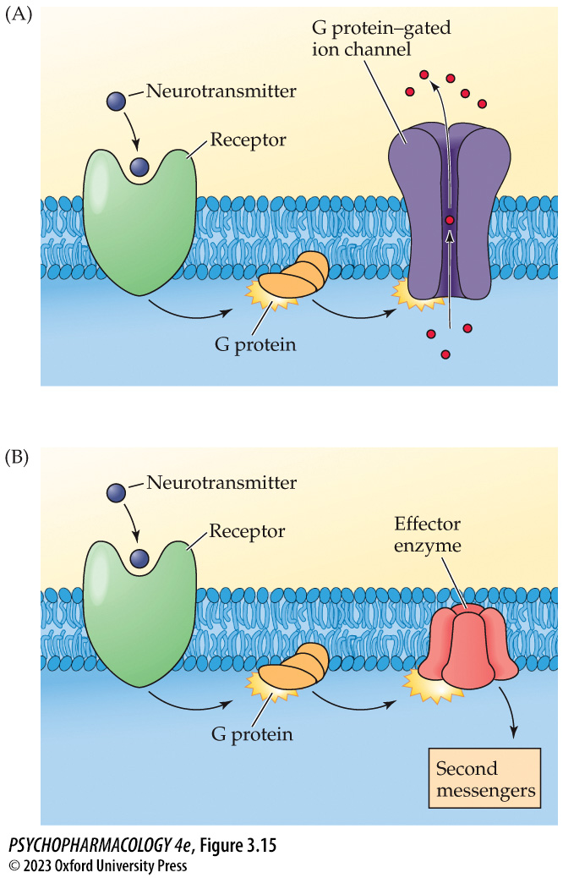
Figure 3.15 Functions of metabotropic receptors
Notes:
Figure 3.15 Functions of metabotropic receptors
Metabotropic receptors activate G proteins in the membrane, which may either (A) alter the opening of a G protein–gated ion channel or (B) stimulate or inhibit an effector enzyme that either synthesizes or breaks down a second messenger.

Slide 37
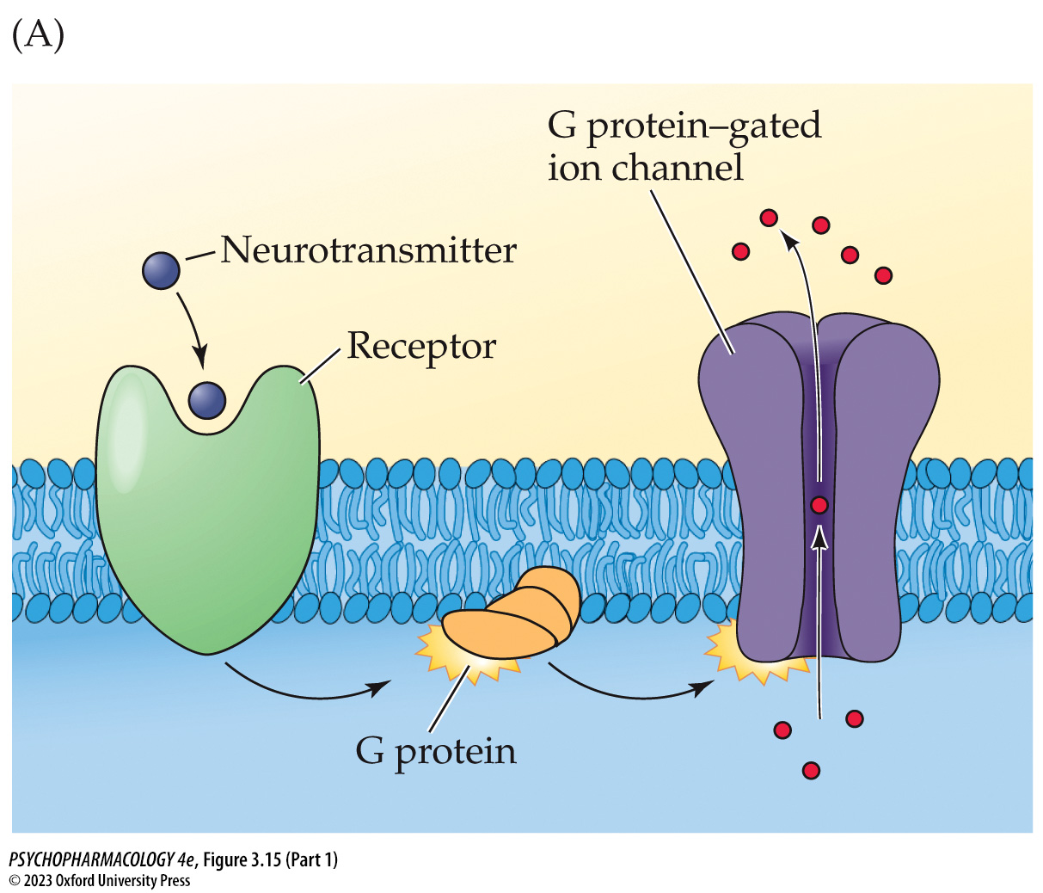
Figure 3.15 Functions of metabotropic receptors (Part 1)
Notes:
Figure 3.15 Functions of metabotropic receptors
Metabotropic receptors activate G proteins in the membrane, which may either (A) alter the opening of a G protein–gated ion channel or (B) stimulate or inhibit an effector enzyme that either synthesizes or breaks down a second messenger.

Slide 38
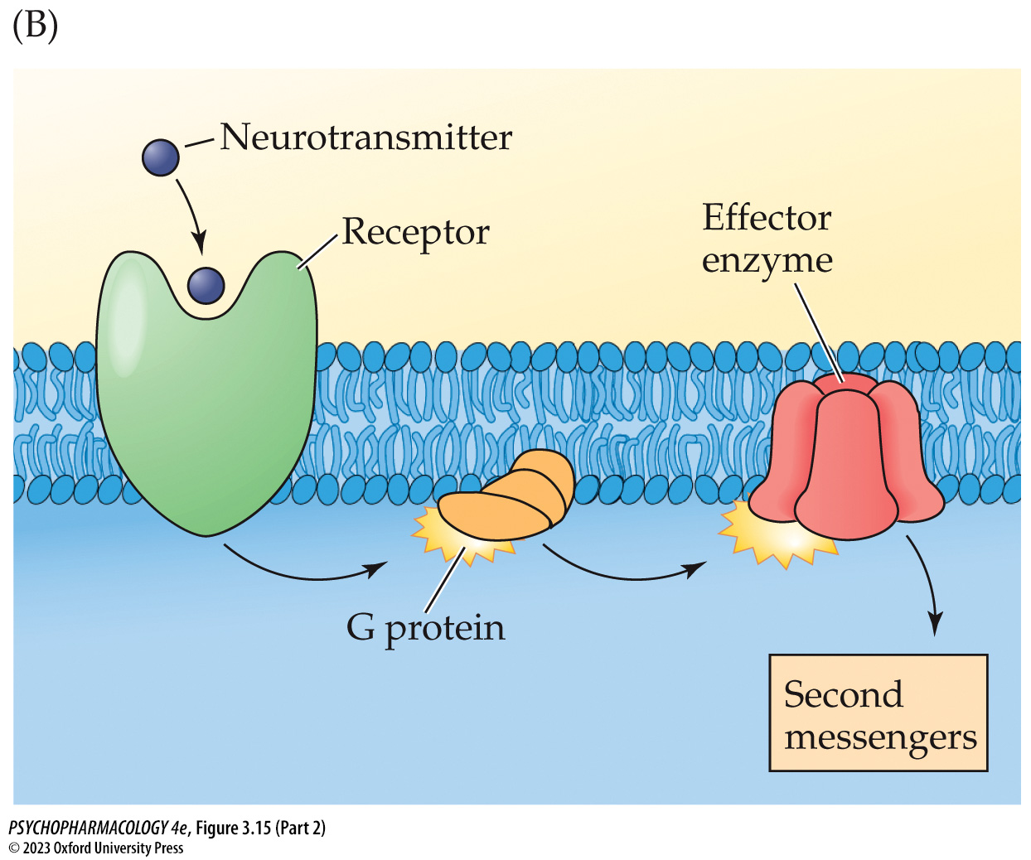
Figure 3.15 Functions of metabotropic receptors (Part 2)
Notes:
Figure 3.15 Functions of metabotropic receptors
Metabotropic receptors activate G proteins in the membrane, which may either (A) alter the opening of a G protein–gated ion channel or (B) stimulate or inhibit an effector enzyme that either synthesizes or breaks down a second messenger.

Slide 39
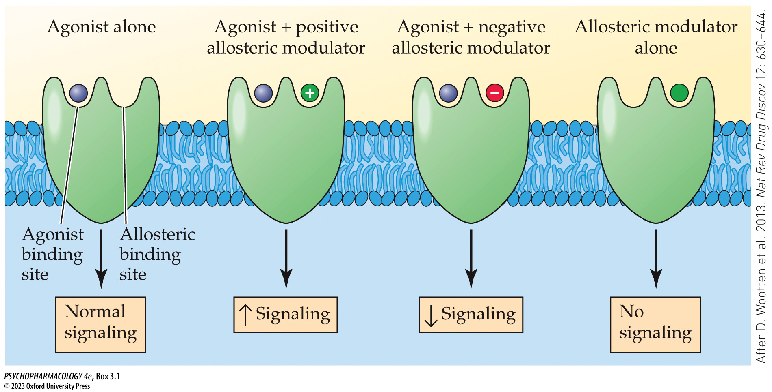
Box 3.1 The Cutting Edge: Allosteric Modulation of Neurotransmitter Receptors
Notes:
Box 3.1 The Cutting Edge: Allosteric Modulation of Neurotransmitter Receptors
Allosteric modulation of neurotransmitter receptor signaling Using metabotropic receptors as an example, the figure shows how allosteric modulators can either positively or negatively influence receptor signaling. In the absence of an agonist, including the neurotransmitter itself, the allosteric modulator produces no receptor signaling. (After D. Wootten et al. 2013. Nat Rev Drug Discov 12: 630–644.)

Slide 40
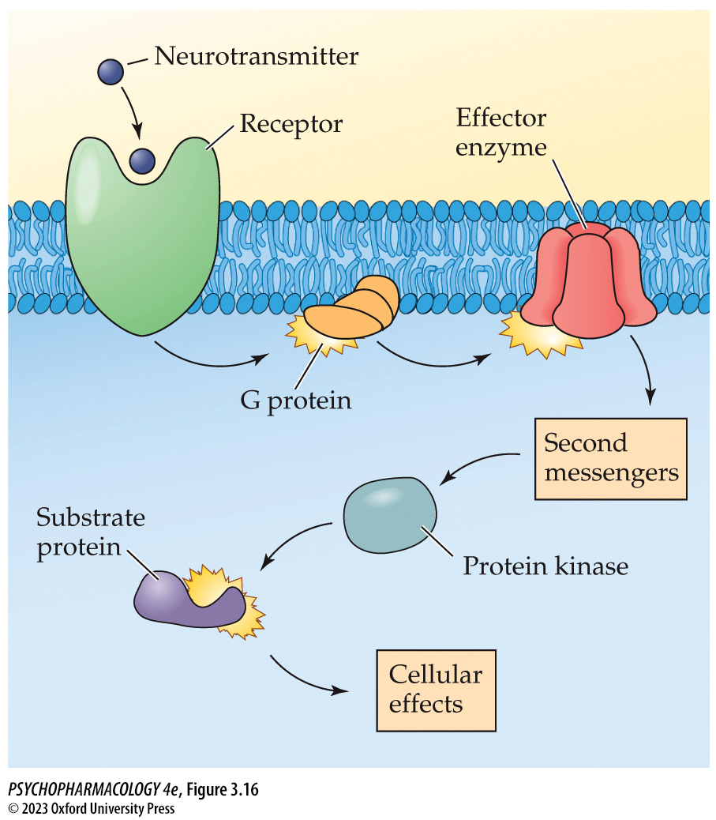
Figure 3.16 The mechanism of action of second messengers
Notes:
Figure 3.16 The mechanism of action of second messengers
Second messengers work by activating protein kinases to cause phosphorylation of substrate proteins within the postsynaptic cell.

Slide 41
Table 3.3 Second-Messenger Systems and Protein Kinases
Second-messenger system | Associated protein kinase
Cyclic AMP (cAMP) | Protein kinase A (PKA)
Cyclic GMP (cGMP) | Protein kinase G (PKG)
Phosphoinositide | Protein kinase C (PKC)
Calcium (Ca²⁺) | Calcium/calmodulin kinase II (CaMKII)

Slide 42
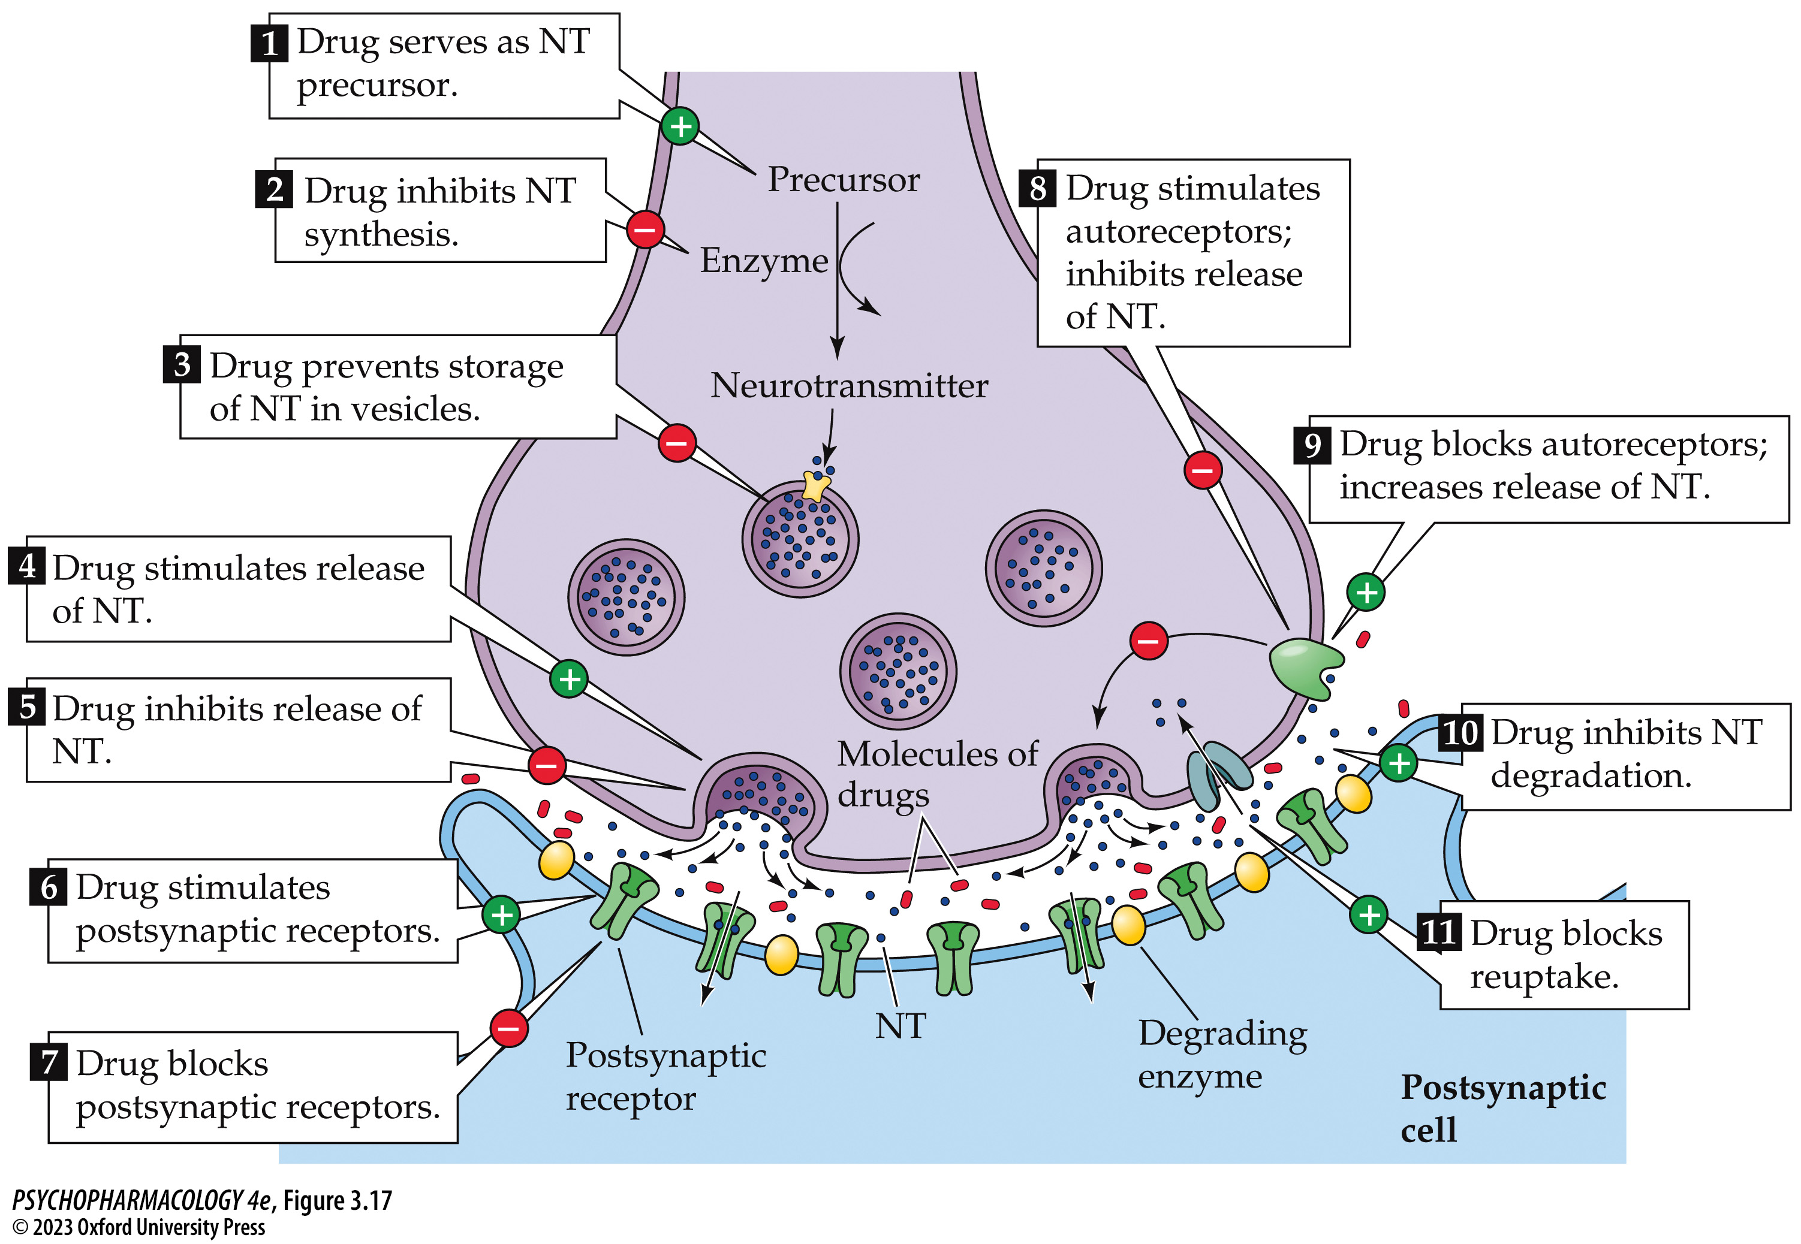
Figure 3.17 Summary of the mechanisms by which drugs can alter synaptic transmission (1)
Notes:
Figure 3.17 Summary of the mechanisms by which drugs can alter synaptic transmission
Neurotransmitter (NT) transmission may be stimulated or facilitated (denoted by +), or it may be inhibited (denoted by –).

Slide 43
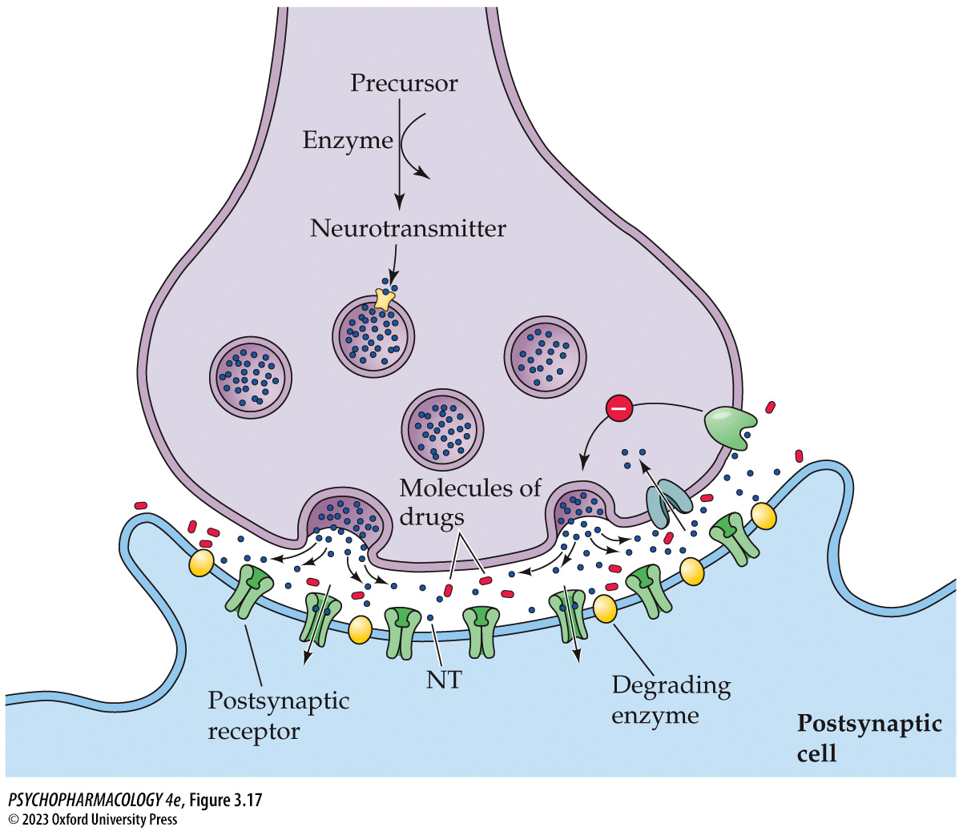
Figure 3.17 Summary of the mechanisms by which drugs can alter synaptic transmission (2)
Notes:
Figure 3.17 Summary of the mechanisms by which drugs can alter synaptic transmission
Neurotransmitter (NT) transmission may be stimulated or facilitated (denoted by +), or it may be inhibited (denoted by –).

Slide 44
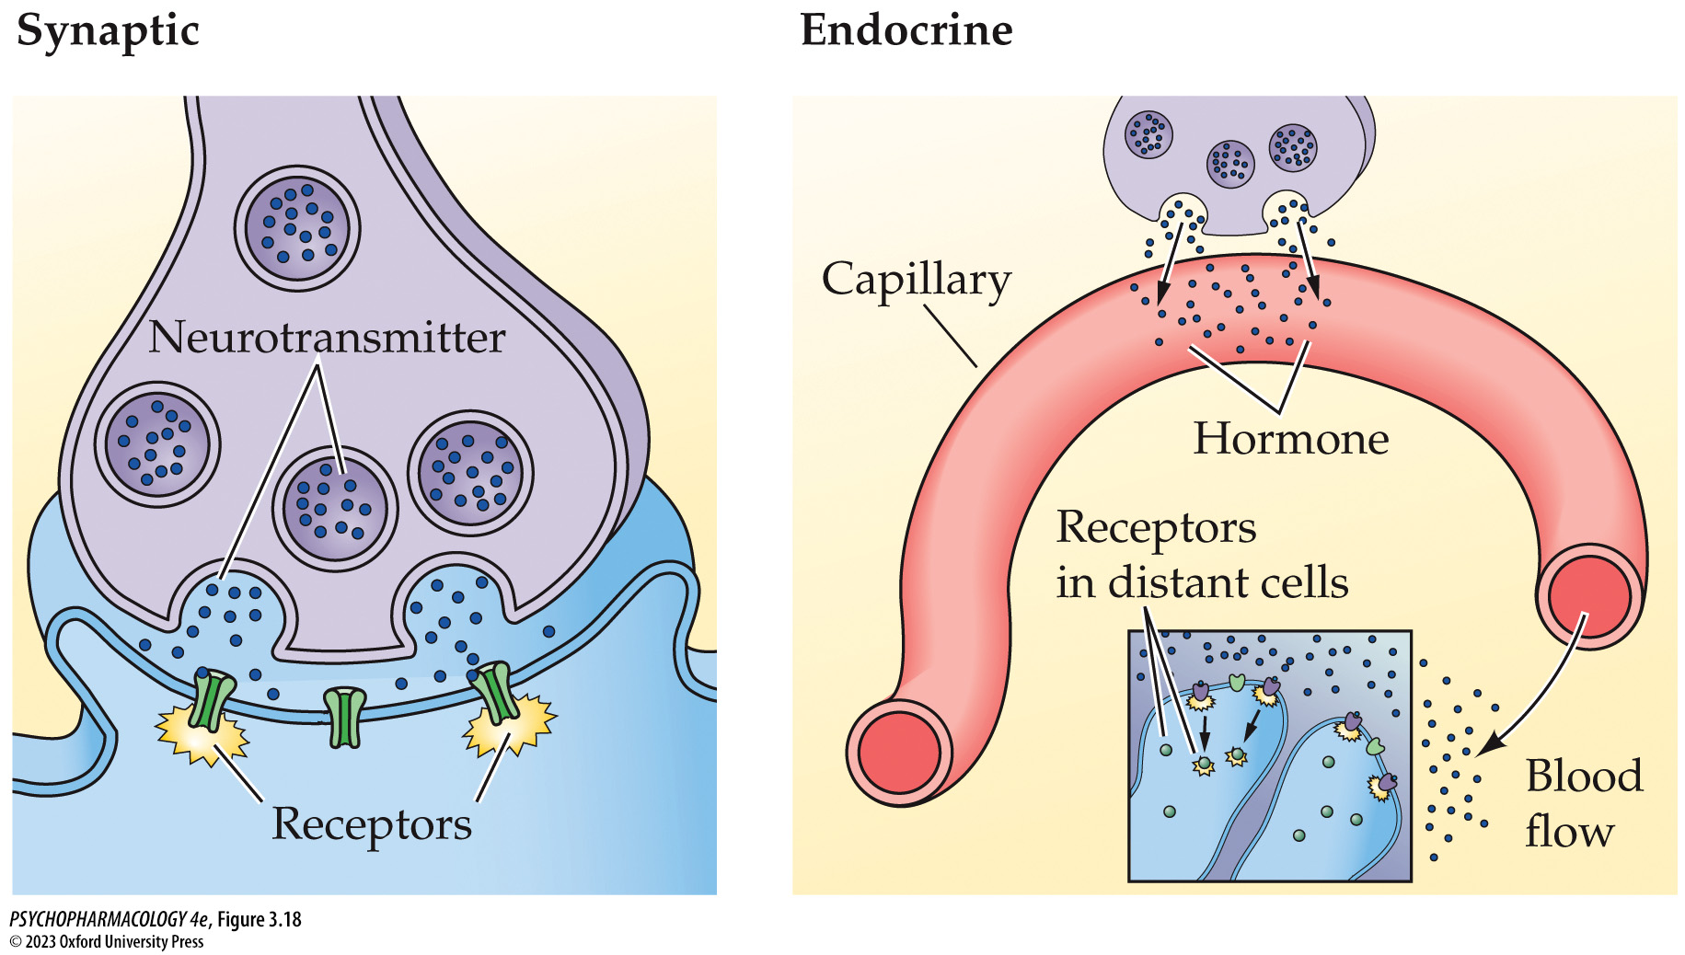
Figure 3.18 Comparison of synaptic and endocrine communication
Notes:
Figure 3.18 Comparison of synaptic and endocrine communication

Slide 45
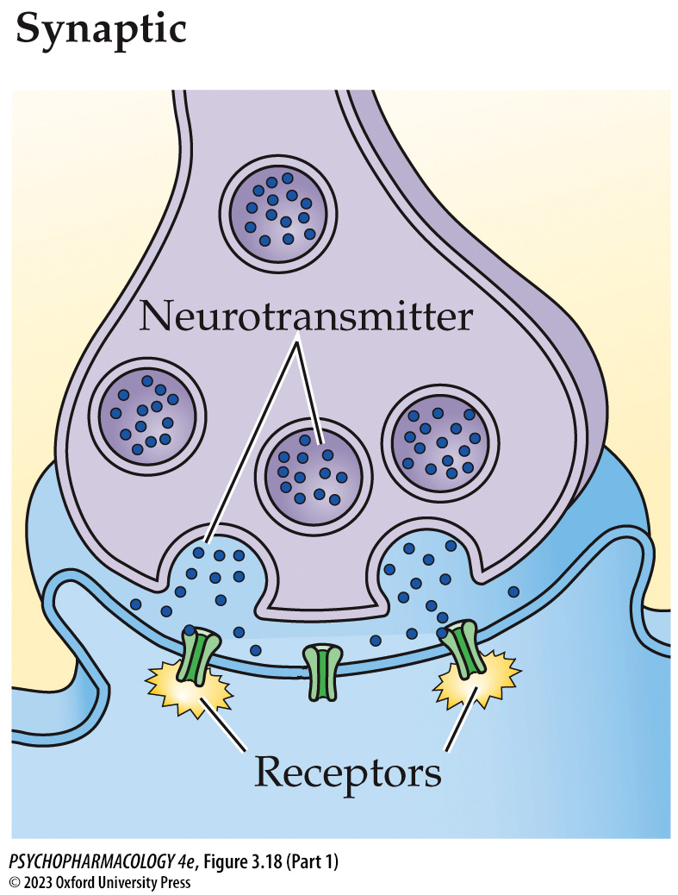
Figure 3.18 Comparison of synaptic and endocrine communication (Part 1)
Notes:
Figure 3.18 Comparison of synaptic and endocrine communication

Slide 46
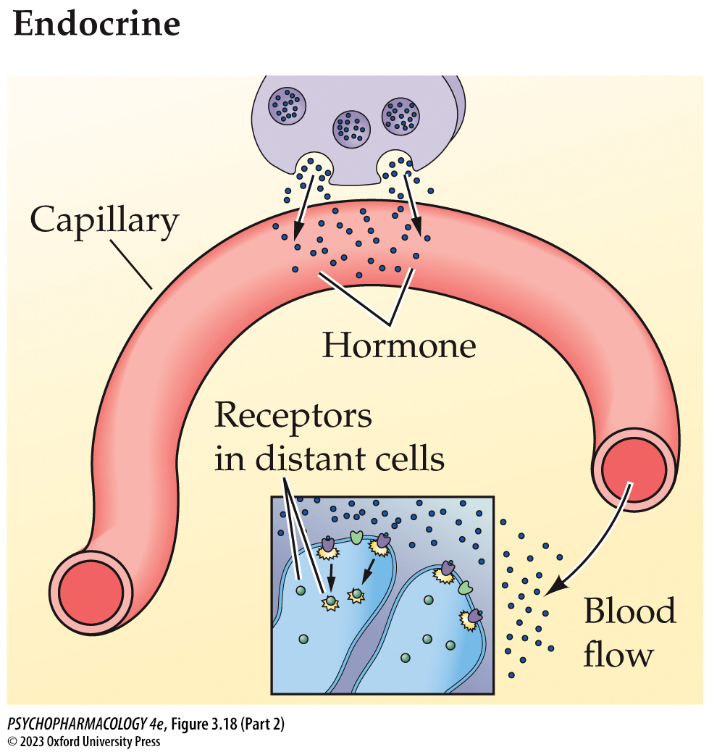
Figure 3.18 Comparison of synaptic and endocrine communication (Part 2)
Notes:
Figure 3.18 Comparison of synaptic and endocrine communication

Slide 47
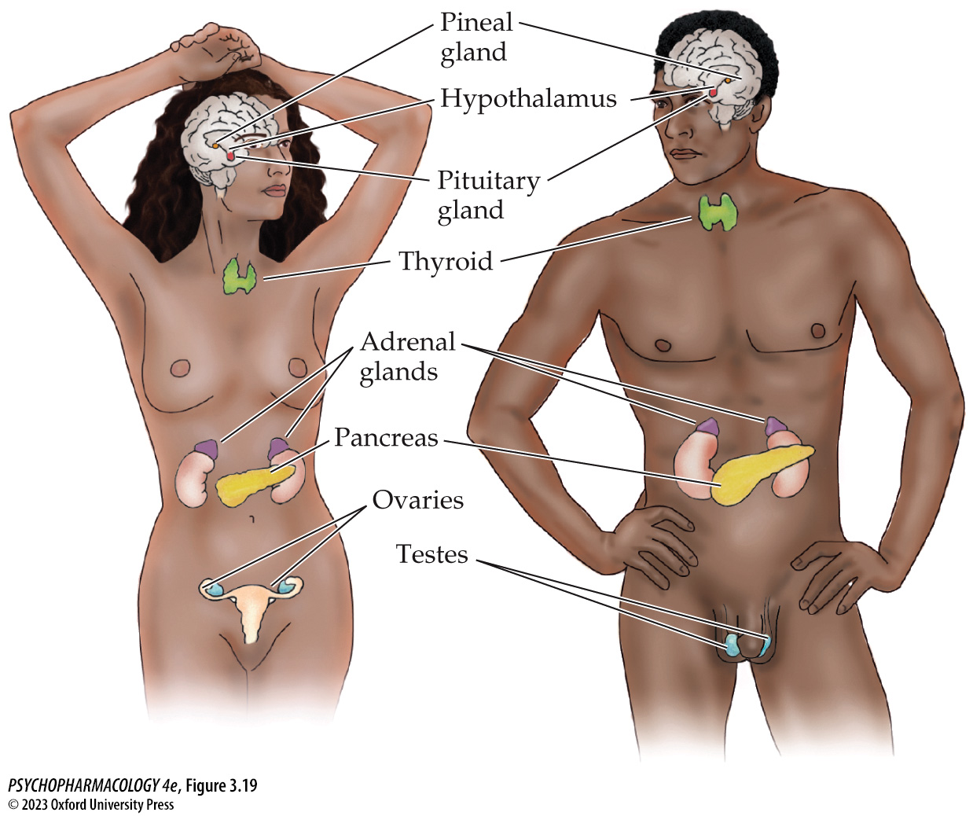
Figure 3.19 Major endocrine glands and their location in the body
Notes:
Figure 3.19 Major endocrine glands and their location in the body

Slide 48
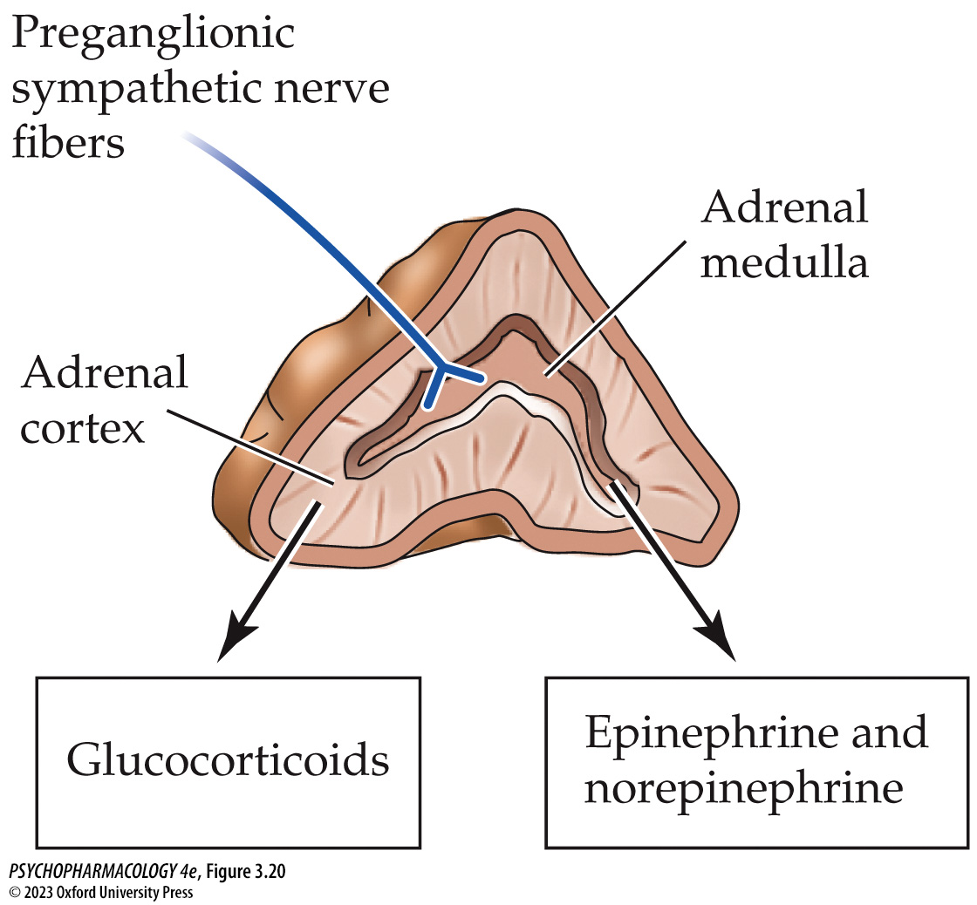
Figure 3.20 Structure of the adrenal gland, showing the outer cortex and the inner medulla
Notes:
Figure 3.20 Structure of the adrenal gland, showing the outer cortex and the inner medulla

Slide 49
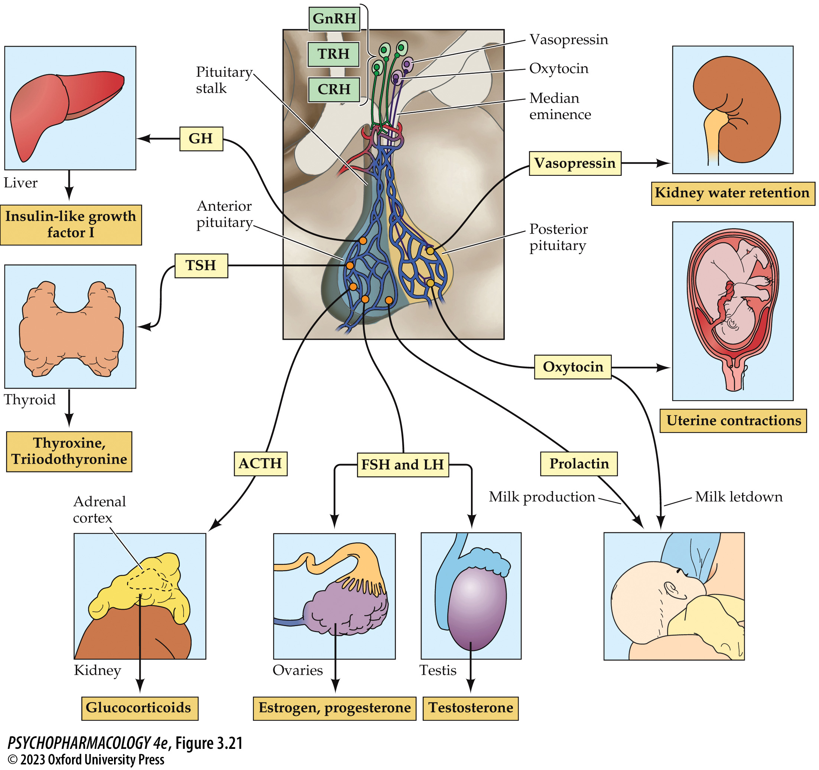
Figure 3.21 Organization of the hypothalamic–pituitary axis
Notes:
Figure 3.21 Organization of the hypothalamic–pituitary axis
Note that the axon terminals of the hypothalamic releasing hormone neurons are located near blood capillaries in the median eminence, whereas oxytocin and vasopressin neurons send their axons all the way into the posterior lobe of the pituitary gland. For the purpose of simplicity, not all hypothalamic releasing hormones are shown. ACTH, adrenocorticotropic hormone; CRH, corticotropin-releasing hormone; FSH, follicle-­stimulating hormone; GH, growth hormone; GnRH, gonadotropin-releasing hormone; LH, luteinizing hormone; TRH, thyrotropin-releasing hormone; TSH, thyroid-stimulating hormone.

Slide 50
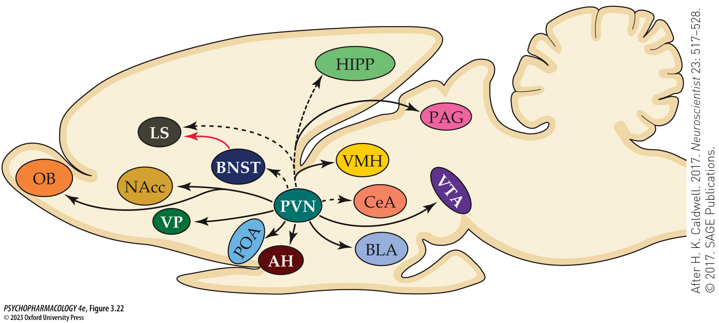
Figure 3.22 Central pathways of vasopressin (VP) and oxytocin (OT) fibers
Notes:
Figure 3.22 Central pathways of vasopressin (VP) and oxytocin (OT) fibers
The cell bodies of centrally projecting VP and OT neurons are located in the paraventricular nucleus and, in the case of VP only, the bed nucleus of the stria terminalis. Solid black lines indicate OT-only fibers, dashed black lines indicate both VP and OT fibers, and the solid red line indicates a VP-only pathway. All of the brain areas receiving VP and/or OT input are either part of or interact with the social behavioral neural network. AH, anterior hypothalamus; BLA, basolateral amygdala; BNST, bed nucleus of the stria terminalis; CeA, central amygdala; HIPP, hippocampus; LS, lateral septum; NAcc, nucleus accumbens; OB, olfactory bulb; PAG, periaqueductal gray; POA, preoptic area; PVN, paraventricular nucleus; VMH, ventromedial hypothalamus; VP, ventral pallidum; VTA, ventral tegmental area. (After H. K. Caldwell. 2017. Neuroscientist 23: 517–528. © 2017. SAGE Publications.)

Slide 51
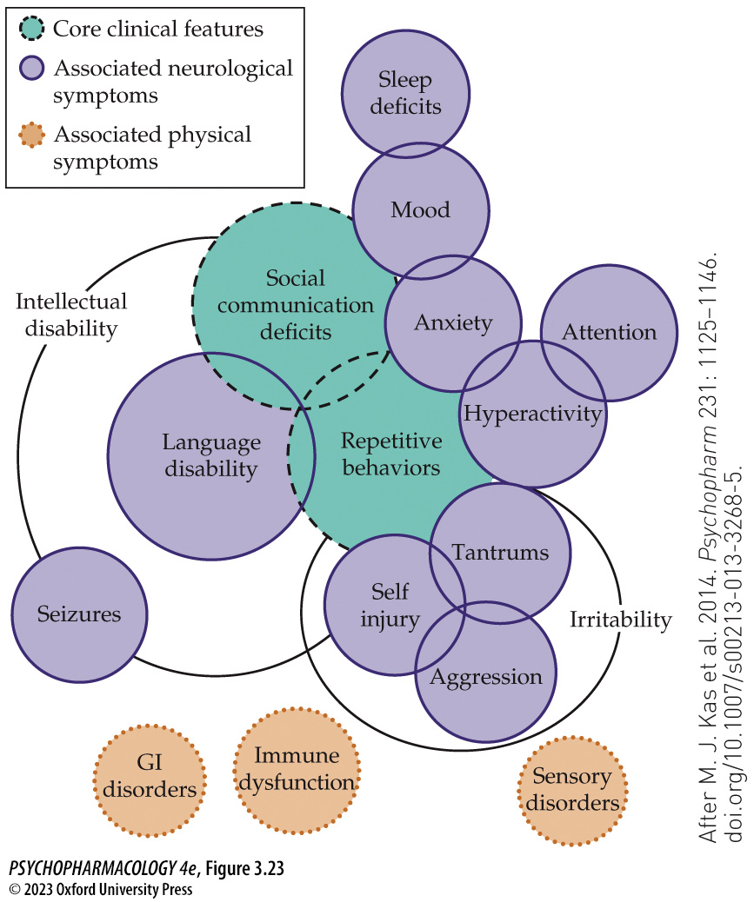
Figure 3.23 Clinical symptoms of autism spectrum disorder
Notes:
Figure 3.23 Clinical symptoms of autism spectrum disorder
ASD patients exhibit core social deficits and repetitive behaviors. Other associated neurological and physical symptoms may also be present to varying degrees, depending on the individual and the severity of the disorder. (After M. J. Kas et al. 2014. Psychopharm 231: 1125–1146. doi.org/10.1007/s00213-013-3268-5.)

Slide 52
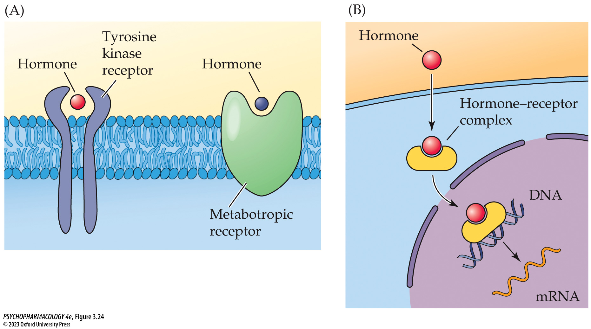
Figure 3.24 Hormonal signaling
Notes:
Figure 3.24 Hormonal signaling
A variety of extra­cellular (A) and intracellular (B) receptors mediate hormone signaling.

Slide 53
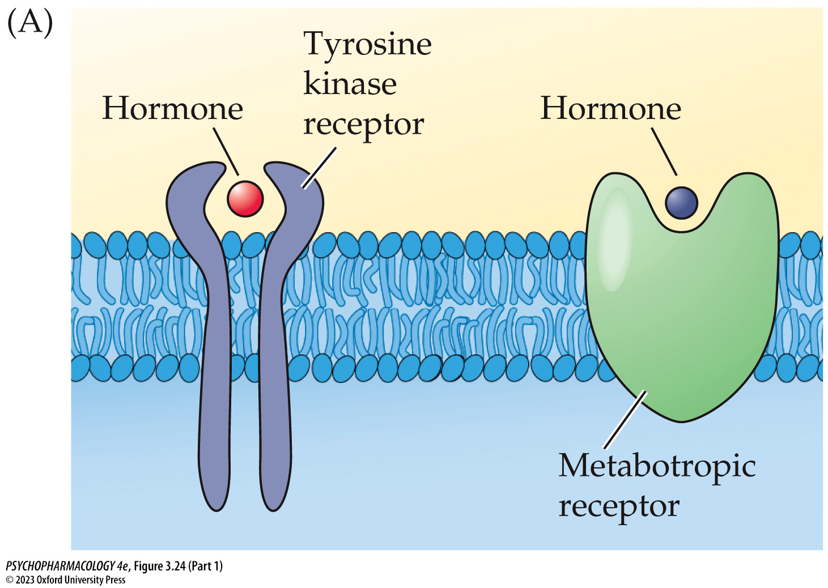
Figure 3.24 Hormonal signaling (Part 1)
Notes:
Figure 3.24 Hormonal signaling
A variety of extra­cellular (A) and intracellular (B) receptors mediate hormone signaling.

Slide 54
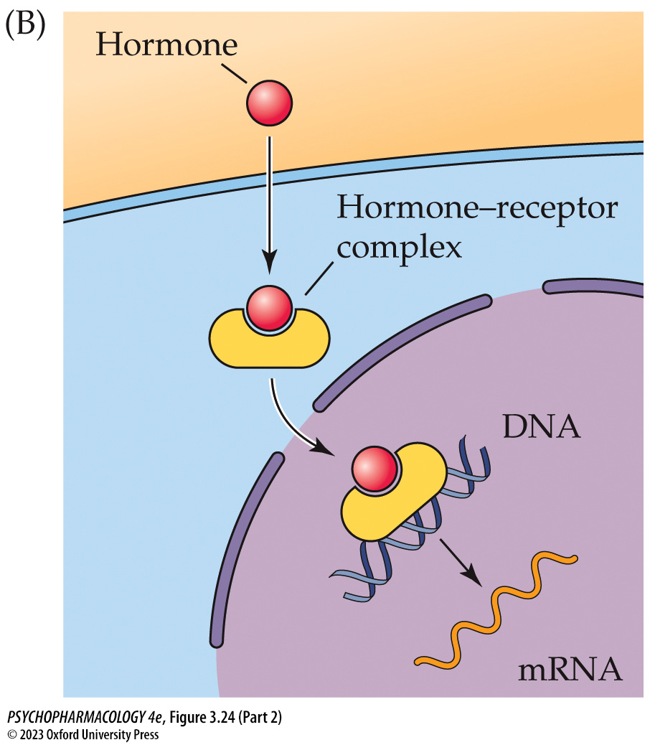
Figure 3.24 Hormonal signaling (Part 2)
Notes:
Figure 3.24 Hormonal signaling
A variety of extra­cellular (A) and intracellular (B) receptors mediate hormone signaling.

