Slide 1
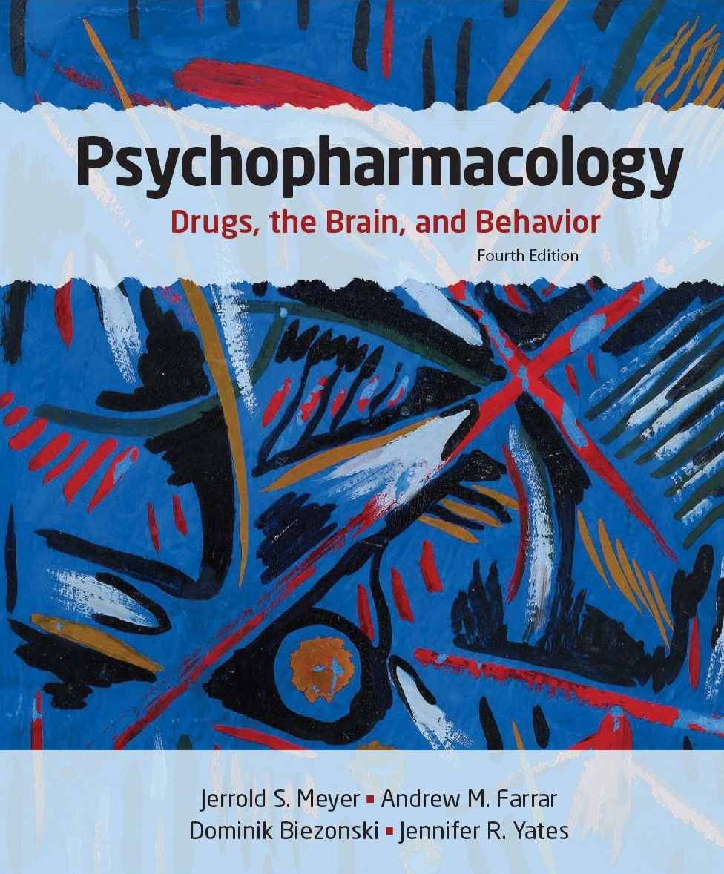
Psychopharmacology: Drugs, the Brain, and Behavior
by Meyer, Farrar, Biezonski, Yates

Slide 2
Chapter 3
Chemical Signaling by Neurotransmitters and Hormones
3.1 Chemical Signaling in the Nervous System
3.2 Neurotransmitter Receptors, Signaling Mechanisms, and Synaptic Plasticity
3.3 The Endocrine System

Slide 3
Chapter 3
Learning Objectives (1 of 3)
3.1.1 Describe the structure of chemical synapses and their possible locations on a neuron.
3.1.2 List and provide examples of the various classes of neurotransmitters along with their respective mechanisms of synthesis and inactivation.
3.1.3 Discuss the processes involved in neurotransmitter release and recycling.
3.1.4 Describe the locations and functions of neurotransmitters outside of the central nervous system.

Slide 4
Chapter 3
Learning Objectives (2 of 3)
3.2.1 Describe the differences between ionotropic and metabotropic receptors with respect to their structure and signaling mechanisms.
3.2.2 Define allosteric modulation of neurotransmitter receptors and explain why allosteric modulators are sometimes preferable to receptor agonists or antagonists in treating neuropsychiatric disorders.
3.2.3 Describe the major second-messenger systems used in neurotransmission, including the identity of each second messenger and its respective protein kinase.
3.2.4 Define synaptic plasticity and describe the various forms of plasticity that have been identified.

Slide 5
Chapter 3
Learning Objectives (3 of 3)
3.3.1 Explain the similarities and differences between hormones and neurotransmitters.
3.3.2 List the major endocrine glands and their associated hormones.
3.3.3 Describe the central vasopressin and oxytocin systems and their roles in regulating social behavior in animals.
3.3.4 Discuss the symptoms of autism spectrum disorder, the basis for hypothesizing that oxytocin could be used therapeutically to treat this disorder, and the current status of clinical oxytocin research.

Slide 6
Chemical Signaling in the Nervous System (1 of 14)
Basic Concepts
Communication between neurons occurs at synapses via chemical neurotransmitters that cross the synaptic cleft.
Transmission is one-way, from presynaptic cell to postsynaptic cell.
Synaptic vesicles in the pre-synaptic neuron contain neurotransmitters.
Notes:
Instructor Notes:

Slide 7
Chemical Signaling in the Nervous System (2 of 14)
Basic Concepts
Types of synapses:
  Axodendritic – axon to dendrite
  Axosomatic – axon to cell body
  Axoaxonic – axon to axon
  Neuromuscular junction – axon to muscle
  Electrical – electric current flows along specialized proteins
  Mixed – both chemical and electrical transmission
Notes:
Instructor Notes:
Postsynaptic density: area on dendrite membrane rich in neurotransmitter receptors and proteins.
Activity at an axoaxonic synapse may reduce transmitter release from the terminal (presynaptic inhibition).
Enhanced release of transmitter is called presynaptic facilitation.

Slide 8
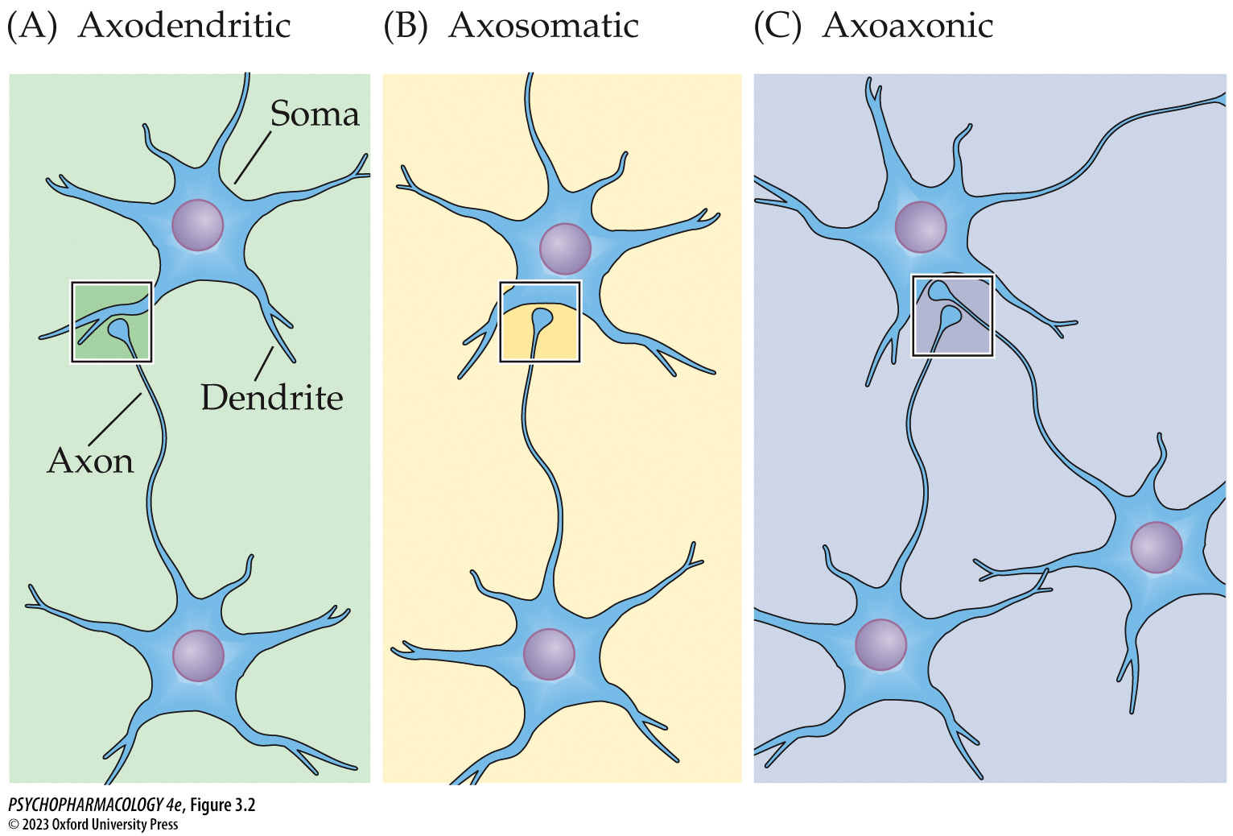
Figure 3.2 The three types of synaptic connections between neurons
Notes:
Figure 3.2 The three types of synaptic connections between neurons

Slide 9
Chemical Signaling in the Nervous System (3 of 14)
Neurotransmitter Synthesis, Release, and Inactivation
Many different chemicals act as neurotransmitters.
Neurotransmitters are manufactured in presynaptic cells, which also have a way to inactivate them.
Receptors for the chemical are located on the postsynaptic cell and mediate the response of that cell.
Over 100 chemicals have been identified as neurotransmitters.
Notes:
Instructor Notes:

Slide 10
Chemical Signaling in the Nervous System (4 of 14)
Neurotransmitters Encompass Several Different Kinds of Chemical Substances
Amino acids and monoamines
Acetylcholine (ACh)
ATP and adenosine
Neuropeptides, lipids, and gases
Some neurons produce more than one type of neurotransmitter.
Notes:
Instructor Notes:
See Table 3.1
Monoamine transmitters are derived from precursor amino acids.

Slide 11
Chemical Signaling in the Nervous System (5 of 14)
Neuropeptides Are Synthesized by a Different Mechanism Than Other Transmitters
Most transmitters are synthesized in the axon terminals.
Neuropeptides are synthesized from precursor proteins that are synthesized in the cell body and shipped to the axon terminals.
Replenishment of neuropeptides is slower than for small-molecule transmitters.
Notes:
Instructor Notes:

Slide 12
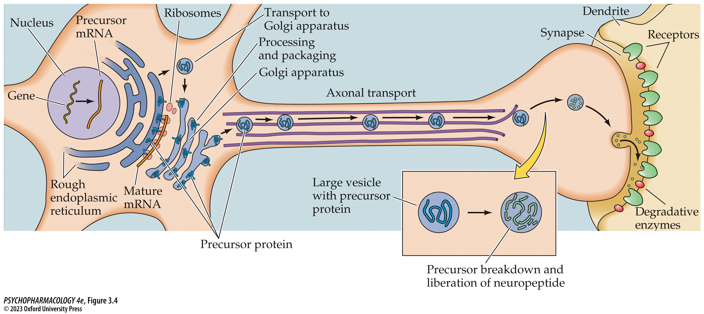
Figure 3.4 Features of neurotransmission using neuro­peptides
Notes:
Figure 3.4 Features of neurotransmission using neuro­peptides
Neuropeptides are synthesized from larger precursor proteins, which are packaged into large vesicles by the Golgi apparatus. During transport from the cell body to the axon terminal, enzymes that have been packaged within the vesicles break down the precursor protein to liberate the neuro­peptide. After it is released at the synapse and stimulates postsynaptic receptors, the neuropeptide is inactivated by degradative enzymes.

Slide 13
Chemical Signaling in the Nervous System (6 of 14)
Neuromodulators Are Chemicals That Do Not Act Like Typical Neurotransmitters
Neuromodulators alter the action of standard neurotransmitters.
They diffuse away from the site of release to influence more distant cells (volume transmission).
Some transmitters may act in both ways.
Notes:
Instructor Notes:
Tight cell-to-cell synaptic interactions is called wiring transmission.

Slide 14
Chemical Signaling in the Nervous System (7 of 14)
Classical Transmitter Release Involves Exocytosis and Recycling of Synaptic Vesicles
Transmitter release is triggered by Ca²⁺ influx at membrane depolarization.
Ca²⁺ mediates release of transmitter from vesicles by exocytosis.
Transmitters are released only at active zones.
Several proteins are critical in vesicle docking and exocytosis.
Vesicles are recycled by endocytosis.
Notes:
Instructor Notes:
There are two pools of synaptic vesicles: the readily releasable pool consists of vesicles at the active zones that can rapidly undergo exocytosis.
The reserve pool contains vesicles farther away from the active zones that can undergo exocytosis later if needed.
A Ca²⁺-sensitive protein in the synaptic vesicle membrane called synaptotagmin-1 rapidly responds to Ca²⁺ influx by permitting the vesicle and terminal membranes to fuse. Synaptobrevin plays a key role in helping the vesicle fuse with the axon terminal membrane to cause exocytosis.

Slide 15
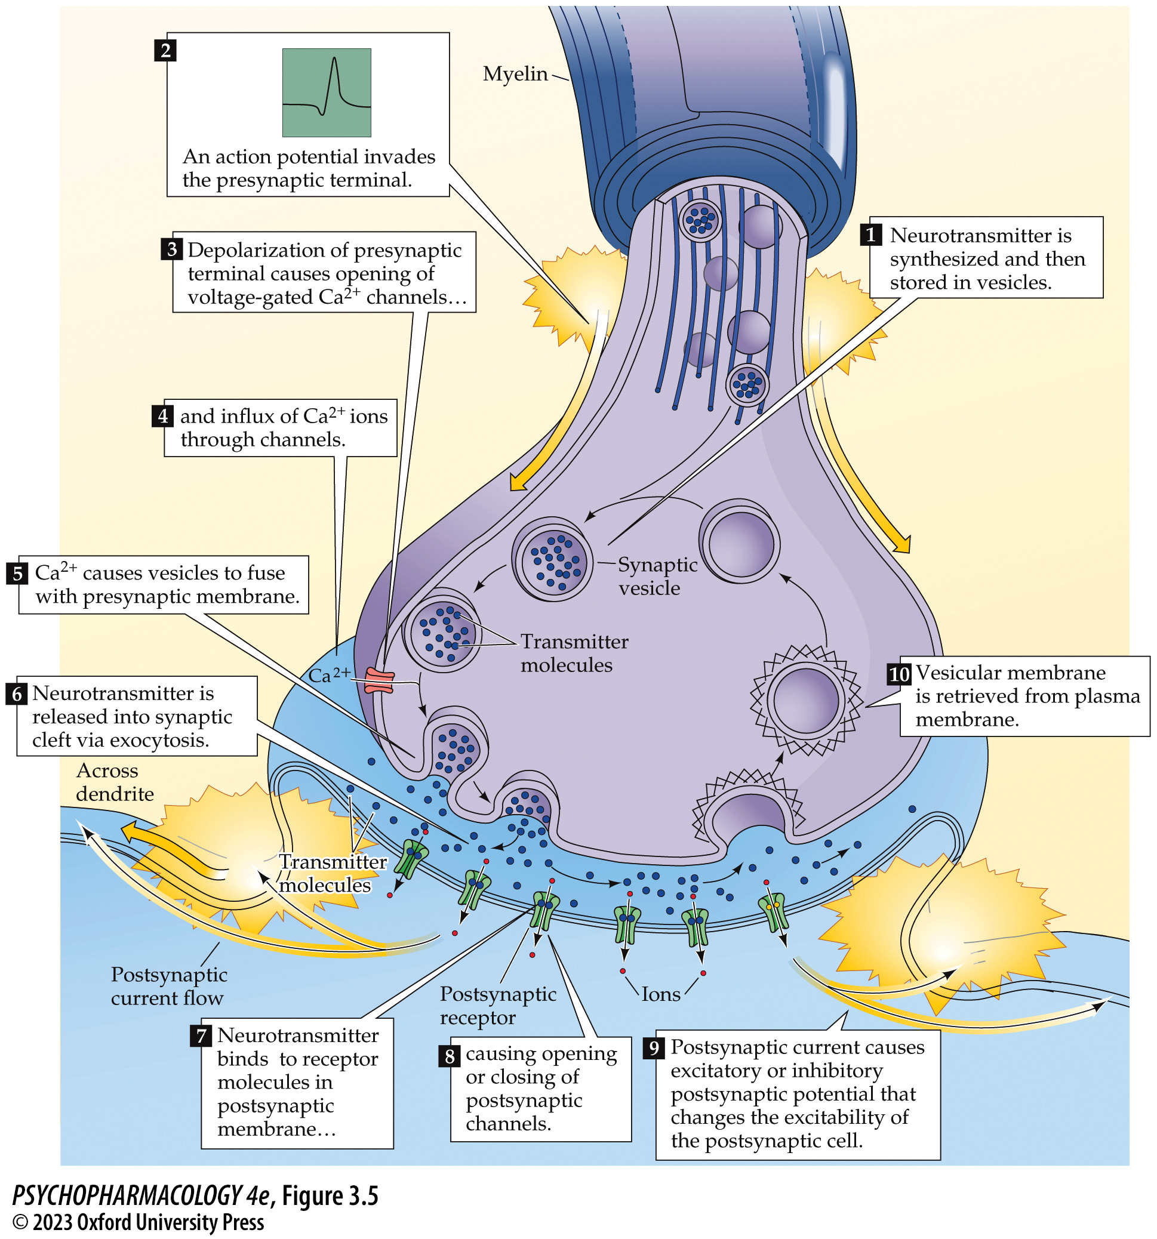
Figure 3.5 Processes involved in neurotransmission at a typical synapse using a classical neurotransmitter
Notes:
Figure 3.5 Processes involved in neurotransmission at a typical synapse using a classical neurotransmitter

Slide 16
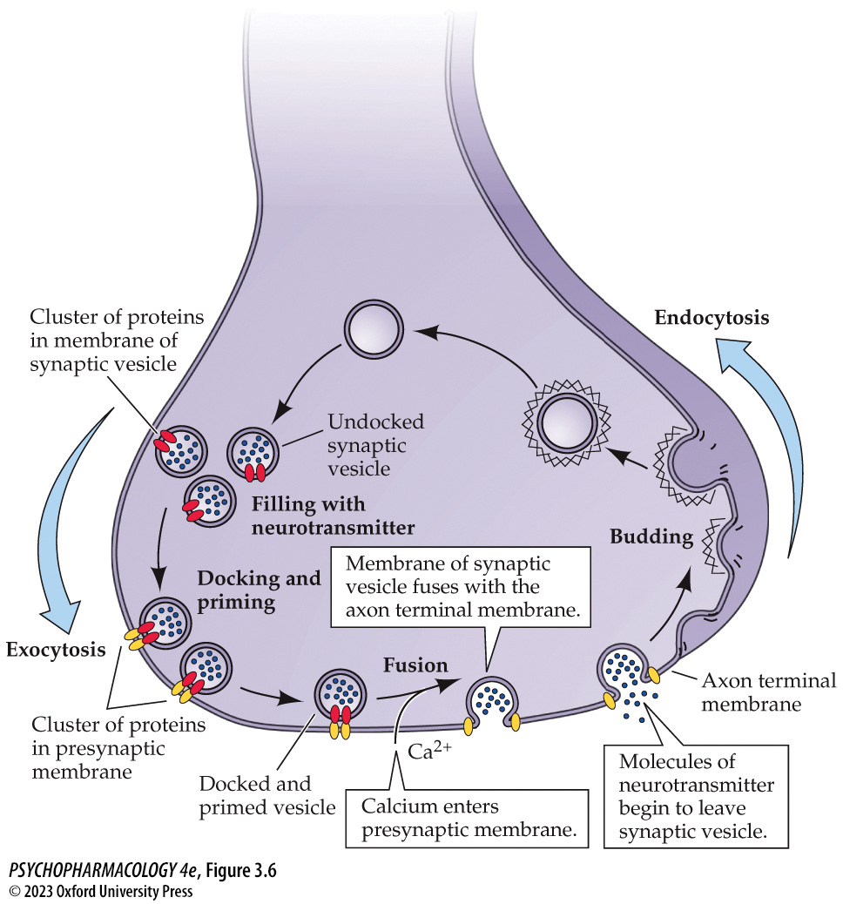
Figure 3.6 The life cycle of the synaptic vesicle
Notes:
Figure 3.6 The life cycle of the synaptic vesicle
Small vesicles containing classical neurotransmitters are constantly being recycled in the axon terminal. Vesicles are filled with neurotransmitter molecules, after which they are transported to the vicinity of release sites in the terminal and undergo processes of docking and priming. Ca²⁺-dependent fusion with the axon terminal membrane, called exocytosis, permits release of the contents of the vesicle into the synaptic cleft. The vesicle membrane is retrieved by a process of invagination (budding) from the terminal membrane, endocytosis, and transmitter refilling, thus completing the cycle.

Slide 17
Chemical Signaling in the Nervous System (8 of 14)
Classical Transmitter Release Involves Exocytosis and Recycling of Synaptic Vesicles
Three models of vesicle recycling:
  Clathrin-mediated endocytosis
  Ultrafast endocytosis
  Kiss-and-run
Bulk endocytosis recycles large amounts of vesicle membrane during high rates of neuronal activity.
Notes:
Instructor Notes:
Clathrin-mediated endocytosis – Clathrin protein forms a coating on the membrane that is needed for membrane invagination and vesicle retrieval.
Ultrafast endocytosis – Quick vesicle retrieval occurs close to the release site. Retrieved vesicles join with endosomes, and the recycling process is completed when new synaptic vesicles bud off from the endosomes using a clathrin-dependent mechanism.
Kiss-and-run – Vesicle fuses with terminal membrane very briefly; the pore closes and the vesicle remains intact.

Slide 18
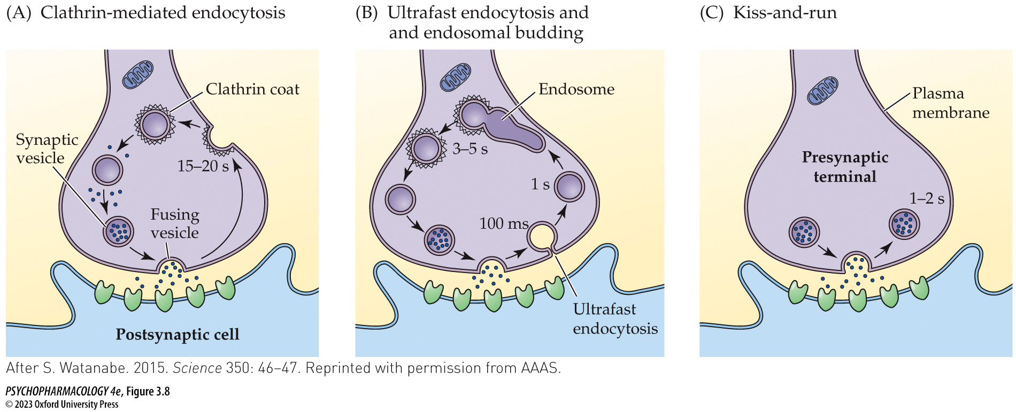
Figure 3.8 Models of synaptic vesicle recycling
Notes:
Figure 3.8 Models of synaptic vesicle recycling
(A) In the well-established clathrin-mediated endocytosis model, the vesicle fully collapses after fusing with the plasma membrane. The vesicle membrane is subsequently retrieved at a point distant from the release site, using a process that requires the protein clathrin. (B) In the more recently proposed model called ultrafast endocytosis and endosomal budding, the vesicle membrane is retrieved extremely rapidly at a point near the release site. Clathrin is not required for membrane retrieval according to this model. The vesicle membrane fuses with an endosome, after which new vesicles bud off from the endosome in a clathrin-dependent mechanism. (C) In the kiss-and-run model, the vesicle membrane briefly fuses with the plasma membrane of the nerve terminal without collapsing. After the vesicle has released its contents into the synaptic cleft, it reforms and detaches from the plasma membrane. Neither clathrin nor endosomes play a role in this model. (After S. Watanabe. 2015. Science 350: 46–47. Reprinted with permission from AAAS.)

Slide 19
Chemical Signaling in the Nervous System (9 of 14)
Lipid and Gaseous Transmitters Are Not Released from Synaptic Vesicles
Not stored in vesicles.
Synthesized on demand by postsynaptic cell after receptor activation by a classical transmitter.
Act as retrograde messengers on the presynaptic cell, and also diffuse to other neurons.
Notes:
Instructor Notes:
Lipids and gases can cross membranes, so they can’t be stored in vesicles.

Slide 20
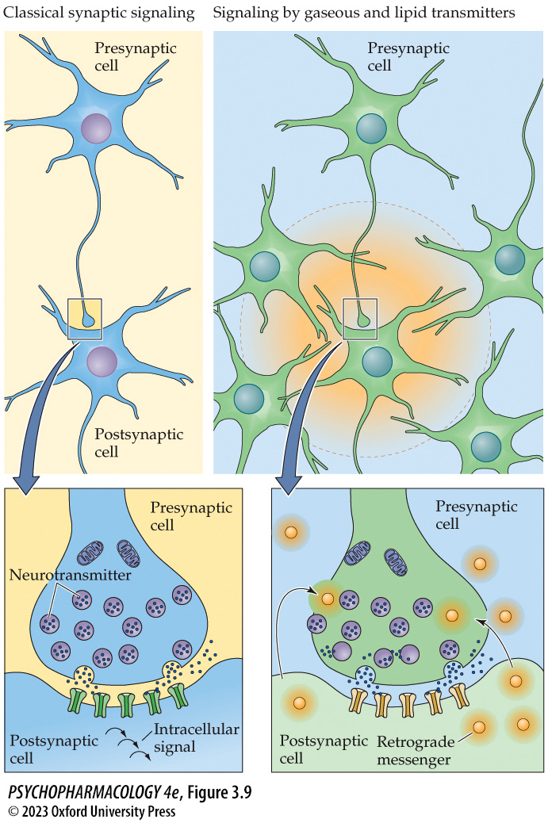
Figure 3.9 Signaling by classical versus gaseous and lipid transmitters
Notes:
Figure 3.9 Signaling by classical versus gaseous and lipid transmitters
In contrast to signaling by classical neurotransmitters (left), gaseous and lipid transmitters (right) are not released from synaptic vesicles. Gases and lipids cannot be stored within vesicles and therefore must be synthesized enzymatically when needed. Synthesis of gaseous and lipid transmitters usually occurs in the postsynaptic cell following release of a classical transmitter from the presynaptic cell and postsynaptic receptor activation. The newly formed gas or lipid subsequently diffuses across the membrane and acts as a retrograde messenger on the presynaptic cell as well as other neurons close enough to receive the signal.

Slide 21
Chemical Signaling in the Nervous System (10 of 14)
Several Mechanisms Control the Rate of Neurotransmitter Release by Nerve Cells
Rate of cell firing.
Probability of transmitter release – synapses vary in the probability that vesicles will undergo exocytosis.
Presence of autoreceptors.
Notes:
Instructor Notes:

Slide 22
Chemical Signaling in the Nervous System (11 of 14)
Several Mechanisms Control the Rate of Neurotransmitter Release by Nerve Cells
Terminal autoreceptors inhibit further transmitter release.
Somatodendritic autoreceptors slow the rate of cell firing.
Heteroreceptors: receive transmitters at axoaxonic synapses; either enhance or reduce transmitter release.
Notes:
Instructor Notes:

Slide 23
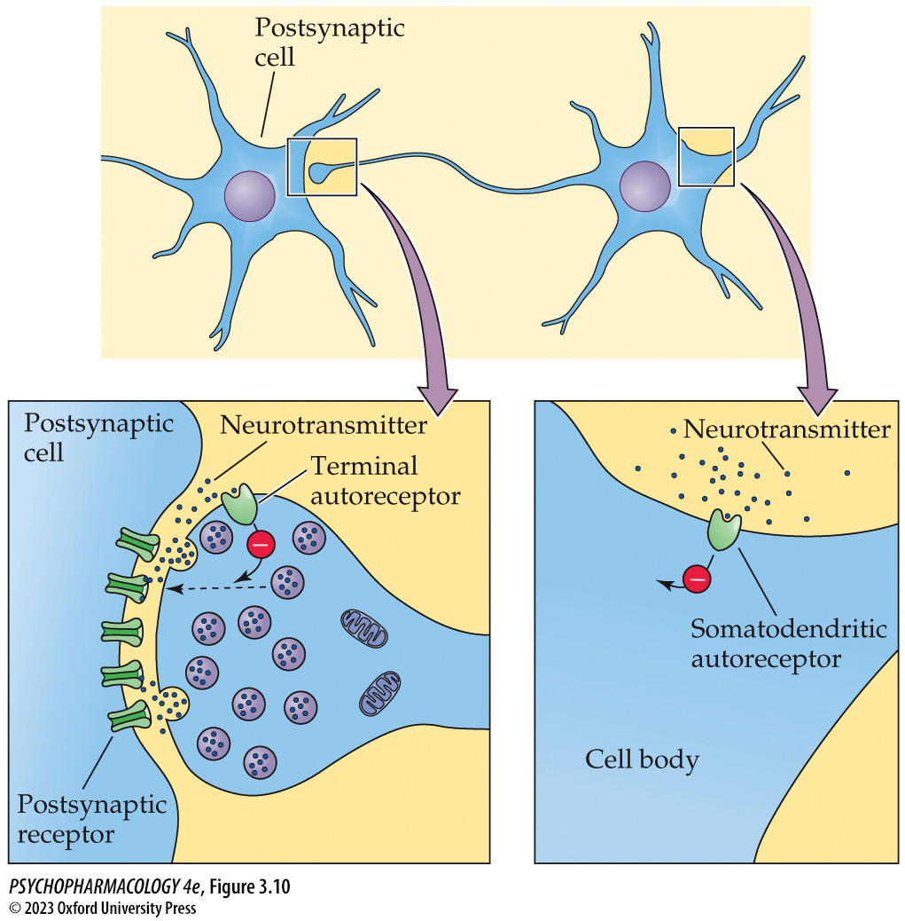
Figure 3.10 Terminal and somatodendritic autoreceptors
Notes:
Figure 3.10 Terminal and somatodendritic autoreceptors
Many neurons possess autoreceptors on their axon terminals and/or on their cell bodies and dendrites. Terminal autoreceptors inhibit neurotransmitter release, whereas somatodendritic autoreceptors reduce the rate of cell firing.

Slide 24
Chemical Signaling in the Nervous System (12 of 14)
Mechanisms of Neurotransmitter Inactivation
Enzymatic breakdown within or near the synaptic cleft.
Removal from synaptic cleft by transporter proteins on the axon terminal membrane (reuptake).
Uptake by postsynaptic cell or glial cells.
Notes:
Instructor Notes:
Enzymatic breakdown is particularly important for ACh, lipid and gaseous transmitters, and neuropeptides.
Uptake/reuptake plays the most important role for the amino acid and monoamine transmitters.

Slide 25
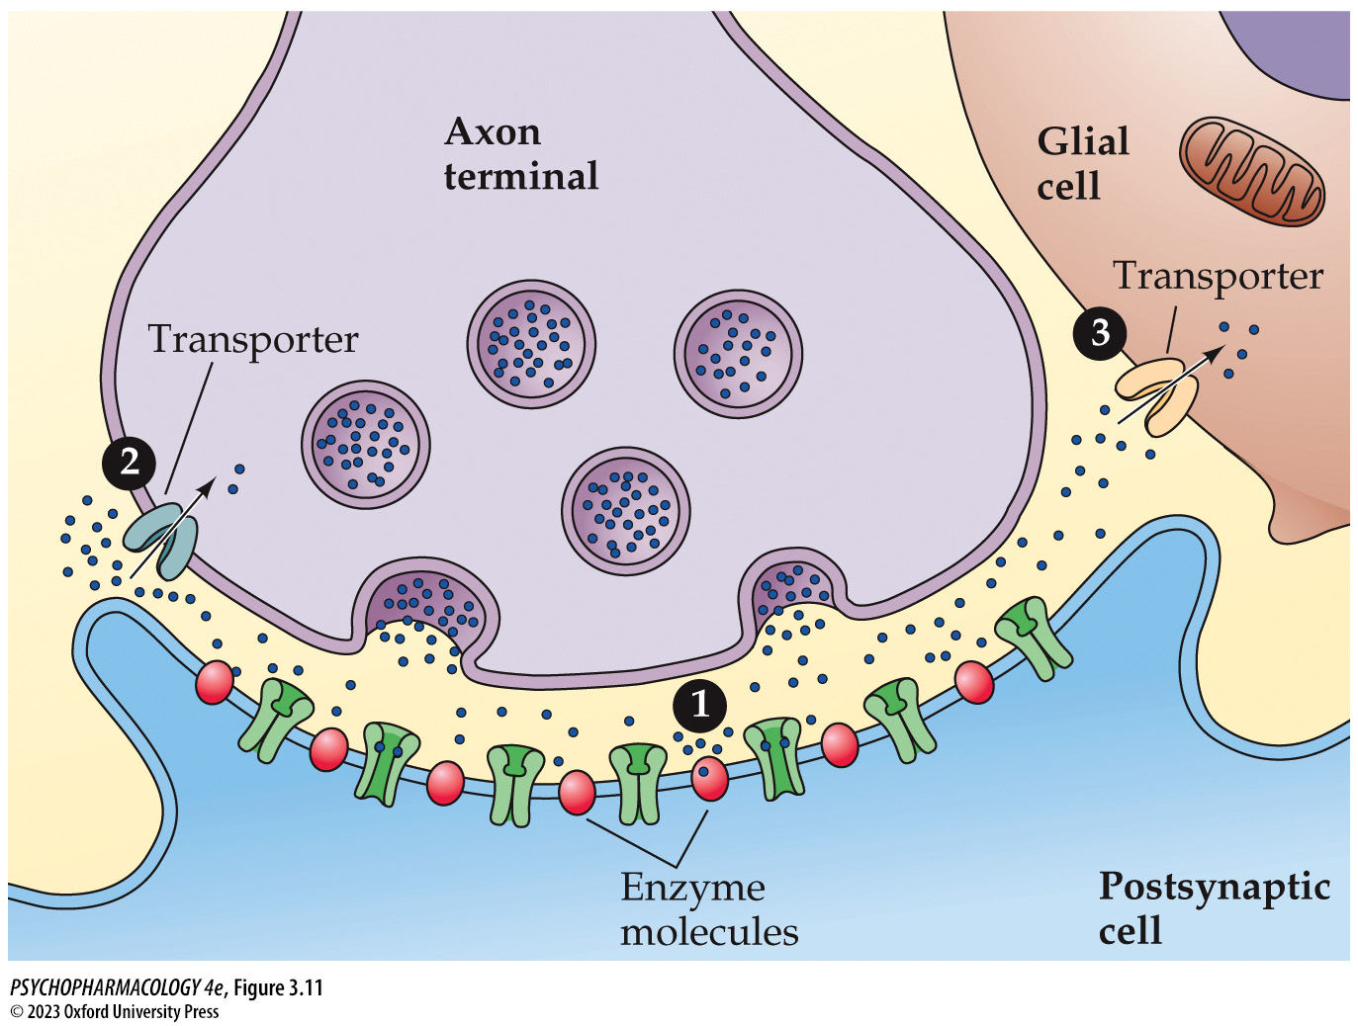
Figure 3.11 Neurotransmitter inactivation
Notes:
Figure 3.11 Neurotransmitter inactivation
Neurotransmitter molecules can be inactivated by (1) enzymatic breakdown, (2) reuptake by the axon terminal, or (3) uptake by nearby glial cells. Cellular uptake is mediated by specific membrane transporters for each neurotransmitter.

Slide 26
Chemical Signaling in the Nervous System (13 of 14)
Neurotransmitters Outside of the CNS
Many of the same transmitters occur both inside and outside the CNS.
Some neurotransmitters are synthesized by gut bacteria; drugs may alter the human microbiome and influence health.
The gut–brain axis refers to signaling back and forth between the gut (including the gut microbiome) and the brain.
Notes:
Instructor Notes:
The gut–brain axis may play a role in many neuropsychiatric and neurological disorders.

Slide 27
Chemical Signaling in the Nervous System (14 of 14)
CLICKER QUESTION 1
Which of the following is a key characteristic that defines a neurotransmitter?
Released from axon terminal when neuron is stimulated.
Can be inactivated by enzyme action or reuptake.
Must be manufactured in the presynaptic neuron.
All of the above
Notes:
Instructor Notes:
Correct answer: d

Slide 28
Review of Learning Objectives (1 of 3)
3.1.1 Describe the structure of chemical synapses and their possible locations on a neuron.
3.1.2 List and provide examples of the various classes of neurotransmitters along with their respective mechanisms of synthesis and inactivation.
3.1.3 Discuss the processes involved in neurotransmitter release and recycling.
3.1.4 Describe the locations and functions of neurotransmitters outside of the central nervous system.

Slide 29
Neurotransmitter Receptors, Signaling Mechanisms, and Synaptic Plasticity (1 of 10)
Neurotransmitter Receptor Families
Receptors are proteins on plasma membranes of a neuron, muscle cell, or secretory cell.
Transmitters bind to specific sites on receptors, which produces a response in the receiving cell.
Effect of receptor activation may be excitatory or inhibitory.
Receptor subtypes – different varieties of receptors for the same neurotransmitter.
Notes:
Instructor Notes:
If a drug can be designed that stimulates or blocks only one receptor subtype it may be able to treat a disease more effectively and with fewer side effects – a central idea underlying modern drug design.

Slide 30
Neurotransmitter Receptors, Signaling Mechanisms, and Synaptic Plasticity (2 of 10)
Ionotropic Receptors Consist of Multiple Subunits That Together Form an Ion Channel
Resting state = ion channel closed.
Neurotransmitter binding opens the channel.
Channel closes when transmitter dissociates.
Act rapidly.
Receptor channels selective for specific ions, such as Na⁺, Ca²⁺, and Cl–.
Can undergo desensitization.
Notes:
Instructor Notes:
Also called ligand-gated channel receptors.
The characteristics of the ion channel are key in determining whether that receptor excites the postsynaptic cell, inhibits the cell, or activates a second-messenger.

Slide 31
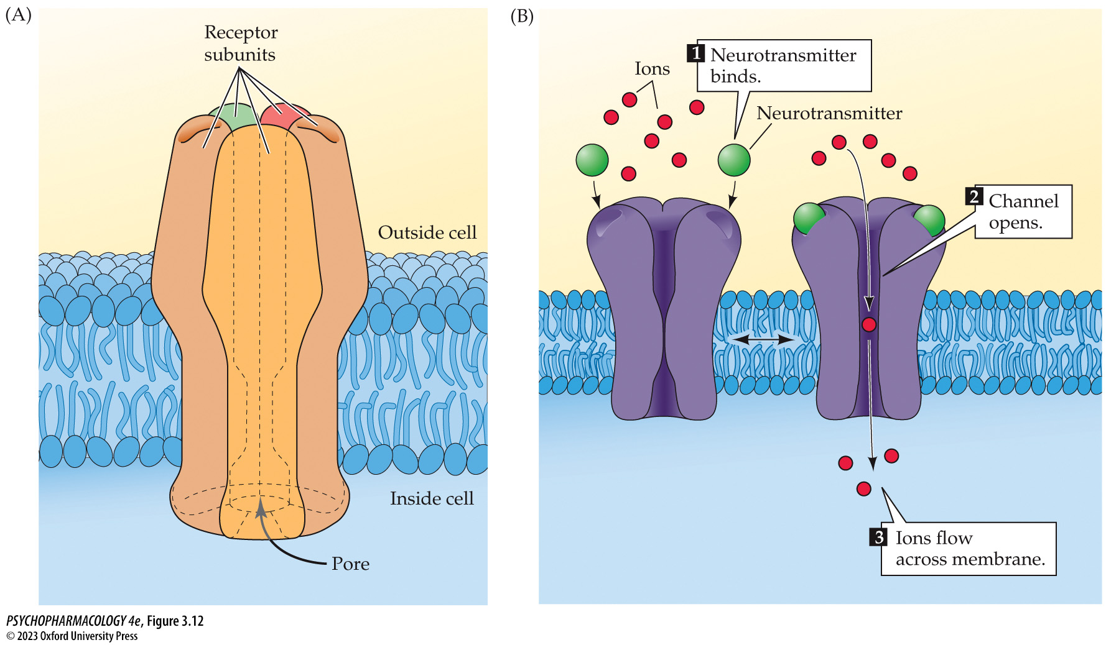
Figure 3.12 Structure and function of ionotropic receptors (1)
Notes:
Figure 3.12 Structure and function of ionotropic receptors
(A) Each receptor complex comprises either five (as shown) or four protein subunits that form a channel or a pore in the cell membrane. (B) Binding of the neurotransmitter to the receptor triggers channel opening and the flow of ions across the membrane.

Slide 32
Neurotransmitter Receptors, Signaling Mechanisms, and Synaptic Plasticity (3 of 10)
Metabotropic Receptors Consist of a Single Subunit That Works by Activating G Proteins
Act slower but response lasts longer.
Activate G proteins when transmitter binds.
G proteins open ion channels, or stimulate or inhibit membrane effector enzymes.
Effector enzymes are involved in synthesis or breakdown of second messengers.
Notes:
Instructor Notes:
Also called G protein–coupled receptors.

Slide 33
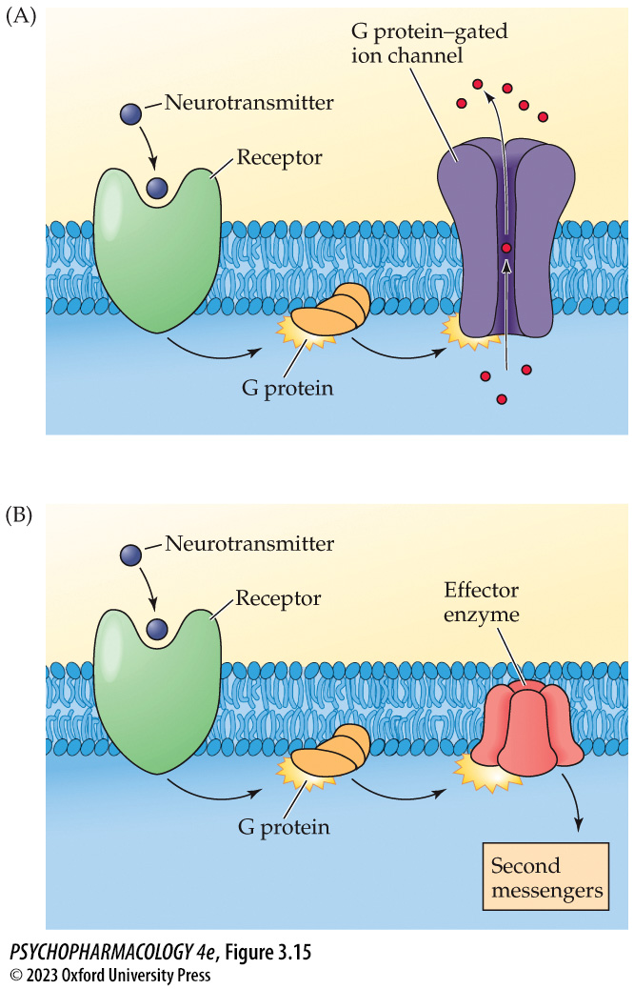
Figure 3.15 Functions of metabotropic receptors
Notes:
Figure 3.15 Functions of metabotropic receptors
Metabotropic receptors activate G proteins in the membrane, which may either (A) alter the opening of a G protein–gated ion channel or (B) stimulate or inhibit an effector enzyme that either synthesizes or breaks down a second messenger.

Slide 34
Neurotransmitter Receptors, Signaling Mechanisms, and Synaptic Plasticity (4 of 10)
BOX 3.1 THE CUTTING EDGE
Allosteric Modulation of Neurotransmitter Receptors
Metabotropic receptors have additional binding sites (allosteric sites).
Allosteric modulators bind to allosteric sites and modify (positively or negatively) the effects of an agonist.
Allosteric modulators have potential for treating psychiatric and neurological disorders.
Notes:
Instructor Notes:
Compared with traditional agonists or antagonists, allosteric modulators often have greater receptor subtype selectivity.
A modulator may “fine-tune” signaling by a neurotransmitter (either amplifying or diminishing
the signaling) in a more controllable manner than would administering a direct agonist or antagonist.

Slide 35
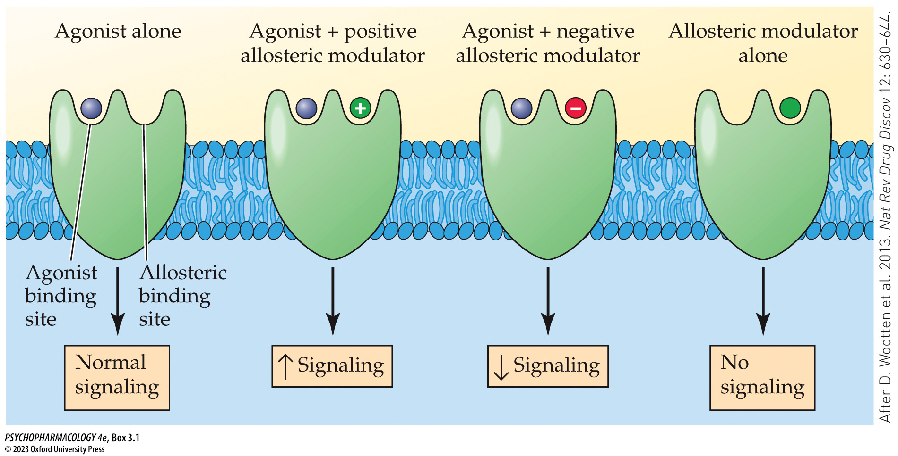
Box 3.1 The Cutting Edge
Notes:
Allosteric modulation of neurotransmitter receptor signaling Using metabotropic receptors as an example, the figure shows how allosteric modulators can either positively or negatively influence receptor signaling. In the absence of an agonist, including the neurotransmitter itself, the allosteric modulator produces no receptor signaling. (After D. Wootten et al. 2013. Nat Rev Drug Discov 12: 630–644.)

Slide 36
Neurotransmitter Receptors, Signaling Mechanisms, and Synaptic Plasticity (5 of 10)
Second Messenger Systems
Second messengers activate protein kinases that phosphorylate another protein molecule.
The added phosphate groups alter functioning of the protein.
Includes cAMP, gAMP, Ca²⁺, and phosphoinositide.
cAMP and cGMP are inactivated by phosphodiesterases (PDEs).
Inhibitors of specific PDEs may be useful in treating various CNS disorders.
Notes:
Instructor Notes:
Phosphorylation: kinases catalyze the addition of one or more phosphate groups (–PO₄^{2–}) to the molecule.
cAMP = cyclic adenosine monophosphate, stimulates protein kinase A (PKA).
gAMP = cyclic guanosine monophosphate, stimulates protein kinase G (PKG).

Slide 37
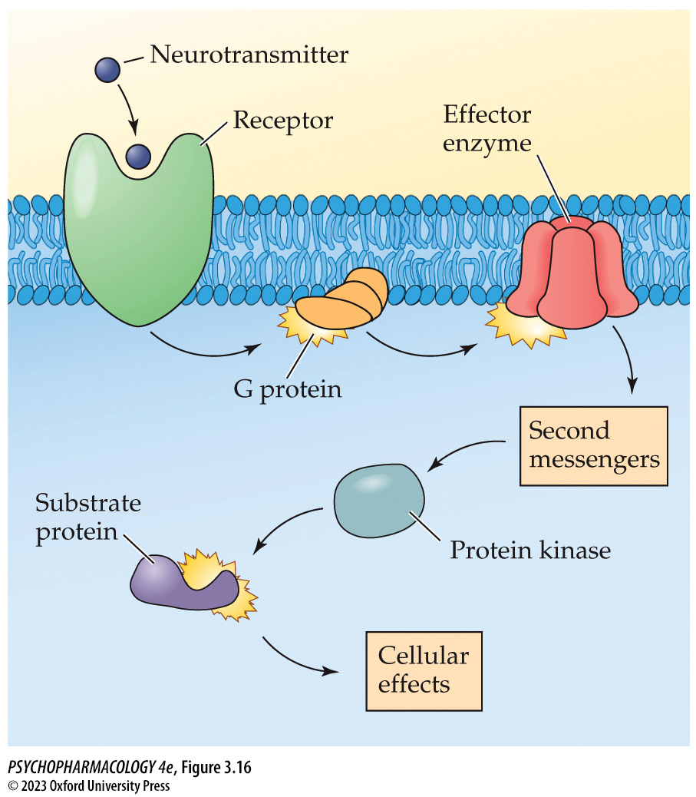
Figure 3.16 The mechanism of action of second messengers
Notes:
Figure 3.16 The mechanism of action of second messengers
Second messengers work by activating protein kinases to cause phosphorylation of substrate proteins within the postsynaptic cell.

Slide 38
Neurotransmitter Receptors, Signaling Mechanisms, and Synaptic Plasticity (6 of 10)
Second-Messenger Systems
The phosphoinositide second-messenger system breaks down a phospholipid in the cell membrane to form two second messengers: diacylglycerol (DAG) and inositol trisphosphate (IP3).
They cause increased Ca²⁺ that activates protein kinase C (PKC).
Ca²⁺ also activates calcium/calmodulin kinase II (CaMKII).
Notes:
Instructor Notes:

Slide 39
Neurotransmitter Receptors, Signaling Mechanisms, and Synaptic Plasticity (7 of 10)
Tyrosine Kinase Receptors
Mediate the action of neurotrophic factors.
Neurotrophic factors stimulate survival and growth of neurons during early development and are involved in neuronal signaling.
These systems generally participate in regulation of long-term changes in gene expression and neuronal functioning.
Notes:
Instructor Notes:

Slide 40
Neurotransmitter Receptors, Signaling Mechanisms, and Synaptic Plasticity (8 of 10)
Pharmacology of Synaptic Transmission
Drugs can alter all aspects of synaptic transmission:
Increase or decrease transmitter synthesis.
Block transmitter breakdown or inhibit reuptake.
Autoreceptor agonists reduce transmitter release, autoreceptor antagonists enhance release.
Mimic or inhibit transmitter’s effect on receptors.
Notes:
Instructor Notes:

Slide 41
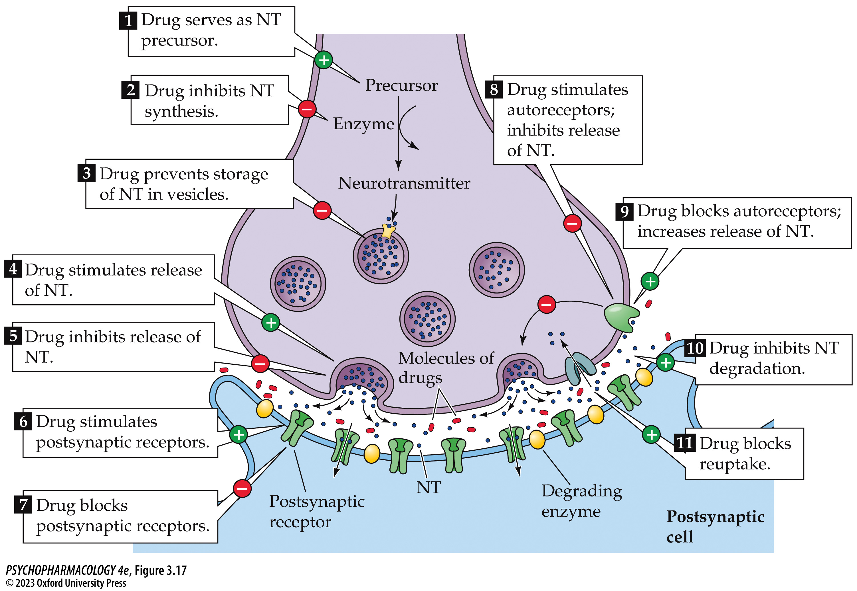
Figure 3.17 Summary of the mechanisms by which drugs can alter synaptic transmission (1)
Notes:
Figure 3.17 Summary of the mechanisms by which drugs can alter synaptic transmission
Neurotransmitter (NT) transmission may be stimulated or facilitated (denoted by +), or it may be inhibited (denoted by –).

Slide 42
Neurotransmitter Receptors, Signaling Mechanisms, and Synaptic Plasticity (9 of 10)
Synaptic Plasticity
Functional changes in strength of existing synapses.
Structural changes – loss of synapses or growth of new ones, change in dendritic length, branching, or spine density.
Neurons can rapidly change the size and shape of dendritic spines, grow new spines, and/or lose existing ones.
Many abused drugs produce changes in neuron dendrites.
Notes:
Instructor Notes:

Slide 43
Neurotransmitter Receptors, Signaling Mechanisms, and Synaptic Plasticity (10 of 10)
CLICKER QUESTION 2
What type of receptor works by using second-messenger systems?
Ionotropic receptor
Metabotropic receptor
Tyrosine kinase receptor
Notes:
Instructor Notes:
Correct answer: b

Slide 44
Review of Learning Objectives (2 of 3)
3.2.1 Describe the differences between ionotropic and metabotropic receptors with respect to their structure and signaling mechanisms.
3.2.2 Define allosteric modulation of neurotransmitter receptors and explain why allosteric modulators are sometimes preferable to receptor agonists or antagonists in treating neuropsychiatric disorders.
3.2.3 Describe the major second-messenger systems used in neurotransmission, including the identity of each second messenger and its respective protein kinase.
3.2.4 Define synaptic plasticity and describe the various forms of plasticity that have been identified.

Slide 45
The Endocrine System (1 of 11)
Endocrine Glands and Their Respective Hormones
Hormones are secreted by endocrine glands; circulate in the bloodstream.
Target cells have hormone-specific receptors.
The same substance sometimes acts as both a neurotransmitter and a hormone.
Notes:
Instructor Notes:

Slide 46
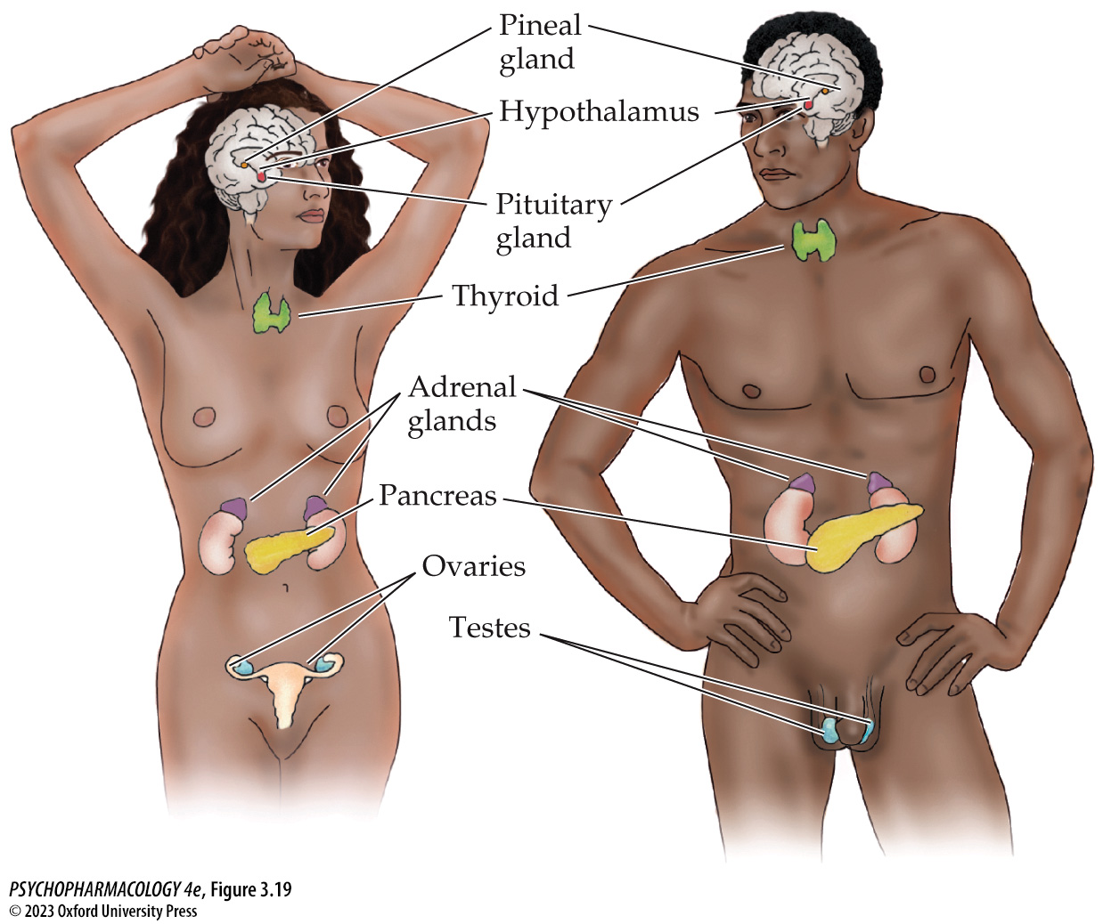
Figure 3.19 Major endocrine glands and their location in the body
Notes:
Figure 3.19 Major endocrine glands and their location in the body

Slide 47
The Endocrine System (2 of 11)
Endocrine Glands and Their Respective Hormones
Adrenal glands:
  Adrenal medulla secretes epinephrine (EPI) and norepinephrine (NE) (monoamines).
  Adrenal cortex secretes glucocorticoids (steroid hormones).
Gonads:
Ovaries secrete estrogens and progesterone.
Testes secrete androgens (e.g., testosterone).
Notes:
Instructor Notes:
Glucocorticoids:
Humans, nonhuman primates, and most other large mammals make cortisol (hydrocortisone).
Most rodents and birds make corticosterone.

Slide 48
The Endocrine System (3 of 11)
Endocrine Glands and Their Respective Hormones
Islets of Langerhans in the pancreas – secrete insulin and glucagon (peptide hormones) – regulation of glucose.
Thyroid gland – secretes thyroxine (T4) and triiodothyronine (T3) – regulate energy metabolism.
Pineal gland – secretes melatonin – control of sleep and other rhythms.
Pituitary gland – secretes hormones that control other glands.
Notes:
Instructor Notes:

Slide 49
The Endocrine System (4 of 11)
Endocrine Glands and Their Respective Hormones
Anterior pituitary – secretes stimulation hormones: TSH, ACTH, FSH, LH, GH, and PRL.
The hypothalamus secretes releasing hormones to trigger secretion of stimulating hormones by the anterior pituitary.
Because this control system consists of multiple layers, the endocrine system works more slowly than chemical communication by neurotransmitters.
Notes:
Instructor Notes:
TSH (thyroid stimulating hormone) stimulates the thyroid gland, ACTH (adrenocorticotropic hormone) promotes synthesis and release of glucocorticoids from the adrenal cortex. FSH (follicle stimulating hormone) and LH (luteinizing hormone ) LH stimulates estrogen and androgen secretion by the ovaries and testes. GH (growth hormone) stimulates production of growth factor I (IGF-I) - critical for skeletal growth during development. PRL (prolactin) promotes milk production by the mammary glands.

Slide 50
The Endocrine System (5 of 11)
Endocrine Glands and Their Respective Hormones
Hypothalamic releasing hormones: released by neurons in the median eminence.
Blood vessels in pituary stalk carry them to the anterior pituitary.
Thyrotropin-releasing hormone (TRH) stimulates TSH, corticotropin-releasing hormone (CRH) stimulates ACTH, gonadotropin-releasing hormone (GnRH) stimulates FSH and LH.
Notes:
Instructor Notes:

Slide 51
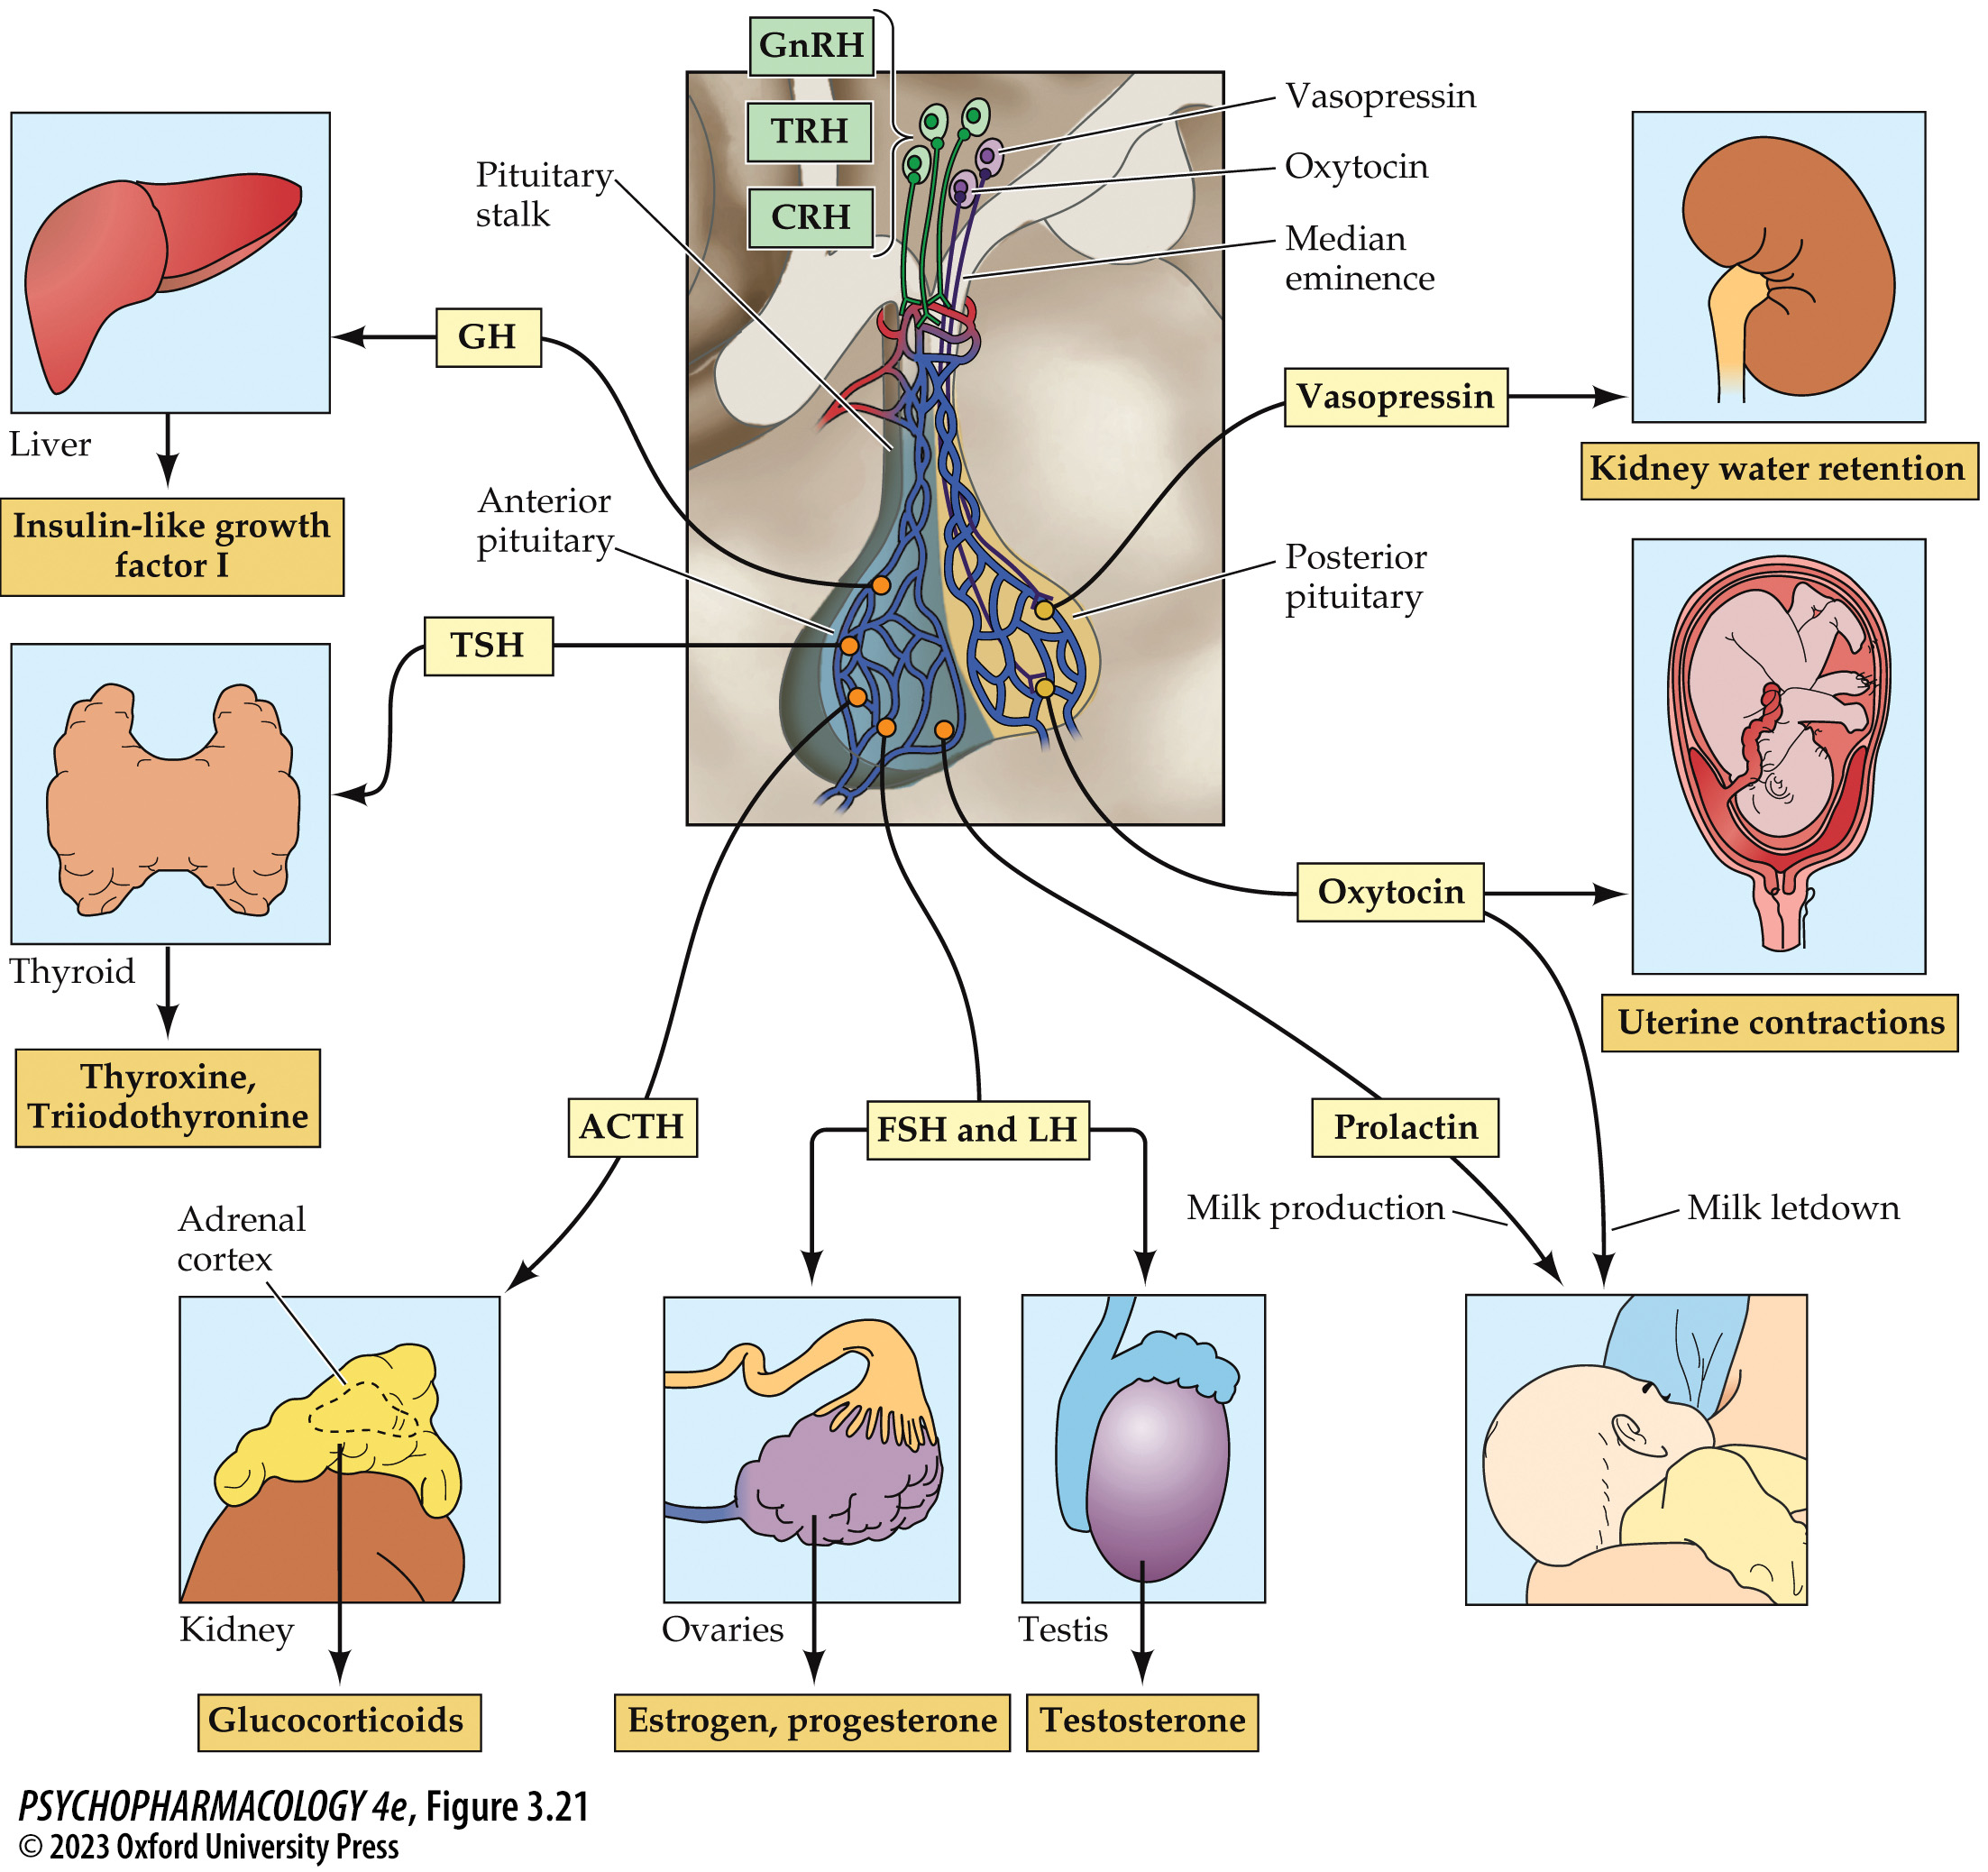
Figure 3.21 Organization of the hypothalamic–pituitary axis
Notes:
Figure 3.21 Organization of the hypothalamic–pituitary axis
Note that the axon terminals of the hypothalamic releasing hormone neurons are located near blood capillaries in the median eminence, whereas oxytocin and vasopressin neurons send their axons all the way into the posterior lobe of the pituitary gland. For the purpose of simplicity, not all hypothalamic releasing hormones are shown. ACTH, adrenocorticotropic hormone; CRH, corticotropin-releasing hormone; FSH, follicle-­stimulating hormone; GH, growth hormone; GnRH, gonadotropin-releasing hormone; LH, luteinizing hormone; TRH, thyrotropin-releasing hormone; TSH, thyroid-stimulating hormone.

Slide 52
The Endocrine System (6 of 11)
Hormonal and Neurotransmitter Functions of Oxytocin and Vasopressin
Vasopressin (VP) and oxytocin (OT): synthesized in the hypothalamus by neurons whose axons reach the posterior pituitary gland.
VP (antidiuretic hormone) regulates water retention in the kidneys.
OT stimulates uterine contractions during childbirth, and triggers milk letdown from the breasts.
Notes:
Instructor Notes:
Vasopressin (VP) and oxytocin (OT) are synthesized by specialized secretory neurons (magnocellular neurons) in the paraventricular and supraoptic nuclei.

Slide 53
The Endocrine System (7 of 11)
Hormonal and Neurotransmitter Functions of Oxytocin and Vasopressin
VP and OT neurons from the paraventricular nucleus connect to many other brain regions.
The brain areas receiving VP and/or OT input are either part of or interact with the social behavioral neural network.
VP and OT pathways in the brain are sexually dimorphic and are influenced by gonadal steroids.
Notes:
Instructor Notes:
Parvocellular neurons in the paraventricular nucleus send VP- and OT-containing axons to many brain regions where these neuropeptides are released like neurotransmitters onto other nerve cells.

Slide 54
The Endocrine System (8 of 11)
Hormonal and Neurotransmitter Functions of Oxytocin and Vasopressin
Oxytocin research: OT can influence a variety of social behaviors, including empathy, altruism, trust, and social memory.
OT may have potential in ameliorating the social deficits in autism spectrum disorder patients.
Notes:
Instructor Notes:
Social cognition refers to the processing of social cues (including attention, emotion and motivation, learning, and memory) to determine the appropriate behavioral responses to these cues.

Slide 55
The Endocrine System (9 of 11)
Mechanisms of Hormone Action
Most peptide hormones act through membrane metabotropic receptors.
Insulin uses tyrosine kinase receptors.
Steroid and thyroid hormones operate mostly through intracellular receptors in the cell nucleus; function as transcription factors.
Notes:
Instructor Notes:

Slide 56
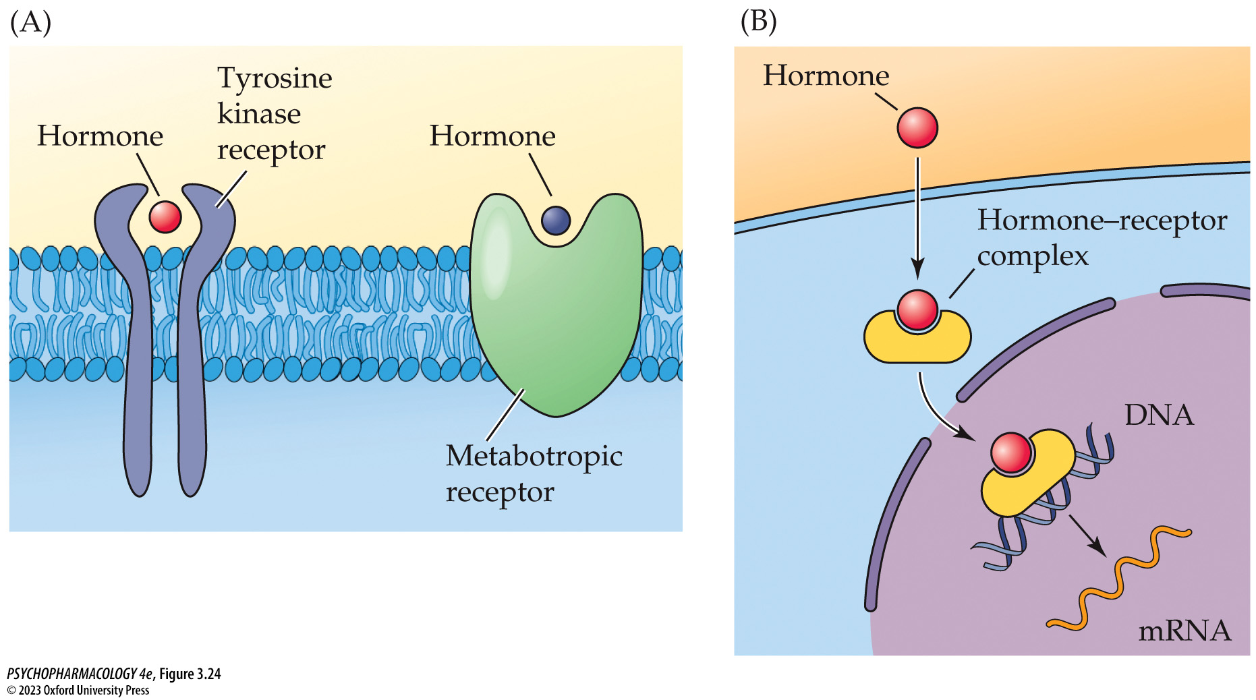
Figure 3.24 Hormonal signaling
Notes:
Figure 3.24 Hormonal signaling
A variety of extra­cellular (A) and intracellular (B) receptors mediate hormone signaling.

Slide 57
The Endocrine System (10 of 11)
The Endocrine System Is Important to Pharmacologists
Drugs can adversely alter endocrine function.
Hormones may alter behavioral responses to drugs.
Hormones sometimes have psychoactive properties.
Because pituitary hormones are controlled by neurotransmitters in the brain, the endocrine system can tell us if a neurotransmitter system has been altered.
Notes:
Instructor Notes:

Slide 58
The Endocrine System (11 of 11)
CLICKER QUESTION 3
Which of these hormones is synthesized in the posterior pituitary gland?
Growth hormone (GH)
Thyroxine
Oxytocin
No hormones are synthesized in the posterior pituitary.
Notes:
Instructor Notes:
Correct answer: d

Slide 59
Review of Learning Objectives (3 of 3)
3.3.1 Explain the similarities and differences between hormones and neurotransmitters.
3.3.2 List the major endocrine glands and their associated hormones.
3.3.3 Describe the central vasopressin and oxytocin systems and their roles in regulating social behavior in animals.
3.3.4 Discuss the symptoms of autism spectrum disorder, the basis for hypothesizing that oxytocin could be used therapeutically to treat this disorder, and the current status of clinical oxytocin research.

