Slide 1

Child Development Context, Culture, and Cascades
by Catherine S. Tamis-LeMonda

Slide 2

1
Chapter 9: Cognitive and Language Development in Early Childhood

Slide 3
Overview of Chapter Topics
Cognitive Development
Social Cognitive Development
Language, Literacy, & Mathematics
Focus on Contexts, Culture, & Cascades

Slide 4

FIGURE 9.1 Horses begin competitive races at equal starting points.
Notes:
Instructor’s Note:
EARLY CHILDHOOD IS A CRITICAL TIME FOR LEARNING.
From text: Each year in the United States, millions of children begin school and embark on the academic race—a race in which they will be required to learn new skills, behave in new ways, and navigate unfamiliar spaces, materials, and people.
WE WILL SEE THAT DIFFERENCES AMONG CHILDREN EARLY ON WILL HAVE CASCADING EFFECTS ACROSS DOMAINS.
Photo caption:
Horses begin competitive races at equal starting points. Young children, however, often begin school with dramatically different skills that can have significant long-term implications for learning and development.

Slide 5
Cognitive Development
Notes:
Instructor’s Note:
HERE, WE WILL DISCUSS KEY DEVELOPMENTS IN CHILDREN’S COGNITIVE DEVELOPMENT.

Slide 6
Piaget & the Preoperational Stage
Young children can think symbolically, but still show limitations in perspective taking, conservation, logical thinking, and causal understanding (~2-7 years of age)

Slide 7
Mental Representation
Internalization of thought that marks the transition from the sensorimotor stage to preoperational thinking
Examples: Language, symbolic play, deferred imitation, and object permanence

Slide 8
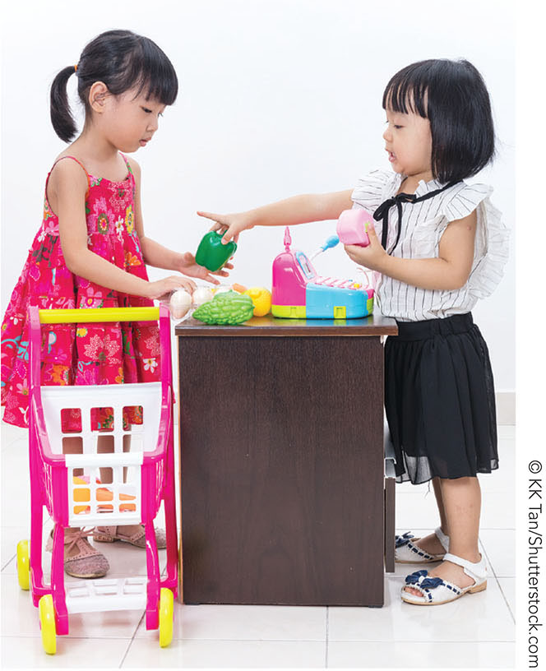
FIGURE 9.2 Preoperational thought
Notes:
Instructor’s Note:
Photo caption: By the end of the preoperational stage, children’s thinking undergoes a kind of cognitive revolution. Children are now capable of mental representation in areas of language, symbolic play, deferred imitation, and understanding of object permanence.

Slide 9
Cognitive Achievements
Symbolic understanding
The understanding that things can stand for other things
Examples: Pretending a block is a toy car, making believe a banana is a phone
Dual representation: Understanding an object may simultaneously be itself and stand for another thing (Judy DeLoache’s work on shrinking room)
Notes:
Instructor’s Note:
SYMBOLIC UNDERSTANDING, OR THE APPRECIATION THAT THINGS CAN STAND FOR OTHER THINGS, IS A KEY ACHIEVEMENT IN CHILDREN’S COGNITIVE DEVELOPMENT DURING THE PREOPERATIONAL STAGE, ACCORDING TO PIAGET.
HOWEVER, DUAL REPRESENTATION DOES NOT TYPICALLY DEVELOP UNTIL ABOUT AGE 3.

Slide 10
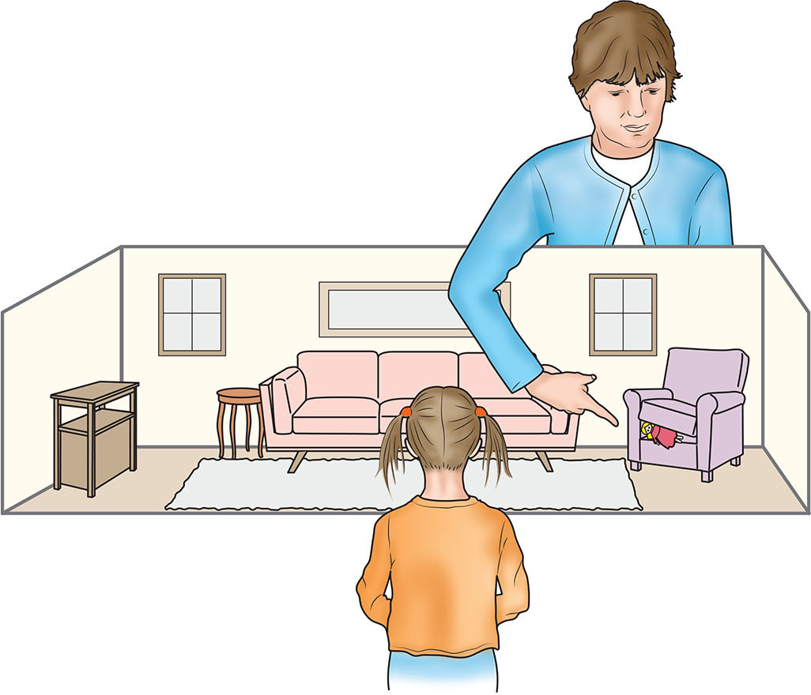
FIGURE 9.3 Dual representational skills.
Notes:
Instructor’s Note:
Photo caption: Judy DeLoache showed that it was not until 3 years of age that children achieved dual-representation, the idea that something can be an entity itself and a symbol for something else.
Children observed an experimenter hide a miniature doll under a couch pillow in a scale model that was physically identical to a nearby room it was meant to represent. The experimenter then asked children to find a larger version of the toy hidden in the same place in the big room.
Three-year-olds were able to use the scale model to locate the large toy in the life-sized, adjacent room, whereas most 2 ½-year-olds could not find the large toy.

Slide 11
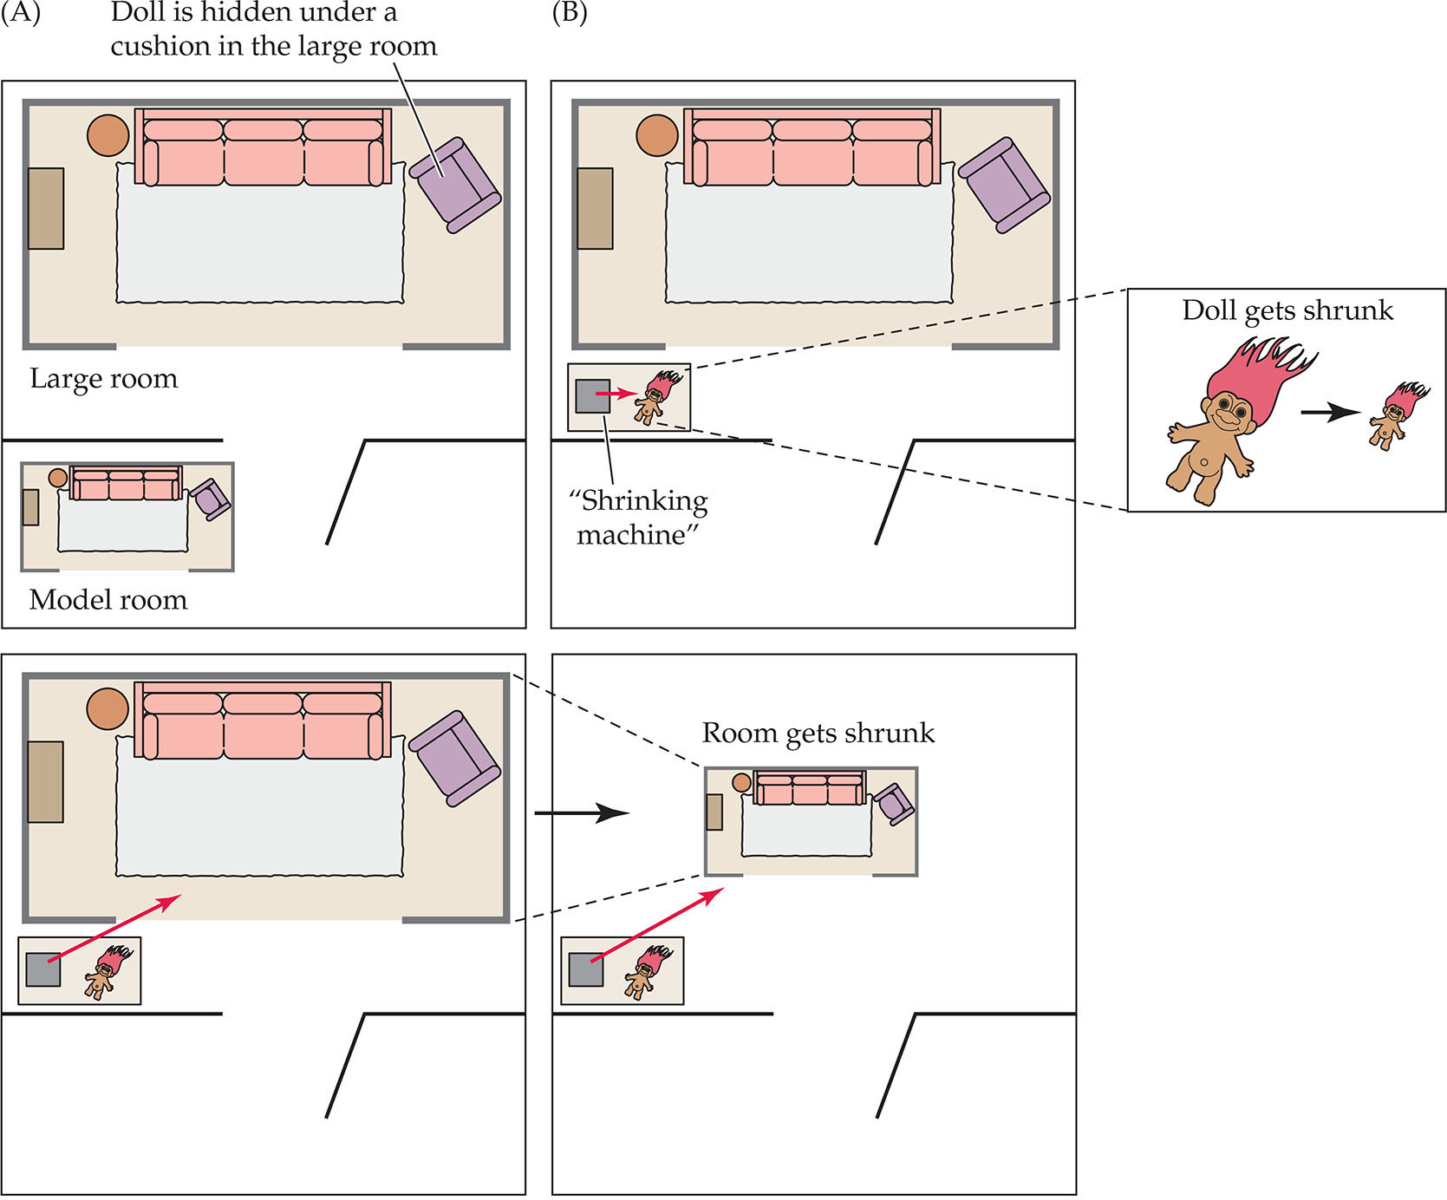
FIGURE 9.4 Shrinking room.
Notes:
Instructor’s Note:
Photo caption: Children were shown a large room and model room (fig A), and were unable to locate the hidden toy.
However, when DeLoache later pretended to “shrink” the large room with a magical machine that children believed could make the room smaller, children younger than 3 years of age could now find the object.
WHY WERE YOUNGER CHILDREN ABLE TO LOCATE THE HIDDEN TOY CORRECTLY?
From text: DeLoache concluded that children believed that the magical machine had indeed shrunk the large room. Thus, the scale model room was actually the original room in their minds.
Because the scale model was no longer a symbol for the large room, children no longer had to simultaneously represent the scale model as an interesting object and a symbol for something else.

Slide 12
Cognitive Achievements 2
Pretend & Fantasy Play or Sociodramatic Play
Pretend play: Children act out imaginary stories related to life experiences and that may involve others in created play scenarios
Examples: Pretending to be doctor; having a pretend tea party
Notes:
Instructor’s Note:
From text:
Children’s engagement in sociodramatic play and other forms of imagination further supports skills in language, perspective taking, causal reasoning, and executive functioning (Kavanaugh, 2006; Pierucci et al., 2014; Thibodeau et al., 2016).

Slide 13
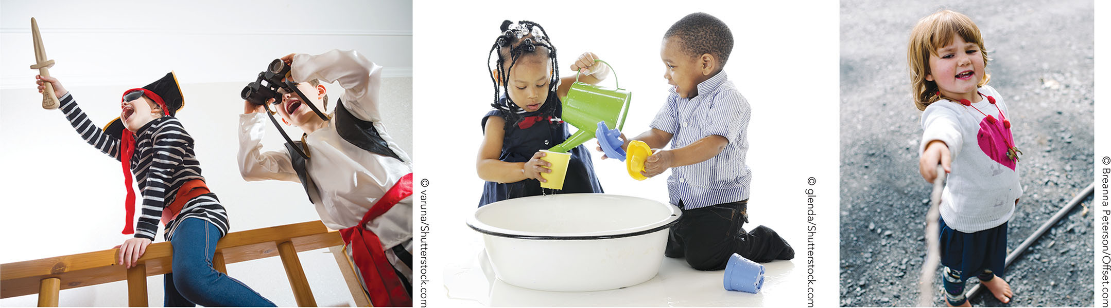
FIGURE 9.5 Sociodramatic play.
Notes:
Instructor’s Note:
Photo caption:
Early childhood is colorfully marked by pretend play that includes other children as actors in created play scenarios.

Slide 14
However, Children Remain Limited in Logical Mental Operations
The ability to combine, separate, and transform information logically in the mind without the need to directly perceive or experience the information
Children show problems with such cognitive skills at this period in development

Slide 15
Cognitive Limitations: Egocentrism
Egocentrism
The tendency of children to think that other people view the world from their perspective
An inability to consider another person’s perspective
Notes:
Instructor’s Note:
From text:
While children are developing representational skills, they are still unable to think logically and have difficulties viewing things from multiple perspectives.

Slide 16
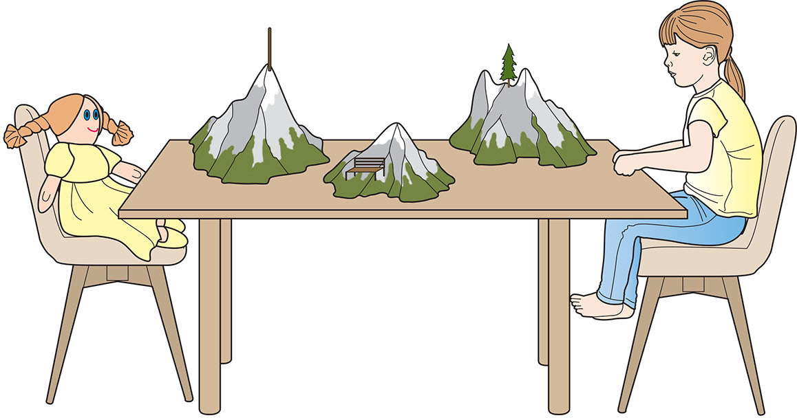
FIGURE 9.6 Piaget’s Three Mountains Task.
Notes:
Instructor’s Note:
Photo caption/from text:
Piaget demonstrated young children’s egocentrism in a game called the Three Mountains Task, in which a model of three mountains of different sizes and landscapes sat on a table.
A child walks around a table containing models of three mountains of different sizes and with different landscapes. The child then sits down, with a doll seated across the table. The child's task is to identify which of several photographs depicted the doll’s point of view.
Although children were able to remember all the landmarks on the mountains, most children failed Piaget’s task. They stated that the doll opposite them saw the same thing that they did.
Piaget and Inhelder concluded that children are unable to differentiate among alternative perspectives until around 7- to 10-years of age because of difficulties in manipulating multiple representations in their minds.

Slide 17
Cognitive Limitations: Animistic Thinking
Animistic thinking
A type of reasoning in which children attribute human qualities to inanimate entities
Piaget: Children have difficulties distinguishing inanimate/animate (clouds are alive!)
But, recent work challenges this view, as we will see

Slide 18

FIGURE 9.7 Cards used in the Gelman and Markman study.
Notes:
Instructor’s Note:
Photo caption/from text:
IN A STUDY BY GELMAN & MARKMAN (1986):
Preschoolers were shown three pictures labeled as “leaf,” “bug,” and “bug” respectively.
Although the leaf-insect looked more like a leaf than it did a bug, when children were asked to make inferences about the odd-looking, novel bug, they based their inferences on the object’s category label rather than its physical features.
For example, when the leaf insect was labeled a bug, they concluded that it would move around by itself.
When hearing the label bug, children drew on their understanding that members of a category share an underlying nature that transcends what things look like.
Developmental researchers refer to children’s belief that entities have an underlying essence as essentialism (Gelman, 2004). In turn, children’s assumptions around the underlying essence of things guides their future expectations.

Slide 19
Cognitive Limitations: Conservation
Conservation & Conservation Tasks
Piagetian tests that assess whether children understand that an entity remains the same in its number, mass, and so on, even if its form changes

Slide 20
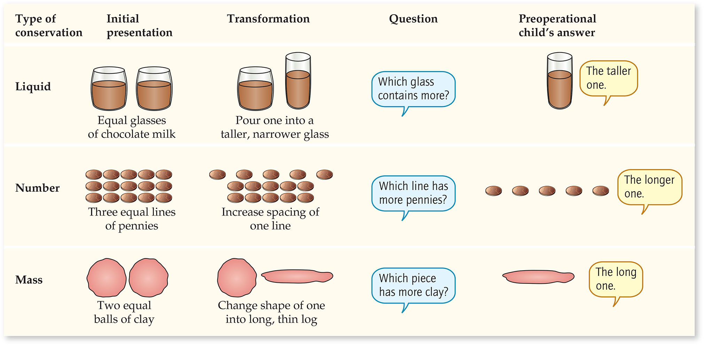
FIGURE 9.8 Conservation tasks.
Notes:
Instructor’s Note:
Photo caption/from text:
Piaget tested children’s skills at conservation using different types of tasks: liquid quantity, number, and matter or mass.
In conservations tasks, children are first presented with two objects or sets of objects of equal mass or number, such as two equal size mounds of clay or two rows of the same number of coins.
Then, the experimenter transforms the two entities to look different, such as pouring liquid into different size beakers.
After the transformation, preoperational children did not understand that the amounts remained equivalent.
MAIN FINDING:
Piaget found that the majority of 4- to 5-year-olds were unable to conserve. Children usually stated that the tall thin beaker had more liquid than the short, wide beaker; the snakelike clay shape had more clay than the round mass of clay; and the longer row had more coins than a cluster of coins or closely spaced coins that formed a shorter row.
Piaget interpreted children’s conservation errors as a problem of centration, the tendency to focus on a single, perceptually salient feature of an entity to the exclusion of others.

Slide 21
Cognitive Limitations
Appearance-Reality Tasks
Tasks that assess children’s ability to differentiate between appearance and reality

Slide 22
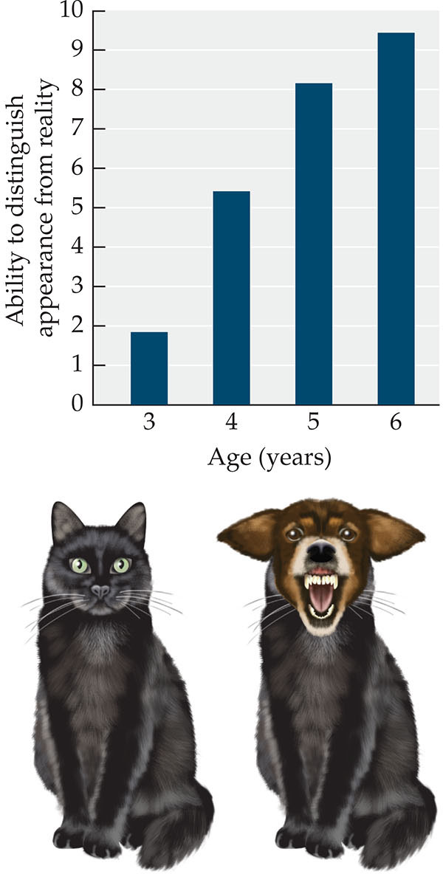
FIGURE 9.9 DeVries’s Appearance-Reality Task featuring Maynard the Cat.
Notes:
Instructor’s Note:
Photo caption/from text:
In a classic study of appearance-reality, children were introduced to Maynard the cat, whose identity was later manipulated with a mask to make Maynard look like a dog.
After playing with Maynard, the examiner hid Maynard’s front half behind a screen and attached a mask of a ferocious dog to Maynard’s head.
When the screen was removed, children were asked what Maynard looked like and whether Maynard was really a dog that could bark.
MAIN FINDING:
The 3-year-olds focused on appearance only, stating that Maynard was a vicious dog who might bite them.
4-year-olds showed a mix of understanding, stating that Maynard was a cat who ate cat food and meowed, but was also a dog now because he looked like a dog.
In contrast, 5- and 6-year-olds understood that Maynard was still a cat, even though he looked like a dog.

Slide 23
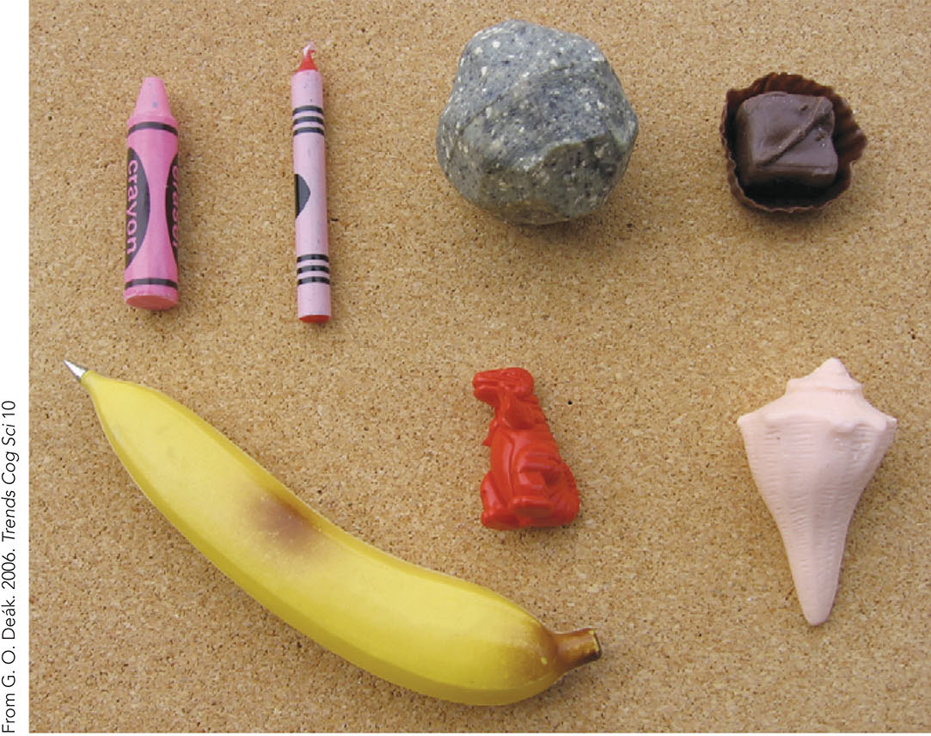
FIGURE 9.10 Distinguishing appearance from reality.
Notes:
Instructor’s Note:
Photo caption:
Children’s ability to distinguish appearance from reality has been shown using many different types of visually deceptive objects, including bananas that were pens and crayons as erasers.
New studies show that young children understand reality-appearance discrepancies when researchers apply the proper methods.
Examples of objects used in appearance-reality tasks include: Left to right: crayon eraser, crayon candle, rubber rock, candy magnet. Bottom row: banana pen, crayon dinosaur, seashell soap.

Slide 24
Cognitive Limitations: Hierarchical Classification
Hierarchical Classification
The ability to organize items into superordinate and subordinate categories

Slide 25
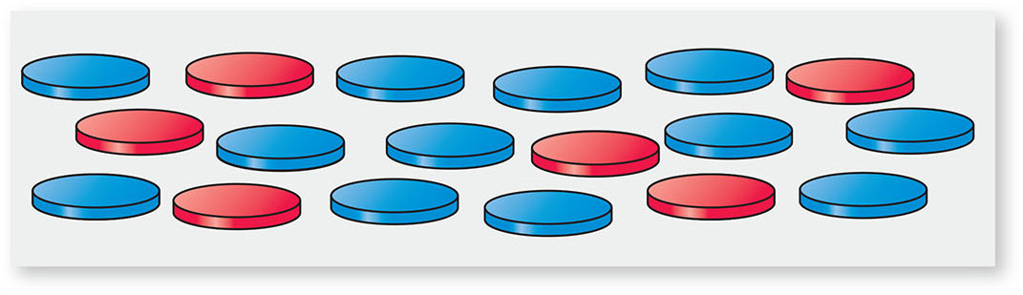
FIGURE 9.11 A class inclusion test.
Notes:
Instructor’s Note:
Photo caption/from text:
CLASS INCLUSION TESTS ARE tasks that assess children’s understanding of hierarchical classification, such as asking children whether there are more “red flowers” or “flowers generally.”
When Piaget asked children whether there were more “chips” (the whole set) or more “blue chips” (a subset), preoperational children erroneously concluded there were more blue chips.
They centered on the large number of blue chips, which prevented them from considering the part/whole relation problem before them.

Slide 26
Cognitive Limitations: Casual Understanding
Causal understanding
The ability to infer the relation between a cause and its effect
Precausal thinking: Errors of logic in cause-effect relations and circular thinking (Piaget, 1930), such as as when a child says “cold makes snow” and “snow makes cold”
Notes:
Instructor’s Note:
DESPITE THESE DEMONSTRATED LIMITATIONS:
From text: Researchers have since found that young children may be capable of impressive causal reasoning.
FOR EXAMPLE:
From text: For example, researchers acted out a scene in which a doll walked across the floor with “muddy” shoes (Harris, German, & Mills, 1996).
They then asked 3- to 5-year-old children two questions to ensure that children understood the story: “Is the floor dirty now?” and “Was the floor dirty before?”
Children understood that muddy shoes would make the floor dirty.

Slide 27
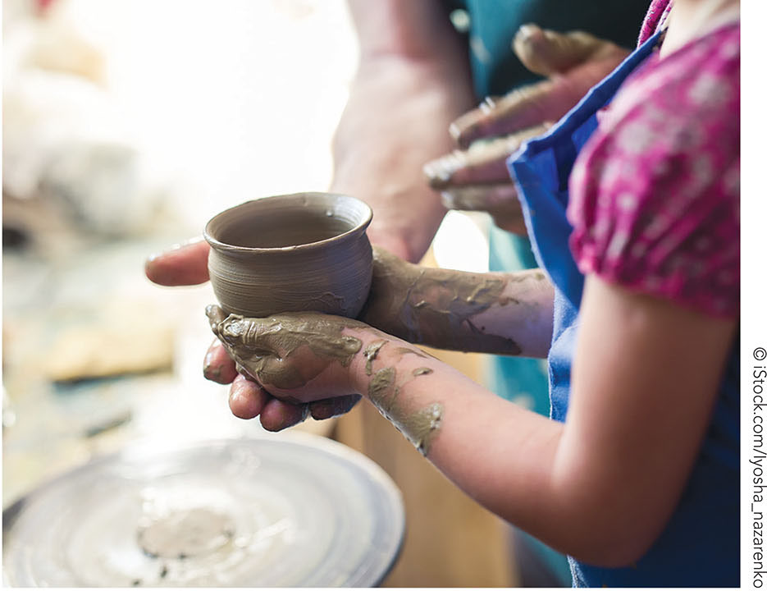
FIGURE 9.12 Conservation.
Notes:
Instructor’s Note:
Photo caption/from text:
Children everywhere display striking similarities in cognitive development across the early childhood years.
However, children also diverge in aspects of cognitive development in line with their unique cultural experiences.
In this photo, children of Mexican pottery makers achieved conservation of mass at younger ages than did children in Piaget’s initial investigations.

Slide 28
Cultural Context of Cognitive Development
Culture & schooling shown to affect taxonomic categorization
The classification of entities based on their similar characteristics or functions
Examples: The category of foods or body parts
Notes:
Instructor’s Note:
From text:
Children from schooled versus unschooled communities differ in how they categorize. When young children in the United States were asked to group a set of items, they typically placed objects into superordinate categories, such as “foods,” “animals,” “vehicles,” and so forth, what is referred to as to as taxonomic categorization (Cole, 1990; Rogoff, 2003).
In contrast, Michael Cole and colleagues found that adults from the Kpelle tribe in Liberia sorted items on the basis of functional relations—such as by placing a knife with an apple (Cole et al., 1971; Sharp & Cole, 1972).

Slide 29
Cognitive Development from an Information Processing Perspective
Cognitive skills & strategies that allow young children to attend to and learn new information
Self-regulation: The ability to manage and integrate attention, thoughts, and behaviors to attain goals
The cognitive component of self-regulation focuses on processing of information

Slide 30
Cognitive Development from an Information Processing Perspective: Overview
Executive functioning
Semantic memory
Episodic memory
Notes:
Instructor’s Note:

Slide 31
Executive Functioning
The collection of skills involved in controlling and coordinating attention, memory, and other behaviors involved in goal-directed actions
3 basic skills: Inhibitory control, cognitive flexibility, and working memory

Slide 32
Research in Action Video: Executive Function: The Brain's Control Center, Part 1
Watch the video here:
Executive Function: The Brain's Control Center, Part 1
Notes:
A fully accessible version of this video is available by logging on to Oxford LearningLink and selecting the appropriate Research-in-Action video.
https://learninglink.oup.com/access/tamis-lemonda1e-student-resources#tag_research-in-action-videos

Slide 33
Inhibitory Control
Component of executive functioning: Children’s ability to respond appropriately to a stimulus while inhibiting an alternative, dominant response
Example: Completing a worksheet rather than playing with a toy

Slide 34

FIGURE 9.13 Day-night Stroop task.
Notes:
Instructor’s Note:
From text:
Many inhibitory control tasks are based on Stroop tasks, named after American psychologist John Ridley Stroop, who developed an adult version of the task.
An example Stroop task for children is the go/no-go task, in which an examiner presents children with pictures, colors, or letters, and instructs them to push a button or touch a screen (the “go” response) when a target stimulus appears (such as a red object) but not when a non-target stimulus appears (such as a green object) (e.g., Obradovic & Willoughby, 2019).
By manipulating the frequency of target stimulus, the examiner can control the child’s tendency to react with a “go” response. As the number of consecutive “go” stimuli increases, so does the child’s likelihood of wrongly responding with a “go” action to a “no-go” stimulus (Casey et al., 1997).
Photo caption:
Another example is the day-night Stroop task (SHOWN HERE), which requires children to say “day” when presented with a picture of a moon and “night” when presented with a picture of a sun. (Obradovic & Willoughby, 2019). Across tasks such as these, children between 3 and 5 years demonstrate marked improvements in their ability to inhibit the automatic response (Zelazo, 2006).
This task requires children to say “day” when presented with a picture of a moon and “night” when presented with a picture of a sun.
Children must focus on the relevant information while inhibiting the more intuitive response of saying “day” to a sun or “night” to a moon.
Young children’s reaction times are slowed when responding to incongruent object-color stimuli compared to congruent or neutral pairings.

Slide 35
Cognitive Flexibility
Component of executive functioning: Children’s ability to shift between different concepts or rules, or to think about multiple concepts simultaneously

Slide 36
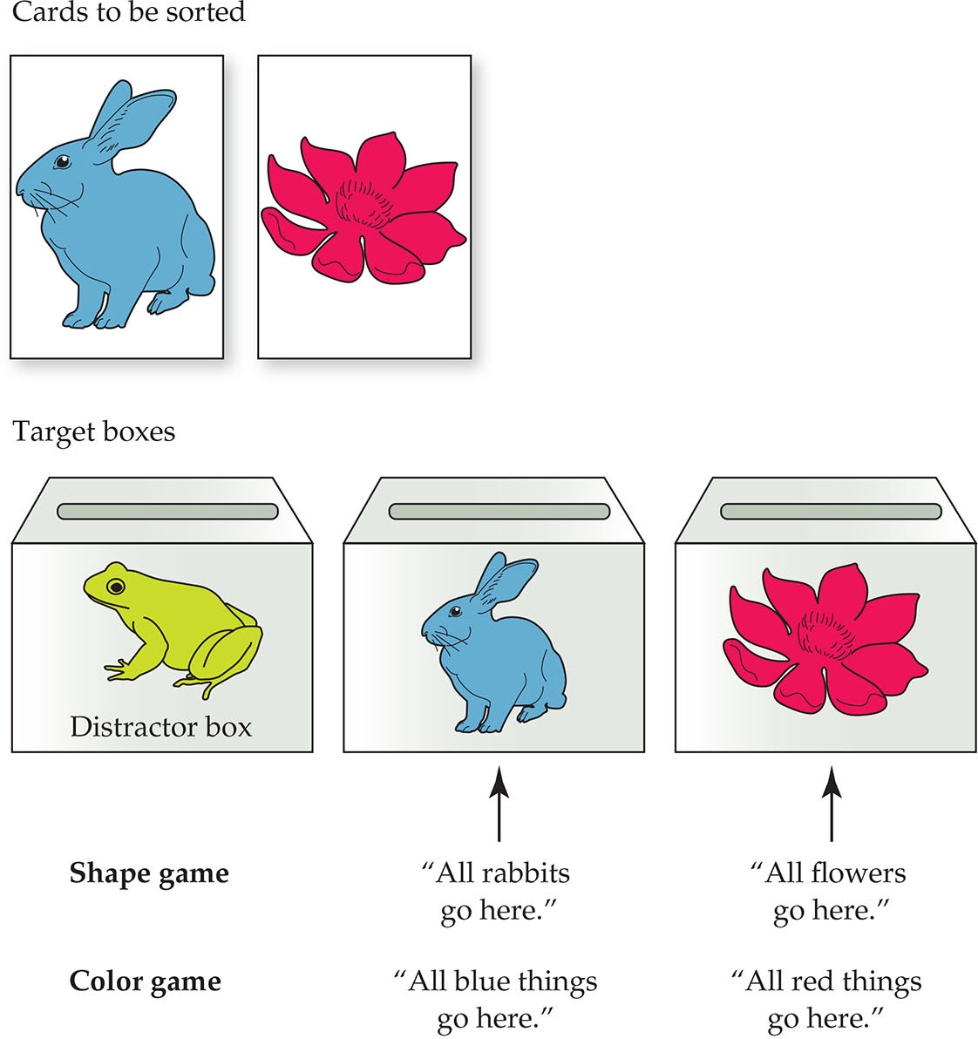
FIGURE 9.14 Dimensional card-sorting tasks.
Notes:
Instructor’s Note:
Dimensional card-sorting tasks are tests used to assess cognitive flexibility and executive functioning in which children sort cards one way (e.g., by object color) and then switch their thinking to sort the same cards a different way (e.g., by object type).
Photo caption:
In these tasks, examiners present children with a set of cards containing pictures such as rabbits and flowers that can be sorted in different ways, for example by color or type of object.
The child’s task is to put all the blue rabbits and blue flowers in one pile and all the red rabbits and red flowers in another.
But then, on switch trials, the examiner now instructs children to group cards by object type by placing the rabbits in one pile and the flowers in another.
Because the switch trials require children to flexibly shift from a color-based-rule to an object-based-rule, younger children have difficulty with the task.

Slide 37
Working Memory
Component of executive functioning: Children’s ability to maintain and manipulate information in the mind over a short period of time
Important for concentration, focus, and following instructions

Slide 38
Memory Span Tests
Tests of children’s working memory that measure the number of items (e.g., words, letters of the alphabet) children can recall and repeat immediately after being presented with a list

Slide 39
Planning
In planning, children must select, coordinate, and execute a sequence of actions while inhibiting other actions
Example test: Tower-of-London task

Slide 40
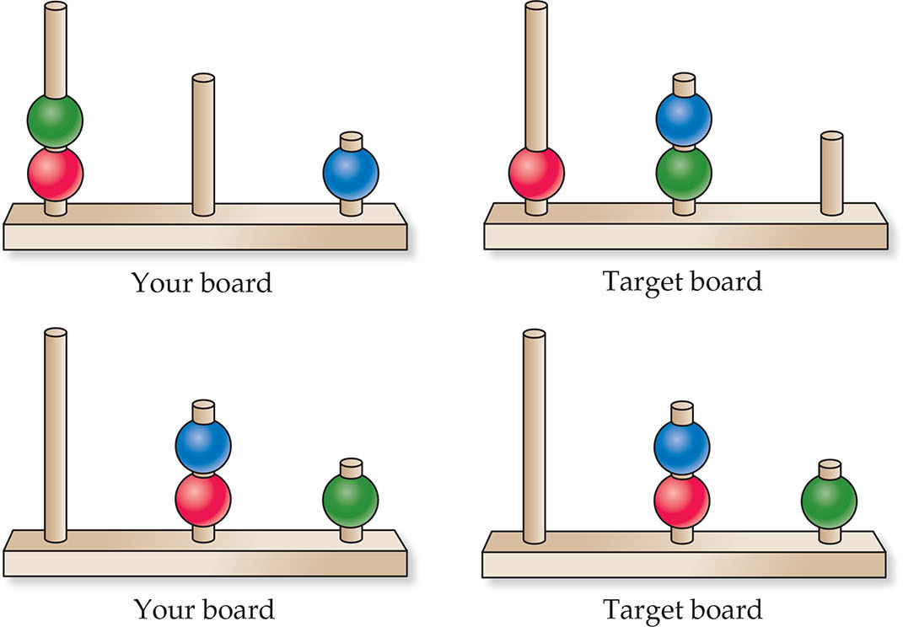
FIGURE 9.15 The Tower of London task.
Notes:
Instructor’s Note:
Photo caption/from text:
A common way that researchers test children’s planning is with the Tower-of-London task (Berg & Byrd, 2002).
The task involves rearranging objects, such as colorful disks that can be placed on rods or colored balls that can be moved on a computer screen to match a target configuration.
Children must move the objects one at a time from an initial configuration to a configuration that matches a display.
Throughout early childhood and into middle childhood, children improve in their ability to plan on Tower of London problems, with children who have problems in attention deficit disorder having difficulties relative to their peers (e.g., Unterrainer et al., 2015).

Slide 41
Strategies for Remembering
Rehearsal: A strategy for remembering that relies on repeating information to aid memory
Organization: A memory strategy marked by imposing a structure on items based on their relations to one another (such as grouping) to aid recall of information
Researchers can probe how children organize to-be-learned information through memory tasks

Slide 42
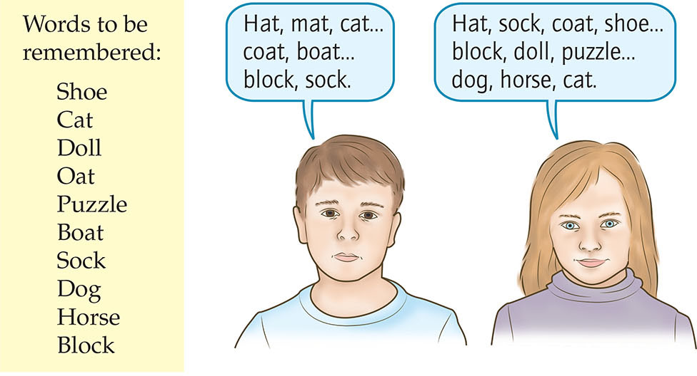
FIGURE 9.16 Encoding and retrieval.
Notes:
Instructor’s Note:
Photo caption/from text:
If children recall the words or pictures in order of “hat”-“mat”-“cat,” and then recall “coat”-“boat”, and then “sock”-“block,” they have grouped items by the sounds of words.
In contrast, if they report the words “hat”-“coat”-“sock,” they have grouped the items into categories, such as clothing.
Most of the time, preschool children cluster items at only chance levels. Sometimes young children cluster items by sound, recalling rhyming words together. Other times children cluster items by functional associations, recalling that cereal goes with a bowl and spoon.
But by around 7-8 years of age, children group items into conceptually-related categories.
And, as clustering by categories improves, so does recall.

Slide 43
Self-Monitoring
Keeping track of one’s performance on a task and making necessary adjustments along the way
Meta-cognitive skill: The understanding of how cognition works or “knowing about knowing”
Notes:
Instructor’s Note:
From text:
For the most part, young children exhibit limited metacognitive understanding. They are out of touch with what they know. As a result, young children tend to overestimate what they know and underestimate how much effort is required to remember things.
In one of the first studies of children’s metacognition, experimenters presented 5- and 8-year-old children with 10 pictures and asked children if they believed they could remember everything (Flavell, Friedrichs, & Hoyt, 1970). Most 5-year-olds said they could remember all 10 pictures, although they could not. Children failed to accurately evaluate how much time they needed to memorize the pictures. Eight-year-olds were more aware of their memory limitations.

Slide 44
The Semantic Piece of Long-term Memory
Long-term memory: The unlimited, enduring storehouse of knowledge in the brain that accumulates over time
Declarative memory: A component of long-term memory that involves memory for facts, events, and personal past experiences

Slide 45
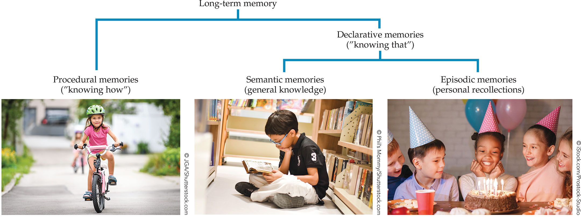
FIGURE 9.17 Types of declarative memory.
Notes:
Instructor’s Note:
From text and glossary:
Declarative memory subdivides into two types of memory—semantic and episodic, as shown here.
SEMANTIC MEMORY: The subtype of declarative memory referring to the knowledge a person has acquired around facts, rules, and concepts (including general world knowledge).
EPISODIC MEMORY: The subtype of declarative memory referring to everyday memories about personal experiences, situations, and events.

Slide 46
Semantic Memory: Scripts
Semantic memory includes knowledge about familiar routines
Example: Knowing the sequence of events around going to a restaurant or to a doctor’s office (Hudson & Nelson, 1983)
Note: A memory about a specific trip to a restaurant, however, is NOT semantic memory; it is personal and episodic

Slide 47
Semantic Memory: Consolidation
Process in which a neural imprint of memories is formed in the brain
Example: A child’s experiences with dogs will create and strengthen connections in memory among such words as “dog,” “bone,” and “tail”
Notes:
Instructor’s Note:
From text (to read at the end of this slide):
As children’s knowledge grows, they access related information faster, their working memory is freed up to manipulate new information, and learning grows further.

Slide 48
The Episodic Piece of Long-term Memory
The sub-type of declarative memory referring to everyday memories about personal experiences, situations, and events
Examples: A cousin’s birthday party, a trip to the zoo, dinner at grandma’s house

Slide 49
Infantile Amnesia
The difficulty adults have in remembering the first years of life
On average, adults report their earliest memories to have occurred between 3 and 4 years old (Bauer, 2015; Wang & Peterson, 2014)
Notes:
Instructor’s Note:
From text:
WHAT RESULTS IN INFANTILE AMNESIA?
Researchers offer several possibilities. Perhaps memories prior to 3 years of age are inaccessible because they never made it to long-term memory (they never existed in the first place!). Freud (1953) in fact was the first to speculate about infantile amnesia, claiming that children’s turmoil over their sexual attraction to their opposite-sex parent led them to repress memories out of consciousness. Today, developmental scientists reject Freud’s claim of memory suppression, and also reject the general idea that early episodic memories never existed.
Children’s limited language in the early years might also account for why the past seems to have disappeared (Fivush & Hammond, 1990). That is, very young children cannot store memories verbally, making retrieving memories difficult later in development when language is a primary means of representing information.
An alternative interpretation of infantile amnesia is that children form memories early on (even in infancy and toddlerhood), but the memories do not last very long.

Slide 50
Forgetting
The decay or degradation of memories over time
May account for infantile amnesia and age-related improvements in episodic memory (Bauer, 2018; Scarf et al., 2013)
Notes:
Instructor’s Note:
From text:
Why might young children’s memories be vulnerable to forgetting?
Perhaps as neural structures and networks change and develop in the infant and toddler brain, early memories are displaced. The remodeling of neural networks thus causes degradation of early memories, leading to high rates of forgetting early in life (Josselyn & Frankland, 2012).
Only memories that have “survived the ‘storm and stress’ of their infancy and early childhood remain accessible to recollection” (Bauer, 2015).

Slide 51
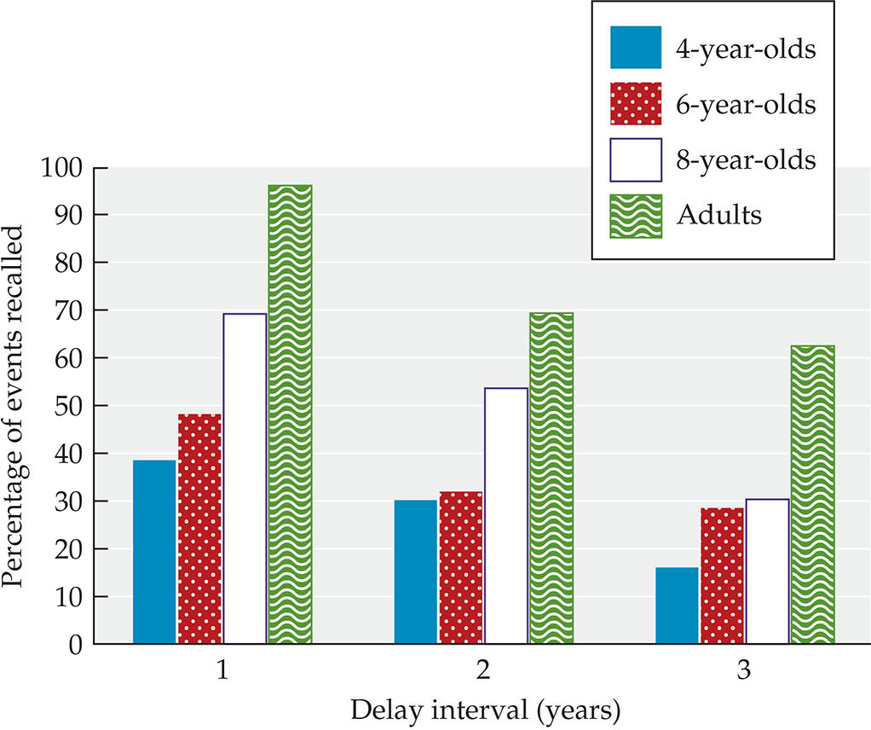
FIGURE 9.18 Developmental changes in semantic memory.
Notes:
Instructor’s Note:
Photo caption/from text:
Children’s episodic memories develop in complexity, detail, and organization across childhood (Bauer, 2015; Waters, Bauer, & Fivush, 2014).
With age, children recall an increasing number of past events and greater details about events (Bauer & Lakina, 2015; Friedman, 2014; Lourenco & Frick, 2013).
Episodic memory improves with age: Young children recall fewer events than 8-year olds and adults across different methods of questioning and delay intervals.

Slide 52
Eyewitness Testimony
A later account of an observed event
Children’s abilities to talk about past experiences also allows them to report on events that they have witnessed
Notes:
Instructor’s Note:
From text:
Eyewitness testimony develops with age, and as long as children are not misled, they can accurately report about events they have observed.

Slide 53
False Memories
Remembering information that is wrong or different from what actually happened
Research by Elizabeth Loftus highlighted people’s false memories
Young children may be prone to false memories

Slide 54
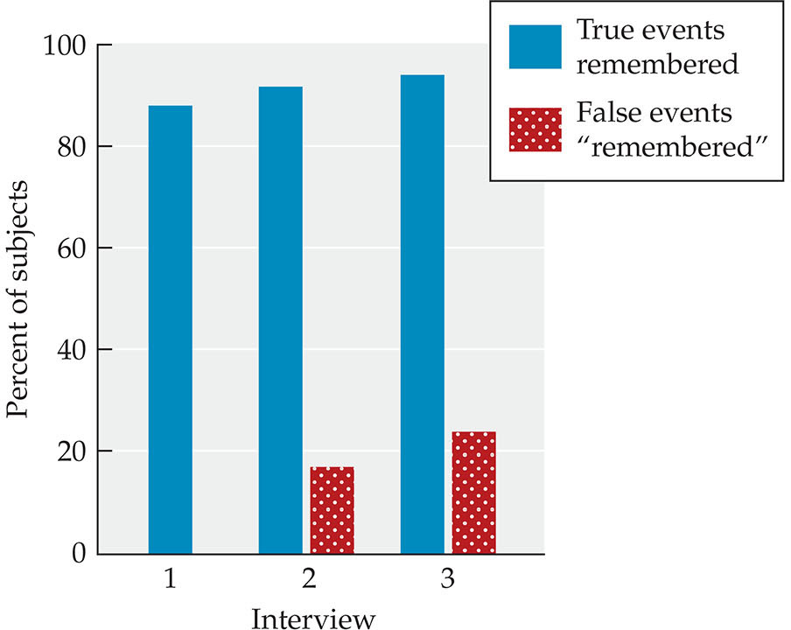
FIGURE 9.19 False memories.
Notes:
Instructor’s Note:
From text:
Cognitive psychologist Elizabeth Loftus conducted groundbreaking studies on the vulnerability of people’s memories to suggestion. In fact, Loftus was able to get people to remember things that had never happened to them, by presenting them with false information (Loftus, 1995).
In one of her most cited studies—Lost in a shopping mall—participants recalled details about being lost in a mall as children, after an experimenter misled them. Participants were given a brief written description of four events that had supposedly occurred when they were around 4 years of age. Three of the events had happened, based on reports by a relative, but the “lost in mall” event had not.
Participants were then asked to write about each event in detail or to acknowledge, “I do not remember this” if they could not recall the event.
About 25% of the adults “remembered” the false event of being lost in a mall, and provided many details about their experience during interviews. For example, one woman reported remembering crying, and stated that a heavy-set elderly lady helped her find her mom, even though none of it had happened.

Slide 55
Suggestibility
The inclination to accept false information as something seen or experienced when the false information is presented to you by someone else

Slide 56
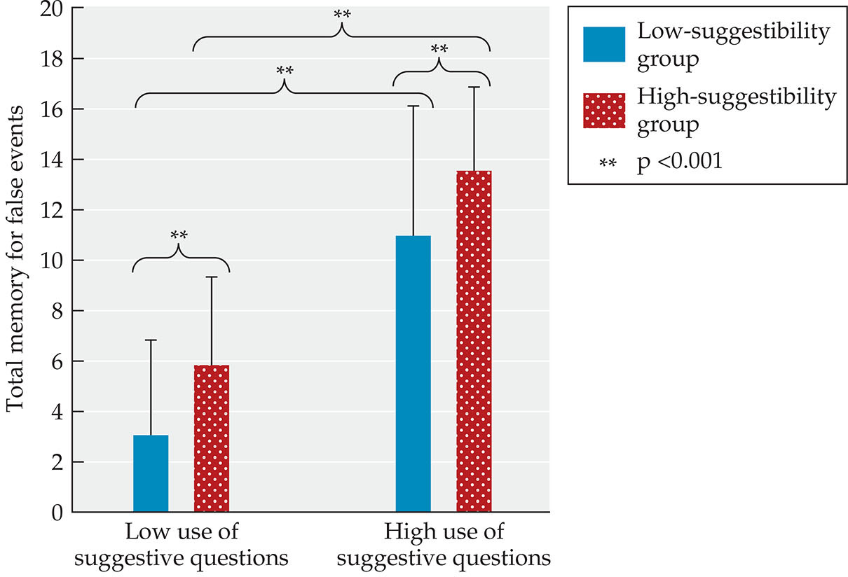
FIGURE 9.20 Children’s suggestibility.
Notes:
Instructor’s Note:
From text: Developmental psychologist Stephen Ceci and his colleagues conducted many studies on children’s false memories, showing that children’s autobiographical recall can be greatly distorted when interviewers ask questions in a suggestive manner. SUGGESTIBILITY IS THE INCLINATION TO ACCEPT FALSE INFORMATION WHEN RECALLING AN EXPERIENCE.
Photo caption:
Examiners tested 4-5 year-olds and 7- to 8-year-olds memory for events under low-pressure and high-pressure interviewing conditions, where children were asked whether a male they encountered 3-months prior had behaved inappropriately.
Although some children were less suggestible than others, interviews containing suggestive questions led to a dramatic increase in children’s memory of false events.

Slide 57
Research in Action Video: Are All of Your Memories Real?
Watch the video here:
Are All of Your Memories Real?
Notes:
A fully accessible version of this video is available by logging on to Oxford LearningLink and selecting the appropriate Research-in-Action video.
https://learninglink.oup.com/access/tamis-lemonda1e-student-resources#tag_research-in-action-videos

Slide 58
Contexts of Information Processing
Family
Preschool
Culture
Notes:
Instructor’s Note:
Children’s information processing develops in three main contexts: family, preschool, and culture, with each context affecting children’s cognitive skills in important ways.

Slide 59
Family Context
Can support or hinder children’s cognitive development
Children in families living in chronic poverty across the first few years of life performed poorer on executive functioning measures than did children living in transitory poverty (Raver, Blair, & Willoughby, 2013)
Notes:
Instructor’s Note:
From text:
Children’s stress response may help explain associations between poverty and cognition. That is, chronic poverty alters children’s physiological reactions to stress by amplifying levels of the stress hormone cortisol.
Cortisol then might compromise children’s executive functioning and forms of self-regulation (Blair et al., 2008, 2011; Evans & Schamberg, 2009).
Moreover, poverty instigates cascading effects that can follow children into the school years. Chaos, unpredictability, and inconsistency found in many impoverished households can undermine young children’s executive functioning, with downstream effects on academic achievement (Crook & Evans, 2014).

Slide 60
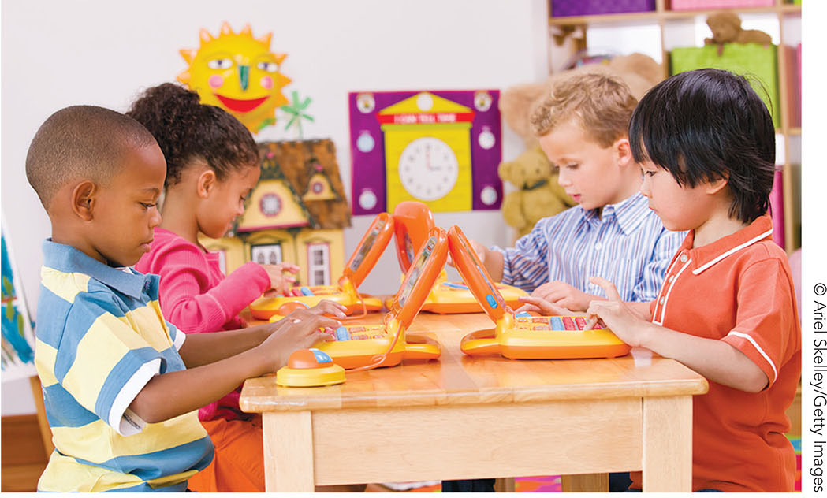
FIGURE 9.21 Preschool context: Tools of the Mind curriculum.
Notes:
Instructor’s Note:
PRESCHOOLS OFFER CHILDREN A WIDE ARRAY OF OPPORTUNITIES TO DEVELOP THEIR COGNITIVE SKILLS.
Photo caption:
Tools of the Mind is an example of a U.S. preschool curriculum that aims to improve preschoolers’ executive functioning skills through a rich range of activities that offer children practice with attention, inhibitory control, working memory, and cognitive flexibility in the context of play.
From text:
Developmental scientist Adele Diamond designed a preschool Tools of the Mind curriculum that aimed to improve preschoolers’ executive functioning through a rich range of activities.
The curriculum is based on the theoretical position advanced by Soviet psychologist Lev Vygotsky that play is a primary context for the development of self-regulation and higher-level cognitive skills (Vygotsky, 1978).

Slide 61
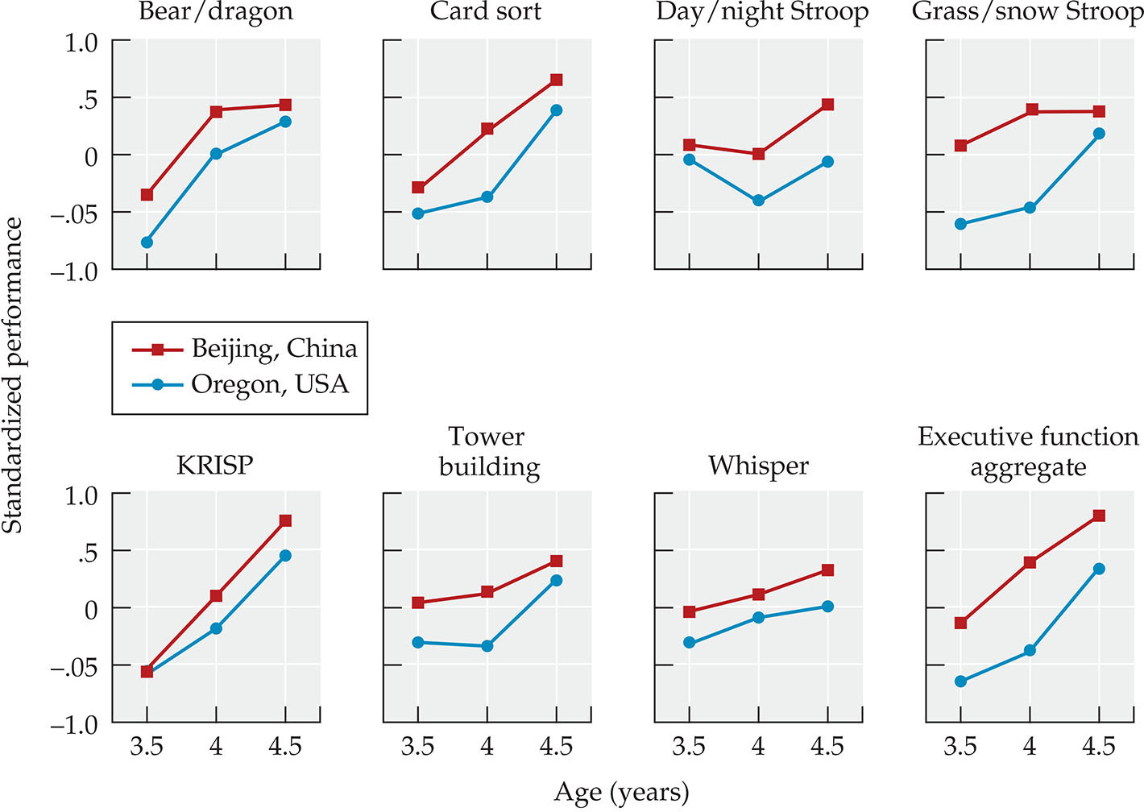
FIGURE 9.22 Cultural context: Cultural differences in executive functioning skills.
Notes:
Instructor’s Note:
From text: Children from cultural communities around the world differ in their executive functioning skills, in part because of the behavioral expectations of parents and teachers.
Photo caption:
Thus, cultural beliefs and practices might produce differences in children’s executive functioning skills. Chinese preschoolers in Beijing outperformed children from North America on multiple measures of executive functioning, performing approximately 6 months ahead of North American preschoolers.
From text:

Slide 62
Social Cognitive Development
Notes:
Instructor’s Note:
From text:
Social cognitive development—the understanding of other people —undergoes dramatic transformation in early childhood.
Children increasingly understand, for instance, that people differ in their knowledge, areas of expertise, and beliefs.
As a result, children express selectivity in whom they turn to for information, whom they trust, and how they reason about the minds of other people.

Slide 63
Social Cognitive Development: Overview
The understanding of other people
Evaluating others’ knowledge & expertise
Theory of Mind

Slide 64
Evaluating Others’ Knowledge & Expertise
A growing understanding that people differ in what they know and can do
Judging a person’s reliability & trustworthiness
Children assess what people know and can do, and use their judgments to determine whom to ask for information or help and whom to believe
But, familiarity with a person may affect judgements (weighing familiarity against reliability)
Notes:
Social cognitive understanding can be seen in how children evaluate other people on whether they are reliable, trustworthy, and so on.
Familiarity may affect children’s judgments.
Children may view someone who is “familiar” to be more trustworthy, for example.

Slide 65
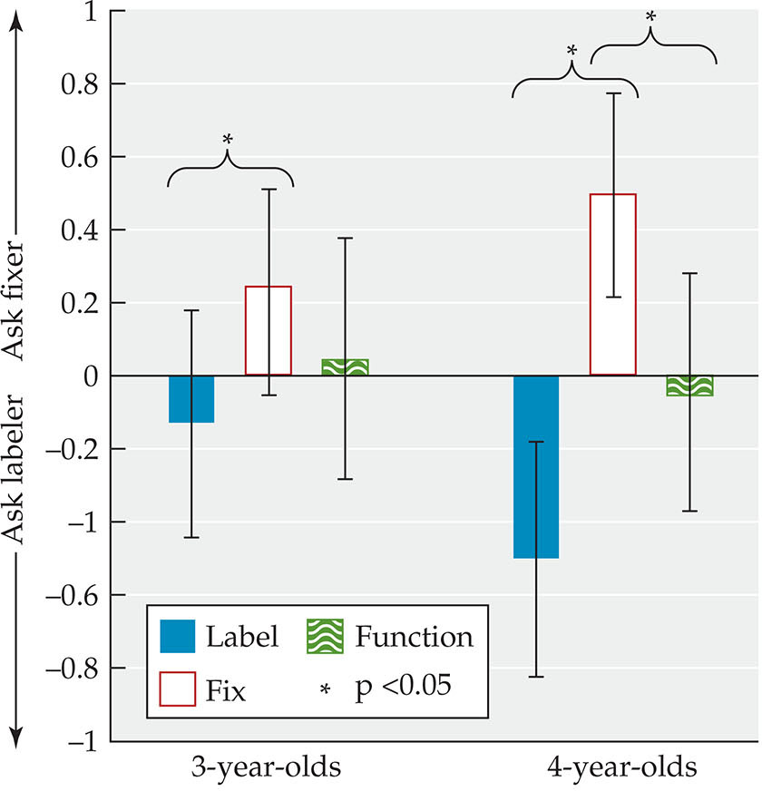
FIGURE 9.23 Reliability, trustworthiness & Familiarity: Reliability and trustworthiness.
Notes:
Instructor’s Note:
From text: Children quickly assess what people know and can do, and they use their judgments to determine whom to ask for information or assistance and whom to believe.
Photo caption:
Young children selectively request information or help from people that are knowledgeable in the relevant areas.
Three- and 4-year-olds were more likely to ask the person they saw fix an object in the past (but who did not know the names of objects) to fix a toy that was broken.
In contrast, children were more likely to ask a person who knew the names of objects (but could not fix objects) the label for an object.
With age, children improved in their ability to direct requests to the individual with the relevant skills.

Slide 66
Weighing Familiarity against Reliability
As children grow in their social cognitive understanding of others, a developmental shift occurs in which they begin to take both familiarity and knowledge into account
Notes:
Instructor’s Note:
EXAMPLE STUDY:
From text:
Children aged 3-, 4- and 5- years old were randomly assigned to one of two conditions. Half of the children saw their familiar caregiver name familiar objects accurately and an unfamiliar person name them inaccurately. The remaining children saw the reverse: The familiar caregiver provided inaccurate information whereas the unfamiliar person provided accurate information.
Three-year-olds favored information provided by their familiar caregivers, even when it was inaccurate. Familiarity trumped accuracy.
But 4-year olds, and even more so 5-year olds, favored information reliability, even if it meant rejecting information from a familiar caregiver (Corriveau & Harris, 2009).

Slide 67
Theory of Mind
The ability to attribute mental states such as knowledge, beliefs, and desires to oneself and others, and to understand that other people can have knowledge, beliefs, and desires that differ from one’s own
Topics we will cover span:
False belief understanding
Explaining developments in theory of mind
Lying, deception, & persuasion

Slide 68
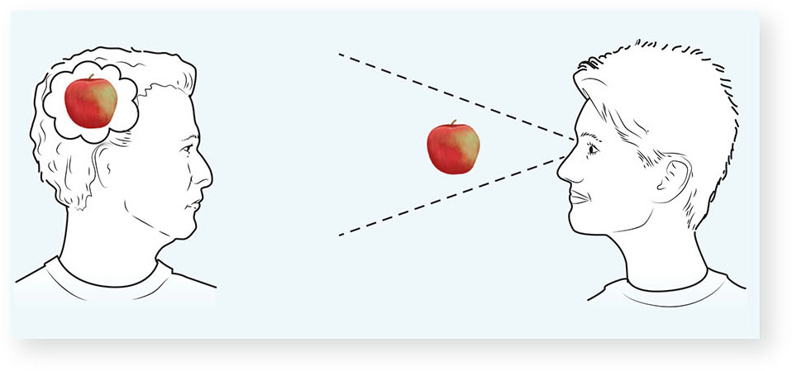
FIGURE 9.24 Theory of mind.
Notes:
Instructor’s Note:
Photo caption:
Theory of mind refers to the ability to attribute mental states such as knowledge, beliefs, and desires to oneself and others, and to understand that other people can have knowledge, beliefs, and desires that differ from one’s own.

Slide 69
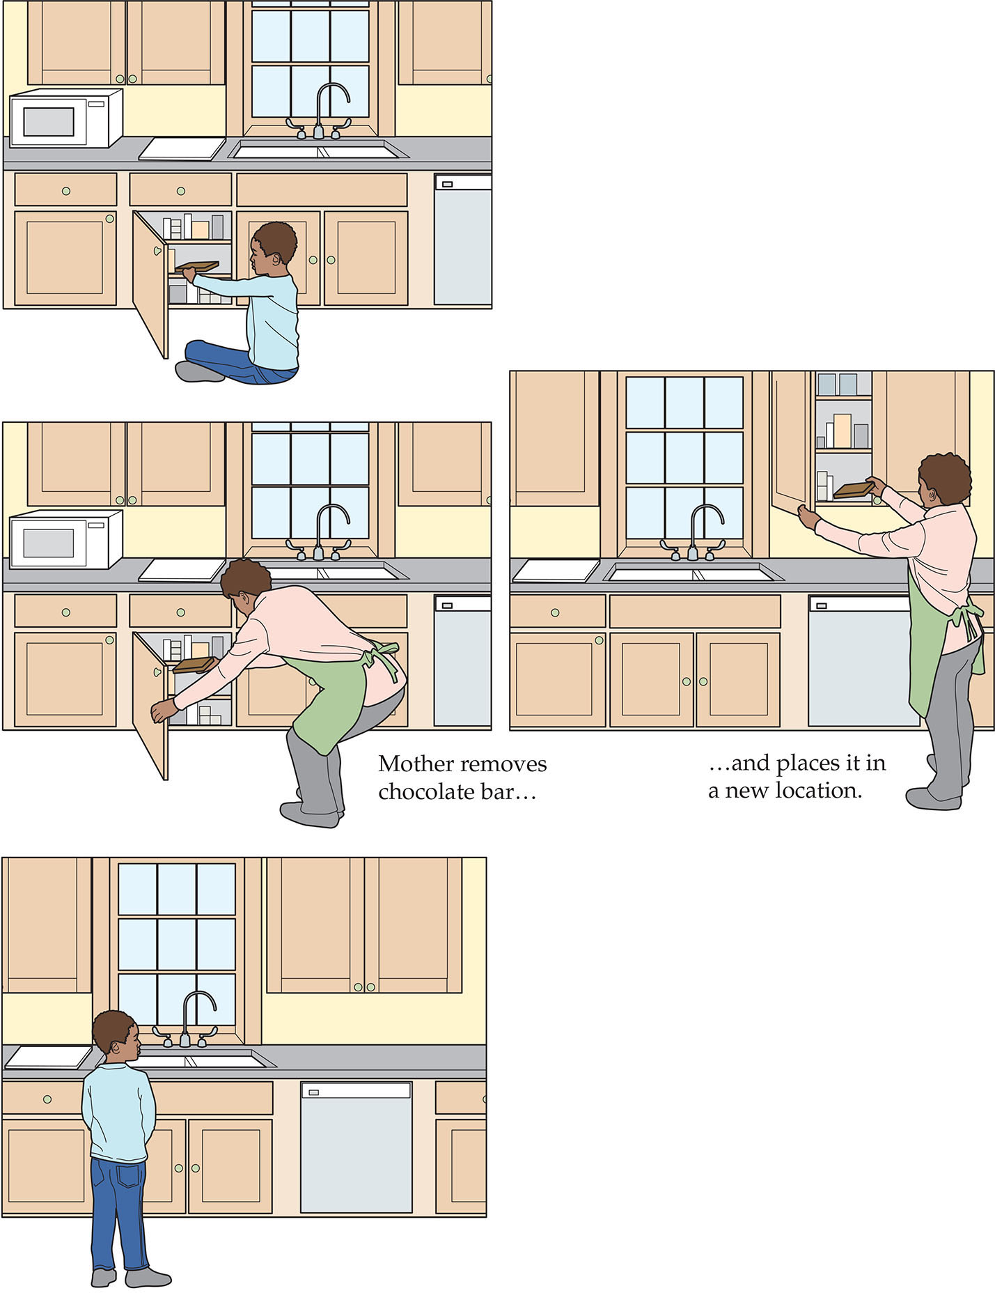
FIGURE 9.25 False belief Understanding: False-belief task.
Notes:
Instructor’s Note:
Photo caption:
Wimmer and Perner presented children between the ages of 3 and 9 years with sketches in which a character Maxi placed his chocolate into a cupboard but his mother then moved it to a different cupboard while Maxi was out of the room.
An examiner then asked the children where Maxi would look for his chocolate when he re-entered the room.
Children younger than 4 to 5 years of age incorrectly stated that Maxi would look for his chocolate at its new location, whereas children older than 4 to 5 years of age understood that Maxi would look in the original location.

Slide 70
Explaining Developments in Theory of Mind
1) Theory-Theory: Changes in children’s performance on false belief tasks are attributed to revisions children make to their theories about their world (Gopnik & Welman, 2012)
Maybe young children think objects reside where you want them to be, not where they actually are
They come to learn wanting something doesn’t mean it will be there

Slide 71
Explaining Developments in Theory of Mind, Continued
2) Limited executive functioning in children younger than 4 years old
Hard to hold conflicting information in mind—where the chocolate WAS and where it IS now
3) Differences in maturation of the brain
Evidenced in studies comparing TOM in children with autism, Down’s Syndrome, & typically developing children
Children with autism have problems with TOM

Slide 72
Lying, Deception, & Persuasion
All three behaviors require children to change another person’s thoughts and behaviors
Notes:
Instructor’s Note:
From text:
To illustrate, an examiner tempted 3- to 8-year-olds to commit a minor transgression—peeking at a toy after being told not to peek.
The examiner then assessed whether children would lie or admit to peeking (Talwar & Lee, 2008).
Children peeked, as expected, but some children were better at lying to conceal their transgression and better at sticking to the lie than were others.
Children who performed well on false-belief tasks were better liars and sustained liars.

Slide 73
Contexts of Social-Cognitive Development
Family
School
Culture

Slide 74
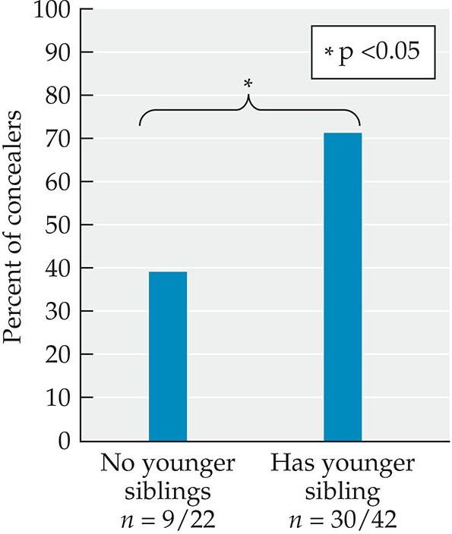
FIGURE 9.26 Family Context: Siblings and lying.
Notes:
Instructor’s Note:
From text:
Children’s interactions with family members help them learn about how other people think and feel. Indeed, parental sensitivity predicts preschoolers’ theory-of-mind performance (Cahill et al., 2007; Meins et al., 2002).
Additionally, parents and other adults support children’s social cognitive skills by exposing children to mental-state talk—statements and questions that refer to other people’s “minds” using words such as think, know, and want that encourage children to reflect on people’s unobserved thoughts and beliefs.
Photo caption:
Children are more likely to conceal lies when they have younger siblings than when they do not.

Slide 75
School Context
Peer interactions promote children’s social cognitive skills
Teachers expose children to mental-state talk
Literacy activities encourage children’s reasoning about character beliefs, emotions, and intentions

Slide 76
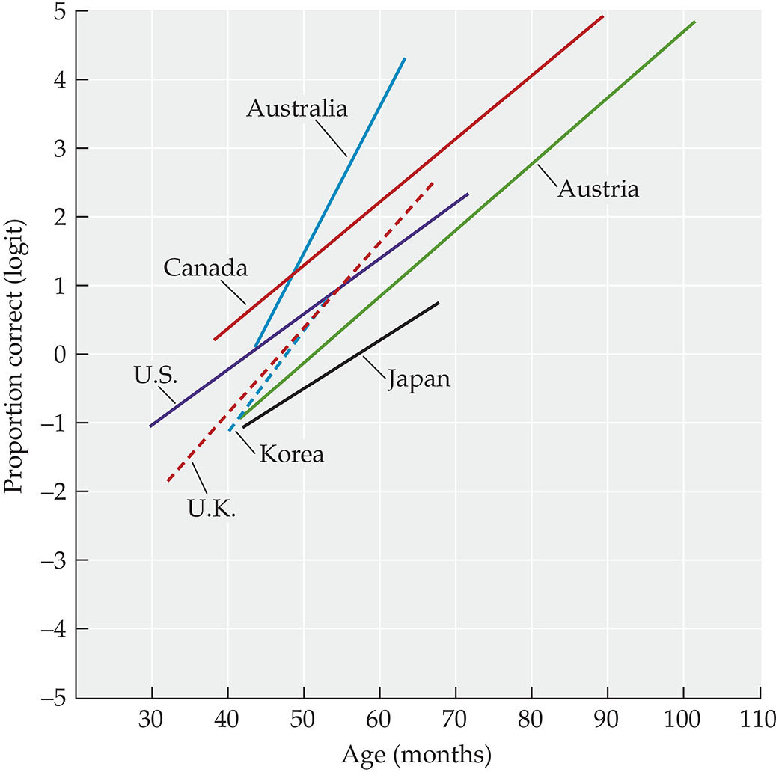
FIGURE 9.27 Cultural context: Cultural comparisons of theory of mind.
Notes:
Instructor’s Note:
From text:
Children everywhere show impressive gains in their understanding of people across the early childhood years. And, as seen for all cognitive phenomena, social-cognitive development follows certain universal processes.
Photo caption:
When researchers analyzed data on the theory of mind of over 4,000 children from countries around the world, they saw similar developmental improvements, with most children younger than 4 or 5 years failing TOM tasks (represented by negative values on proportion correct), but passing after ages 5 years.
Children across countries improved in their performance from 5 years onward.

Slide 77
Language, Literacy, & Mathematical Understanding

Slide 78
Language, Literacy, & Mathematics
Growing language skills
Emergent literacy
Emergent math

Slide 79
Growing Language Skills
Remarkable strides!
Phonology
Semantics
Grammar
Pragmatics
Notes:
Instructor’s Note:
From text:
Young children can do a lot with language. They use language to pretend, tell stories, joke, explain, evaluate, refuse, whine, and complain.
Developments in language support these abilities. Young children hone their phonological skills, expand the breadth and depth of their vocabularies, and learn how to construct grammatically accurate sentences. Additionally, children grow in the pragmatics of language, as they learn the social norms and expectations around communication.

Slide 80
Phonology
Children’s phonological skills improve rapidly during early childhood
Key factors include practice talking and greater control and coordination of speech muscles

Slide 81
Semantics
Vocabulary expansion allows greater specificity and detail as children generate sentences
Semantic development reflects a child’s growing network of information about how words connect to one another

Slide 82
Grammar or Syntax
The set of rules that govern the ordering of parts of speech to form meaningful sentences
Developmental improvements to grammar can be attributed to gains in:
Morphology: How words are formed; such as increasing units of words with plurals
Use of Clauses: Combining clauses – smallest grammatical unit that expresses a complete thought – with words like and, but, etc.

Slide 83
Grammar or Syntax, Continued
But, children show errors as they learn grammatical rules:
Overregularization: The use of a regular morpheme in a word that is irregular (e.g., saying “taked” instead of “took”)
Notes:
Instructor’s Note:
From text:
Developments in morphology and syntax permit longer sentences that contain more meaning than seen in children’s initial sentences.

Slide 84
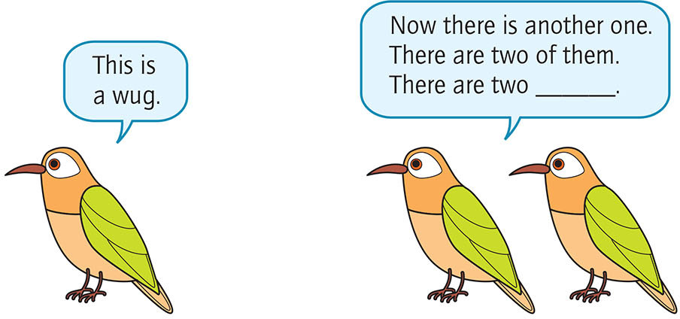
FIGURE 9.28 A WUG test.
Notes:
Instructor’s Note:
From text: Young children learn how to make minor changes or additions to words to modify a word’s meaning.
Children everywhere show impressive gains in their understanding of people across the early childhood years. And, as seen for all cognitive phenomena, social-cognitive development follows certain universal processes.
Photo caption:
Jean Berko (1958) used a clever method called the wug test to study children’s understanding of the English plural “s.”
Berko showed children a picture of a birdlike animal and labeled the animal for them using a nonsense word (“This is a wug”).

Slide 85
Pragmatics
The norms of language use and the contexts in which language is used, including when to talk, how to talk, and what to talk about
Notes:
Instructor’s Note:
From text:
Children’s expanding vocabulary and knowledge about grammar ushers in a new world of social interactions. Children are now full-fledged participants in the conversations of daily life.
At the same time, however, children must learn the norms of language use, such as when to talk, how much to talk, and what to talk about with other people, what is referred to as the pragmatics of language

Slide 86
Emergent Literacy
The collection of skills, knowledge, and attitudes that are early precursors to reading and writing
Notes:
Instructor’s Note:
From text:
Children’s oral language skills, including word knowledge, grammatical knowledge, and narrative abilities set the stage for emergent literacy.

Slide 87
Reading & Writing require:
Oral language skills: Knowing words
Code-related skills: The formalities of writing, sounding out, and reading letters and words on a page that include skills such as forming letters and connecting letters to sounds
Examples: Print conventions, naming and writing letters, connecting letters to sounds
Notes:
Instructor’s Note:
Oral language and code-related skills are core to recognizing letters and words and understanding text.
A child who has code-related skills but insufficient semantic and grammatical skills may be able to read an unfamiliar word by sounding it out, but the word and sentences will remain meaningless.

Slide 88
Emergent Math: Quantity & Number
Children’s emergent understanding of quantity and number
Number concepts tend to appear between 2 and 3 years of age
By about 3 years, children begin to connect number words to their precise quantities
Notes:
Instructor’s Note:
From text:
Attention to young children’s math skills continues to grow in response to global trends in the workforce. The majority of current U.S. economic growth revolves around innovations in the sciences, technology, engineering, and mathematics (the STEM disciplines).
With the proper support, young children learn to count, discriminate quantities, and discern patterns (Berch, 2005; Gersten, Jordan, & Flojo, 2005; Jordan et al., 2007)

Slide 89
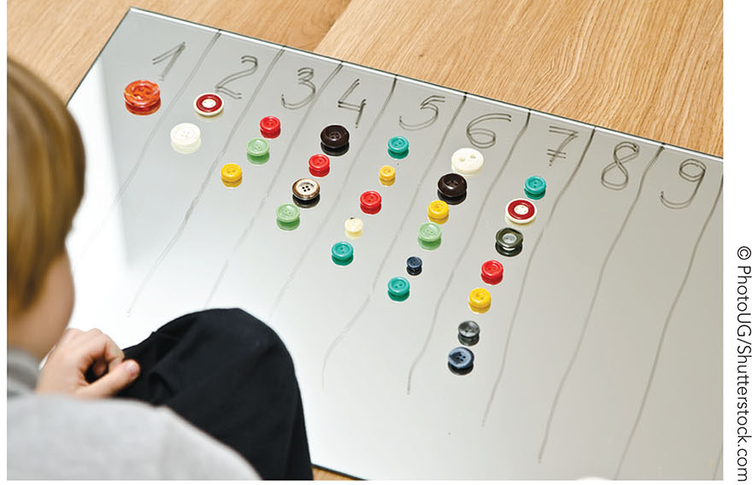
FIGURE 9.29 The cardinal principle.
Notes:
Instructor’s Note:
Photo caption:
Once children understand the meaning of three or four, they rapidly acquire the meanings of higher number words.
Children have now experienced a conceptual shift in their understanding of the cardinal principle that each number in a sequence represents a specific number of elements in a set.

Slide 90
Emergent Math: Spatial Cognition
Spatial Cognition: Abilities to understand and represent shapes, locations, and spatial relations among objects
Examples: Using words such as “on top of” and “square”

Slide 91
Contexts of Language, Literacy, & Mathematics
Home
Family SES
Preschool
Culture
Notes:
Instructor’s Note:
From text:
School readiness is not just “within the child.” Children’s readiness for school requires ready families, ready schools, and ready communities (Pianta, Cox, & Snow, 2007).

Slide 92
Home Context: Talk
Caregiver Talk: Amount of talk directed to children & diversity of words used with children
The number of different words mothers use during interactions with their children relates to children’s language skills in areas of vocabulary size, grammatical complexity, and literacy (e.g., Huttenlocher et al., 2007; Quiroz, Snow, & Zhao, 2010)
Math talk and spatial talk foster children’s number and spatial understanding (Gunderson & Levine, 2011; Levine et al., 2012; Susperreguy & Davis-Kean, 2016)

Slide 93
Home Context: Book Sharing & Literacy Experiences
Parental elaborations during book reading (sometimes referred to as “elaborativeness”) is particularly central to children’s narrative skills (Melzi, Schick, & Kennedy, 2011; Escobar, Melzi, & Tamis-LeMonda, 2017)
Notes:
Instructor’s Note:
From text:
Book sharing offers children opportunities to expand their vocabularies and learn about the world.

Slide 94
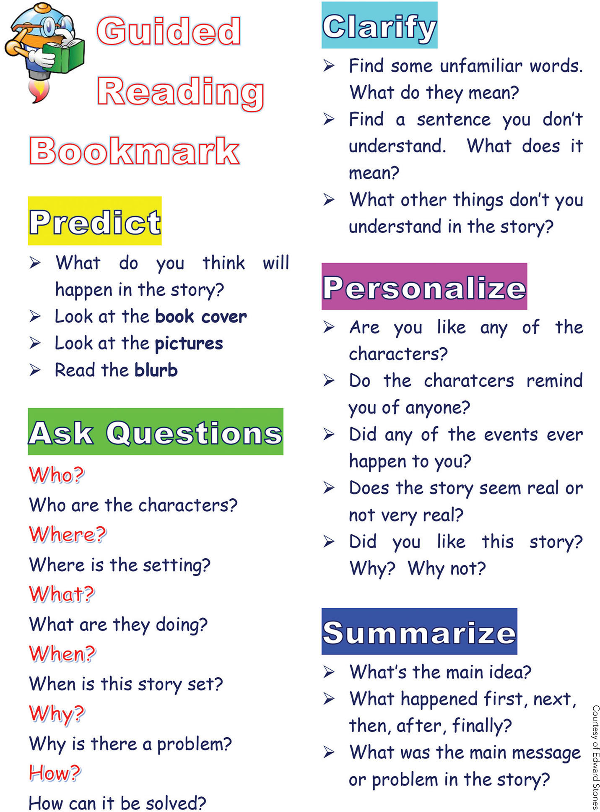
FIGURE 9.30 Dialogic reading.
Notes:
Instructor’s Note:
From text:
Live elaborativeness, dialogic reading promotes children’s language, emergent literacy, and early reading skills (e.g., Arnold & Whitehurst, 1994; Flack, Field, & Horst, 2018; Mol, Bus, de Jong, & Smeets, 2008).
Photo caption:
The use of WH questions is a core feature of dialogic reading —a reading style whereby adults prompt children and engage them in discussion while reading to them.

Slide 95
Home Context: Math-Related Activities
Math games and activities foster math:
Learning about object sizes
Counting numbers during a board game
Fitting shapes into a puzzle
Notes:
Instructor’s Note:
From text:
Home activities such as playing board games and puzzles predict children’s performance on non-symbolic math tasks, children’s developing fluency with basic number skills, and spatial thinking (e.g., Levine et al., 2012; Skwarchuk, Sowinski, & LeFevre, 2014; ).

Slide 96
Family SES Context: Literacy
“30-million word gap” study by Hart and Risley (1995):
By preschool entry, children from low SES households had vocabularies half the size of children from high SES homes
By kindergarten, fewer than half of children from low SES backgrounds were at grade level in their school readiness skills (Isaacs, 2012)
Notes:
Instructor’s Note:
From text:
A family’s socio-economic status (SES) can affect children’s language development, literacy, and math through effects on parent talk to children and the opportunities children have to engage in activities such as book reading and block play.

Slide 97
Family SES Context: Math
Disparities in math by family SES. Why?
Children from middle-income families have more opportunities to play number board games and engage in block play than do children from low-income backgrounds, and such experiences relate to children’s math skills (Siegler, 2009; Verdine et al., 2013)

Slide 98
Preschool Context: Teacher Quality
Teacher Quality:
One of the most important aspects of school quality
Children show large gains in cognitive skills when teachers provide frequent, warm and responsive interactions, encourage children to speak, and offer opportunities to elaborate on topics (Burchinal et al., 2008)
Notes:
Instructor’s Note:
From text:
Quality, center-based early childhood education supports cognitive development across multiple areas, and may help buffer the adverse effects of low-stimulating home environments.

Slide 99
Preschool Context: Literacy-focused Curriculum
Literacy-focused Curriculum:
A curriculum that targets opportunities for children to develop literacy skills through the use of varied activities, such as dialogic reading and phonological awareness activities
Notes:
Instructor’s Note:
From text:
Quality, center-based early childhood education supports cognitive development across multiple areas, and may help buffer the adverse effects of low-stimulating home environments.

Slide 100
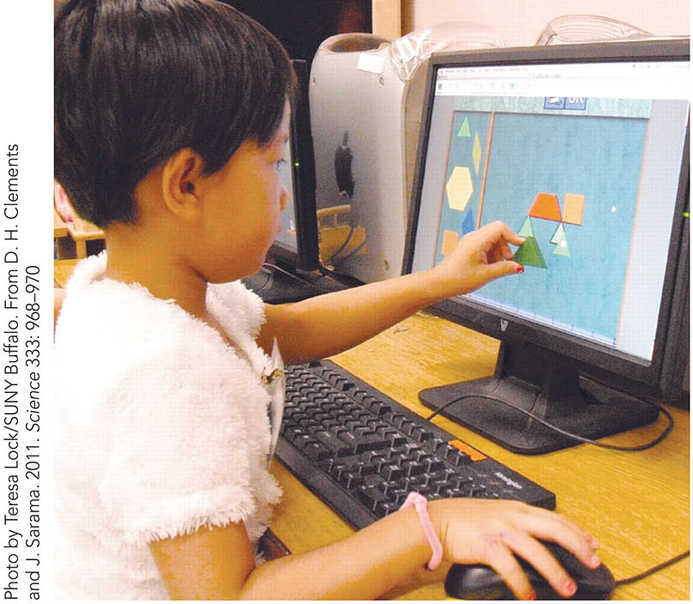
FIGURE 9.31 Preschool Context: Big Math for Little Kids and Building Blocks Curriculum.
Notes:
Instructor’s Note:
From text: Preschool curricula have also been designed to promote emergent math skills.
Photo caption:
Early childhood curricula such as the Big Math for Little Kids and Building Blocks aim to promote children’s early math skills.
Big Math for Little Kids (BMLK) target children’s thinking and problem solving about number, shape, pattern, logical reasoning, measurement, operations on numbers, and space.
Building Blocks similarly aims to support children’s early math skills, and shows impact from early math skills to elementary grade math outcomes.

Slide 101
Cultural Context: Language Practices
Unique practices of cultural communities, including features of their language, shape children’s language, literacy, and math skills
Example: Piraha˜ language has few words to express time and does not contain numbers or terms for quantification (Gordon, 2004)
Notes:
Instructor’s Note:
From text:
The unique practices of cultural communities shape children’s language, literacy and math development.
FOR EXAMPLE, IN TERMS OF LANGUAGE DEVELOPMENT,
The Piraha˜ language has few words to express time and does not contain numbers or terms for quantification (Gordon, 2004). Its phonemic inventory is the smallest in the world, being limited to eight consonants and three vowels. Color terms, relative tenses, and any kind of created myth or fiction are absent. Individual or collective stories about the past can be traced back to at most two generations. Characteristics of the Piraha˜ language are thought to reflect the importance attributed to a person’s immediate (rather than past or future) experiences (Everett, 2005).
As a result, unlike U.S. preschoolers, Piraha˜ children do not reflect on the past, talk about the future, or ask about time.

Slide 102
Cultural Context: Language Practices, Continued
Its phonemic inventory is the smallest in the world, being limited to eight consonants and three vowels
Unlike U.S. preschoolers, Piraha˜ children do not reflect on the past or talk about the future
Notes:
Instructor’s Note:
From text:
The unique practices of cultural communities shape children’s language, literacy and math development.
FOR EXAMPLE, IN TERMS OF LANGUAGE DEVELOPMENT,
The Piraha˜ language has few words to express time and does not contain numbers or terms for quantification (Gordon, 2004). Its phonemic inventory is the smallest in the world, being limited to eight consonants and three vowels. Color terms, relative tenses, and any kind of created myth or fiction are absent. Individual or collective stories about the past can be traced back to at most two generations. Characteristics of the Piraha˜ language are thought to reflect the importance attributed to a person’s immediate (rather than past or future) experiences (Everett, 2005).
As a result, unlike U.S. preschoolers, Piraha˜ children do not reflect on the past, talk about the future, or ask about time.

Slide 103

FIGURE 9.32 Cultural differences in learning mathematics.
Notes:
Instructor’s Note:
From text: The ways that numbers are named in a language offers another example of how language influences children’s math cognition. Consider, for example, differences between Chinese and English words for numbers.
Photo caption:
The ways that numbers are named in a language makes a difference for children’s math cognition as well.
The graphics of Chinese written language challenges children to learn an intricate system of notation that requires strokes in all four directions, and may result in different brain activation patterns that support math.

Slide 104
Cultural Context: Parent-Child Stories
Cultural practices around bookreading and storytelling differ across communities
The content of parent-child narratives differs across cultural communities as well
Oral storytelling is a rich part of many U.S. communities as a way to share cultural traditions with children
Notes:
Instructor’s Note:
From text:
Bookreading: Parents from Chinese, Norwegian, Latine communities are more likely to control the conversation, expecting children to attend and listen rather than actively contribute (Aukrust, 2004; Melzi & Caspe, 2005; Wang, Leichtman, & Davies, 2000).
Content: For example, during book sharing narratives and conversations about the past, Chinese mothers from China and the United States talked about their young children’s behaviors and actions, and the consequences of those actions, whereas European American mothers talked about children’s thoughts and feelings (Doan & Wang, 2010; Fivush & Wang, 2005).
Differences in narrative content may reflect cultural emphases on social norms around behavior (Chinese) versus the personal self (United States). U.S. mothers of European American backgrounds may view language as a tool to express individuality, whereas Chinese mothers might view language as a tool to guide actions and instill norms around the proper ways to behave (Hansen, 1983).
Oral storytelling: Shirley Bryce Heath documented the rich oral tradition of storytelling in certain cultures. She wrote about an African American community in the southeastern United States where children rarely had books or access to literacy-based materials (Heath, 2008).
Adults did not read to their children or expect younger children to sit still and listen when older children tried to read to them. However, adults asked young children many analytical questions that called for comparisons (“What’s that like?”), origin of information (“Where’d you get that from?”), or reasons for actions (“How come you did that?”) during conversations.

Slide 105
Cultural Context: Mathematical Practices
Cultural practices and beliefs affect children’s development of mathematical concepts across diverse communities
Example: Later development of early counting and other math skills in children in the Tsimane’ (Piantadosi, Jara‐Ettinger, & Gibson, 2014)
Notes:
Instructor’s Note:
From text:
Steven Piantadosi and colleagues investigated the development of basic numeracy skills such as early counting and understanding cardinality in uneducated communities in the Tsimane’ (Piantadosi, Jara‐Ettinger, & Gibson, 2014).
They tested children ages 3 to 12 years (adults too) on math problems traditionally used to examine early childhood skills in industrialized communities. For instance, researchers asked children to move a specific number of coins from one half of a white paper to another, with the number of coins to be moved ranging from 1 to 8.
The Tsimane’ children’s number skills were substantially delayed relative to children from the United States, Russia, and Japan.
However, the sequence of children’s learning paralleled that of children from technological societies. For example, Tsimane’ children learned the first three or four number words before they fully understood how counting works, just like U.S. children.
Thus, although cultural context might affect the timing of skill onsets, the developmental progression around learning numbers may be universal.

Slide 106
Developmental Cascades
Academic Domains
Social Domains
Language & Social Competence
Theory of Mind & Social Relationships

Slide 107

FIGURE 9.33 Math requires children to hold and efficiently manipulate different pieces of information in working memory while executing parts of a problem.
Notes:
Instructor’s Note:
From text:
Consider what schooling would be like for a child who finds it difficult to sit still and pay attention to the teacher, hold and manipulate information in working memory, and control impulses. Indeed, executive functioning is critical to performance in school, especially in mathematics (Cragg & Gilmore, 2014).
Photo caption:
Math requires children to hold and efficiently manipulate different pieces of information in working memory while executing parts of a problem. Children must inhibit less sophisticated but more familiar strategies in favor of advanced but difficult strategies, for example, by suppressing the urge to count with all their fingers

Slide 108
Research in Action Video: Executive Function: The Brain's Control Center, Part 2
Watch the video here:
Executive Function: The Brain's Control Center, Part 2
Notes:
A fully accessible version of this video is available by logging on to Oxford LearningLink and selecting the appropriate Research-in-Action video.
https://learninglink.oup.com/access/tamis-lemonda1e-student-resources#tag_research-in-action-videos

Slide 109
Developmental Cascades: Social Domains
Children’s understanding of the world grows as they extend their social networks to friends and neighborhoods
Social cognition and language work together to shape peer interactions

Slide 110
Developmental Cascades: Language & Social Competence
Language is essential for developing social relationships
Talking, sympathizing, using emotional language

Slide 111
Developmental Cascades: Language Deficits
Children with deficits in language sometimes struggle in social relationships
Because of difficulties in controlling emotions
Initiating conversations
Responding to children’s requests to play (e.g., Cohen & Mendez, 2009; Fujiki, Brinton, & Clarke, 2002)

Slide 112
Developmental Cascades: Theory of Mind & Social Relationships
Children who understand others’ minds are more capable of positive social interactions than are children without such an understanding (Hughes & Leekam, 2004)
Theory of mind also allows children to consider the underlying intentions of others’ actions in moral dilemmas

Slide 113
In Closing
Cognitive development in early childhood is rapid, spans many areas, and paves the way to school readiness
Inequities at the starting gate can endure
Many contexts (family, school, culture) contribute to long-term associations
On the positive side, early development is a time of unsurpassed potential for future well being

